Slide 1
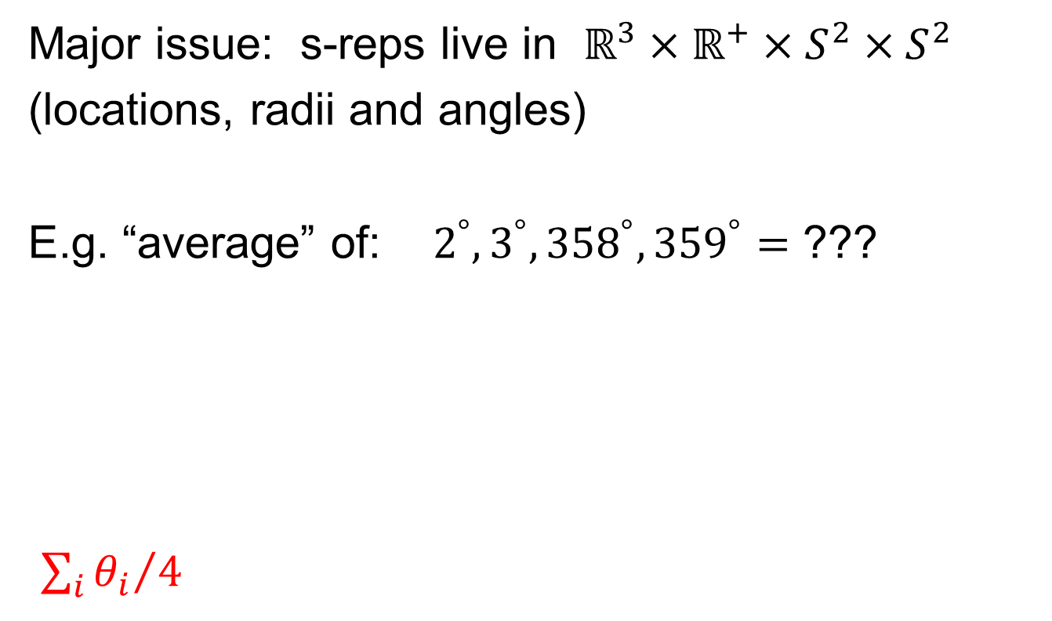
Principal Nested Spheres
Main Goal:
Extend Principal Arc Analysis ($S^{2}$ to $S^{k}$)
Jung et al (2012)
Important Landmark:
This Motivated Backwards PCA

Slide 2
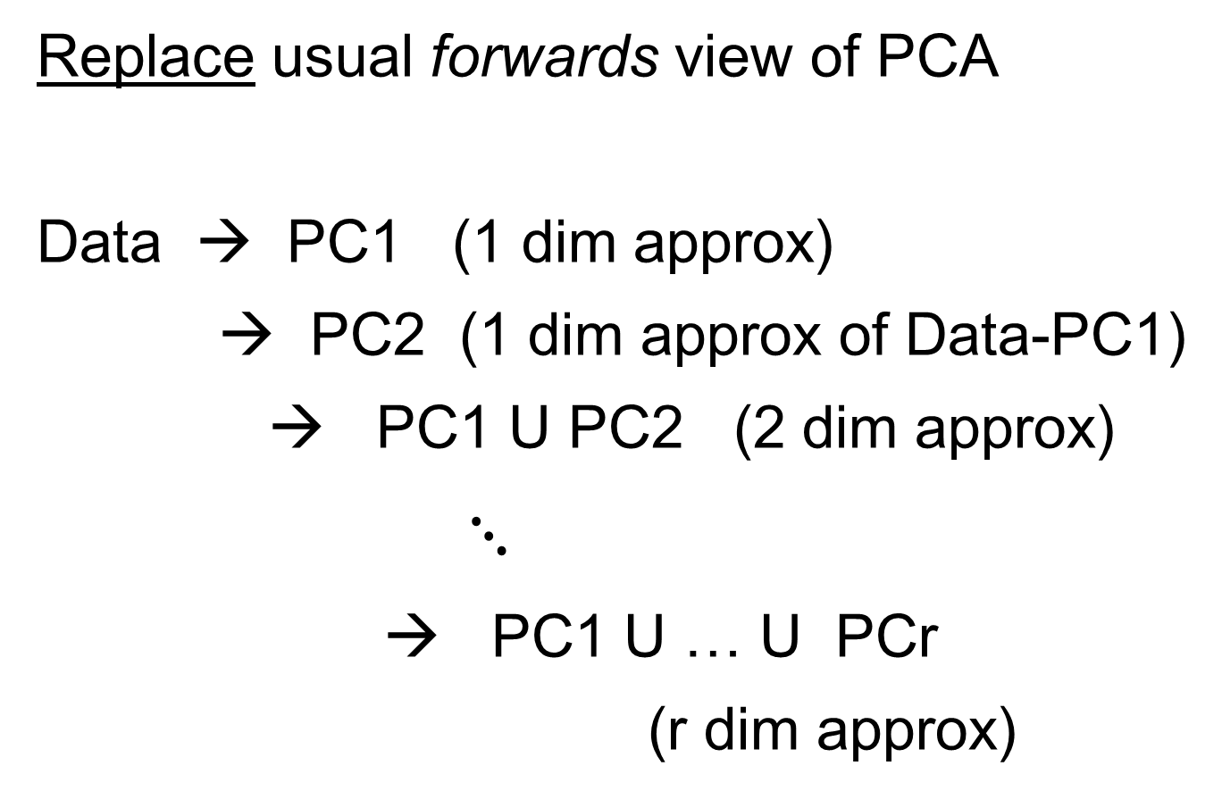
Backwards PCA
Replace usual forwards view of PCA
Data → PC1 (1 dim approx)
→ PC2 (1 dim approx of Data-PC1)
→ PC1 U PC2 (2 dim approx)
$⋱$
→ PC1 U … U PCr
(r dim approx)

Slide 3
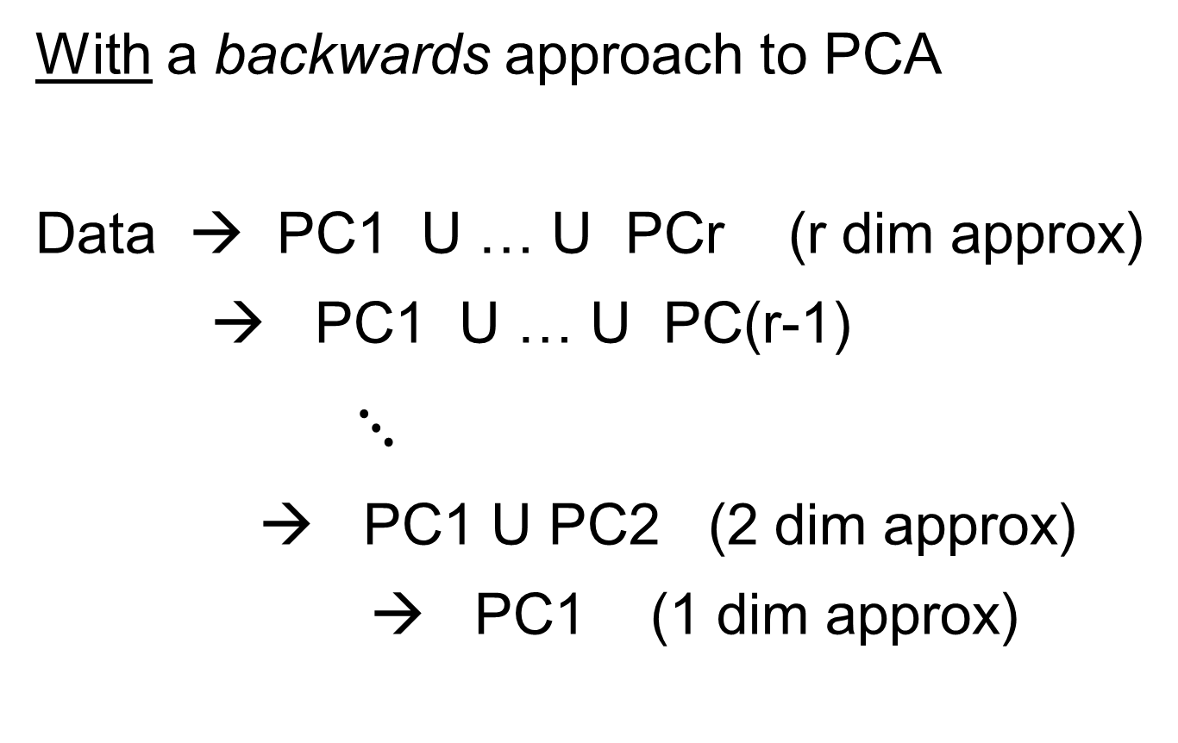
Backwards PCA
With a backwards approach to PCA
Data → PC1 U … U PCr (r dim approx)
→ PC1 U … U PC(r-1)
$⋱$
→ PC1 U PC2 (2 dim approx)
→ PC1 (1 dim approx)

Slide 4
Backwards PCA
Euclidean Settings:
Forwards PCA = Backwards PCA
(Pythagorean Theorem,
ANOVA Decomposition)
So Not Interesting
But Very Different in Non-Euclidean Settings
(Backwards is Better !?!)

Slide 5
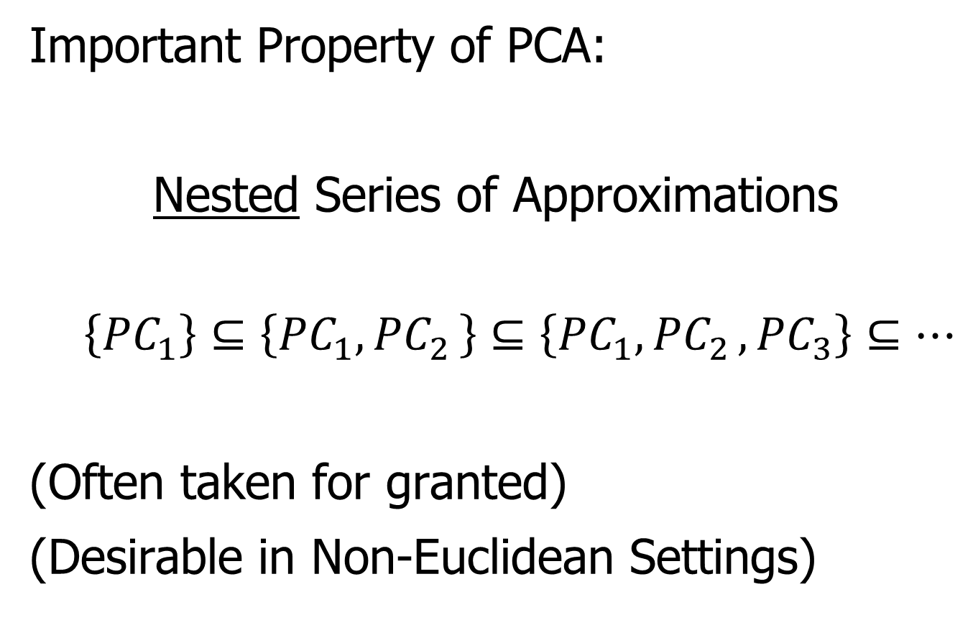
Backwards PCA
Important Property of PCA:
Nested Series of Approximations
$$\left\{{PC}_{1}\right\}⊆\left\{{PC}_{1}{,PC}_{2}\right\}⊆\left\{{PC}_{1}{,PC}_{2},{PC}_{3}\right\}⊆⋯$$
(Often taken for granted)
(Desirable in Non-Euclidean Settings)

Slide 6
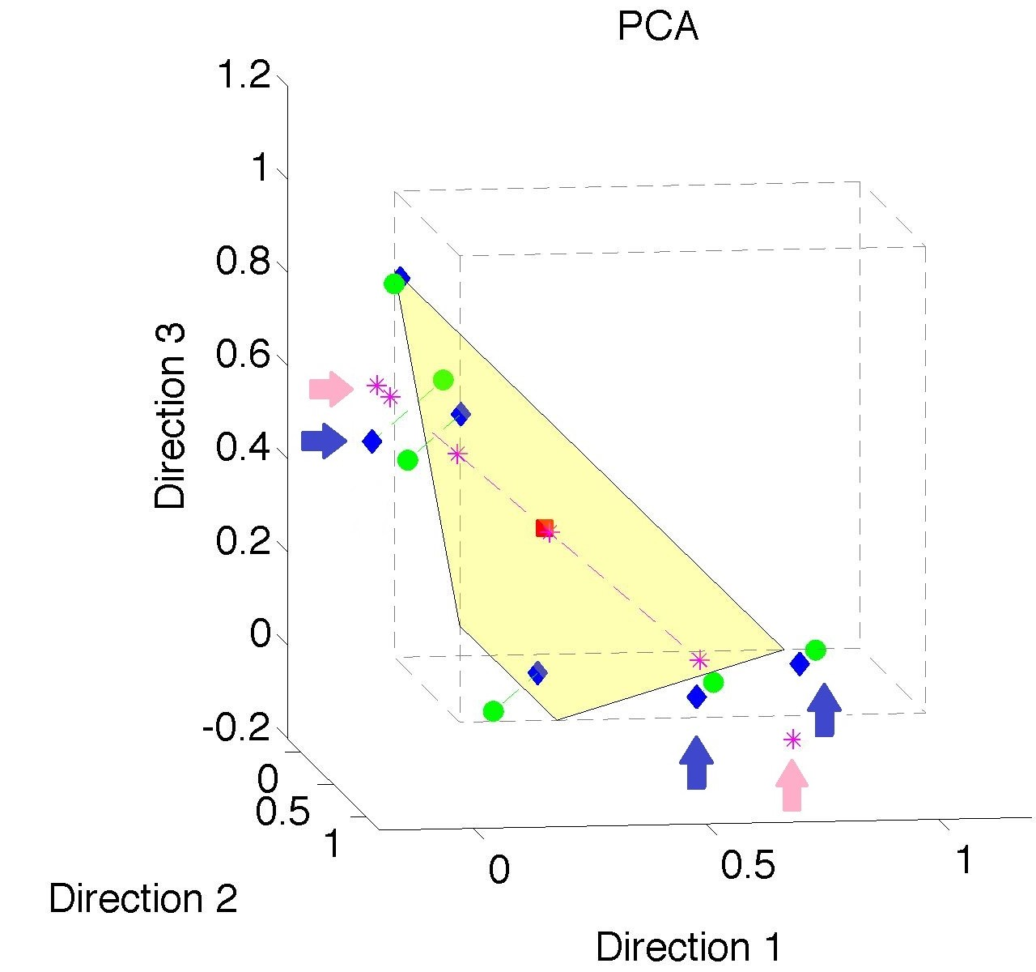

Nonnegative Matrix Factorization
Isn’t This
Just PCA?
Data
Mean
PC1 Projections
PC1 $⋃$ 2 Proj’ns
Leave Orthant!

Slide 7
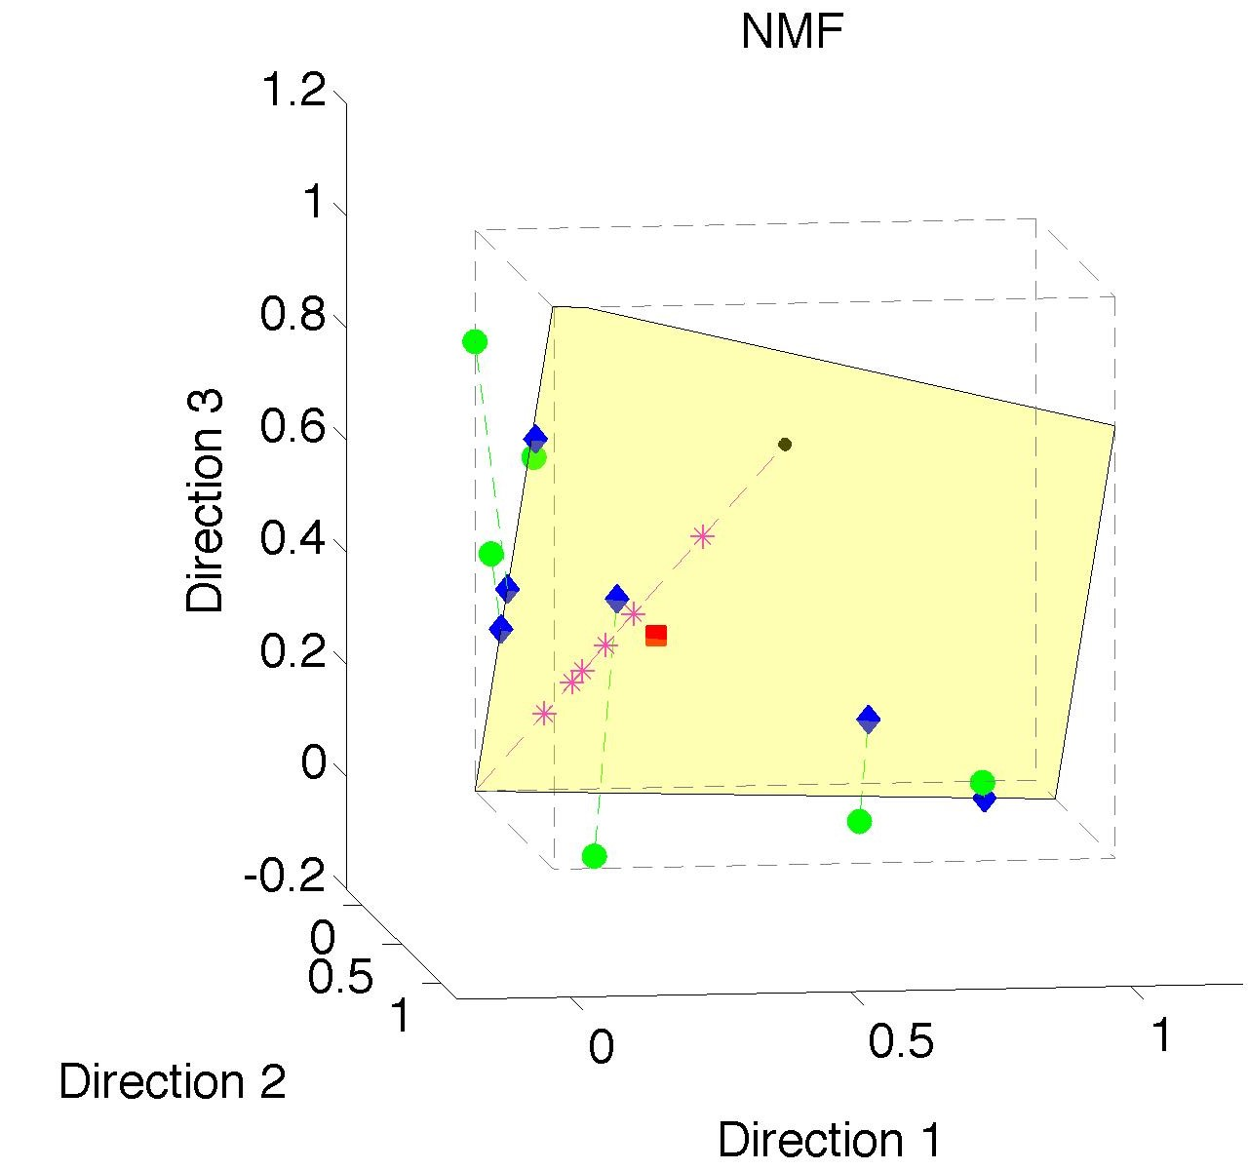
Nonnegative Matrix Factorization
Standard NMF
(Projections
All Inside
Orthant)

Slide 8
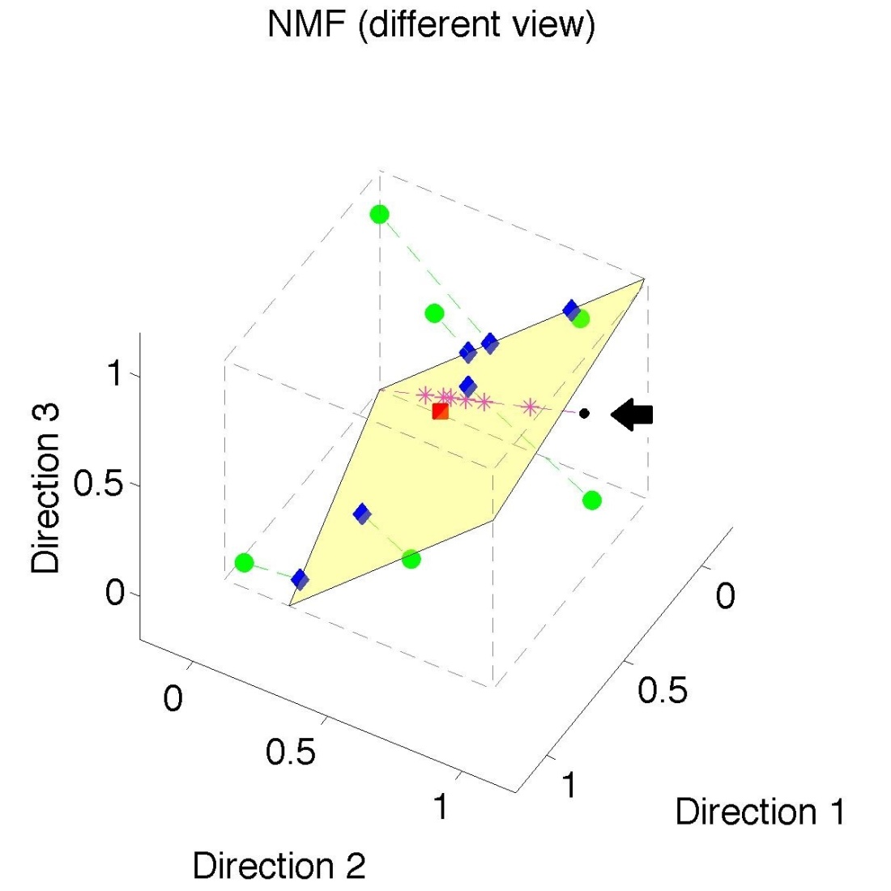
Nonnegative Matrix Factorization
Standard NMF
But Note
Not Nested
No “Multi-scale”
Analysis Possible
(Scores Plot?!?)

Slide 9
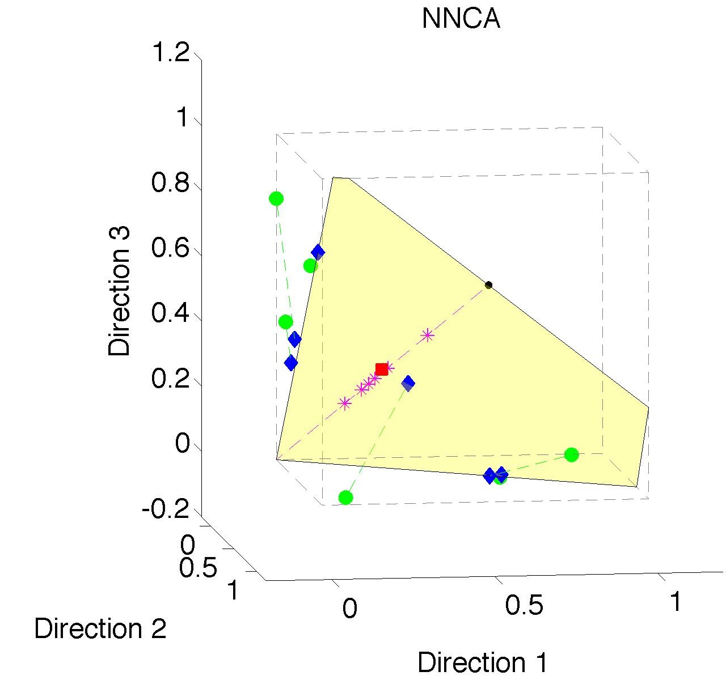
Nonnegative Nested Cone Analysis
Same Toy
Data Set
All
Projections
In Orthant

Slide 10
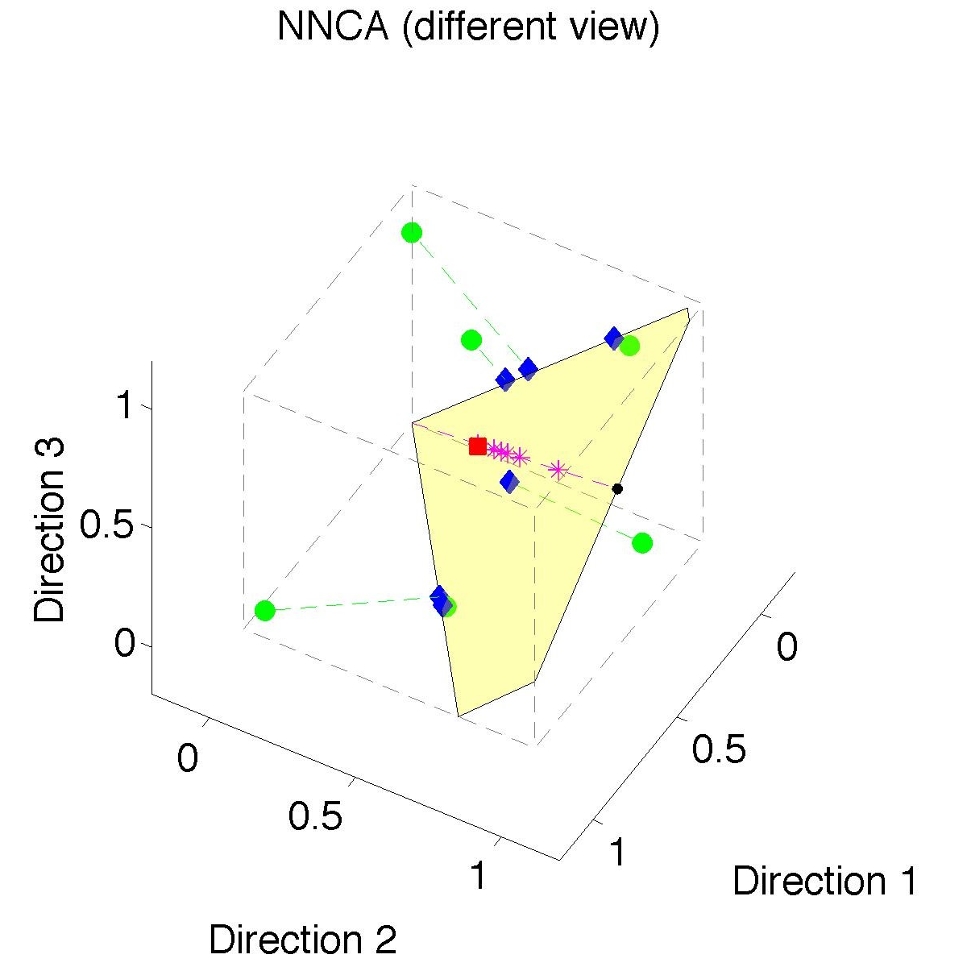
Nonnegative Nested Cone Analysis
Same Toy
Data Set
Rank 1
Approx.
Properly
Nested

Slide 11
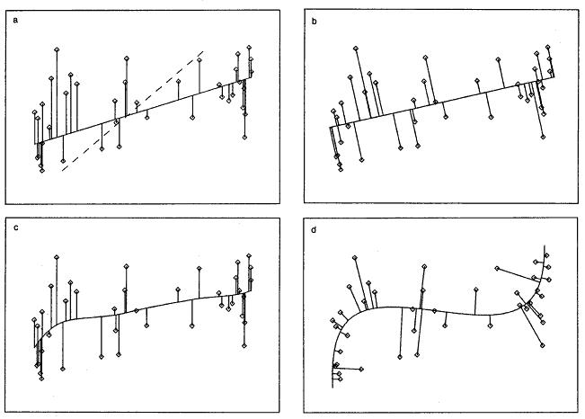
1st Principal Curve
Linear Reg’n
Proj’s Reg’n
Usual Smooth
Princ’l Curve

Slide 12
Manifold Learning
How generally applicable is
Backwards approach to PCA?
Potential Application: Principal Curves
Perceived Major Challenge:
How to find 2nd Principal Curve?

Slide 13
Manifold Learning
Key Component:
Principal Surfaces
LeBlanc & Tibshirani (1996)
Challenge:
Can have any dimensional surface,
But how to nest???
Proposal: Backwards Approach

Slide 14
An Interesting Question
How generally applicable is
Backwards approach to PCA?
An Attractive Answer:
James Damon, UNC Mathematics
Key Idea: Express Backwards PCA as
Nested Series of Constraints

Slide 15
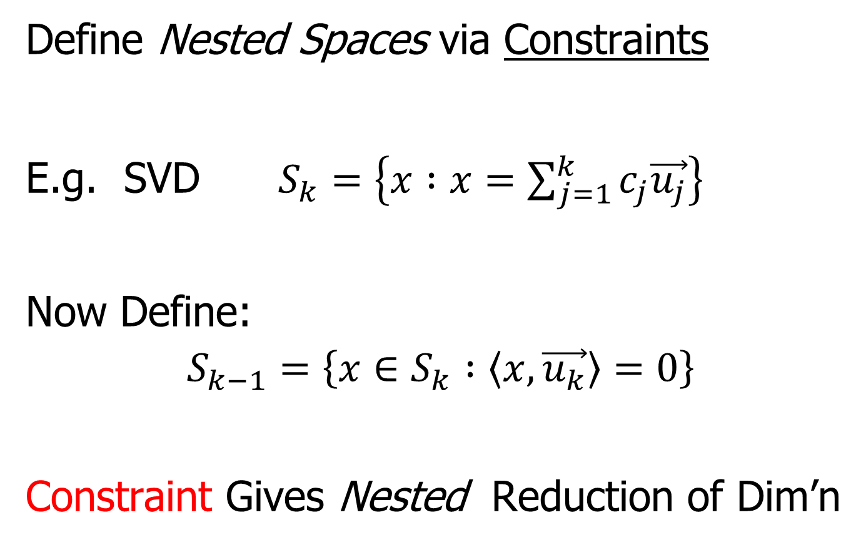
General View of Backwards PCA
Define Nested Spaces via Constraints
E.g. SVD $S_{k}=\left\{x :x=\sum_{j=1}^{k}{c_{j}\vec{u_{j}}}\right\}$
Now Define:
$$S_{k−1}=\left\{x∈S_{k} :\left\langle x,\vec{u_{k}}\right\rangle =0\right\}$$
Constraint Gives Nested Reduction of Dim’n

Slide 16
General View of Backwards PCA
Define Nested Spaces via Constraints
Backwards PCA
Principal Nested Spheres
Principal Surfaces
Other Manifold Data Spaces
Sub-Manifold Constraints??
(Algebraic Geometry)

Slide 17
Detailed Look at PCA
Now Study “Folklore” More Carefully
BackGround
History
Underpinnings
(Mathematical & Computational)
Good Overall Reference: Jolliffe (2002)

Slide 18
PCA: Rediscovery – Renaming
Statistics:
Principal Component Analysis (PCA)
Social Sciences:
Factor Analysis (PCA is a subset)
Probability / Electrical Eng:
Karhunen – Loeve expansion
Applied Mathematics:
Proper Orthogonal Decomposition (POD)
Geo-Sciences:
Empirical Orthogonal Functions (EOF)

Slide 19

An Interesting Historical Note
The 1st (?) application of PCA to Functional Data Analysis:
Rao (1958)
1st Paper with “Curves as Data Objects” viewpoint

Slide 20
Detailed Look at PCA
Three Important (& Interesting) Viewpoints:
Mathematics
Numerics
Statistics
Goal: Study Interrelationships

Slide 21
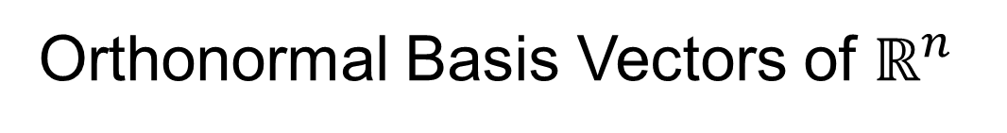

Review of Linear Algebra (Cont.)
SVD Full Representation:
=
Orthonormal Basis Vectors of $ℝ^{d}$
Diagonal Matrix of Singular Values
Orthonormal Basis Vectors of $ℝ^{n}$

Slide 22
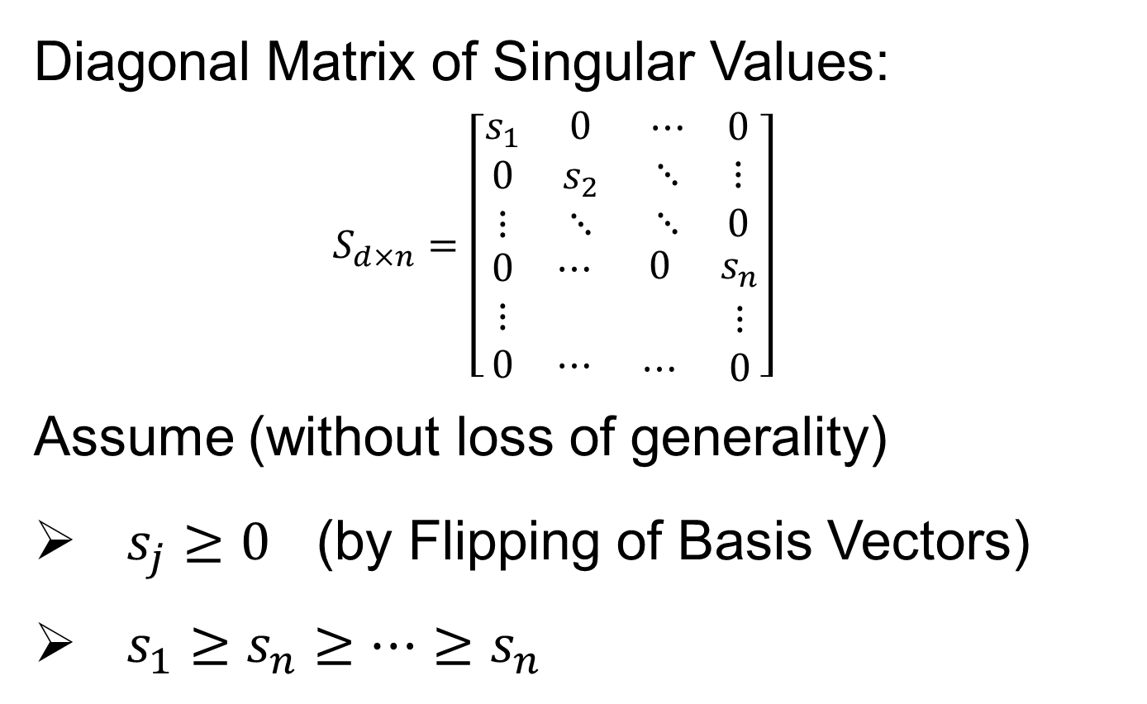

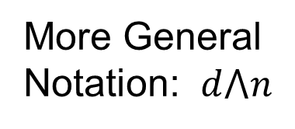
Review of Linear Algebra (Cont.)
Diagonal Matrix of Singular Values:
$$S_{d×n}=\left[\begin{matrix}\begin{matrix}s_{1} & 0 \\ 0 & s_{2} \\ ⋮ & ⋱\end{matrix} & \begin{matrix}⋯ & 0 \\ ⋱ & ⋮ \\ ⋱ & 0\end{matrix} \\ \begin{matrix}0 & ⋯ \\ ⋮ & \\ 0 & ⋯\end{matrix} & \begin{matrix}0 & s_{n} \\ & ⋮ \\ ⋯ & 0\end{matrix}\end{matrix}\right]$$
Assume (without loss of generality)
$s_{j}≥0$ (by Flipping of Basis Vectors)
$s_{1}≥s_{n}≥⋯≥s_{n}$
Uses Visual Case
Here: $d>n$
More General
Notation: $d⋀n$

Slide 23
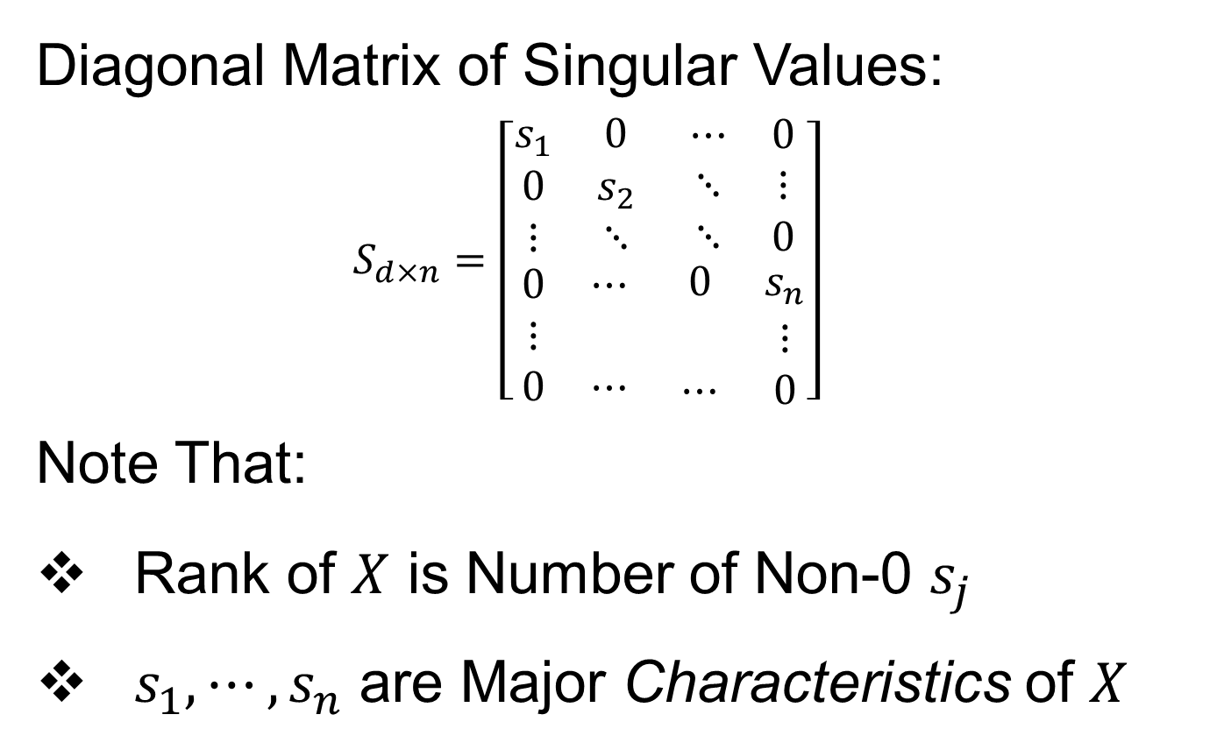
Review of Linear Algebra (Cont.)
Diagonal Matrix of Singular Values:
$$S_{d×n}=\left[\begin{matrix}\begin{matrix}s_{1} & 0 \\ 0 & s_{2} \\ ⋮ & ⋱\end{matrix} & \begin{matrix}⋯ & 0 \\ ⋱ & ⋮ \\ ⋱ & 0\end{matrix} \\ \begin{matrix}0 & ⋯ \\ ⋮ & \\ 0 & ⋯\end{matrix} & \begin{matrix}0 & s_{n} \\ & ⋮ \\ ⋯ & 0\end{matrix}\end{matrix}\right]$$
Note That:
Rank of $X$ is Number of Non-0 $s_{j}$
$s_{1},⋯,s_{n}$ are Major Characteristics of $X$

Slide 24

Review of Linear Algebra (Cont.)
SVD Full Representation:
=
Intuition: For $X$ as Linear Operator:
Represent as:
Isometry (~Rotation)
Coordinate Rescaling
Isometry (~Rotation)

Slide 25
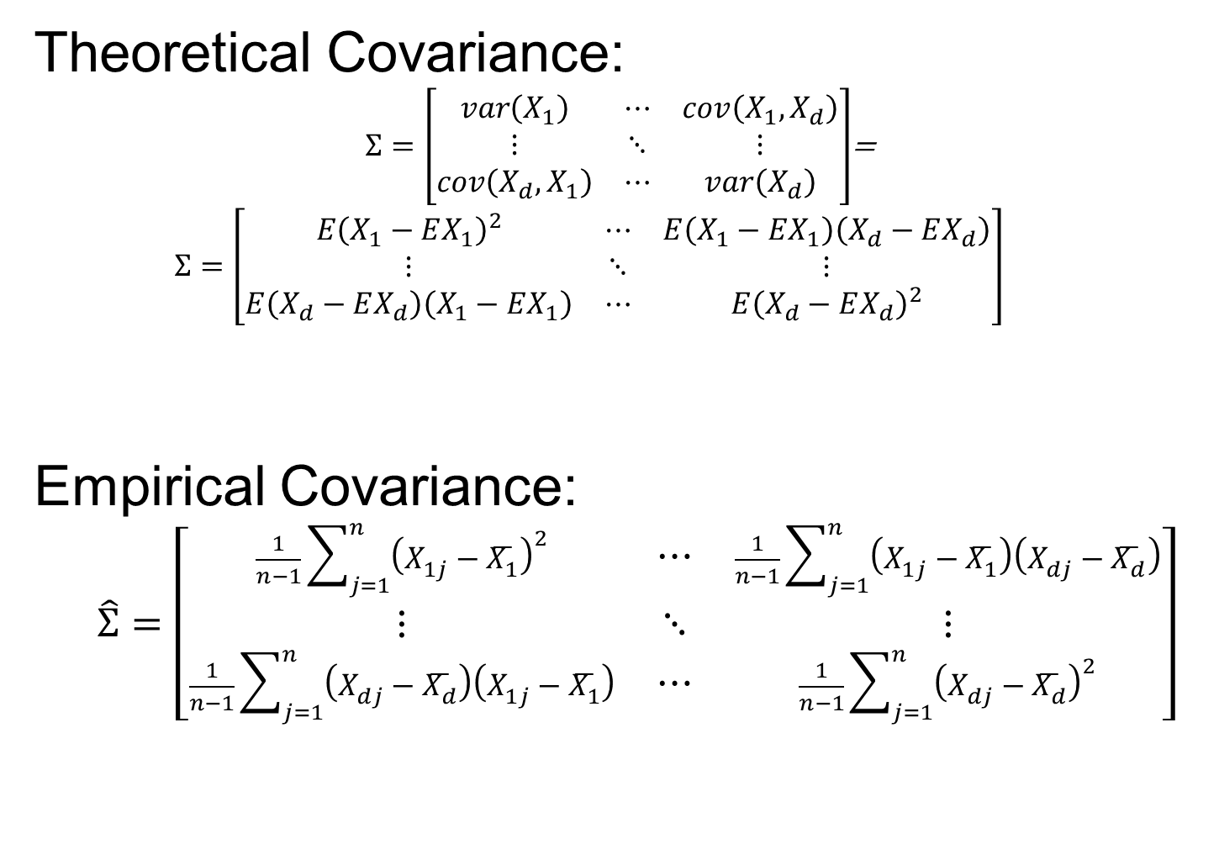
Covariance Matrices
Theoretical Covariance:
$Σ=\left[\begin{matrix}var\left(X_{1}\right) & ⋯ & cov\left(X_{1},X_{d}\right) \\ ⋮ & ⋱ & ⋮ \\ cov\left(X_{d},X_{1}\right) & ⋯ & var\left(X_{d}\right)\end{matrix}\right]$=
$$Σ=\left[\begin{matrix}E{\left(X_{1}−EX_{1}\right)}^{2} & ⋯ & E\left(X_{1}−EX_{1}\right)\left(X_{d}−EX_{d}\right) \\ ⋮ & ⋱ & ⋮ \\ E\left(X_{d}−EX_{d}\right)\left(X_{1}−EX_{1}\right) & ⋯ & E{\left(X_{d}−EX_{d}\right)}^{2}\end{matrix}\right]$$
Empirical Covariance:
$$\hat{Σ}=\left[\begin{matrix}\frac{1}{n−1}\sum_{j=1}^{n}{{\left(X_{1j}−\overline{X_{1}}\right)}^{2}} & ⋯ & \frac{1}{n−1}\sum_{j=1}^{n}{\left(X_{1j}−\overline{X_{1}}\right)\left(X_{dj}−\overline{X_{d}}\right)} \\ ⋮ & ⋱ & ⋮ \\ \frac{1}{n−1}\sum_{j=1}^{n}{\left(X_{dj}−\overline{X_{d}}\right)\left(X_{1j}−\overline{X_{1}}\right)} & ⋯ & \frac{1}{n−1}\sum_{j=1}^{n}{{\left(X_{dj}−\overline{X_{d}}\right)}^{2}}\end{matrix}\right]$$

Slide 26

Covariance Matrices
Notation: Data Matrix
$$X=\left[\begin{matrix}X_{11} & ⋯ & X_{1n} \\ ⋮ & ⋱ & ⋮ \\ X_{d1} & ⋯ & X_{dn}\end{matrix}\right]$$
Indexed by Rows $i=1,⋯,d$ Cols $j=1,⋯,n$
Empirical Covariance:
$$\hat{Σ}=\left[\begin{matrix}\frac{1}{n−1}\sum_{j=1}^{n}{{\left(X_{1j}−\overline{X_{1}}\right)}^{2}} & ⋯ & \frac{1}{n−1}\sum_{j=1}^{n}{\left(X_{1j}−\overline{X_{1}}\right)\left(X_{dj}−\overline{X_{d}}\right)} \\ ⋮ & ⋱ & ⋮ \\ \frac{1}{n−1}\sum_{j=1}^{n}{\left(X_{dj}−\overline{X_{d}}\right)\left(X_{1j}−\overline{X_{1}}\right)} & ⋯ & \frac{1}{n−1}\sum_{j=1}^{n}{{\left(X_{dj}−\overline{X_{d}}\right)}^{2}}\end{matrix}\right]$$
Are Data
Objects
Essentially Inner
Products of Rows

Slide 27

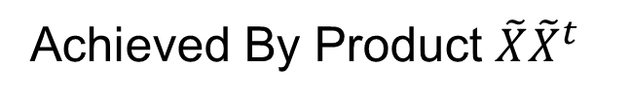
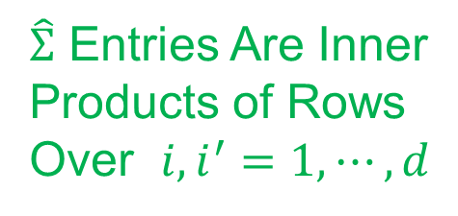
Covariance Matrices
Compact Representation of $\hat{Σ}$ Comes From
Centered & $\sqrt{n}$ Scaled Version of Data:
$$\tilde{X}=\left[\begin{matrix}\frac{1}{\sqrt{n−1}}\left(X_{11}−\overline{X_{1}}\right) & ⋯ & \frac{1}{\sqrt{n−1}}\left(X_{1n}−\overline{X_{1}}\right) \\ ⋮ & ⋱ & ⋮ \\ \frac{1}{\sqrt{n−1}}\left(X_{d1}−\overline{X_{d}}\right) & ⋯ & \frac{1}{\sqrt{n−1}}\left(X_{dn}−\overline{X_{d}}\right)\end{matrix}\right]$$
Where Row Averages (for $i=1,⋯,d$) are
$$\overline{X_{i}}=\frac{1}{n}\sum_{j=1}^{n}{X_{ij}}$$
$\hat{Σ}$ Entries Are Inner
Products of Rows
Over $i,i^{′}=1,⋯,d$
Achieved By Product $\tilde{X}{\tilde{X}}^{t}$

Slide 28

Covariance Matrices
Compact Representation of Covariance:
$$\hat{Σ}=\tilde{X}{\tilde{X}}^{t}$$
Called “Outer Product”
(Complementary to “Inner Product”,
$\left\langle x,y\right\rangle =x^{t}y$)

Slide 29
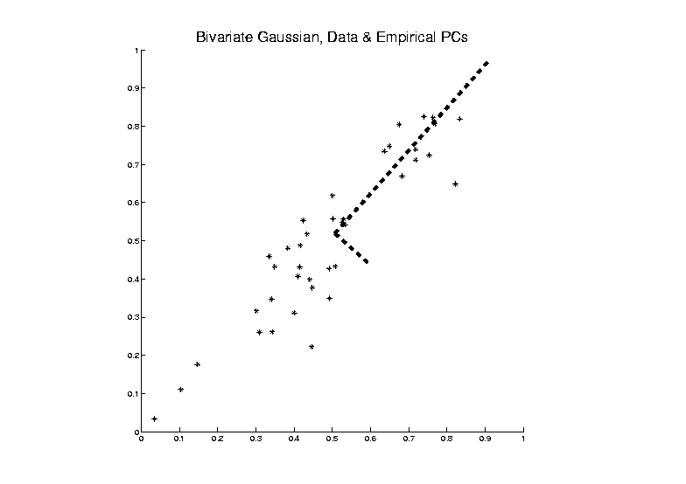
PCA as an Optimization Problem
Find Direction of Greatest Variability:
Centered At Mean

Slide 30


PCA as an Optimization Problem
Find Direction of Greatest Variability:
Approach to
Calculation:
And Optimize Over $u$
Start with
Candidate
Direction $u$

Slide 31

PCA as Optimization (Cont.)
Again Start With Data Matrix
$$X=\left[\begin{matrix}X_{11} & ⋯ & X_{1n} \\ ⋮ & ⋱ & ⋮ \\ X_{d1} & ⋯ & X_{dn}\end{matrix}\right]$$
Columns as Data Objects, Indexed $j=1,⋯,n$
$\underline{X_{j}}=\left[\begin{matrix}X_{1j} \\ ⋮ \\ X_{dj}\end{matrix}\right]$ With Mean Vector $\overline{\underline{X}}=\left[\begin{matrix}\overline{X_{1}} \\ ⋮ \\ \overline{X_{d}}\end{matrix}\right]$
Same
Notation
as Above

Slide 32

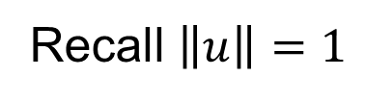
PCA as Optimization (Cont.)
Given a Candidate Direction $u∈ℝ^{d}$,
Projections of Centered Data Onto $u$ are:
$$P_{u}\left(\underline{X_{j}}−\overline{\underline{X}}\right)=\left\langle \underline{X_{j}}−\overline{\underline{X}},u\right\rangle u, j=1,⋯,n$$
Quantify Variation in the Direction $u$:
$$\frac{1}{n−1}\sum_{j=1}^{n}{{\left\|P_{u}\left(\underline{X_{j}}−\overline{\underline{X}}\right)\right\|}^{2}}$$
Recall $\left\|u\right\|=1$
Sample
Variance
of Scores

Slide 33

PCA as Optimization (Cont.)
Quantify Variation in the Direction $u$:
$$\frac{1}{n−1}\sum_{j=1}^{n}{{\left\|P_{u}\left(\underline{X_{j}}−\overline{\underline{X}}\right)\right\|}^{2}}=$$
$$=\frac{1}{n−1}\sum_{j=1}^{n}{{\left(u{\left(\underline{X_{j}}−\overline{\underline{X}}\right)}^{t}u\right)}^{t}u{\left(\underline{X_{j}}−\overline{\underline{X}}\right)}^{t}u}=$$
$$=u^{t}\left(\frac{1}{n−1}\sum_{j=1}^{n}{\left(\underline{X_{j}}−\overline{\underline{X}}\right){\left(\underline{X_{j}}−\overline{\underline{X}}\right)}^{t}}\right)u=$$
$$=u^{t}\tilde{X}{\tilde{X}}^{t}u=$$
$$=u^{t}\hat{Σ}u$$
Looks Like “Products
Of Rows” From Above
Cov. Matrix Repr’n

Slide 34


PCA as Optimization (Cont.)
Quantify Variation in the Direction $u$:
$$\frac{1}{n−1}\sum_{j=1}^{n}{{\left\|P_{u}\left(\underline{X_{j}}−\overline{\underline{X}}\right)\right\|}^{2}}=u^{t}\hat{Σ}u$$
Quadratic Form in the
Sample Covariance Matrix $\hat{Σ}$
Simple Solution Comes from the Eigenvalue Representation of $\hat{Σ}$:
$$\hat{Σ}=BDB^{t}$$
Orthonormal
Basis of $ℝ^{d}$
Diagonal Matrix of Eigenvalues

Slide 35
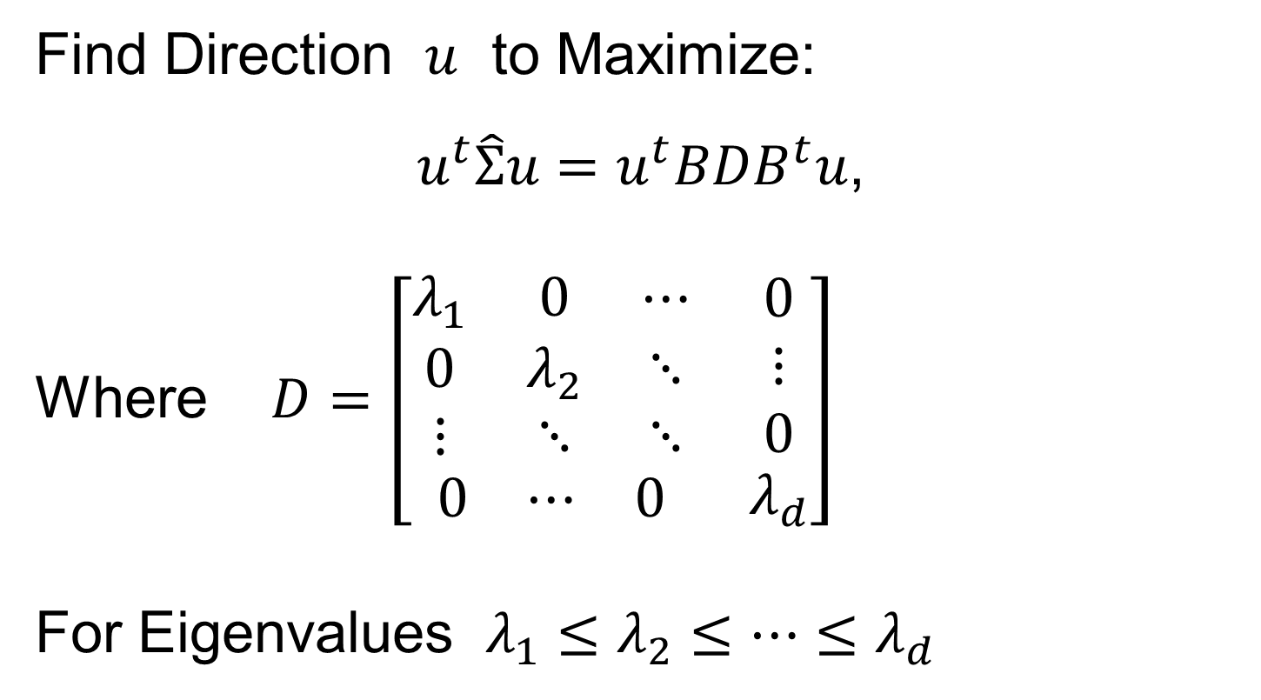
PCA as Optimization (Cont.)
Find Direction $u$ to Maximize:
$u^{t}\hat{Σ}u=u^{t}BDB^{t}u$,
Where $D=\left[\begin{matrix}\begin{matrix}λ_{1} & 0 & ⋯ \\ 0 & λ_{2} & ⋱ \\ ⋮ & ⋱ & ⋱\end{matrix} & \begin{matrix}0 \\ ⋮ \\ 0\end{matrix} \\ \begin{matrix}0 & ⋯ & 0\end{matrix} & λ_{d}\end{matrix}\right]$
For Eigenvalues $λ_{1}≤λ_{2}≤⋯≤λ_{d}$

Slide 36
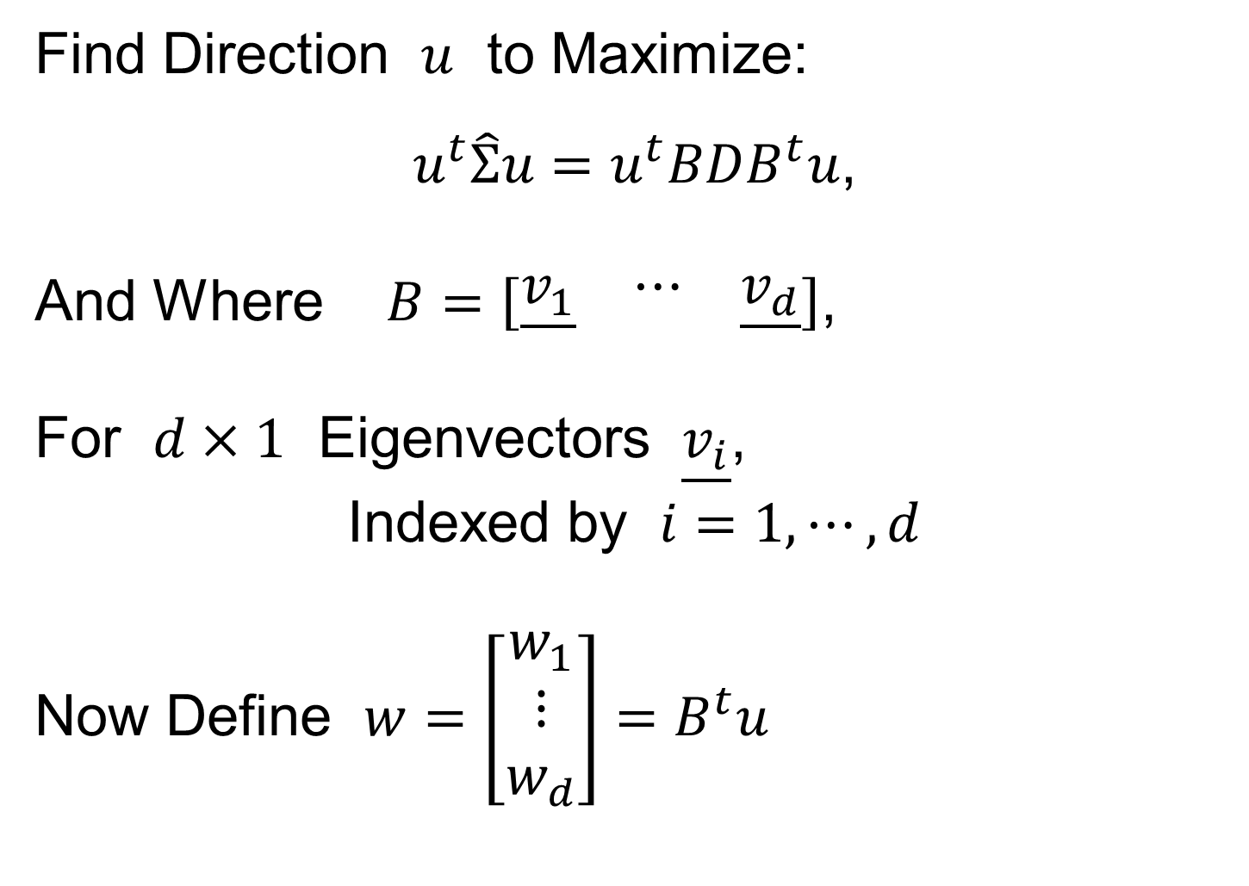
PCA as Optimization (Cont.)
Find Direction $u$ to Maximize:
$u^{t}\hat{Σ}u=u^{t}BDB^{t}u$,
And Where $B=\left[\begin{matrix}\underline{v_{1}} & ⋯ & \underline{v_{d}}\end{matrix}\right]$,
For $d×1$ Eigenvectors $\underline{v_{i}}$,
Indexed by $i=1,⋯,d$
Now Define $w=\left[\begin{matrix}w_{1} \\ ⋮ \\ w_{d}\end{matrix}\right]=B^{t}u$

Slide 37
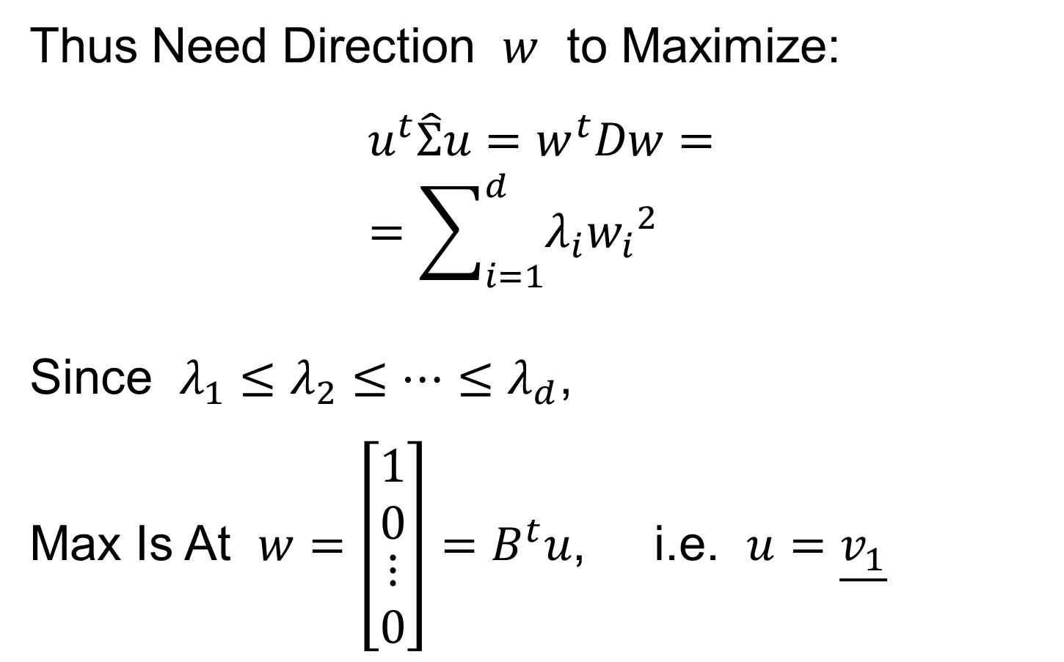
PCA as Optimization (Cont.)
Thus Need Direction $w$ to Maximize:
$$u^{t}\hat{Σ}u=w^{t}Dw=$$
$$=\sum_{i=1}^{d}{λ_{i}{w_{i}}^{2}}$$
Since $λ_{1}≤λ_{2}≤⋯≤λ_{d}$,
Max Is At $w=\left[\begin{matrix}\begin{matrix}1 \\ 0\end{matrix} \\ \begin{matrix}⋮ \\ 0\end{matrix}\end{matrix}\right]=B^{t}u$, i.e. $u=\underline{v_{1}}$

Slide 38
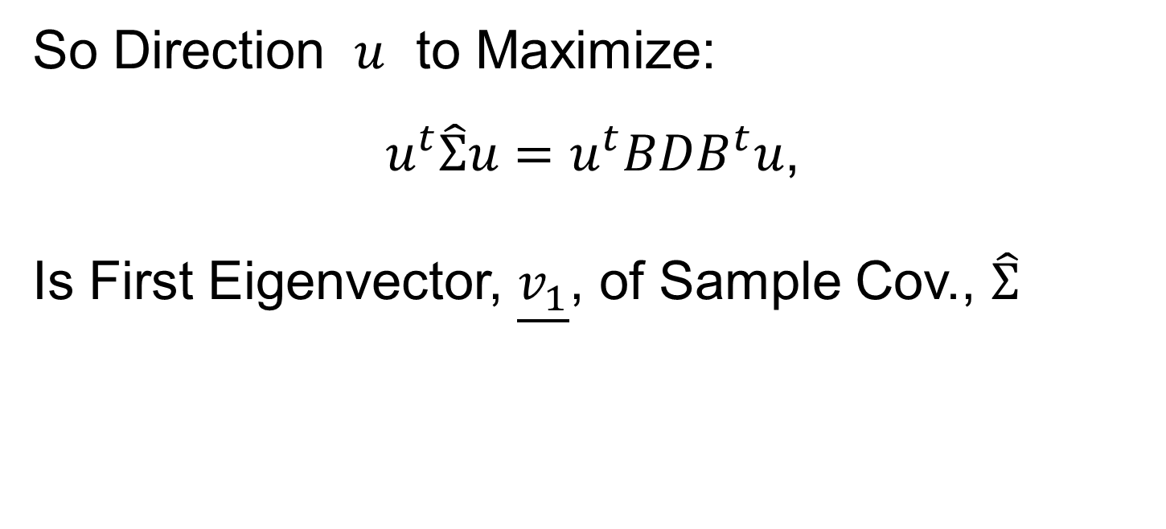
PCA as Optimization (Cont.)
So Direction $u$ to Maximize:
$u^{t}\hat{Σ}u=u^{t}BDB^{t}u$,
Is First Eigenvector, $\underline{v_{1}}$, of Sample Cov., $\hat{Σ}$

Slide 39
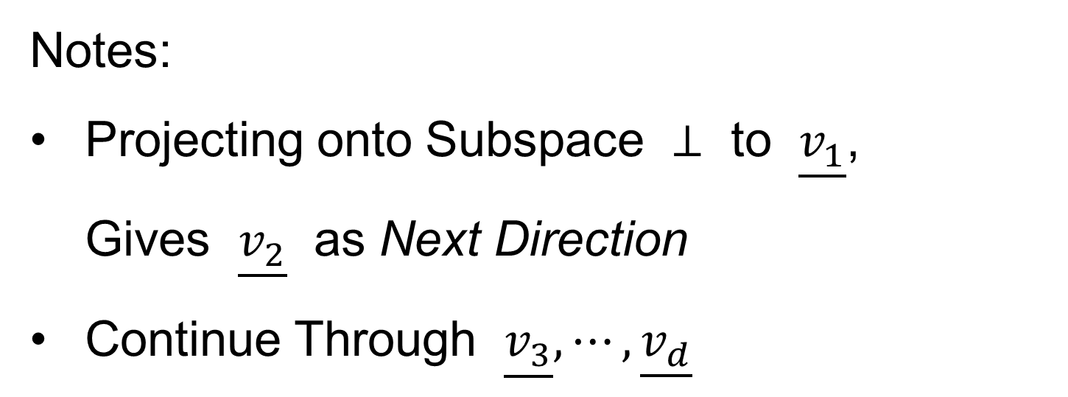
PCA as Optimization (Cont.)
Notes:
Projecting onto Subspace $⊥$ to $\underline{v_{1}}$,
Gives $\underline{v_{2}}$ as Next Direction
Continue Through $\underline{v_{3}},⋯,\underline{v_{d}}$

Slide 40
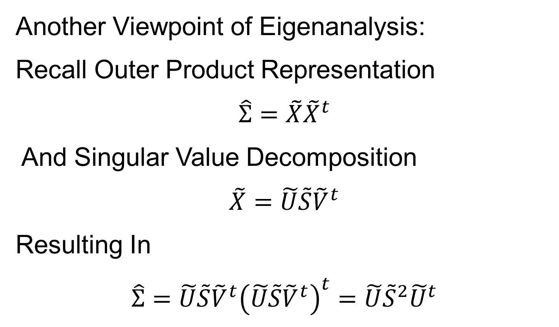
PCA as Optimization (Cont.)
Another Viewpoint of Eigenanalysis:
Recall Outer Product Representation
$$\hat{Σ}=\tilde{X}{\tilde{X}}^{t}$$
And Singular Value Decomposition
$$\tilde{X}=\tilde{U}\tilde{S}{\tilde{V}}^{t}$$
Resulting In
$$\hat{Σ}=\tilde{U}\tilde{S}{\tilde{V}}^{t}{\left(\tilde{U}\tilde{S}{\tilde{V}}^{t}\right)}^{t}=\tilde{U}{\tilde{S}}^{2}{\tilde{U}}^{t}$$

Slide 41



PCA as Optimization (Cont.)
Relate Eigenanalysis and SVD:
$$\hat{Σ}=\tilde{U}\tilde{S}{\tilde{V}}^{t}{\left(\tilde{U}\tilde{S}{\tilde{V}}^{t}\right)}^{t}=\tilde{U}{\tilde{S}}^{2}{\tilde{U}}^{t}$$
Can Think of PCA Either as SVD Or Eigen-An.
Same Rotation Matrix $\tilde{U}$ for Both
EigenValues $λ_{i}={s_{i}}^{2}$, $i=1,⋯,d$

Slide 42

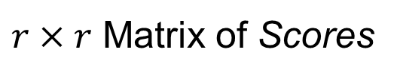
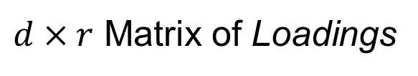
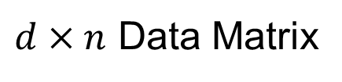
PCA as Optimization (Cont.)
Terminology Relates to SVD View
For $r$ = Rank of $\tilde{X}$
$$\tilde{X}=\tilde{U}\tilde{S}{\tilde{V}}^{t}$$
$d×n$ Data Matrix
$d×r$ Matrix of Loadings
$r×r$ Matrix of Scores

Slide 43

PCA as Optimization (Cont.)
Connection to Modes of Variation:
Define:
Loadings Matrix, $\tilde{U}=L=\left[\begin{matrix}\underline{L_{1}} & ⋯ & \underline{L_{r}}\end{matrix}\right]$
Scores Matrix, $\tilde{S}{\tilde{V}}^{t}=S=\left[\begin{matrix}\underline{S_{1}} \\ ⋮ \\ \underline{S_{r}}\end{matrix}\right]$

Slide 44

PCA as Optimization (Cont.)
Connection to Modes of Variation:
Thus:
$$\tilde{X}=LS=\sum_{k=1}^{r}{\underline{L_{k}} \underline{S_{k}}}$$
Modes of Variation

Slide 45
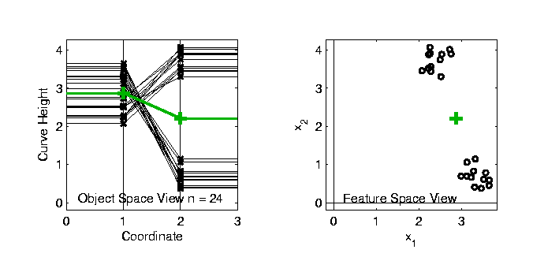
Connect Math to Graphics
2-d Toy Example
From Much Earlier Class Meeting
2-d Curves as Data In Object Space
Simple, Visualizable Feature Space

Slide 46
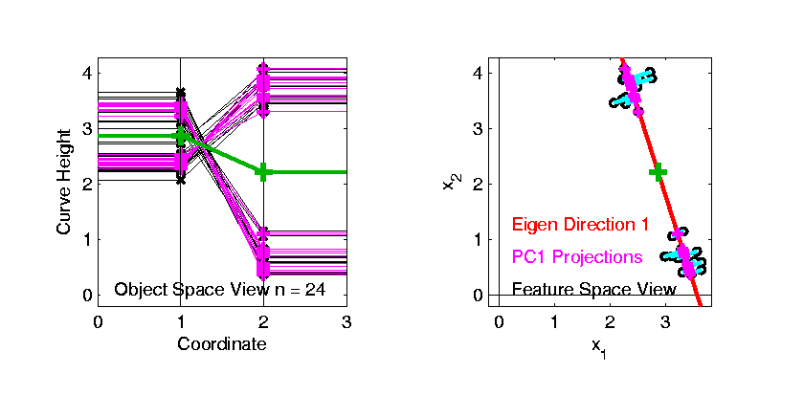
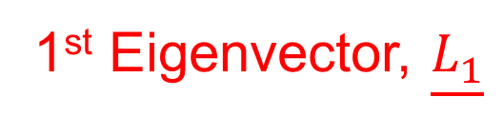
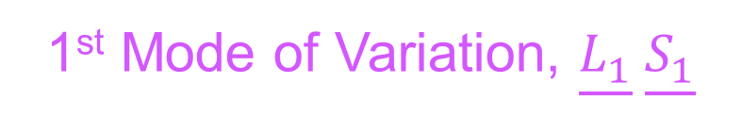
Connect Math to Graphics
2-d Toy Example
1st Eigenvector, $\underline{L_{1}}$
1st Mode of Variation, $\underline{L_{1}} \underline{S_{1}}$

Slide 47
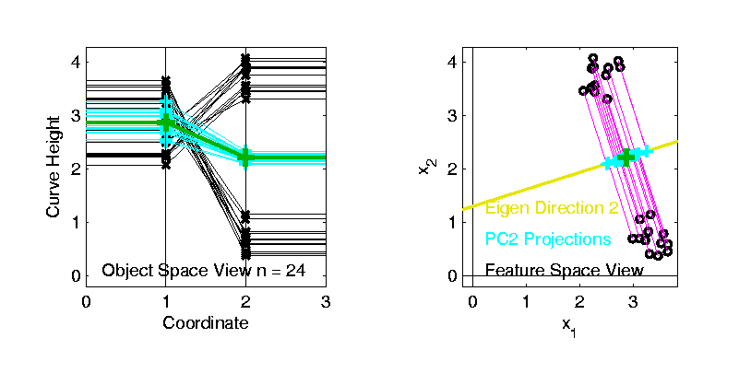
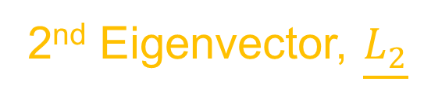
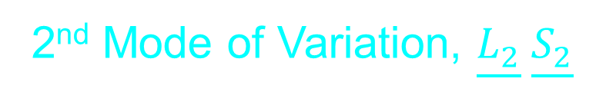
Connect Math to Graphics
2-d Toy Example
2nd Eigenvector, $\underline{L_{2}}$
2nd Mode of Variation, $\underline{L_{2}} \underline{S_{2}}$

Slide 48

PCA Redistribution of Energy
Now for Scree Plots (Upper Right of FDA Anal.)
Carefully Look At:
Intuition
Relation to Eigenanalysis
Numerical Calculation

Slide 49

PCA Redist’n of Energy (Cont.)
ANOVA Mean Decomposition:
Total Variation =
= Mean Variation + Mean Residual Variation
$\sum_{i=1}^{n}{{\left\|X_{i}\right\|}^{2}}$= $\sum_{i=1}^{n}{{\left\|\overline{X}\right\|}^{2}}+\sum_{i=1}^{n}{{\left\|X_{i}−\overline{X}\right\|}^{2}}$
Mathematics: Pythagorean Theorem
Intuition Quantified via Sums of Squares
(Squares More Intuitive Than Absolutes)

Slide 50

PCA Redist’n of Energy (Cont.)
$$\frac{1}{n−1}\sum_{j=1}^{d}{{\left\|\underline{X_{i}}−\overline{\underline{X}}\right\|}^{2}}=tr\left(BDB^{t}\right)=tr\left(BB^{t}D\right)=tr\left(D\right)=\sum_{j=1}^{d}{λ_{j}}$$
Eigenvalues Provide Atoms of SS Decompos’n
Useful Plots are:
Power Spectrum: $λ_{j}$ vs. $j$
log Power Spectrum: $log\left(λ_{j}\right)$ vs. $j$
Cumulative Power Spectrum: $\sum_{j^{′}=1}^{j}{λ_{j′}}$ vs. $j$
Note PCA Gives SS’s for Free (As Eigenval’s),
But Watch Factors of $\sqrt{n−1}$
Notes:
50

Slide 51

PCA Redist’n of Energy (Cont.)
Note, have already considered some of these Useful Plots:
Power Spectrum (as %s)
Cumulative Power Spectrum (%)
Recall Common Terminology:
Power Spectrum is Called
“Scree Plot”
Kruskal (1964) Cattell (1966)
(all but name “scree”) (1st Appearance of name???)
Notes:
51

Slide 52
PCA vs. SVD
Sometimes “SVD Analysis of Data”
= Uncentered PCA = 0-Centered PCA

Slide 53
PCA vs. SVD
Sometimes “SVD Analysis of Data”
= Uncentered PCA = 0-Centered PCA
Consequence: Skip this step

Slide 54

PCA vs. SVD
Sometimes “SVD Analysis of Data”
= Uncentered PCA = 0-Centered PCA
Useful view point: For Data Matrix $X$
Ignore scaled, centered $\tilde{X}=\frac{1}{\sqrt{n−1}}\left(X−\overline{X}\right)$
Instead do eigen-analysis of $XX^{t}$
(in contrast to $\hat{Σ}=\tilde{X}{\tilde{X}}^{t}$)

Slide 55

PCA vs. SVD
Sometimes “SVD Analysis of Data”
= Uncentered PCA = 0-Centered PCA
Eigen-analysis of $XX^{t}$
Intuition:
Find Directions of Maximal Variation
From the Origin

Slide 56
PCA vs. SVD
Sometimes “SVD Analysis of Data”
= Uncentered PCA = 0-Centered PCA
Investigate with Similar Toy Example

Slide 57

PCA vs. SVD
2-d Toy Example
Direction of “Maximal Variation”???

Slide 58

PCA vs. SVD
2-d Toy Example
Direction of “Maximal Variation”???
PC1 Solution (Mean Centered) Very Good!

Slide 59

PCA vs. SVD
2-d Toy Example
Direction of “Maximal Variation”???
SV1 Solution (Origin Centered) Poor Rep’n

Slide 60

PCA vs. SVD
2-d Toy Example
Look in Orthogonal Direction:
PC2 Solution (Mean Centered) Very Good!

Slide 61

PCA vs. SVD
2-d Toy Example
Look in Orthogonal Direction:
SV2 Solution (Origin Centered) Off Map!

Slide 62

PCA vs. SVD
2-d Toy Example
SV2 Solution Larger Scale View:
Not Representative of Data

Slide 63
PCA vs. SVD
Sometimes “SVD Analysis of Data”
= Uncentered PCA
Investigate with Similar Toy Example:
Conclusions:
PCA Generally Better
Unless “Origin Is Important”
Deeper Look: Zhang et al (2007)

Slide 64
Different Views of PCA
Solves several optimization problems:
Direction to maximize SS of 1-d proj’d data
Notes:
64

Slide 65

Different Views of PCA
2-d Toy Example
Max SS of Projected Data
Notes:
65

Slide 66
Different Views of PCA
Solves several optimization problems:
Direction to maximize SS of 1-d proj’d data
Direction to minimize SS of residuals
Notes:
66

Slide 67
Different Views of PCA
2-d Toy Example
Max SS of Projected Data
Min SS of Residuals
Notes:
67

Slide 68
Different Views of PCA
Solves several optimization problems:
Direction to maximize SS of 1-d proj’d data
Direction to minimize SS of residuals
(same, by Pythagorean Theorem)
“Best fit line” to data in “orthogonal sense”
(vs. regression of Y on X = vertical sense
& regression of X on Y = horizontal sense)
Notes:
68

Slide 69
Different Views of PCA
2-d Toy Example
Max SS of Projected Data
Min SS of Residuals
Best Fit Line
Notes:
69

Slide 70
Different Views of PCA
Toy Example Comparison of Fit Lines:
PC1
Regression of Y on X
Regression of X on Y
Notes:
70

Slide 71

Different Views of PCA
Normal
Data
ρ = 0.3
Notes:
71

Slide 72

Different Views of PCA
Projected
Residuals
Notes:
72

Slide 73

Different Views of PCA
Vertical
Residuals
(X predicts Y)
Notes:
73

Slide 74

Different Views of PCA
Horizontal
Residuals
(Y predicts X)
Notes:
74

Slide 75
Different Views of PCA
Projected
Residuals
(Balanced
Treatment)
Notes:
75

Slide 76
Different Views of PCA
Toy Example Comparison of Fit Lines:
PC1
Regression of Y on X
Regression of X on Y
Note: Big Difference Prediction Matters
Notes:
76

Slide 77
Different Views of PCA
Solves several optimization problems:
Direction to maximize SS of 1-d proj’d data
Direction to minimize SS of residuals
(same, by Pythagorean Theorem)
“Best fit line” to data in “orthogonal sense”
(vs. regression of Y on X = vertical sense
& regression of X on Y = horizontal sense)
Use one that makes sense…
Notes:
77

Slide 78
Participant Presentation
Siyao Liu:
Clustering Single Cell RNAseq Data

