Slide 1
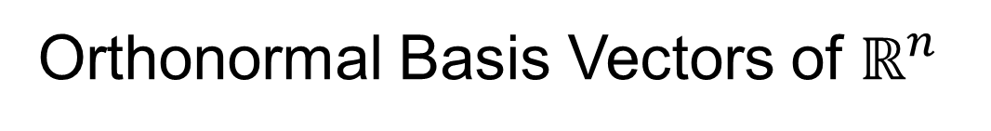
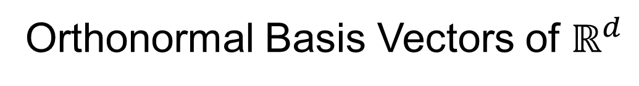
Review of Linear Algebra (Cont.)
SVD Full Representation:
=
Orthonormal Basis Vectors of $ℝ^{d}$
Diagonal Matrix of Singular Values
Orthonormal Basis Vectors of $ℝ^{n}$

Slide 2
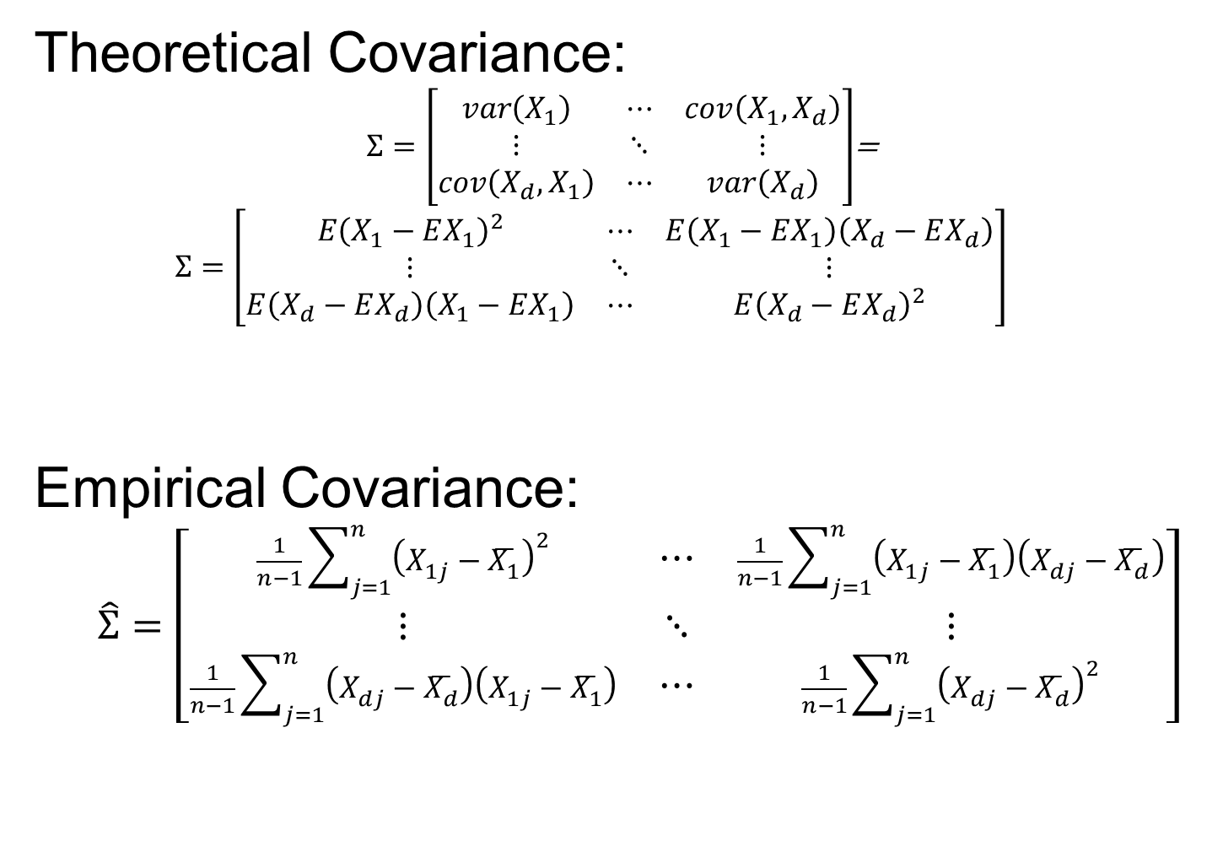
Covariance Matrices
Theoretical Covariance:
$Σ=\left[\begin{matrix}var\left(X_{1}\right) & ⋯ & cov\left(X_{1},X_{d}\right) \\ ⋮ & ⋱ & ⋮ \\ cov\left(X_{d},X_{1}\right) & ⋯ & var\left(X_{d}\right)\end{matrix}\right]$=
$$Σ=\left[\begin{matrix}E{\left(X_{1}−EX_{1}\right)}^{2} & ⋯ & E\left(X_{1}−EX_{1}\right)\left(X_{d}−EX_{d}\right) \\ ⋮ & ⋱ & ⋮ \\ E\left(X_{d}−EX_{d}\right)\left(X_{1}−EX_{1}\right) & ⋯ & E{\left(X_{d}−EX_{d}\right)}^{2}\end{matrix}\right]$$
Empirical Covariance:
$$\hat{Σ}=\left[\begin{matrix}\frac{1}{n−1}\sum_{j=1}^{n}{{\left(X_{1j}−\overline{X_{1}}\right)}^{2}} & ⋯ & \frac{1}{n−1}\sum_{j=1}^{n}{\left(X_{1j}−\overline{X_{1}}\right)\left(X_{dj}−\overline{X_{d}}\right)} \\ ⋮ & ⋱ & ⋮ \\ \frac{1}{n−1}\sum_{j=1}^{n}{\left(X_{dj}−\overline{X_{d}}\right)\left(X_{1j}−\overline{X_{1}}\right)} & ⋯ & \frac{1}{n−1}\sum_{j=1}^{n}{{\left(X_{dj}−\overline{X_{d}}\right)}^{2}}\end{matrix}\right]$$

Slide 3

Covariance Matrices
Compact Representation of Covariance:
$$\hat{Σ}=\tilde{X}{\tilde{X}}^{t}$$
Called “Outer Product”
(Complementary to “Inner Product”,
$\left\langle x,y\right\rangle =x^{t}y$)

Slide 4

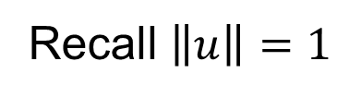
PCA as Optimization (Cont.)
Given a Candidate Direction $u∈ℝ^{d}$,
Projections of Centered Data Onto $u$ are:
$$P_{u}\left(\underline{X_{j}}−\overline{\underline{X}}\right)=\left\langle \underline{X_{j}}−\overline{\underline{X}},u\right\rangle u, j=1,⋯,n$$
Quantify Variation in the Direction $u$:
$$\frac{1}{n−1}\sum_{j=1}^{n}{{\left\|P_{u}\left(\underline{X_{j}}−\overline{\underline{X}}\right)\right\|}^{2}}$$
Recall $\left\|u\right\|=1$
Sample
Variance
of Scores

Slide 5
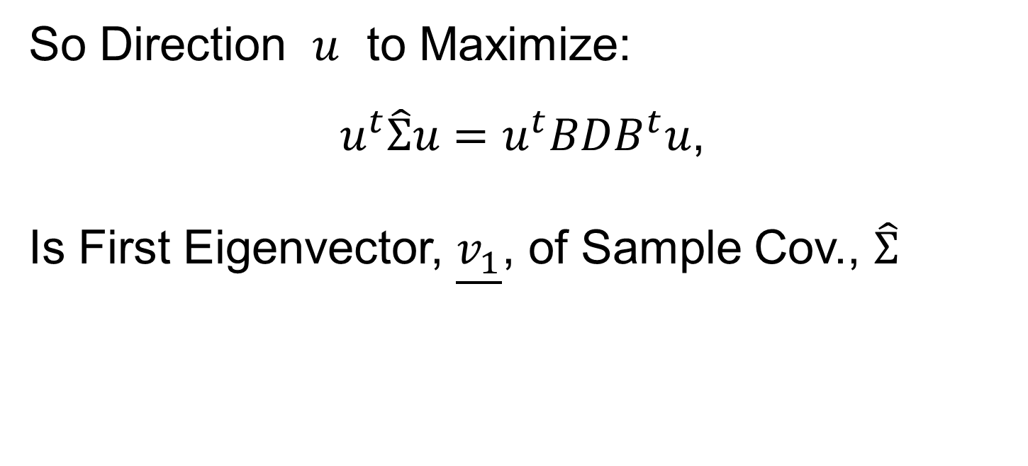
PCA as Optimization (Cont.)
So Direction $u$ to Maximize:
$u^{t}\hat{Σ}u=u^{t}BDB^{t}u$,
Is First Eigenvector, $\underline{v_{1}}$, of Sample Cov., $\hat{Σ}$

Slide 6
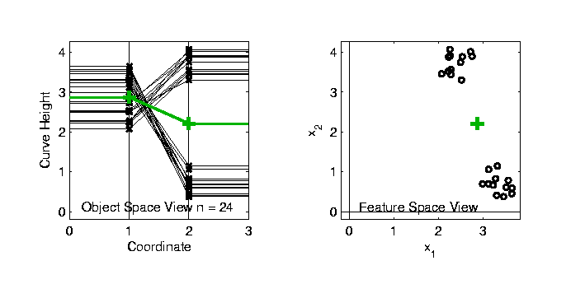
Connect Math to Graphics
2-d Toy Example
From Much Earlier Class Meeting
2-d Curves as Data In Object Space
Simple, Visualizable Feature Space

Slide 7
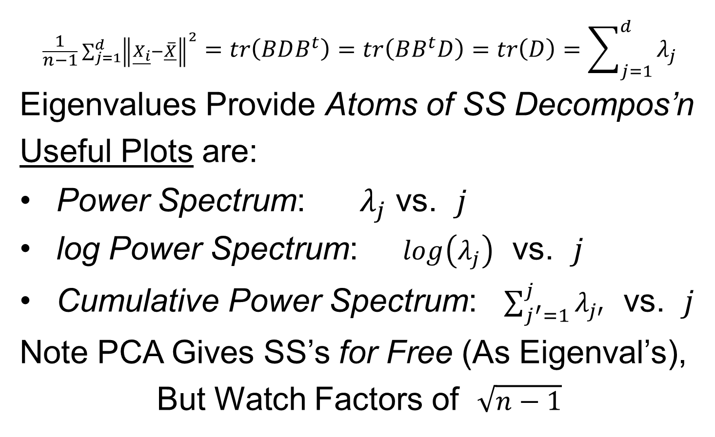
PCA Redist’n of Energy (Cont.)
$$\frac{1}{n−1}\sum_{j=1}^{d}{{\left\|\underline{X_{i}}−\overline{\underline{X}}\right\|}^{2}}=tr\left(BDB^{t}\right)=tr\left(BB^{t}D\right)=tr\left(D\right)=\sum_{j=1}^{d}{λ_{j}}$$
Eigenvalues Provide Atoms of SS Decompos’n
Useful Plots are:
Power Spectrum: $λ_{j}$ vs. $j$
log Power Spectrum: $log\left(λ_{j}\right)$ vs. $j$
Cumulative Power Spectrum: $\sum_{j^{′}=1}^{j}{λ_{j′}}$ vs. $j$
Note PCA Gives SS’s for Free (As Eigenval’s),
But Watch Factors of $\sqrt{n−1}$
Notes:
7

Slide 8
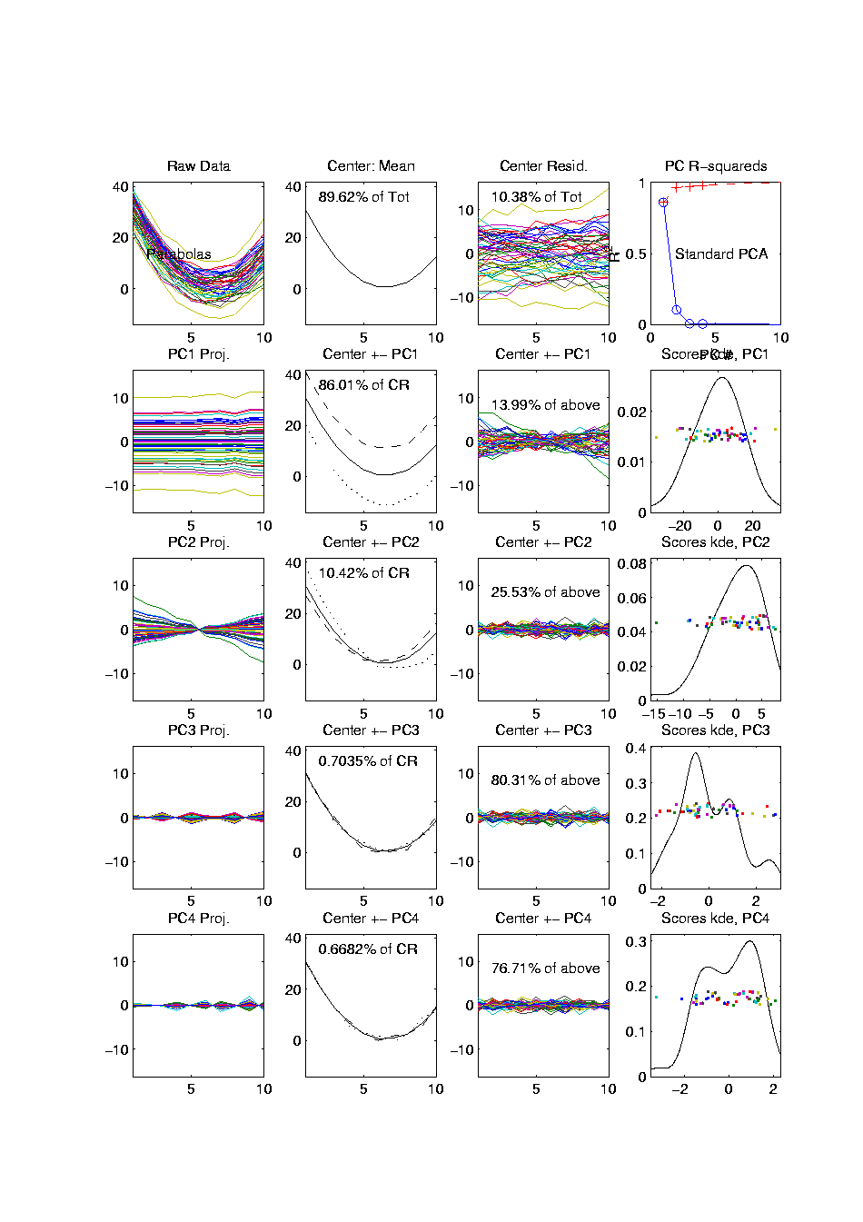
PCA Redist’n of Energy (Cont.)
Note, have already considered some of these Useful Plots:
Power Spectrum (as %s)
Cumulative Power Spectrum (%)
Recall Common Terminology:
Power Spectrum is Called
“Scree Plot”
Kruskal (1964) Cattell (1966)
(all but name “scree”) (1st Appearance of name???)
Notes:
8

Slide 9
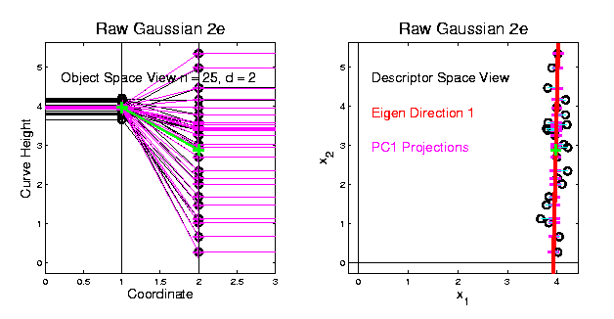
PCA vs. SVD
2-d Toy Example
Direction of “Maximal Variation”???
PC1 Solution (Mean Centered) Very Good!

Slide 10
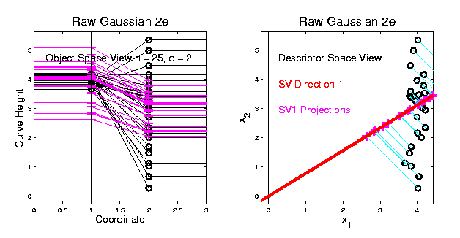
PCA vs. SVD
2-d Toy Example
Direction of “Maximal Variation”???
SV1 Solution (Origin Centered) Poor Rep’n

Slide 11
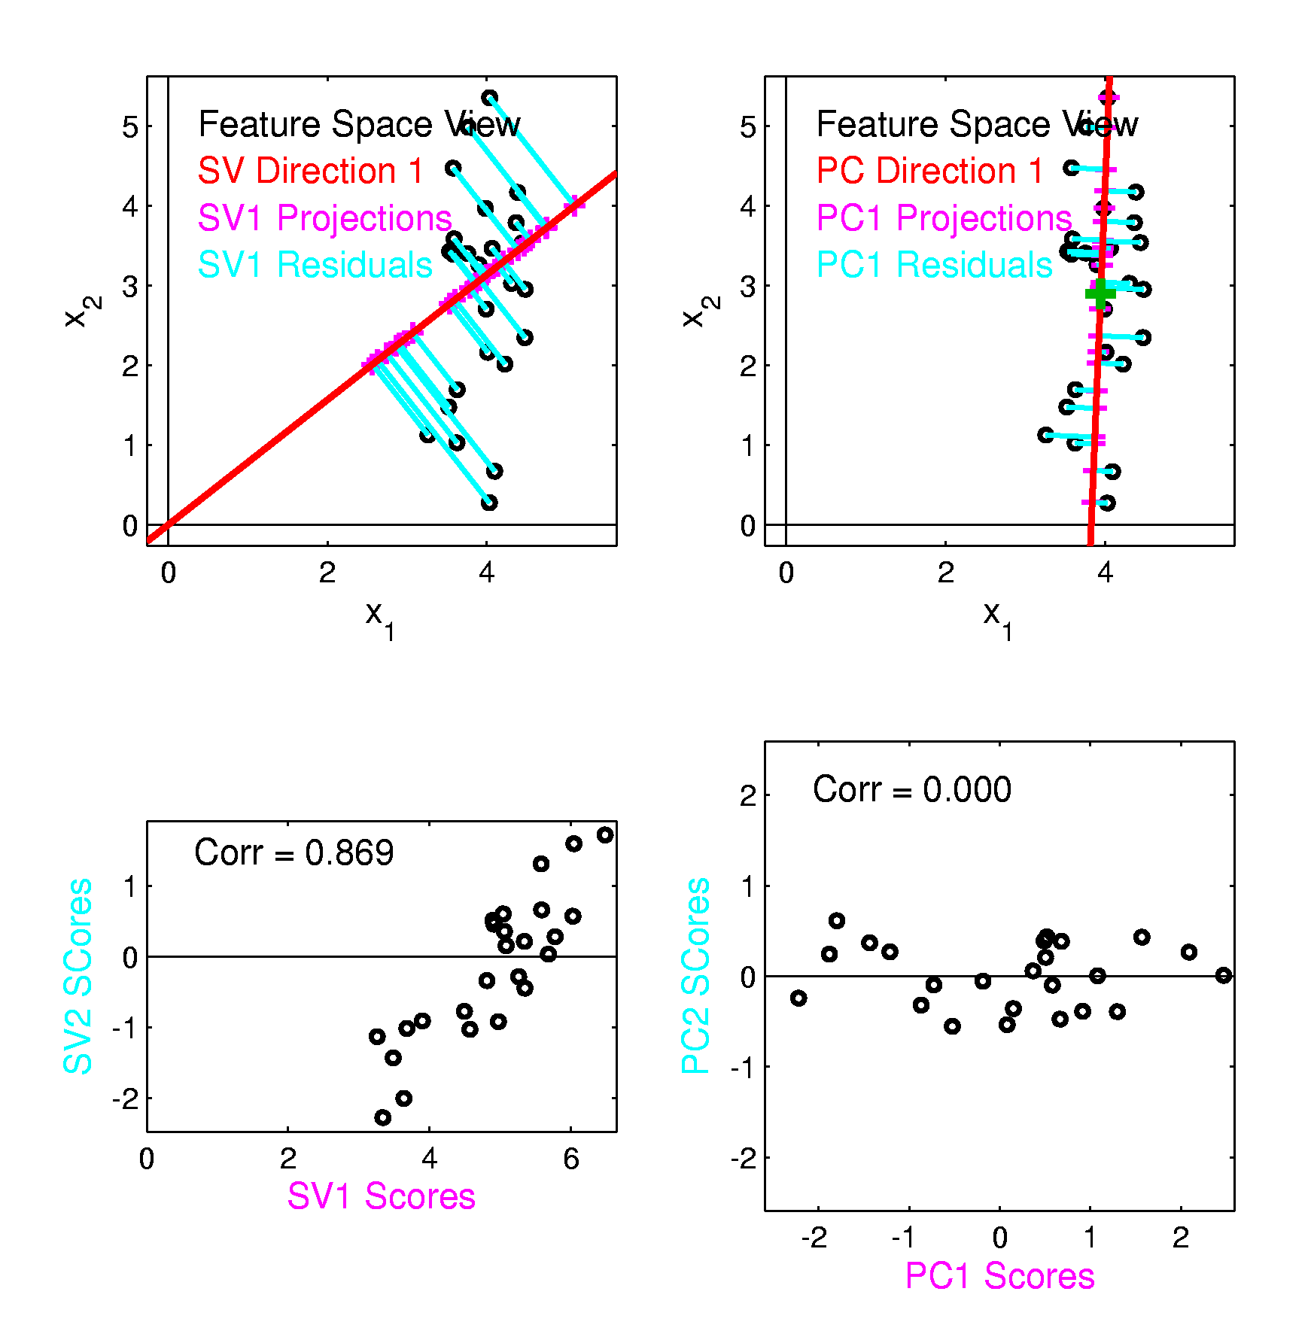
PCA vs. SVD
Similar 2-d
Toy Example
Now
Compare
Scores

Slide 12
PCA vs. SVD
Consequences
Of Centering:
PCA Scores Are
Mean Centered
Not SVD Scores

Slide 13
PCA vs. SVD
Consequences
Of Centering:
PCA Scores Are
Uncorrelated
Not SVD Scores

Slide 14
PCA vs. SVD
Sometimes “SVD Analysis of Data”
= Uncentered PCA
Investigate with Similar Toy Example:
Conclusions:
PCA Generally Better
Unless “Origin Is Important”
Deeper Look: Zhang et al (2007)

Slide 15
Different Views of PCA
Solves several optimization problems:
Direction to maximize SS of 1-d proj’d data
Direction to minimize SS of residuals
(same, by Pythagorean Theorem)
“Best fit line” to data in “orthogonal sense”
(vs. regression of Y on X = vertical sense
& regression of X on Y = horizontal sense)
Use one that makes sense…
Notes:
15

Slide 16
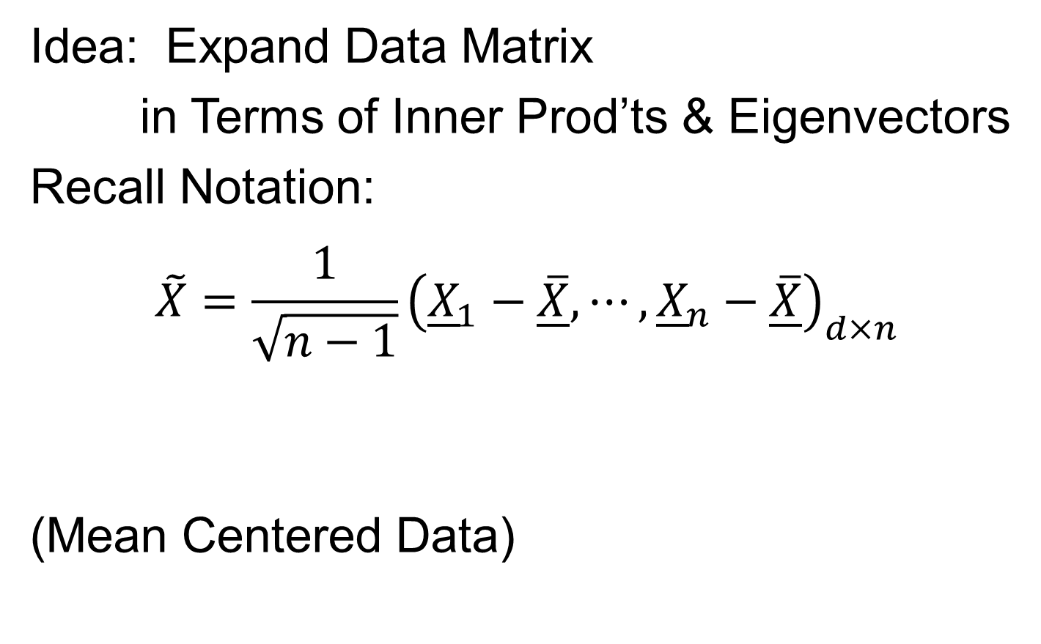
PCA Data Representation
Idea: Expand Data Matrix
in Terms of Inner Prod’ts & Eigenvectors
Recall Notation:
$$\tilde{X}=\frac{1}{\sqrt{n−1}}{\left({\underline{X}}_{1}−\underline{\overline{X}},⋯,{\underline{X}}_{n}−\underline{\overline{X}}\right)}_{d×n}$$
(Mean Centered Data)

Slide 17
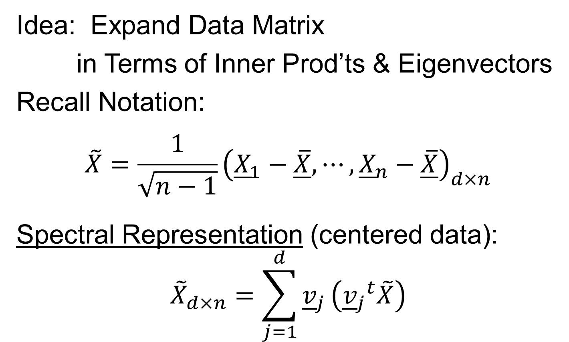
PCA Data Representation
Idea: Expand Data Matrix
in Terms of Inner Prod’ts & Eigenvectors
Recall Notation:
$$\tilde{X}=\frac{1}{\sqrt{n−1}}{\left({\underline{X}}_{1}−\underline{\overline{X}},⋯,{\underline{X}}_{n}−\underline{\overline{X}}\right)}_{d×n}$$
Spectral Representation (centered data):
$${\tilde{X}}_{d×n}=\sum_{j=1}^{d}{{\underline{v}}_{j}}\left({{\underline{v}}_{j}}^{t}\tilde{X}\right)$$

Slide 18
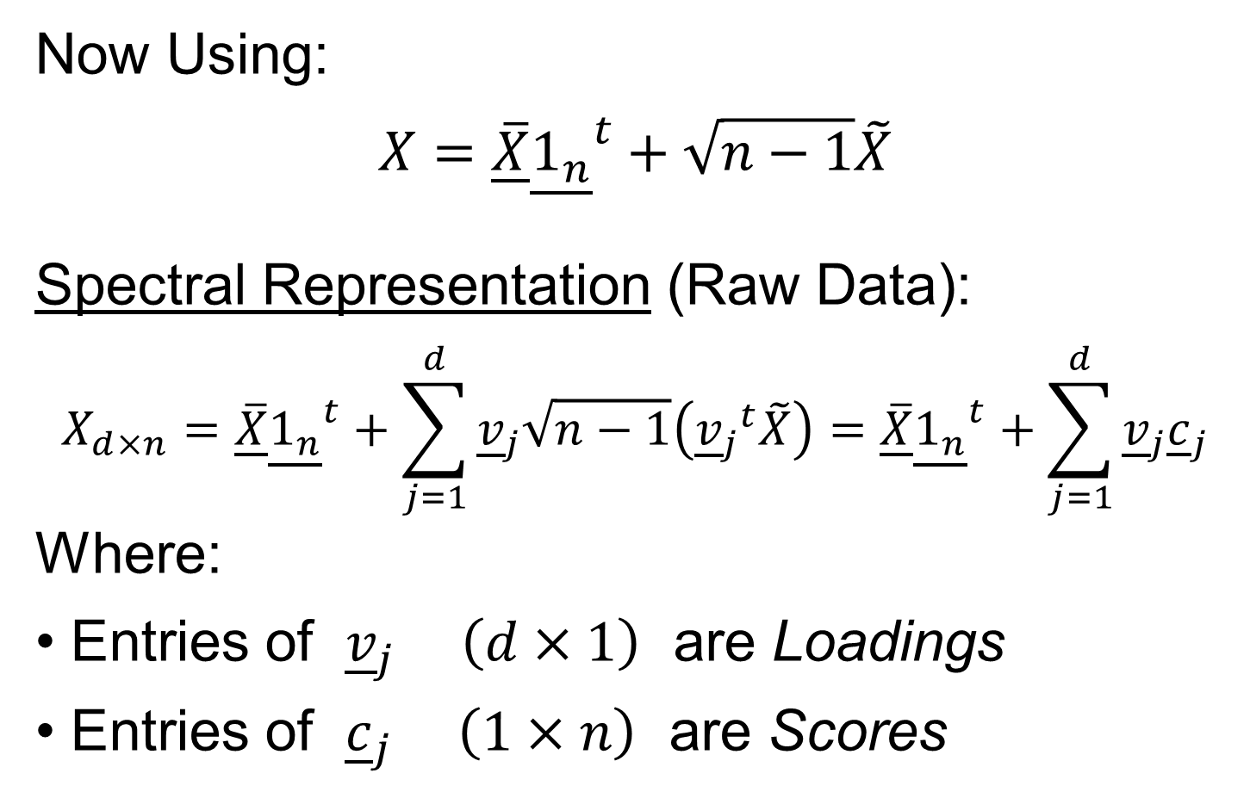
PCA Data Represent’n (Cont.)
Vector of 1s
Now Using:
$$X=\underline{\overline{X}}{\underline{1_{n}}}^{t}+\sqrt{n−1}\tilde{X}$$
Spectral Representation (Raw Data):
$$X_{d×n}=\underline{\overline{X}}{\underline{1_{n}}}^{t}+\sum_{j=1}^{d}{{\underline{v}}_{j}\sqrt{n−1}\left({{\underline{v}}_{j}}^{t}\tilde{X}\right)}=\underline{\overline{X}}{\underline{1_{n}}}^{t}+\sum_{j=1}^{d}{{\underline{v}}_{j}{\underline{c}}_{j}}$$
Where:
Entries of ${\underline{v}}_{j}$ $\left(d×1\right)$ are Loadings
Entries of ${\underline{c}}_{j}$ $\left(1×n\right)$ are Scores

Slide 19
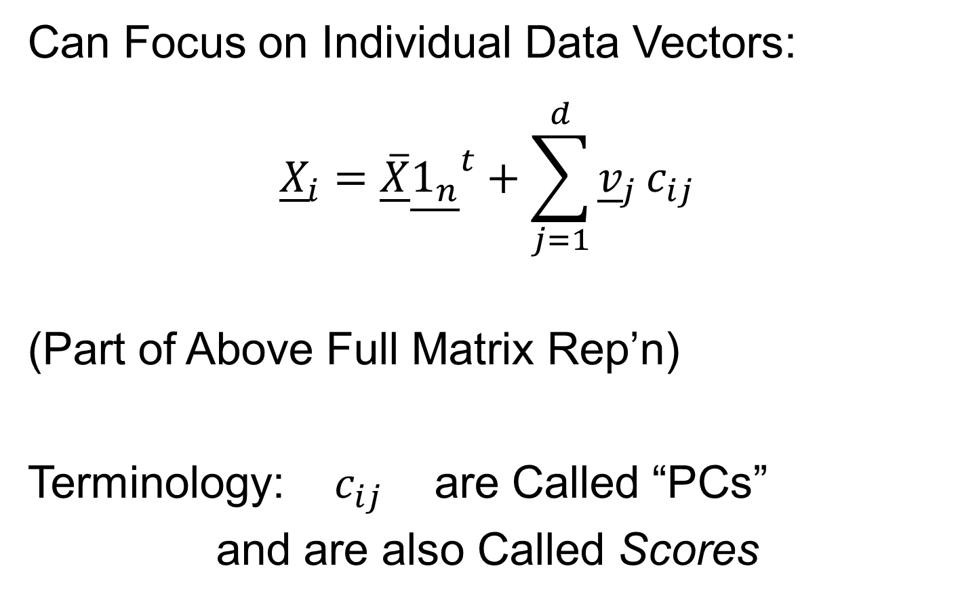
PCA Data Represent’n (Cont.)
Can Focus on Individual Data Vectors:
$${\underline{X}}_{i}=\underline{\overline{X}}{\underline{1_{n}}}^{t}+\sum_{j=1}^{d}{{\underline{v}}_{j}}c_{ij}$$
(Part of Above Full Matrix Rep’n)
Terminology: $c_{ij}$ are Called “PCs”
and are also Called Scores

Slide 20
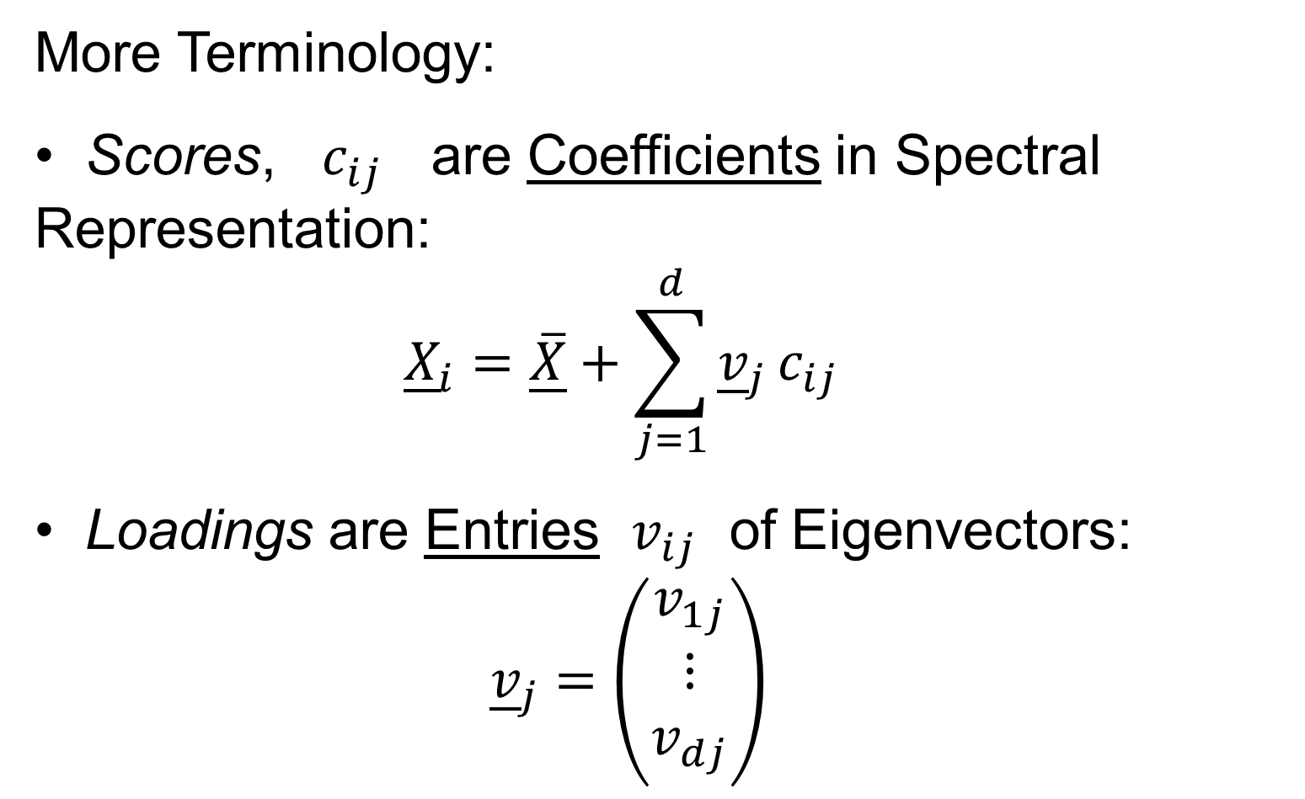
PCA Data Represent’n (Cont.)
More Terminology:
Scores, $c_{ij}$ are Coefficients in Spectral Representation:
$${\underline{X}}_{i}=\underline{\overline{X}}+\sum_{j=1}^{d}{{\underline{v}}_{j}}c_{ij}$$
Loadings are Entries $v_{ij}$ of Eigenvectors: ${\underline{v}}_{j}=\left(\begin{matrix}v_{1j} \\ ⋮ \\ v_{dj}\end{matrix}\right)$

Slide 21
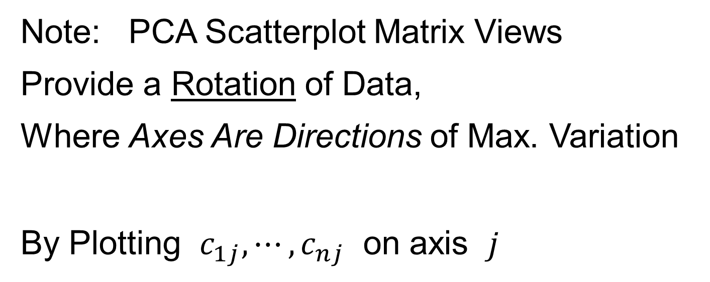
PCA Data Represent’n (Cont.)
Note: PCA Scatterplot Matrix Views
Provide a Rotation of Data,
Where Axes Are Directions of Max. Variation
By Plotting $c_{1j},⋯,c_{nj}$ on axis $j$

Slide 22
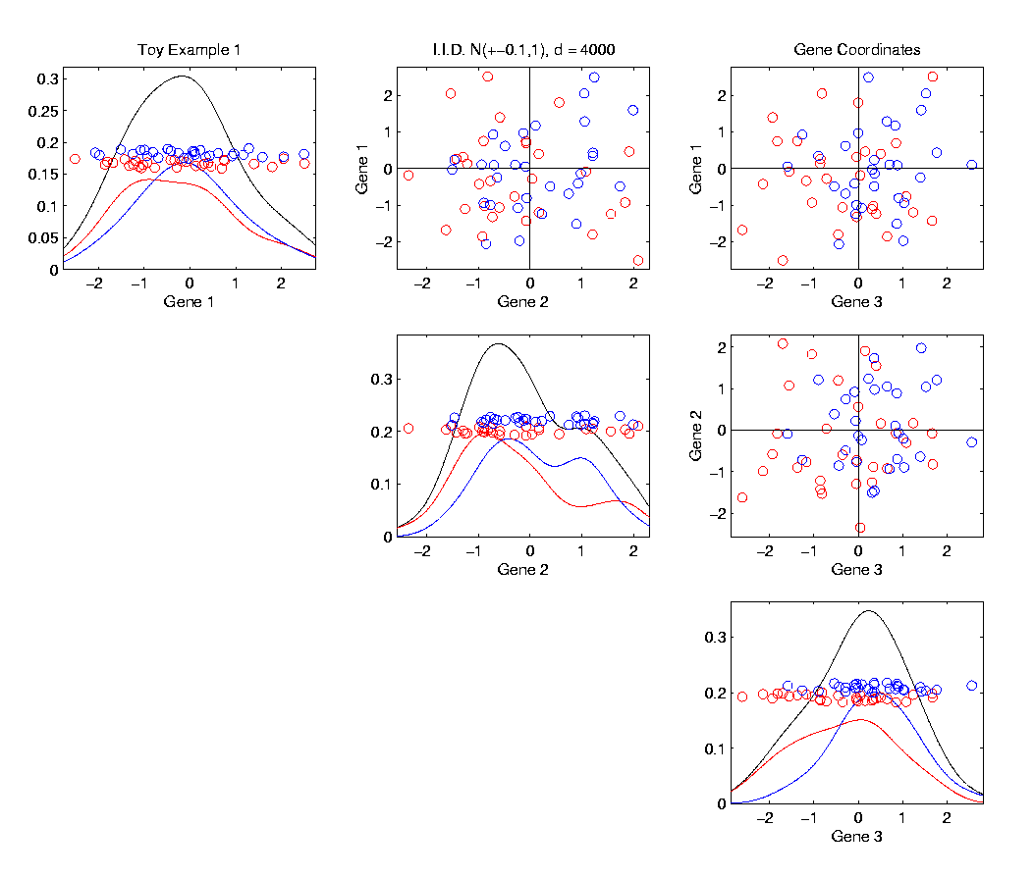

PCA Data Represent’n (Cont.)
E.g. Recall Raw Data,
Slightly
Mean
Shifted
Gaussian
Data

Slide 23
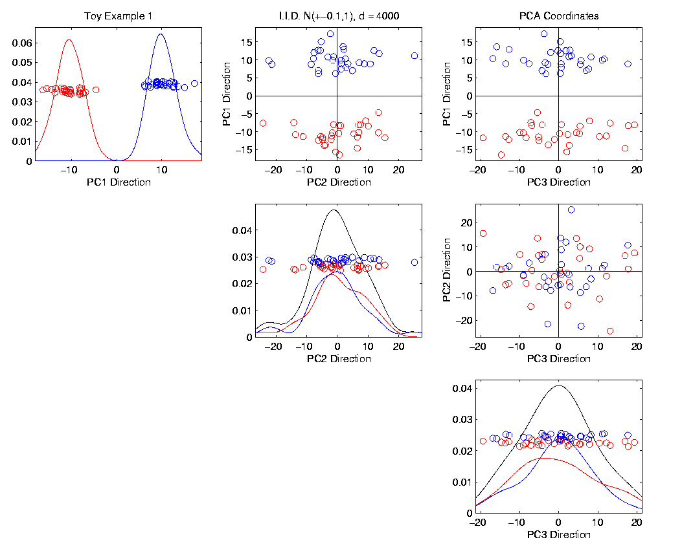

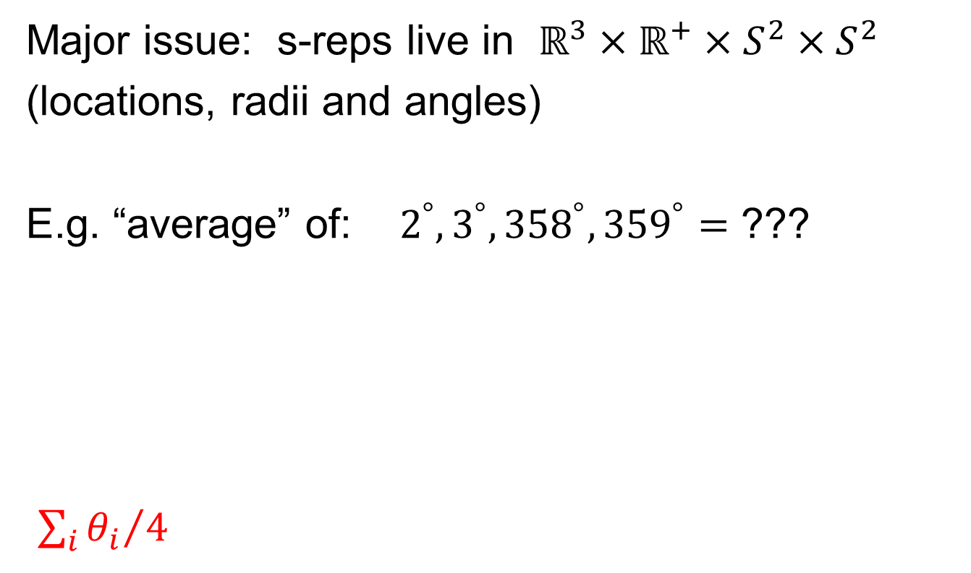
PCA Data Represent’n (Cont.)
PCA Rotation: Scatterplot Matrix View
$c_{11},⋯,c_{n1}$
$c_{12},⋯,c_{n2}$

Slide 24
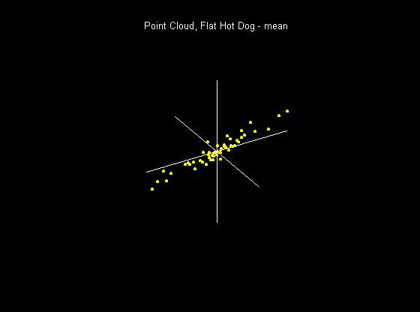
PCA Data Represent’n (Cont.)
PCA Rotates to Directions of Max. Variation

Slide 25
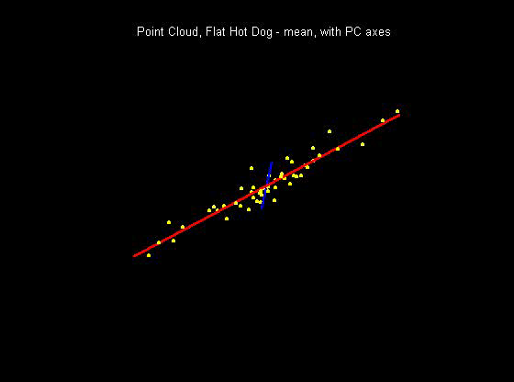
PCA Data Represent’n (Cont.)
PCA Rotates to Directions of Max. Variation
Will Use
This
Later

Slide 26
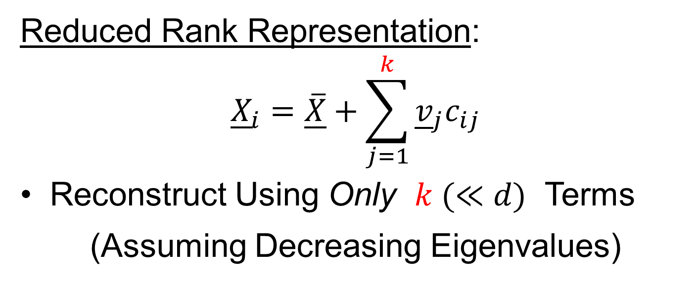
PCA Data Represent’n (Cont.)
Reduced Rank Representation:
$${\underline{X}}_{i}=\underline{\overline{X}}+\sum_{j=1}^{k}{{\underline{v}}_{j}c_{ij}}$$
Reconstruct Using Only $k (≪d)$ Terms
(Assuming Decreasing Eigenvalues)

Slide 27
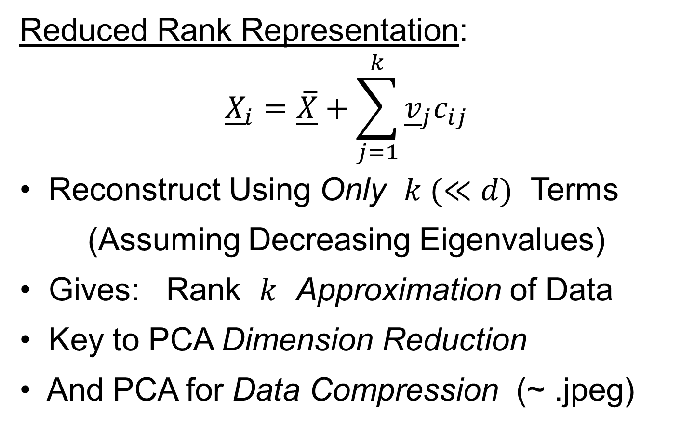
PCA Data Represent’n (Cont.)
Reduced Rank Representation:
$${\underline{X}}_{i}=\underline{\overline{X}}+\sum_{j=1}^{k}{{{\underline{v}}_{j}c}_{ij}}$$
Reconstruct Using Only $k (≪d)$ Terms
(Assuming Decreasing Eigenvalues)
Gives: Rank $k$ Approximation of Data
Key to PCA Dimension Reduction
And PCA for Data Compression (~ .jpeg)

Slide 28
PCA Data Represent’n (Cont.)
Choice of in Reduced Rank Represent’n:
Generally Very Slippery Problem
Not Recommended:
Arbitrary Choice
E.g. % Variation Explained 90%? 95%?

Slide 29
PCA Data Represent’n (Cont.)
Choice of in Reduced Rank Represent’n:
Generally Very Slippery Problem
SCREE Plot (Kruskal 1964):
Find Knee in Power Spectrum

Slide 30
PCA Data Represent’n (Cont.)
SCREE Plot Drawbacks:
What is a Knee?
What if There are Several?
Knees Depend on Scaling (Power? log?)
Personal Suggestions:
Find Auxiliary Cutoffs (Inter-Rater Variation)
Use the Full Range

Slide 31
PCA Simulation
Idea: given
Mean Vector
Eigenvectors
Eigenvalues
Simulate data from Corresponding Normal Distribution

Slide 32
PCA Simulation
Idea: given
Mean Vector
Eigenvectors
Eigenvalues
Simulate data from Corresponding Normal Distribution
Approach: Invert PCA Data Represent’n
where

Slide 33
PCA & Graphical Displays
Small caution on PC directions & plotting:
PCA directions (may) have sign flip
Mathematically no difference
Numerically caused artifact of round off
Can have large graphical impact

Slide 34
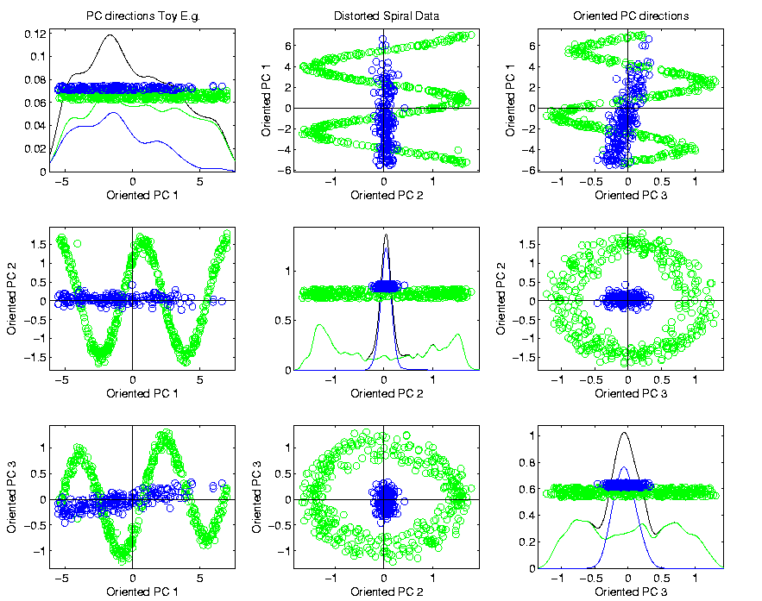
PCA & Graphical Displays
Toy Example (2 colored “clusters” in data)

Slide 35

PCA & Graphical Displays
Toy Example (1 point moved)

Slide 36
PCA & Graphical Displays
Toy Example (1 point moved)
Important
Point:
Constant
Axes

Slide 37
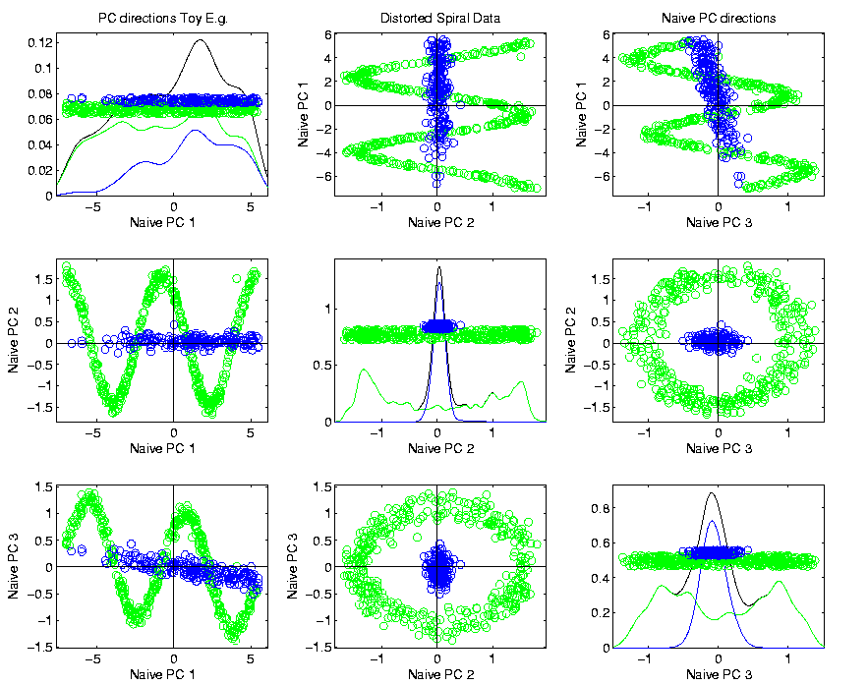
PCA & Graphical Displays
Original Data (arbitrary PC flip)

Slide 38
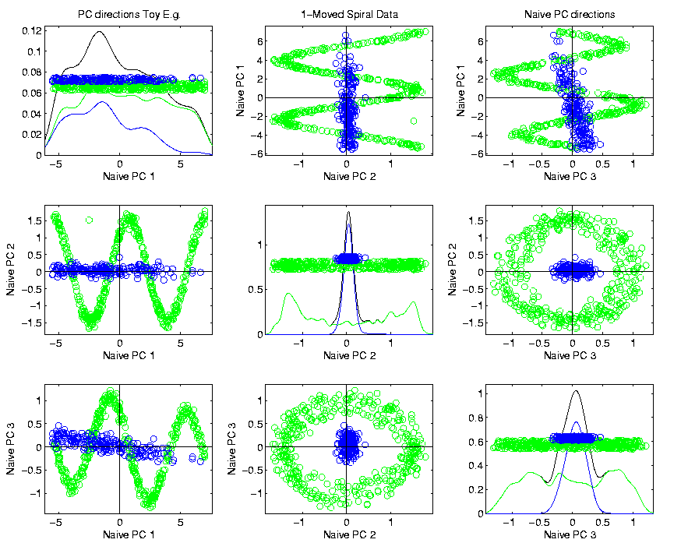
PCA & Graphical Displays
Point Moved Data (arbitrary PC flip)
Much
Harder
To See
Moving
Point

Slide 39
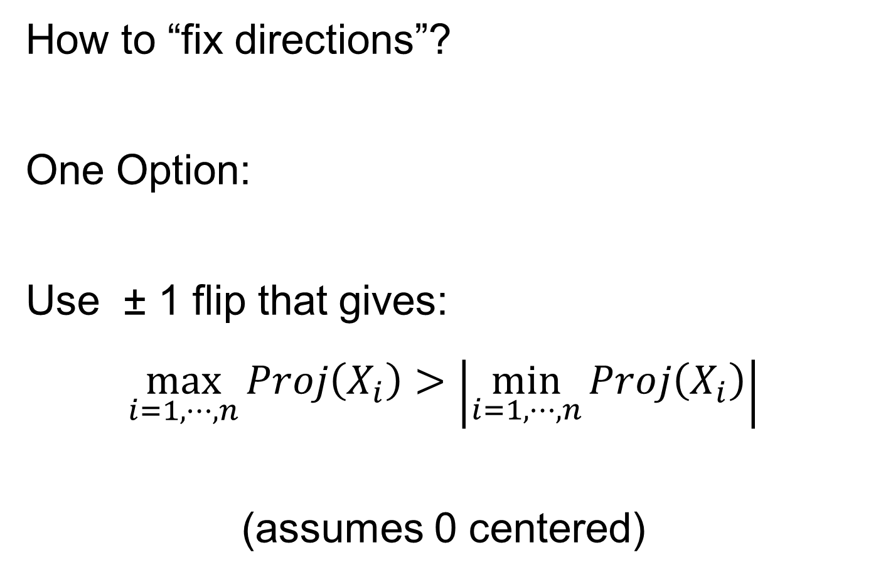
PCA & Graphical Displays
How to “fix directions”?
One Option:
Use ± 1 flip that gives:
$$\max_{i=1,⋯,n}{Proj\left(X_{i}\right)}>\left|\min_{i=1,⋯,n}{Proj\left(X_{i}\right)}\right|$$
(assumes 0 centered)

Slide 40
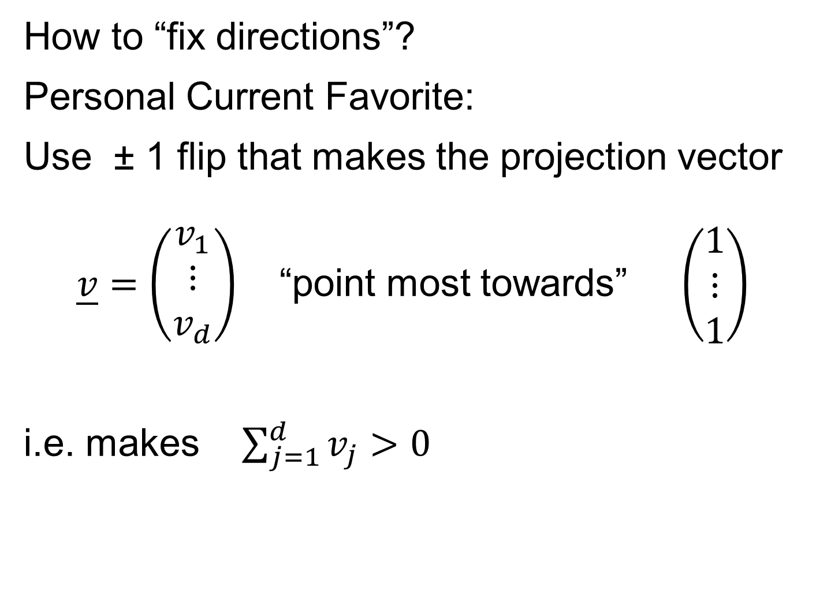
PCA & Graphical Displays
How to “fix directions”?
Personal Current Favorite:
Use ± 1 flip that makes the projection vector
$\underline{v}=\left(\begin{matrix}v_{1} \\ ⋮ \\ v_{d}\end{matrix}\right)$ “point most towards” $\left(\begin{matrix}1 \\ ⋮ \\ 1\end{matrix}\right)$
i.e. makes $\sum_{j=1}^{d}{v_{j}}>0$

Slide 41
Return to Big Picture
Main statistical goals of OODA:
Understanding population structure
  Low dim’al Projections, PCA …
Classification (i. e. Discrimination)
  Understanding 2+ populations
Time Series of Data Objects
  Chemical Spectra, Mortality Data
“Vertical Integration” of Data Types

Slide 42
Classification - Discrimination
Background: Two Class (Binary) version:
Using “training data” from
Class +1 and Class -1
Develop a “rule” for
assigning new data to a Class
Canonical Example: Disease Diagnosis
New Patients are “Healthy” or “Ill”
Determine based on measurements

Slide 43
Classification - Discrimination
Important Distinction:
Classification vs. Clustering
Classification:
Class labels are known,
Goal: understand differences
Clustering:
Goal: Find class labels (to be similar)
Both are about clumps of similar data,
but much different goals

Slide 44
Classification - Discrimination
Important Distinction:
Classification vs. Clustering
Useful terminology:
Classification: supervised learning
Clustering: unsupervised learning

Slide 45
Classification - Discrimination
Terminology:
For statisticians, these are synonyms

Slide 46
Classification - Discrimination
Terminology:
For statisticians, these are synonyms
For biologists, classification means:
Constructing taxonomies
And sorting organisms into them
(maybe this is why discrimination
was used, until politically incorrect…)

Slide 47
Classification (i.e. discrimination)
There are a number of:
Approaches
Philosophies
Schools of Thought
Too often cast as:
Statistics vs. EE - CS

Slide 48
Classification (i.e. discrimination)
EE – CS variations:
Pattern Recognition
Artificial Intelligence
Neural Networks (Deep Learning)
Data Mining
Machine Learning

Slide 49
Classification (i.e. discrimination)
Differing Viewpoints:
Statistics
Model Classes with Probability Distribut’ns
Use to study class diff’s & find rules
EE – CS
Data are just Sets of Numbers
Optimize Separation Rules
Current thought: combine these

Slide 50
Classification (i.e. discrimination)
Important Overview Reference:
Duda, Hart and Stork (2001)
Too much about neural nets???
Pizer disagrees…
Update of Duda & Hart (1973)

Slide 51

Classification (i.e. discrimination)
For a more classical statistical view:
McLachlan (2004).
Gaussian Likelihood theory, etc.
Not well tuned to HDLSS data
Notes:
51

Slide 52
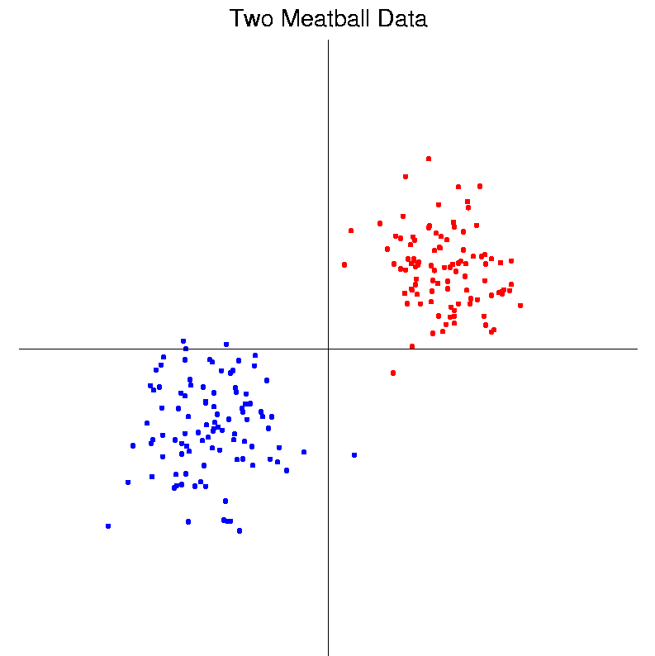
Classification Basics
Personal Viewpoint: Point Clouds
(In
Feature
Space)
Notes:
HDLSStmbRaw.ps

Slide 53
Classification Basics
Simple and Natural Approach:
Mean Difference
a.k.a.
Centroid Method
Find “skewer through two meatballs”

Slide 54
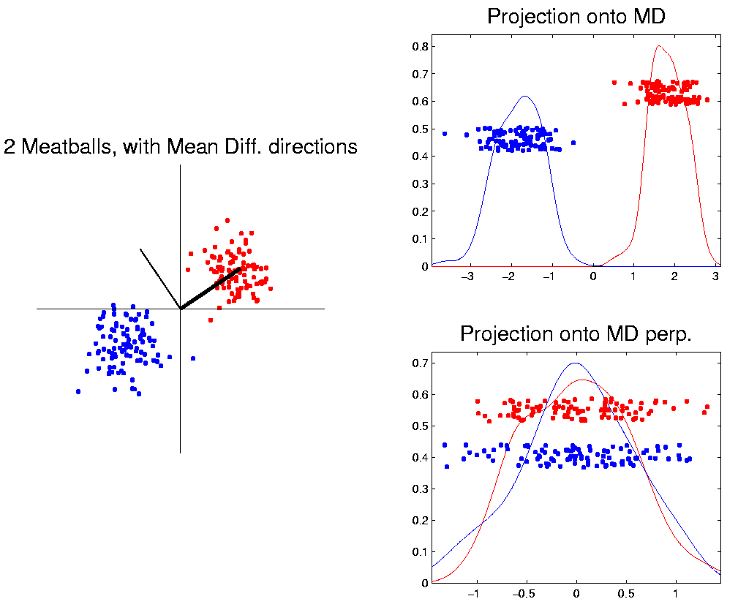
Classification Basics
For Simple Toy Example:
Project
On MD
& split
at center
Notes:
HDLSStmbMdif.ps

Slide 55
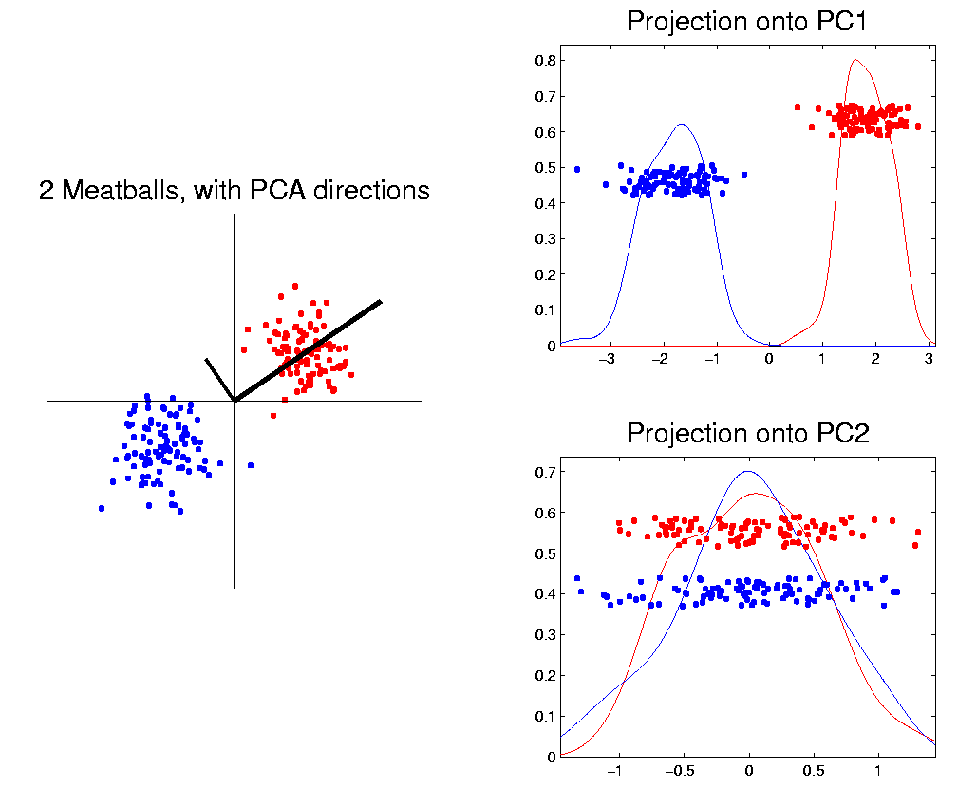
Classification Basics
Why not use PCA?
Reasonable
Result?
Doesn’t use
class labels…
Good?
Bad?
Notes:
HDLSStmbPCA.ps

Slide 56
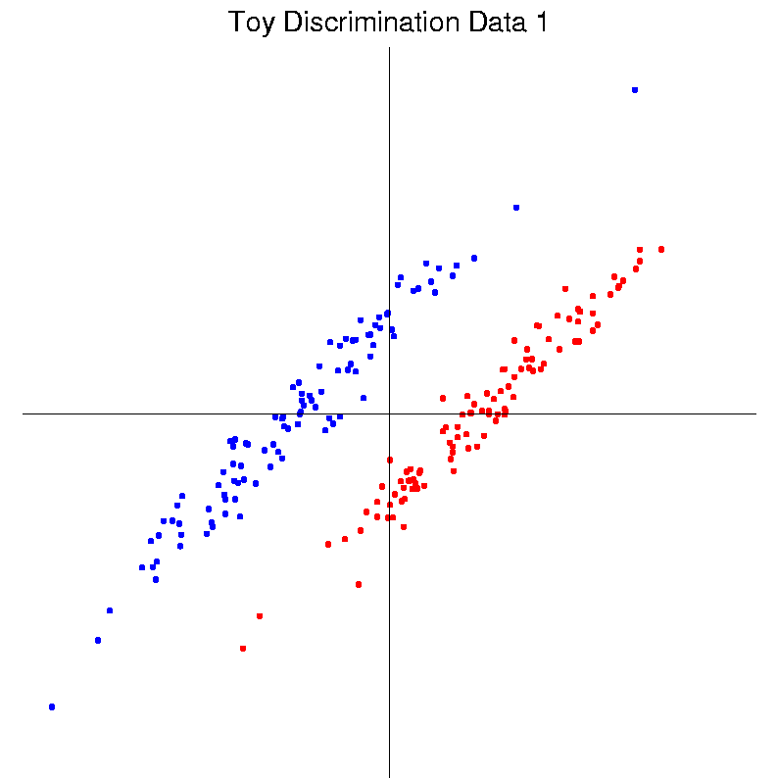
Classification Basics
Harder Example (slanted clouds):
Notes:
HDLSSod1Raw.ps

Slide 57
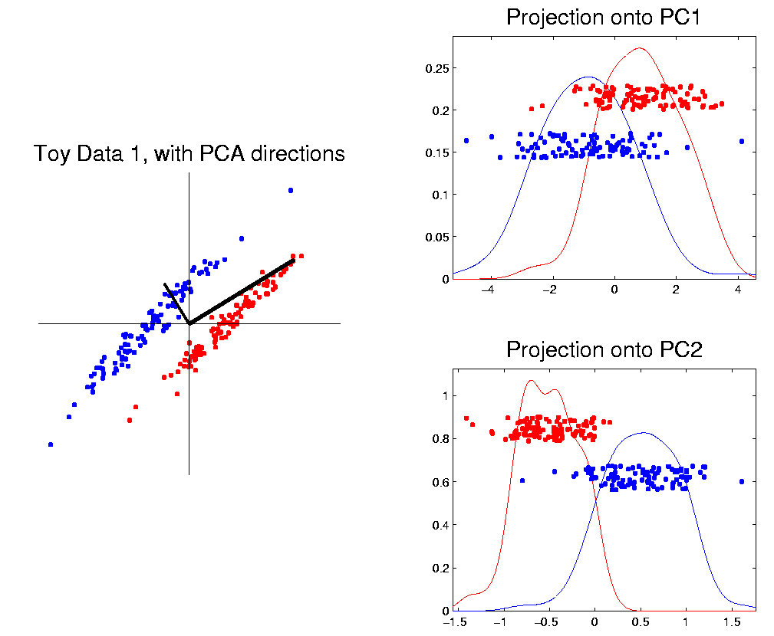
Classification Basics
PCA for slanted clouds:
PC1 terrible
PC2 better?
Still misses
right dir’n
Doesn’t use
Class Labels
Notes:
HDLSSod1PCA.ps

Slide 58
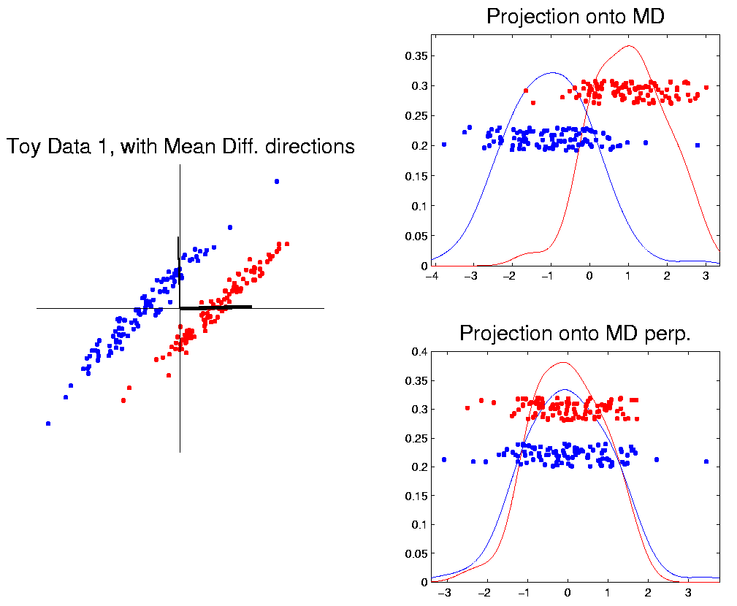
Classification Basics
Mean Difference for slanted clouds:
A little
better?
Still misses
right dir’n
Want to
account for
covariance
Notes:
HDLSSod1Mdif.ps

Slide 59
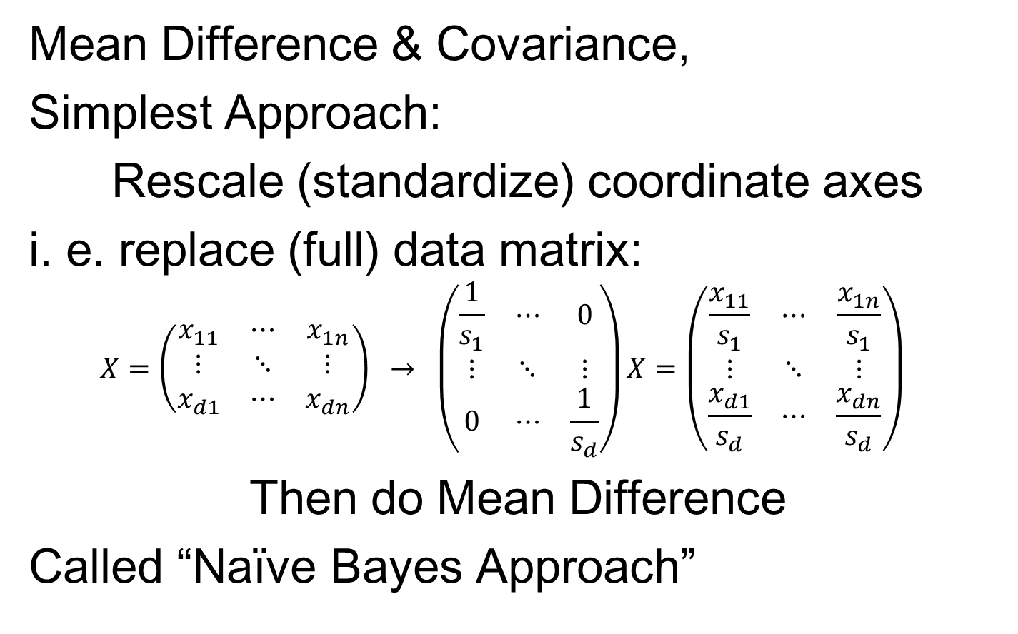
Classification Basics
Mean Difference & Covariance,
Simplest Approach:
Rescale (standardize) coordinate axes
i. e. replace (full) data matrix:
$$X=\left(\begin{matrix}x_{11} & ⋯ & x_{1n} \\ ⋮ & ⋱ & ⋮ \\ x_{d1} & ⋯ & x_{dn}\end{matrix}\right) → \left(\begin{matrix}\frac{1}{s_{1}} & ⋯ & 0 \\ ⋮ & ⋱ & ⋮ \\ 0 & ⋯ & \frac{1}{s_{d}}\end{matrix}\right)X=\left(\begin{matrix}\frac{x_{11}}{s_{1}} & ⋯ & \frac{x_{1n}}{s_{1}} \\ ⋮ & ⋱ & ⋮ \\ \frac{x_{d1}}{s_{d}} & ⋯ & \frac{x_{dn}}{s_{d}}\end{matrix}\right)$$
Then do Mean Difference
Called “Naïve Bayes Approach”

Slide 60
Classification Basics
Naïve Bayes Reference:
Domingos & Pazzani (1997)
Most sensible contexts:
Non-comparable data
E.g. different units

Slide 61
Classification Basics
Problem with Naïve Bayes:
Only adjusts
Variances
Not Covariances
Doesn’t solve
this problem
Notes:
HDLSSod1Raw.ps

Slide 62
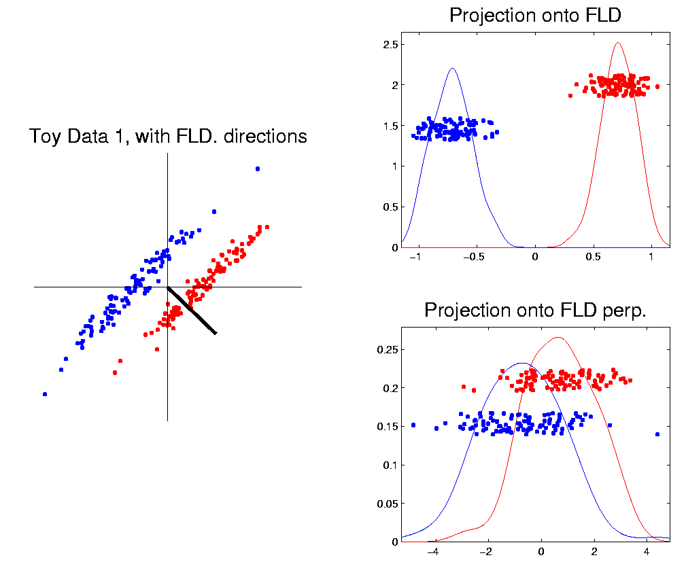
Classification Basics
Better Solution: Fisher Linear Discrimination
Gets the
right dir’n
How does
it work?
Notes:
HDLSSod1FLD.ps

Slide 63
Fisher Linear Discrimination
Other common terminology (for FLD):
Linear Discriminant Analysis (LDA)
Original Paper: Fisher (1936)

Slide 64
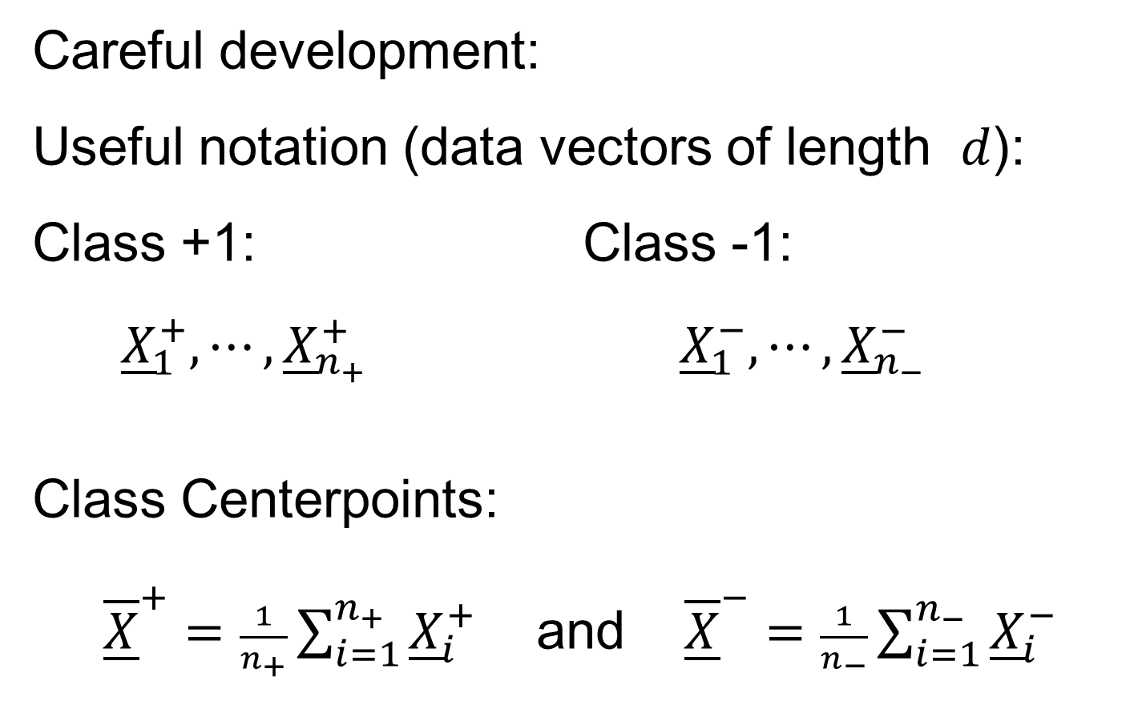
Fisher Linear Discrimination
Careful development:
Useful notation (data vectors of length $d$):
Class +1: Class -1:
${\underline{X}}_{1}^{+},⋯,{\underline{X}}_{n_{+}}^{+}$ ${\underline{X}}_{1}^{−},⋯,{\underline{X}}_{n_{−}}^{−}$
Class Centerpoints:
${\overline{\underline{X}}}^{+}=\frac{1}{n_{+}}\sum_{i=1}^{n_{+}}{{\underline{X}}_{i}^{+}}$ and ${\overline{\underline{X}}}^{−}=\frac{1}{n_{−}}\sum_{i=1}^{n_{−}}{{\underline{X}}_{i}^{−}}$

Slide 65
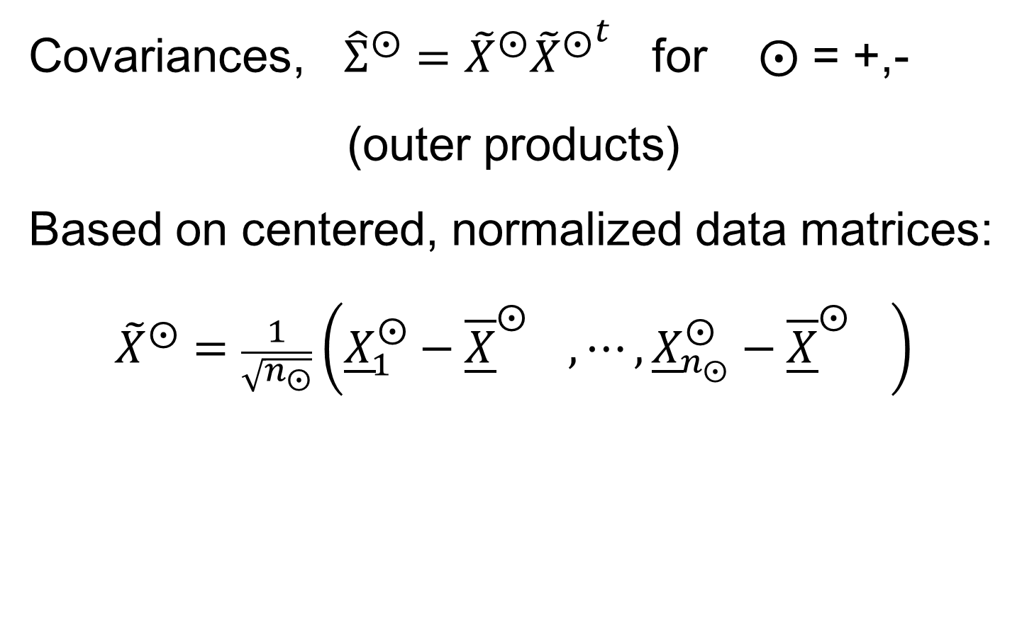
Fisher Linear Discrimination
Covariances, ${\hat{Σ}}^{⨀}={\tilde{X}}^{⨀}{{\tilde{X}}^{⨀}}^{t}$ for $⨀$ = +,-
(outer products)
Based on centered, normalized data matrices:
$${\tilde{X}}^{⨀}=\frac{1}{\sqrt{n_{⨀}}}\left({\underline{X}}_{1}^{⨀}−{\overline{\underline{X}}}^{⨀{}},⋯,{\underline{X}}_{n_{⨀}}^{⨀}−{\overline{\underline{X}}}^{⨀{}}\right)$$
Note: use “MLE” version of estimated
covariance matrices, for simpler notation

Slide 66
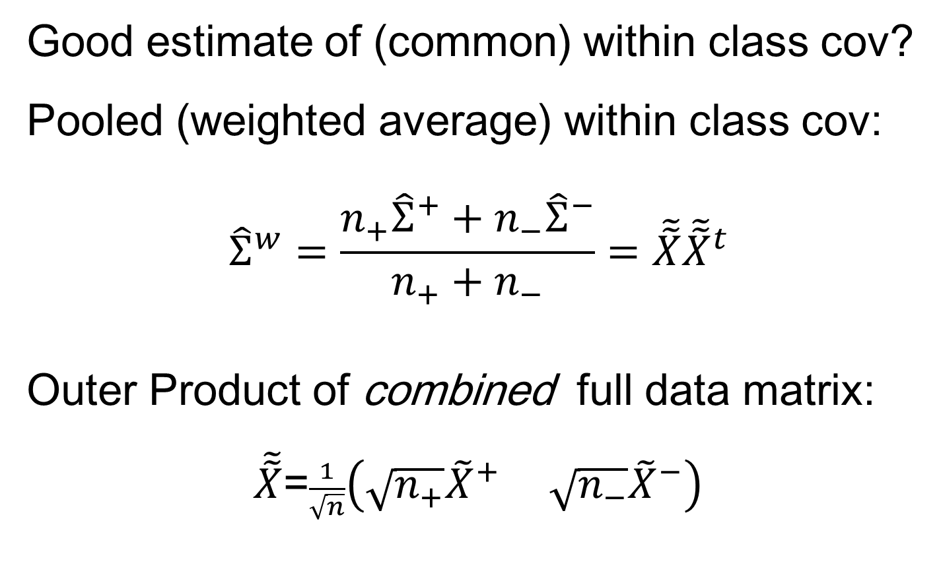
Fisher Linear Discrimination
Good estimate of (common) within class cov?
Pooled (weighted average) within class cov:
$${\hat{Σ}}^{w}=\frac{n_{+}{\hat{Σ}}^{+}+n_{−}{\hat{Σ}}^{−}}{n_{+}+n_{−}}=\tilde{\tilde{X}}{\tilde{\tilde{X}}}^{t}$$
Outer Product of combined full data matrix:
$\tilde{\tilde{X}}$=$\frac{1}{\sqrt{n}}\left(\sqrt{n_{+}}{\tilde{X}}^{+} \sqrt{n_{−}}{\tilde{X}}^{−}\right)$
Note: Different Means

Slide 67
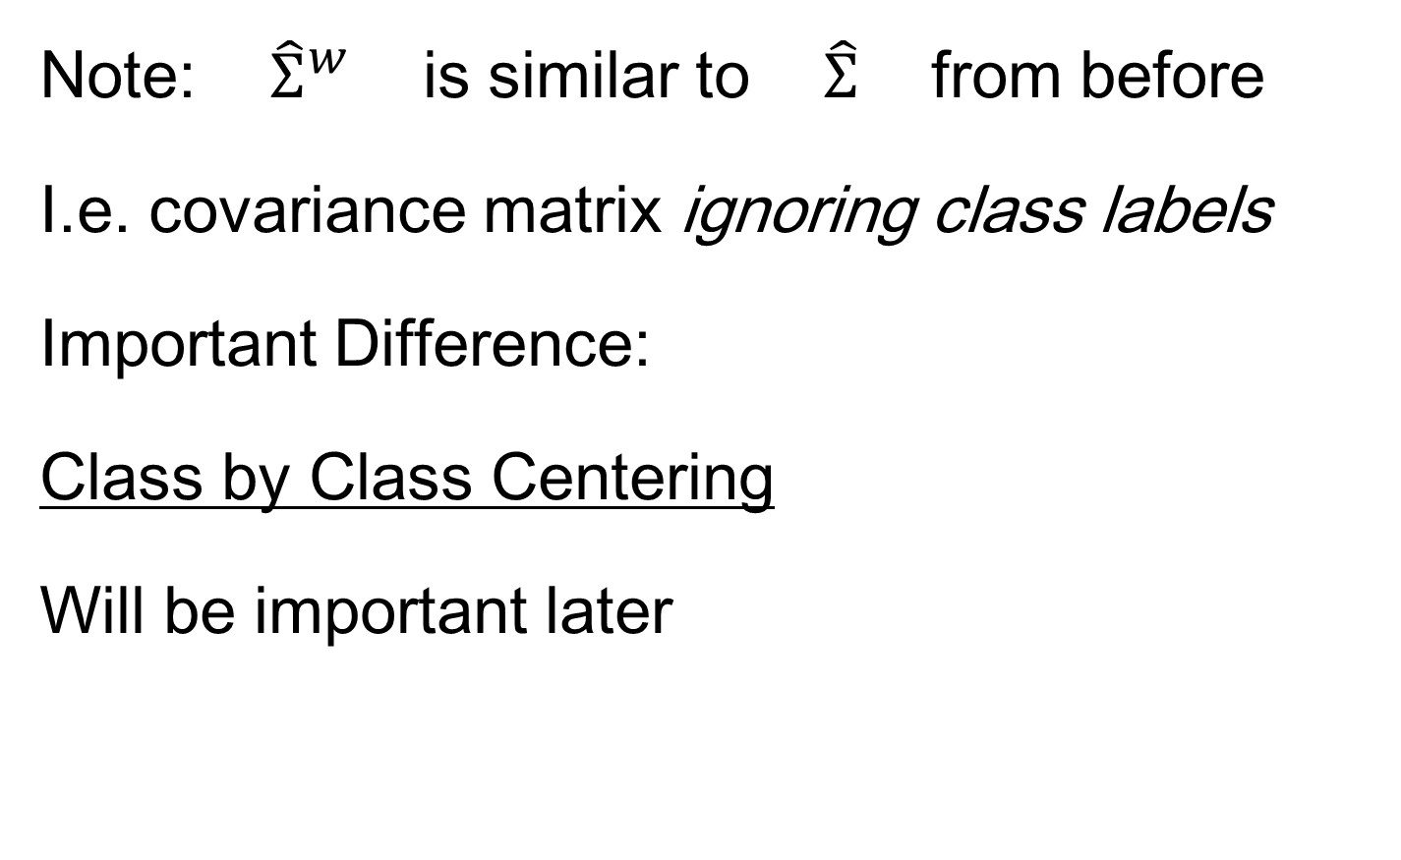
Fisher Linear Discrimination
Note: ${\hat{Σ}}^{w}$ is similar to $\hat{Σ}$ from before
I.e. covariance matrix ignoring class labels
Important Difference:
Class by Class Centering
Will be important later
Notes:
HDLSSod1Raw.ps

Slide 68
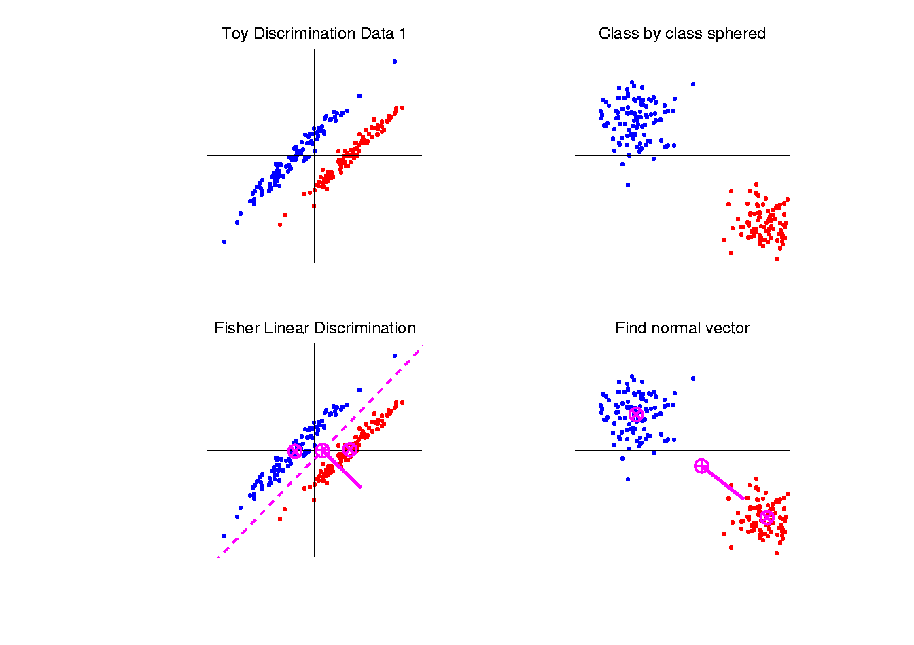

Fisher Linear Discrimination
Simple way to find “correct cov. adjustment”:
Individually transform subpopulations so
“spherical” about their means
For $⨀$ = +,- define ${\underline{Z}}_{i}^{⨀}={\left({\hat{Σ}}^{w}\right)}^{−1/2}{\underline{X}}_{i}^{⨀}$
Notes:
HDLSSod1egFLD.ps

Slide 69
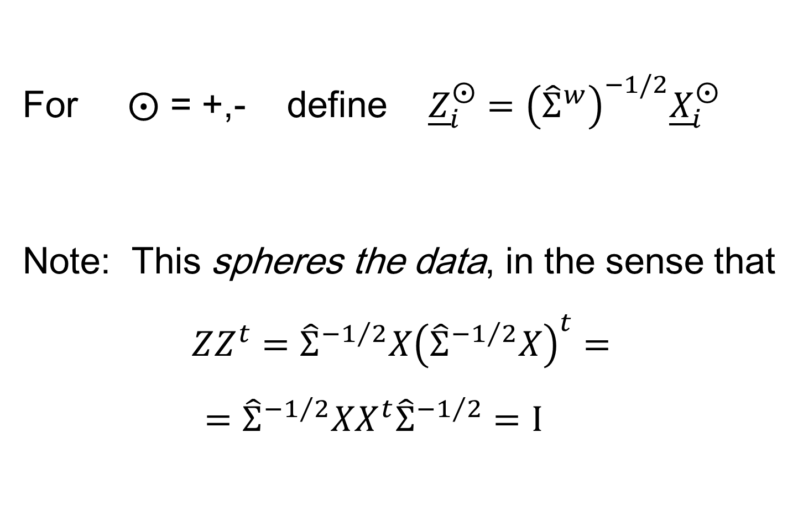
Fisher Linear Discrimination
For $⨀$ = +,- define ${\underline{Z}}_{i}^{⨀}={\left({\hat{Σ}}^{w}\right)}^{−1/2}{\underline{X}}_{i}^{⨀}$
Note: This spheres the data, in the sense that
$$ZZ^{t}={\hat{Σ}}^{{−1}/2}X{\left({\hat{Σ}}^{{−1}/2}X\right)}^{t}=$$
$$={\hat{Σ}}^{{−1}/2}XX^{t}{\hat{Σ}}^{{−1}/2}=I$$
Notes:
HDLSSod1egFLD.ps

Slide 70
Fisher Linear Discrimination
Then:
In Transformed Space,
Best separating hyperplane
is
Perpendicular bisector of
line between means
Notes:
HDLSSod1egFLD.ps

Slide 71
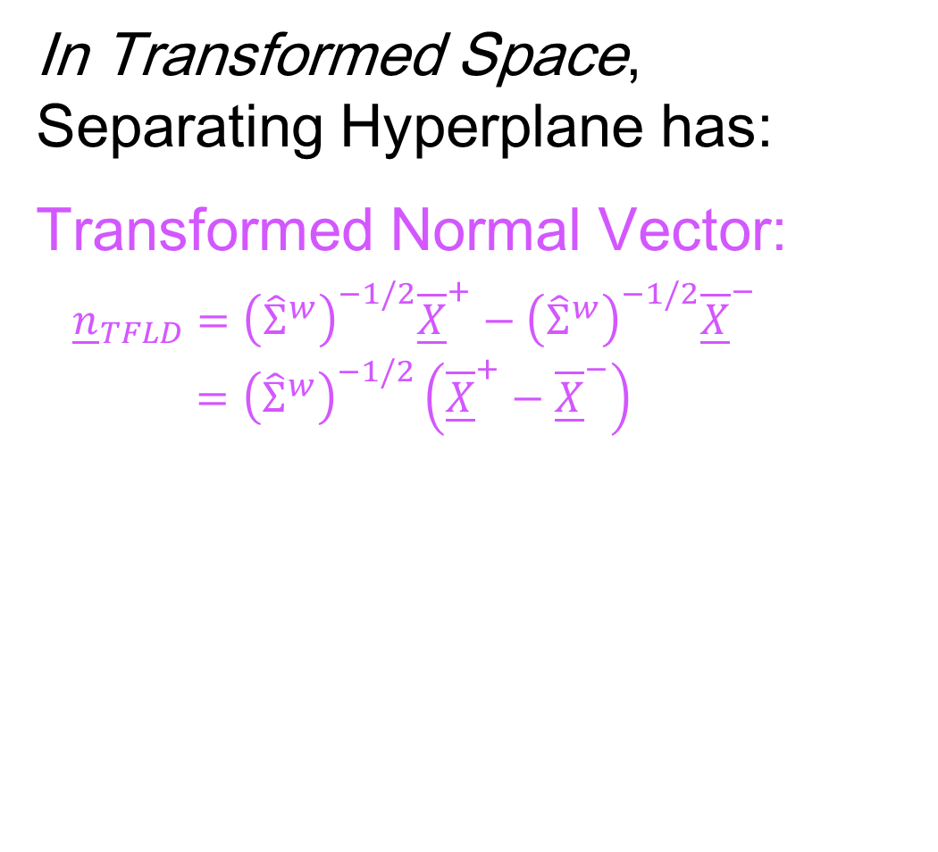
Fisher Linear Discrimination
In Transformed Space,
Separating Hyperplane has:
Transformed Normal Vector:
${\underline{n}}_{TFLD}={\left({\hat{Σ}}^{w}\right)}^{−1/2}{\overline{\underline{X}}}^{+}−{\left({\hat{Σ}}^{w}\right)}^{−1/2}{\overline{\underline{X}}}^{−}$
$={\left({\hat{Σ}}^{w}\right)}^{−1/2}\left({\overline{\underline{X}}}^{+}−{\overline{\underline{X}}}^{−}\right)$
Notes:
HDLSSod1egFLD.ps

Slide 72
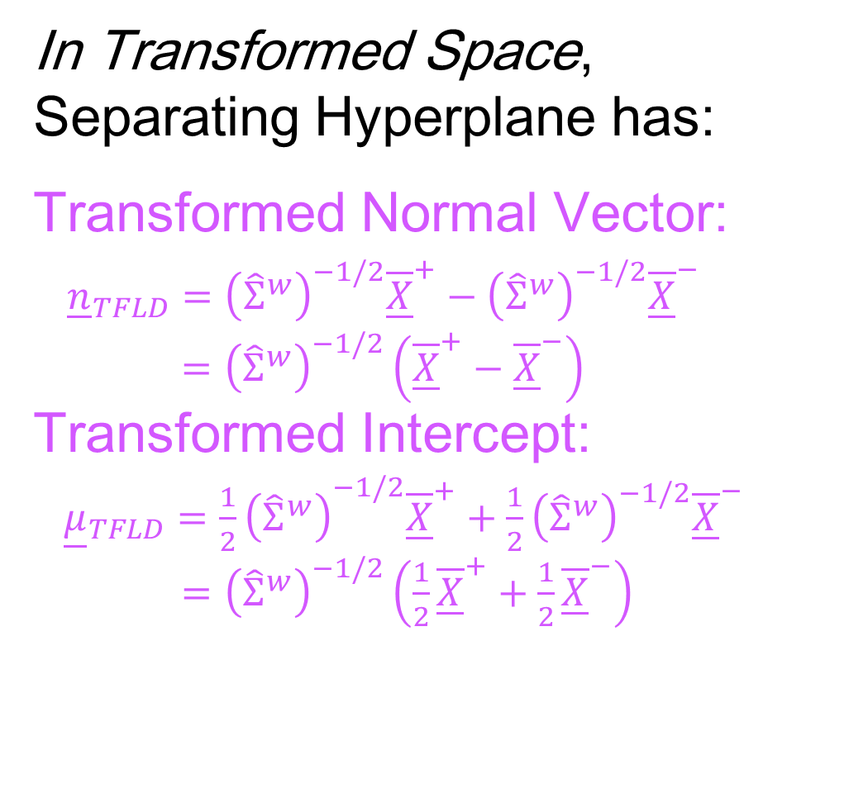
Fisher Linear Discrimination
In Transformed Space,
Separating Hyperplane has:
Transformed Normal Vector:
${\underline{n}}_{TFLD}={\left({\hat{Σ}}^{w}\right)}^{−1/2}{\overline{\underline{X}}}^{+}−{\left({\hat{Σ}}^{w}\right)}^{−1/2}{\overline{\underline{X}}}^{−}$
$={\left({\hat{Σ}}^{w}\right)}^{−1/2}\left({\overline{\underline{X}}}^{+}−{\overline{\underline{X}}}^{−}\right)$
Transformed Intercept:
${\underline{μ}}_{TFLD}={\frac{1}{2}\left({\hat{Σ}}^{w}\right)}^{−1/2}{\overline{\underline{X}}}^{+}+\frac{1}{2}{\left({\hat{Σ}}^{w}\right)}^{−1/2}{\overline{\underline{X}}}^{−}$
$={\left({\hat{Σ}}^{w}\right)}^{−1/2}\left(\frac{1}{2}{\overline{\underline{X}}}^{+}+\frac{1}{2}{\overline{\underline{X}}}^{−}\right)$
Notes:
HDLSSod1egFLD.ps

Slide 73
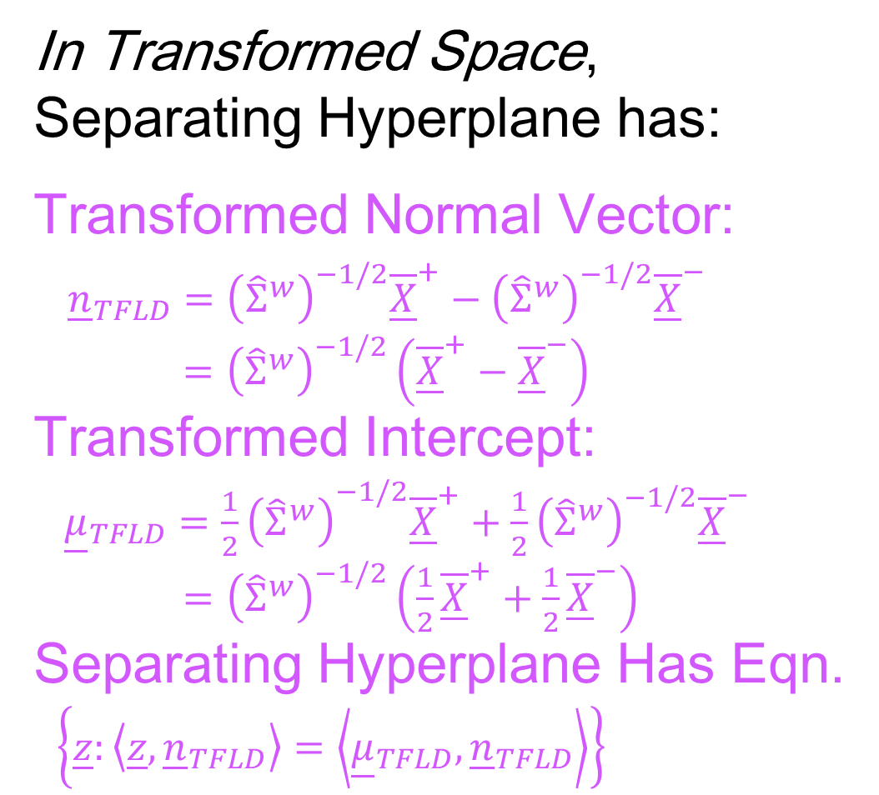
Fisher Linear Discrimination
In Transformed Space,
Separating Hyperplane has:
Transformed Normal Vector:
${\underline{n}}_{TFLD}={\left({\hat{Σ}}^{w}\right)}^{−1/2}{\overline{\underline{X}}}^{+}−{\left({\hat{Σ}}^{w}\right)}^{−1/2}{\overline{\underline{X}}}^{−}$
$={\left({\hat{Σ}}^{w}\right)}^{−1/2}\left({\overline{\underline{X}}}^{+}−{\overline{\underline{X}}}^{−}\right)$
Transformed Intercept:
${\underline{μ}}_{TFLD}={\frac{1}{2}\left({\hat{Σ}}^{w}\right)}^{−1/2}{\overline{\underline{X}}}^{+}+\frac{1}{2}{\left({\hat{Σ}}^{w}\right)}^{−1/2}{\overline{\underline{X}}}^{−}$
$={\left({\hat{Σ}}^{w}\right)}^{−1/2}\left(\frac{1}{2}{\overline{\underline{X}}}^{+}+\frac{1}{2}{\overline{\underline{X}}}^{−}\right)$
Separating Hyperplane Has Eqn.
$\left\{\underline{z}:\left\langle \underline{z},{\underline{n}}_{TFLD}\right\rangle =\left\langle {\underline{μ}}_{TFLD},{\underline{n}}_{TFLD}\right\rangle \right\}$
Notes:
HDLSSod1egFLD.ps

Slide 74


Fisher Linear Discrimination
Thus discrimination rule is:
Given a new data vector ${\underline{X}}^{0}$,
Choose Class +1 when:
$$\left\langle {\left({\hat{Σ}}^{w}\right)}^{−1/2}{\underline{X}}^{0},{\underline{n}}_{TFLD}\right\rangle ≥\left\langle {\underline{μ}}_{TFLD},{\underline{n}}_{TFLD}\right\rangle$$
Using Boundary: $\left\{\underline{z}:\left\langle \underline{z},{\underline{n}}_{TFLD}\right\rangle =\left\langle {\underline{μ}}_{TFLD},{\underline{n}}_{TFLD}\right\rangle \right\}$

Slide 75
Fisher Linear Discrimination
Thus discrimination rule is:
Given a new data vector ${\underline{X}}^{0}$,
Choose Class +1 when:
$$\left\langle {\left({\hat{Σ}}^{w}\right)}^{−1/2}{\underline{X}}^{0},{\underline{n}}_{TFLD}\right\rangle ≥\left\langle {\underline{μ}}_{TFLD},{\underline{n}}_{TFLD}\right\rangle$$
i.e. (transforming back to original space)
$$\left\langle {\underline{X}}^{0},{\left({\hat{Σ}}^{w}\right)}^{−1/2}{\underline{n}}_{TFLD}\right\rangle ≥\left\langle {\left({\hat{Σ}}^{w}\right)}^{1/2}{\underline{μ}}_{TFLD},{\left({\hat{Σ}}^{w}\right)}^{−1/2}{\underline{n}}_{TFLD}\right\rangle$$
$$\left\langle {\underline{X}}^{0}, {\underline{n}}_{FLD}\right\rangle ≥\left\langle {\underline{μ}}_{FLD}, {\underline{n}}_{FLD}\right\rangle$$
where:
$${\underline{n}}_{FLD}={\left({\hat{Σ}}^{w}\right)}^{−1/2}{\underline{n}}_{TFLD}={\left({\hat{Σ}}^{w}\right)}^{−1}\left({\overline{\underline{X}}}^{+}−{\overline{\underline{X}}}^{−}\right)$$
$${\underline{μ}}_{FLD}={\left({\hat{Σ}}^{w}\right)}^{1/2}{\underline{μ}}_{TFLD}=\left(\frac{1}{2}{\overline{\underline{X}}}^{+}+\frac{1}{2}{\overline{\underline{X}}}^{−}\right)$$

Slide 76
Fisher Linear Discrimination
Thus discrimination rule is:
Classify ${\underline{X}}^{0}$ to Class +1 when:
$$\left\langle {\underline{X}}^{0}, {\underline{n}}_{FLD}\right\rangle ≥\left\langle {\underline{μ}}_{FLD}, {\underline{n}}_{FLD}\right\rangle$$
where:
$${\underline{n}}_{FLD}={\left({\hat{Σ}}^{w}\right)}^{−1/2}{\underline{n}}_{TFLD}={\left({\hat{Σ}}^{w}\right)}^{−1}\left({\overline{\underline{X}}}^{+}−{\overline{\underline{X}}}^{−}\right)$$
$${\underline{μ}}_{FLD}={\left({\hat{Σ}}^{w}\right)}^{1/2}{\underline{μ}}_{TFLD}=\left(\frac{1}{2}{\overline{\underline{X}}}^{+}+\frac{1}{2}{\overline{\underline{X}}}^{−}\right)$$
i.e.
${{\underline{X}}^{0}}^{t}{\left({\hat{Σ}}^{w}\right)}^{−1}\left({\overline{\underline{X}}}^{+}−{\overline{\underline{X}}}^{−}\right)≥$
$≥{\frac{1}{2}\left({\overline{\underline{X}}}^{+}+{\overline{\underline{X}}}^{−}\right)}^{t}{\left({\hat{Σ}}^{w}\right)}^{−1}\left({\overline{\underline{X}}}^{+}−{\overline{\underline{X}}}^{−}\right)$
Same Inner Product
Of Center Point
Inner Product of New Data
Point & Transf’d Direction

Slide 77
Fisher Linear Discrimination
So (in orig’l space) have separ’ting hyperplane with:
Normal vector: ${\underline{n}}_{FLD}$
Intercept: ${\underline{μ}}_{FLD}$
Notes:
HDLSSod1egFLD.ps

Slide 78

Fisher Linear Discrimination
Relationship to Mahalanobis distance
Idea: For $X_{1},X_{2}\sim N\left(μ,Σ\right)$, a natural distance
measure is: $d_{M}={\left[{\left(X_{1}−X_{2}\right)}^{t}Σ^{−1}\left(X_{1}−X_{2}\right)\right]}^{1/2}$
$$d_{1}=d_{2}$$

Slide 79
Fisher Linear Discrimination
Relationship to Mahalanobis distance
Idea: For $X_{1},X_{2}\sim N\left(μ,Σ\right)$, a natural distance
measure is: $d_{M}={\left[{\left(X_{1}−X_{2}\right)}^{t}Σ^{−1}\left(X_{1}−X_{2}\right)\right]}^{1/2}$
“unit free”, i.e. “standardized”
essentially mod out covariance structure
Euclidean dist. applied to $Σ^{−1/2}X_{1}$ & $Σ^{−1/2}X_{2}$
Same as key transformation for FLD
I.e. FLD is
mean difference in Mahalanobis space

