Slide 1
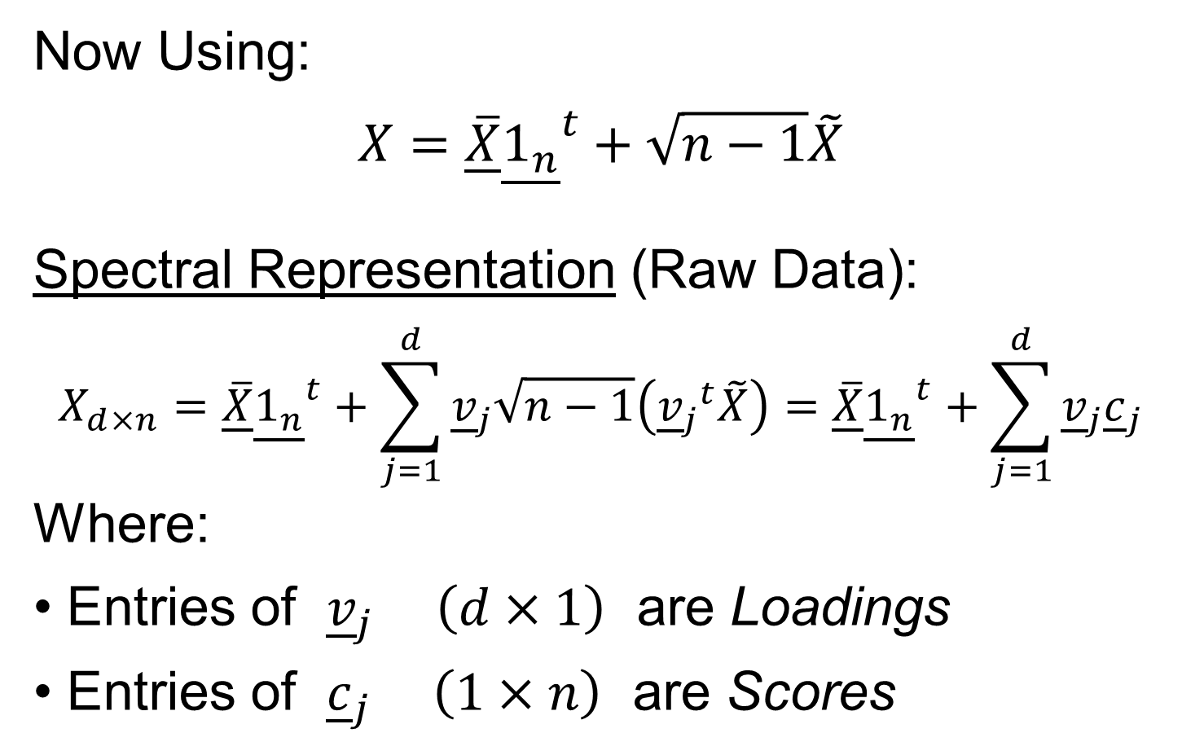
PCA Data Represent’n (Cont.)
Vector of 1s
Now Using:
$$X=\underline{\overline{X}}{\underline{1_{n}}}^{t}+\sqrt{n−1}\tilde{X}$$
Spectral Representation (Raw Data):
$$X_{d×n}=\underline{\overline{X}}{\underline{1_{n}}}^{t}+\sum_{j=1}^{d}{{\underline{v}}_{j}\sqrt{n−1}\left({{\underline{v}}_{j}}^{t}\tilde{X}\right)}=\underline{\overline{X}}{\underline{1_{n}}}^{t}+\sum_{j=1}^{d}{{\underline{v}}_{j}{\underline{c}}_{j}}$$
Where:
Entries of ${\underline{v}}_{j}$ $\left(d×1\right)$ are Loadings
Entries of ${\underline{c}}_{j}$ $\left(1×n\right)$ are Scores

Slide 2
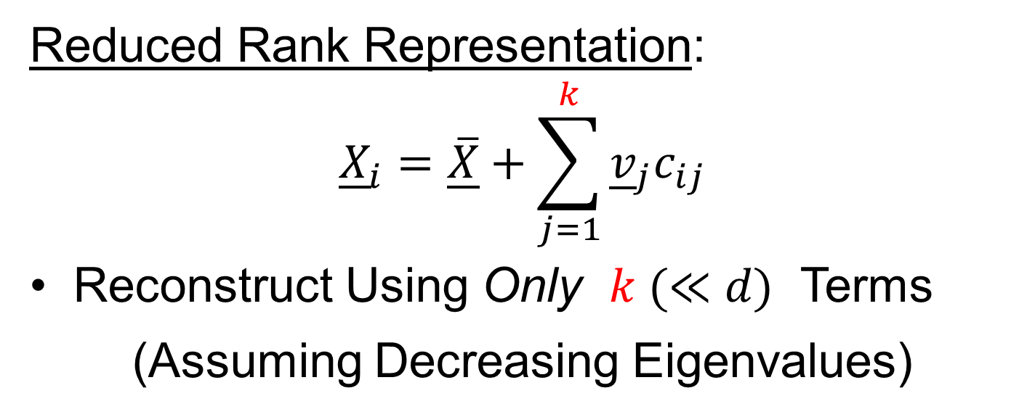
PCA Data Represent’n (Cont.)
Reduced Rank Representation:
$${\underline{X}}_{i}=\underline{\overline{X}}+\sum_{j=1}^{k}{{\underline{v}}_{j}c_{ij}}$$
Reconstruct Using Only $k (≪d)$ Terms
(Assuming Decreasing Eigenvalues)

Slide 3
Return to Big Picture
Main statistical goals of OODA:
Understanding population structure
  Low dim’al Projections, PCA …
Classification (i. e. Discrimination)
  Understanding 2+ populations
Time Series of Data Objects
  Chemical Spectra, Mortality Data
“Vertical Integration” of Data Types

Slide 4
Classification - Discrimination
Background: Two Class (Binary) version:
Using “training data” from
Class +1 and Class -1
Develop a “rule” for
assigning new data to a Class
Canonical Example: Disease Diagnosis
New Patients are “Healthy” or “Ill”
Determine based on measurements

Slide 5
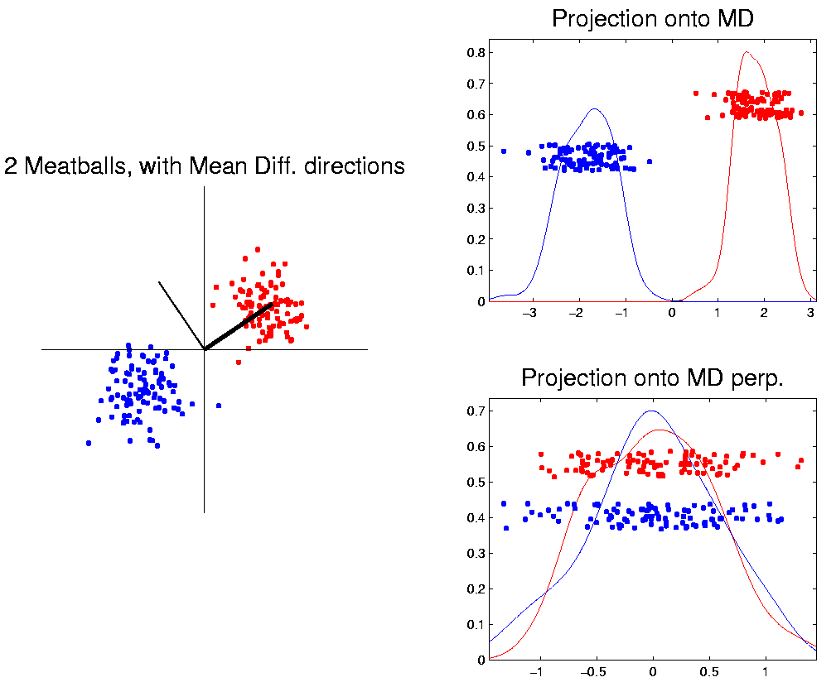
Classification Basics
For Simple Toy Example:
Project
On MD
& split
at center
Notes:
HDLSStmbMdif.ps

Slide 6
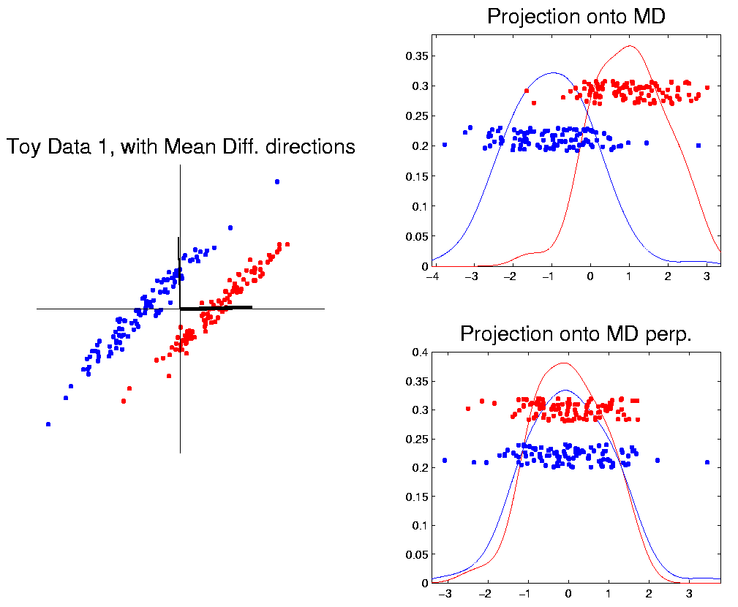
Classification Basics
Mean Difference for slanted clouds:
A little
better?
Still misses
right dir’n
Want to
account for
covariance
Notes:
HDLSSod1Mdif.ps

Slide 7
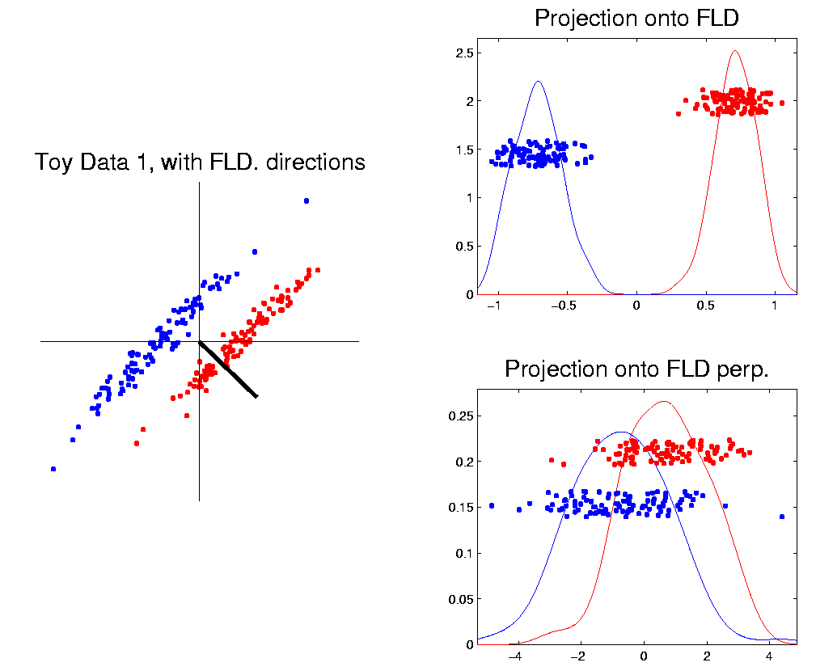
Classification Basics
Better Solution: Fisher Linear Discrimination
Gets the
right dir’n
How does
it work?
Notes:
HDLSSod1FLD.ps

Slide 8
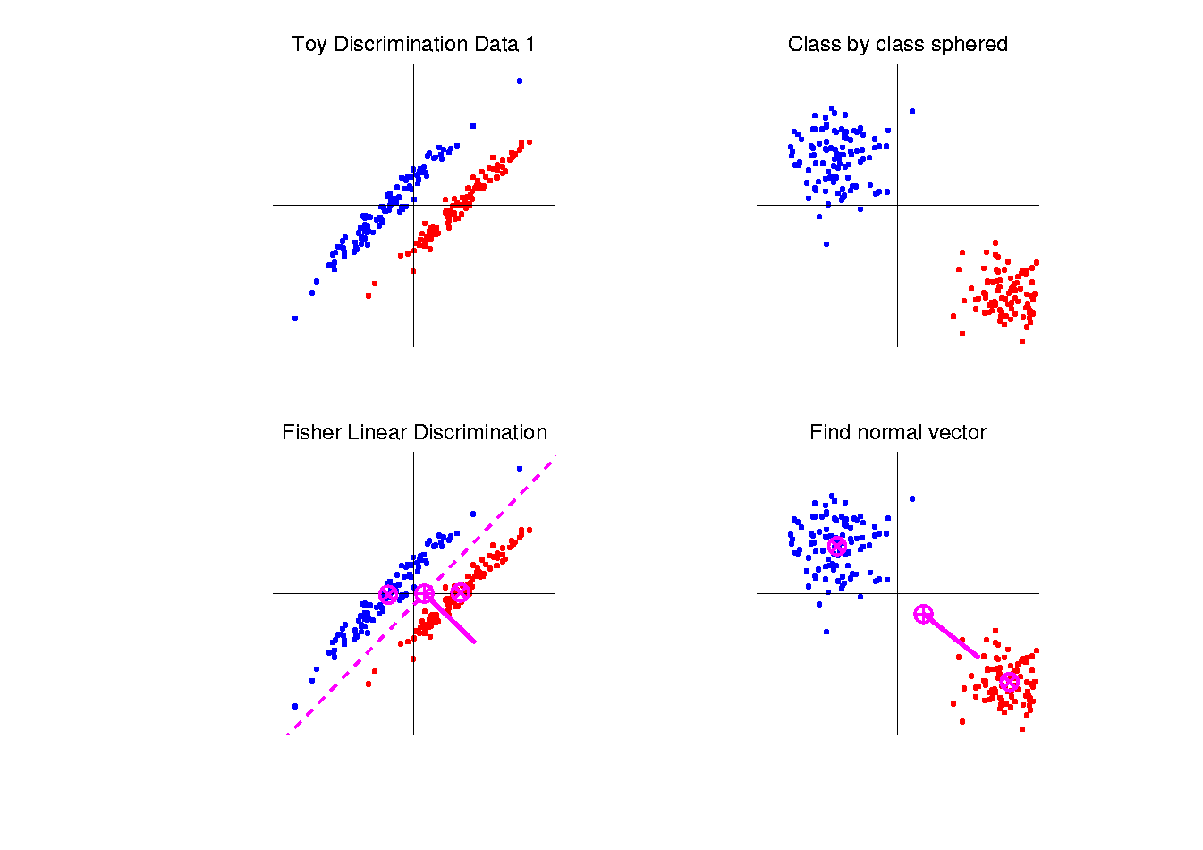

Fisher Linear Discrimination
Simple way to find “correct cov. adjustment”:
Individually transform subpopulations so
“spherical” about their means
For $⨀$ = +,- define ${\underline{Z}}_{i}^{⨀}={\left({\hat{Σ}}^{w}\right)}^{−1/2}{\underline{X}}_{i}^{⨀}$
Notes:
HDLSSod1egFLD.ps

Slide 9
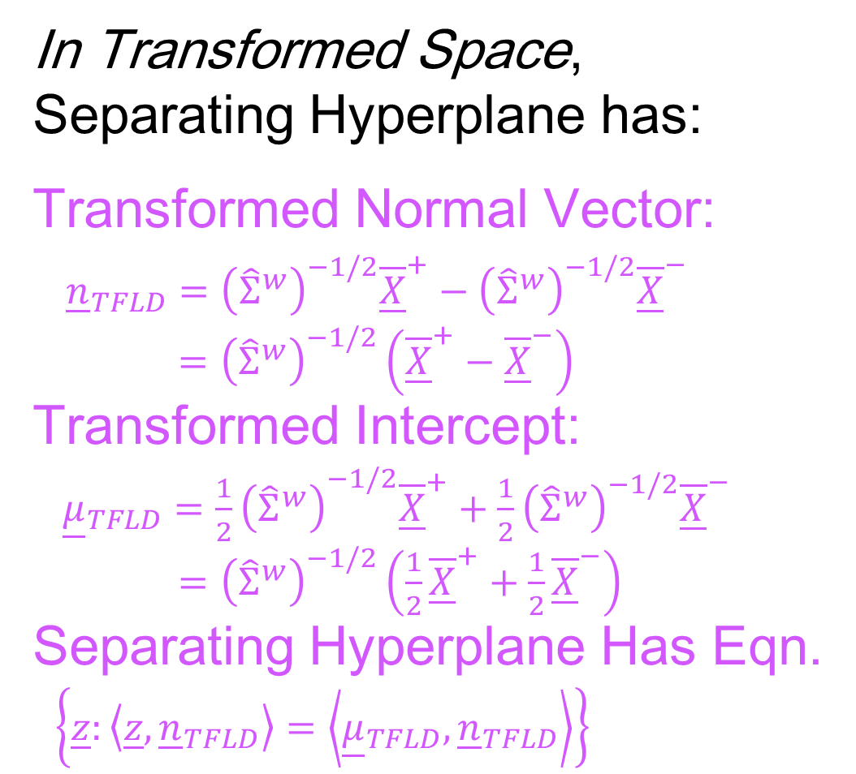
Fisher Linear Discrimination
In Transformed Space,
Separating Hyperplane has:
Transformed Normal Vector:
${\underline{n}}_{TFLD}={\left({\hat{Σ}}^{w}\right)}^{−1/2}{\overline{\underline{X}}}^{+}−{\left({\hat{Σ}}^{w}\right)}^{−1/2}{\overline{\underline{X}}}^{−}$
$={\left({\hat{Σ}}^{w}\right)}^{−1/2}\left({\overline{\underline{X}}}^{+}−{\overline{\underline{X}}}^{−}\right)$
Transformed Intercept:
${\underline{μ}}_{TFLD}={\frac{1}{2}\left({\hat{Σ}}^{w}\right)}^{−1/2}{\overline{\underline{X}}}^{+}+\frac{1}{2}{\left({\hat{Σ}}^{w}\right)}^{−1/2}{\overline{\underline{X}}}^{−}$
$={\left({\hat{Σ}}^{w}\right)}^{−1/2}\left(\frac{1}{2}{\overline{\underline{X}}}^{+}+\frac{1}{2}{\overline{\underline{X}}}^{−}\right)$
Separating Hyperplane Has Eqn.
$\left\{\underline{z}:\left\langle \underline{z},{\underline{n}}_{TFLD}\right\rangle =\left\langle {\underline{μ}}_{TFLD},{\underline{n}}_{TFLD}\right\rangle \right\}$
Notes:
HDLSSod1egFLD.ps

Slide 10
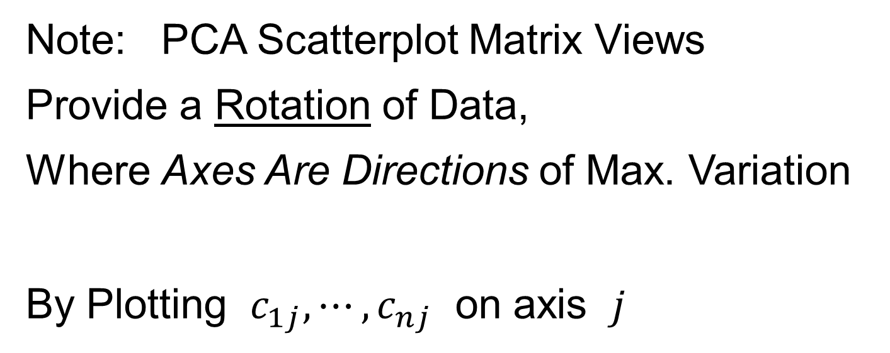
Fisher Linear Discrimination
Thus discrimination rule is:
Classify ${\underline{X}}^{0}$ to Class +1 when:
$$\left\langle {\underline{X}}^{0}, {\underline{n}}_{FLD}\right\rangle ≥\left\langle {\underline{μ}}_{FLD}, {\underline{n}}_{FLD}\right\rangle$$
where:
$${\underline{n}}_{FLD}={\left({\hat{Σ}}^{w}\right)}^{−1/2}{\underline{n}}_{TFLD}={\left({\hat{Σ}}^{w}\right)}^{−1}\left({\overline{\underline{X}}}^{+}−{\overline{\underline{X}}}^{−}\right)$$
$${\underline{μ}}_{FLD}={\left({\hat{Σ}}^{w}\right)}^{1/2}{\underline{μ}}_{TFLD}=\left(\frac{1}{2}{\overline{\underline{X}}}^{+}+\frac{1}{2}{\overline{\underline{X}}}^{−}\right)$$
i.e.
${{\underline{X}}^{0}}^{t}{\left({\hat{Σ}}^{w}\right)}^{−1}\left({\overline{\underline{X}}}^{+}−{\overline{\underline{X}}}^{−}\right)≥$
$≥{\frac{1}{2}\left({\overline{\underline{X}}}^{+}+{\overline{\underline{X}}}^{−}\right)}^{t}{\left({\hat{Σ}}^{w}\right)}^{−1}\left({\overline{\underline{X}}}^{+}−{\overline{\underline{X}}}^{−}\right)$
Same Inner Product
Of Center Point
Inner Product of New Data
Point & Transf’d Direction

Slide 11
Classical Discrimination
Above derivation of FLD was:
Nonstandard
Not in any textbooks(?)
Nonparametric (don’t need Gaussian data)
I.e. Used no probability distributions
More Machine Learning than Statistics
(but careful about HDLSS case)

Slide 12
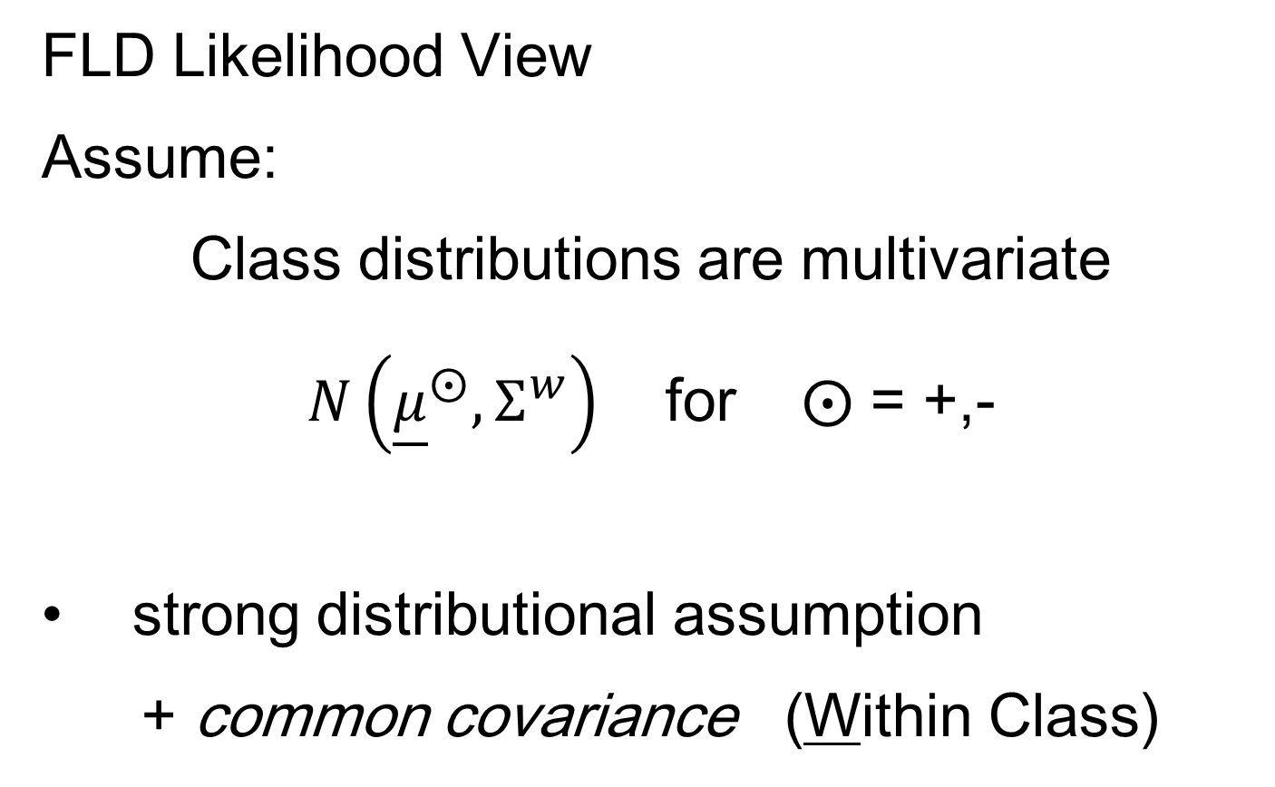
Classical Discrimination
FLD Likelihood View
Assume:
Class distributions are multivariate
$N\left({\underline{μ}}^{⨀},Σ^{w}\right)$ for $⨀$ = +,-
strong distributional assumption
+ common covariance (Within Class)

Slide 13
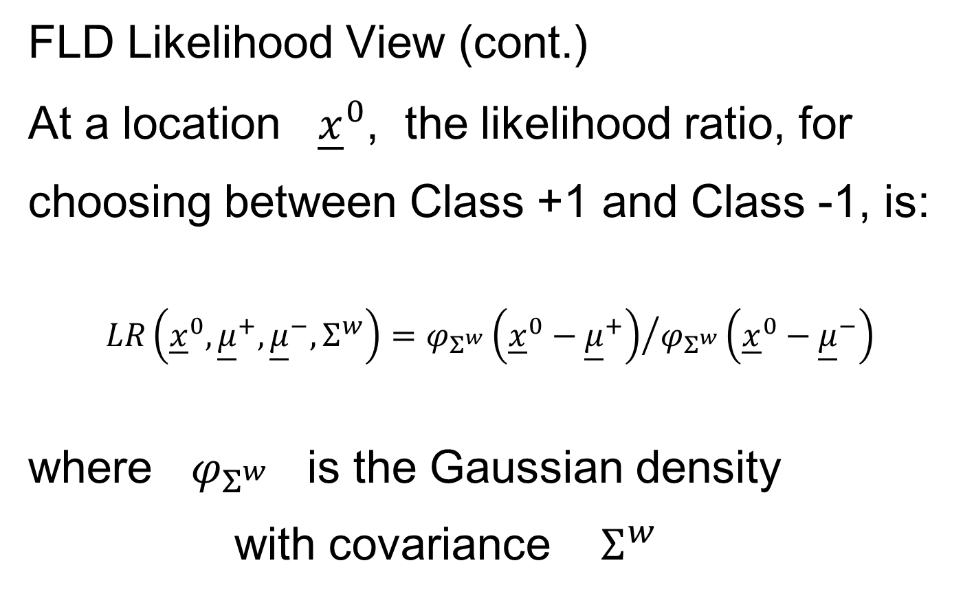
Classical Discrimination
FLD Likelihood View (cont.)
At a location ${\underline{x}}^{0}$, the likelihood ratio, for
choosing between Class +1 and Class -1, is:
$$LR\left({\underline{x}}^{0},{\underline{μ}}^{+},{\underline{μ}}^{−},Σ^{w}\right)={φ_{Σ^{w}}\left({\underline{x}}^{0}−{\underline{μ}}^{+}\right)}/{φ_{Σ^{w}}\left({\underline{x}}^{0}−{\underline{μ}}^{−}\right)}$$
where $φ_{Σ^{w}}$ is the Gaussian density
with covariance $Σ^{w}$

Slide 14
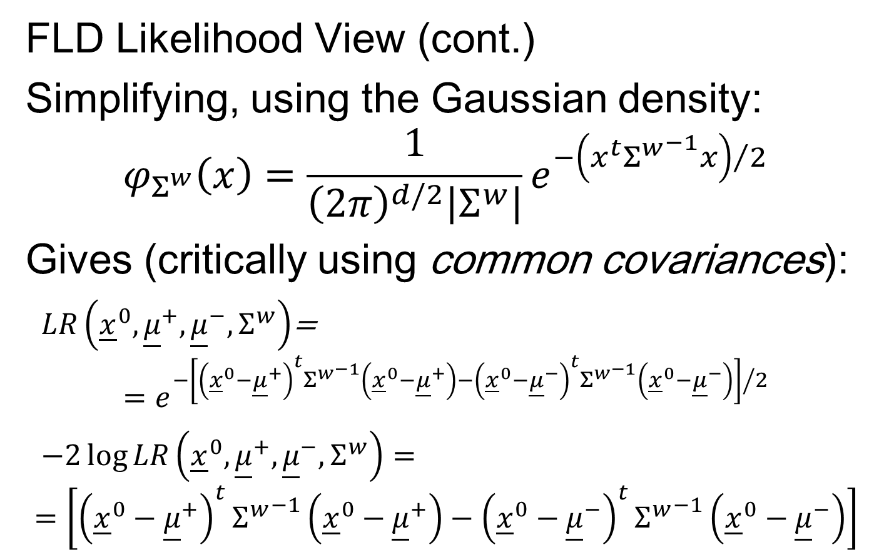
Classical Discrimination
FLD Likelihood View (cont.)
Simplifying, using the Gaussian density:
$$φ_{Σ^{w}}\left(x\right)=\frac{1}{{\left(2π\right)}^{d/2}\left|Σ^{w}\right|}e^{{−\left(x^{t}{Σ^{w}}^{−1}x\right)}/2}$$
Gives (critically using common covariances):
$LR\left({\underline{x}}^{0},{\underline{μ}}^{+},{\underline{μ}}^{−},Σ^{w}\right)$=
$$=e^{{−\left[{\left({\underline{x}}^{0}−{\underline{μ}}^{+}\right)}^{t}{Σ^{w}}^{−1}\left({\underline{x}}^{0}−{\underline{μ}}^{+}\right)−{\left({\underline{x}}^{0}−{\underline{μ}}^{−}\right)}^{t}{Σ^{w}}^{−1}\left({\underline{x}}^{0}−{\underline{μ}}^{−}\right)\right]}/2}$$
$−2\log{LR\left({\underline{x}}^{0},{\underline{μ}}^{+},{\underline{μ}}^{−},Σ^{w}\right)}=$
$$=\left[{\left({\underline{x}}^{0}−{\underline{μ}}^{+}\right)}^{t}{Σ^{w}}^{−1}\left({\underline{x}}^{0}−{\underline{μ}}^{+}\right)−{\left({\underline{x}}^{0}−{\underline{μ}}^{−}\right)}^{t}{Σ^{w}}^{−1}\left({\underline{x}}^{0}−{\underline{μ}}^{−}\right)\right]$$

Slide 15

Classical Discrimination
FLD Likelihood View (cont.)
But: ${\left({\underline{x}}^{0}−{\underline{μ}}^{⨀}\right)}^{t}{Σ^{w}}^{−1}\left({\underline{x}}^{0}−{\underline{μ}}^{⨀}\right)=$
$$={{\underline{x}}^{0}}^{t}{Σ^{w}}^{−1}{\underline{x}}^{0}−2{{\underline{x}}^{0}}^{t}{Σ^{w}}^{−1}{\underline{μ}}^{⨀}+{{\underline{μ}}^{⨀}}^{t}{Σ^{w}}^{−1}{\underline{μ}}^{⨀}$$
for $⨀{}=−1, +1$

Slide 16
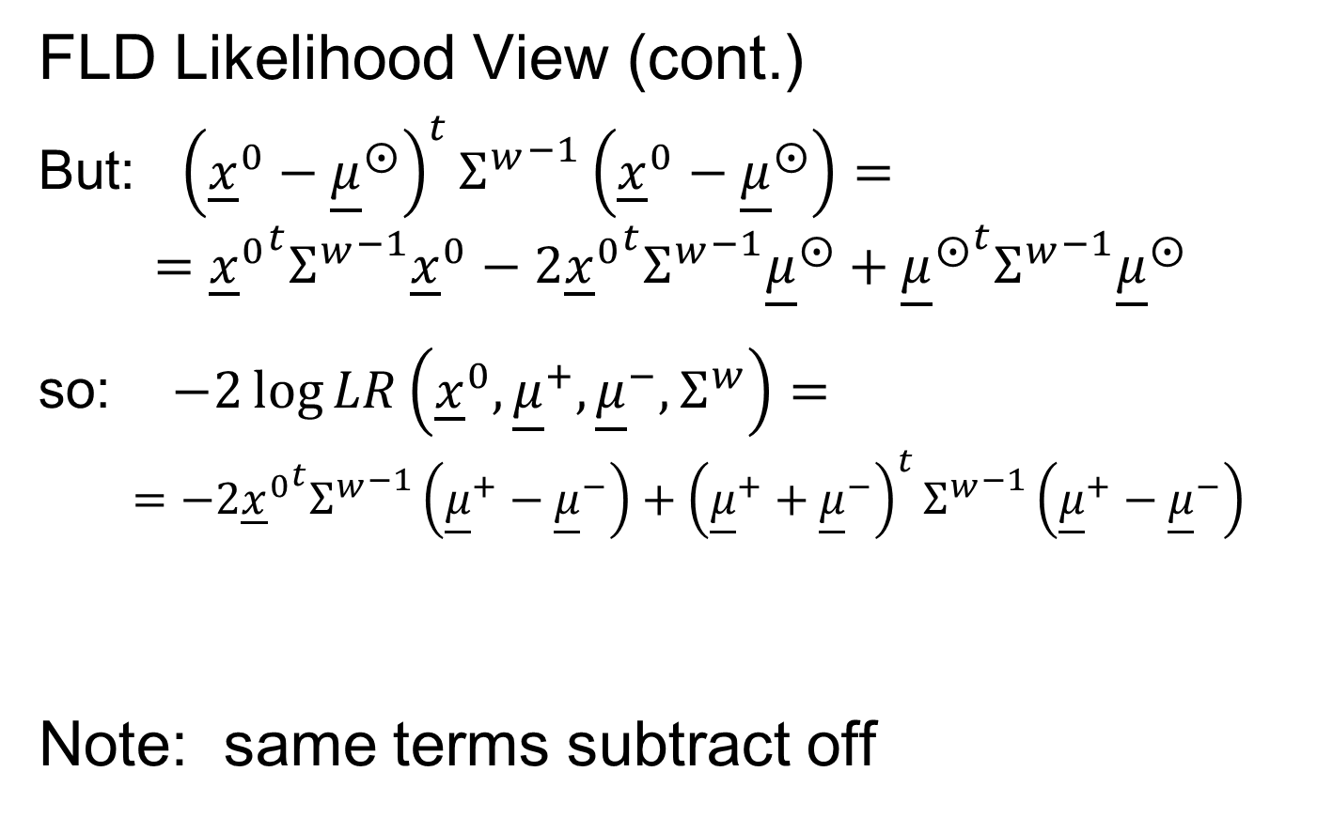
Classical Discrimination
FLD Likelihood View (cont.)
But: ${\left({\underline{x}}^{0}−{\underline{μ}}^{⨀}\right)}^{t}{Σ^{w}}^{−1}\left({\underline{x}}^{0}−{\underline{μ}}^{⨀}\right)=$
$$={{\underline{x}}^{0}}^{t}{Σ^{w}}^{−1}{\underline{x}}^{0}−2{{\underline{x}}^{0}}^{t}{Σ^{w}}^{−1}{\underline{μ}}^{⨀}+{{\underline{μ}}^{⨀}}^{t}{Σ^{w}}^{−1}{\underline{μ}}^{⨀}$$
so: $−2\log{LR\left({\underline{x}}^{0},{\underline{μ}}^{+},{\underline{μ}}^{−},Σ^{w}\right)}=$
$$=−2{{\underline{x}}^{0}}^{t}{Σ^{w}}^{−1}\left({\underline{μ}}^{+}−{\underline{μ}}^{−}\right)+{\left({\underline{μ}}^{+}+{\underline{μ}}^{−}\right)}^{t}{Σ^{w}}^{−1}\left({\underline{μ}}^{+}−{\underline{μ}}^{−}\right)$$
Note: same terms subtract off

Slide 17
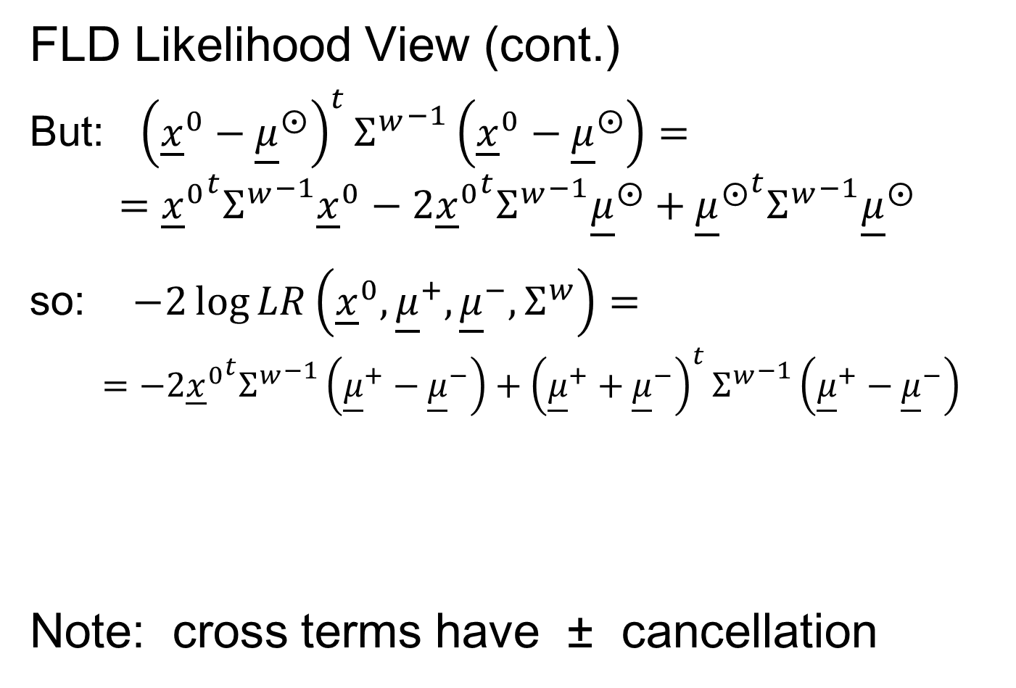
Classical Discrimination
FLD Likelihood View (cont.)
But: ${\left({\underline{x}}^{0}−{\underline{μ}}^{⨀}\right)}^{t}{Σ^{w}}^{−1}\left({\underline{x}}^{0}−{\underline{μ}}^{⨀}\right)=$
$$={{\underline{x}}^{0}}^{t}{Σ^{w}}^{−1}{\underline{x}}^{0}−2{{\underline{x}}^{0}}^{t}{Σ^{w}}^{−1}{\underline{μ}}^{⨀}+{{\underline{μ}}^{⨀}}^{t}{Σ^{w}}^{−1}{\underline{μ}}^{⨀}$$
so: $−2\log{LR\left({\underline{x}}^{0},{\underline{μ}}^{+},{\underline{μ}}^{−},Σ^{w}\right)}=$
$$=−2{{\underline{x}}^{0}}^{t}{Σ^{w}}^{−1}\left({\underline{μ}}^{+}−{\underline{μ}}^{−}\right)+{\left({\underline{μ}}^{+}+{\underline{μ}}^{−}\right)}^{t}{Σ^{w}}^{−1}\left({\underline{μ}}^{+}−{\underline{μ}}^{−}\right)$$
Note: cross terms have ± cancellation
Seen in Above
Nonparametric
Derivation
Similar To
Above Center

Slide 18
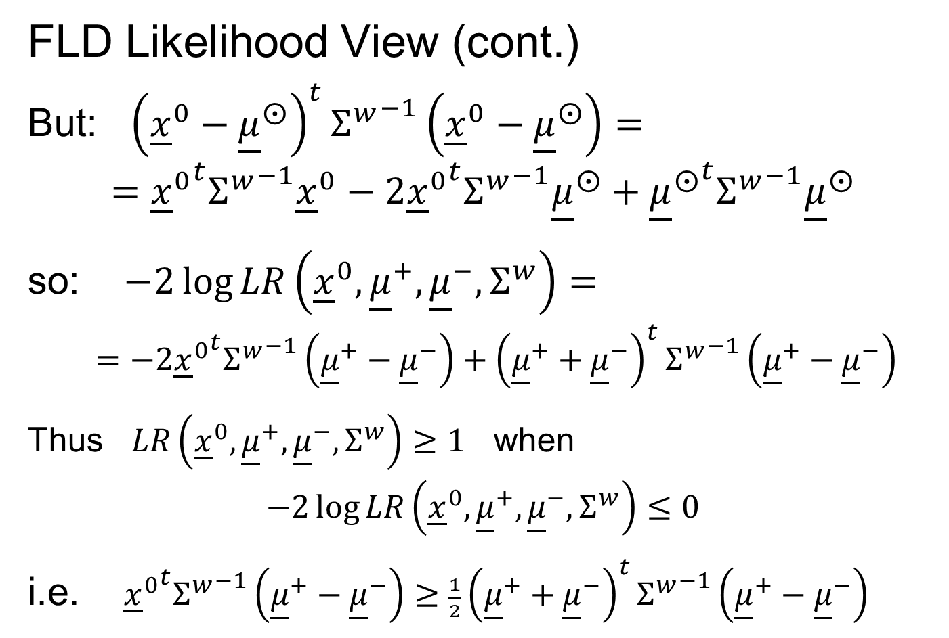
Classical Discrimination
FLD Likelihood View (cont.)
But: ${\left({\underline{x}}^{0}−{\underline{μ}}^{⨀}\right)}^{t}{Σ^{w}}^{−1}\left({\underline{x}}^{0}−{\underline{μ}}^{⨀}\right)=$
$$={{\underline{x}}^{0}}^{t}{Σ^{w}}^{−1}{\underline{x}}^{0}−2{{\underline{x}}^{0}}^{t}{Σ^{w}}^{−1}{\underline{μ}}^{⨀}+{{\underline{μ}}^{⨀}}^{t}{Σ^{w}}^{−1}{\underline{μ}}^{⨀}$$
so: $−2\log{LR\left({\underline{x}}^{0},{\underline{μ}}^{+},{\underline{μ}}^{−},Σ^{w}\right)}=$
$$=−2{{\underline{x}}^{0}}^{t}{Σ^{w}}^{−1}\left({\underline{μ}}^{+}−{\underline{μ}}^{−}\right)+{\left({\underline{μ}}^{+}+{\underline{μ}}^{−}\right)}^{t}{Σ^{w}}^{−1}\left({\underline{μ}}^{+}−{\underline{μ}}^{−}\right)$$
Thus $LR\left({\underline{x}}^{0},{\underline{μ}}^{+},{\underline{μ}}^{−},Σ^{w}\right)≥1$ when
$$−2\log{LR\left({\underline{x}}^{0},{\underline{μ}}^{+},{\underline{μ}}^{−},Σ^{w}\right)}≤0$$
i.e. ${{\underline{x}}^{0}}^{t}{Σ^{w}}^{−1}\left({\underline{μ}}^{+}−{\underline{μ}}^{−}\right)≥\frac{1}{2}{\left({\underline{μ}}^{+}+{\underline{μ}}^{−}\right)}^{t}{Σ^{w}}^{−1}\left({\underline{μ}}^{+}−{\underline{μ}}^{−}\right)$

Slide 19
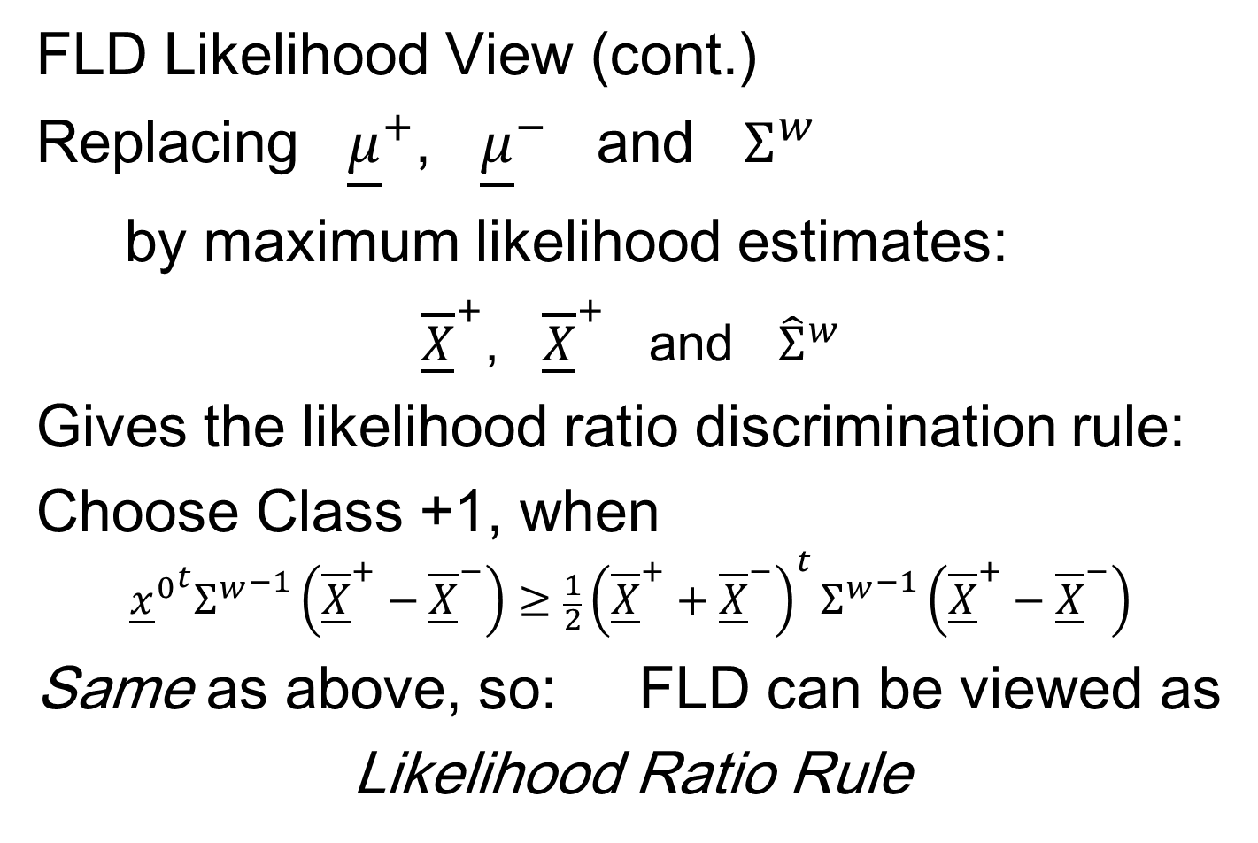
Classical Discrimination
FLD Likelihood View (cont.)
Replacing ${\underline{μ}}^{+}$, ${\underline{μ}}^{−}$ and $Σ^{w}$
by maximum likelihood estimates:
${\overline{\underline{X}}}^{+}$, ${\overline{\underline{X}}}^{+}$ and ${\hat{Σ}}^{w}$
Gives the likelihood ratio discrimination rule:
Choose Class +1, when
$${{\underline{x}}^{0}}^{t}{Σ^{w}}^{−1}\left({\overline{\underline{X}}}^{+}−{\overline{\underline{X}}}^{−}\right)≥\frac{1}{2}{\left({\overline{\underline{X}}}^{+}+{\overline{\underline{X}}}^{−}\right)}^{t}{Σ^{w}}^{−1}\left({\overline{\underline{X}}}^{+}−{\overline{\underline{X}}}^{−}\right)$$
Same as above, so: FLD can be viewed as
Likelihood Ratio Rule

Slide 20
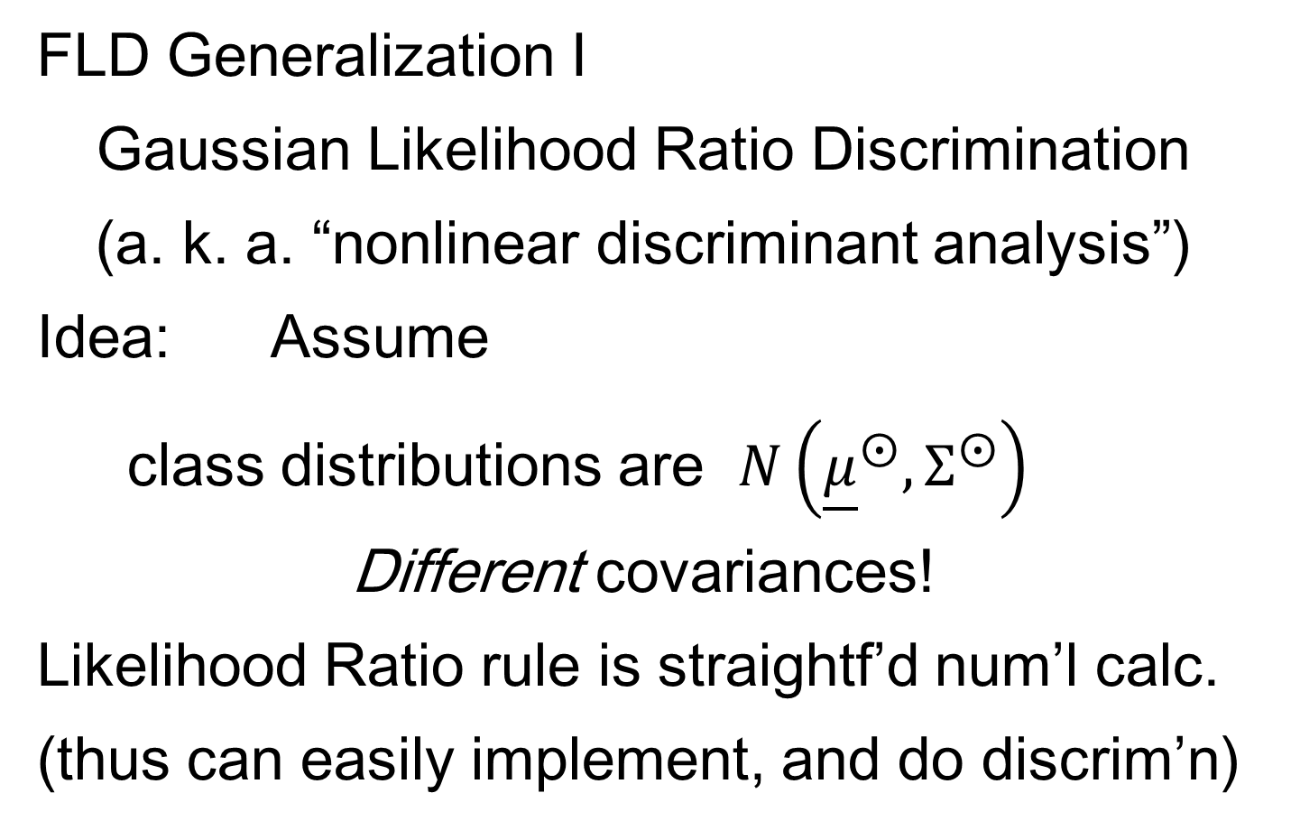
Classical Discrimination
FLD Generalization I
Gaussian Likelihood Ratio Discrimination
(a. k. a. “nonlinear discriminant analysis”)
Idea: Assume
class distributions are $N\left({\underline{μ}}^{⨀},Σ^{⨀}\right)$
Different covariances!
Likelihood Ratio rule is straightf’d num’l calc.
(thus can easily implement, and do discrim’n)

Slide 21
Classical Discrimination
Gaussian Likelihood Ratio Discrim’n (cont.)
No longer have separ’g hyperplane repr’n
(instead regions determined by quadratics)
(fairly complicated case-wise calculations)
Graphical display: for grid of test points,
color as:
Yellow if assigned to Class +1
Cyan if assigned to Class -1
(intensity is strength of assignment)

Slide 22
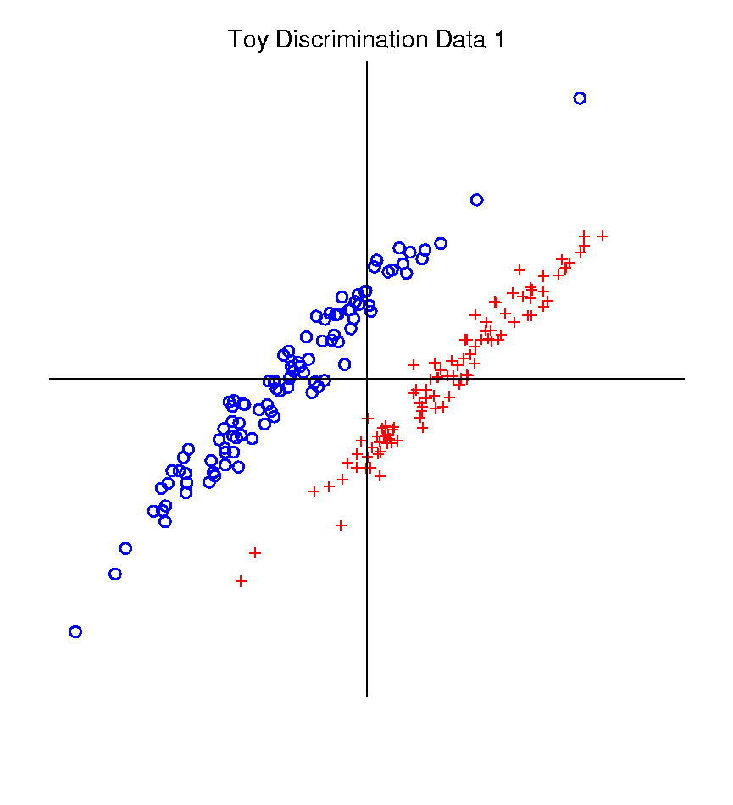
Classical Discrimination
Graphical Display of Classifiers
Use Yellow for Grid
Points Assigned
to Plus Class
Use Cyan for Grid
Points Assigned
to Minus Class
Notes:
PEod1FLDe1.ps

Slide 23
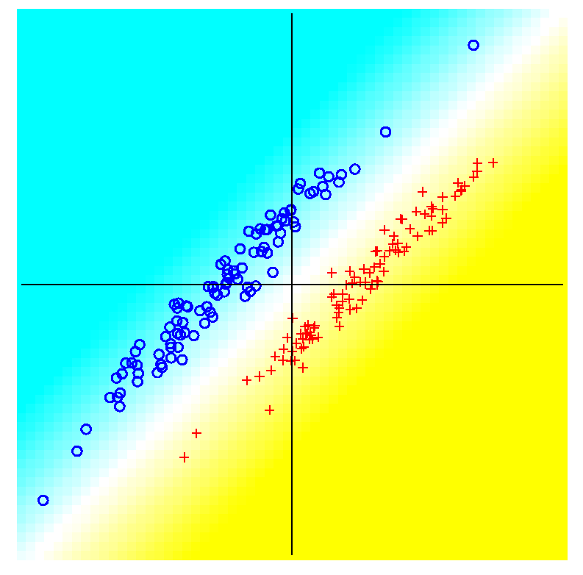
Classical Discrimination
FLD for Tilted Point Clouds – Works well
Notes:
PEod1FLDe1.ps

Slide 24
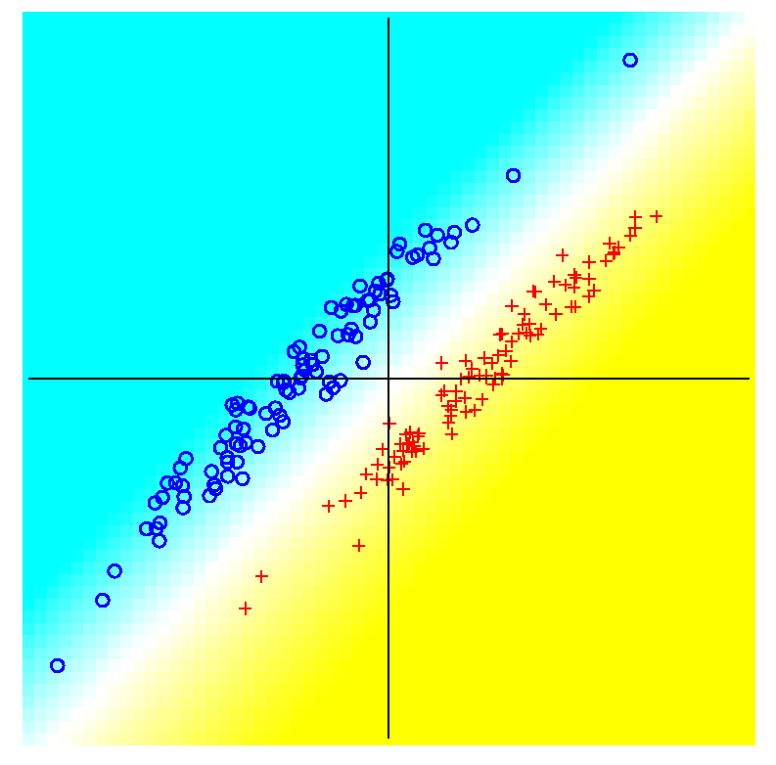
Classical Discrimination
GLR for Tilted Point Clouds – Works well
Notes:
PEod1GLRe1.ps

Slide 25
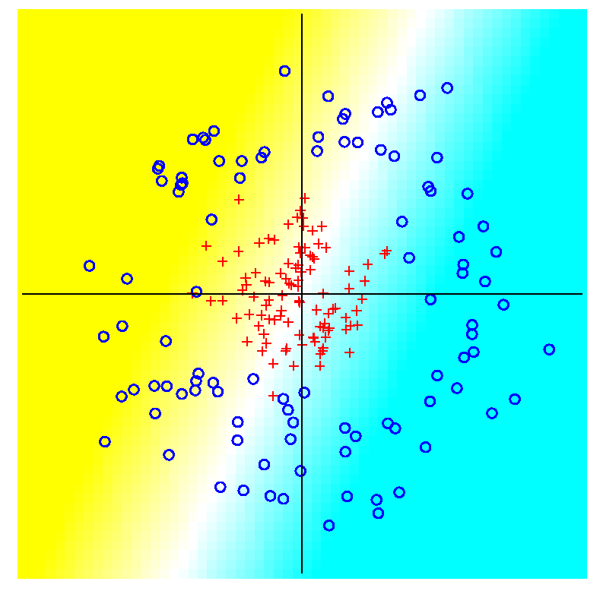
Classical Discrimination
FLD for Donut – Poor, no plane can work
Notes:
PEdonFLDe1.ps

Slide 26
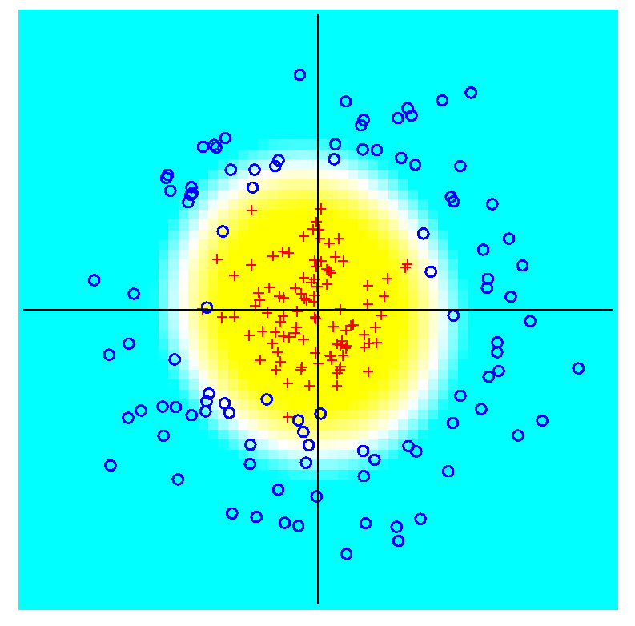
Classical Discrimination
GLR for Donut – Works well (good quadratic)
(Even
though
data not
Gaussian)
Notes:
PEdonGLRe1.ps

Slide 27
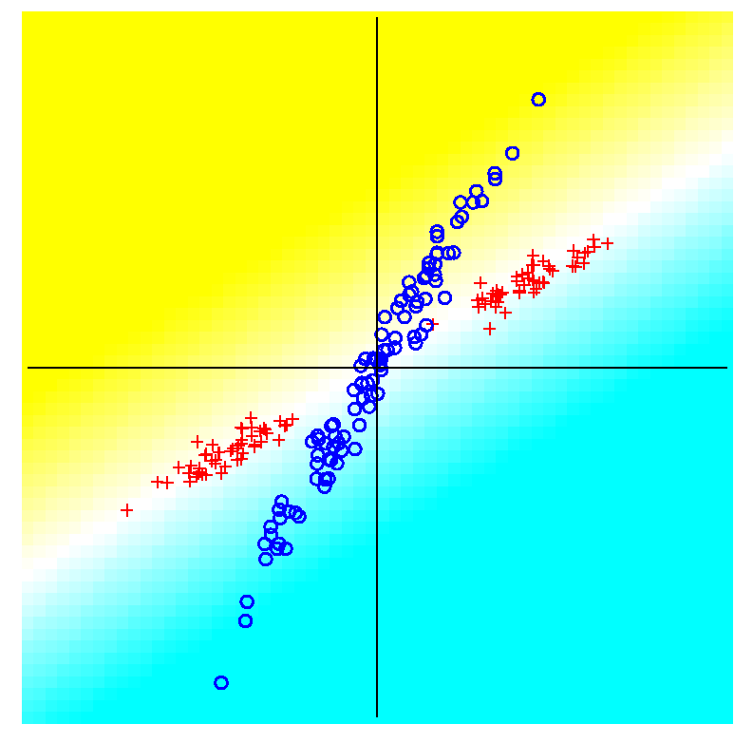
Classical Discrimination
FLD for X – Poor, no plane can work
Notes:
PExd3FLDe1.ps

Slide 28
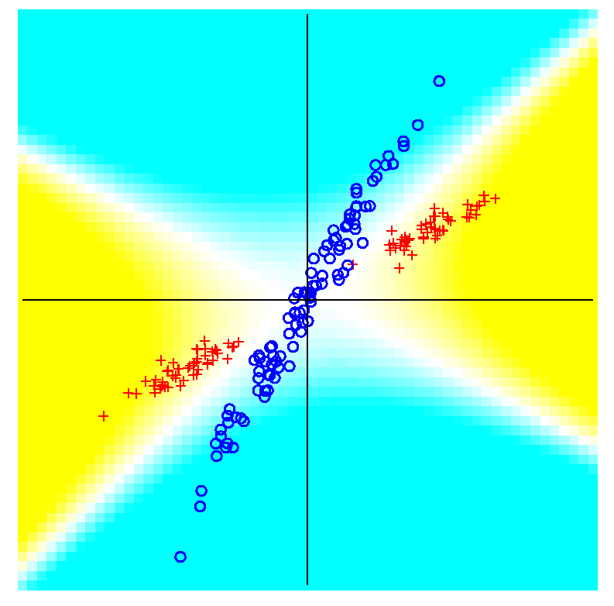
Classical Discrimination
GLR for X – Better, but not great
Notes:
PExd3GLRe1.ps

Slide 29
Classical Discrimination
Summary of FLD vs. GLR:
Tilted Point Clouds Data
  FLD good
  GLR good
Donut Data
  FLD bad
  GLR good
X Data
  FLD bad
  GLR OK, not great
Classical Conclusion: GLR generally better
(will see a different answer for HDLSS data)

Slide 30
Classical Discrimination
FLD Generalization II (Gen. I was GLR)
Different prior probabilities
Main idea:
Give different weights to 2 classes
I.e. assume not a priori equally likely
Canonical Example: Rare Disease Testing
(Often Train on Mostly Rare Cases)

Slide 31
Classical Discrimination
FLD Generalization II (Gen. I was GLR)
Different prior probabilities
Main idea:
Give different weights to 2 classes
I.e. assume not a priori equally likely
Development is “straightforward”
Modified likelihood
Change intercept in FLD
Won’t explore further here

Slide 32
Classical Discrimination
FLD Generalization III
Principal Discriminant Analysis
Also Called:
Multiple Discriminant Analysis
Duda, et al. (2001)
Canonical Variate Analysis
Mardia, et al. (1979)

Slide 33
Classical Discrimination
FLD Generalization III
Principal Discriminant Analysis
Idea: FLD-like approach to > 2 classes
Assumption: Class covariance matrices are the same (similar)
(but not Gaussian, same situation as for FLD)
Main idea:
Quantify “location of classes” by their means
$${\underline{μ}}^{(1)},{\underline{μ}}^{(2)},⋯,{\underline{μ}}^{(k)}$$

Slide 34
Classical Discrimination
Principal Discriminant Analysis (cont.)
Simple way to find “interesting directions” among the means:
PCA on set of means
(Think Analog of Mean Difference)

Slide 35
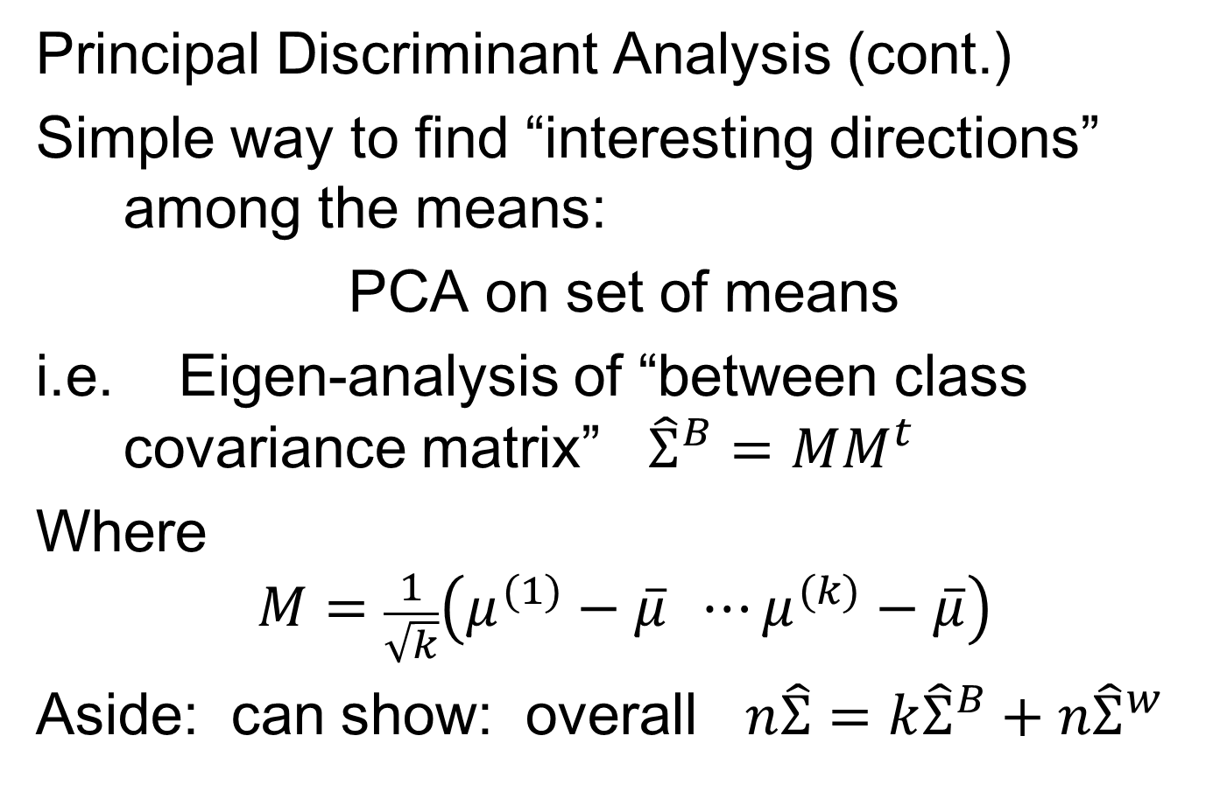
Classical Discrimination
Principal Discriminant Analysis (cont.)
Simple way to find “interesting directions” among the means:
PCA on set of means
i.e. Eigen-analysis of “between class covariance matrix” ${\hat{Σ}}^{B}=MM^{t}$
Where
$$M=\frac{1}{\sqrt{k}}\left(μ^{(1)}−\overline{μ} ⋯μ^{(k)}−\overline{μ}\right)$$
Aside: can show: overall $n\hat{Σ}=k{\hat{Σ}}^{B}+n{\hat{Σ}}^{w}$
Mean of Means

Slide 36
Classical Discrimination
Principal Discriminant Analysis (cont.)
But PCA only works like Mean Difference,
Expect can improve by
taking covariance into account.
(Recall Improvement of FLD over MD)

Slide 37
Classical Discrimination
Principal Discriminant Analysis (cont.)
But PCA only works like Mean Difference,
Expect can improve by
taking covariance into account.
Blind application of above ideas suggests eigen-analysis of: ${Σ^{w}}^{−1}Σ^{B}$

Slide 38
Classical Discrimination
Principal Discriminant Analysis (cont.)
There are:
smarter ways to compute
(“generalized eigenvalue”)
other representations
(this solves optimization prob’s)
Special case: 2 classes,
reduces to standard FLD
Good reference for more: Section 3.8 of:
Duda et al. (2001)

Slide 39
Classical Discrimination
Summary of Classical Ideas:
Among “Simple Methods”
  MD and FLD sometimes similar
  Sometimes FLD better
  So FLD is preferred
Among Complicated Methods
  GLR is best
  So always use that?
Caution:
  Story changes for HDLSS settings

Slide 40
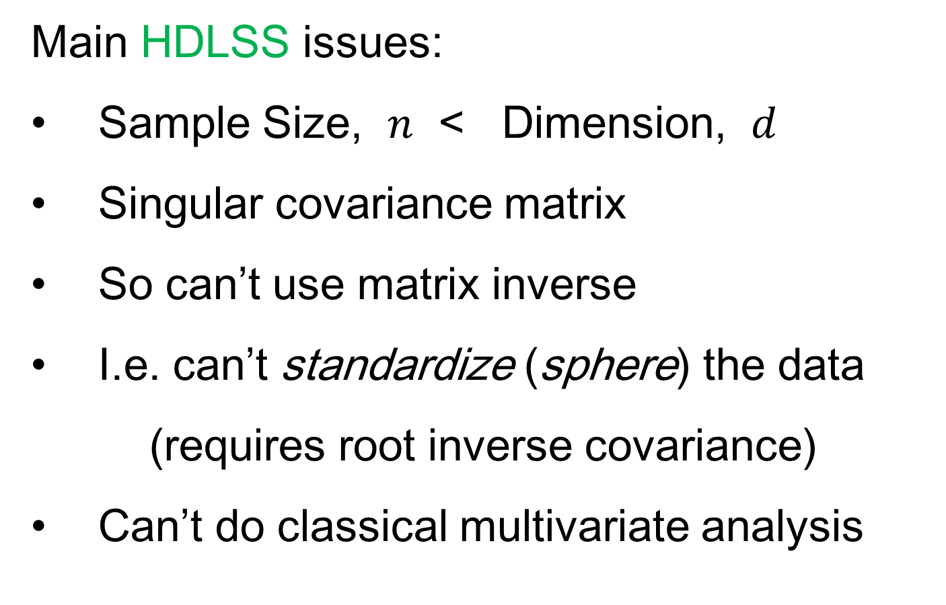
HDLSS Discrimination
Main HDLSS issues:
Sample Size, $n$ < Dimension, $d$
Singular covariance matrix
So can’t use matrix inverse
I.e. can’t standardize (sphere) the data
(requires root inverse covariance)
Can’t do classical multivariate analysis

Slide 41
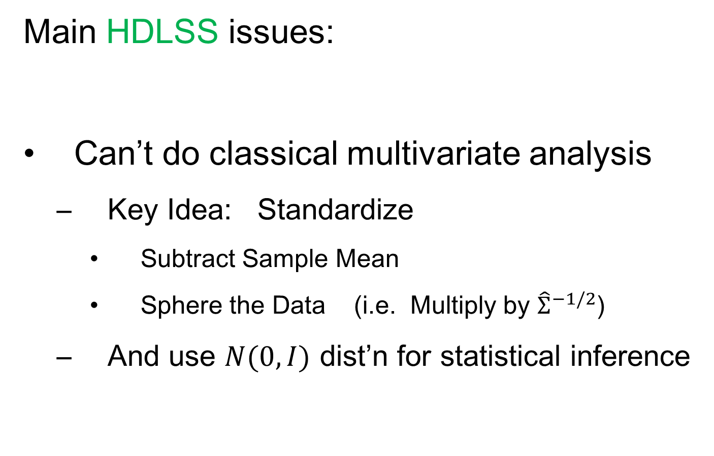
HDLSS Discrimination
Main HDLSS issues:
Can’t do classical multivariate analysis
  Key Idea: Standardize
    Subtract Sample Mean
    Sphere the Data (i.e. Multiply by ${\hat{Σ}}^{−1/2}$)
  And use $N(0,I)$ dist’n for statistical inference

Slide 42
HDLSS Discrimination
An approach to non-invertible covariances:
Replace by generalized inverses
Sometimes called pseudo inverses
Note: there are several
Here use Moore Penrose inverse
As used by Matlab (pinv.m)
Often provides useful results
(but not always)

Slide 43
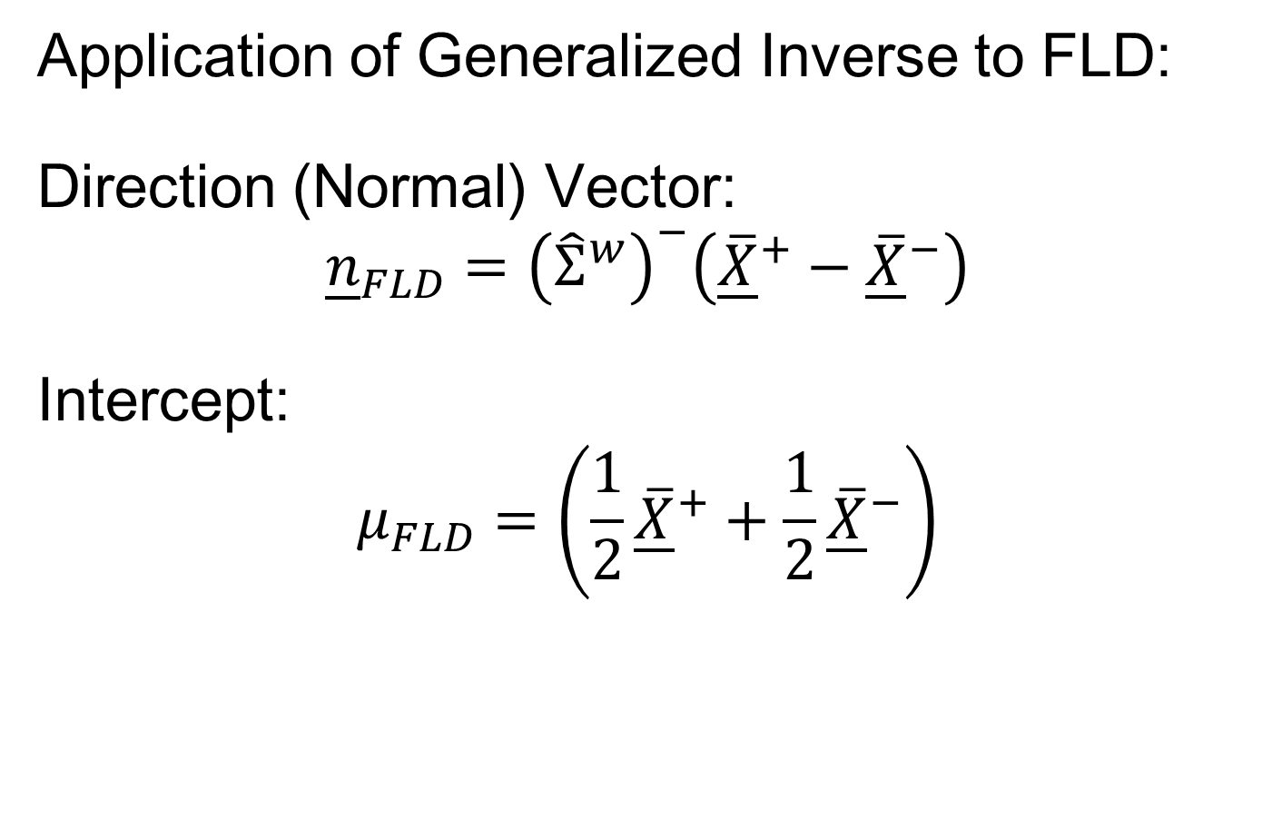
HDLSS Discrimination
Application of Generalized Inverse to FLD:
Direction (Normal) Vector:
$${\underline{n}}_{FLD}={\left({\hat{Σ}}^{w}\right)}^{−}\left({\underline{\overline{X}}}^{+}−{\underline{\overline{X}}}^{−}\right)$$
Intercept:
$$μ_{FLD}=\left(\frac{1}{2}{\underline{\overline{X}}}^{+}+\frac{1}{2}{\underline{\overline{X}}}^{−}\right)$$

Slide 44
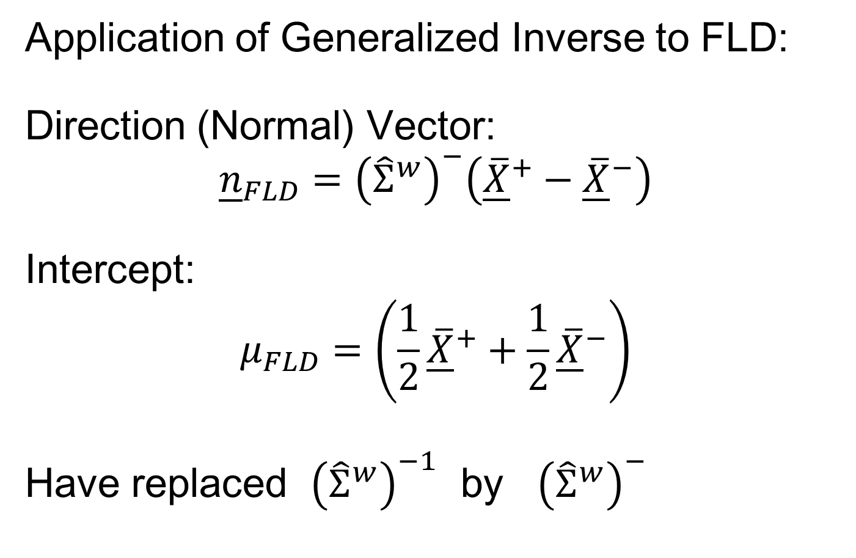
HDLSS Discrimination
Application of Generalized Inverse to FLD:
Direction (Normal) Vector:
$${\underline{n}}_{FLD}={\left({\hat{Σ}}^{w}\right)}^{−}\left({\underline{\overline{X}}}^{+}−{\underline{\overline{X}}}^{−}\right)$$
Intercept:
$$μ_{FLD}=\left(\frac{1}{2}{\underline{\overline{X}}}^{+}+\frac{1}{2}{\underline{\overline{X}}}^{−}\right)$$
Have replaced ${\left({\hat{Σ}}^{w}\right)}^{−1}$ by ${\left({\hat{Σ}}^{w}\right)}^{−}$

Slide 45
HDLSS Discrimination
Toy Example: Increasing Dimension
$n_{+}=n_{−}=20$ data vectors:
Entry 1:
Class +1: $N\left(+2.2,1\right)$ Class –1: $N\left(−2.2,1\right)$
Other Entries: $N\left(0,1\right)$
All Entries Independent
Look through dimensions, $d=1, 2, ⋯, 1000$

Slide 46
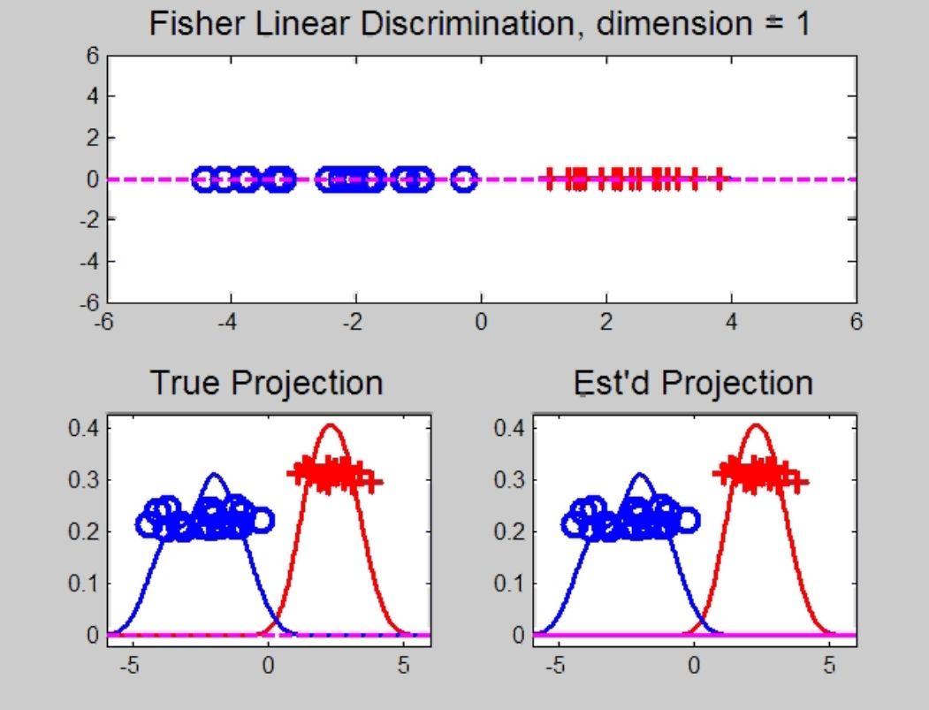
HDLSS Discrimination
Increasing Dimension Example
Project on
Optimal
Direction
Project on
FLD Direction
Project on
Both

Slide 47
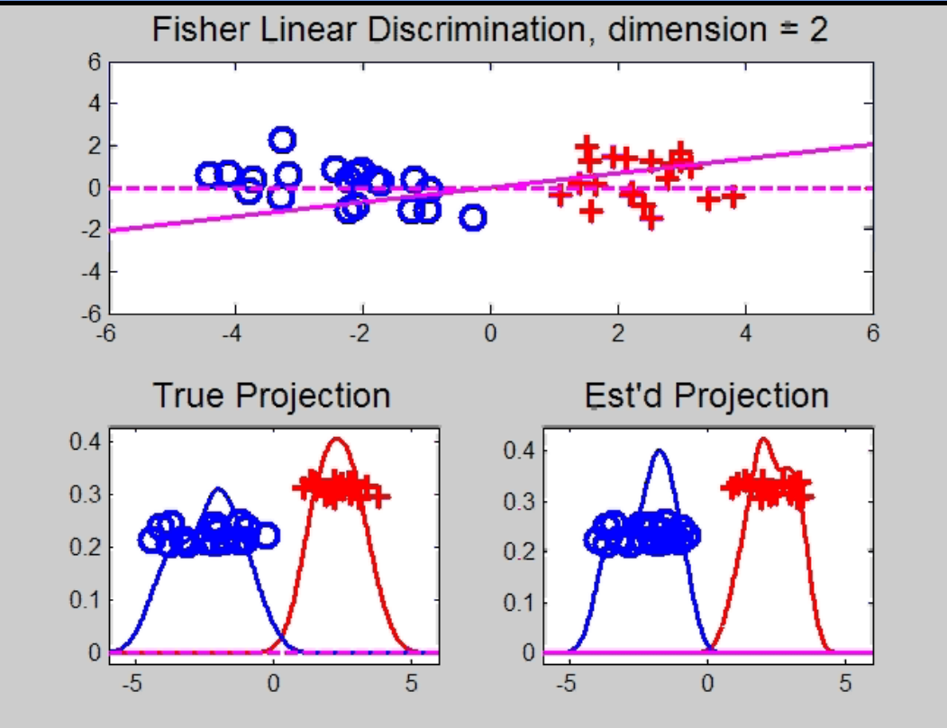
HDLSS Discrimination
Add a 2nd Dimension ($N\left(0,1\right)$ noise)
Same Projections on
Optimal Direction
Axes Here
Are Same As
Directions Here
Now See 2
Dimensions

Slide 48
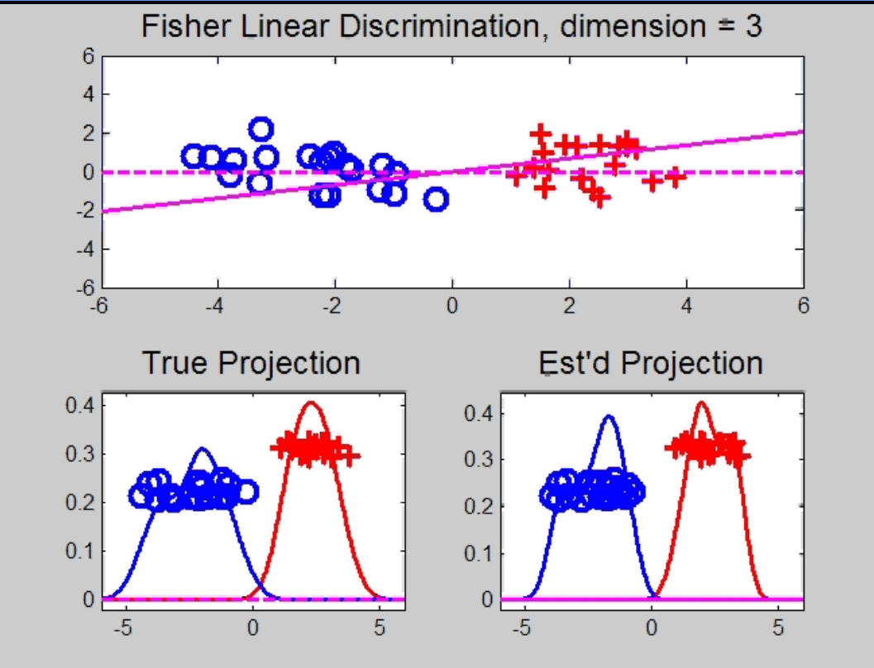
HDLSS Discrimination
Add a 3rd Dimension ($N\left(0,1\right)$ noise)
Project on
2-d subspace
generated
by optimal
dir’n & by
FLD dir’n

Slide 49
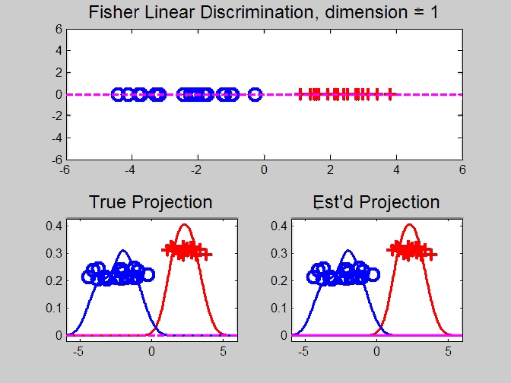
HDLSS Discrimination
Movie Through Increasing Dimensions

Slide 50
HDLSS Discrimination
FLD in Increasing Dimensions:
Low dimensions (d = 2-9):
  Visually good separation
  Small angle between FLD and Optimal
  Good generalizability
Medium Dimensions (d = 10-26):
  Visual separation too good?!?
  Larger angle between FLD and Optimal
  Worse generalizability
  Feel effect of sampling noise

Slide 51
HDLSS Discrimination
FLD in Increasing Dimensions:
High Dimensions (d=27-37):
  Much worse angle
  Very poor generalizability
  But very small within class variation
  Poor separation between classes
  Large separation / variation ratio

Slide 52
HDLSS Discrimination
FLD in Increasing Dimensions:
At HDLSS Boundary (d=38):
  38 = degrees of freedom
  (need to estimate 2 class means)
  Within class variation = 0 ?!?
  Data pile up, on just two points
  Perfect separation / variation ratio?
  But only feels microscopic noise aspects
  So likely not generalizable
  Angle to optimal very large

Slide 53
HDLSS Discrimination
FLD in Increasing Dimensions:
Just beyond HDLSS boundary (d=39-70):
  Improves with higher dimension?!?
  Angle gets better
  Improving generalizability?
  More noise helps classification?!?

Slide 54
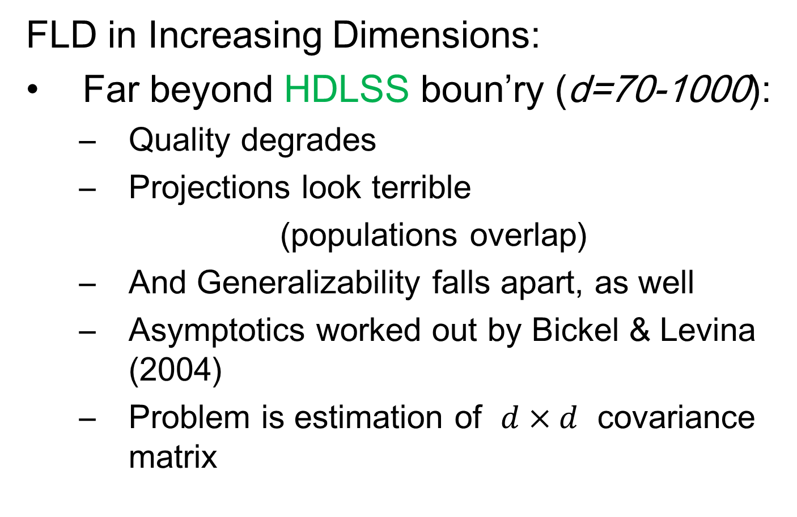
HDLSS Discrimination
FLD in Increasing Dimensions:
Far beyond HDLSS boun’ry (d=70-1000):
  Quality degrades
  Projections look terrible
  (populations overlap)
  And Generalizability falls apart, as well
  Asymptotics worked out by Bickel & Levina (2004)
  Problem is estimation of $d×d$ covariance matrix

Slide 55
HDLSS Discrimination
Simple Solution:
Mean Difference (Centroid) Method
Recall not classically recommended
  Usually no better than FLD
  Sometimes worse
But avoids estimation of covariance
Means are very stable
Expect less HDLSS problem

Slide 56
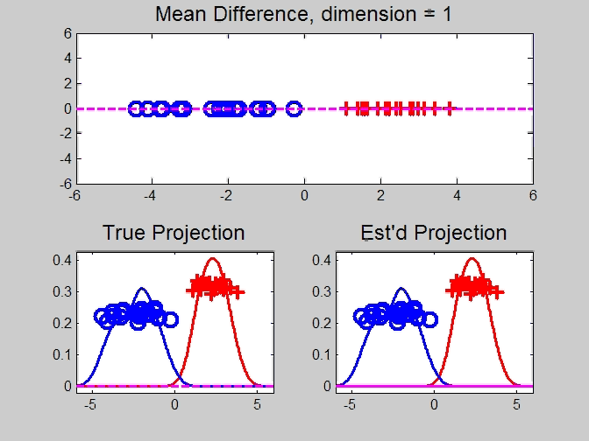
HDLSS Discrimination
Mean Difference (Centroid) Method
Same
Data,
Movie
over
dim’s

Slide 57
HDLSS Discrimination
Mean Difference (Centroid) Method
Far more stable over dimensions
Because is likelihood ratio solution
(for known variance - Gaussians)
Doesn’t feel HDLSS boundary
Eventually becomes too good?!?
Widening gap between clusters?!?
Careful: angle to optimal grows
So lose generalizability (since noise inc’s)
HDLSS data present some odd effects…

Slide 58
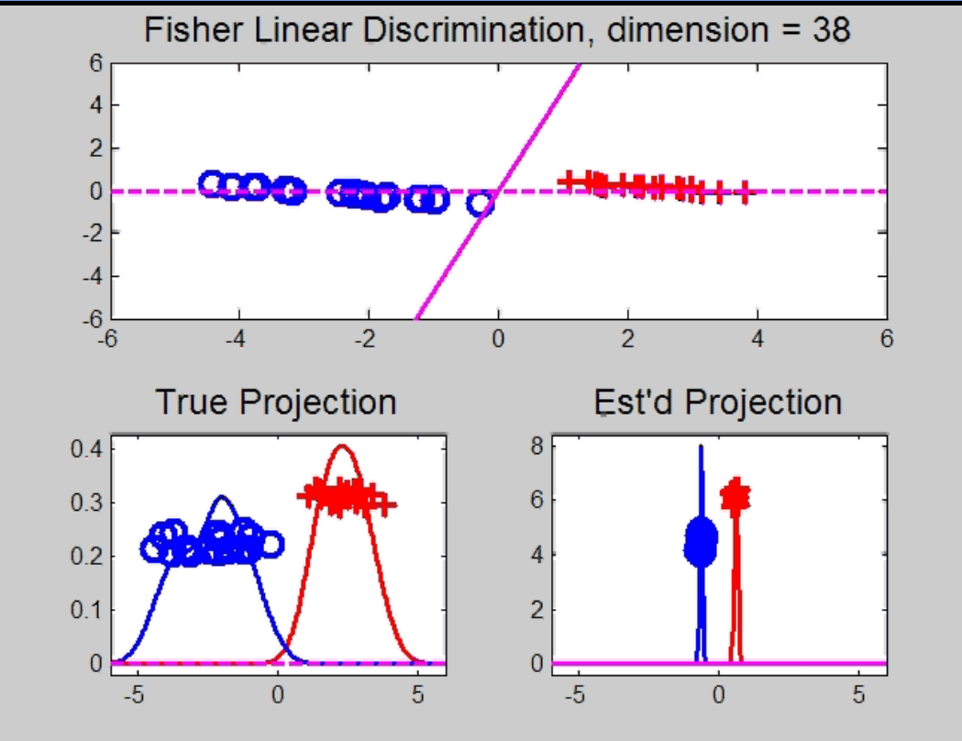
Maximal Data Piling
Strange FLD effect at HDLSS boundary:
Data Piling:
For each class,
all data
project to
single
value

Slide 59
Maximal Data Piling
What is happening?
Hard to imagine
Since our intuition is 3-dim’al
Came from our ancestors…
Try to understand data piling with
some simple examples

Slide 60

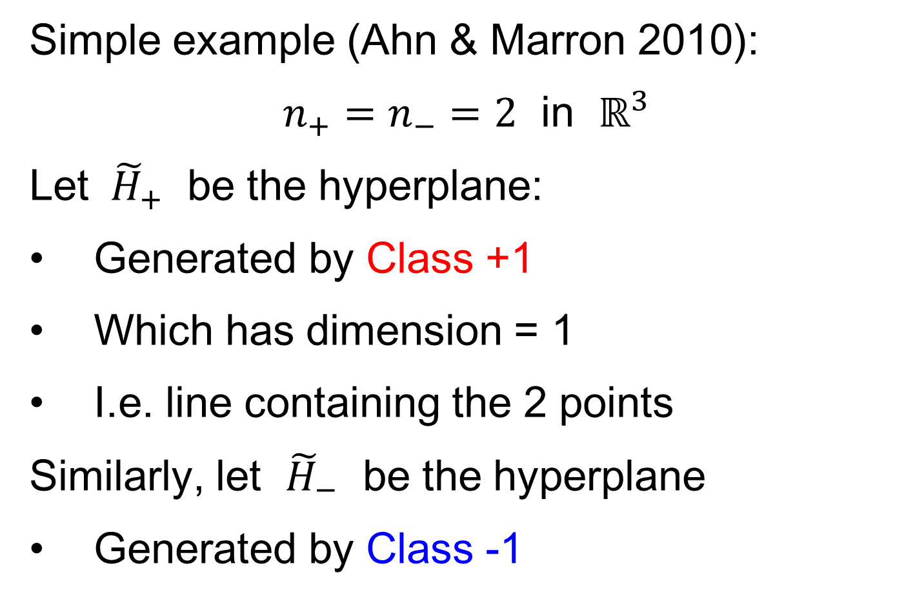
Maximal Data Piling
Simple example (Ahn & Marron 2010):
$n_{+}=n_{−}=2$ in $ℝ^{3}$
Let ${ \tilde{H}}_{+}$ be the hyperplane:
Generated by Class +1
Which has dimension = 1
I.e. line containing the 2 points
Similarly, let ${\tilde{H}}_{−}$ be the hyperplane
Generated by Class -1

Slide 61
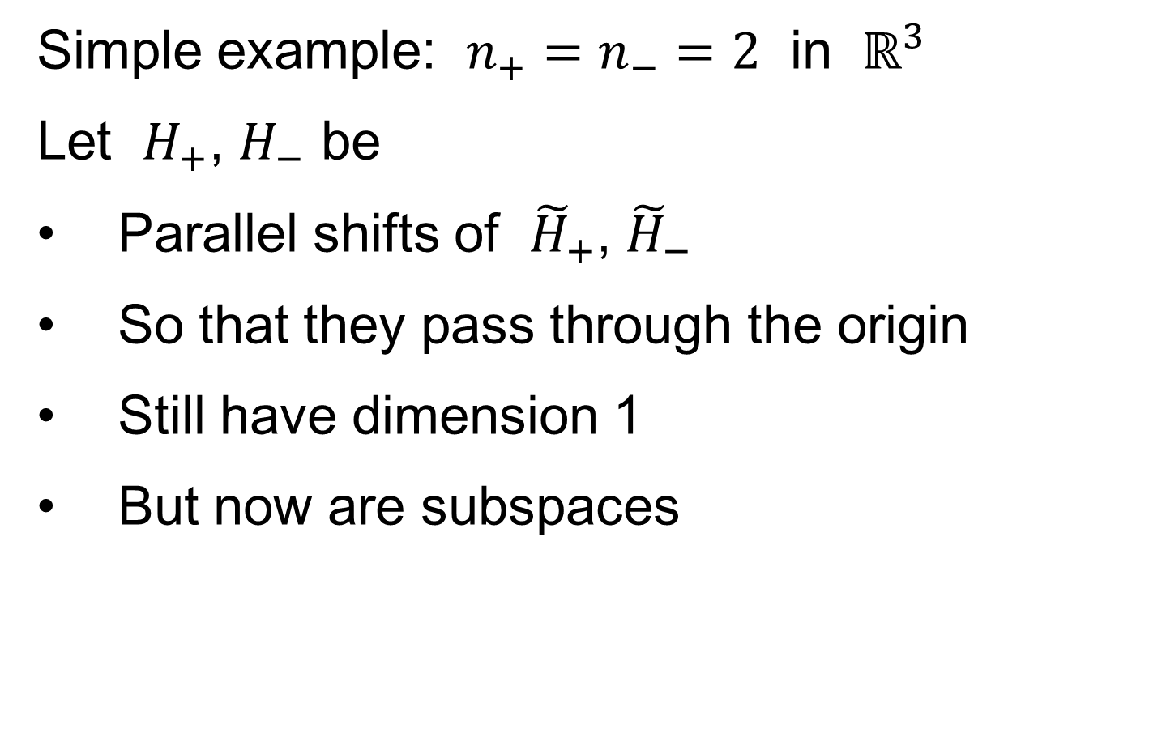
Maximal Data Piling
Simple example: $n_{+}=n_{−}=2$ in $ℝ^{3}$
Let $H_{+}$, $H_{−}$ be
Parallel shifts of ${\tilde{H}}_{+}$, ${\tilde{H}}_{−}$
So that they pass through the origin
Still have dimension 1
But now are subspaces

Slide 62
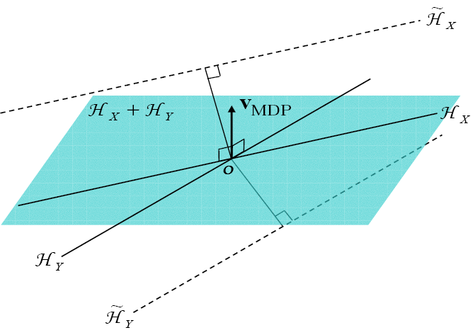

Maximal Data Piling
Simple example: $n_{+}=n_{−}=2$ in $ℝ^{3}$
Notes:
C:\Documents and Settings\J S Marron\My Documents\Research\ComplexPopn\MaxDataPiling\dppic2_2.pdf

Slide 63
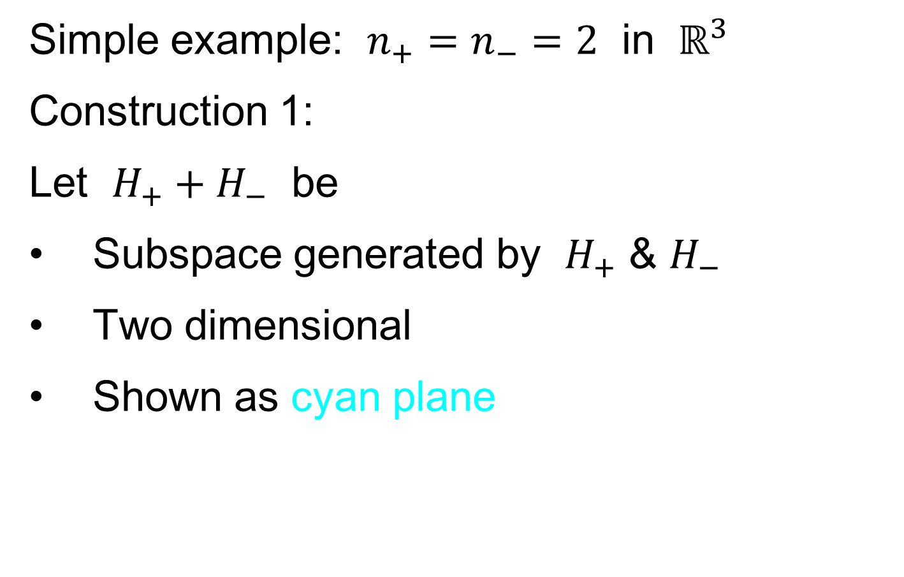
Maximal Data Piling
Simple example: $n_{+}=n_{−}=2$ in $ℝ^{3}$
Construction 1:
Let $H_{+}+H_{−}$ be
Subspace generated by $H_{+}$ & $H_{−}$
Two dimensional
Shown as cyan plane

Slide 64
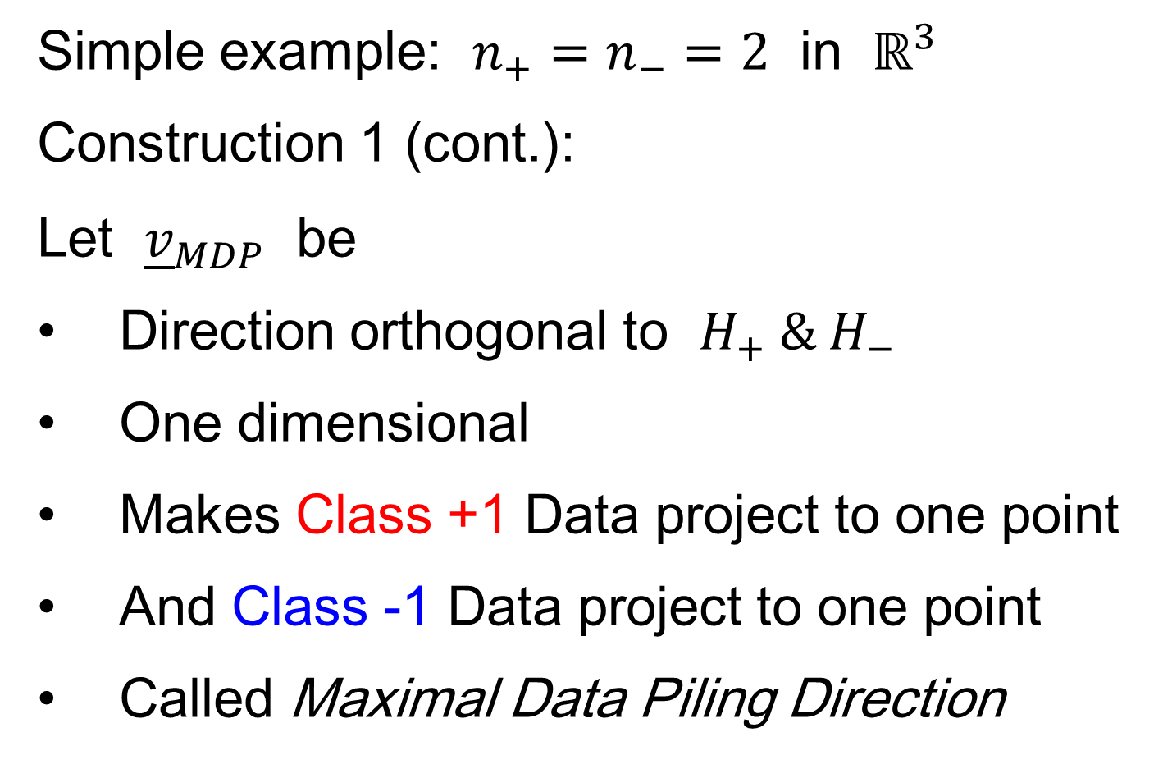
Maximal Data Piling
Simple example: $n_{+}=n_{−}=2$ in $ℝ^{3}$
Construction 1 (cont.):
Let ${\underline{v}}_{MDP}$ be
Direction orthogonal to $H_{+} \& H_{−}$
One dimensional
Makes Class +1 Data project to one point
And Class -1 Data project to one point
Called Maximal Data Piling Direction

Slide 65
Maximal Data Piling
Simple example: $n_{+}=n_{−}=2$ in $ℝ^{3}$
Notes:
C:\Documents and Settings\J S Marron\My Documents\Research\ComplexPopn\MaxDataPiling\dppic2_2.pdf

Slide 66
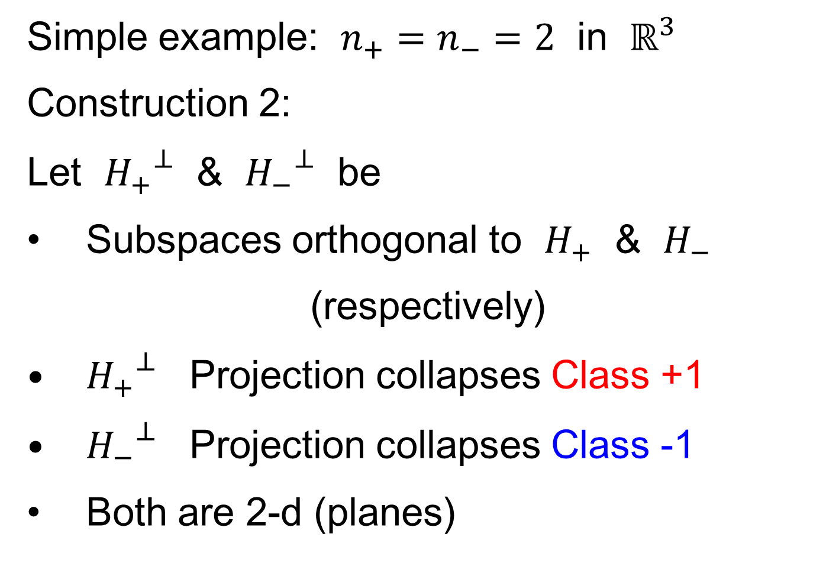
Maximal Data Piling
Simple example: $n_{+}=n_{−}=2$ in $ℝ^{3}$
Construction 2:
Let ${H_{+}}^{⊥}$ & ${H_{−}}^{⊥}$ be
Subspaces orthogonal to $H_{+}$ & $H_{−}$
(respectively)
${H_{+}}^{⊥}$ Projection collapses Class +1
${H_{−}}^{⊥}$ Projection collapses Class -1
Both are 2-d (planes)

Slide 67
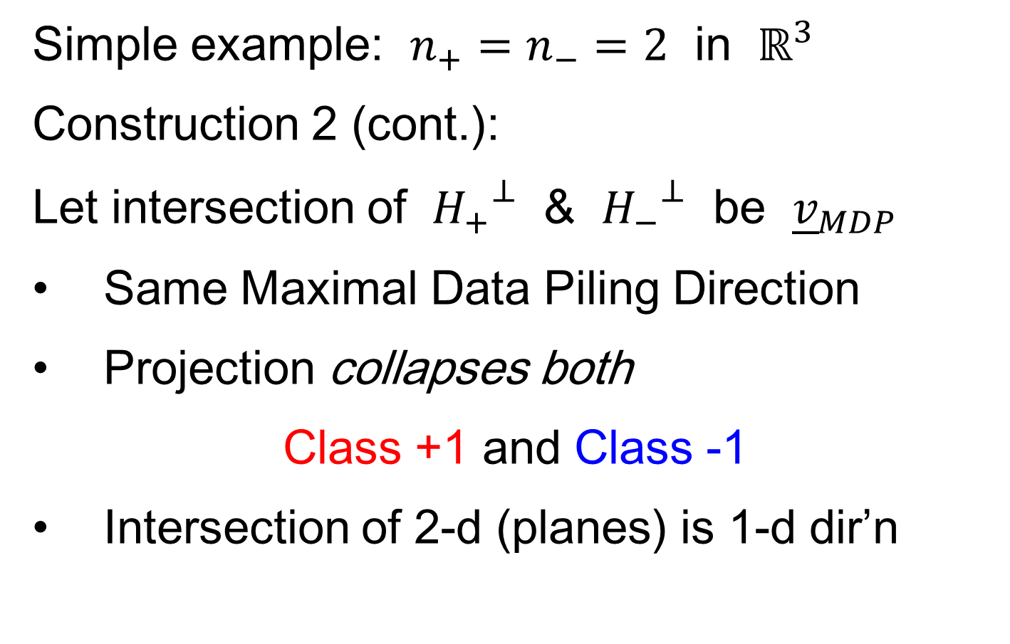
Maximal Data Piling
Simple example: $n_{+}=n_{−}=2$ in $ℝ^{3}$
Construction 2 (cont.):
Let intersection of ${H_{+}}^{⊥}$ & ${H_{−}}^{⊥}$ be ${\underline{v}}_{MDP}$
Same Maximal Data Piling Direction
Projection collapses both
Class +1 and Class -1
Intersection of 2-d (planes) is 1-d dir’n

Slide 68
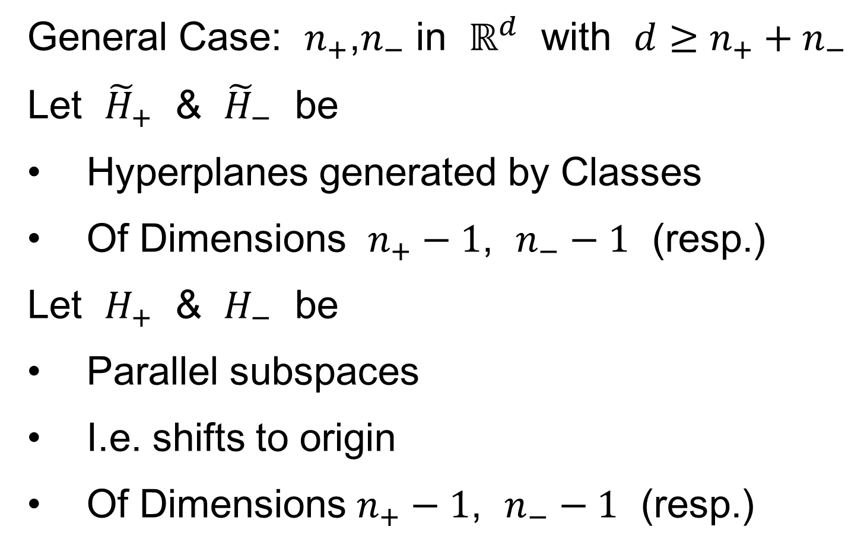
Maximal Data Piling
General Case: $n_{+}$,$n_{−}$ in $ℝ^{d}$ with $d≥n_{+}+n_{−}$
Let ${\tilde{H}}_{+}$ & ${\tilde{H}}_{−}$ be
Hyperplanes generated by Classes
Of Dimensions $n_{+}−1$, $n_{−}−1$ (resp.)
Let $H_{+}$ & $H_{−}$ be
Parallel subspaces
I.e. shifts to origin
Of Dimensions $n_{+}−1$, $n_{−}−1$ (resp.)

Slide 69
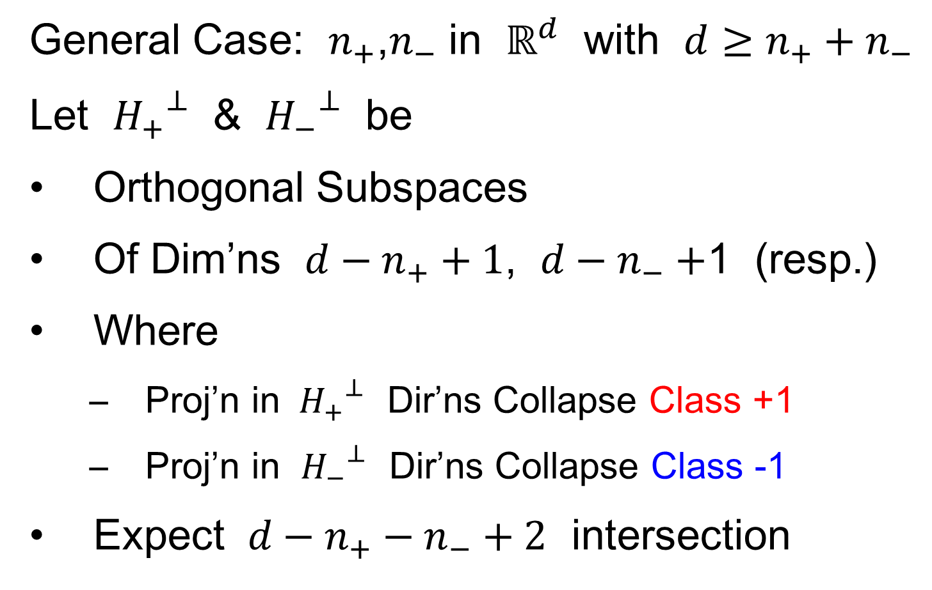
Maximal Data Piling
General Case: $n_{+}$,$n_{−}$ in $ℝ^{d}$ with $d≥n_{+}+n_{−}$
Let ${H_{+}}^{⊥}$ & ${H_{−}}^{⊥}$ be
Orthogonal Subspaces
Of Dim’ns $d−n_{+}+1$, $d−n_{−}+$1 (resp.)
Where
  Proj’n in ${H_{+}}^{⊥}$ Dir’ns Collapse Class +1
  Proj’n in ${H_{−}}^{⊥}$ Dir’ns Collapse Class -1
Expect $d−n_{+}−n_{−}+2$ intersection

Slide 70
Participant Presentation
Yifeng Shi:
Dealing with Histological Images
Using Set-structured Method

