Slide 1
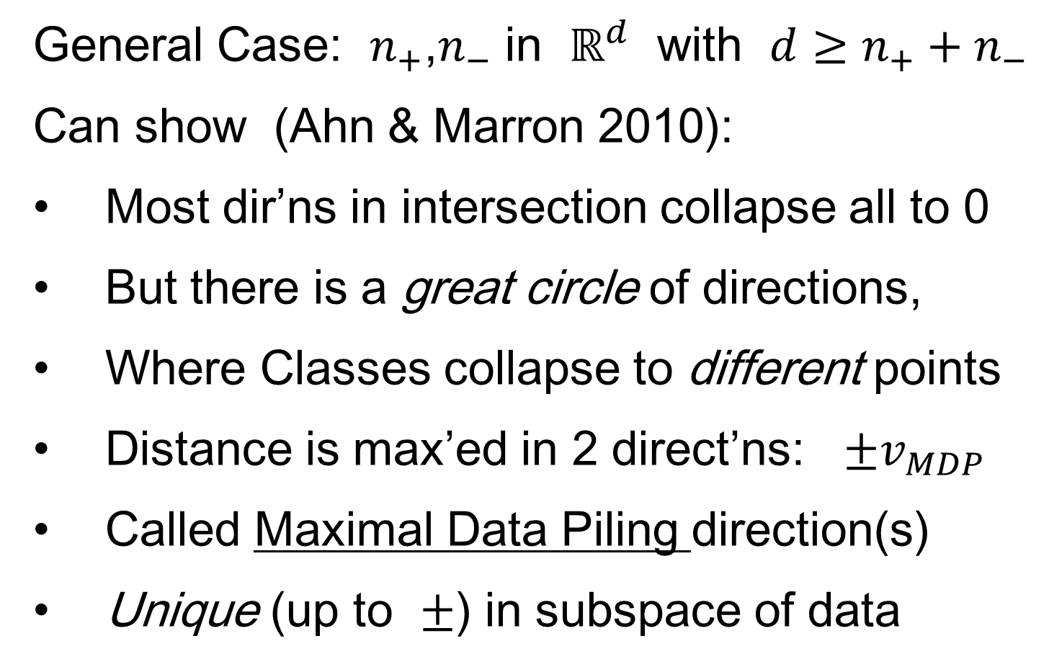
Maximal Data Piling
General Case: $n_{+}$,$n_{−}$ in $ℝ^{d}$ with $d≥n_{+}+n_{−}$
Can show (Ahn & Marron 2010):
Most dir’ns in intersection collapse all to 0
But there is a great circle of directions,
Where Classes collapse to different points
Distance is max’ed in 2 direct’ns: $±v_{MDP}$
Called Maximal Data Piling direction(s)
Unique (up to $±$) in subspace of data

Slide 2
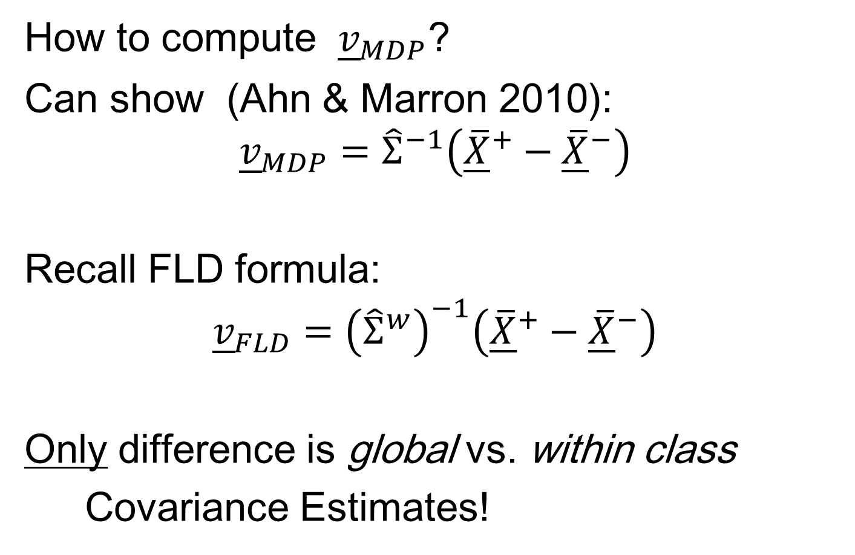
Maximal Data Piling
How to compute ${\underline{v}}_{MDP}$?
Can show (Ahn & Marron 2010):
$${\underline{v}}_{MDP}={\hat{Σ}}^{−1}\left({\underline{\overline{X}}}^{+}−{\underline{\overline{X}}}^{−}\right)$$
Recall FLD formula:
$${\underline{v}}_{FLD}={\left({\hat{Σ}}^{w}\right)}^{−1}\left({\underline{\overline{X}}}^{+}−{\underline{\overline{X}}}^{−}\right)$$
Only difference is global vs. within class
Covariance Estimates!

Slide 3
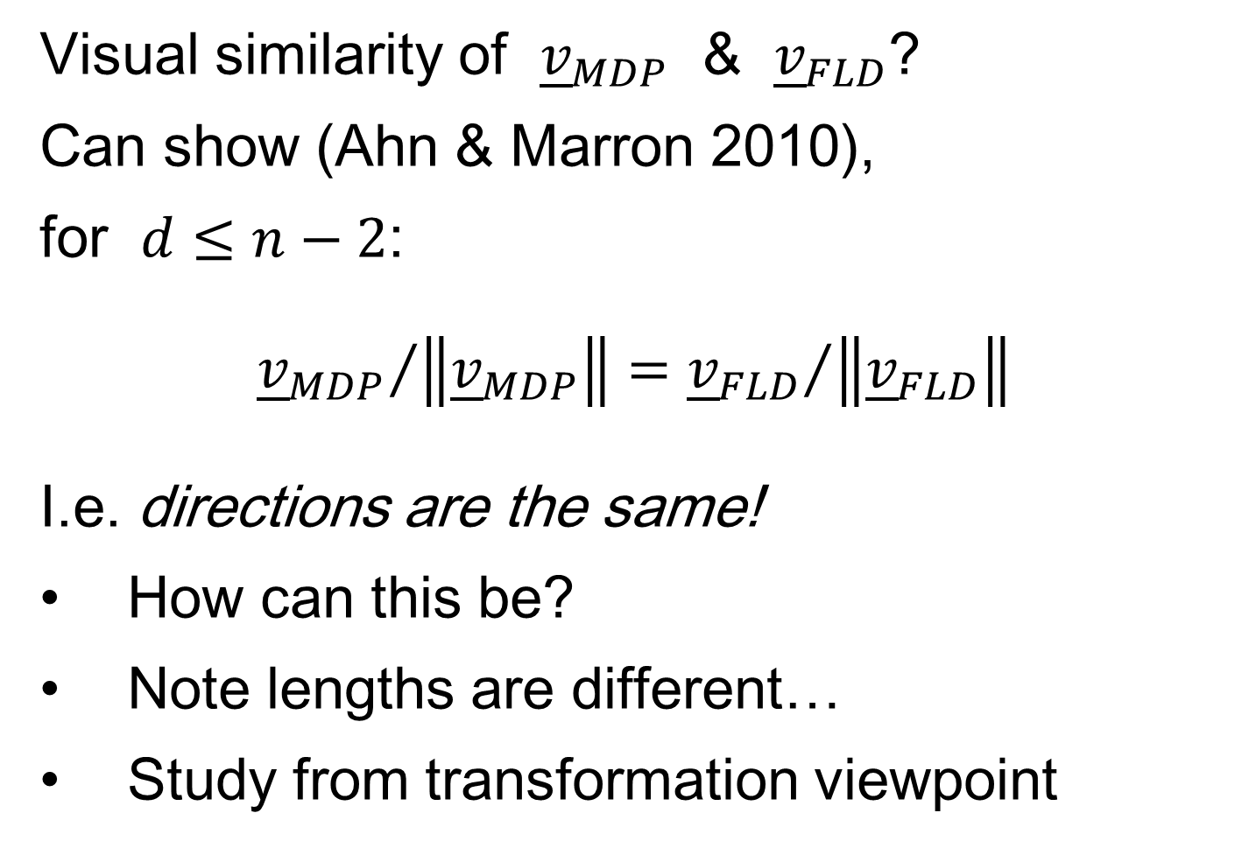
Maximal Data Piling
Visual similarity of ${\underline{v}}_{MDP}$ & ${\underline{v}}_{FLD}$?
Can show (Ahn & Marron 2010),
for $d≤n−2$:
$${{\underline{v}}_{MDP}}/{\left\|{\underline{v}}_{MDP}\right\|}={{\underline{v}}_{FLD}}/{\left\|{\underline{v}}_{FLD}\right\|}$$
I.e. directions are the same!
How can this be?
Note lengths are different…
Study from transformation viewpoint

Slide 4
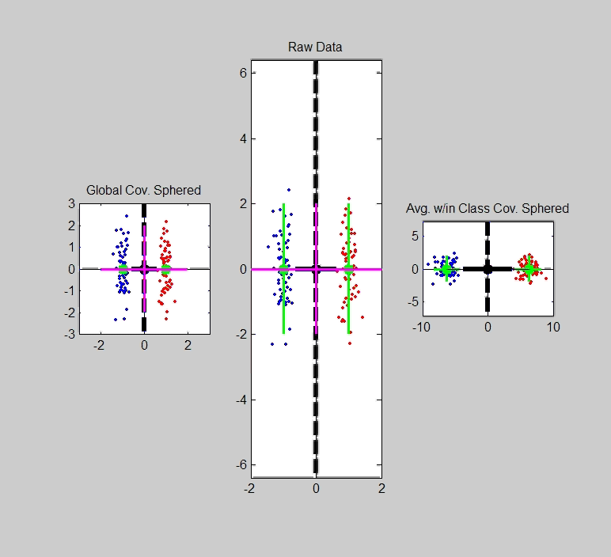
Maximal Data Piling
Include
Corres-
ponding
MDP
Transfo’:
Both give
Same
Result!

Slide 5
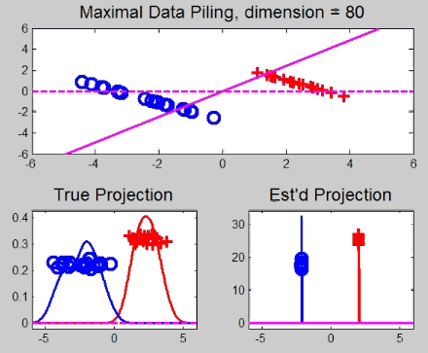
Maximal Data Piling
A point of terminology (Ahn & Marron 2010):
MDP is “maximal” in 2 senses:
# of data piled
Size of gap
(within subspace
gen’d by data)

Slide 6
Kernel Embedding
Aizerman, Braverman and Rozoner (1964)
Motivating idea:
Extend scope of linear discrimination,
By adding nonlinear components to data
(embedding in a higher dim’al space)
Better use of name:
nonlinear discrimination?

Slide 7
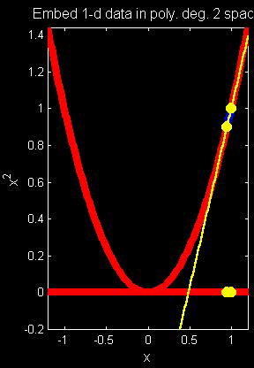
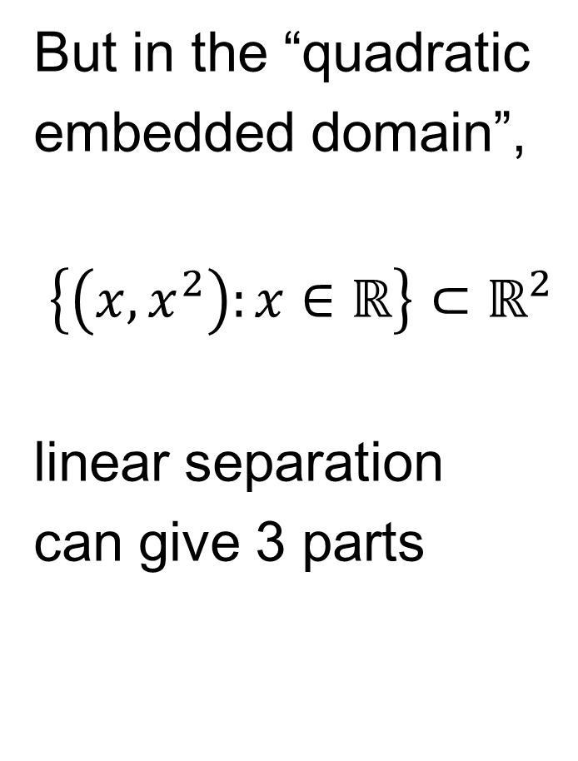
Kernel Embedding
But in the “quadratic
embedded domain”,
$\left\{\left(x,x^{2}\right):x∈ℝ\right\}⊂ℝ^{2}$
linear separation
can give 3 parts

Slide 8
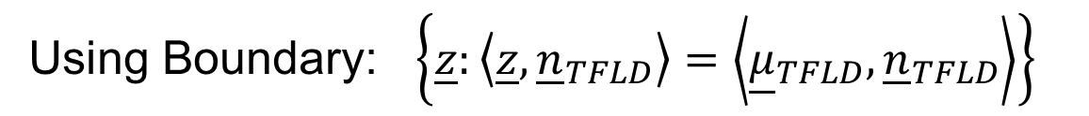
Kernel Embedding
But in the quadratic embedded domain
$\left\{\left(x,x^{2}\right):x∈ℝ\right\}⊂ℝ^{2}$
Linear separation can give 3 parts
original data space lies in 1d manifold
very sparse region of $ℝ^{2}$
curvature of manifold gives:
better linear separation
can have any 2 break points
(2 points $⟹$ line)

Slide 9
Kernel Embedding
Visualization for Toy Examples:
Have Linear Disc. In Embedded Space
Study Effect in Original Data Space
Via Implied Nonlinear Regions
Approach:
Use Test Set in Original Space
(dense equally spaced grid)
Apply embedded discrimination Rule
Color Using the Result

Slide 10
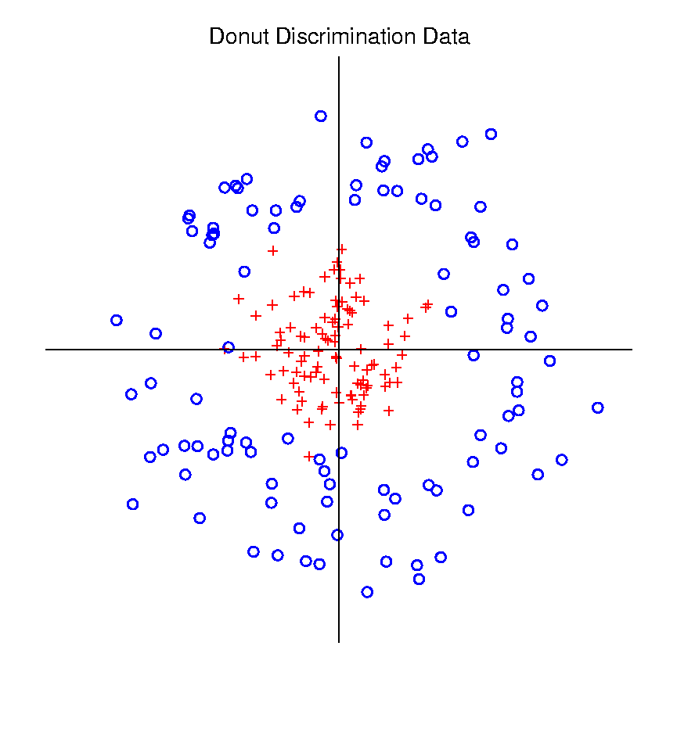
Kernel Embedding
Polynomial Embedding, Toy Example 3:
Donut
Very Challenging
For Any Linear
Approach
Notes:
PEod1Raw.ps

Slide 11
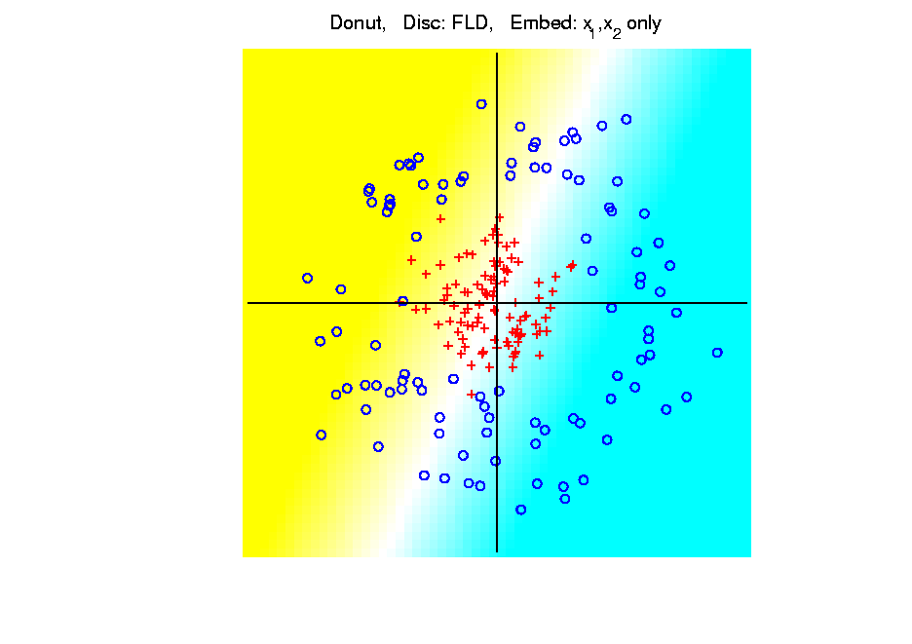
Kernel Embedding
Polynomial Embedding, Toy Example 3:
Donut
FLD
Original
Data
Very
Bad
Notes:
PEod1Raw.ps

Slide 12
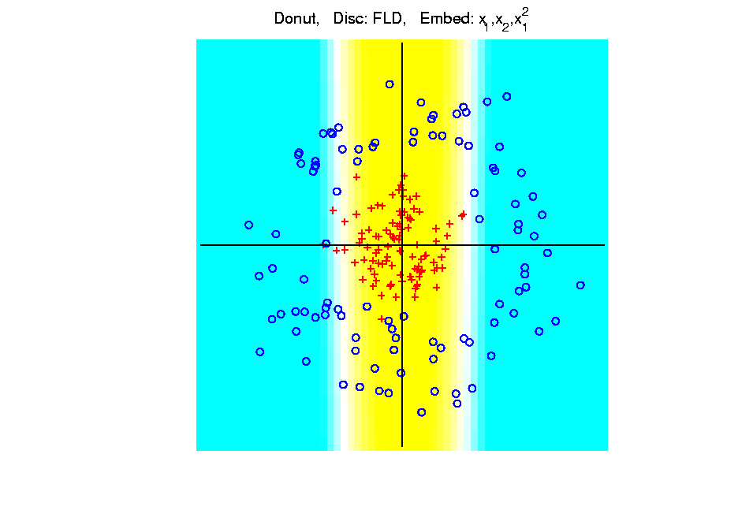
Kernel Embedding
Polynomial Embedding, Toy Example 3:
Donut
FLD
Somewhat
Better
(Parabolic Fold)
Notes:
PEod1Raw.ps

Slide 13
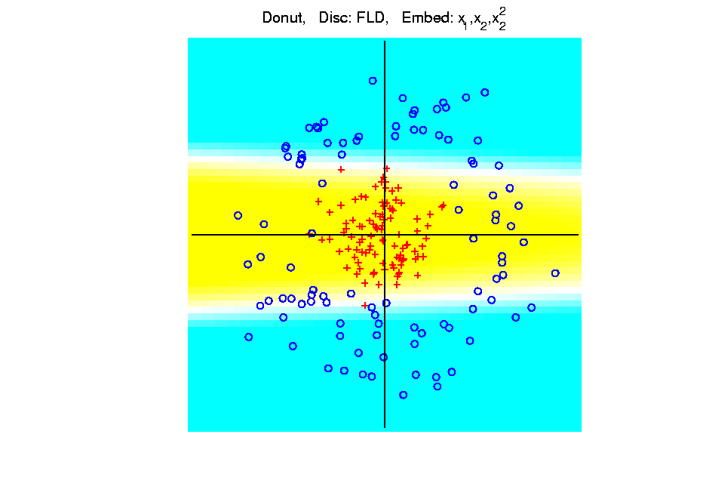
Kernel Embedding
Polynomial Embedding, Toy Example 3:
Donut
FLD
Somewhat
Better
(Other Fold)
Notes:
PEod1Raw.ps

Slide 14
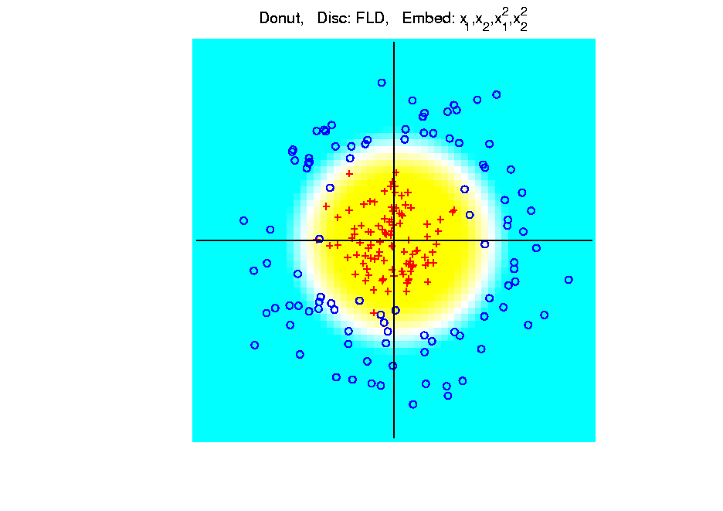
Kernel Embedding
Polynomial Embedding, Toy Example 3:
Donut
FLD
Good
Performance
(Slice of
Paraboloid)
Notes:
PEod1Raw.ps

Slide 15
Kernel Embedding
Drawbacks to polynomial embedding:
Too many extra terms create spurious structure
i.e. have “overfitting”
Too much flexibility
HDLSS problems typically get worse
Iain D Carmichael <idc9@uw.edu>
Iain D Carmichael <idc9@uw.edu>

Slide 16
Kernel Embedding
Important Variation: “Kernel Machines”
Idea: replace polynomials by
other nonlinear functions
e.g. 1: sigmoid functions from neural nets
e.g. 2: radial basis functions
Gaussian kernels
Related to “kernel density estimation”
(study more later)

Slide 17
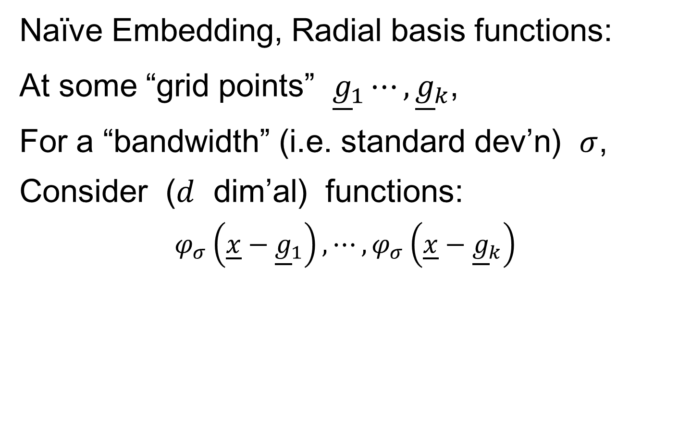
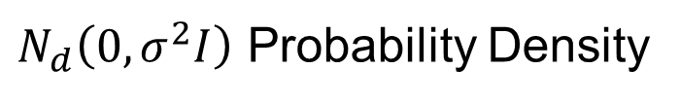
Kernel Embedding
Naïve Embedding, Radial basis functions:
At some “grid points” ${\underline{g}}_{1}⋯,{\underline{g}}_{k}$,
For a “bandwidth” (i.e. standard dev’n) $σ$,
Consider ($d$ dim’al) functions:
$$φ_{σ}\left(\underline{x}−{\underline{g}}_{1}\right),⋯,φ_{σ}\left(\underline{x}−{\underline{g}}_{k}\right)$$
$N_{d}\left(0,σ^{2}I\right)$ Probability Density

Slide 18
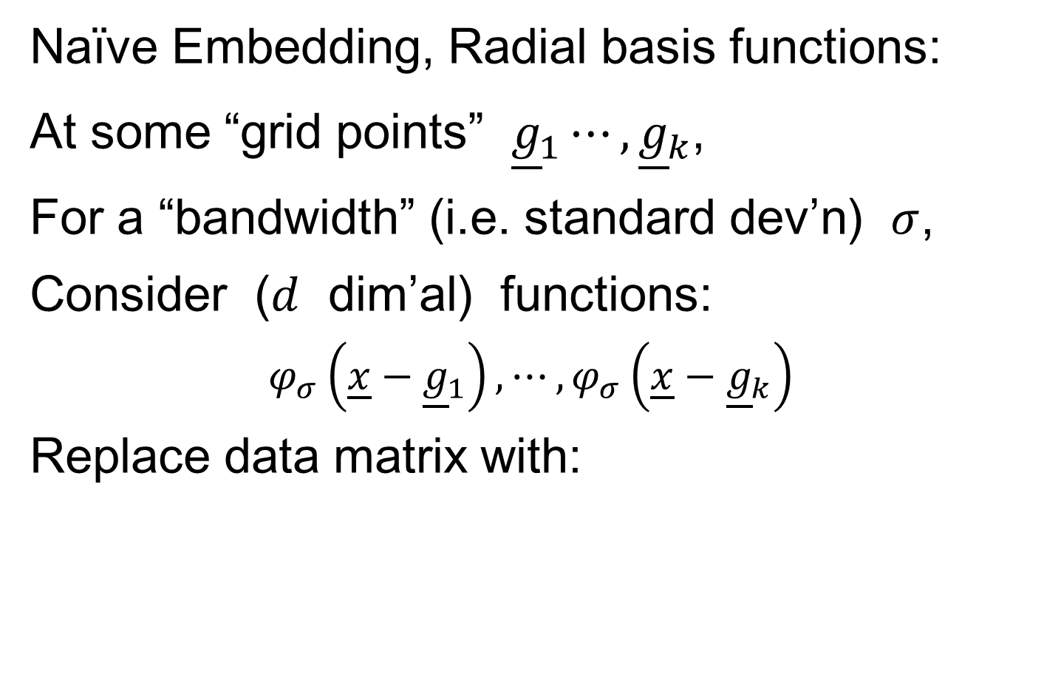
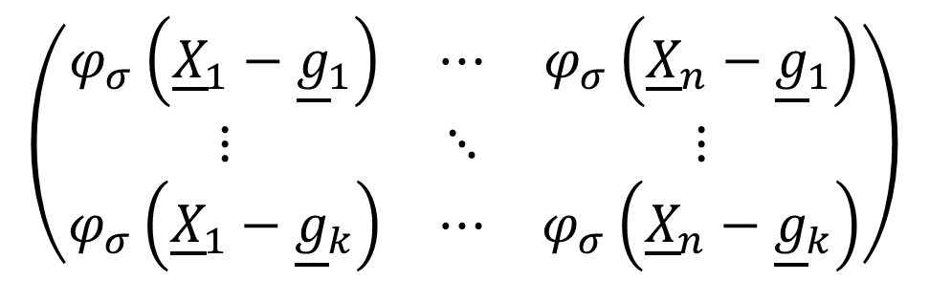
Kernel Embedding
Naïve Embedding, Radial basis functions:
At some “grid points” ${\underline{g}}_{1}⋯,{\underline{g}}_{k}$,
For a “bandwidth” (i.e. standard dev’n) $σ$,
Consider ($d$ dim’al) functions:
$$φ_{σ}\left(\underline{x}−{\underline{g}}_{1}\right),⋯,φ_{σ}\left(\underline{x}−{\underline{g}}_{k}\right)$$
Replace data matrix with:
$$\left(\begin{matrix}φ_{σ}\left({\underline{X}}_{1}−{\underline{g}}_{1}\right) & ⋯ & φ_{σ}\left({\underline{X}}_{n}−{\underline{g}}_{1}\right) \\ ⋮ & ⋱ & ⋮ \\ φ_{σ}\left({\underline{X}}_{1}−{\underline{g}}_{k}\right) & ⋯ & φ_{σ}\left({\underline{X}}_{n}−{\underline{g}}_{k}\right)\end{matrix}\right)$$

Slide 19
Kernel Embedding
Naïve Embedding, Radial basis functions:
For discrimination: work in radial basis space, With new data vector ${\underline{X}}_{0}$,
represented by: $\left(\begin{matrix}φ_{σ}\left({\underline{X}}_{0}−{\underline{g}}_{1}\right) \\ ⋮ \\ φ_{σ}\left({\underline{X}}_{0}−{\underline{g}}_{k}\right)\end{matrix}\right)$

Slide 20
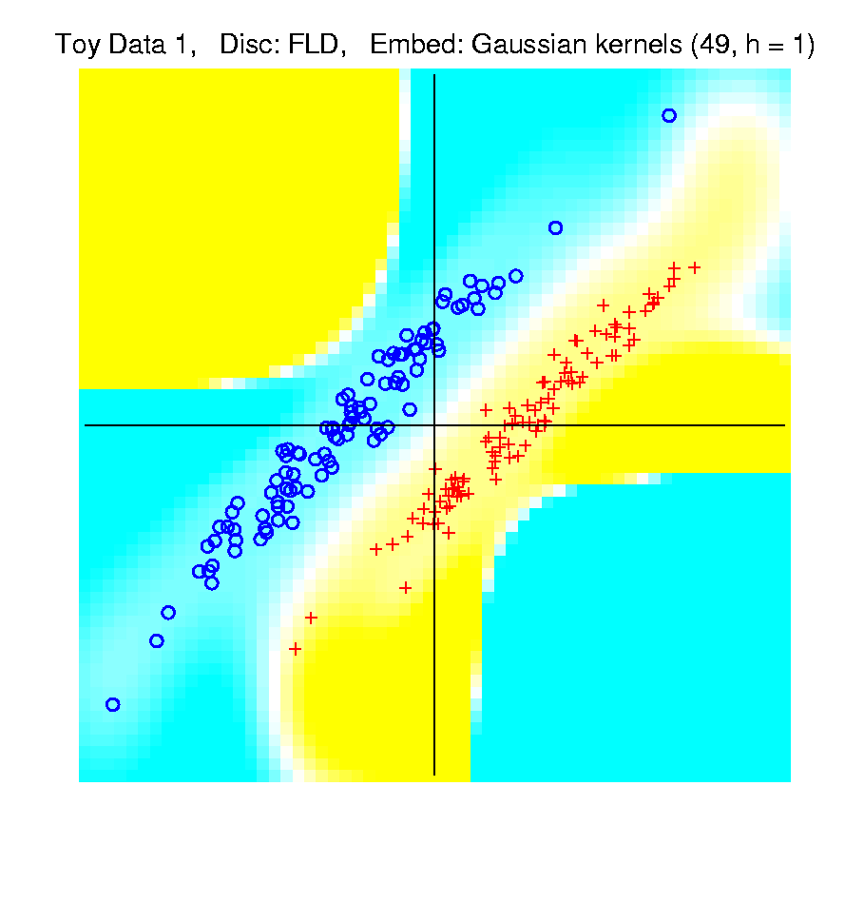
Kernel Embedding
Naïve Embedd’g, Toy E.g. 1: Parallel Clouds
Good
at data
Poor
outside

Slide 21
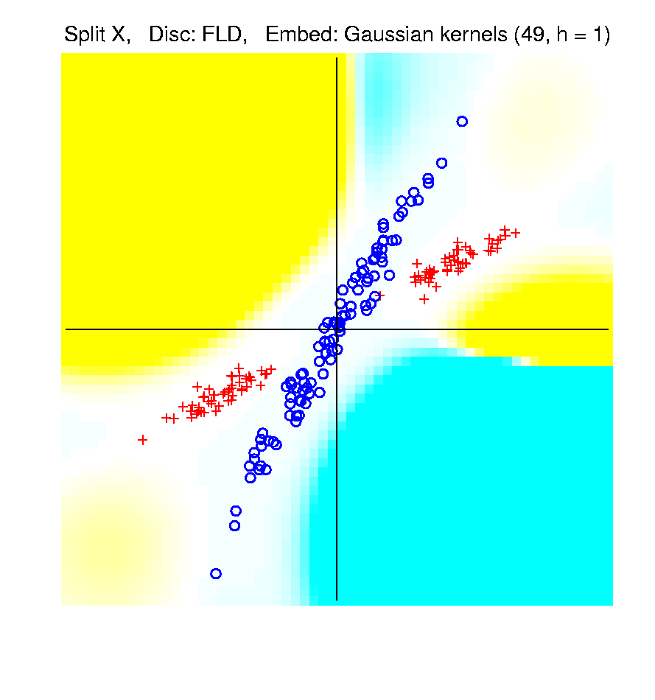
Kernel Embedding
Naïve Embedd’g, Toy E.g. 2: Split X
OK at
data
Strange
outside

Slide 22
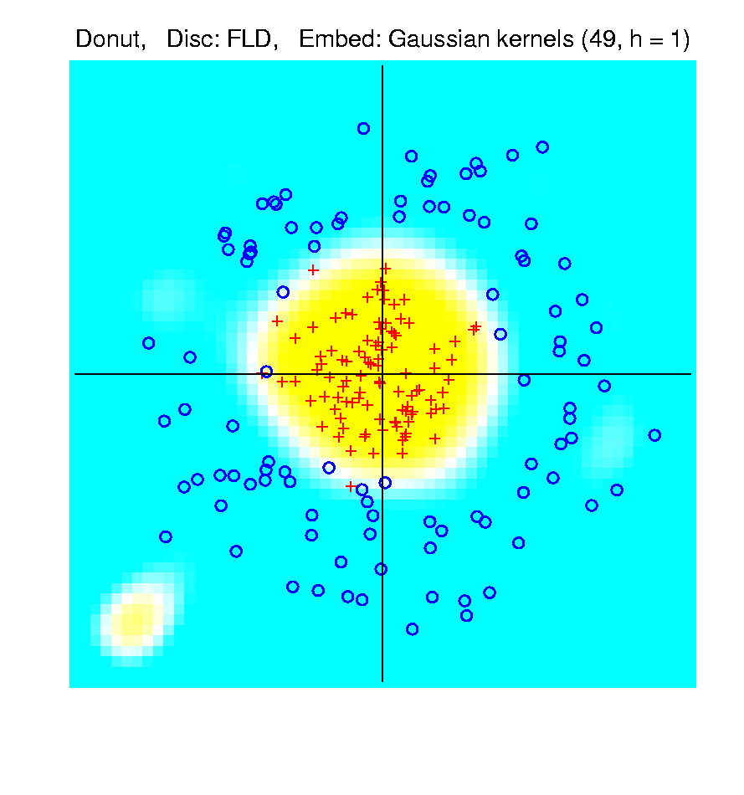
Kernel Embedding
Naïve Embedd’g, Toy E.g. 3: Donut
Mostly
good
Slight
mistake
for one
kernel

Slide 23
Kernel Embedding
Naïve Embedding, Radial basis functions:
Toy Example, Main lessons:
Generally good in regions with data,
Unpredictable where data are sparse

Slide 24
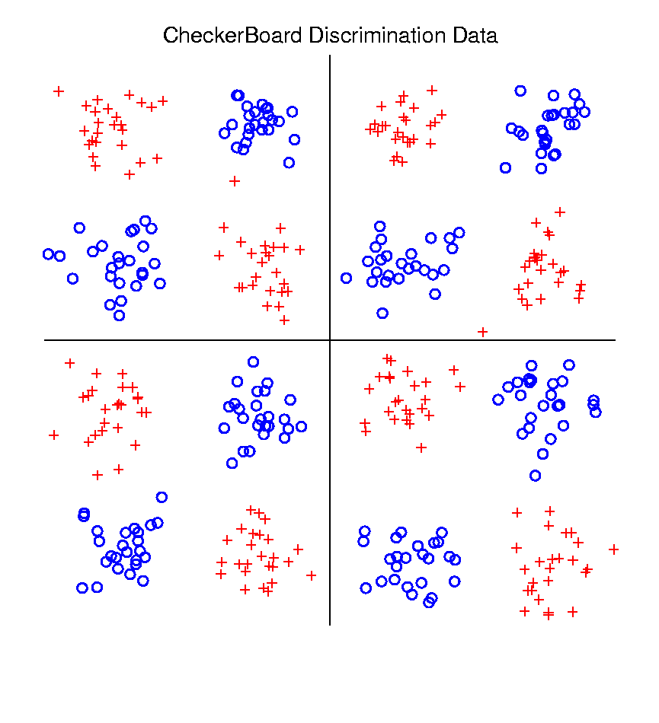
Kernel Embedding
Toy Example 4: Checkerboard
Very
Challenging!
Linear
Method?
Polynomial
Embedding?
Notes:
PEod1Raw.ps

Slide 25
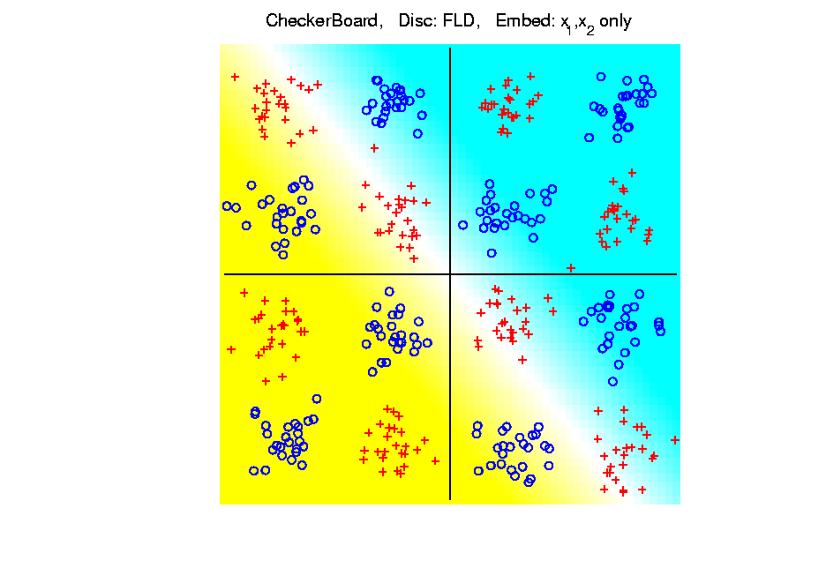
Kernel Embedding
Toy Example 4: Checkerboard
Very
Challenging!
FLD
Linear Is
Hopeless
Notes:
PEod1Raw.ps

Slide 26
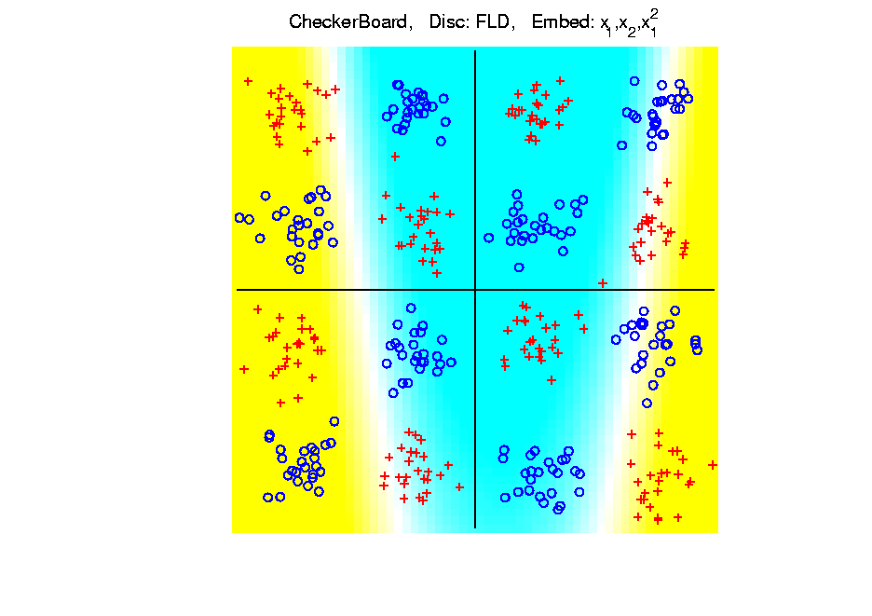
Kernel Embedding
Toy Example 4: Checkerboard
Very
Challenging!
FLD
Notes:
PEod1Raw.ps

Slide 27
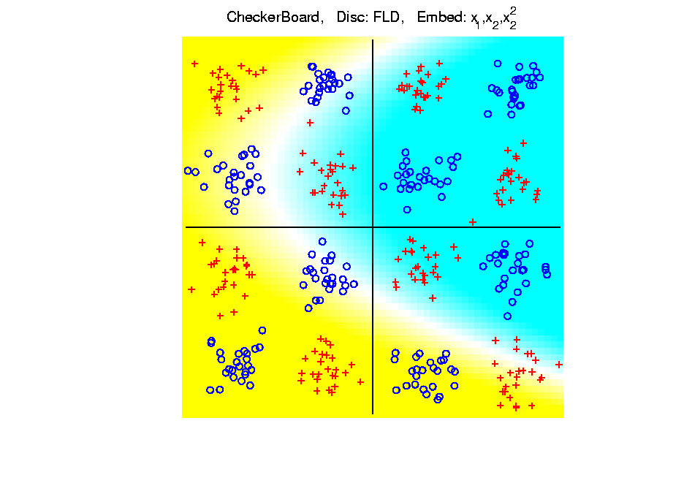
Kernel Embedding
Toy Example 4: Checkerboard
Very
Challenging!
FLD
Notes:
PEod1Raw.ps

Slide 28
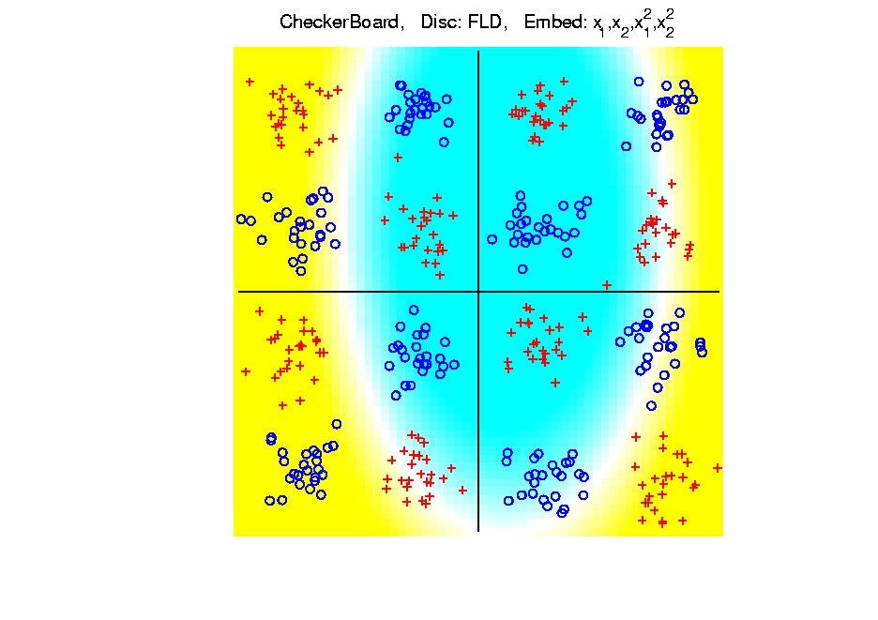
Kernel Embedding
Toy Example 4: Checkerboard
Very
Challenging!
FLD
Notes:
PEod1Raw.ps

Slide 29
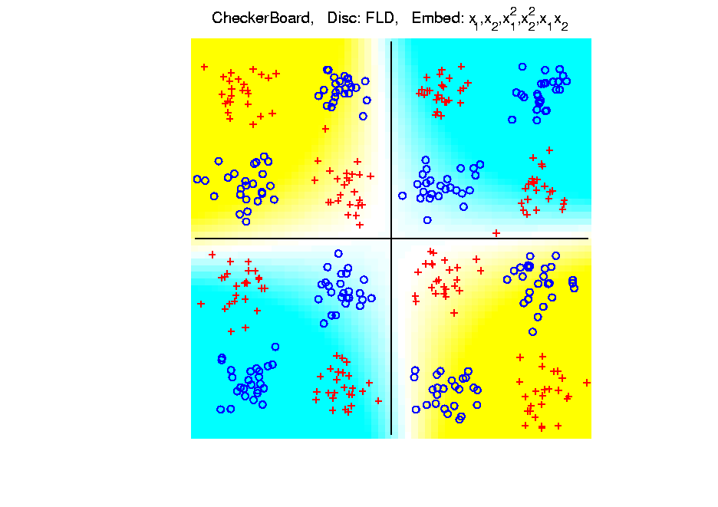
Kernel Embedding
Toy Example 4: Checkerboard
Very
Challenging!
FLD
Notes:
PEod1Raw.ps

Slide 30
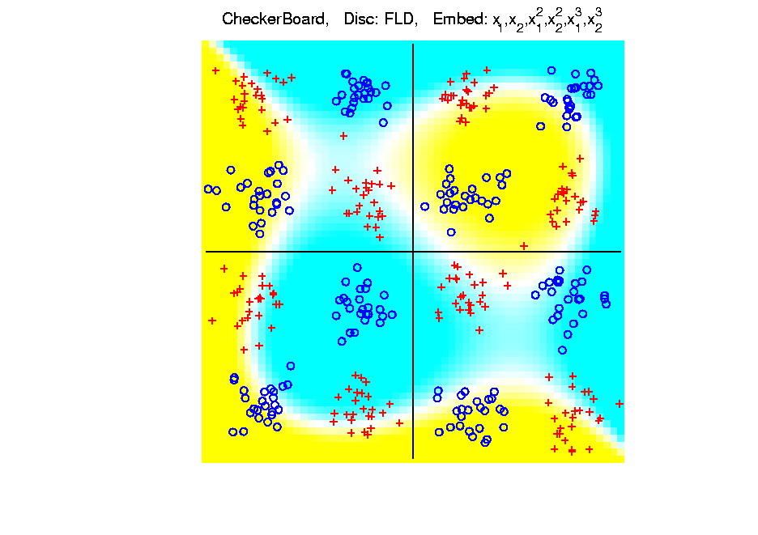
Kernel Embedding
Toy Example 4: Checkerboard
Very
Challenging!
FLD
Embedding
Gets Better
But Still
Not Great
Notes:
PEod1Raw.ps

Slide 31
Kernel Embedding
Toy Example 4: Checkerboard
Very
Challenging!
Polynomials
Don’t Have
Needed
Flexiblity
Notes:
PEod1Raw.ps

Slide 32
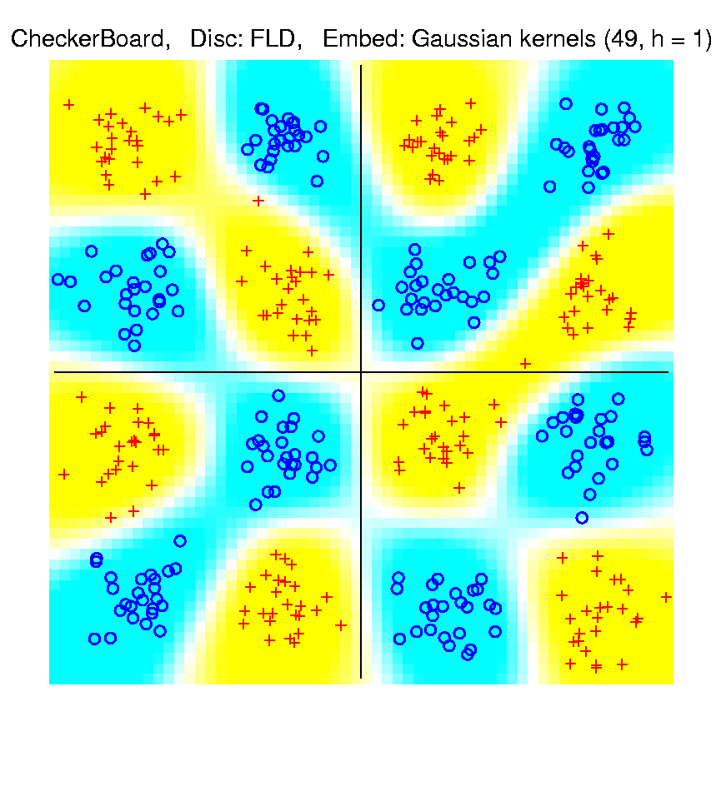
Kernel Embedding
Toy Example 4: Checkerboard
Radial
Basis
Embedding
+ FLD
Is
Excellent!
Notes:
PEod1Raw.ps

Slide 33
Kernel Embedding
Drawbacks to naïve embedding:
Equally spaced grid too big in high $d$
Not computationally tractable $\left(g^{d}\right)$
Approach:
Evaluate only at data points
Not on full grid
But where data live

Slide 34
Kernel Embedding
Other types of embedding:
Explicit
Implicit
Will be studied soon, after
introduction to Support Vector Machines…

Slide 35
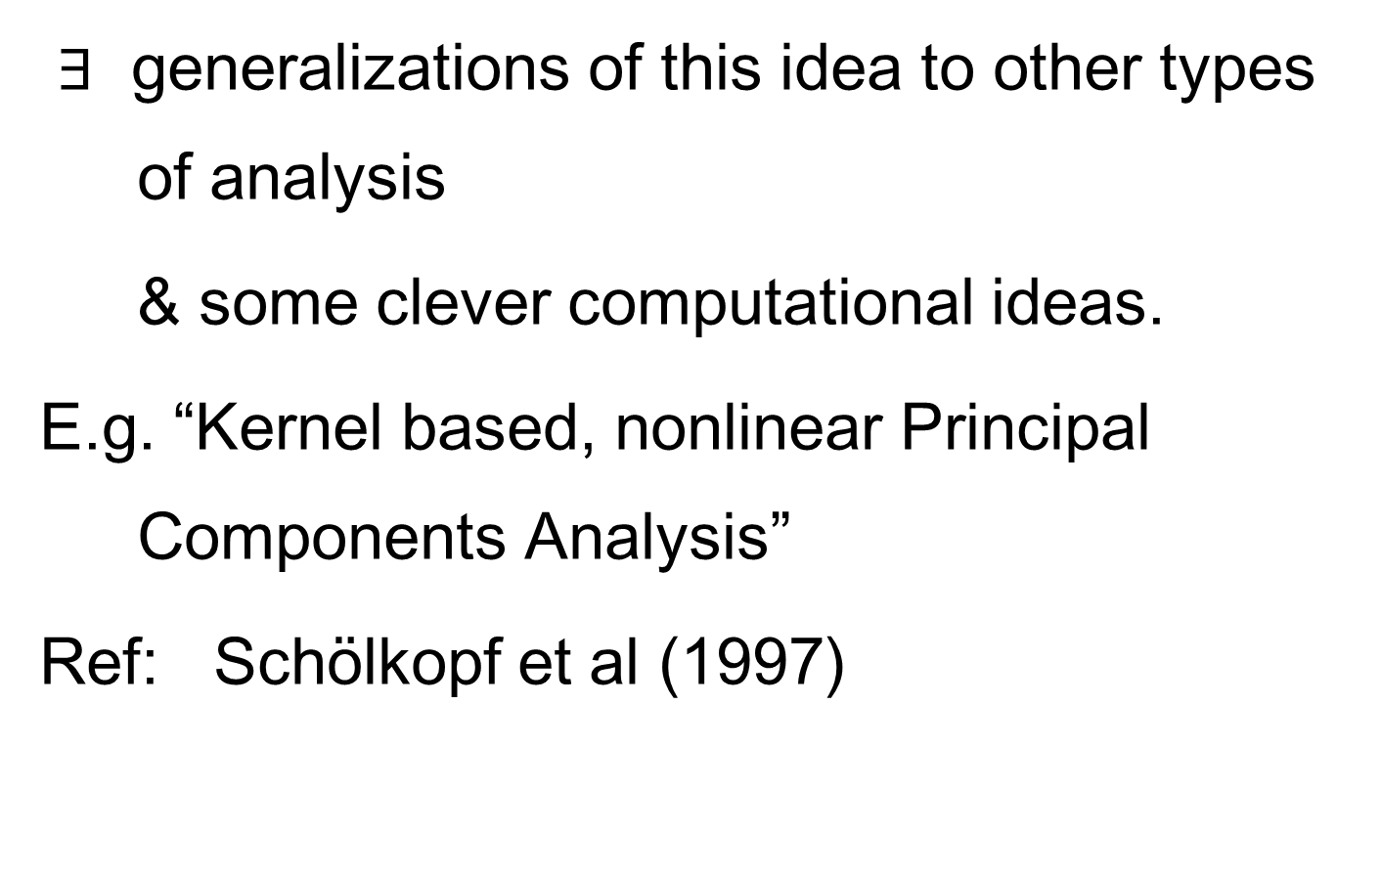
Kernel Embedding
$∃$ generalizations of this idea to other types of analysis
& some clever computational ideas.
E.g. “Kernel based, nonlinear Principal Components Analysis”
Ref: Schölkopf et al (1997)

Slide 36
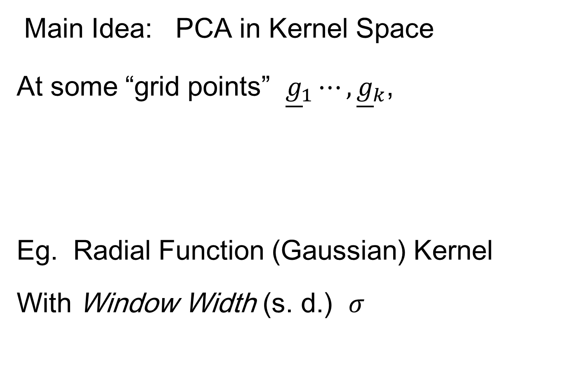
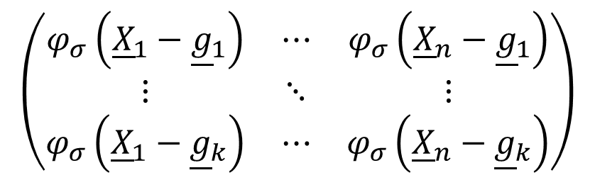
Kernel PCA
Main Idea: PCA in Kernel Space
At some “grid points” ${\underline{g}}_{1}⋯,{\underline{g}}_{k}$,
Eg. Radial Function (Gaussian) Kernel
With Window Width (s. d.) $σ$
$$\left(\begin{matrix}φ_{σ}\left({\underline{X}}_{1}−{\underline{g}}_{1}\right) & ⋯ & φ_{σ}\left({\underline{X}}_{n}−{\underline{g}}_{1}\right) \\ ⋮ & ⋱ & ⋮ \\ φ_{σ}\left({\underline{X}}_{1}−{\underline{g}}_{k}\right) & ⋯ & φ_{σ}\left({\underline{X}}_{n}−{\underline{g}}_{k}\right)\end{matrix}\right)$$

Slide 37
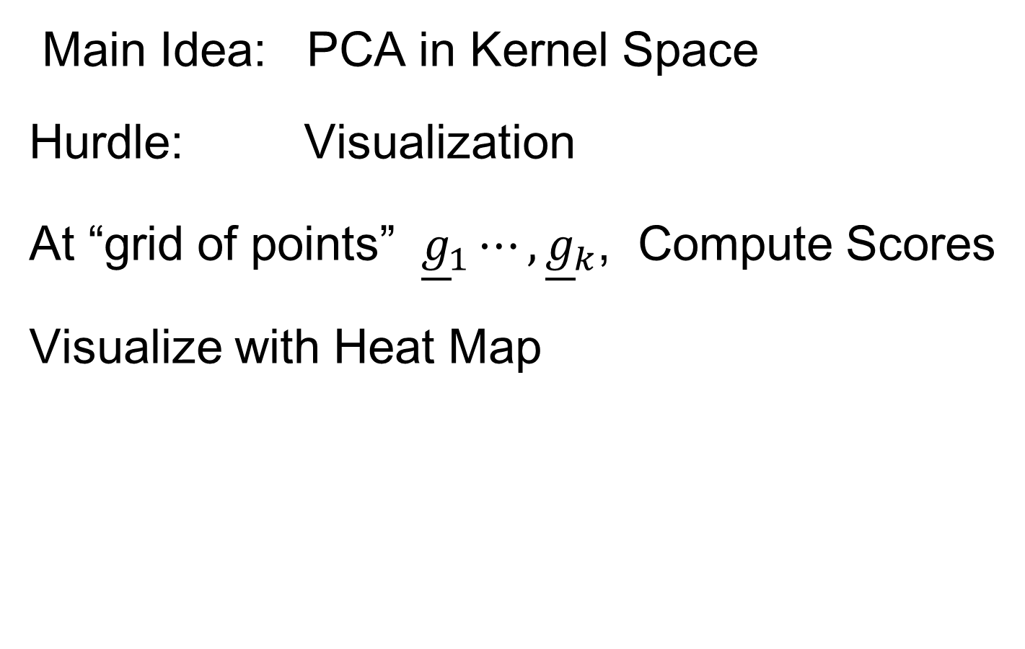
Kernel PCA
Main Idea: PCA in Kernel Space
Hurdle: Visualization
At “grid of points” ${\underline{g}}_{1}⋯,{\underline{g}}_{k}$, Compute Scores
Visualize with Heat Map

Slide 38
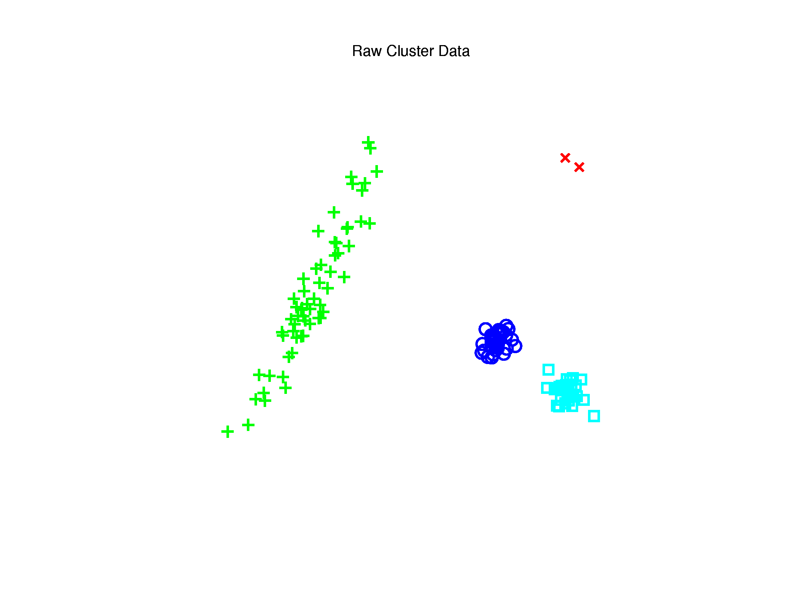

Kernel PCA
Toy $ℝ^{2}$ Example: Raw Data
Long Stretched
Cluster
Round Clusters
Outliers?
Small Cluster?

Slide 39
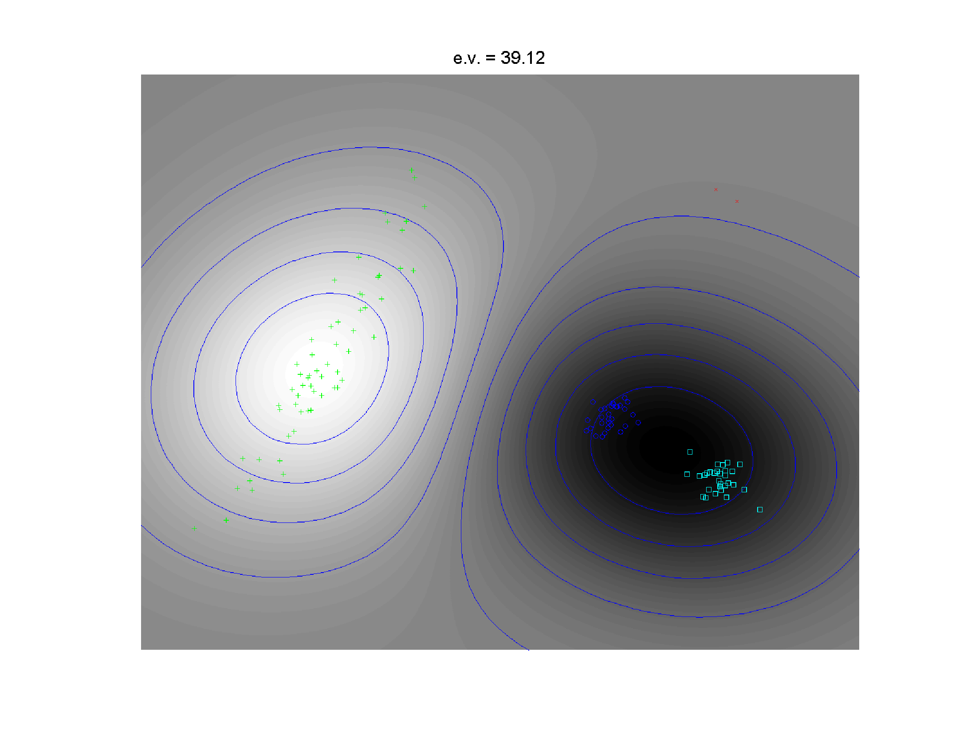
Kernel PCA
1st Component
Finds Coarse
Scale Green
vs. Blues

Slide 40
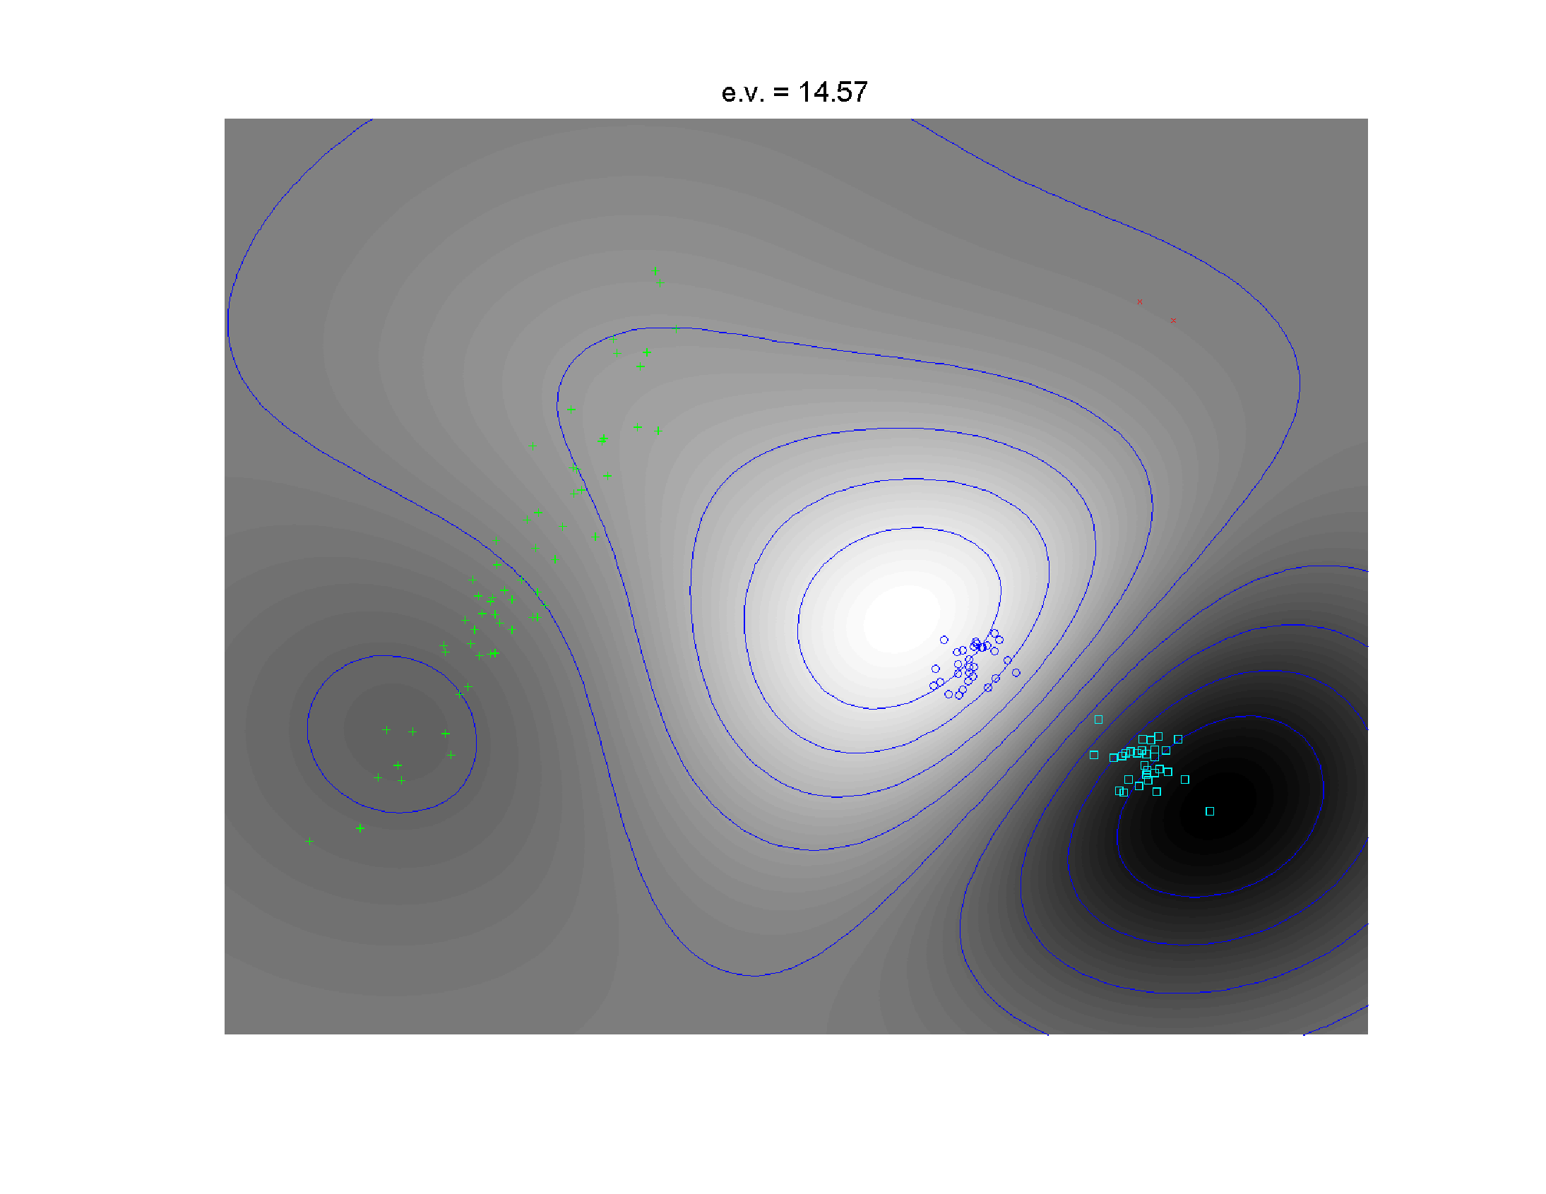
Kernel PCA
2nd Component
Separates
Blue & Cyan
Strong
Locality!

Slide 41
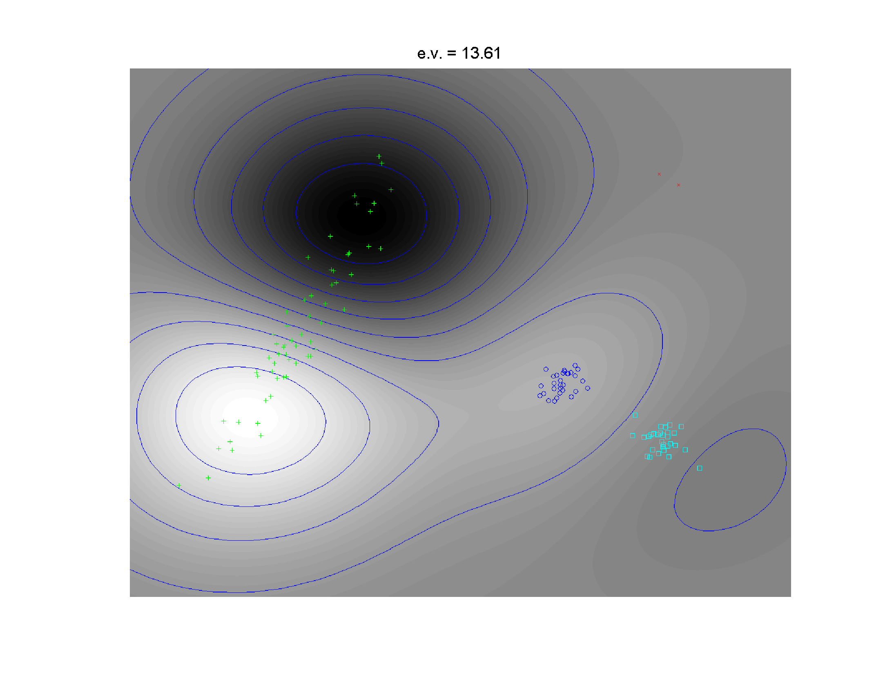
Kernel PCA
3rd Component
Splits
Greens

Slide 42
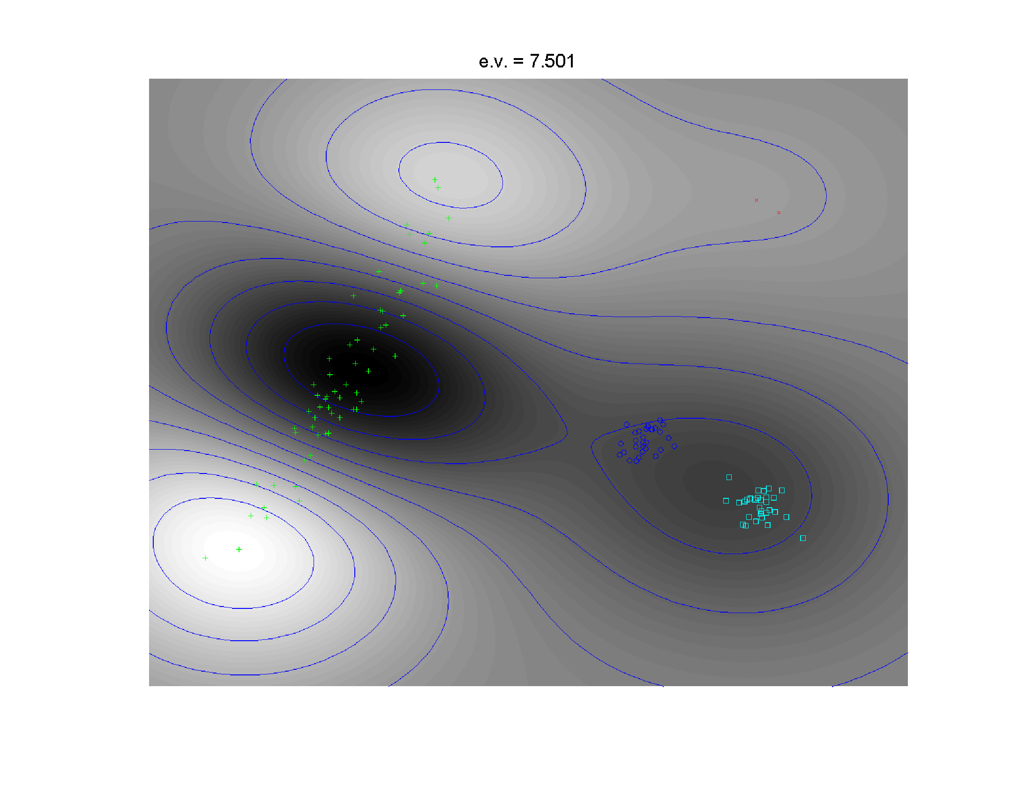
Kernel PCA
4th Component
Higher
Harmonic
Of Greens

Slide 43
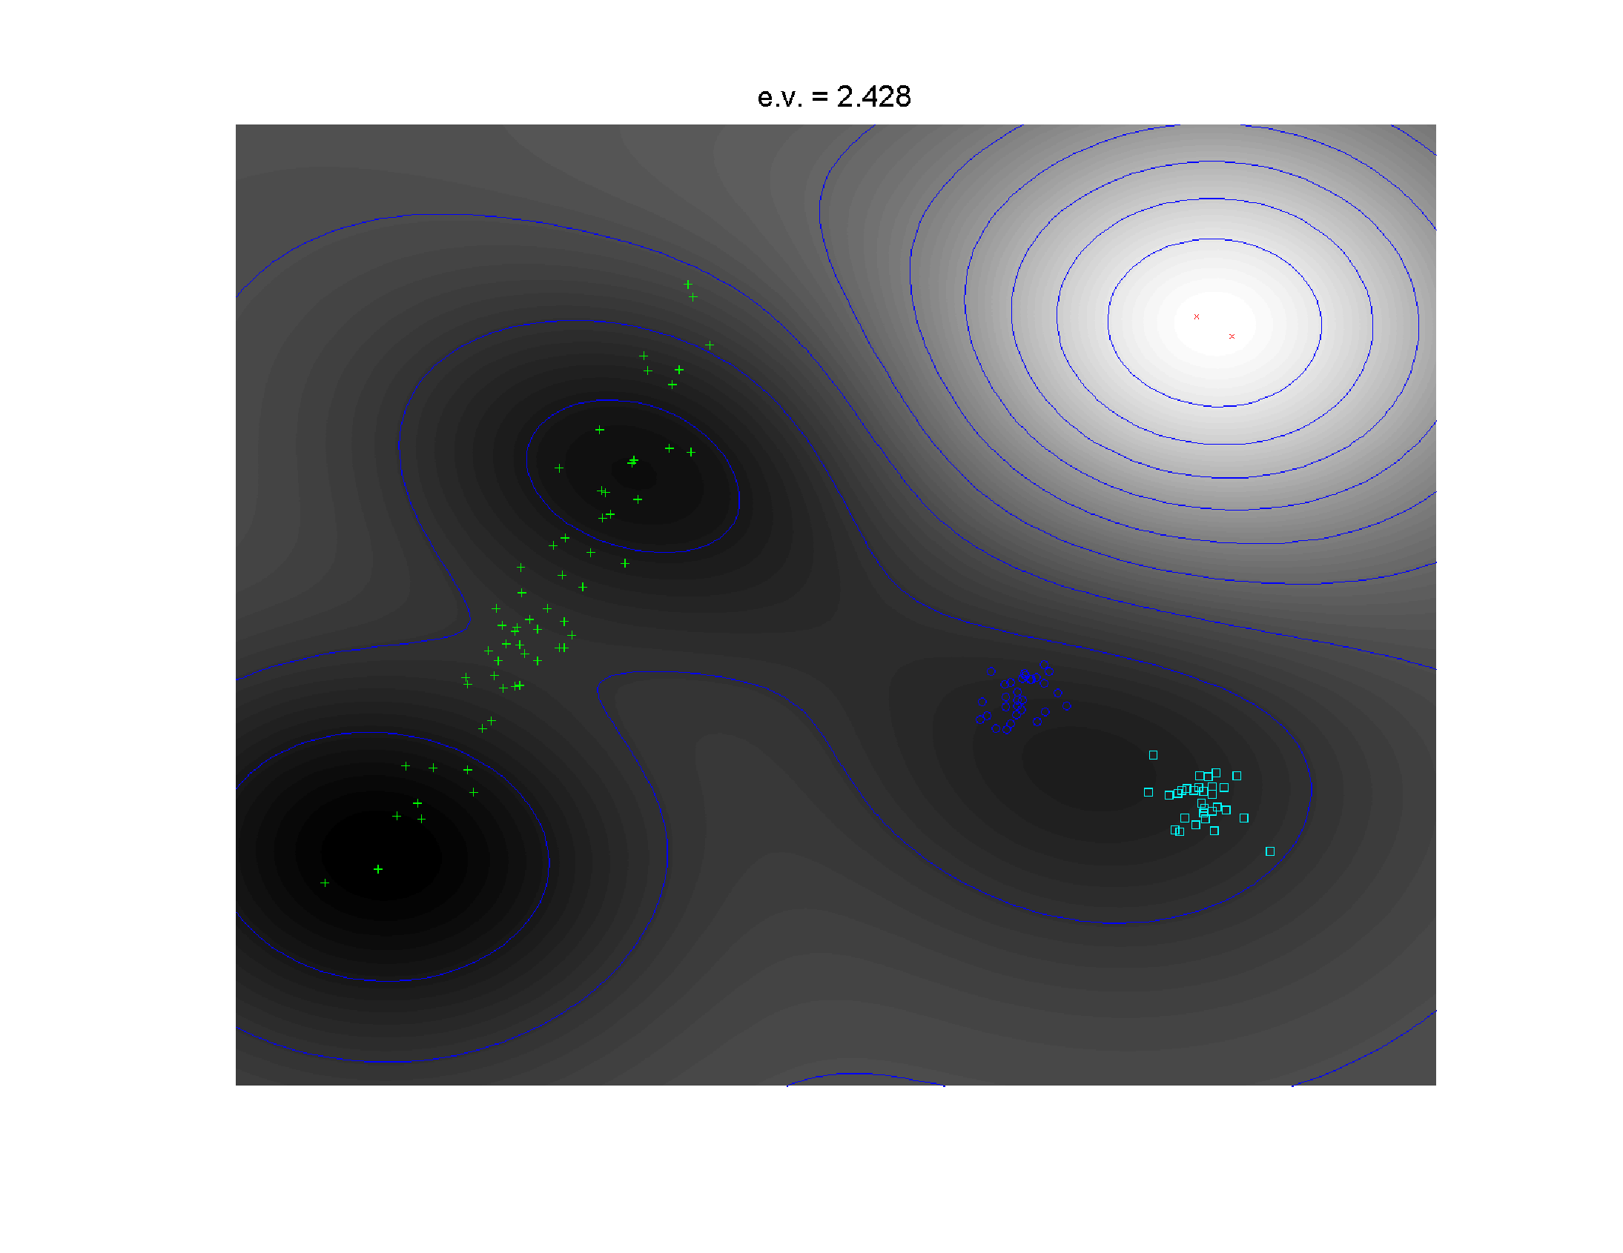
Kernel PCA
5th Component
Finally Find
Outliers

Slide 44
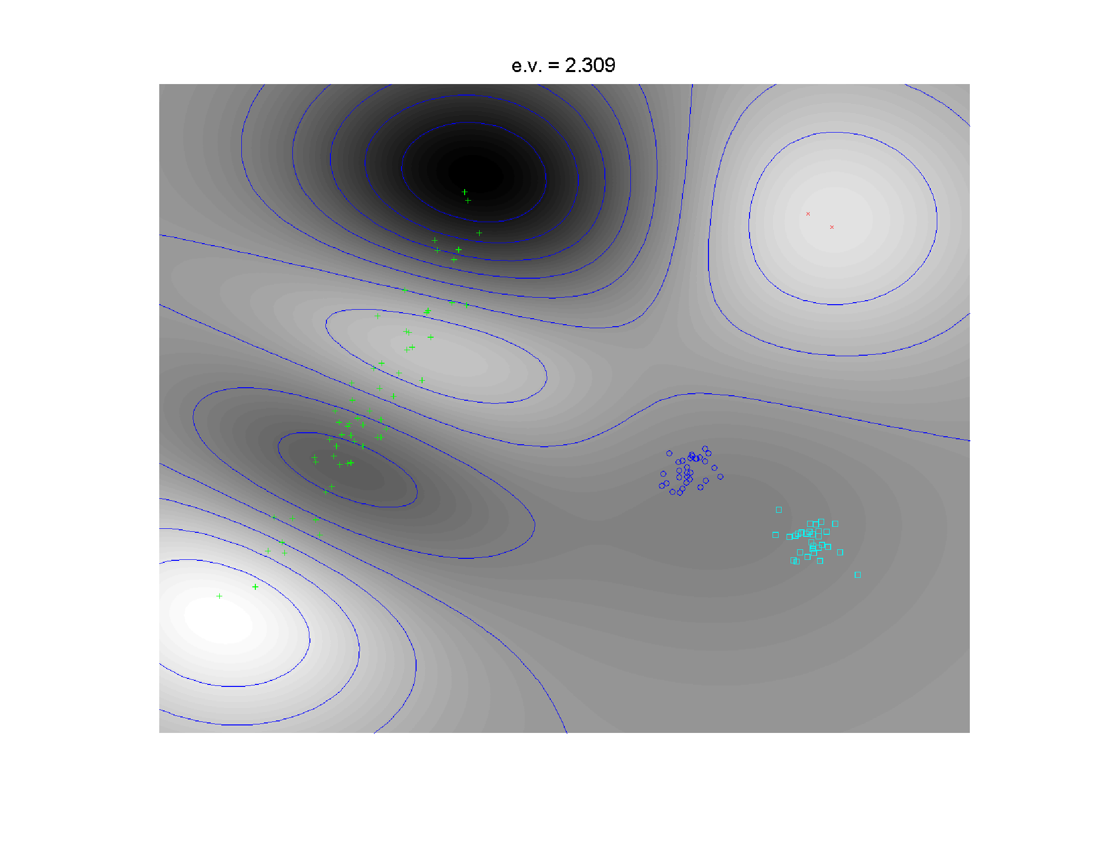
Kernel PCA
6th Component
Even Higher
Harmonic
Of Greens

Slide 45
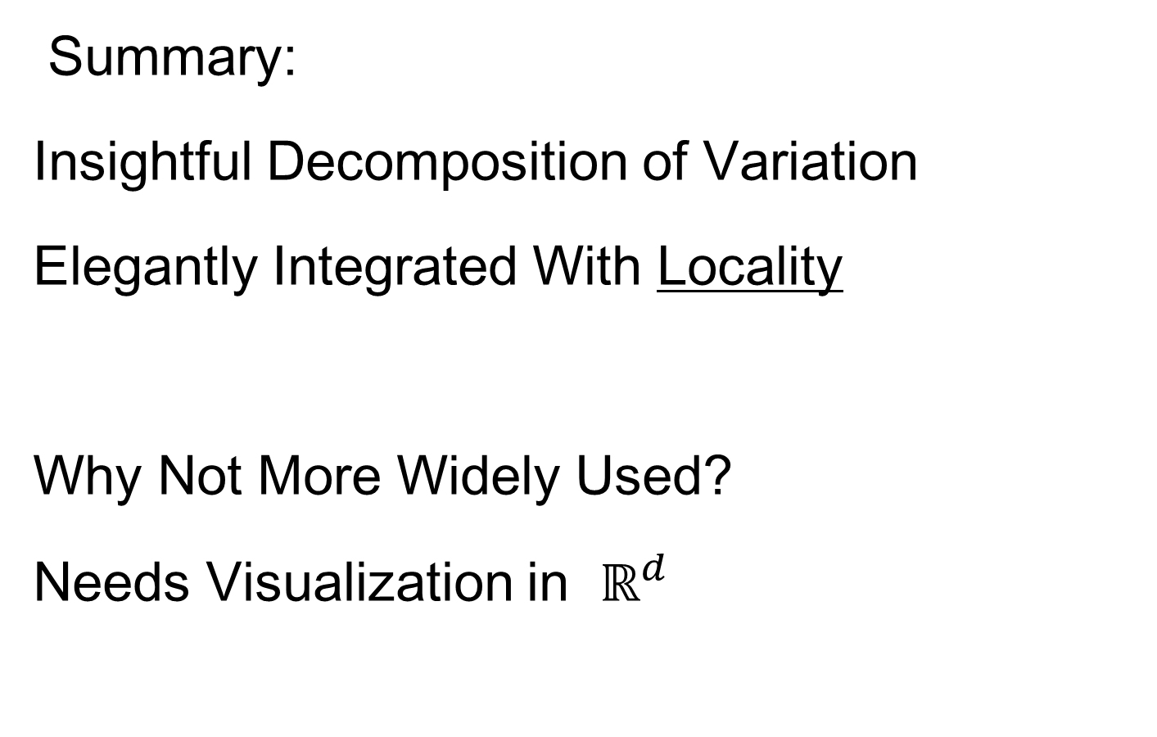
Kernel PCA
Summary:
Insightful Decomposition of Variation
Elegantly Integrated With Locality
Why Not More Widely Used?
Needs Visualization in $ℝ^{d}$

Slide 46
Kernel PCA
Caution:
Results Depend on Window Width
(will study later)

Slide 47

Kernel PCA
Why Not More Widely Used?
Needs Visualization in $ℝ^{d}$

Slide 48
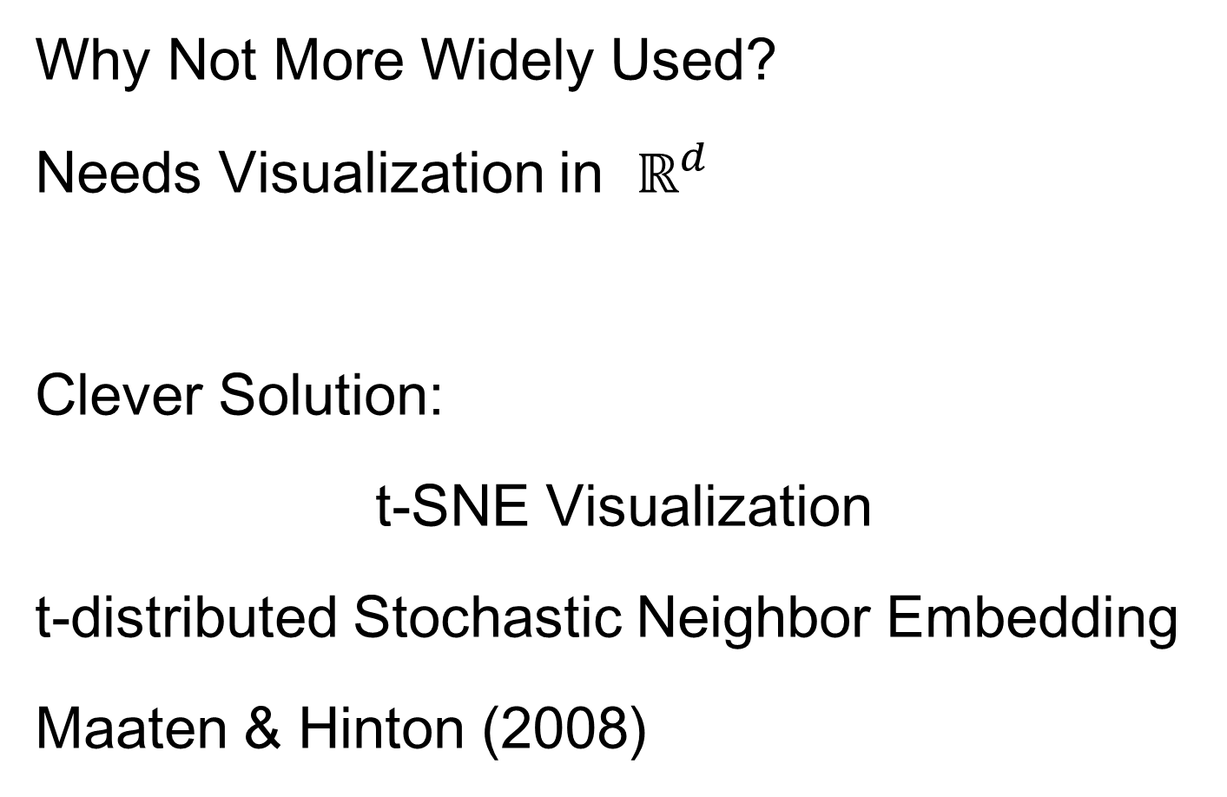
Kernel PCA
Why Not More Widely Used?
Needs Visualization in $ℝ^{d}$
Clever Solution:
t-SNE Visualization
t-distributed Stochastic Neighbor Embedding
Maaten & Hinton (2008)

Slide 49
t-SNE Visualization
Main Idea:
Data
Kernel Space
MDS Type Representers
Induces Kernel
PCA Type Locality
Gaussian Kernel
Transformation
Cauchy Kernel
Transformation
Pushes Away
Farther Points
Optimization: Make
Close As Possible

Slide 50
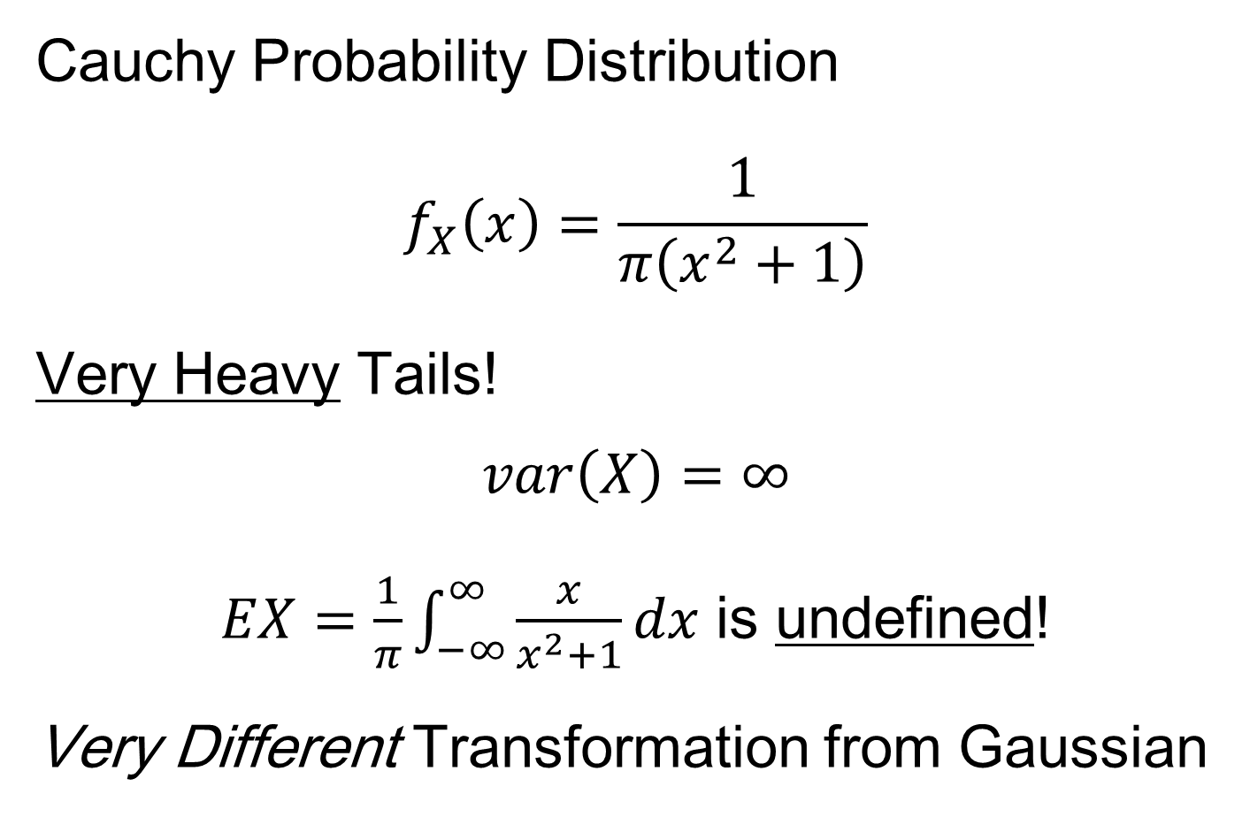
t-SNE Visualization
Cauchy Probability Distribution
$$f_{X}\left(x\right)=\frac{1}{π\left(x^{2}+1\right)}$$
Very Heavy Tails!
$$var\left(X\right)=∞$$
$EX=\frac{1}{π}\int_{−∞}^{∞}{\frac{x}{x^{2}+1}dx}$ is undefined!
Very Different Transformation from Gaussian
Also “Student’s t
Distribution with 1
degree of freedom”
Hence the Name
So No Central Limit
Theorem Or Even
Law of Large Numbers

Slide 51
t-SNE Visualization
Tuning Parameter: “Perplexity”
Roughly a Smoothing Parameter
~ Nearest Neighbor Type
(So Bigger In Sparser Regions)

Slide 52

t-SNE Visualization
Same Toy $ℝ^{2}$ Example
4(?) Quite
Diverse
Clusters

Slide 53
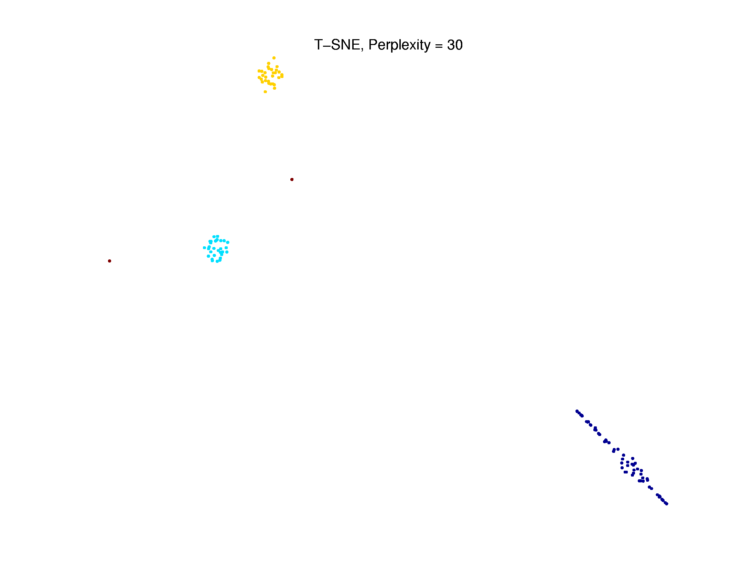
t-SNE Visualization
Perplexity = 30 (Default)
Keeps Local
Structure
But Global
Rearangement
And Outlier
Cluster is Split

Slide 54
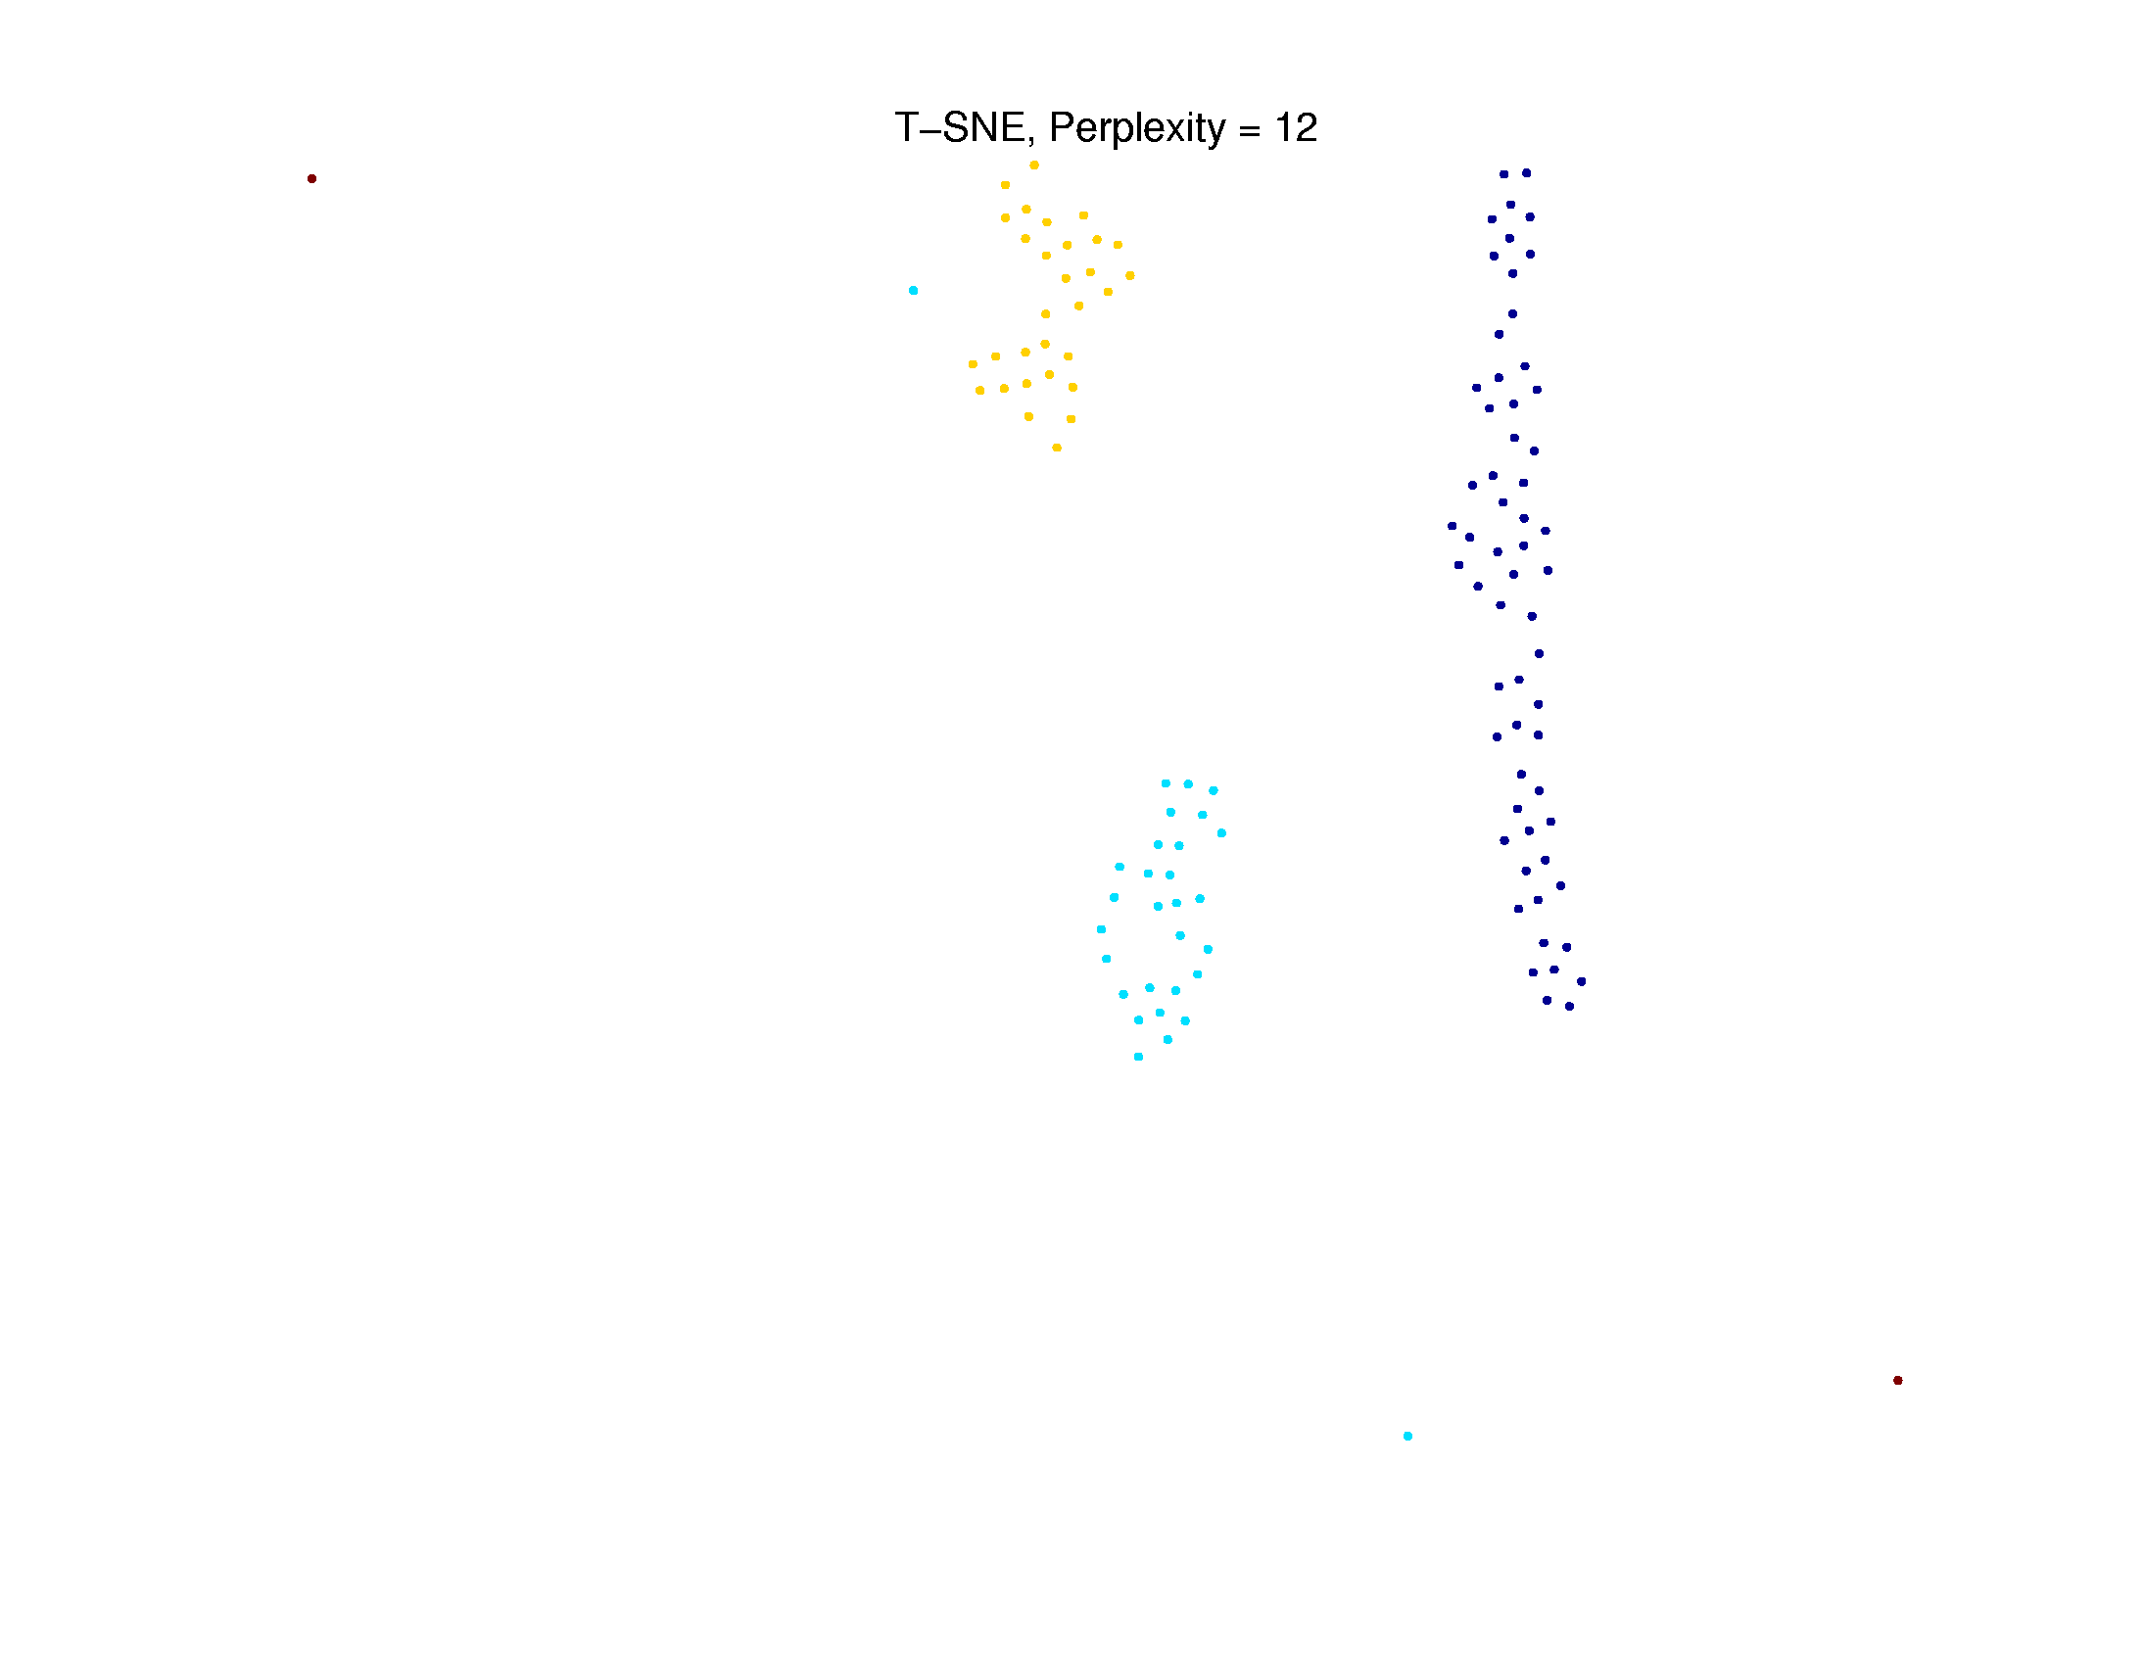
t-SNE Visualization
Perplexity = 12 (Small ?)
Structure
Added to
Clusters?
Outliers Even
More Split
One Stray Point

Slide 55
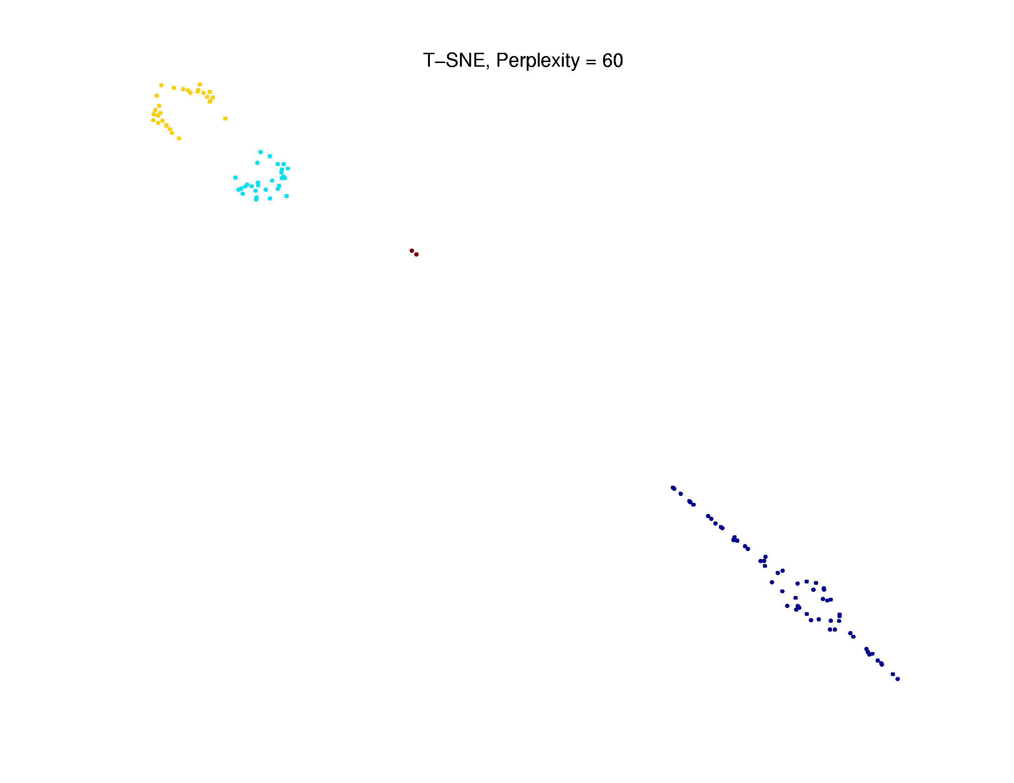
t-SNE Visualization
Perplexity = 60 (Big ?)
Gets 2 Outliers
But Adds
Spurious
Structure

Slide 56
Kernel Embedding
T Distribution With 1
Degree of Freedom
Summary of This Variation:
t-SNE Cluster Visualization
(t distributed Stochastic Neighbor Embedding)
Maaten & Hinton (2008)
Idea: Gaussian Kernel PCA (Front End)
“Inverted” with Cauchy Kernel PCA
As With MDS: Find “Representers”
Heavy Tails of
Cauchy “Pulls
Apart” Clusters

Slide 57
Kernel Embedding
Another Variation:
“Generalized Principal Components Analysis”
Ref: Vidal et al (2016)
Main Idea:
Find “Interesting Subsets” Using PCA
Recompute PCA Visualization There
(Sometimes Called “Drill Down”)
A Common
Visualization
Approach
Automated
& Formalized
Here, Using
Optimization

Slide 58
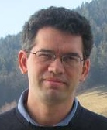
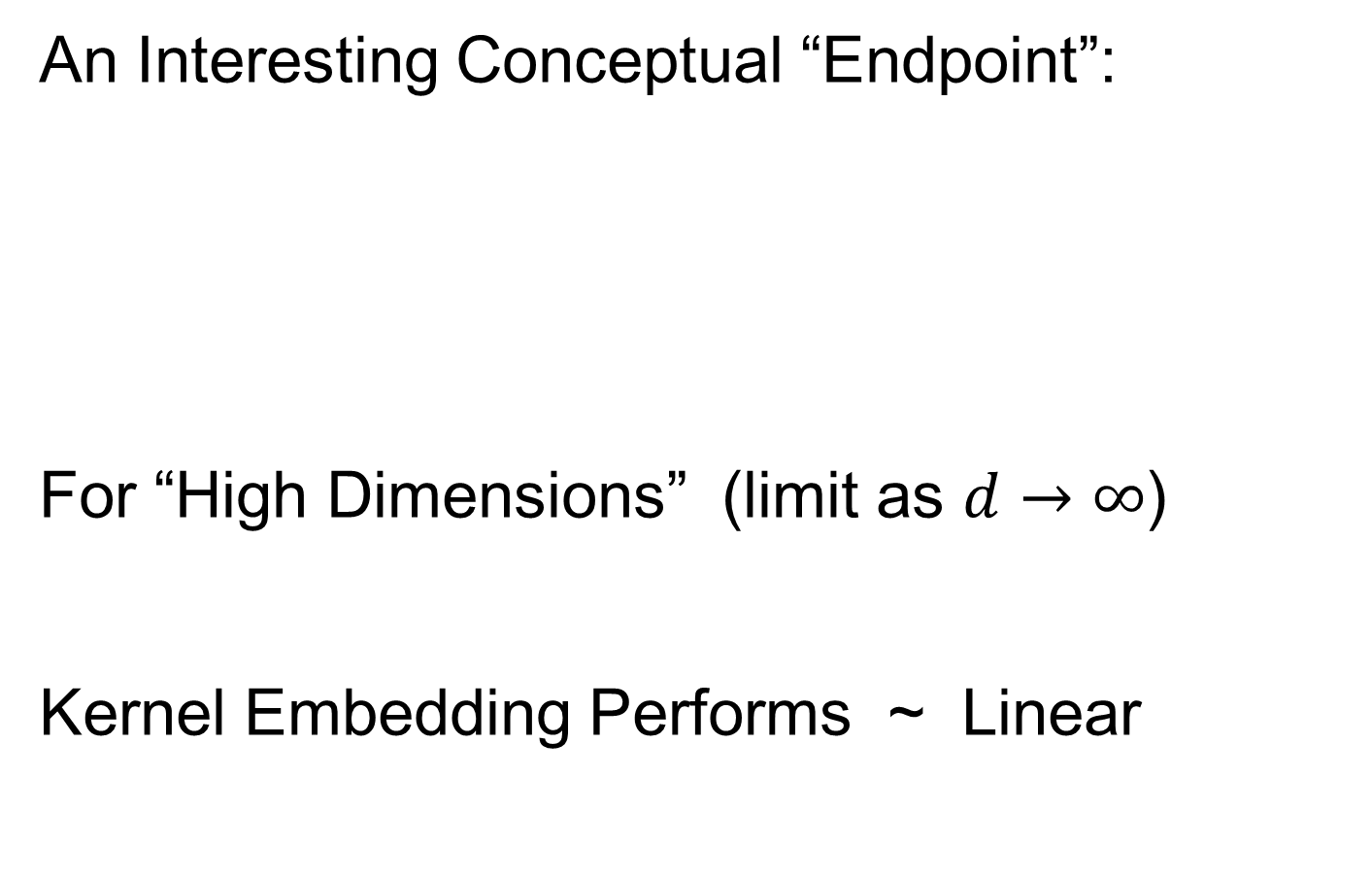
Kernel Embedding
An Interesting Conceptual “Endpoint”:
For “High Dimensions” (limit as $d→∞$)
Kernel Embedding Performs ~ Linear
El Karoui (2010)

Slide 59
Support Vector Machines
Motivation:
Find a linear method that “works well”
for embedded data
Note: Embedded data are
very non-Gaussian
Classical Statistics: “Use Prob. Dist’n”
Looks Hopeless
Not Even
Absolutely
Continuous
With Respect
To Lebesgue
Measure

Slide 60
Support Vector Machines
Motivation:
Find a linear method that “works well”
for embedded data
Note: Embedded data are
very non-Gaussian
Suggests value of
really new approach

Slide 61
Support Vector Machines
Classical References:
Vapnik (1982)
Boser, Guyon & Vapnik (1992)
Vapnik (1995)

Slide 62
Support Vector Machines
Recommended tutorial:
Burges (1998)
Early Monographs:
Cristianini & Shawe-Taylor (2000)
Schölkopf & Smola (2002)
More Recent Monographs:
Hastie et al (2001, 2005)
Bishop (2006)

Slide 63

Support Vector Machines
Graphical View, using Toy Example:

Slide 64
Support Vector Machines
Graphical View, using Toy Example:
Find separating plane
To maximize distances from data to plane

Slide 65

Support Vector Machines
Graphical View, using Toy Example:

Slide 66

Support Vector Machines
Graphical View, using Toy Example:

Slide 67
Support Vector Machines
Graphical View, using Toy Example:
Find separating plane
To maximize distances from data to plane
In particular smallest distance

Slide 68

Support Vector Machines
Graphical View, using Toy Example:

Slide 69
Support Vector Machines
Graphical View, using Toy Example:
Find separating plane
To maximize distances from data to plane
In particular smallest distance
Data points closest are called
support vectors
Gap between is called margin
Caution: For some “margin” is different

Slide 70
SVMs, Optimization Viewpoint
Formulate Optimization problem, based on:
Data (feature) vectors $x_{1},⋯,x_{n}$
Class Labels $y_{i}=±1$
Normal Vector $w$
Location (determines intercept) $b$
Residuals (right side) $r_{i}=y_{i}\left({x_{i}}^{t}w+b\right)$
Residuals (wrong side) $ξ_{i}=−r_{i}$
Solve (convex problem) by quadratic programming

Slide 71


SVMs, Optimization Viewpoint
Lagrange Multipliers primal formulation (separable case):
Minimize:
$L_{P}\left(w,b,α\right)=\frac{1}{2}{\left\|w\right\|}^{2}−\sum_{i=1}^{n}{α_{i}}\left(y_{i}\left(x_{i}∙w+b\right)−1\right)$
Where $α_{1},⋯,α_{n}$ are Lagrange multipliers
Notation: “dot product” = inner product
Elsewhere: $u∙v= \left\langle u,v\right\rangle =u^{t}v$

Slide 72

SVMs, Optimization Viewpoint
Lagrange Multipliers primal formulation (separable case):
Minimize:
$L_{P}\left(w,b,α\right)=\frac{1}{2}{\left\|w\right\|}^{2}−\sum_{i=1}^{n}{α_{i}}\left(y_{i}\left(x_{i}∙w+b\right)−1\right)$
Where $α_{1},⋯,α_{n}$ are Lagrange multipliers
Dual Lagrangian version:
Maximize: $L_{D}=\sum_{i}{α_{i}}−\frac{1}{2}\sum_{i,j}{α_{i}α_{j}y_{i}}y_{j}x_{i}∙x_{j}$
Get classification function:
$f\left(x\right)=\sum_{i=1}^{n}{α_{i}y_{i}x∙x_{i}+b}$

Slide 73


SVMs, Optimization Viewpoint
Get classification function:
$$f\left(x\right)=\sum_{i=1}^{n}{α_{i}y_{i}x∙x_{i}+b}$$
Choose Class:
+1, when $f\left(x\right)>0$
-1, when $f\left(x\right)<0$
Note: linear function of $x$
i.e. have found separating hyperplane

Slide 74

SVMs, Computation
Major Computational Point:
Classifier only depends on data through inner products!
$$f\left(x\right)=\sum_{i=1}^{n}{α_{i}y_{i}x∙x_{i}+b}$$

Slide 75
SVMs, Computation
Major Computational Point:
Classifier only depends on data through inner products!
Thus enough to only store inner products
Creates big savings in optimization
Especially for HDLSS data
But also creates variations in kernel embedding (interpretation?!?)
This is almost always done in practice

Slide 76


SVMs, Comput’n & Embedding
For an “Embedding Map”, $Φ\left(x\right)$
e.g.
Explicit Embedding:
Maximize:
$$L_{D}=\sum_{i}{α_{i}}−\frac{1}{2}\sum_{i,j}{α_{i}α_{j}y_{i}}y_{j}Φ\left(x_{i}\right)∙Φ\left(x_{j}\right)$$
Get classification function:
$$f\left(x\right)=\sum_{i=1}^{n}{α_{i}y_{i}Φ\left(x\right)∙Φ\left(x_{i}\right)+b}$$
Straightforward application of embedding
But loses inner product advantage
$$Φ\left(x\right)=\left(\begin{matrix}x \\ x^{2}\end{matrix}\right)$$

Slide 77

SVMs, Comput’n & Embedding
Implicit Embedding:
Maximize:
$$L_{D}=\sum_{i}{α_{i}}−\frac{1}{2}\sum_{i,j}{α_{i}α_{j}y_{i}}y_{j}Φ\left(x_{i}∙x_{j}\right)$$

Slide 78

SVMs, Comput’n & Embedding
Implicit Embedding:
Maximize:
$$L_{D}=\sum_{i}{α_{i}}−\frac{1}{2}\sum_{i,j}{α_{i}α_{j}y_{i}}y_{j}Φ\left(x_{i}∙x_{j}\right)$$
Note Difference from Explicit Embedding:
$$L_{D}=\sum_{i}{α_{i}}−\frac{1}{2}\sum_{i,j}{α_{i}α_{j}y_{i}}y_{j}Φ\left(x_{i}\right)∙Φ\left(x_{j}\right)$$

Slide 79

SVMs, Comput’n & Embedding
Implicit Embedding:
Maximize:
$$L_{D}=\sum_{i}{α_{i}}−\frac{1}{2}\sum_{i,j}{α_{i}α_{j}y_{i}}y_{j}Φ\left(x_{i}∙x_{j}\right)$$
Get classification function:
$$f\left(x\right)=\sum_{i=1}^{n}{α_{i}y_{i}Φ\left(x∙x_{i}\right)+b}$$
Still defined only via inner products
Retains optimization advantage
Thus used very commonly
Comparison to explicit embedding?
Which is “better”???

Slide 80
SVMs, Comput’n & Embedding
Implicit vs. Explicit Embedding:
Still defined only via inner products
Retains optimization advantage
Thus used very commonly
Comparison to explicit embedding?
Which is “better”???
Explored in Schölkopf & Smola (2002)
Via Mercer’s Theorem

Slide 81
SVMs & Robustness
Usually not severely affected by outliers,
But a possible weakness:
Can have very influential points
Toy E.g., only 2 points drive SVM

Slide 82

SVMs & Robustness
Can have very influential points

Slide 83
SVMs & Robustness
Usually not severely affected by outliers,
But a possible weakness:
Can have very influential points
Toy E.g., only 2 points drive SVM
Notes:
Huge range of chosen hyperplanes
But all are “pretty good discriminators”
Only happens when whole range is OK???
Good or bad?

Slide 84

SVMs & Robustness
Effect of violators:

Slide 85

SVMs, Tuning Parameter
Recall Regularization Parameter C:
Controls penalty for violation
I.e. lying on wrong side of plane
Appears in slack variables
Affects performance of SVM
Study Toy Example:
$d=50$, Spherical Gaussian data

Slide 86


SVMs, Tuning Parameter
Toy Example: $d=50$, Sph’l Gaussian data

Slide 87

SVMs, Tuning Parameter
Toy Example: $d=50$, Sph’l Gaussian data
For Large Values of C
Lots of Data Piling
Large Angle to Optimal
Thus Less Generalizable
(For This Data Set)
Called Hard Margin SVM

Slide 88
Participant Presentation
Alexander Murph:
Visual Disturbances
Haodong Wang:
Comparing t-SNE and UMAP
for visualizing scRNA-seq data

