Slide 1
Participant Presentations
Please Send Title:
Seoyoon Cho
Sumit Kar
Jose Sanchez
Yue Pan
David Bang
Dhruv Patel
Wei Gu
Bohan Li
Siqi Xiang
Nicolas Wolczynski
Mingyi Wang

Slide 2
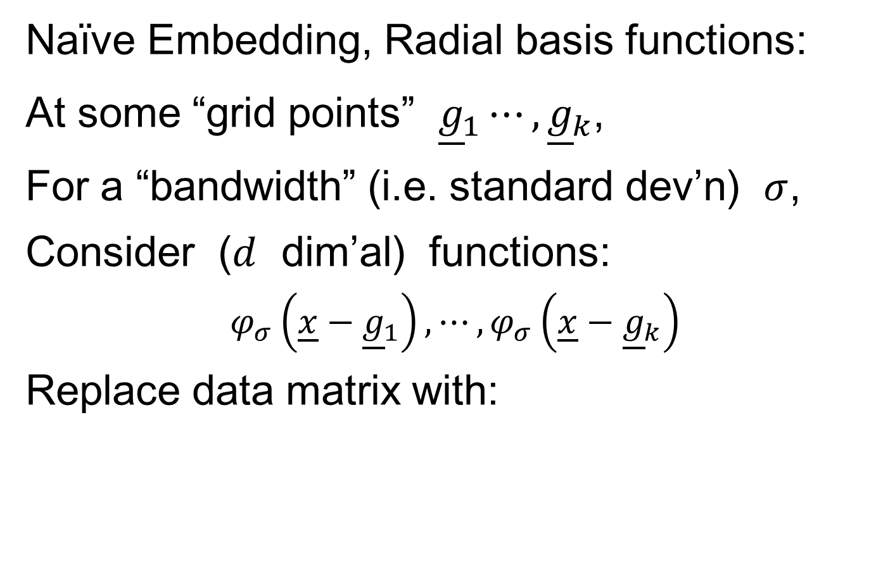
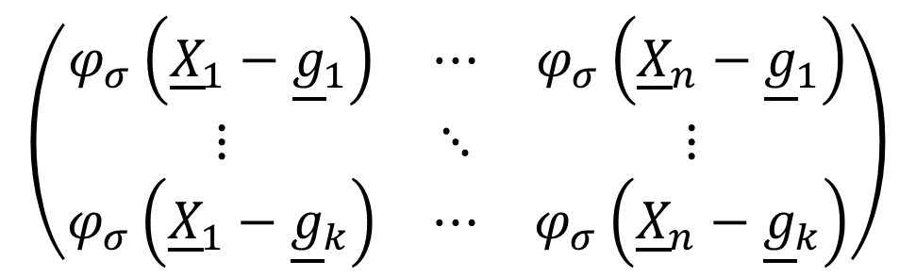
Kernel Embedding
Naïve Embedding, Radial basis functions:
At some “grid points” ${\underline{g}}_{1}⋯,{\underline{g}}_{k}$,
For a “bandwidth” (i.e. standard dev’n) $σ$,
Consider ($d$ dim’al) functions:
$$φ_{σ}\left(\underline{x}−{\underline{g}}_{1}\right),⋯,φ_{σ}\left(\underline{x}−{\underline{g}}_{k}\right)$$
Replace data matrix with:
$$\left(\begin{matrix}φ_{σ}\left({\underline{X}}_{1}−{\underline{g}}_{1}\right) & ⋯ & φ_{σ}\left({\underline{X}}_{n}−{\underline{g}}_{1}\right) \\ ⋮ & ⋱ & ⋮ \\ φ_{σ}\left({\underline{X}}_{1}−{\underline{g}}_{k}\right) & ⋯ & φ_{σ}\left({\underline{X}}_{n}−{\underline{g}}_{k}\right)\end{matrix}\right)$$

Slide 3
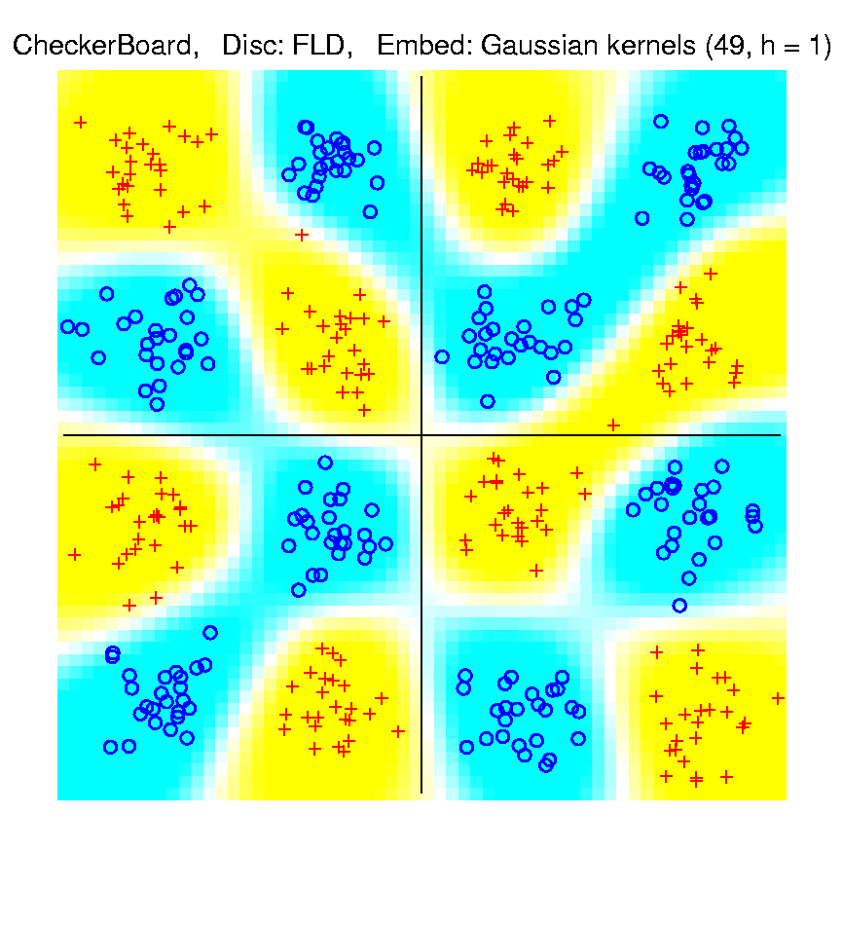
Kernel Embedding
Toy Example 4: Checkerboard
Radial
Basis
Embedding
+ FLD
Is
Excellent!
Notes:
PEod1Raw.ps

Slide 4
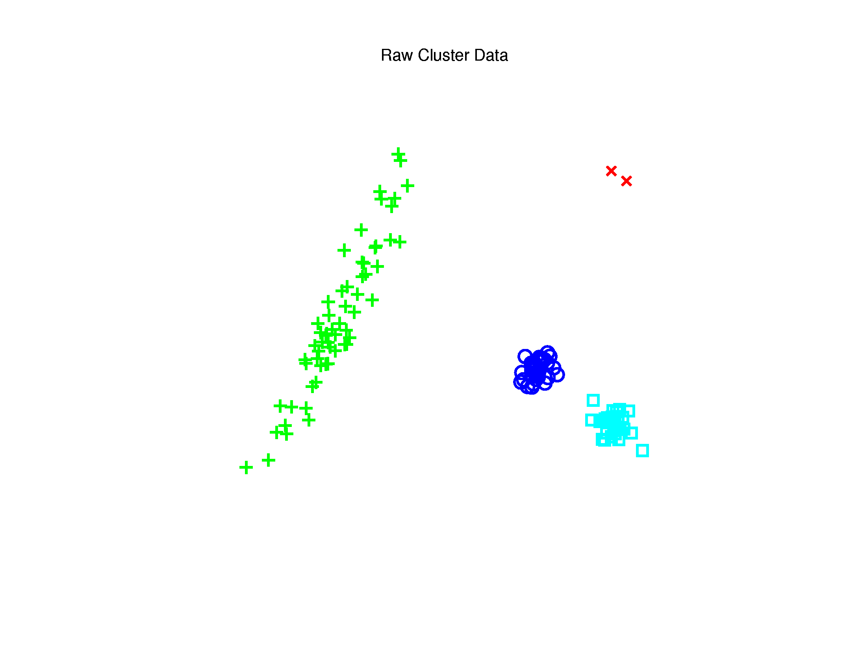

Kernel PCA
Toy $ℝ^{2}$ Example: Raw Data
Long Stretched
Cluster
Round Clusters
Outliers?
Small Cluster?

Slide 5
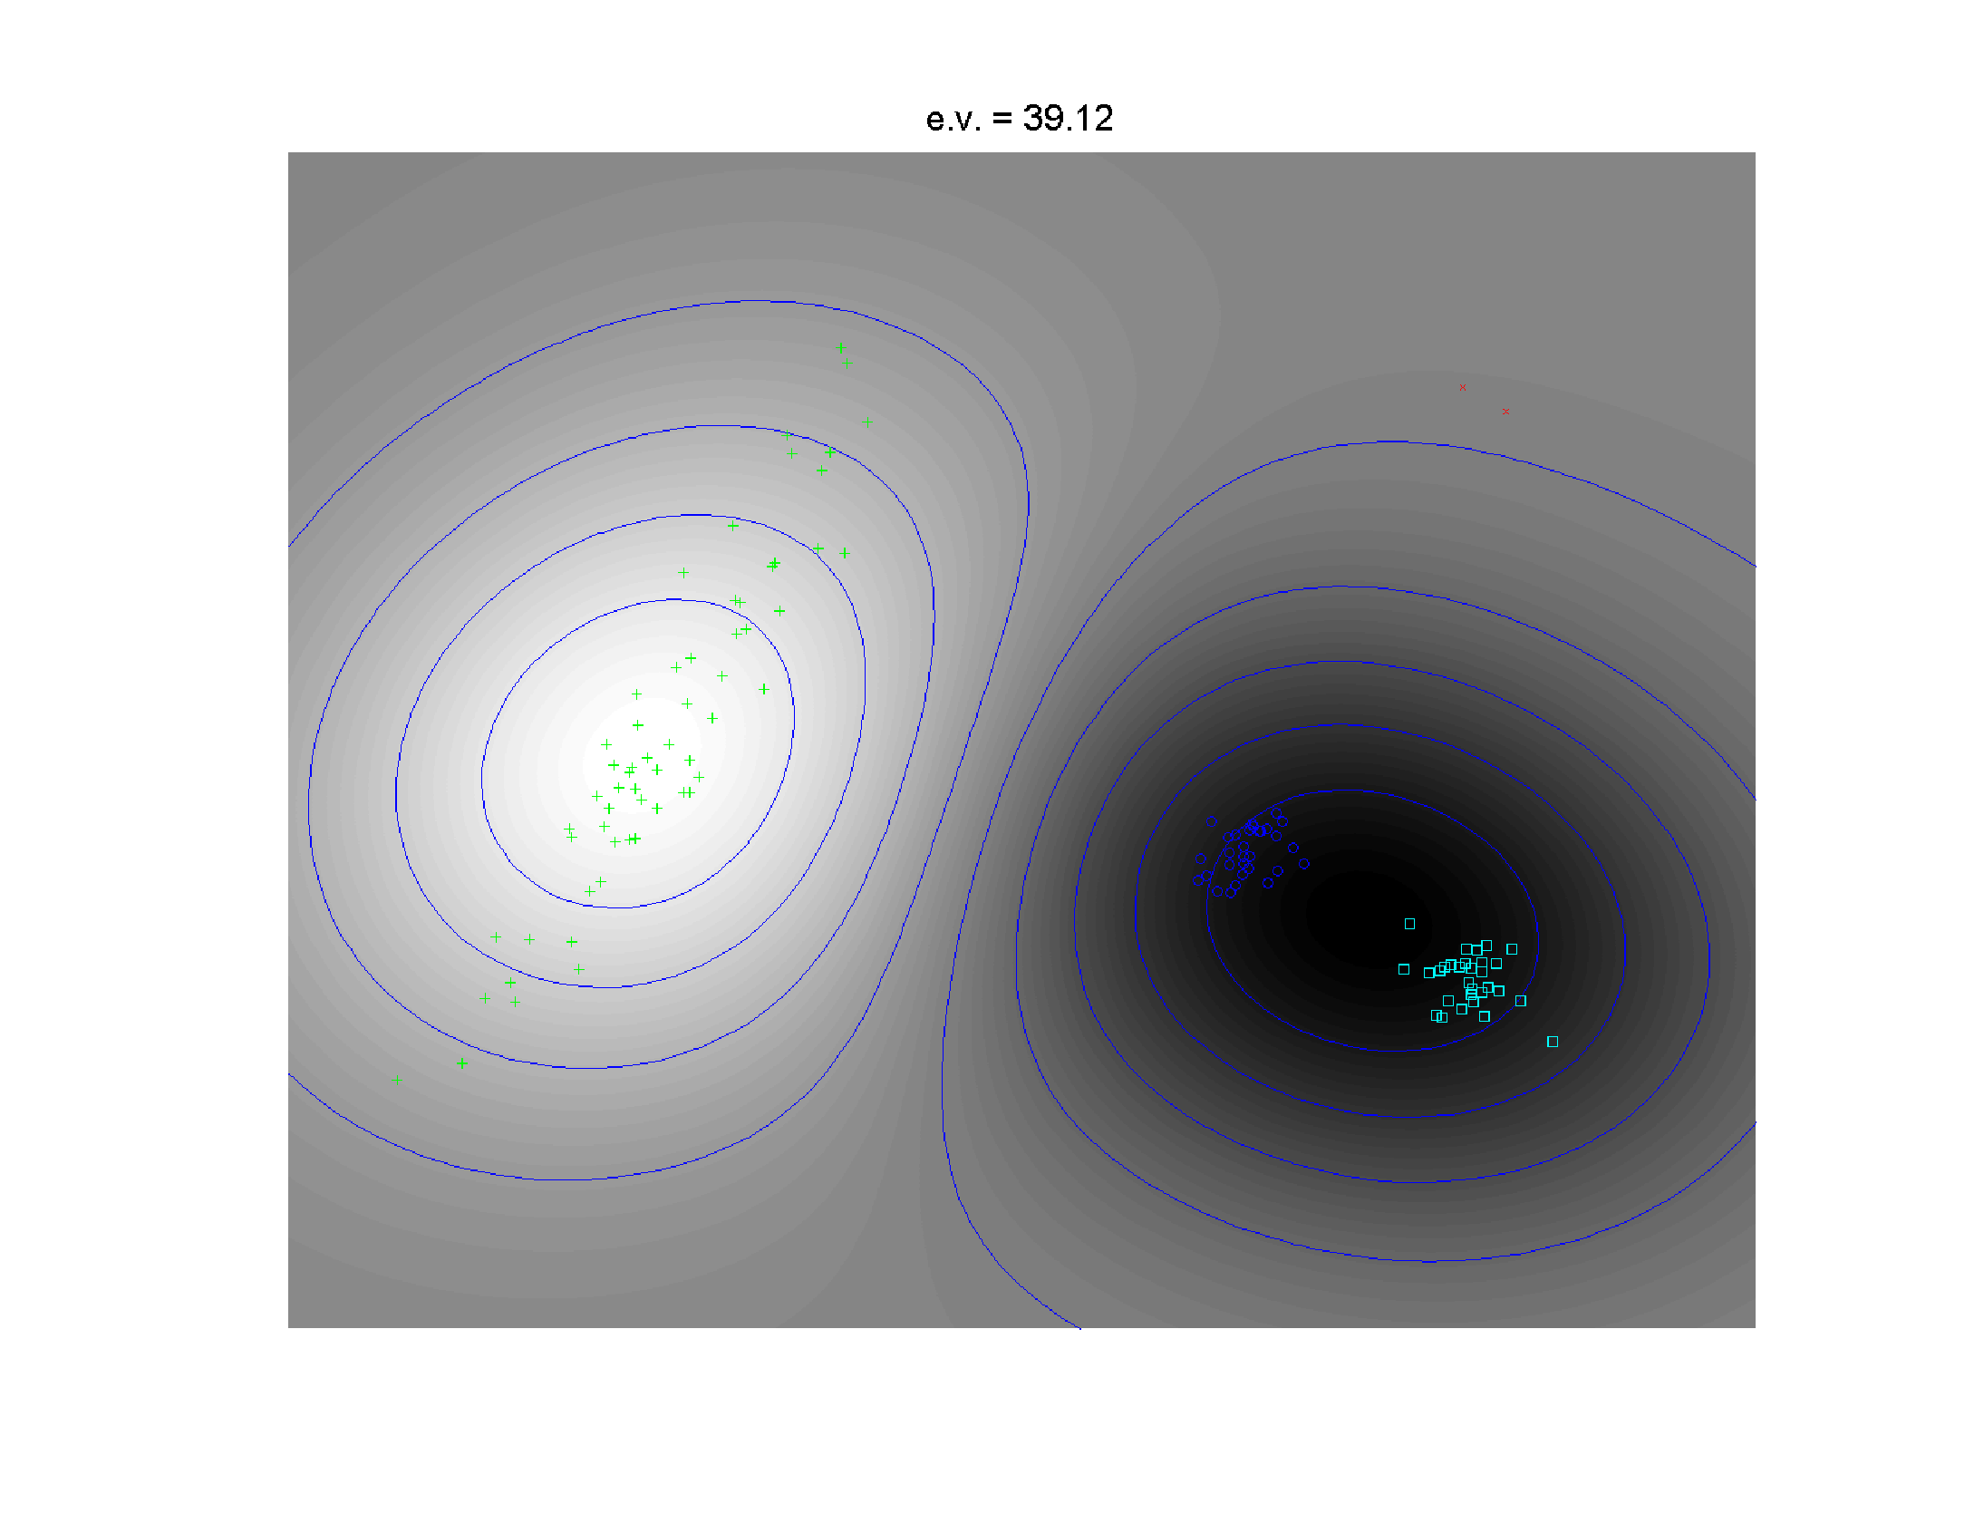
Kernel PCA
1st Component
Finds Coarse
Scale Green
vs. Blues

Slide 6
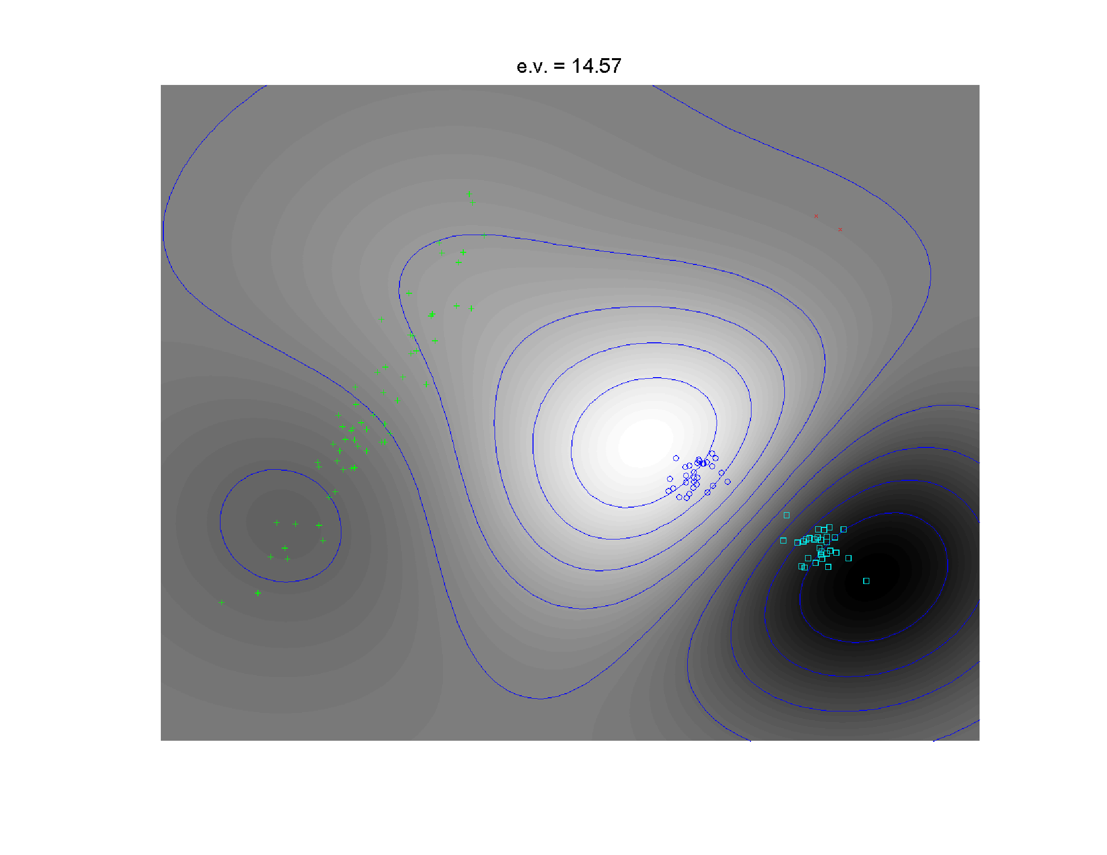
Kernel PCA
2nd Component
Separates
Blue & Cyan
Strong
Locality!

Slide 7
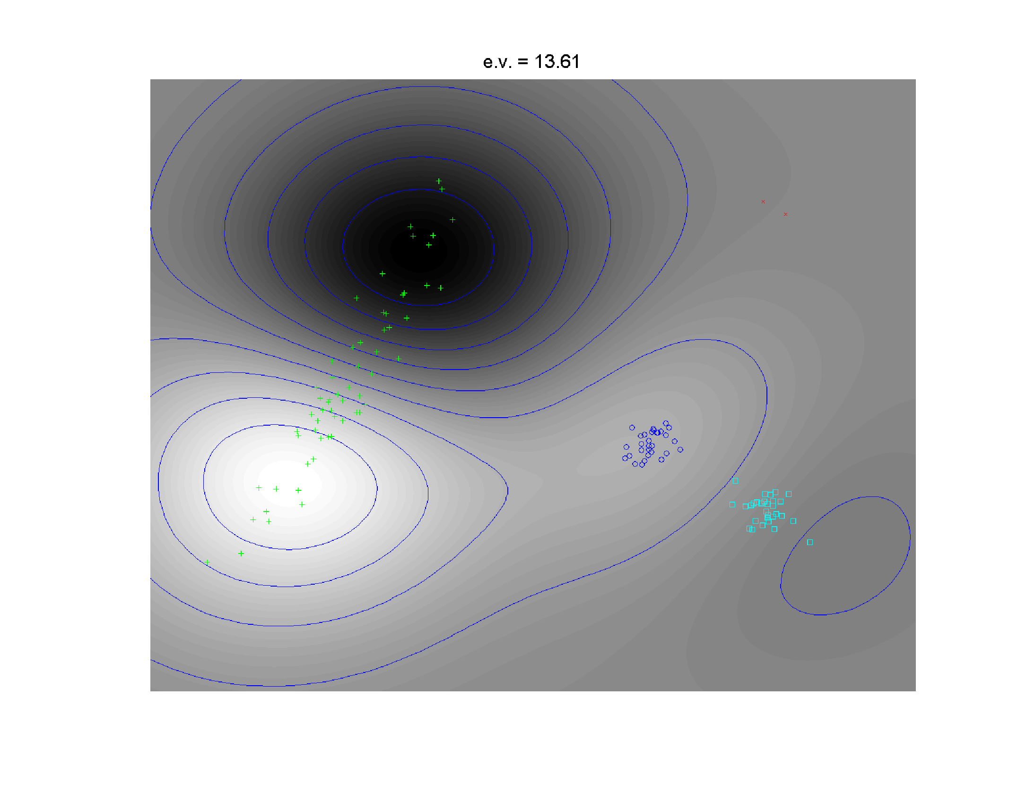
Kernel PCA
3rd Component
Splits
Greens

Slide 8
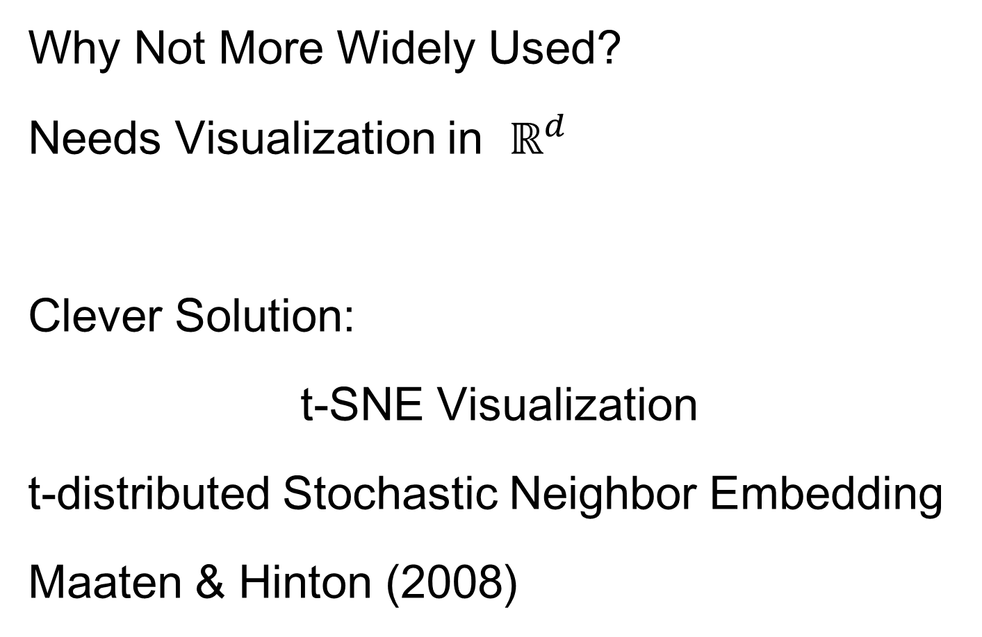
Kernel PCA
Why Not More Widely Used?
Needs Visualization in $ℝ^{d}$
Clever Solution:
t-SNE Visualization
t-distributed Stochastic Neighbor Embedding
Maaten & Hinton (2008)

Slide 9
t-SNE Visualization
Main Idea:
Data
Kernel Space
MDS Type Representers
Induces Kernel
PCA Type Locality
Gaussian Kernel
Transformation
Cauchy Kernel
Transformation
Pushes Away
Farther Points
Optimization: Make
Close As Possible

Slide 10

t-SNE Visualization
Same Toy $ℝ^{2}$ Example
4(?) Quite
Diverse
Clusters

Slide 11
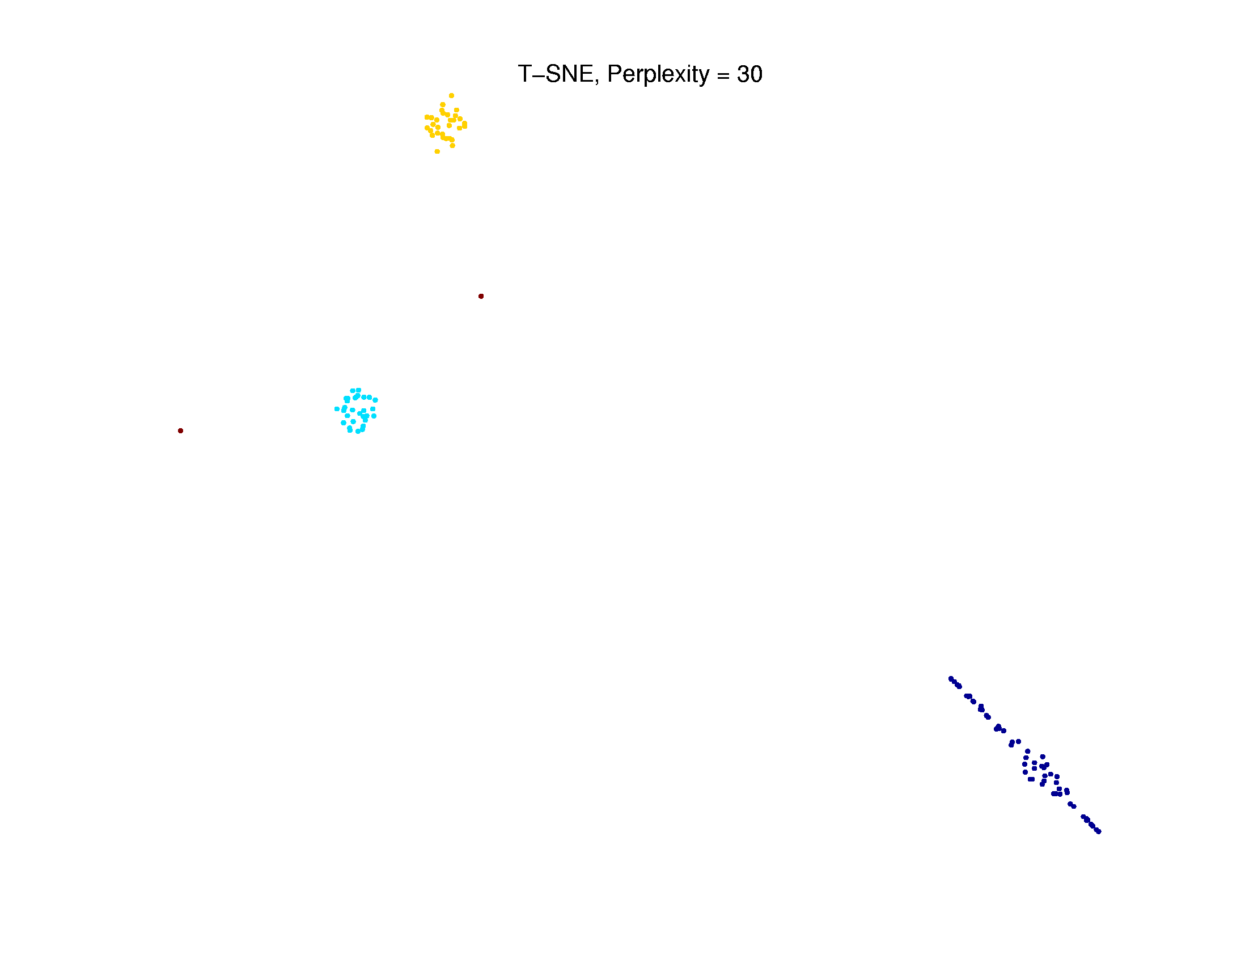
t-SNE Visualization
Perplexity = 30 (Default)
Keeps Local
Structure
But Global
Rearangement
And Outlier
Cluster is Split

Slide 12
Support Vector Machines
Motivation:
Find a linear method that “works well”
for embedded data
Note: Embedded data are
very non-Gaussian
Suggests value of
really new approach

Slide 13
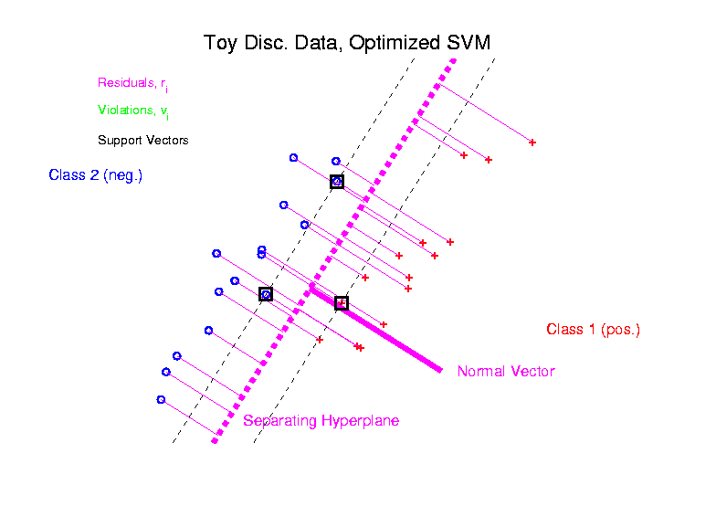
Support Vector Machines
Graphical View, using Toy Example:

Slide 14
Support Vector Machines
Graphical View, using Toy Example:
Find separating plane
To maximize distances from data to plane
In particular smallest distance
Data points closest are called
support vectors
Gap between is called margin
Caution: For some “margin” is different

Slide 15
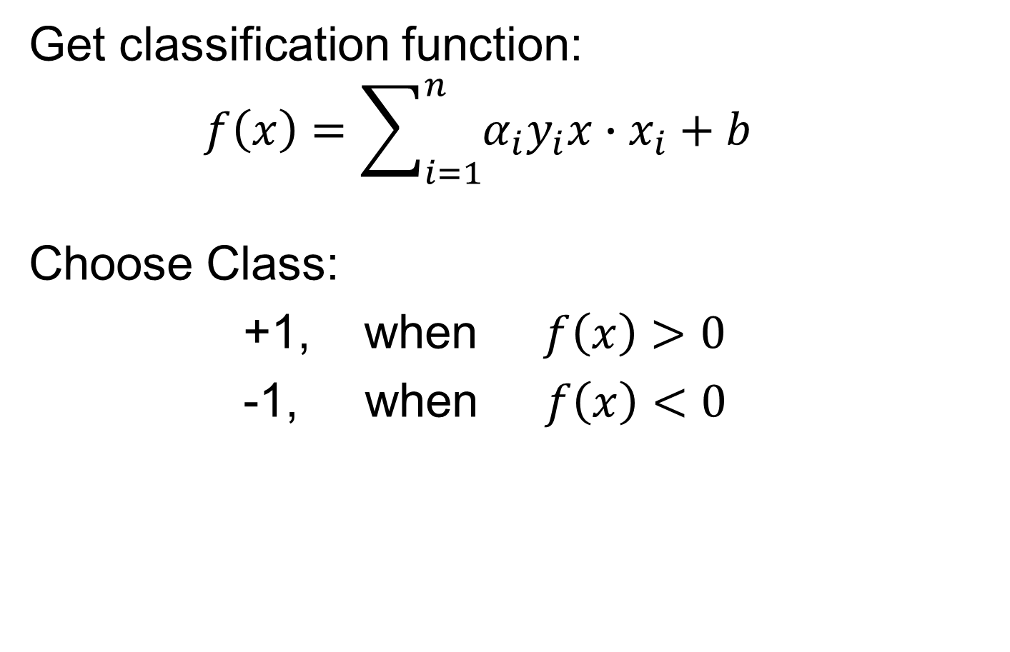

SVMs, Optimization Viewpoint
Get classification function:
$$f\left(x\right)=\sum_{i=1}^{n}{α_{i}y_{i}x∙x_{i}+b}$$
Choose Class:
+1, when $f\left(x\right)>0$
-1, when $f\left(x\right)<0$
Note: linear function of $x$
i.e. have found separating hyperplane

Slide 16
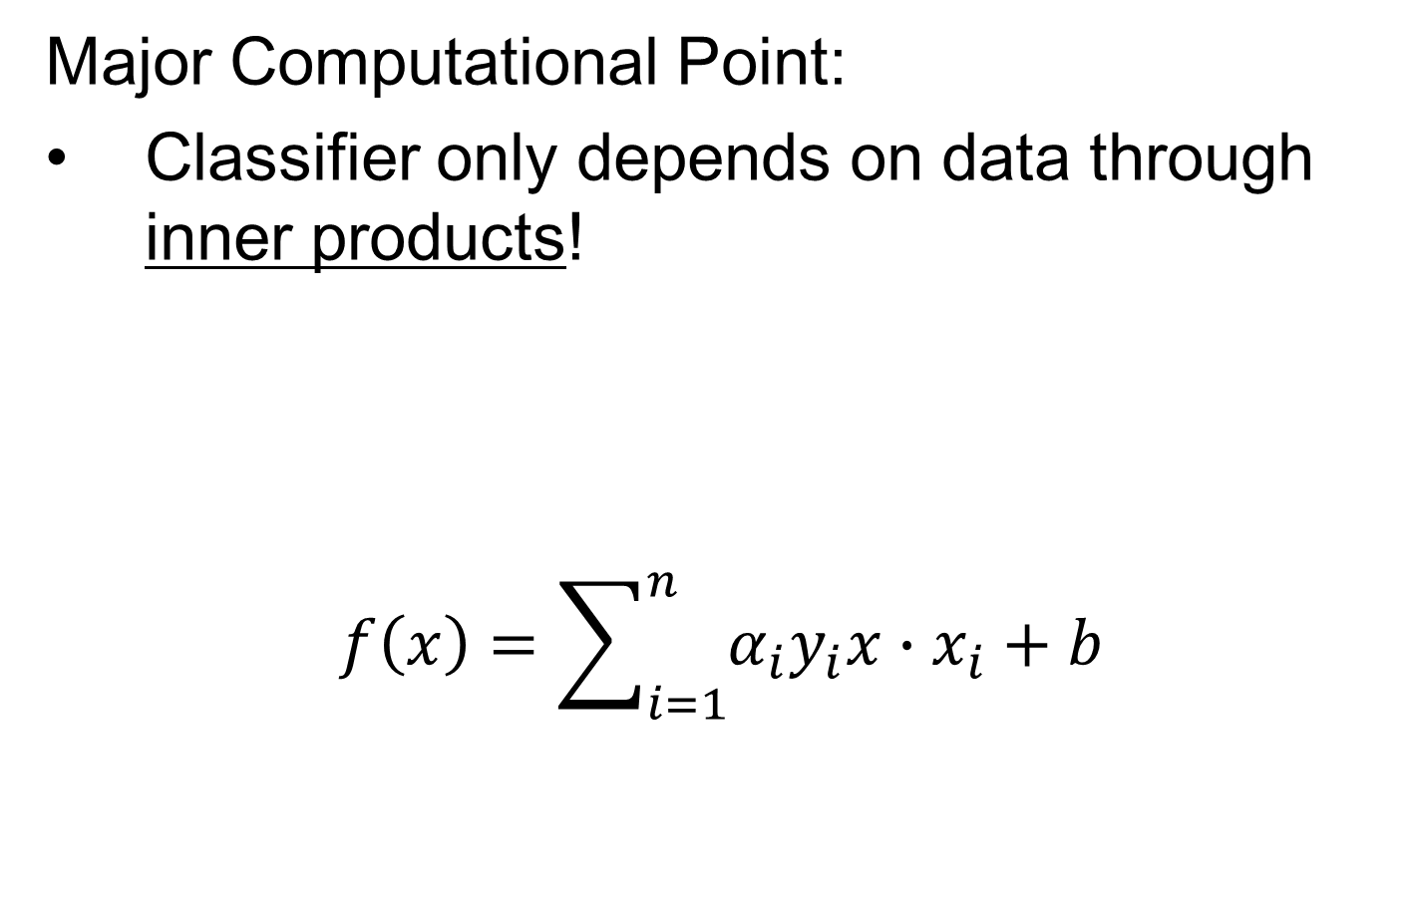
SVMs, Computation
Major Computational Point:
Classifier only depends on data through inner products!
$$f\left(x\right)=\sum_{i=1}^{n}{α_{i}y_{i}x∙x_{i}+b}$$

Slide 17
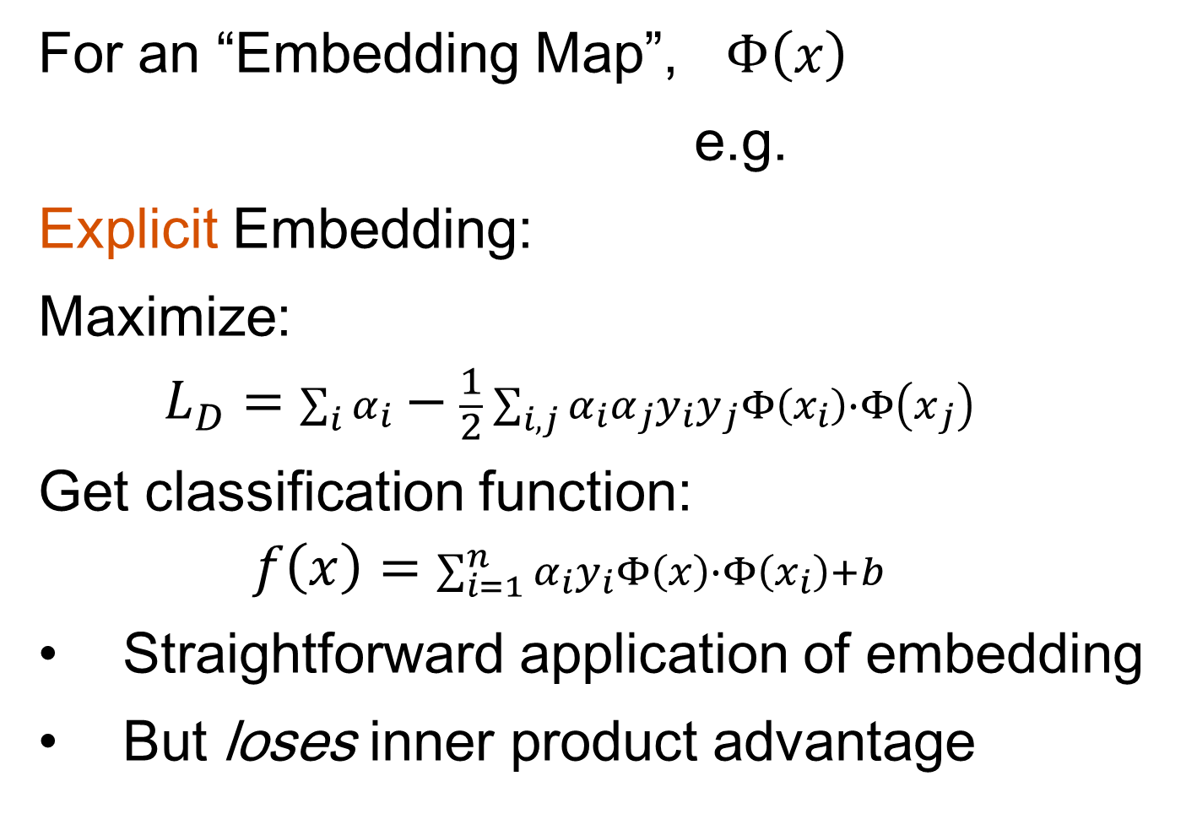
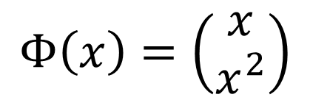
SVMs, Comput’n & Embedding
For an “Embedding Map”, $Φ\left(x\right)$
e.g.
Explicit Embedding:
Maximize:
$$L_{D}=\sum_{i}{α_{i}}−\frac{1}{2}\sum_{i,j}{α_{i}α_{j}y_{i}}y_{j}Φ\left(x_{i}\right)∙Φ\left(x_{j}\right)$$
Get classification function:
$$f\left(x\right)=\sum_{i=1}^{n}{α_{i}y_{i}Φ\left(x\right)∙Φ\left(x_{i}\right)+b}$$
Straightforward application of embedding
But loses inner product advantage
$$Φ\left(x\right)=\left(\begin{matrix}x \\ x^{2}\end{matrix}\right)$$

Slide 18
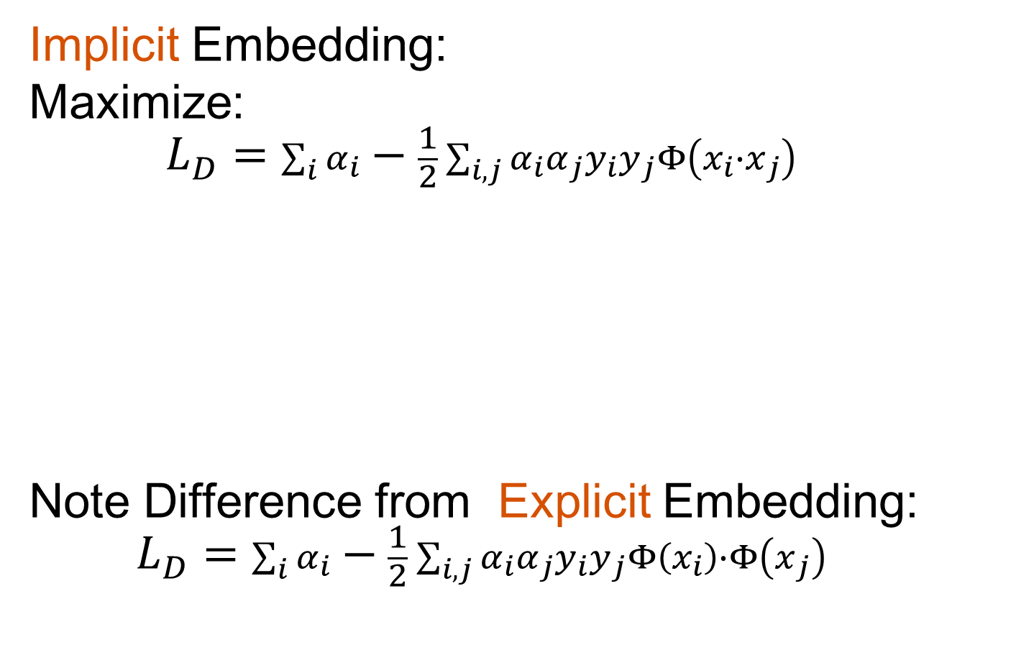
SVMs, Comput’n & Embedding
Implicit Embedding:
Maximize:
$$L_{D}=\sum_{i}{α_{i}}−\frac{1}{2}\sum_{i,j}{α_{i}α_{j}y_{i}}y_{j}Φ\left(x_{i}∙x_{j}\right)$$
Note Difference from Explicit Embedding:
$$L_{D}=\sum_{i}{α_{i}}−\frac{1}{2}\sum_{i,j}{α_{i}α_{j}y_{i}}y_{j}Φ\left(x_{i}\right)∙Φ\left(x_{j}\right)$$

Slide 19
SVMs, Comput’n & Embedding
Implicit vs. Explicit Embedding:
Still defined only via inner products
Retains optimization advantage
Thus used very commonly
Comparison to explicit embedding?
Which is “better”???
Explored in Schölkopf & Smola (2002)
Via Mercer’s Theorem

Slide 20
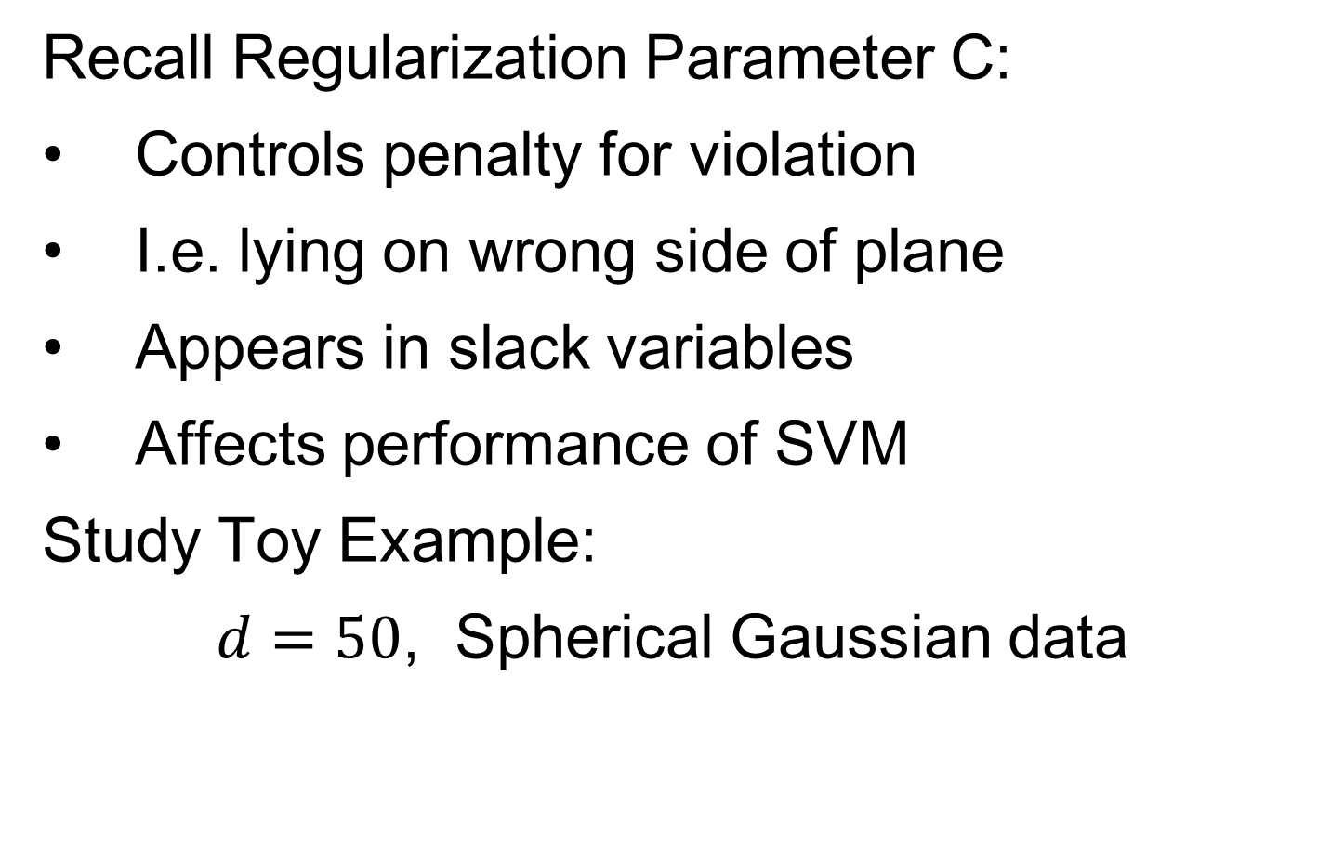
SVMs, Tuning Parameter
Recall Regularization Parameter C:
Controls penalty for violation
I.e. lying on wrong side of plane
Appears in slack variables
Affects performance of SVM
Study Toy Example:
$d=50$, Spherical Gaussian data

Slide 21
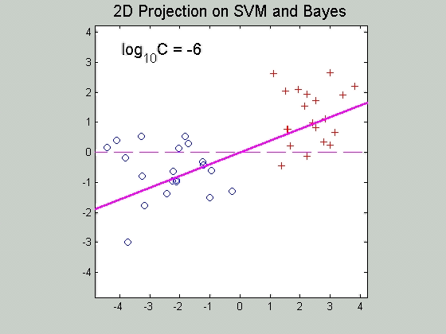

SVMs, Tuning Parameter
Toy Example: $d=50$, Sph’l Gaussian data

Slide 22
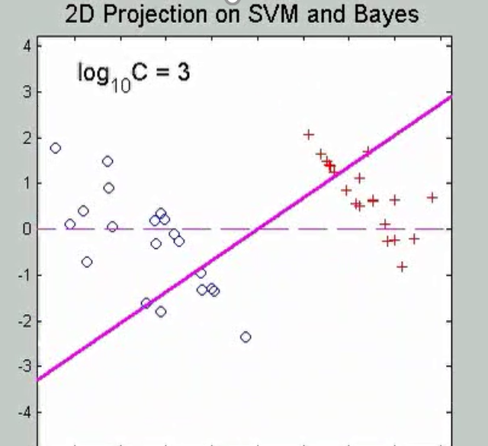
SVMs, Tuning Parameter
Toy Example: $d=50$, Sph’l Gaussian data
For Large Values of C
Lots of Data Piling
Large Angle to Optimal
Thus Less Generalizable
(For This Data Set)
Called Hard Margin SVM

Slide 23
SVMs, Tuning Parameter
Toy Example: $d=50$, Sph’l Gaussian data

Slide 24
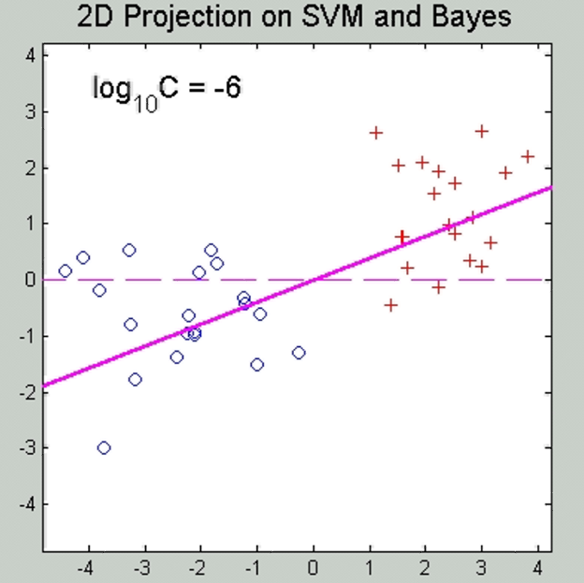
SVMs, Tuning Parameter
Toy Example: $d=50$, Sph’l Gaussian data
For Small Values of C
No Apparent Data Piling
Smaller Angle to Optimal
So More Generalizable
Connection to MD?
Add MD Axis to Plot

Slide 25
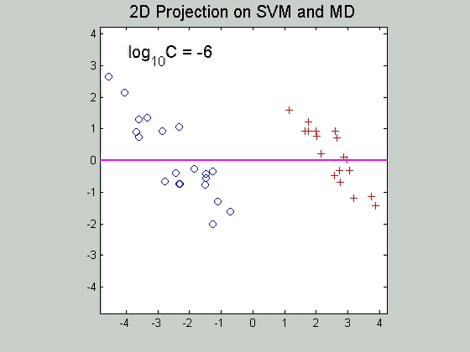

SVMs, Tuning Parameter
Toy Example: $d=50$, Sph’l Gaussian data
Put MD on horizontal axis
Note:
For C Small
SVM Dir’n =
= MD Dir’n

Slide 26
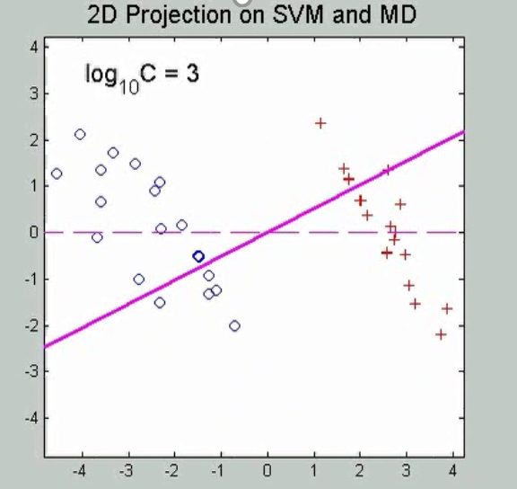
SVMs, Tuning Parameter
Toy Example: $d=50$, Sph’l Gaussian data
Put MD on horizontal axis
For Large Values of C
SVM not MD
Hard Margin SVM
Clearly Different
Yet Same for Small C!
(For This Data Set)

Slide 27
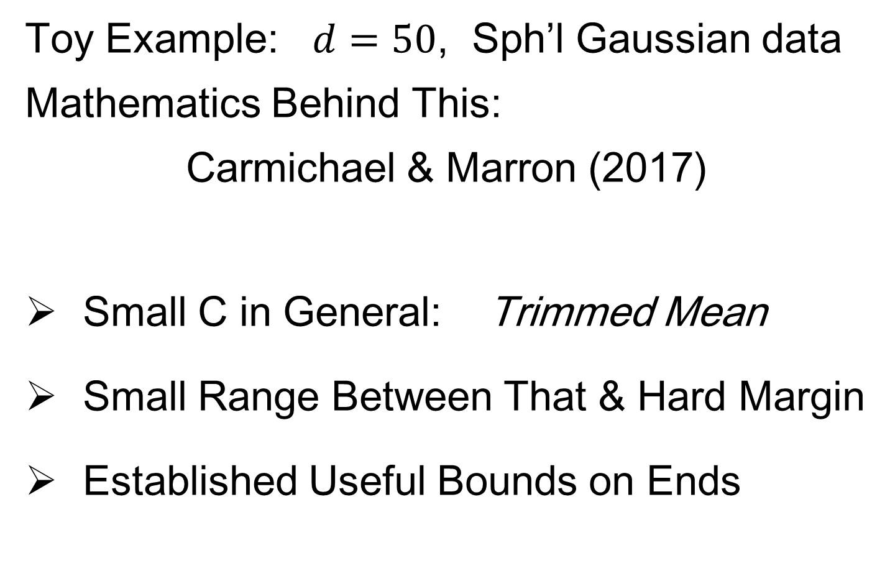
SVMs, Tuning Parameter
Toy Example: $d=50$, Sph’l Gaussian data
Mathematics Behind This:
Carmichael & Marron (2017)
Small C in General: Trimmed Mean
Small Range Between That & Hard Margin
Established Useful Bounds on Ends

Slide 28
Support Vector Machines
Important Extension:
Multi-Class SVMs
Hsu & Lin (2002)
Lee, Lin, & Wahba (2002)
Defined for “implicit” version
“Direction Based” variation???

Slide 29
Support Vector Machines
SVM Tuning Parameter Selection:
Joachims (2000)
Wahba et al. (1999, 2003)

Slide 30
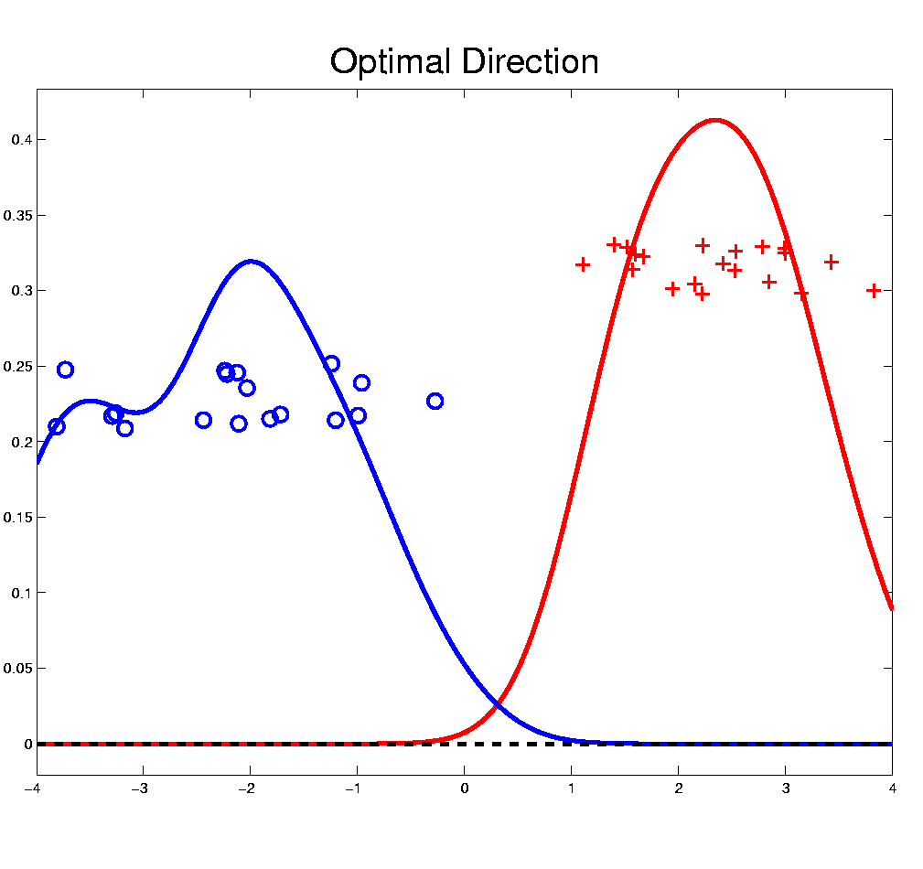

Distance Weighted Discrim’n
Improvement of SVM for HDLSS Data
Toy e.g.
$d=50$
indep. $N\left(0,1\right)$
$μ_{1}=±2$
$n_{+}=n_{−}=20$
(similar to
earlier movie)

Slide 31
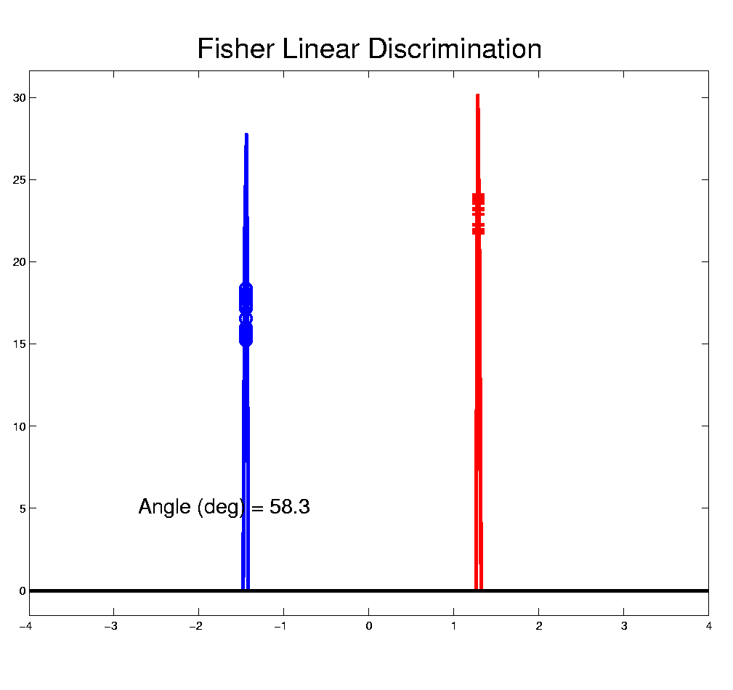
Distance Weighted Discrim’n
Toy e.g.: Maximal Data Piling Direction
- Perfect
Separation
- Gross
Overfitting
- Large Angle
- Poor
Gen’ability
MDP
Feels Small Scale
Noise Artifacts

Slide 32
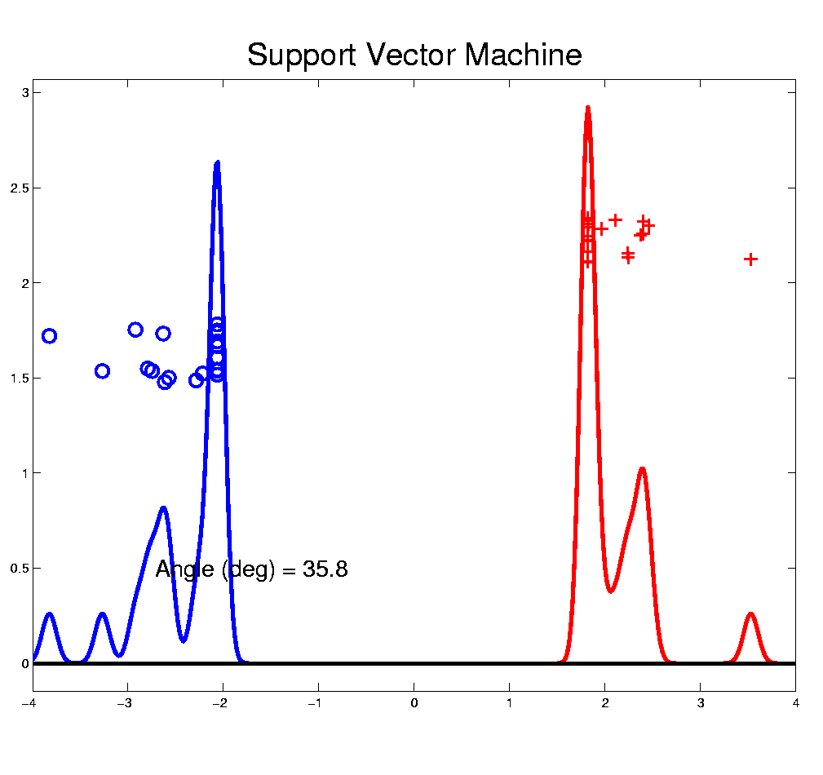
Distance Weighted Discrim’n
Toy e.g.: Support Vector Machine Direction
- Bigger Gap
- Smaller Angle
- Better
Gen’ability
- Feels support
vectors too
strongly???
- Ugly subpops?
- Improvement?
Similarly Feels Small
Scale Noise Artifacts

Slide 33
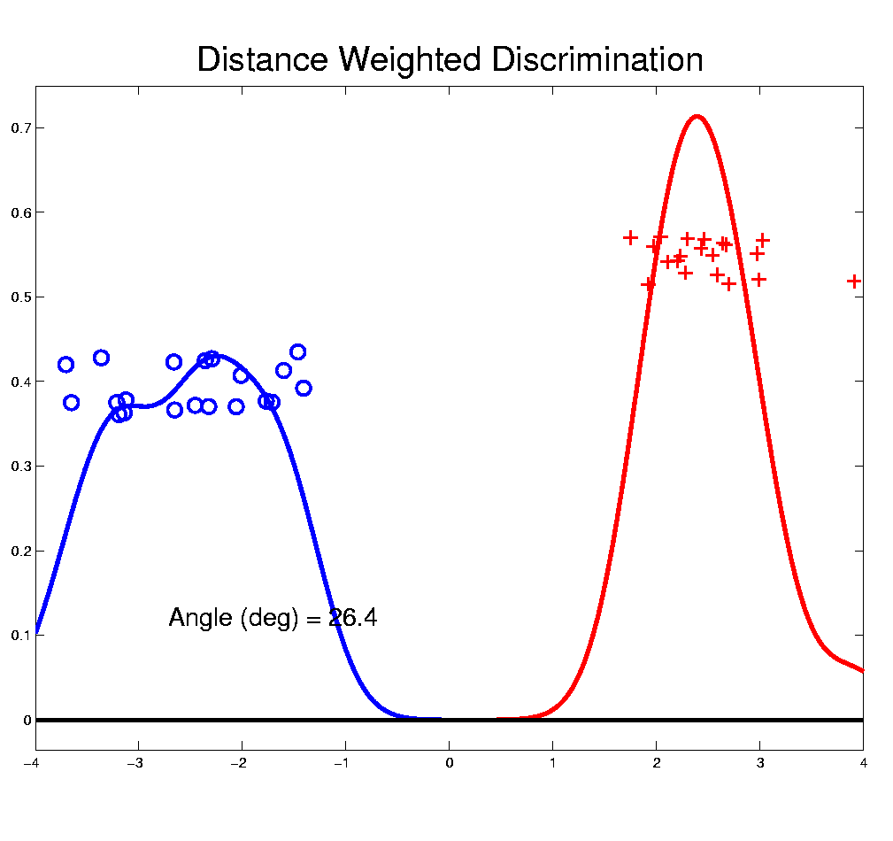
Distance Weighted Discrim’n
Toy e.g.: Distance Weighted Discrimination
- Addresses
these issues
- Smaller Angle
- Better
Gen’ability
- Nice subpops
- Replaces
min dist. by
avg. dist.

Slide 34
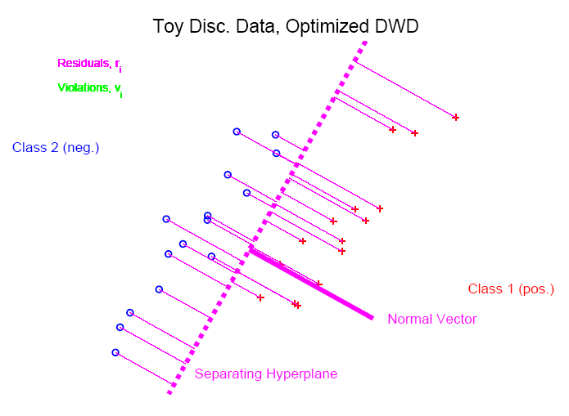
Distance Weighted Discrim’n
Based on Optimization Problem:
For “Residuals”:

Slide 35
Distance Weighted Discrim’n
Based on Optimization Problem:
Uses “poles” to push plane away from data

Slide 36
Distance Weighted Discrim’n
Based on Optimization Problem:
More precisely:
Work in appropriate penalty for violations
Optimization Method:
Second Order Cone Programming
“Still convex” gen’n of quad’c program’g
Allows fast greedy solution
Can use available fast software
(SDP3, Michael Todd, et al)

Slide 37
Distance Weighted Discrim’n
References for more on DWD:
Main paper:
Marron, Todd and Ahn (2007)
Links to more papers:
Ahn (2006)
R Implementation of DWD:
CRAN (2014)
SDPT3 Software:
Toh et al (1999)
Sparse DWD: Wang & Zou (2016)
Notes:
37

Slide 38
Distance Weighted Discrim’n
References for more on DWD:
Faster Version:
Lam et al. (2018)
Robust (Against Heterogeneity) Version:
Wang & Zou (2016)
Approach: three-block
semiproximal alternating
direction method of
multipliers
Will Discuss
More Later
Notes:
38

Slide 39
Distance Weighted Discrim’n
2-d Visualization:
Pushes Plane
Away From
Data
All Points
Have Some
Influence
(not just support vectors)

Slide 40
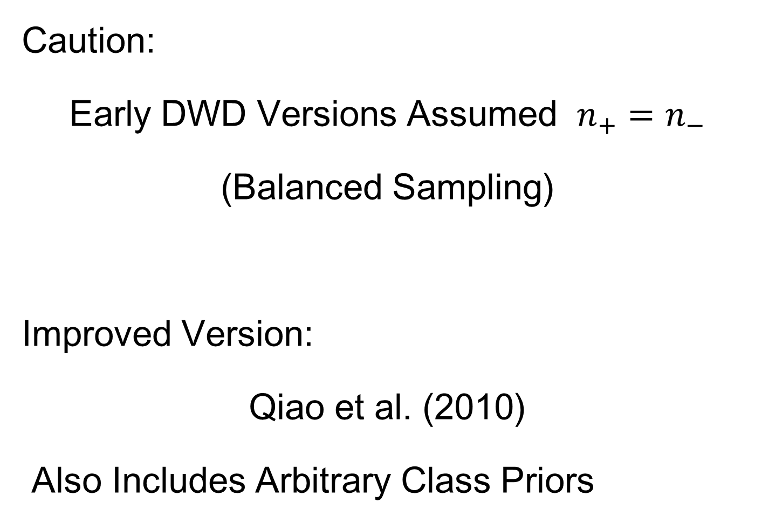
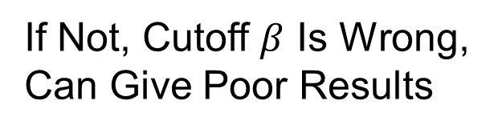
Distance Weighted Discrim’n
Caution:
Early DWD Versions Assumed $n_{+}=n_{−}$
(Balanced Sampling)
Improved Version:
Qiao et al. (2010)
Also Includes Arbitrary Class Priors
If Not, Cutoff $β$ Is Wrong,
Can Give Poor Results
Notes:
40

Slide 41
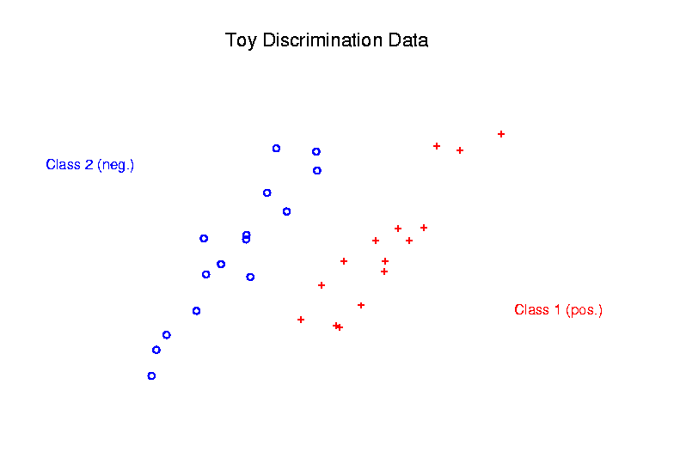
Support Vector Machines
Graphical View, using Toy Example:

Slide 42
Support Vector Machines
Graphical View, using Toy Example:

Slide 43
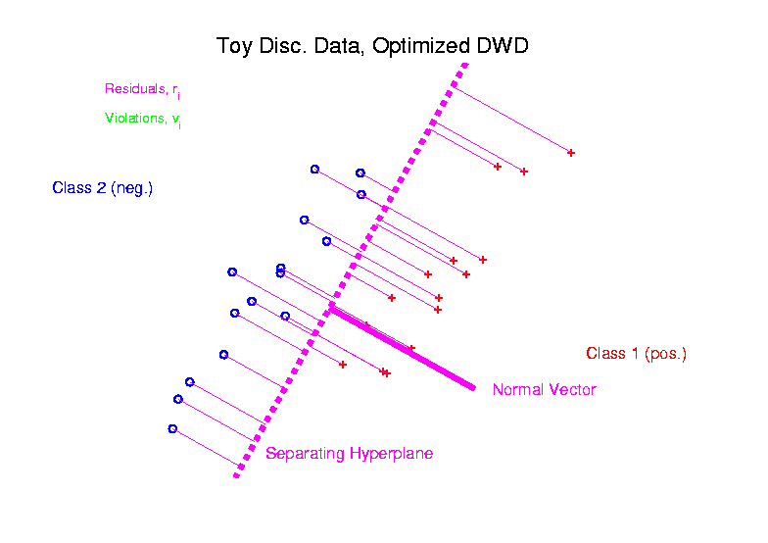
Distance Weighted Discrim’n
Graphical View, using Toy Example:

Slide 44
HDLSS Discrim’n Simulations
Main idea:
Comparison of
SVM (Support Vector Machine)
DWD (Distance Weighted Discrimination)
MD (Mean Difference, a.k.a. Centroid)
Linear versions, across dimensions
Notes:
44

Slide 45
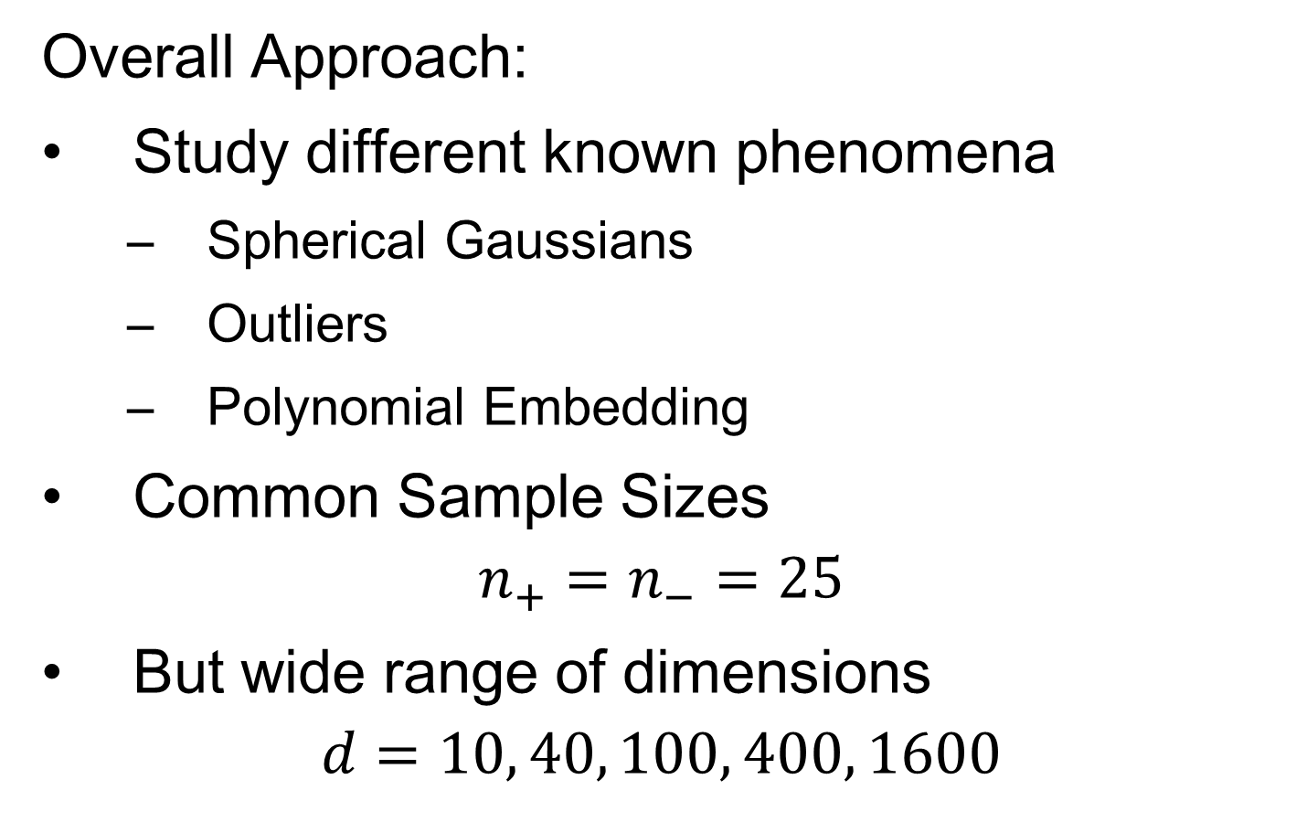
HDLSS Discrim’n Simulations
Overall Approach:
Study different known phenomena
  Spherical Gaussians
  Outliers
  Polynomial Embedding
Common Sample Sizes
$$n_{+}=n_{−}=25$$
But wide range of dimensions
$$d=10, 40, 100, 400, 1600$$

Slide 46
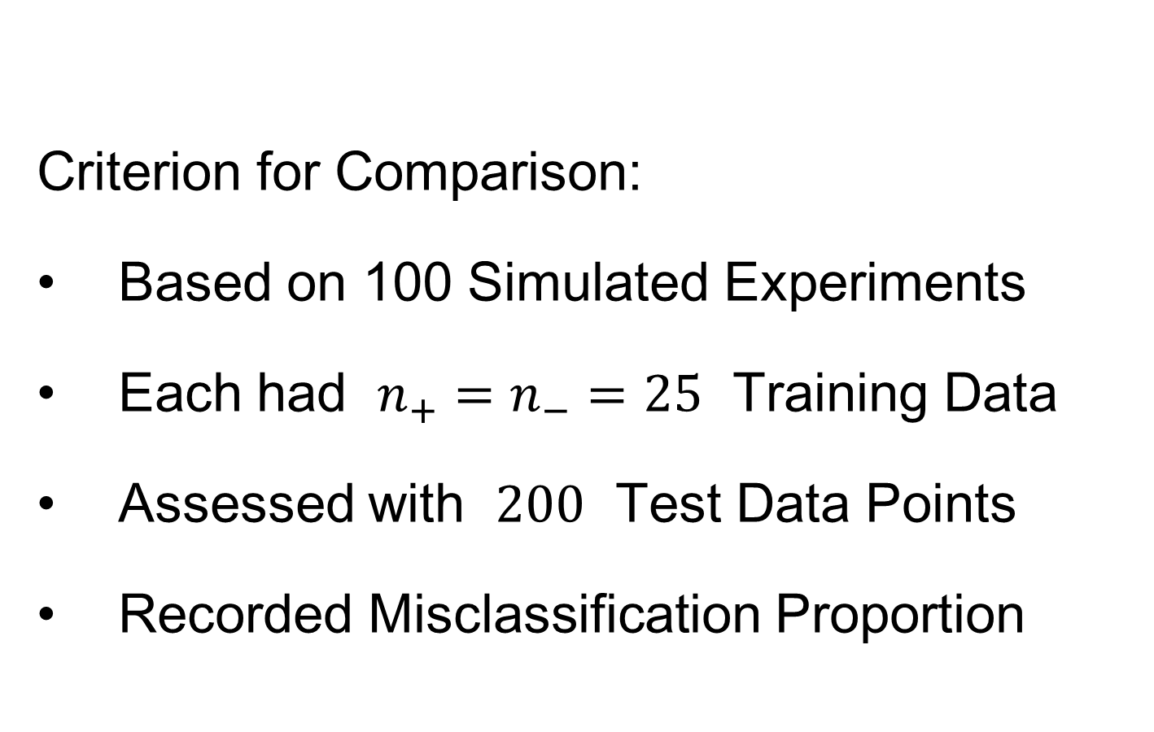
HDLSS Discrim’n Simulations
Criterion for Comparison:
Based on 100 Simulated Experiments
Each had $n_{+}=n_{−}=25$ Training Data
Assessed with $200$ Test Data Points
Recorded Misclassification Proportion

Slide 47
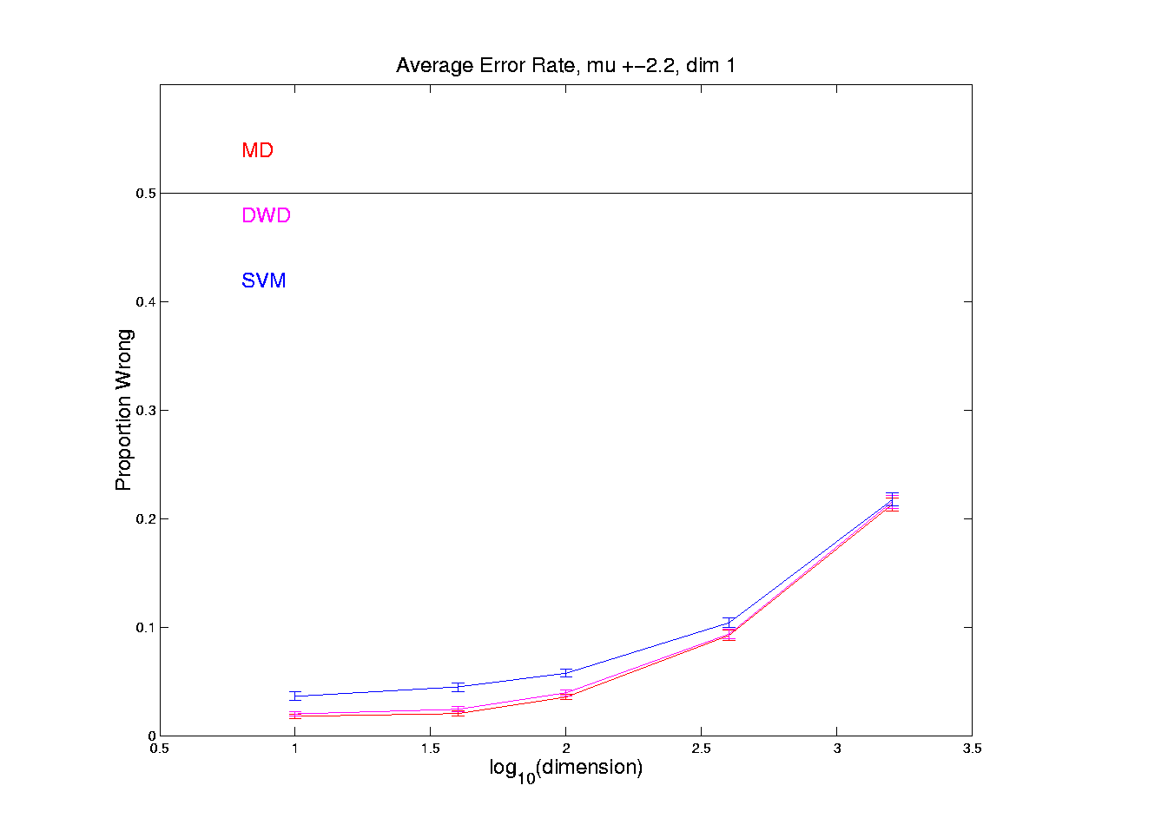
HDLSS Discrim’n Simulations
Spherical Gaussians:
Notes:
DWD1figEBig.ps

Slide 48
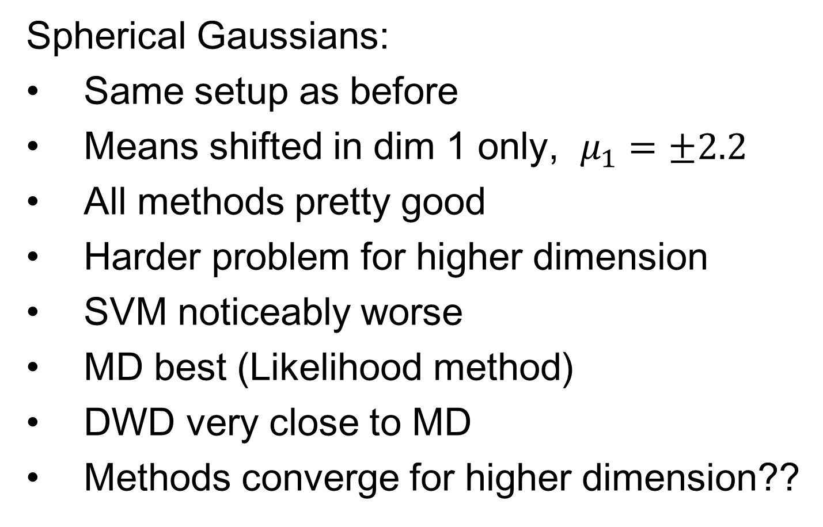
HDLSS Discrim’n Simulations
Spherical Gaussians:
Same setup as before
Means shifted in dim 1 only, $μ_{1}=±2.2$
All methods pretty good
Harder problem for higher dimension
SVM noticeably worse
MD best (Likelihood method)
DWD very close to MD
Methods converge for higher dimension??

Slide 49
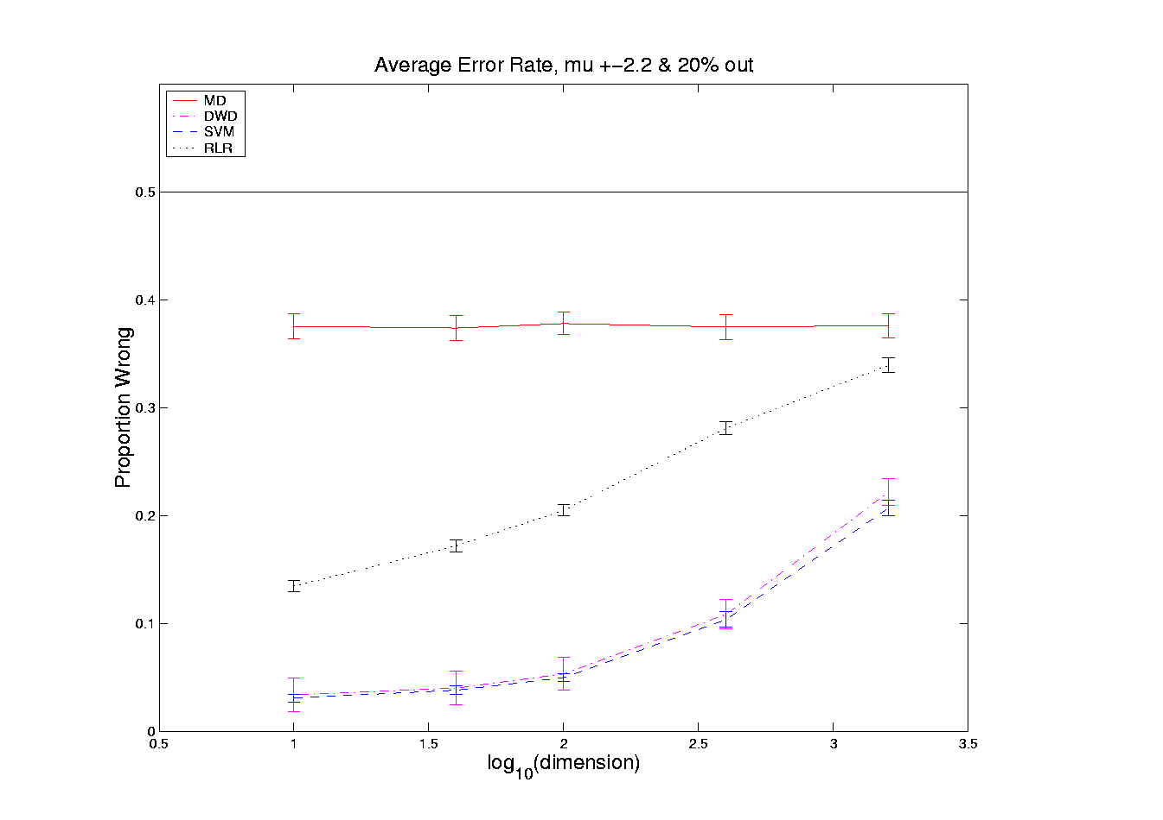
HDLSS Discrim’n Simulations
Outlier Mixture:
Notes:
DWD1figFBig.ps

Slide 50
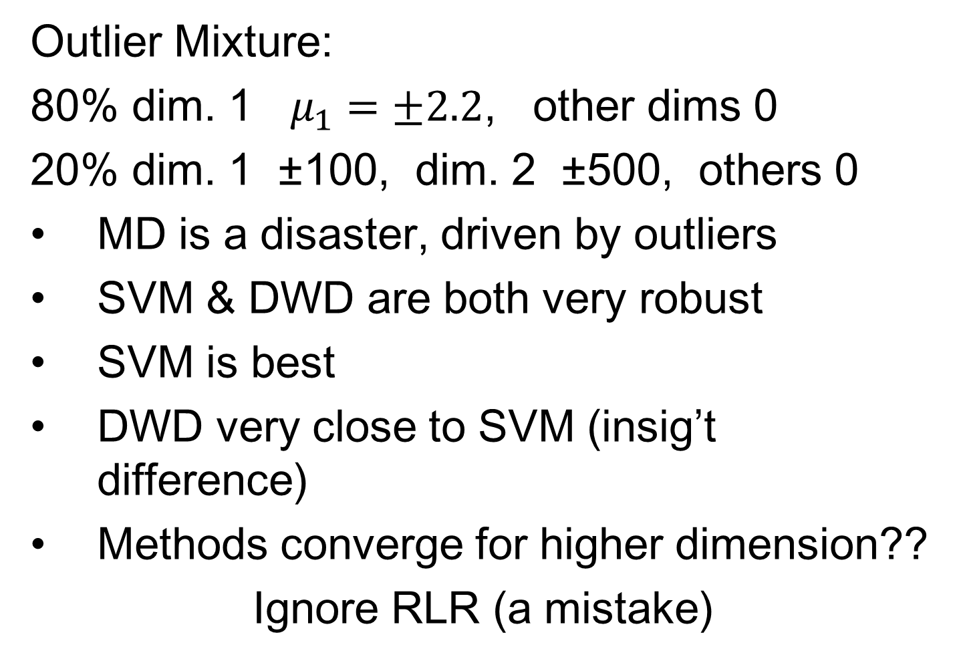
HDLSS Discrim’n Simulations
Outlier Mixture:
80% dim. 1 $μ_{1}=±2.2$, other dims 0
20% dim. 1 ±100, dim. 2 ±500, others 0
MD is a disaster, driven by outliers
SVM & DWD are both very robust
SVM is best
DWD very close to SVM (insig’t difference)
Methods converge for higher dimension??
Ignore RLR (a mistake)

Slide 51
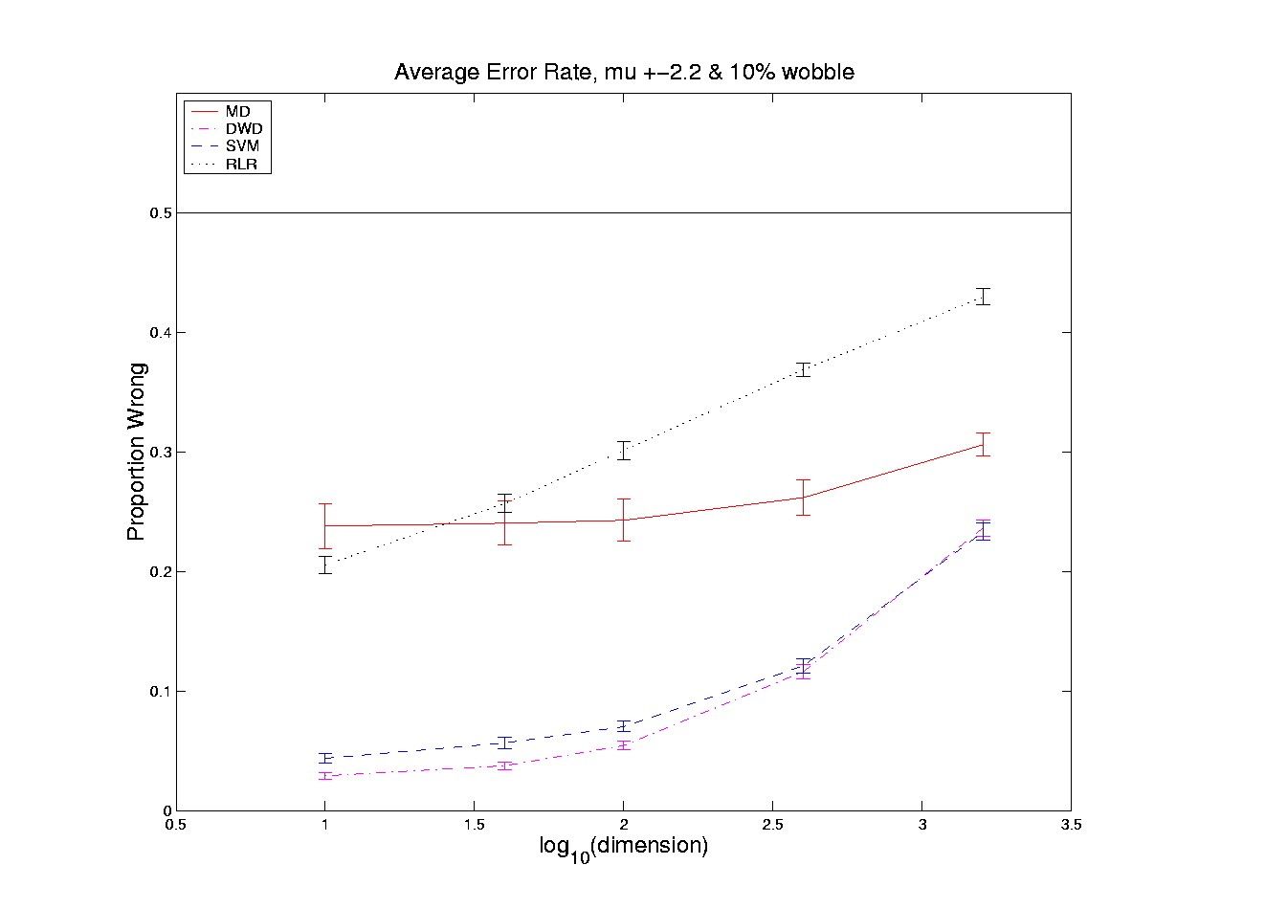
HDLSS Discrim’n Simulations
Wobble Mixture:
Notes:
DWD1figGBig.ps

Slide 52
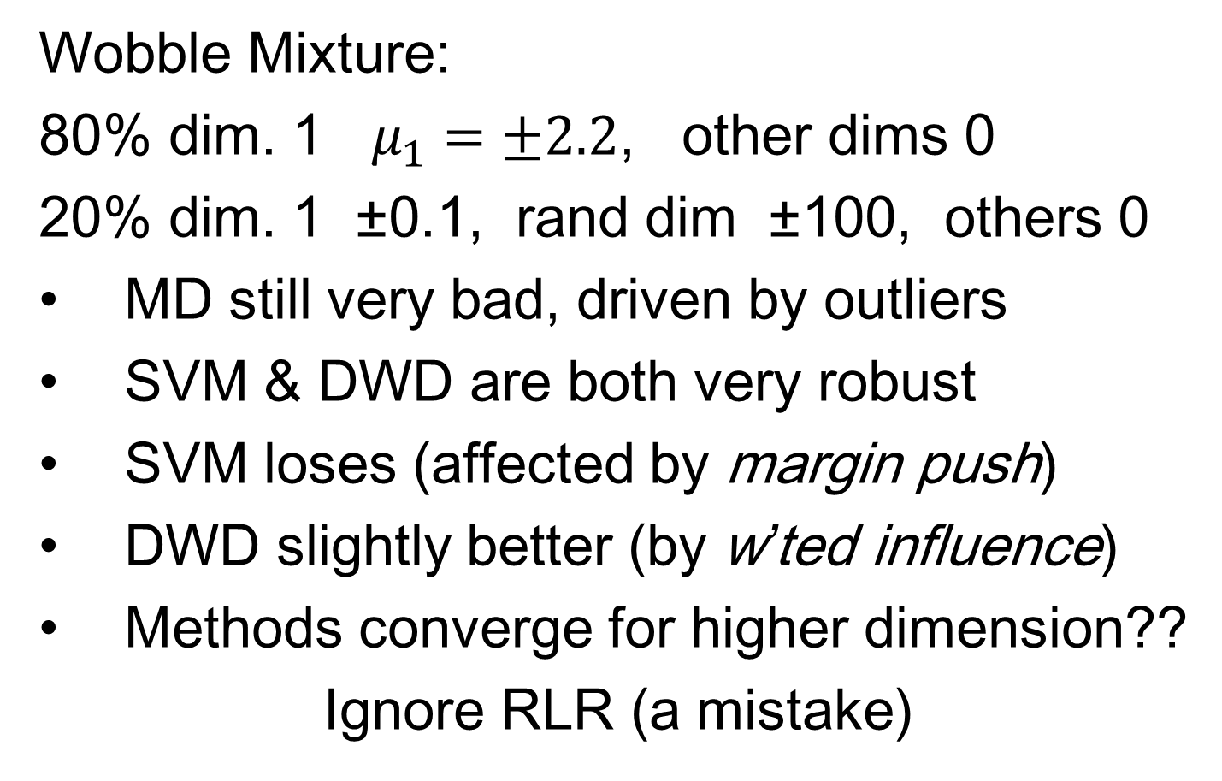
HDLSS Discrim’n Simulations
Wobble Mixture:
80% dim. 1 $μ_{1}=±2.2$, other dims 0
20% dim. 1 ±0.1, rand dim ±100, others 0
MD still very bad, driven by outliers
SVM & DWD are both very robust
SVM loses (affected by margin push)
DWD slightly better (by w’ted influence)
Methods converge for higher dimension??
Ignore RLR (a mistake)

Slide 53
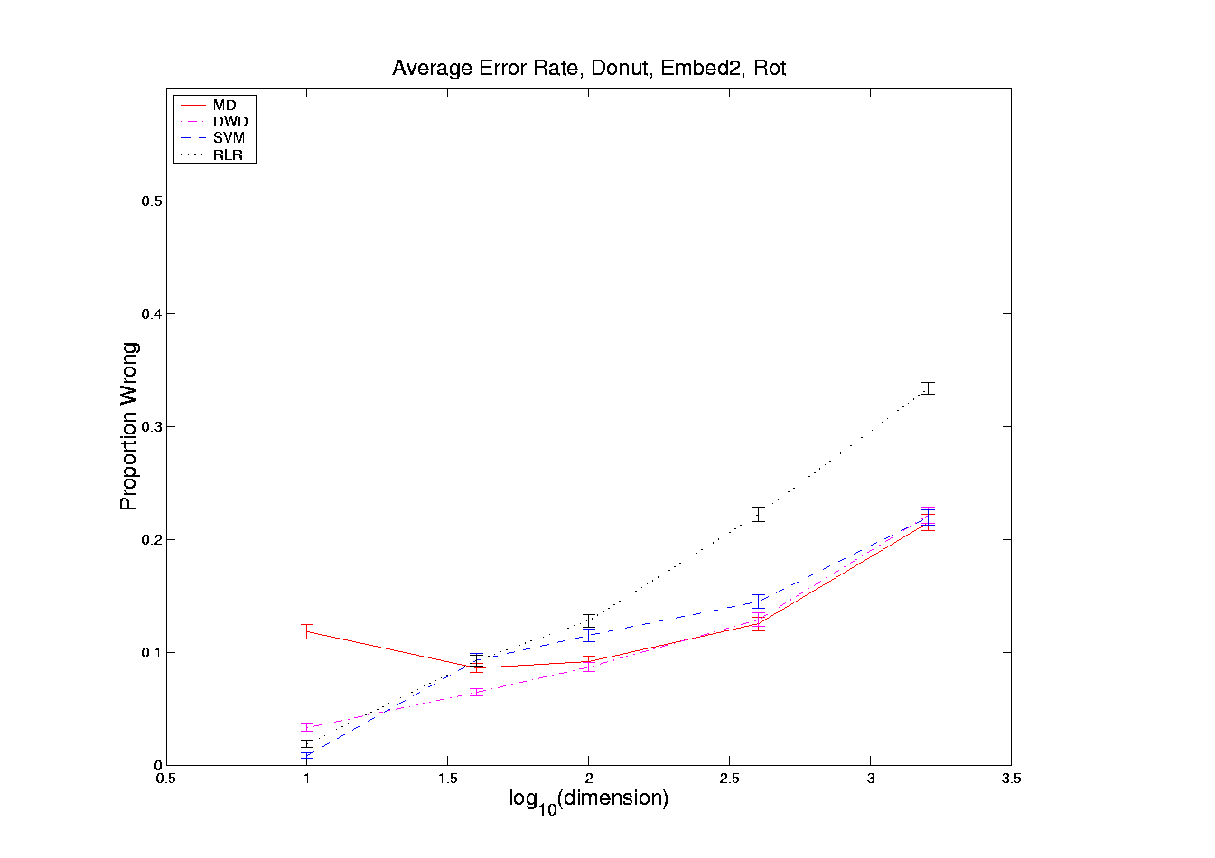
HDLSS Discrim’n Simulations
Nested Spheres:
Notes:
DWD1figHBig.ps

Slide 54
HDLSS Discrim’n Simulations
Nested Spheres:
1st d/2 dim’s, Gaussian with var 1 or C
2nd d/2 dim’s, the squares of the 1st dim’s
(as for 2nd degree polynomial embedding)
Each method best somewhere
MD best in highest d (data non-Gaussian)
Methods not comparable (realistic)
Methods converge for higher dimension??
HDLSS space is a strange place
Ignore RLR (a mistake)

Slide 55
HDLSS Discrim’n Simulations
Conclusions:
Everything (sensible) is best sometimes
DWD often very near best
MD weak beyond Gaussian
Caution about simulations (and examples):
Very easy to cherry pick best ones
Good practice in Machine Learning
  “Ignore method proposed, but read
  paper for useful comparison of others”
Every Dog Has his Day

Slide 56
HDLSS Discrim’n Simulations
Caution: There are additional players
E.g. Regularized Logistic Regression
looks also very competitive
Interesting Phenomenon:
All methods come together
in very high dimensions???

Slide 57
HDLSS Discrim’n Simulations
Can we say more about:
All methods come together
in very high dimensions???
Mathematical Statistical Question:
Mathematics behind this???
Notes:
57

Slide 58
Batch and Source Adjustment
  Important Application
  of
  Distance Weighted Discrimination

Slide 59
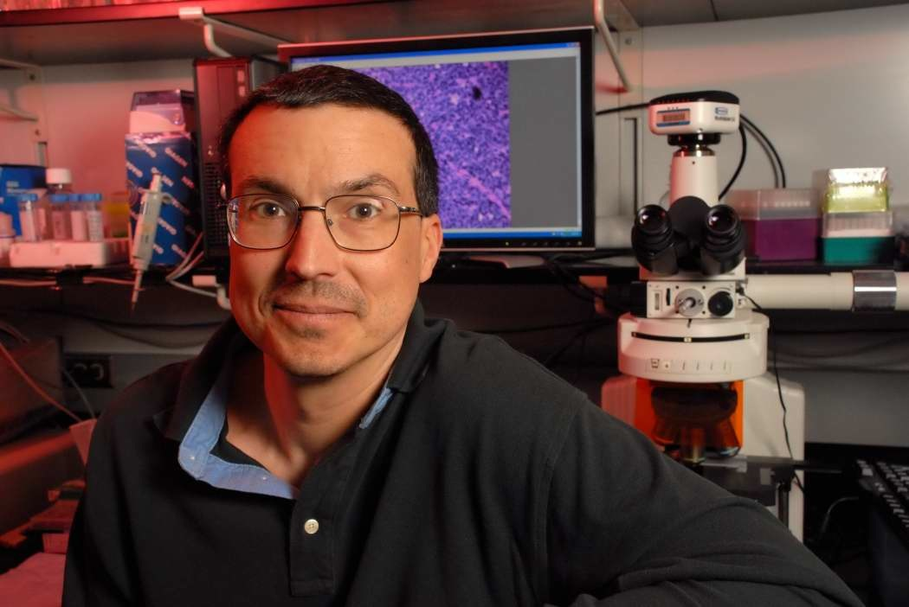
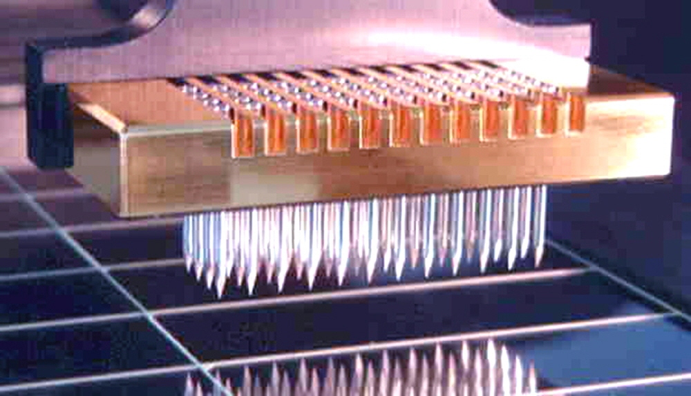
Batch and Source Adjustment
For Stanford Breast Cancer Data
From Perou et al (2000)
Microarray for Measuring Gene Expression
Old Style: Arrays Printed in Lab

Slide 60
Batch and Source Adjustment
For Stanford Breast Cancer Data
From Perou et al (2000)
Analysis in Benito et al (2004)
Adjust for Source Effects
  Different sources of mRNA
Adjust for Batch Effects
  Arrays fabricated at different times

Slide 61
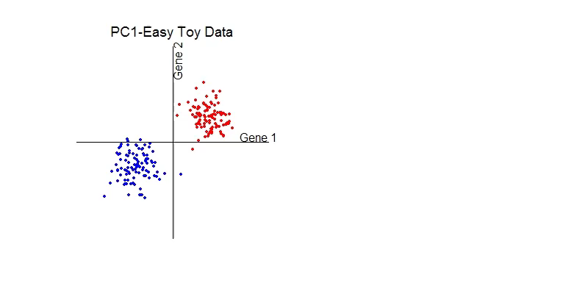
Idea Behind Adjustment
Early Approach: Alter et al (2000)
Squash Out PC1 direction
Eliminates variation in that direction

Slide 62
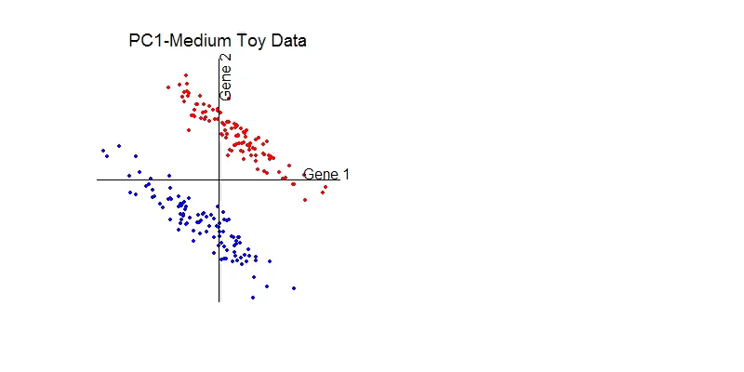
DWD: Why not PC1?
PC 1 Direction feels variation, not classes
Also eliminates (important?) within class variation

Slide 63
DWD: Why not PC1?
Direction driven by classes
“Sliding” maintains (important?) within class variation

Slide 64
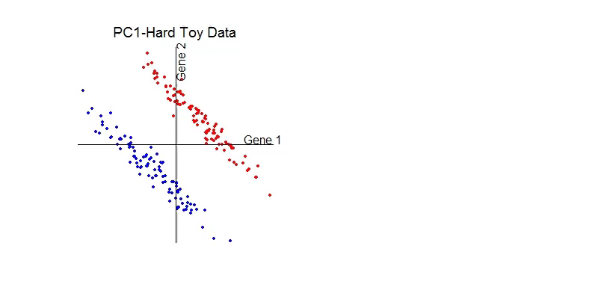
E. g. even worse for PCA
PC1 direction is worst possible

Slide 65
But easy for DWD
Since DWD uses class label information

Slide 66

Batch and Source Adjustment
Try Out Real Data:
Stanford Breast Cancer Data
From Perou et al (2000)
$d=1753$ “Intrinsic” Genes
$n=107$ Breast Cancer Patients
Discovered With Clustering: Subtypes

Slide 67

Source Batch Adj: Raw Breast Cancer data

Slide 68

Source Batch Adj: Source Colors

Slide 69

Source Batch Adj: Batch Colors

Slide 70

Source Batch Adj: Biological Class Colors

Slide 71

Source Batch Adj: Biological Class Col. & Symbols

Slide 72

Source Batch Adj: Biological Class Symbols

Slide 73

Source Batch Adj: Source Colors

Slide 74

Source Batch Adj: PC 1-3 & DWD direction

Slide 75

Source Batch Adj: DWD Source Adjustment

Slide 76

Source Batch Adj: Source Adj’d, PCA view

Slide 77

Source Batch Adj: Source Adj’d, Class Colored

Slide 78

Source Batch Adj: Source Adj’d, Batch Colored

Slide 79

Source Batch Adj: Source Adj’d, 5 PCs

Slide 80

Source Batch Adj: S. Adj’d, Batch 1,2 vs. 3 DWD

Slide 81

Source Batch Adj: S. & B1,2 vs. 3 Adjusted

Slide 82

Source Batch Adj: S. & B1,2 vs. 3 Adj’d, 5 PCs

Slide 83

Source Batch Adj: S. & B Adj’d, B1 vs. 2 DWD

Slide 84

Source Batch Adj: S. & B Adj’d, B1 vs. 2 Adj’d

Slide 85

Source Batch Adj: S. & B Adj’d, 5 PC view

Slide 86

Source Batch Adj: S. & B Adj’d, 4 PC view

Slide 87

Source Batch Adj: S. & B Adj’d, Class Colors

Slide 88

Source Batch Adj: S. & B Adj’d, Adj’d PCA

Slide 89
Participant Presentation
Bryce Rowland:
NMF for Hi-C Data
Thomas Keefe:
Haar Wavelet Bases
Feng Cheng:
Magnetic Resonance Fingerprinting

