Slide 1
Participant Presentations
Please Send Title:
Jose Sanchez
Wei Gu
Bohan Li
Siqi Xiang
Mingyi Wang

Slide 2
Interesting Benchmark Data Set
NCI 60 Cell Lines
Interesting benchmark, since same cells
Data Web available:
http://discover.nci.nih.gov/datasetsNature2000.jsp
Both cDNA and Affymetrix Platforms
Different from Breast Cancer Data
Which had no common samples
See Liu et al. (2009)

Slide 3
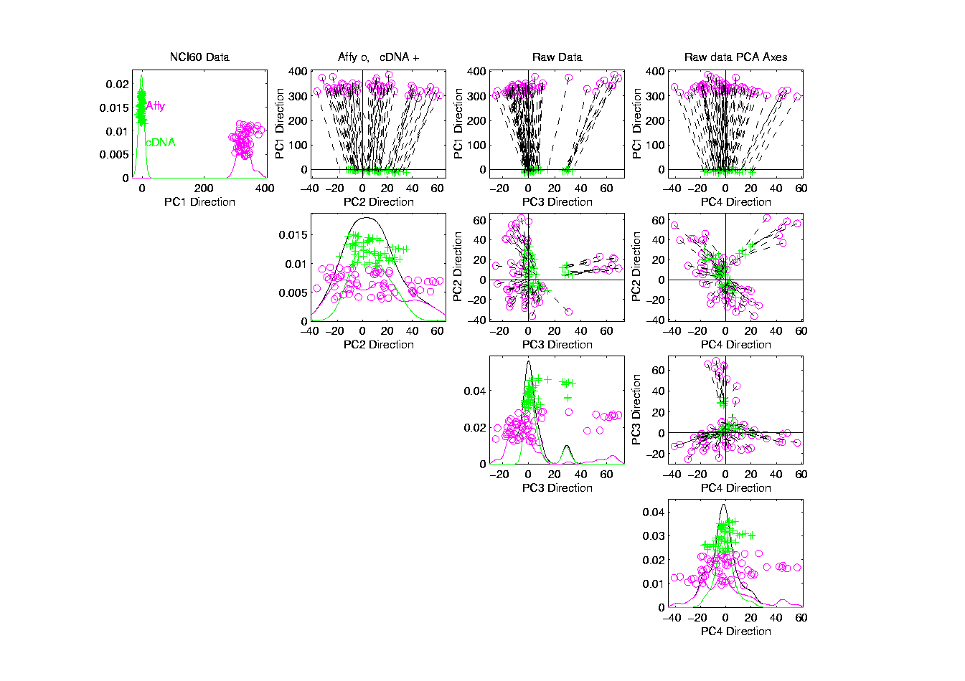
NCI 60: Raw Data, Platform Colored

Slide 4
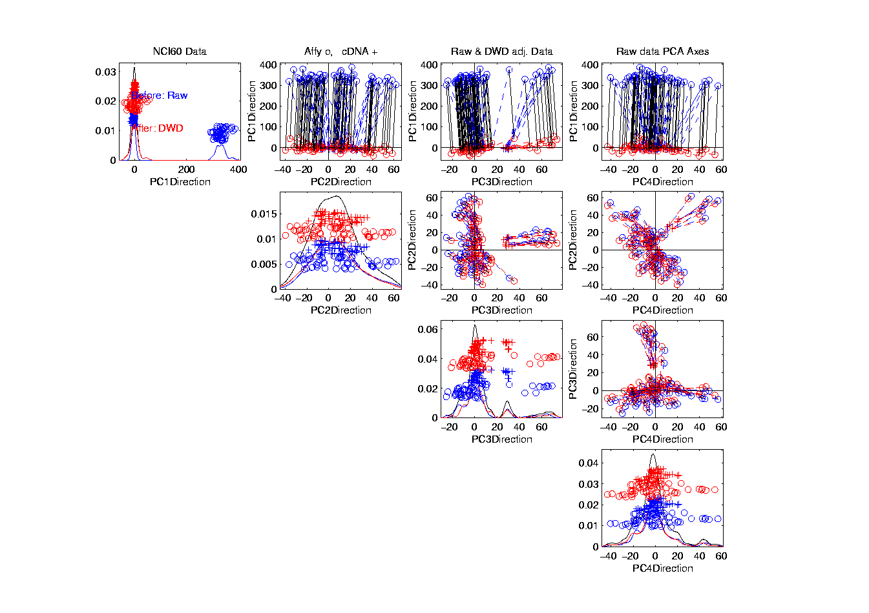
NCI 60: Before & After DWD adjustment

Slide 5
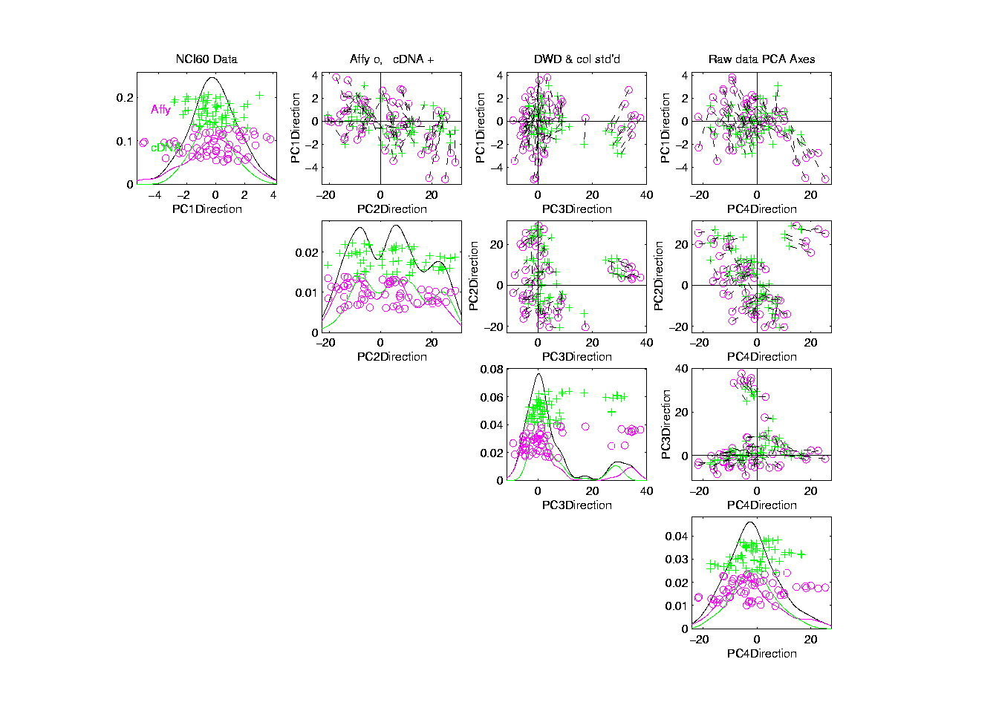
NCI 60: Fully Adjusted Data, Platform Colored

Slide 6
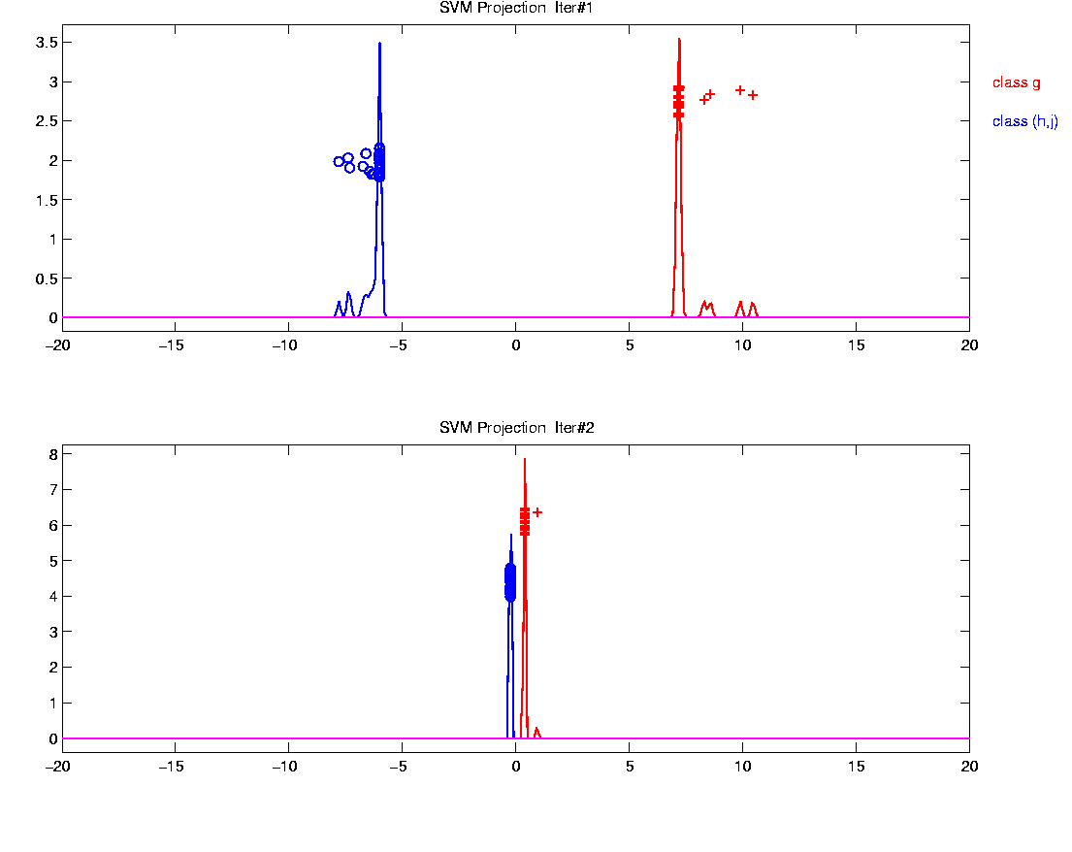
Why not adjust using SVM?
Major Problem: Proj’d Distrib’al Shape
Triangular Dist’ns (opposite skewed)
Does not allow sensible rigid shift

Slide 7
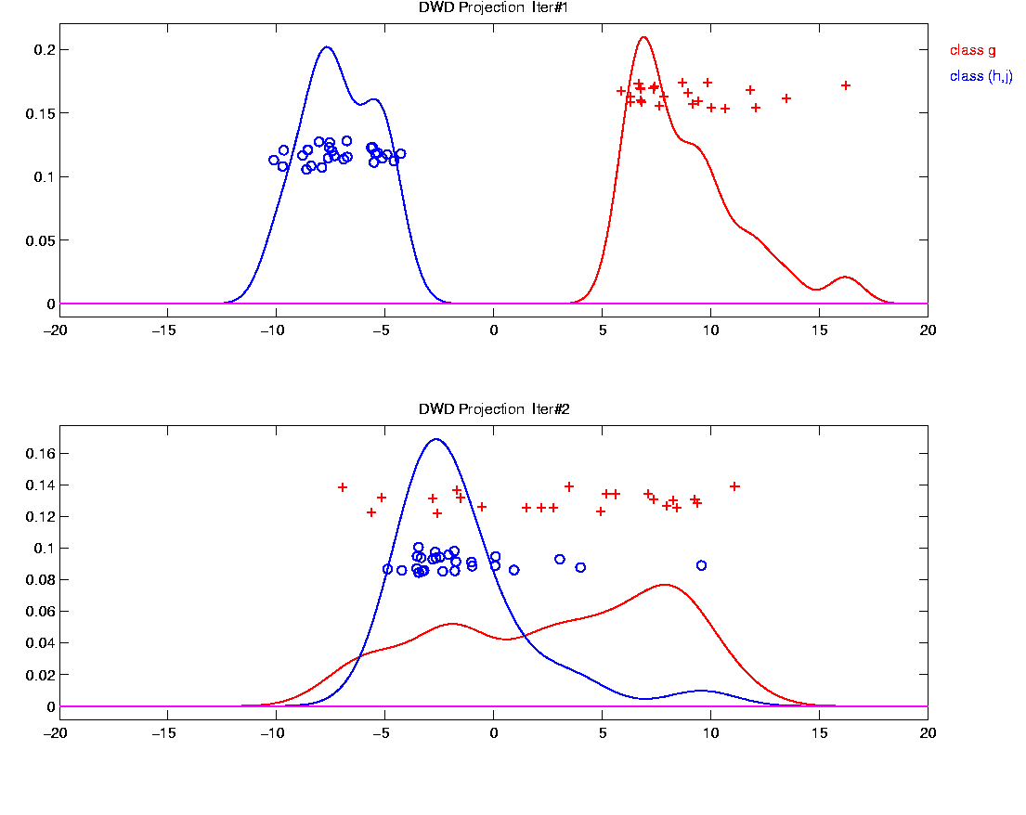
Why not adjust using SVM?
Nicely Fixed by DWD
Projected Dist’ns near Gaussian
Sensible to shift

Slide 8
Why not adjust by means?
But Why Not PAM (~Mean Difference)?
Simpler is Better
Why not means, i.e. point cloud centerpoints?
Drawback to PAM:
Poor Handling of Unbalanced Biological Subtypes
DWD more Resistant to Unbalance

Slide 9
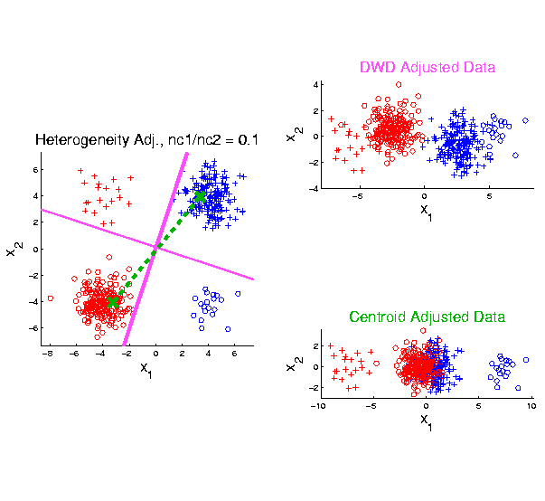
Twiddle ratios of subtypes
2-d Toy
Example
Unbalanced
Mixture
Note: Losing
Distinction
To Be Studied

Slide 10
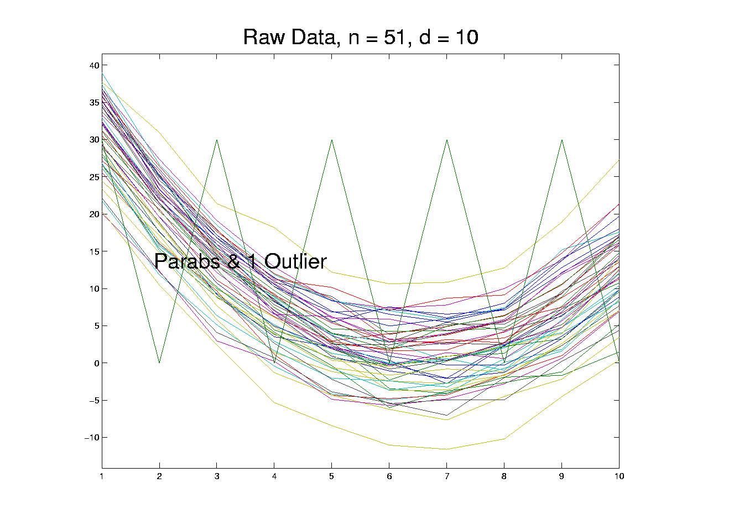
Outliers in PCA
Deep Toy Example:

Slide 11
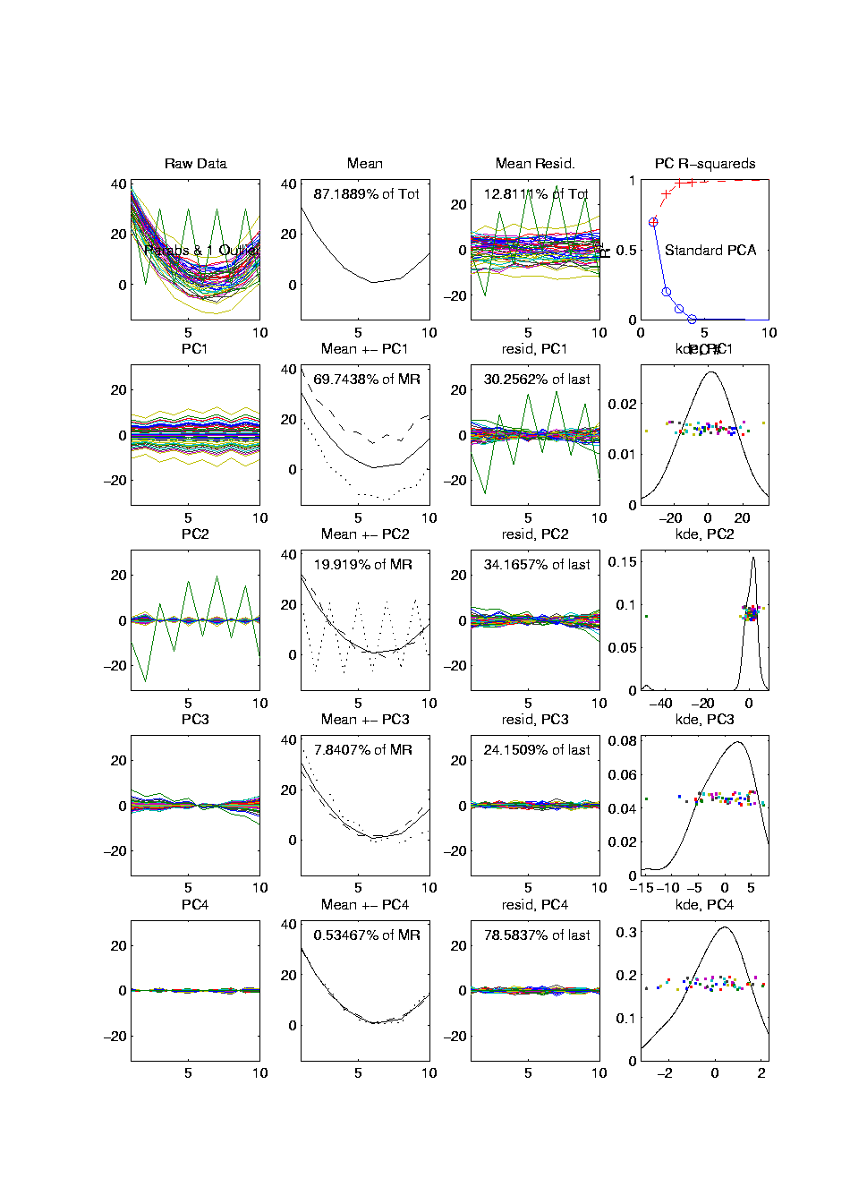
Outliers in PCA
PCA for
Deeper
Toy E.g.
Data:

Slide 12
Outliers in PCA
What can (should?) be done about outliers?
Context 1: Outliers are important aspects of the population
They need to be highlighted in the analysis
Although could separate into subpopulations
Context 2: Outliers are “bad data”, of no interest
recording errors? Other mistakes?
Then should avoid distorted view of PCA

Slide 13
Outliers in PCA
Controversy:
Is median’s “equal vote” scheme good or bad?
Huber:
Outliers contain some information,
So should only control “influence”
(e.g. median)
Hampel, et. al.:
Outliers contain no useful information
Should be assigned weight 0
(not done by median)
Using “proper robust method”
(not simply deleted)

Slide 14
Outliers in PCA
Robustness Controversy (cont.):
Both are “right” (depending on context)
Source of major (unfortunately bitter) debate!

Slide 15

Robust PCA
What is multivariate median?
There are several!
(“median” generalizes in different ways)
Coordinate-wise median
Often worst
Not rotation invariant
(2-d data uniform on “L”)
Can lie on convex hull of data
(same example)
Thus can be poor notion of “center”
$$\left(\begin{matrix}median\left(X_{i,1}\right) \\ ⋮ \\ median\left(X_{d,1}\right)\end{matrix}\right)$$

Slide 16
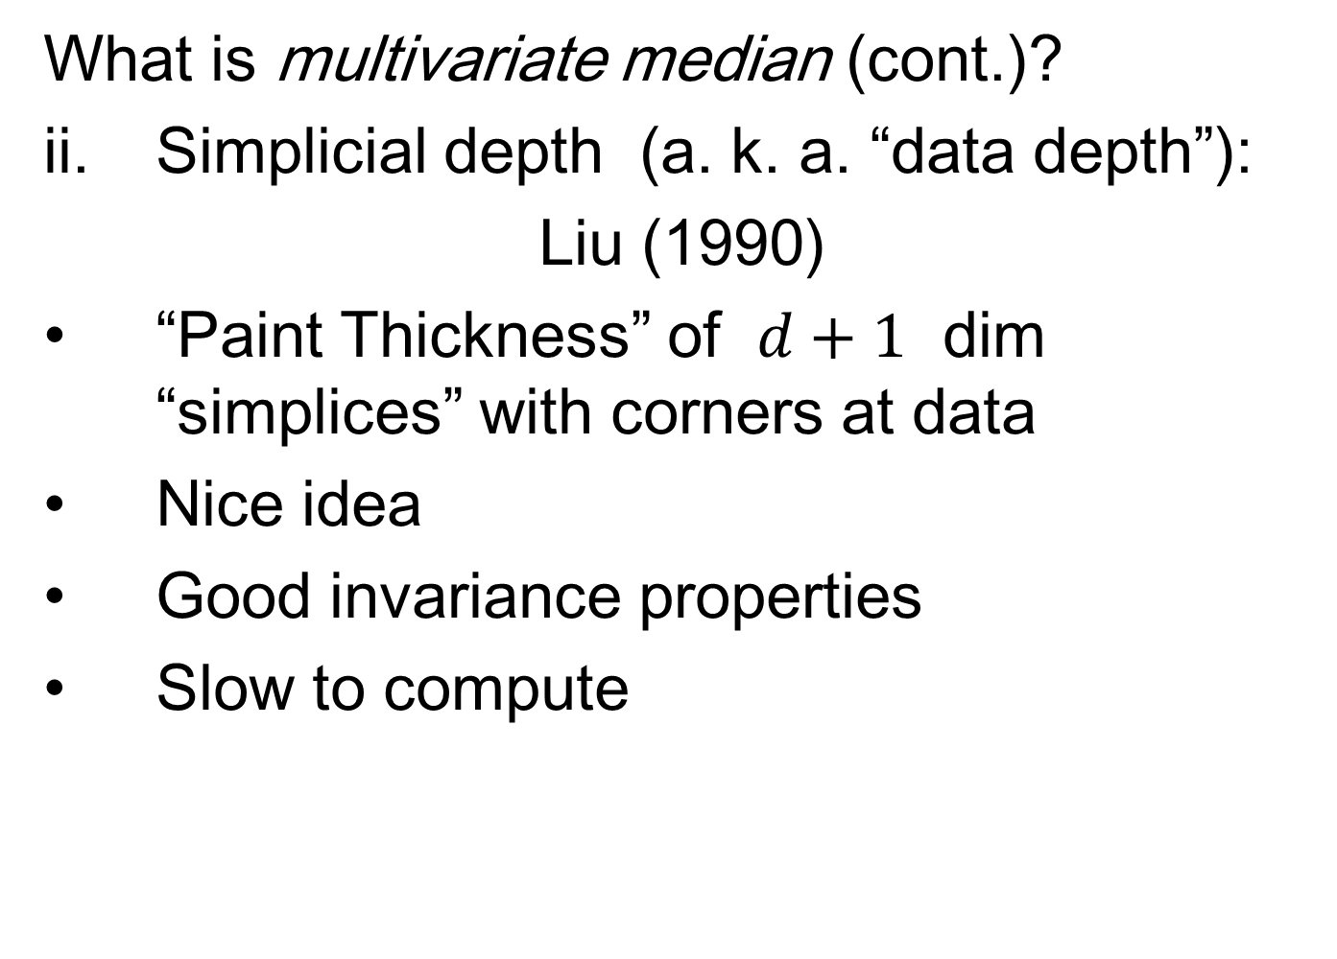
Robust PCA
What is multivariate median (cont.)?
ii. Simplicial depth (a. k. a. “data depth”):
Liu (1990)
“Paint Thickness” of $d+1$ dim “simplices” with corners at data
Nice idea
Good invariance properties
Slow to compute

Slide 17
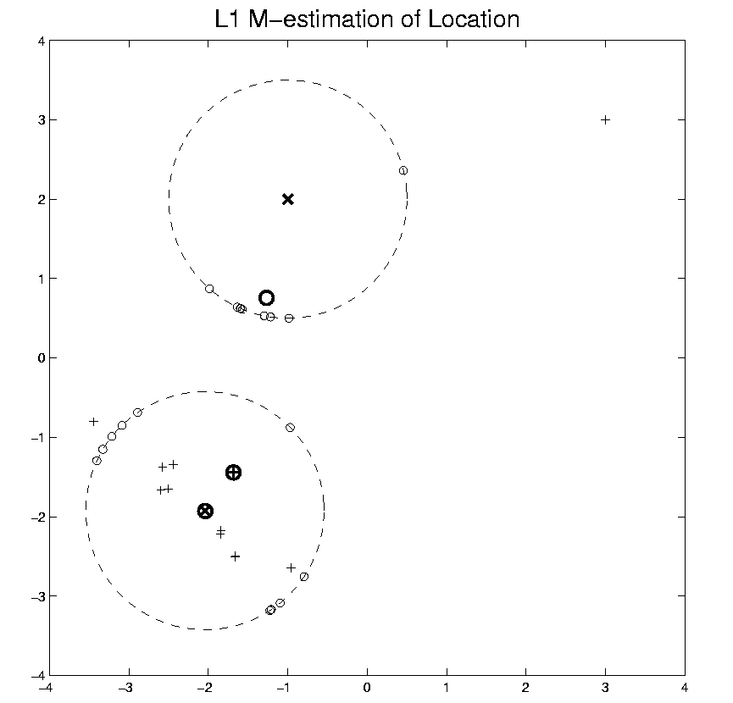
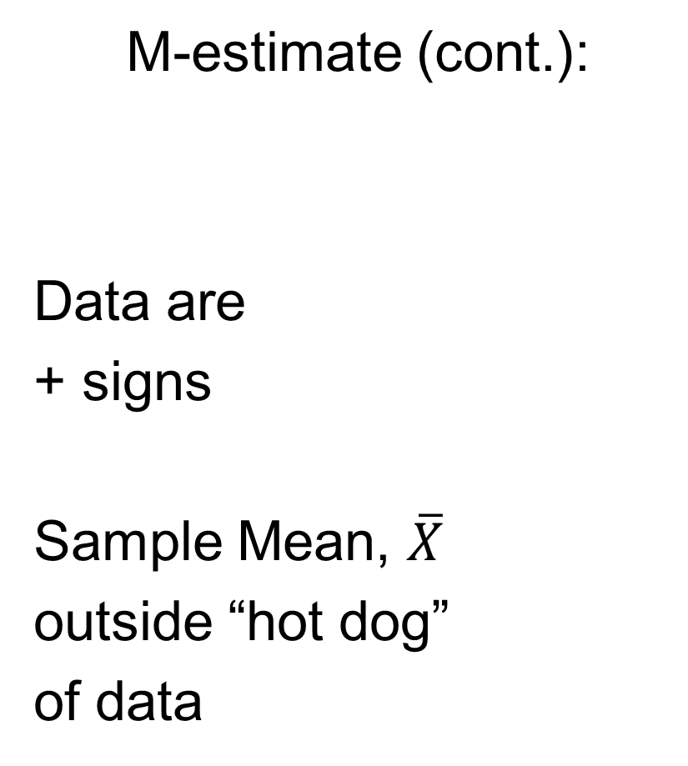
Robust PCA
M-estimate (cont.):
Data are
+ signs
Sample Mean, $\overline{X}$
outside “hot dog”
of data

Slide 18
Robust PCA
M-estimate (cont.):
“Slide sphere
around until
mean (of
projected data)
is at center”

Slide 19
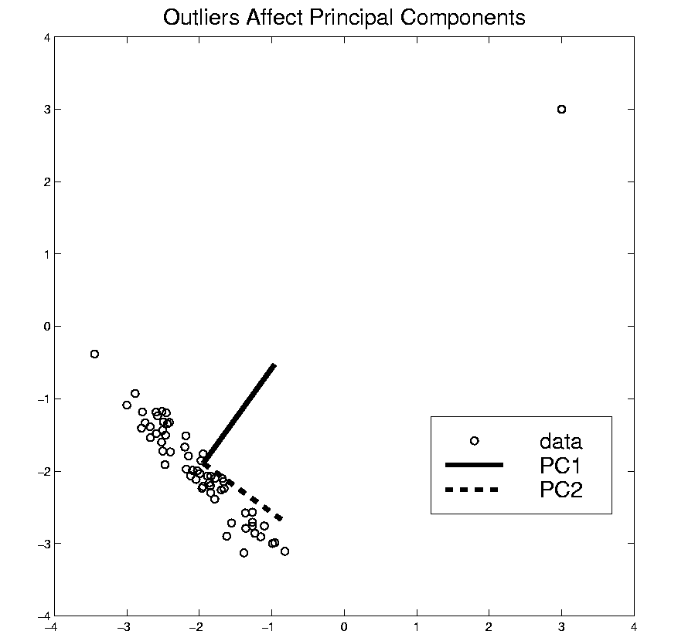
Robust PCA
Now have robust measure of “center”,
how about
“spread”?
I.e. how
can we
do robust
PCA?

Slide 20
Robust PCA
Now have robust measure of “center”,
how about
“spread”?
How
can we
do robust
PCA?

Slide 21
Robust PCA
Approaches to Robust PCA:
Robust Estimation of Covariance Matrix
Projection Pursuit
Spherical PCA

Slide 22
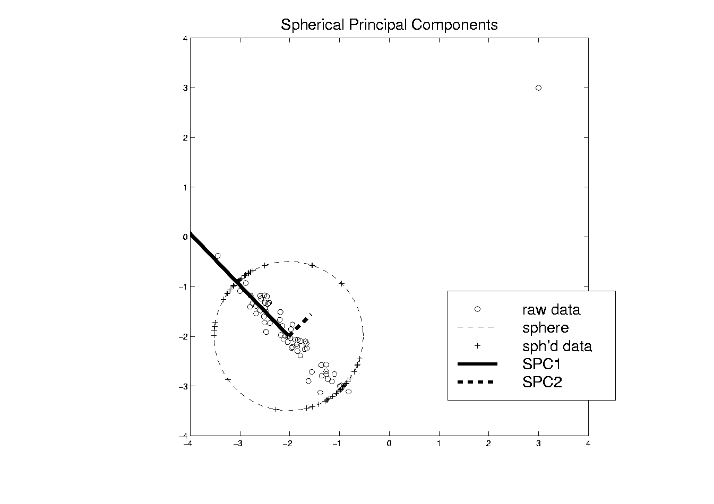
Robust PCA
Robust PCA 3:
Spherical
PCA
Locantore et al (1999)

Slide 23
Robust PCA
Robust PCA 3: Spherical PCA
Idea: use “projection to sphere” idea from M-estimation
In particular project data to centered sphere
“Hot Dog” of data becomes “Ice Caps”
Easily found by PCA (on proj’d data)
Outliers pulled in to reduce influence
Radius of sphere unimportant
Notes:
23

Slide 24
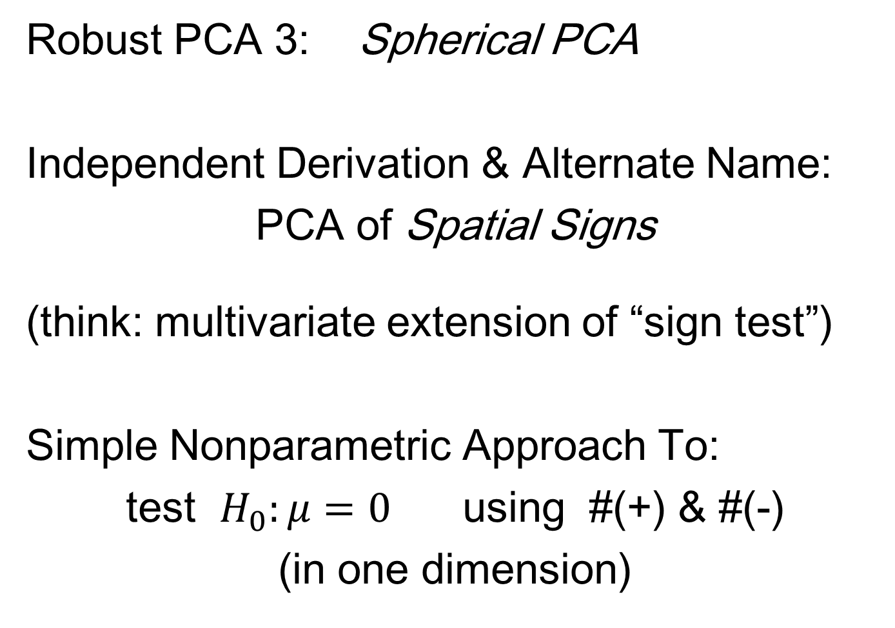
Robust PCA
Robust PCA 3: Spherical PCA
Independent Derivation & Alternate Name:
PCA of Spatial Signs
(think: multivariate extension of “sign test”)
Simple Nonparametric Approach To:
test $H_{0}:μ=0$ using #(+) & #(-)
(in one dimension)
Notes:
24

Slide 25
Robust PCA
Robust PCA 3: Spherical PCA
Independent Derivation & Alternate Name:
PCA of Spatial Signs
Spatial Signs Are
Angles in Polar
Coordinates
Notes:
25

Slide 26

Robust PCA
Robust PCA 3: Spherical PCA
Independent Derivation & Alternate Name:
PCA of Spatial Signs
1st Paper:
Möttönen & Oja (1995)
Complete Description:
Oja (2010)
Notes:
26

Slide 27
Robust PCA
Spatial Signs
Interesting Variation:
Spatial Ranks
Idea: Keep
Track of “Depth”
Via Ranks of Radii
Notes:
27

Slide 28
Robust PCA
Spatial Signs and Ranks
Interesting Decomposition of Variation
(Useful to do PCA of Each)
Parallel to “Amplitude & Phase Variation”
Notes:
28

Slide 29
Robust PCA
Spherical PCA for Toy Example:
Curve Data
With an
Outlier
First recall
Conventional
PCA
Strongly
Impacted
By Outlier
Notes:
29

Slide 30
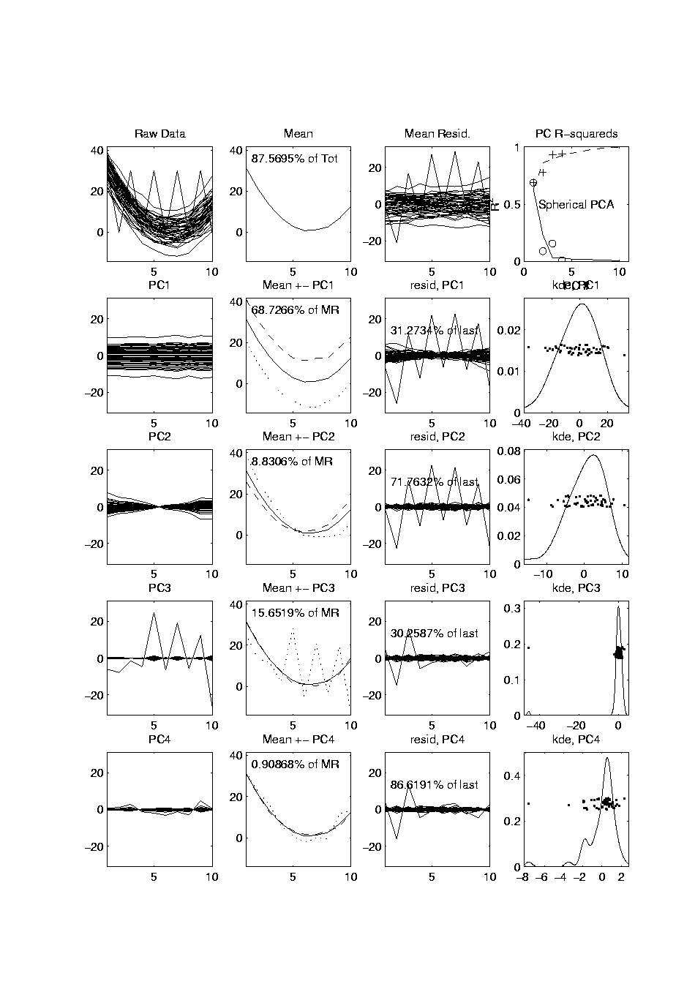
Robust PCA
Mean Looks
Smoother
Spherical PCA for Toy Example:
Now do
Spherical
PCA
Better result?
PC1 Nearly Flat
Lines are Eigenvalues on Sphere
Circles Show Original Variances
PC2 is Tilt (NOT Outlier)
Outlier Demoted to PC3
Notes:
30

Slide 31
Robust PCA
Spherical PCA for Toy Example:
Check out
Later
Components
Notes:
31

Slide 32
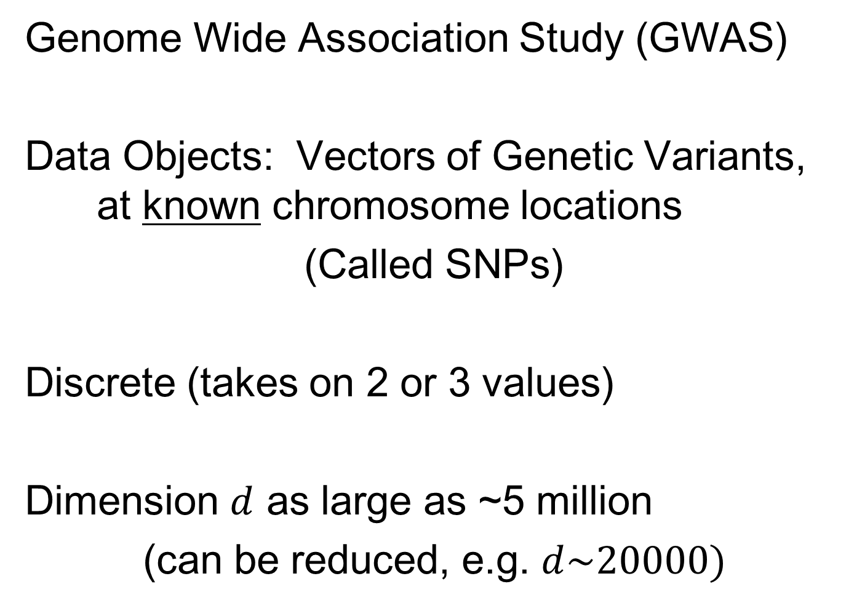
GWAS Data Analysis
Genome Wide Association Study (GWAS)
Data Objects: Vectors of Genetic Variants, at known chromosome locations
(Called SNPs)
Discrete (takes on 2 or 3 values)
Dimension $d$ as large as ~5 million
(can be reduced, e.g. $d\sim 20000)$
How can we visualize such data?

Slide 33
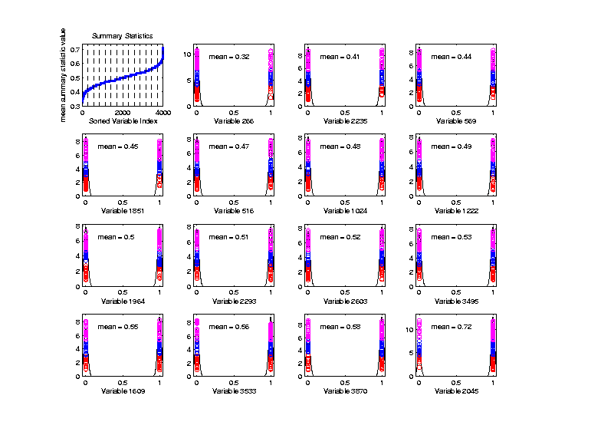
Big Picture View of PCA
Common Fallacy:
PCA only useful for Gaussian data
Clearly NOT
Gaussian
n = 100, d = 4000
Toy Example:
Each Marginal
Binary

Slide 34
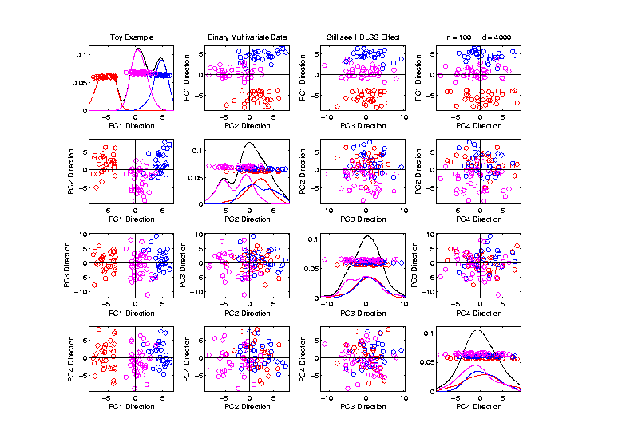
Big Picture View of PCA
Common Fallacy:
PCA only useful for Gaussian data
But PCA
Reveals
Trimodal
Structure

Slide 35

GWAS Data Analysis
Genome Wide Association Study (GWAS)
Cystic Fibrosis Study: Wright et al (2011)
Interesting Feature:
Some Subjects are Close Relatives
(e.g. ~half SNPs are same)

Slide 36
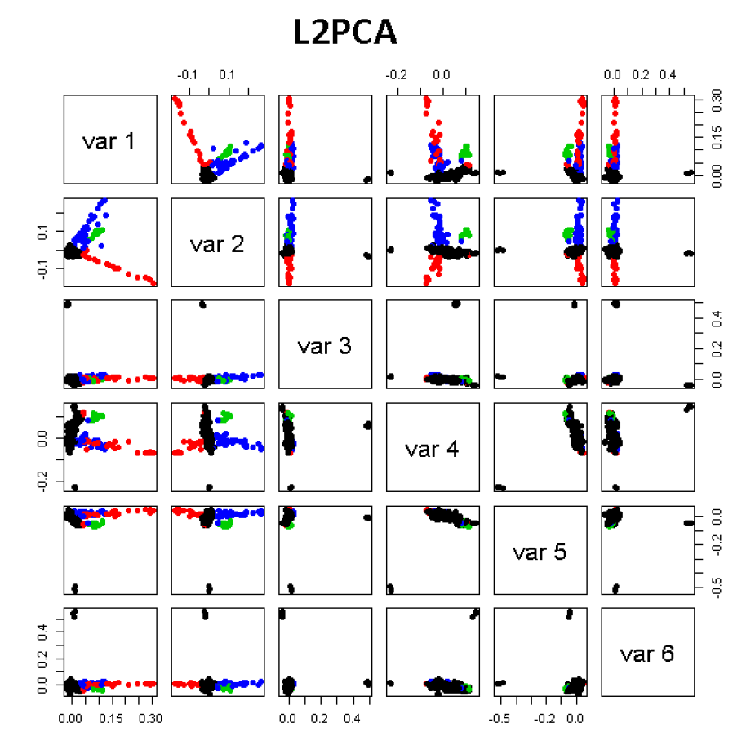
GWAS Data Analysis
PCA View
Clear Ethnic
Groups

Slide 37
GWAS Data Analysis
PCA View
Clear Ethnic
Groups
And Several
Outliers!
Eliminate With
Spherical PCA?

Slide 38
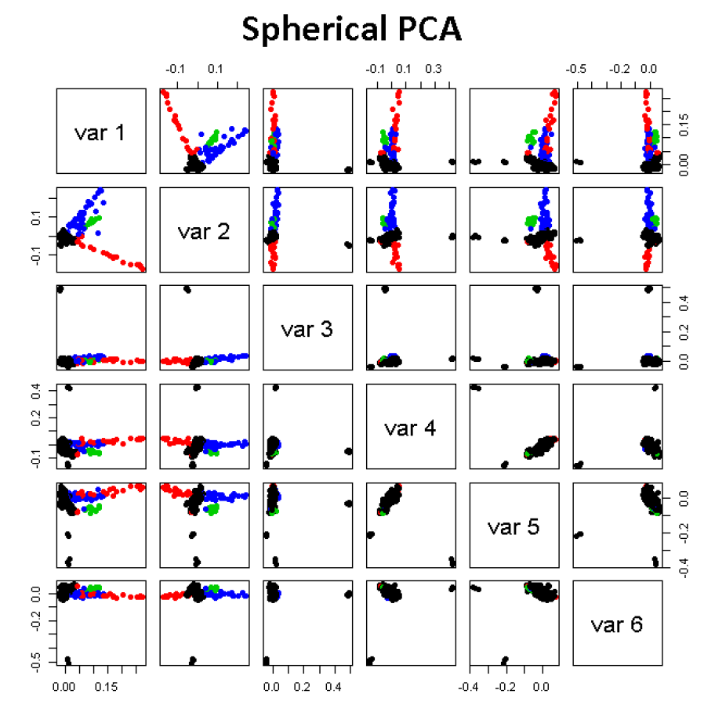
GWAS Data Analysis
Spherical
PCA
Looks Same?!?
What is
going on?
Will Explain
Later

Slide 39
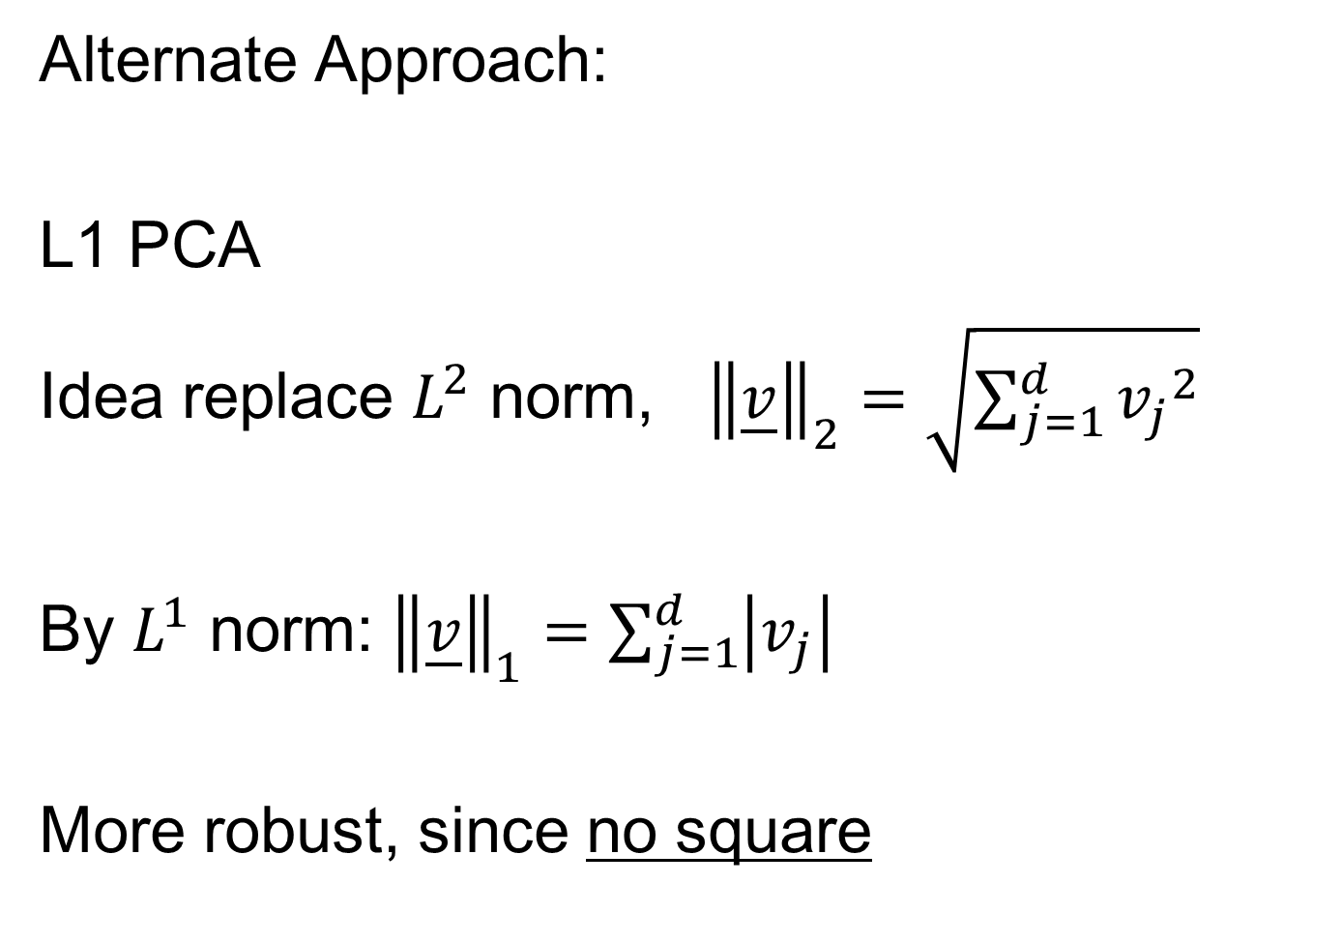
GWAS Data Analysis
Alternate Approach:
L1 PCA
Idea replace $L^{2}$ norm, ${\left\|\underline{v}\right\|}_{2}=\sqrt{\sum_{j=1}^{d}{{v_{j}}^{2}}}$
By $L^{1}$ norm: ${\left\|\underline{v}\right\|}_{1}=\sum_{j=1}^{d}{\left|v_{j}\right|}$
More robust, since no square

Slide 40
L1 Statistics
E.g. Conventional PCA in 2-d
Replace
Best L2 Fit

Slide 41
L1 Statistics
E.g. Conventional PCA in 2-d
Replace
Best L2 Fit
With
Best L1 Fit

Slide 42
L1 Statistics
E.g. Conventional PCA in 2-d
Best L1 Fit
Advantages:
Robust Against Outliers
Good “Sparsity” Properties

Slide 43
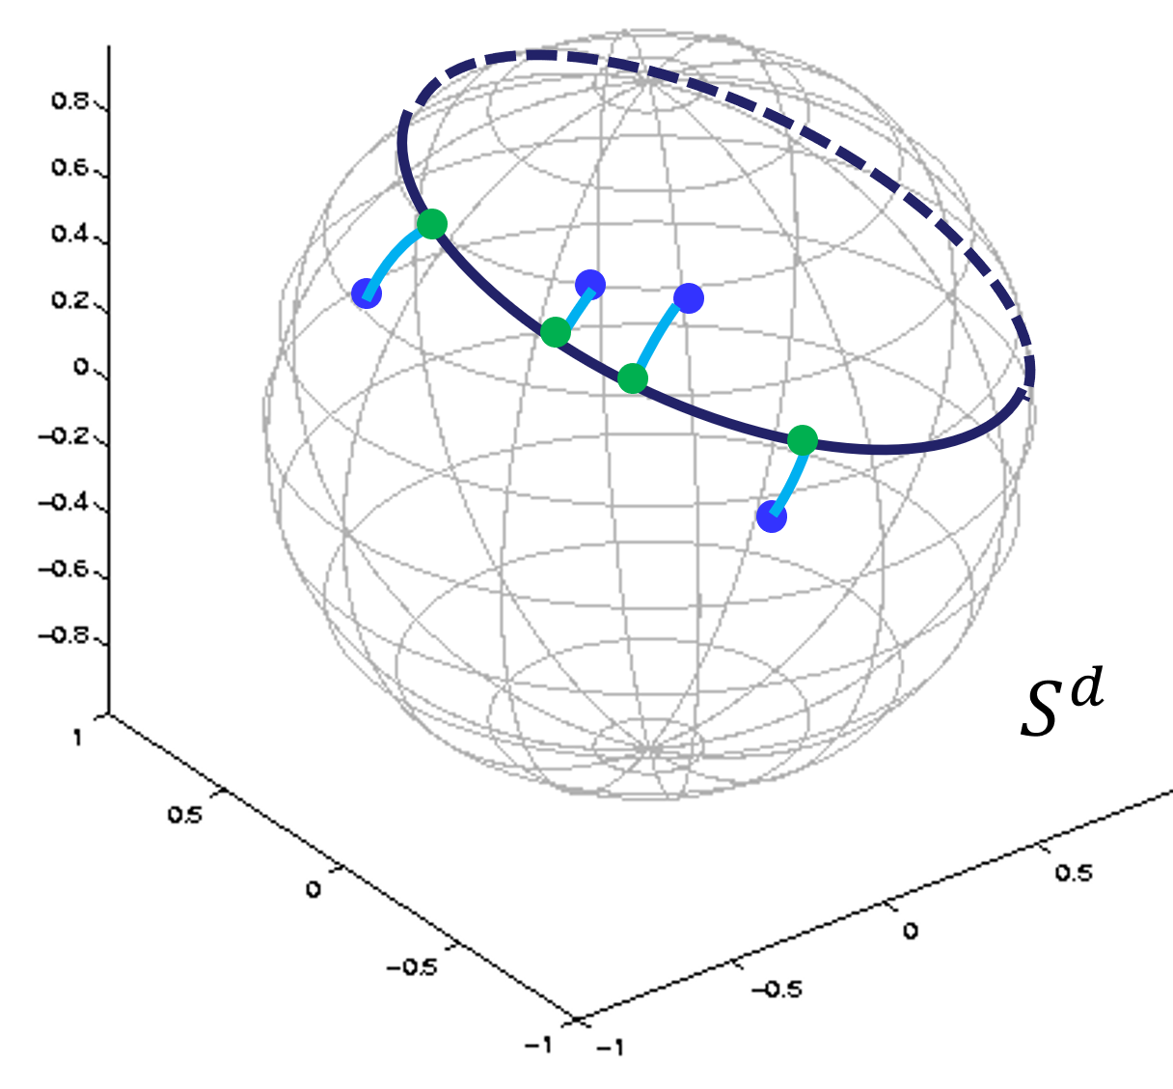
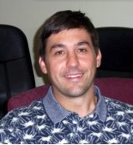


L1 PCA
Recall Backwards PCA From
Principal Nested Spheres
Calculation:
Clever Backwards Algorithm
Brooks, Dulá, Boone (2013)

Slide 44
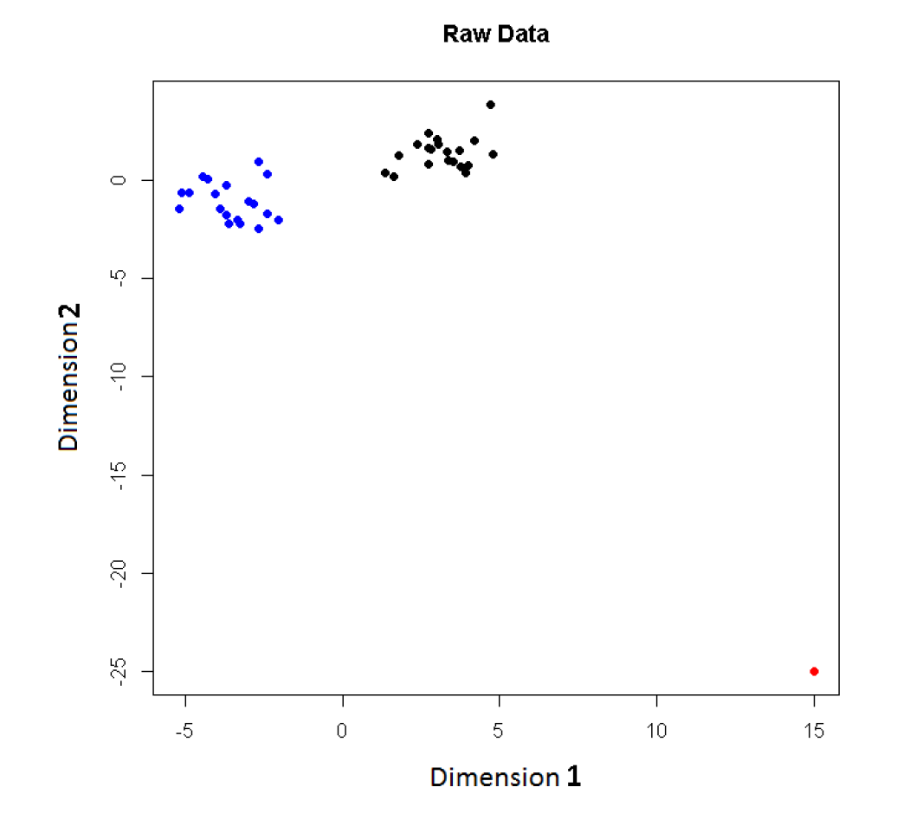
L1 PCA
Challenge:
L1 Projections
Hard to
Interpret
2-d Toy
Example
Note
Outlier

Slide 45
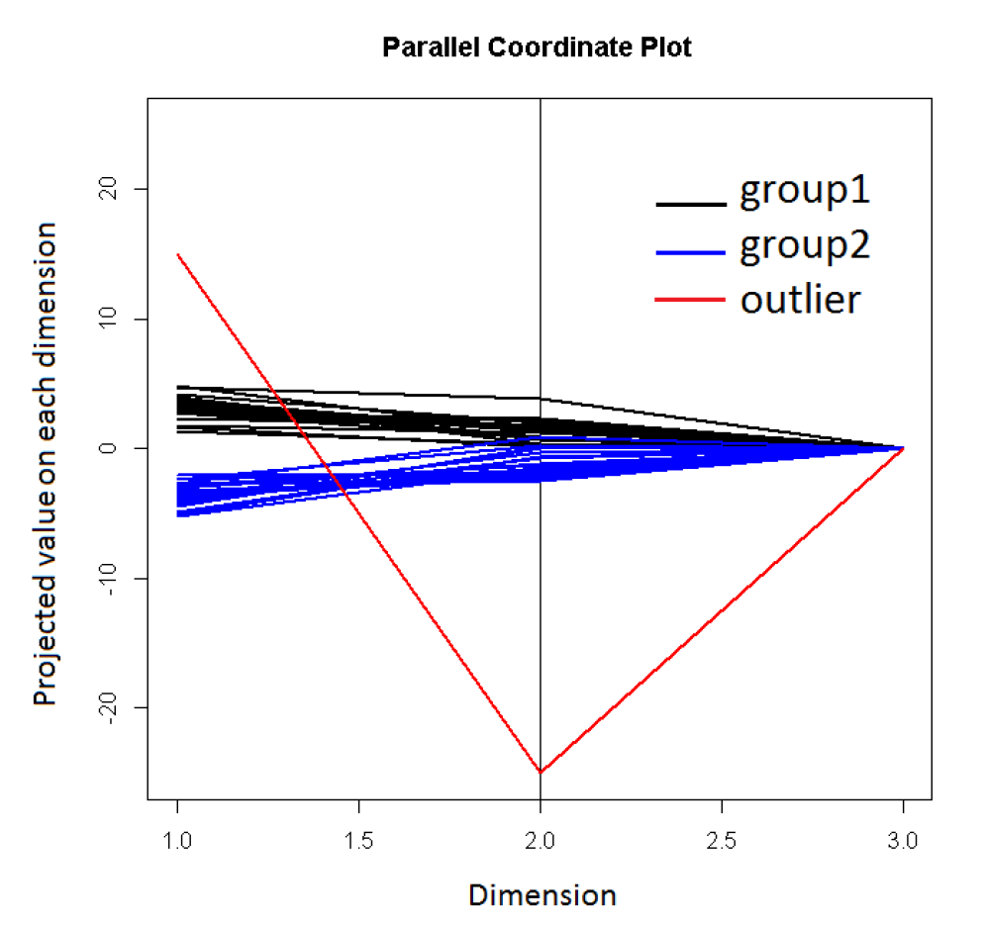
L1 PCA
3rd Coordinate With
Very Small Variation
Challenge:
L1 Projections
Hard to
Interpret
Parallel
Coordinate
View
Clusters Mostly
In Dimension 1
Outlier (+,-)

Slide 46
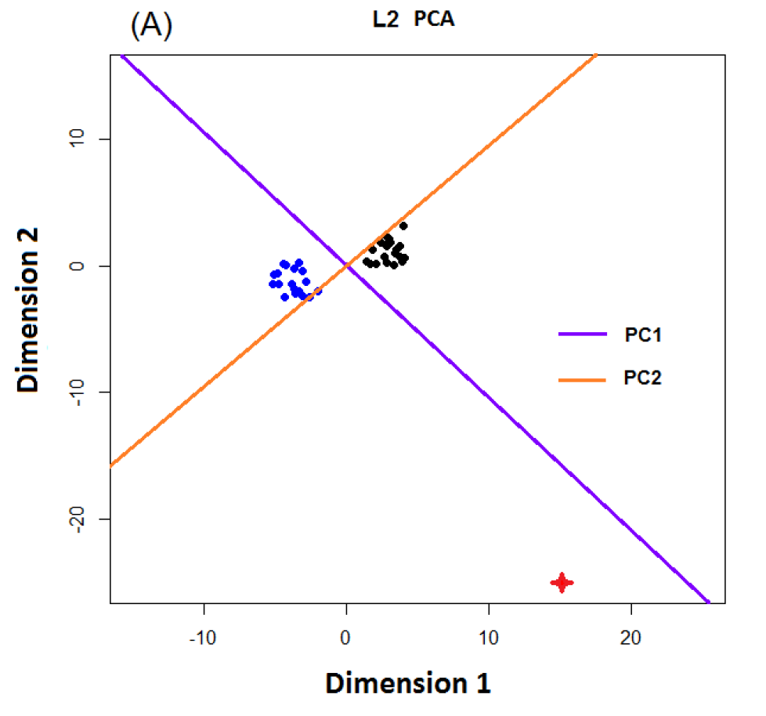
L1 PCA
Conventional
L2 PCA
Outlier Pulls
Off PC1
Direction

Slide 47
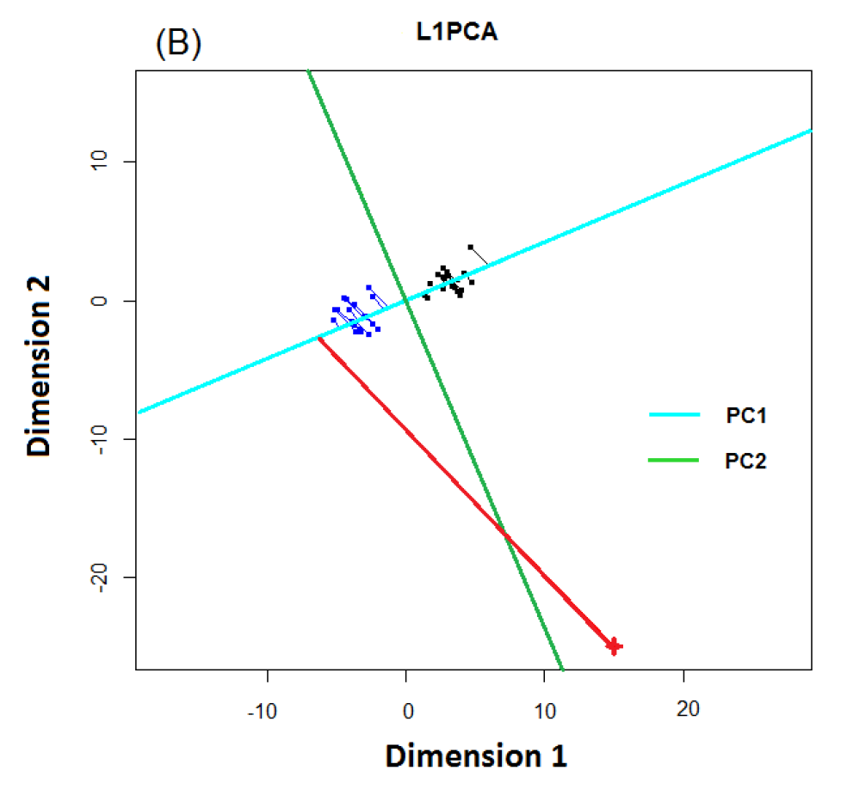
L1 PCA
L1 PCA
Much Better
PC1 Direction

Slide 48
L1 PCA
L1 PCA
Much Better
PC1 Direction
But Very Strange
Projections
(i.e. Little
Data Insight)

Slide 49
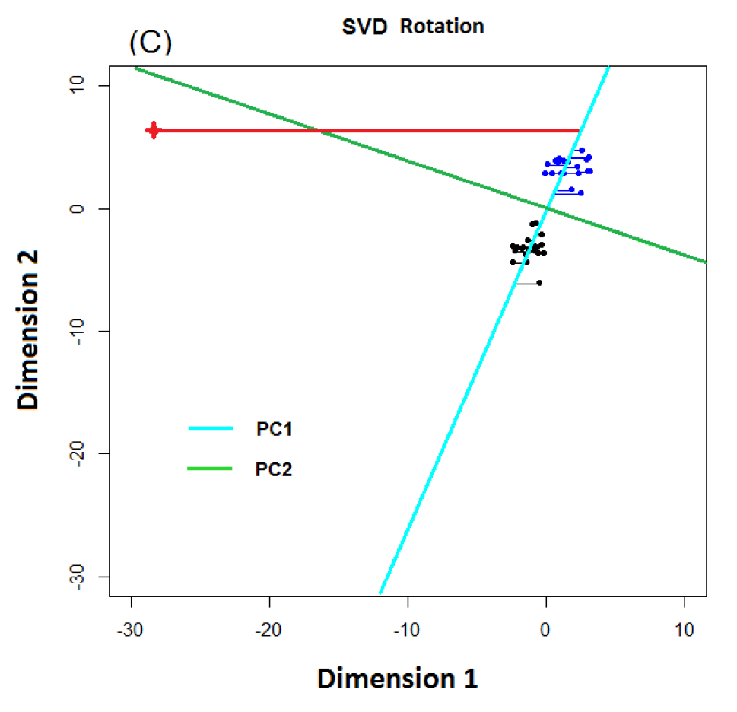
L1 PCA
L1 PCA
Reason:
SVD Rotation
Before L1
Computation
Note: L1 Methods
Not Rotation Invariant

Slide 50

L1 PCA
Challenge: L1 Projections Hard to Interpret
(i.e. Little Data Insight)
Solution:
Compute PC Directions Using L1
Compute Projections (Scores) Using L2
Called “Visual L1 PCA” (VL1PCA)
Zhou & Marron (2016)

Slide 51
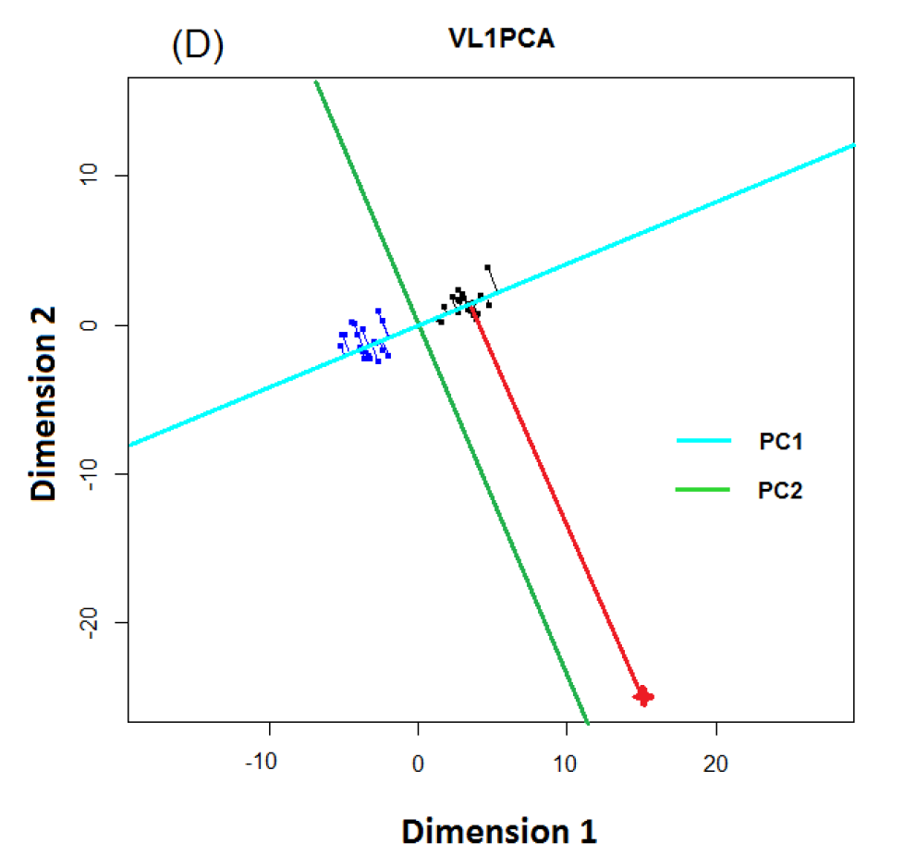
L1 PCA
VL1 PCA
Excellent PC
Directions
Interpretable
Scores

Slide 52
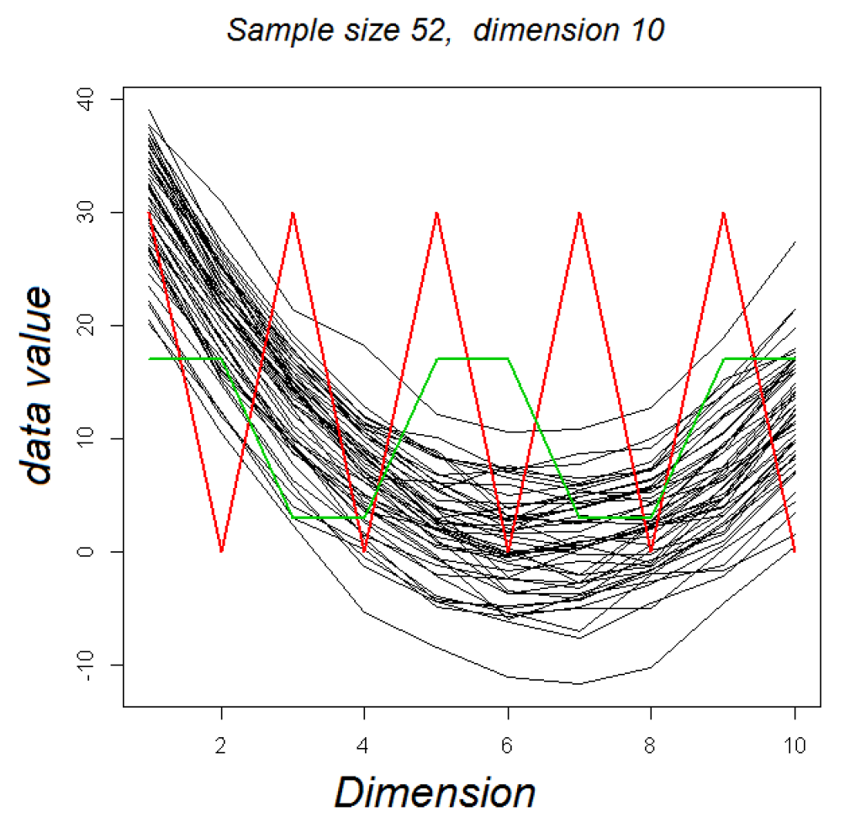
VL1 PCA
10-d Toy Example:
Parabolas
From Before
With Two
Outliers
Half Frequency
So Orthogonal

Slide 53
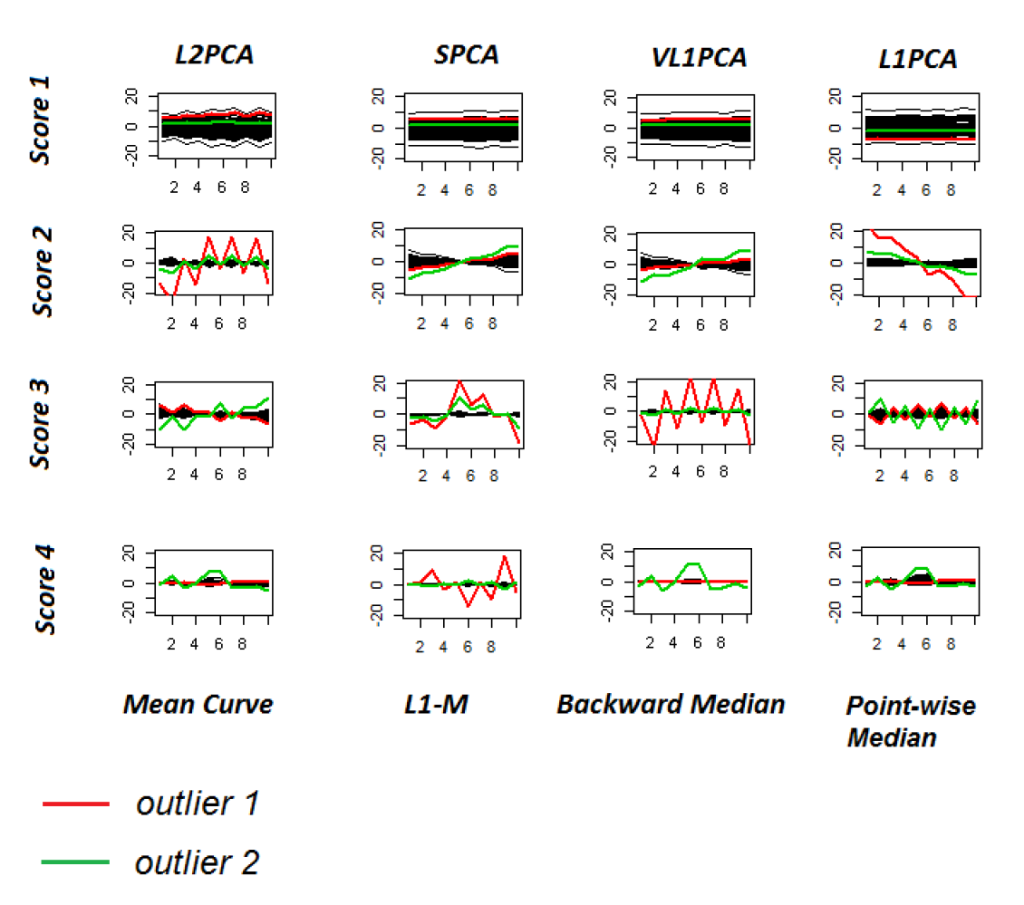
VL1 PCA
10-d Toy Example:
L2PCA
Strongly
Impacted
(In All
Components)
Outlier Impact

Slide 54
VL1 PCA
10-d Toy Example:
SCPA &
VL1PCA
Nicely
Robust
(Vl1PCA
Slightly
Better)
Recover Tilt in PC2
Better Outlier Rep’n

Slide 55
VL1 PCA
10-d Toy Example:
L1PCA
Hard To
Interpret
Nonintuitive Vis’n

Slide 56
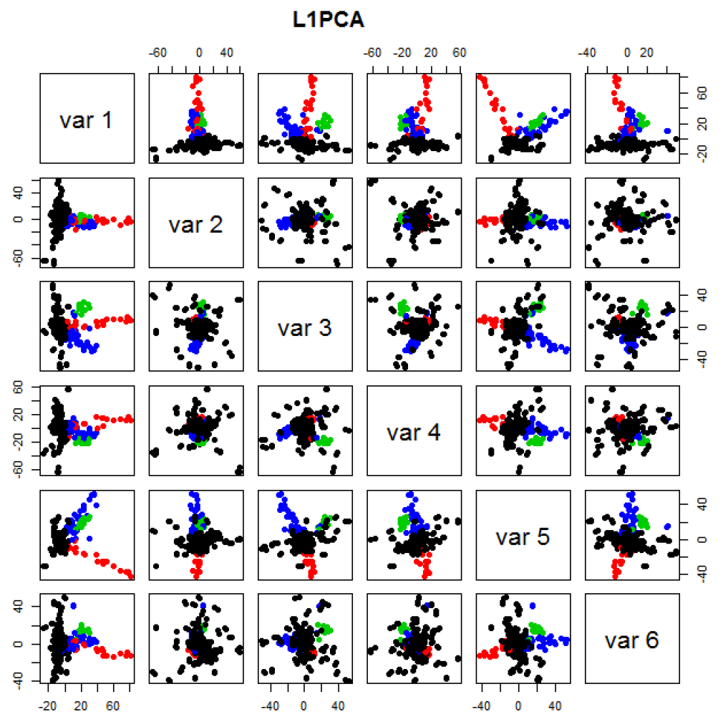
GWAS Data
L1 PCA
No Longer
Feels Outliers
But Still
Highlights
Individuals

Slide 57
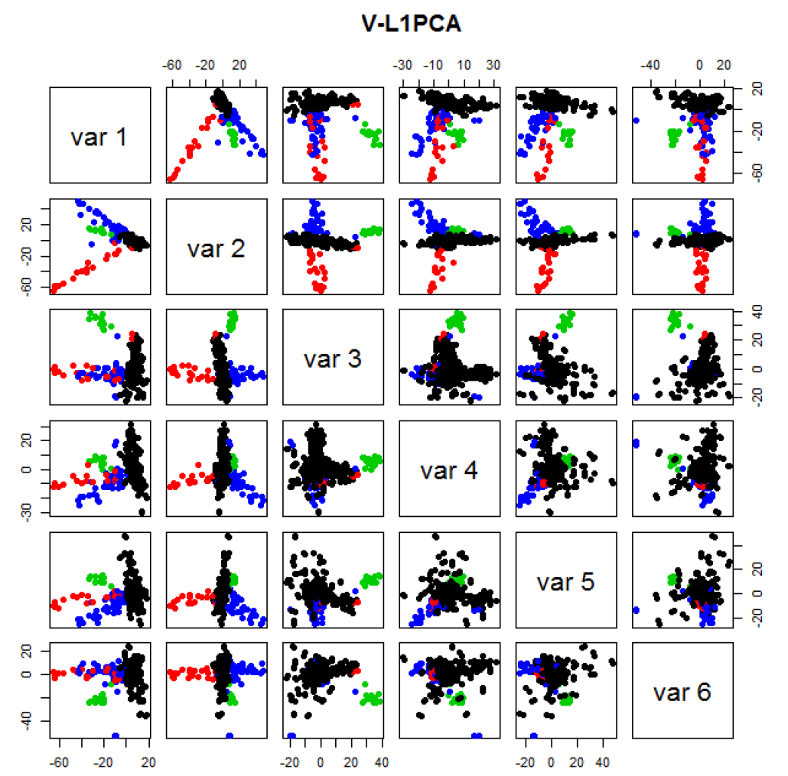
GWAS Data
VL1 PCA
Best Focus
On Ethnic
Groups

Slide 58
GWAS Data
VL1 PCA
Best Focus
On Ethnic
Groups
Seems To
Find Unlabelled
Clusters

Slide 59

HDLSS Asymptotics
Recall Various “Mysteries” about
High Dimension Low Sample Size Data
Natural Separation of $N_{1000}\left(0,I\right)$ Data
Notes:
59

Slide 60
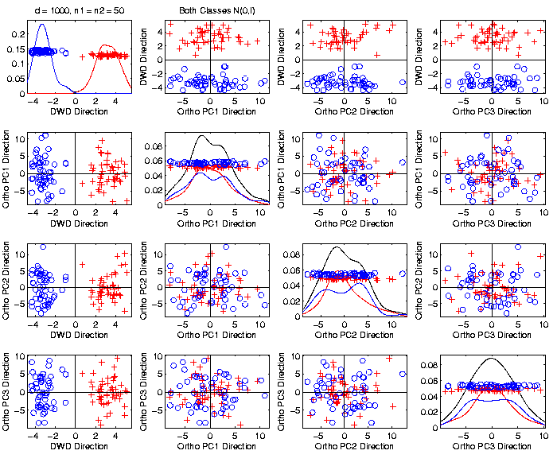
Caution
Toy 2-Class
Example
Separation
Is Natural
Sampling
Variation
(Will Study in Detail Later)

Slide 61
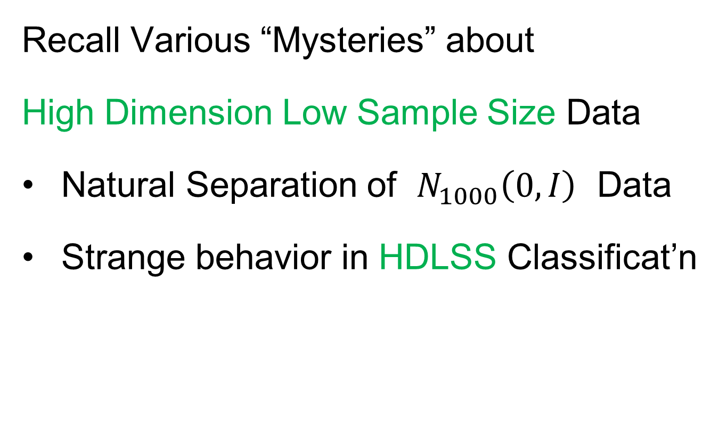
HDLSS Asymptotics
Recall Various “Mysteries” about
High Dimension Low Sample Size Data
Natural Separation of $N_{1000}\left(0,I\right)$ Data
Strange behavior in HDLSS Classificat’n
Notes:
61

Slide 62
HDLSS Discrimination
Mean Difference (Centroid) Method
Far more stable over dimensions
Because is likelihood ratio solution
(for known variance - Gaussians)
Doesn’t feel HDLSS boundary
Eventually becomes too good?!?
Widening gap between clusters?!?
Careful: angle to optimal grows
So lose generalizability (since noise inc’s)
HDLSS data present some odd effects…

Slide 63
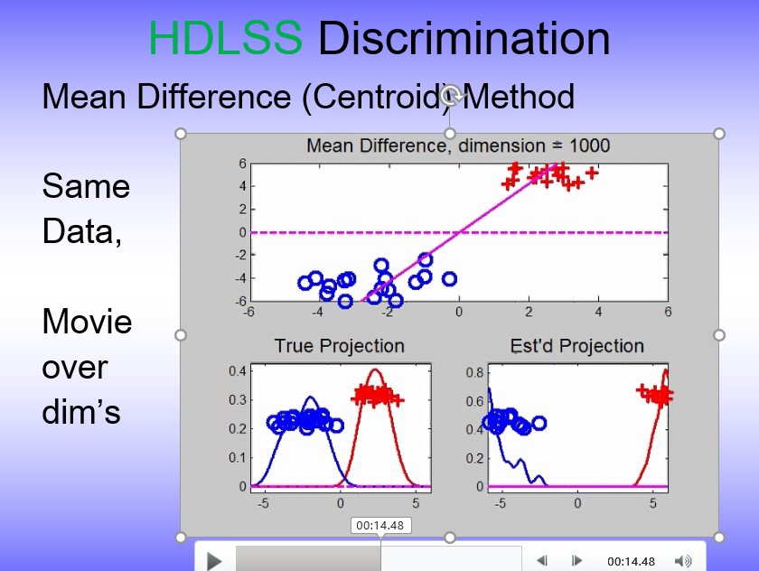
HDLSS Discrimination
Mean Difference (Centroid) Method
Far more stable over dimensions
Because is likelihood ratio solution
(for known variance - Gaussians)
Doesn’t feel HDLSS boundary
Eventually becomes too good?!?
Widening gap between clusters?!?
Careful: angle to optimal grows
So lose generalizability (since noise inc’s)
HDLSS data present some odd effects…

Slide 64
HDLSS Discrim’n Simulations
Can we say more about:
All methods come together
in very high dimensions???
Mathematical Statistical Question:
Mathematics behind this???
Notes:
64

Slide 65
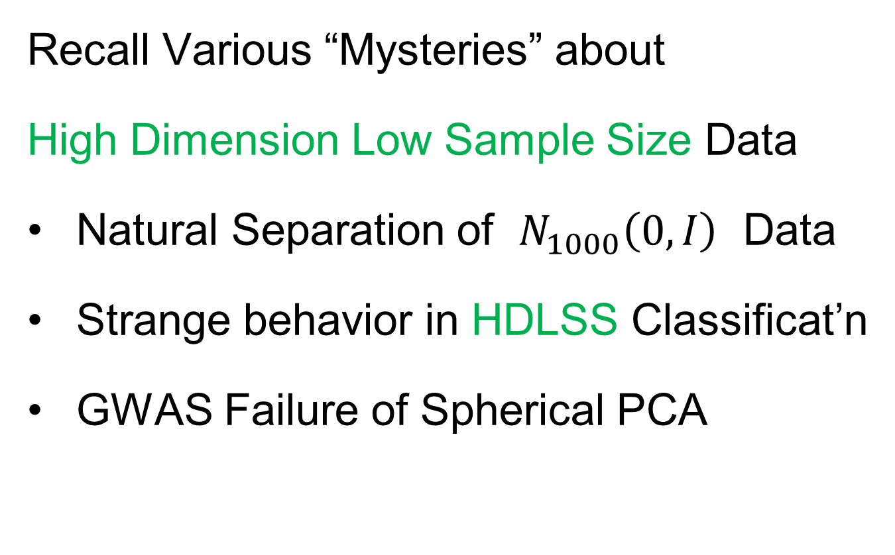
HDLSS Asymptotics
Recall Various “Mysteries” about
High Dimension Low Sample Size Data
Natural Separation of $N_{1000}\left(0,I\right)$ Data
Strange behavior in HDLSS Classificat’n
GWAS Failure of Spherical PCA
Notes:
65

Slide 66
GWAS Data Analysis
PCA View
Clear Ethnic
Groups
And Several
Outliers!
Eliminate With
Spherical PCA?

Slide 67
GWAS Data Analysis
Spherical
PCA
Looks Same?!?
What is
going on?
Will Explain
Later

Slide 68
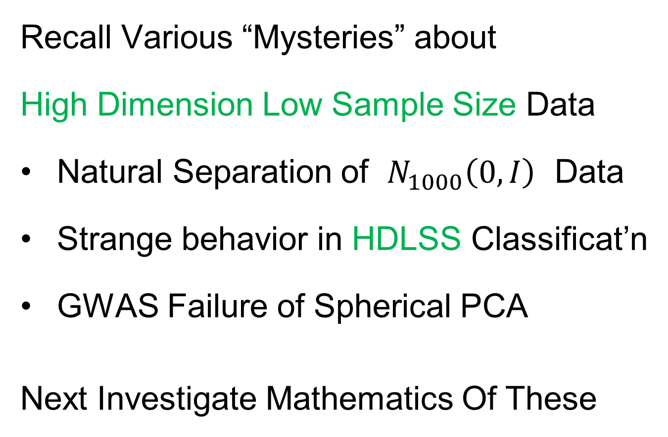
HDLSS Asymptotics
Recall Various “Mysteries” about
High Dimension Low Sample Size Data
Natural Separation of $N_{1000}\left(0,I\right)$ Data
Strange behavior in HDLSS Classificat’n
GWAS Failure of Spherical PCA
Next Investigate Mathematics Of These
Notes:
68

Slide 69
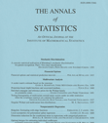
HDLSS Asymptotics
Modern Mathematical Statistics:
Based on asymptotic analysis
Notes:
69

Slide 70
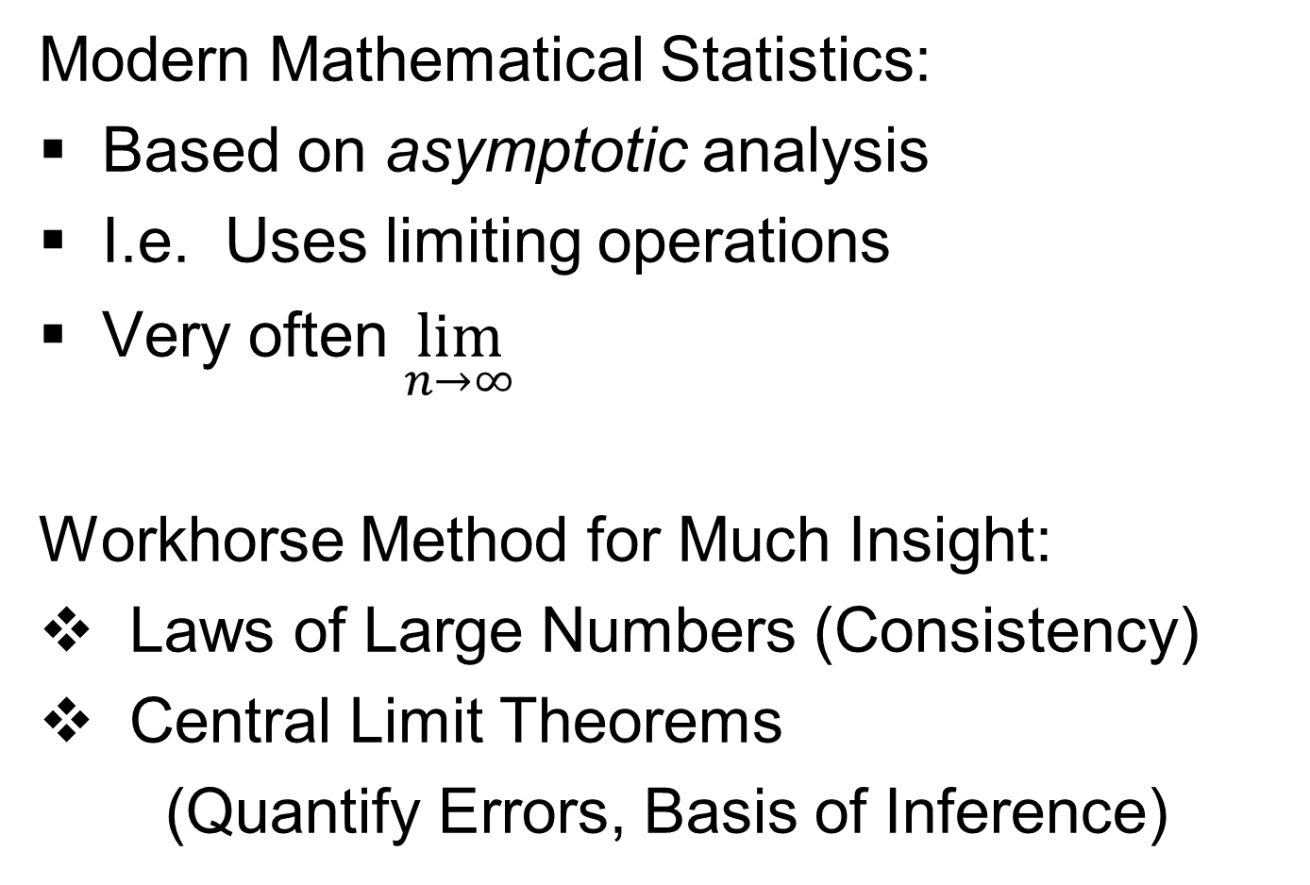
HDLSS Asymptotics
Modern Mathematical Statistics:
Based on asymptotic analysis
I.e. Uses limiting operations
Very often $\lim_{n→∞}{}$
Workhorse Method for Much Insight:
Laws of Large Numbers (Consistency)
Central Limit Theorems
(Quantify Errors, Basis of Inference)
Notes:
70

Slide 71
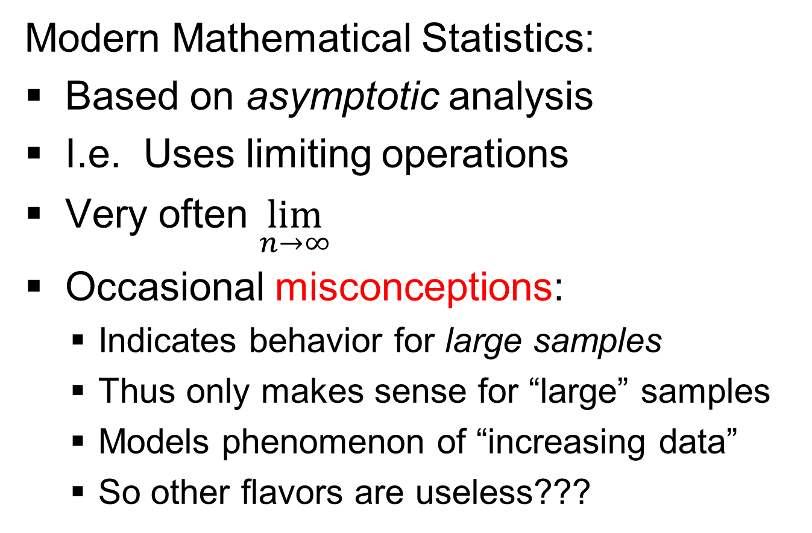
HDLSS Asymptotics
Modern Mathematical Statistics:
Based on asymptotic analysis
I.e. Uses limiting operations
Very often $\lim_{n→∞}{}$
Occasional misconceptions:
Indicates behavior for large samples
Thus only makes sense for “large” samples
Models phenomenon of “increasing data”
So other flavors are useless???
Notes:
71

Slide 72
HDLSS Asymptotics
Modern Mathematical Statistics:
Based on asymptotic analysis
Real Reasons:
Approximation provides insights
Can find simple underlying structure
In complex situations
Thus various flavors are fine:
$$\lim_{n→∞}{} \lim_{d→∞}{} \lim_{n,d→∞}{} \lim_{σ→0}{}$$
Even desirable! (find additional insights)
Notes:
72

Slide 73
HDLSS Asymptotics
Personal Observations:
HDLSS world is…
Surprising (many times!)
[Think I’ve got it, and then …]
Mathematically Beautiful (?)
Practically Relevant

Slide 74
Participant Presentation
Richard Sizelove:
Integrative Analysis for Brain Functional Networks
Sumit Kar:
Community structure in biological networks

