Slide 1
Participant Presentations
Please Send Title:
Wei Gu

Slide 2
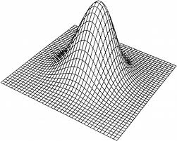
HDLSS Asymptotics: Simple Paradoxes
For $d$ dimensional Standard Normal dist’n:
$$\underline{Z}=\left(\begin{matrix}Z_{1} \\ ⋮ \\ Z_{d}\end{matrix}\right)\sim N_{d}\left(0,I_{d}\right)$$
Where are the Data?
Near Peak of Density?
Thanks to: psycnet.apa.org

Slide 3
HDLSS Asymptotics: Simple Paradoxes
As $d→∞$,
$$\left\|\underline{Z}\right\|=\sqrt{d}+O_{p}\left(1\right)$$
Data lie roughly on surface of sphere,
with radius $\sqrt{d}$
- Yet origin is point of highest density???
- Paradox resolved by:
density w. r. t. Lebesgue Measure
Notes:
3

Slide 4
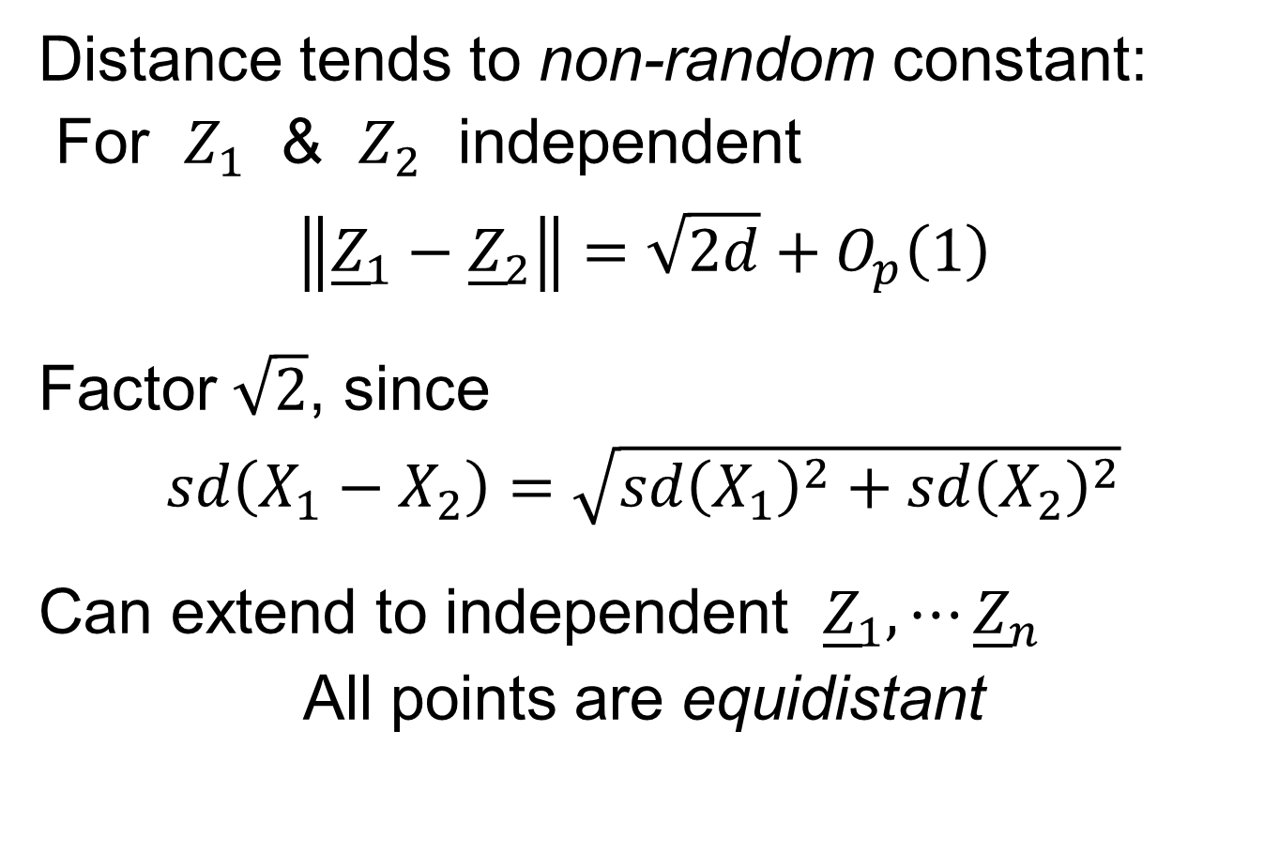
HDLSS Asymptotics: Simple Paradoxes
Distance tends to non-random constant:
For $Z_{1}$ & $Z_{2}$ independent
$$\left\|{\underline{Z}}_{1}−{\underline{Z}}_{2}\right\|=\sqrt{2d}+O_{p}\left(1\right)$$
Factor $\sqrt{2}$, since
$sd\left(X_{1}−X_{2}\right)=\sqrt{{sd\left(X_{1}\right)}^{2}+{sd\left(X_{2}\right)}^{2}}$
Can extend to independent ${\underline{Z}}_{1},⋯{\underline{Z}}_{n}$
All points are equidistant
(We can only perceive 3 dimensions)
Notes:
4

Slide 5
HDLSS Asymptotics: Simple Paradoxes
For $d$ dim’al Standard Normal dist’n:
${\underline{Z}}_{1}$ indep. of ${\underline{Z}}_{2}\sim N_{d}\left(\underline{0},I_{d}\right)$
High dim’al Angles (as $d→∞$):
$$Angle\left({\underline{Z}}_{1},{\underline{Z}}_{2}\right)={90}^{°}+O_{p}\left(d^{−1/2}\right)$$
- Everything is orthogonal???

Slide 6
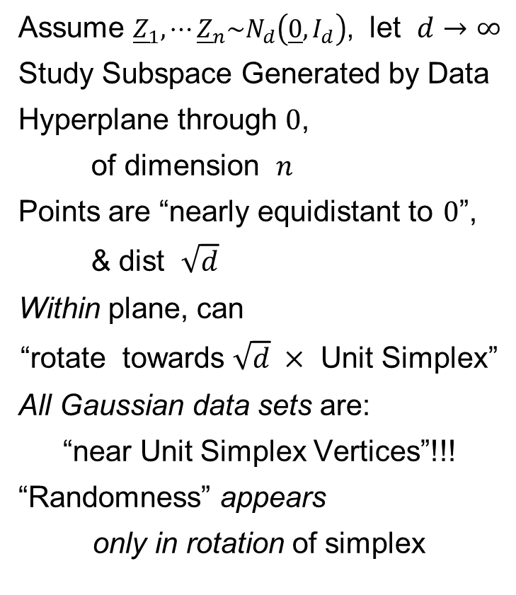
HDLSS Asy’s: Geometrical Represent’n
Assume ${\underline{Z}}_{1},⋯{\underline{Z}}_{n}\sim N_{d}\left(\underline{0},I_{d}\right)$, let $d→∞$
Study Subspace Generated by Data
Hyperplane through $0$,
of dimension $n$
Points are “nearly equidistant to $0$”,
& dist $\sqrt{d}$
Within plane, can
“rotate towards $\sqrt{d} ×$ Unit Simplex”
All Gaussian data sets are:
“near Unit Simplex Vertices”!!!
“Randomness” appears
only in rotation of simplex
Hall, Marron & Neeman (2005)

Slide 7
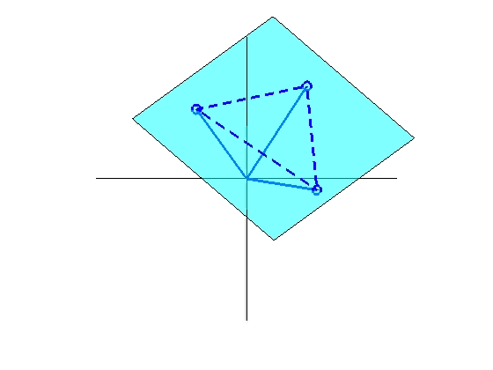
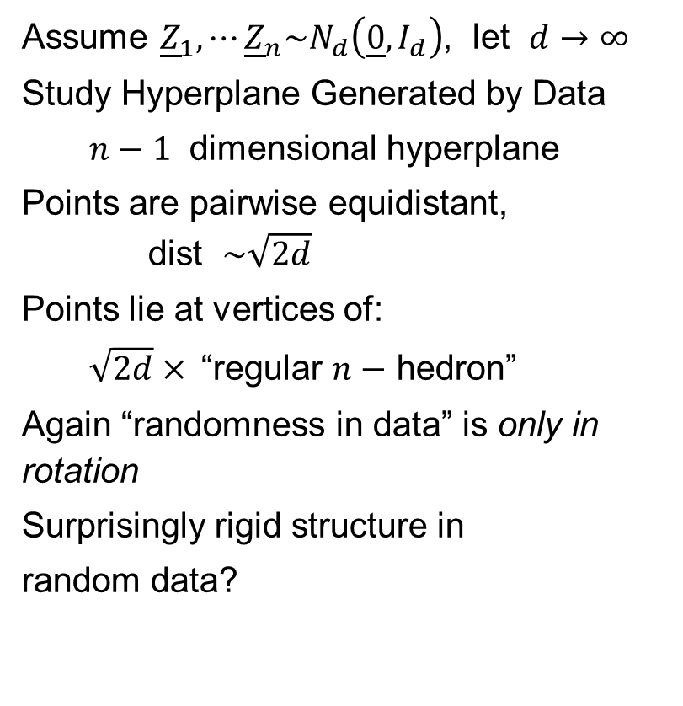
HDLSS Asy’s: Geometrical Represent’n
Assume ${\underline{Z}}_{1},⋯{\underline{Z}}_{n}\sim N_{d}\left(\underline{0},I_{d}\right)$, let $d→∞$
Study Hyperplane Generated by Data
$n−1$ dimensional hyperplane
Points are pairwise equidistant, dist $\sim \sqrt{2d}$
Points lie at vertices of:
$\sqrt{2d}×$“regular $n−$ hedron”
Again “randomness in data” is only in rotation
Surprisingly rigid structure in
random data?

Slide 8
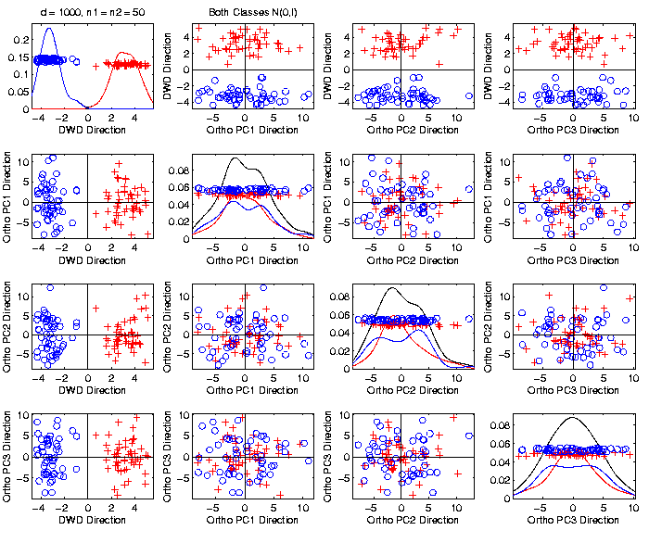

An Interesting HDLSS Explanation
Recall Two
Class $N\left(0,I\right)$
Example
$\left\|\overline{x_{1}}−\overline{x_{2}}\right\|$
$≈6.3$

Slide 9
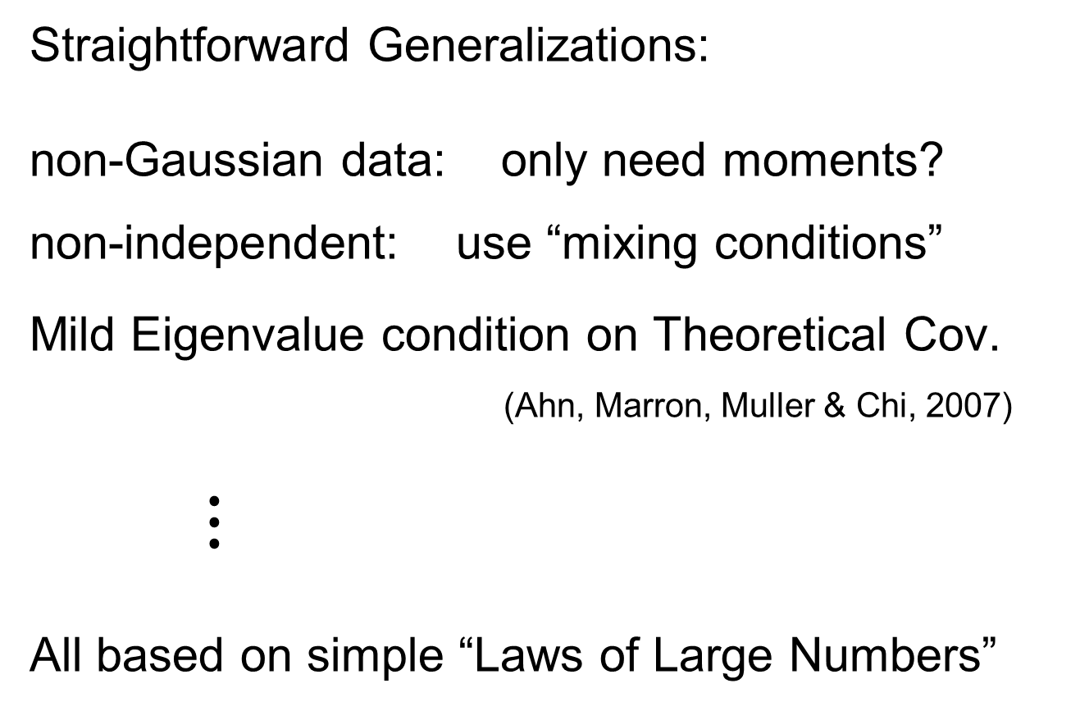
HDLSS Asy’s: Geometrical Represen’tion
Straightforward Generalizations:
non-Gaussian data: only need moments?
non-independent: use “mixing conditions”
Mild Eigenvalue condition on Theoretical Cov.
(Ahn, Marron, Muller & Chi, 2007)
$⋮$
All based on simple “Laws of Large Numbers”

Slide 10
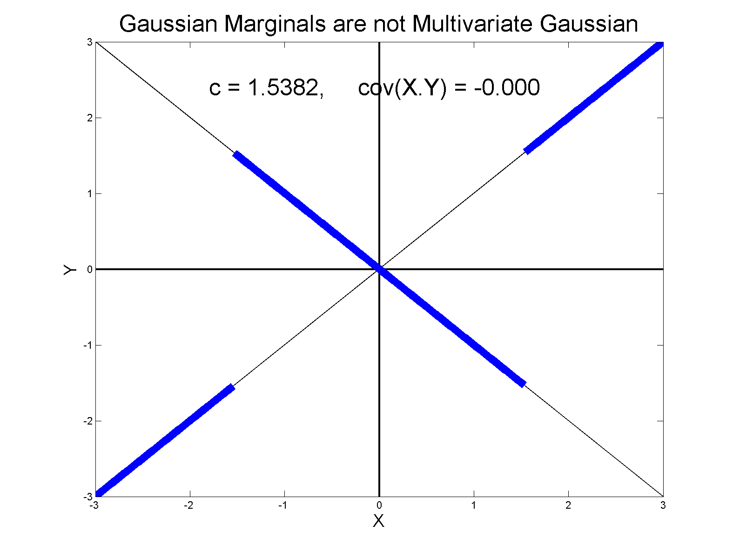
0 Covariance is not independence
Simple Example, c to make cov(X,Y) = 0
Yet Strongly Dependent!

Slide 11
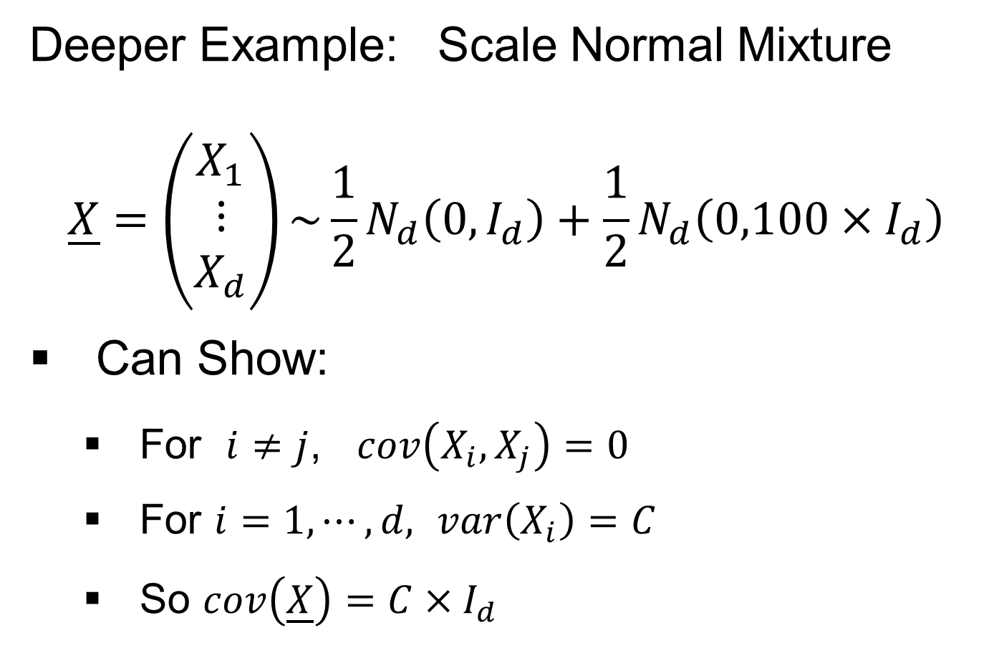
0 Covariance is not independence
Deeper Example: Scale Normal Mixture
$$\underline{X}=\left(\begin{matrix}X_{1} \\ ⋮ \\ X_{d}\end{matrix}\right)\sim {\frac{1}{2}N}_{d}\left(0,I_{d}\right)+\frac{1}{2}N_{d}\left(0,100×I_{d}\right)$$
Can Show:
For $i≠j$, $cov\left(X_{i},X_{j}\right)=0$
For $i=1,⋯,d,$ $var\left(X_{i}\right)=C$
So $cov\left(\underline{X}\right)=C×I_{d}$

Slide 12
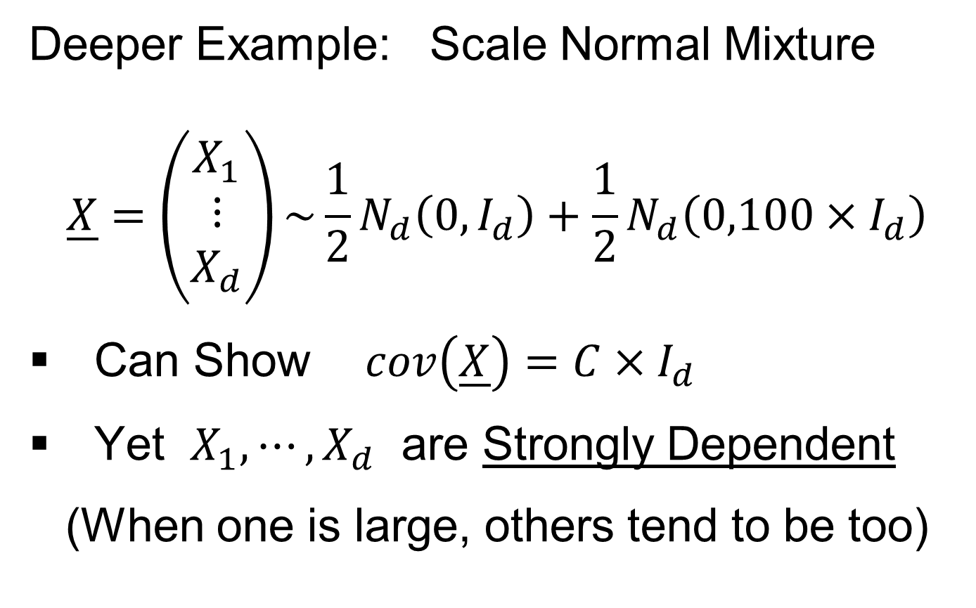
0 Covariance is not independence
Deeper Example: Scale Normal Mixture
$$\underline{X}=\left(\begin{matrix}X_{1} \\ ⋮ \\ X_{d}\end{matrix}\right)\sim {\frac{1}{2}N}_{d}\left(0,I_{d}\right)+\frac{1}{2}N_{d}\left(0,100×I_{d}\right)$$
Can Show $cov\left(\underline{X}\right)=C×I_{d}$
Yet $X_{1},⋯,X_{d}$ are Strongly Dependent
(When one is large, others tend to be too)

Slide 13
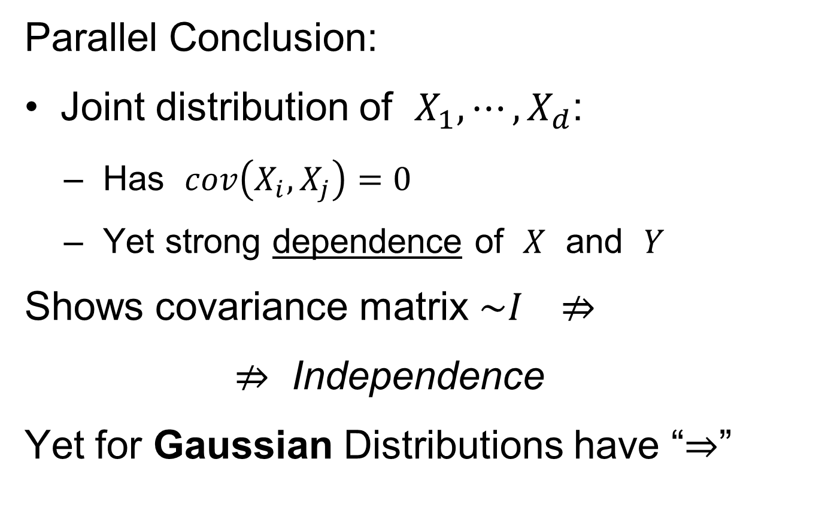
0 Covariance is not independence
Parallel Conclusion:
Joint distribution of $X_{1},⋯,X_{d}$:
Has $cov\left(X_{i},X_{j}\right)=0$
Yet strong dependence of $X$ and $Y$
Shows covariance matrix $\sim I ⇏$
$⇏$ Independence
Yet for Gaussian Distributions have “$⇒$”

Slide 14
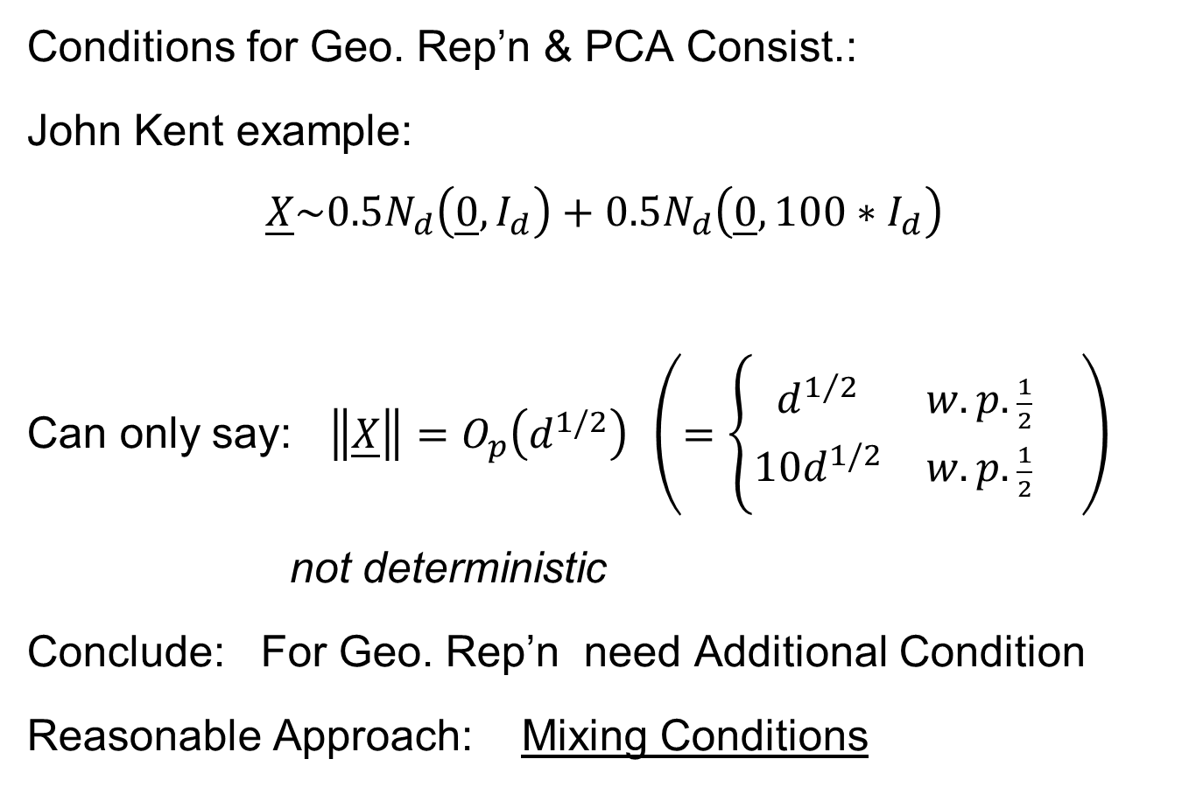
HDLSS Math. Stat. of PCA
Conditions for Geo. Rep’n & PCA Consist.:
John Kent example:
$$\underline{X}\sim 0.5N_{d}\left(\underline{0},I_{d}\right)+0.5N_{d}\left(\underline{0},{100∗I}_{d}\right)$$
Can only say: $\left\|\underline{X}\right\|=O_{p}\left(d^{1/2}\right)$ $\left(=\left\{\begin{matrix}d^{1/2} & w.p.\frac{1}{2} \\ 10d^{1/2} & w.p.\frac{1}{2}\end{matrix}\right. \right)$
not deterministic
Conclude: For Geo. Rep’n need Additional Condition
Reasonable Approach: Mixing Conditions

Slide 15
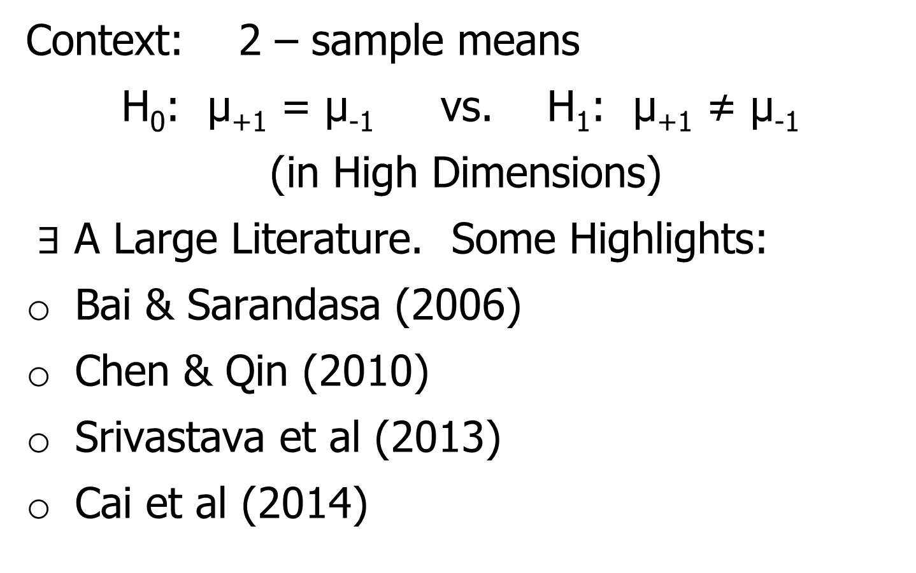
Mixing Conditions
Idea From Probability Theory:
Recall Standard Asymptotic Results, as $n→∞:$
Law of Large Numbers,
$$\overline{X}→μ$$
(“Weak” = in prob., “Strong” = a.s.)

Slide 16
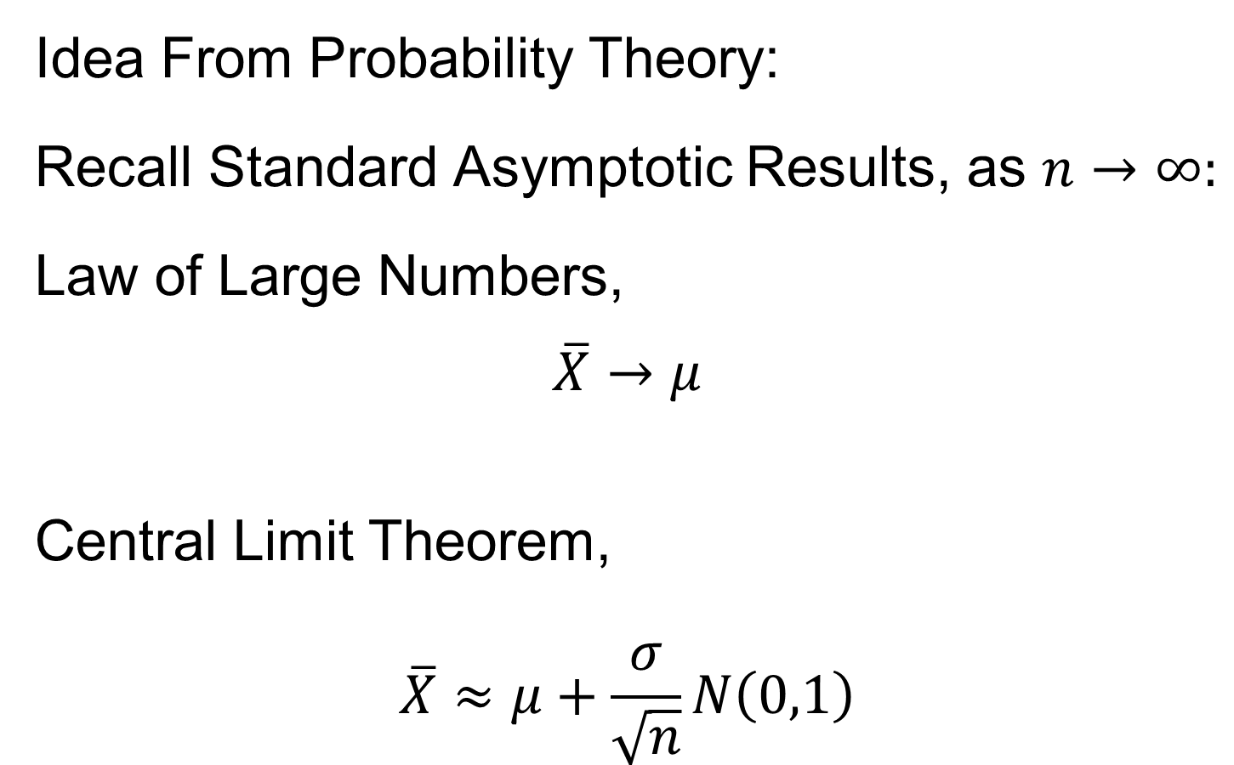
Mixing Conditions
Idea From Probability Theory:
Recall Standard Asymptotic Results, as $n→∞:$
Law of Large Numbers,
$$\overline{X}→μ$$
Central Limit Theorem,
$$\overline{X}≈μ+\frac{σ}{\sqrt{n}}N\left(0,1\right)$$

Slide 17
Mixing Conditions
Idea From Probability Theory:
Law of Large Numbers,
Central Limit Theorem,
Both have Technical Assumptions
(Usually Ignore ???)

Slide 18
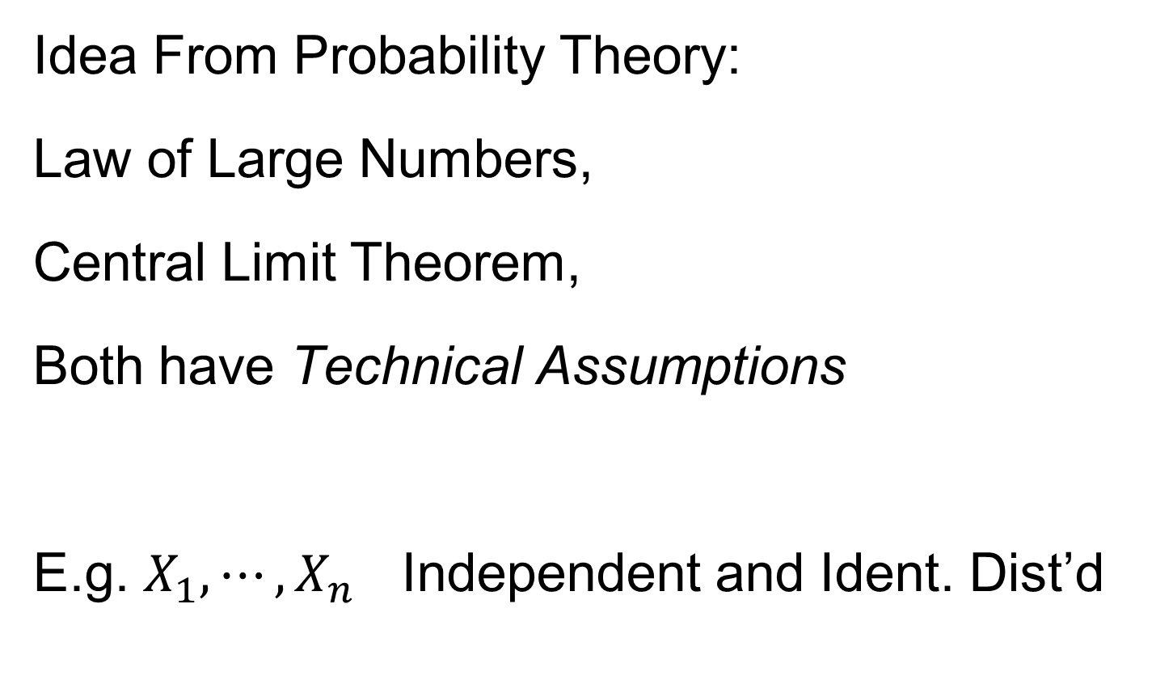
Mixing Conditions
Idea From Probability Theory:
Law of Large Numbers,
Central Limit Theorem,
Both have Technical Assumptions
E.g. $X_{1},⋯,X_{n}$ Independent and Ident. Dist’d

Slide 19
Mixing Conditions
Idea From Probability Theory:
Mixing Conditions:
Explore Weaker Assumptions, to Still Get
Law of Large Numbers,
Central Limit Theorem

Slide 20

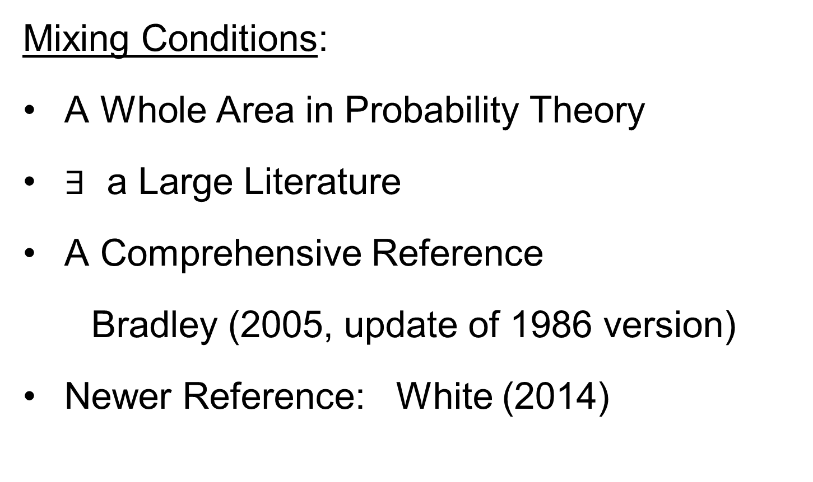
Mixing Conditions
Mixing Conditions:
A Whole Area in Probability Theory
$∃$ a Large Literature
A Comprehensive Reference
Bradley (2005, update of 1986 version)
Newer Reference: White (2014)

Slide 21
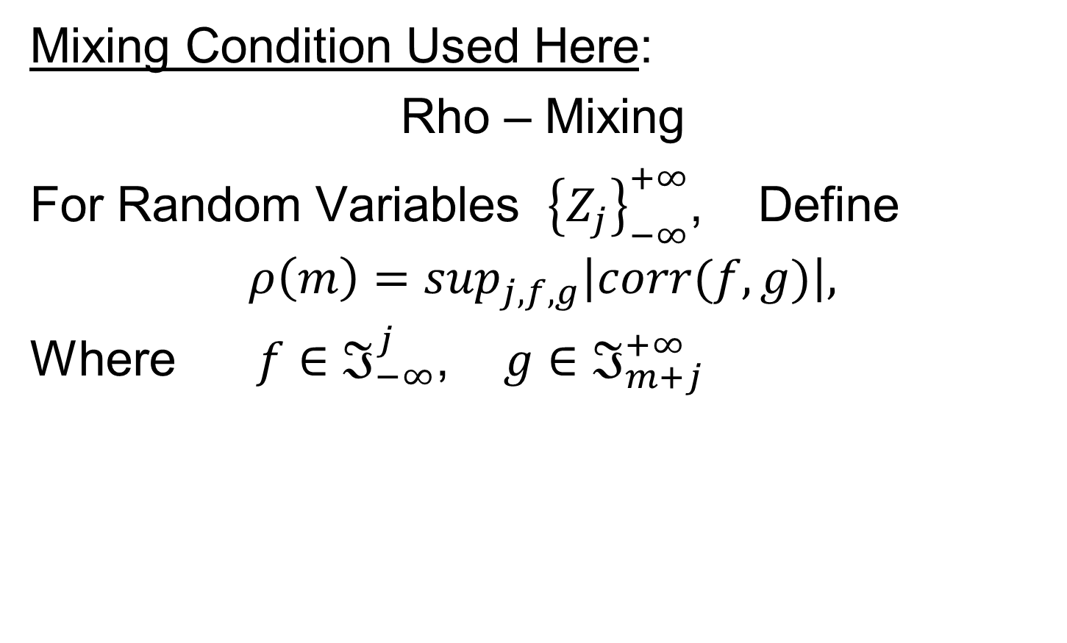
Mixing Conditions
Mixing Condition Used Here:
Rho – Mixing
For Random Variables ${\left\{Z_{j}\right\}}_{−∞}^{+∞}$, Define
$$ρ\left(m\right)=\sup_{j,f,g}\left|corr(f,g)\right|,$$
Where $f∈ℑ_{−∞}^{j}$, $g∈ℑ_{m+j}^{+∞}$

Slide 22
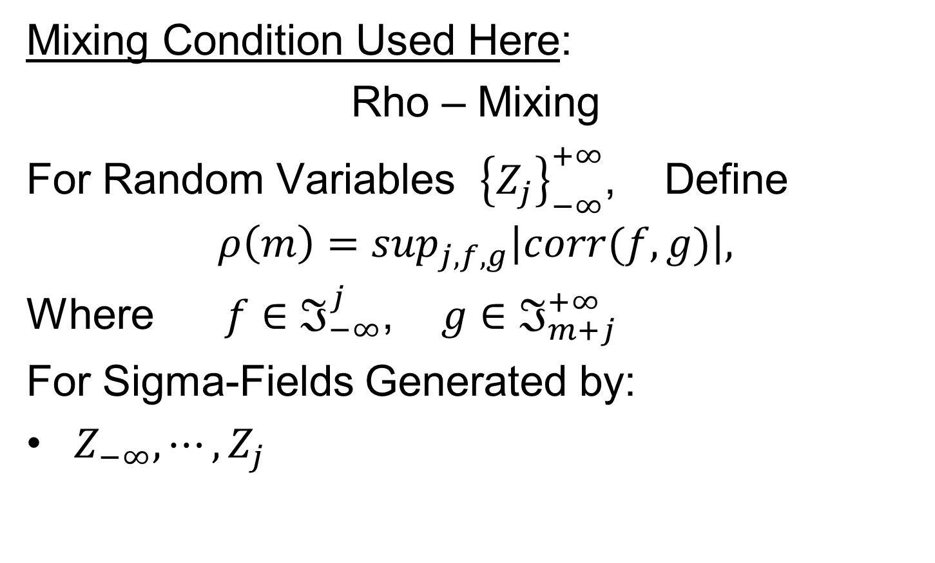
Mixing Conditions
Mixing Condition Used Here:
Rho – Mixing
For Random Variables ${\left\{Z_{j}\right\}}_{−∞}^{+∞}$, Define
$$ρ\left(m\right)=\sup_{j,f,g}\left|corr(f,g)\right|,$$
Where $f∈ℑ_{−∞}^{j}$, $g∈ℑ_{m+j}^{+∞}$
For Sigma-Fields Generated by:
$Z_{−∞},⋯,Z_{j}$

Slide 23
Mixing Conditions
Mixing Condition Used Here:
Rho – Mixing
For Random Variables ${\left\{Z_{j}\right\}}_{−∞}^{+∞}$, Define
$$ρ\left(m\right)=\sup_{j,f,g}\left|corr(f,g)\right|,$$
Where $f∈ℑ_{−∞}^{j}$, $g∈ℑ_{m+j}^{+∞}$
For Sigma-Fields Generated by:
$Z_{−∞},⋯,Z_{j}$
$Z_{m+j},⋯,Z_{∞}$

Slide 24
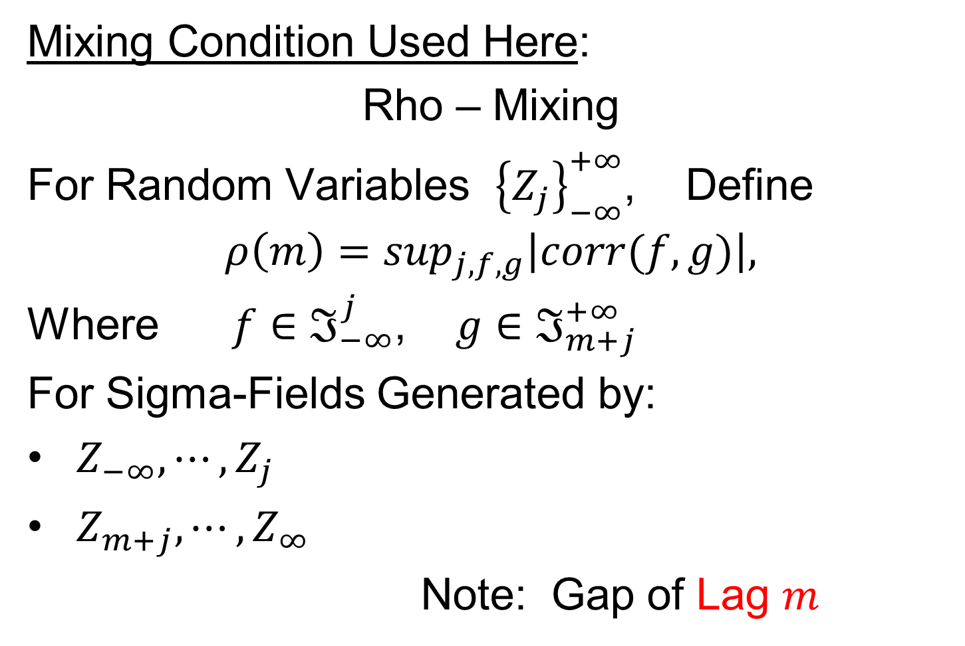
Mixing Conditions
Mixing Condition Used Here:
Rho – Mixing
For Random Variables ${\left\{Z_{j}\right\}}_{−∞}^{+∞}$, Define
$$ρ\left(m\right)=\sup_{j,f,g}\left|corr(f,g)\right|,$$
Where $f∈ℑ_{−∞}^{j}$, $g∈ℑ_{m+j}^{+∞}$
For Sigma-Fields Generated by:
$Z_{−∞},⋯,Z_{j}$
$Z_{m+j},⋯,Z_{∞}$
Note: Gap of Lag $m$

Slide 25
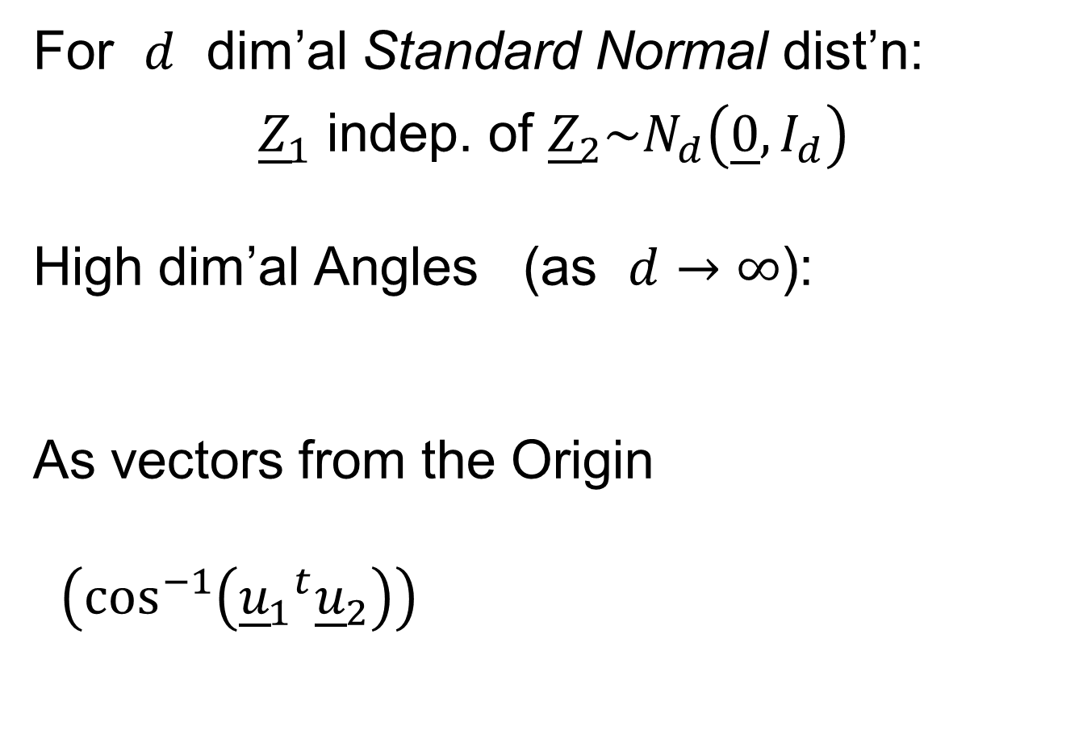
Mixing Conditions
Mixing Condition Used Here:
Rho – Mixing
For Random Variables ${\left\{Z_{j}\right\}}_{−∞}^{+∞}$, Define
$$ρ\left(m\right)=\sup_{j,f,g}\left|corr(f,g)\right|,$$
Where $f∈ℑ_{−∞}^{j}$, $g∈ℑ_{m+j}^{+∞}$
Assume: $\lim_{m→∞}{ρ\left(m\right)=0}$
Idea: Uncorrelated at Far Lags

Slide 26
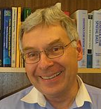

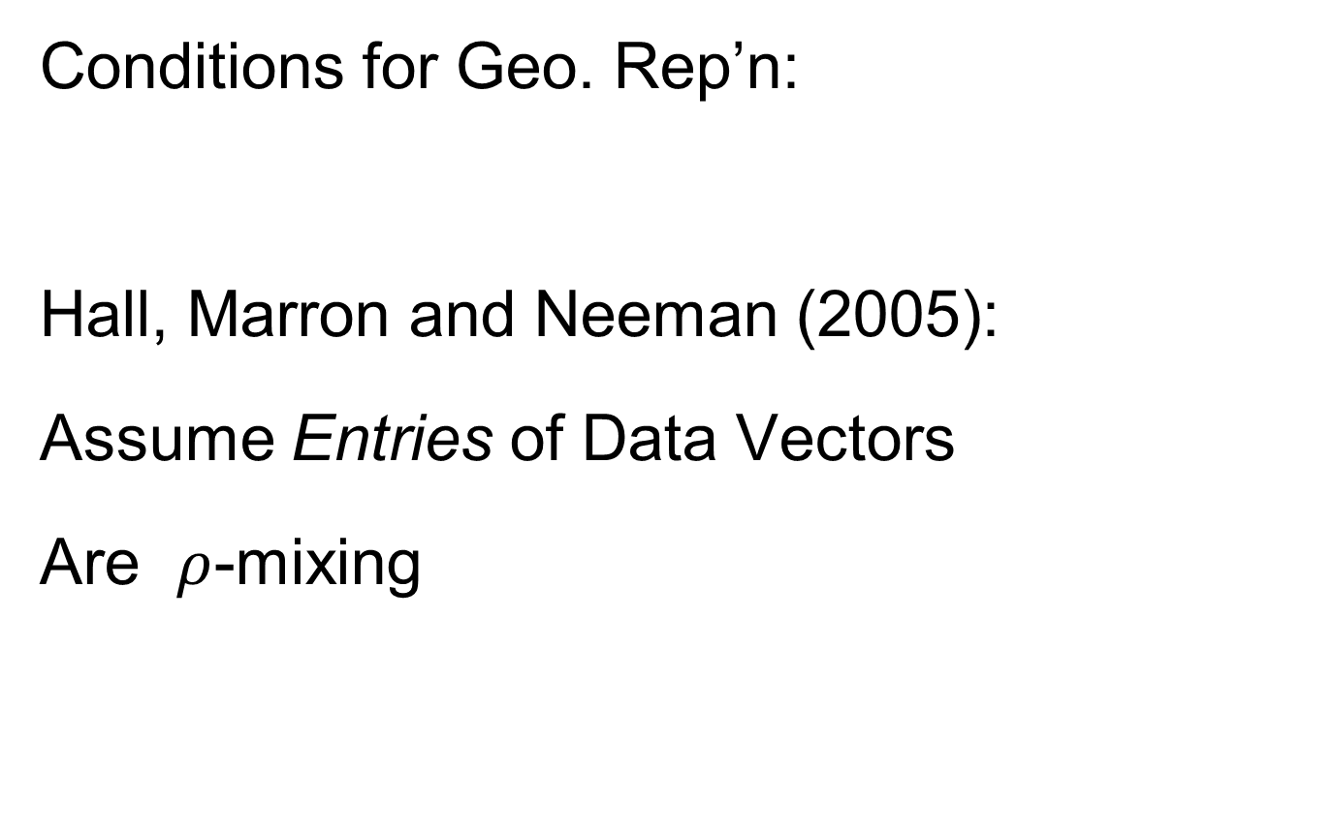
HDLSS Geometric Representation
Conditions for Geo. Rep’n:
Hall, Marron and Neeman (2005):
Assume Entries of Data Vectors
Are $ρ$-mixing

Slide 27
HDLSS Geometric Representation
Conditions for Geo. Rep’n:
Hall, Marron and Neeman (2005):
Drawback: Strong Assumption
(???)
In JRSS-B, since Biometrika Rejected

Slide 28
HDLSS Geometric Representation
Conditions for Geo. Rep’n:
Hall, Marron and Neeman (2005):
Later Realization:
This Mixing is Very Natural in
Genome Wide Association Studies
1st such: Klein et al (2005)

Slide 29
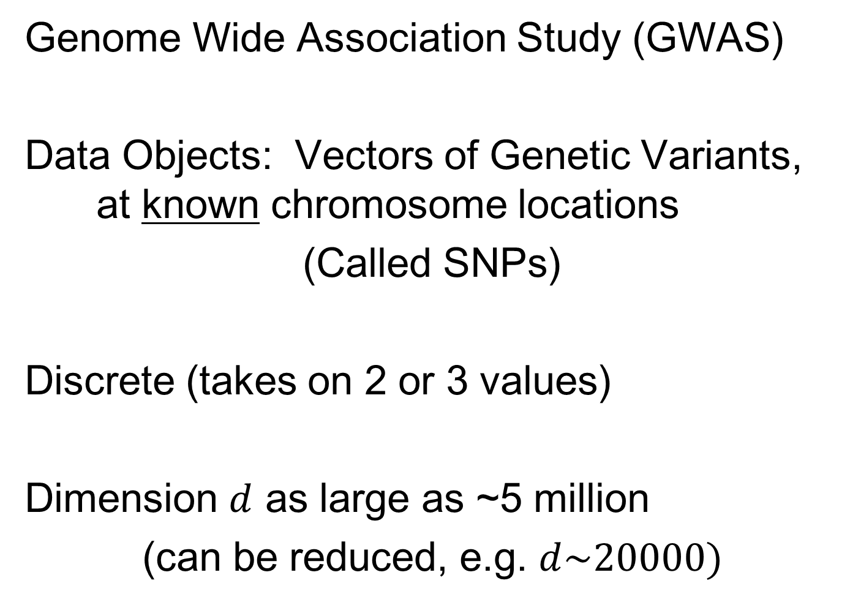
Recall GWAS Data Analysis
Genome Wide Association Study (GWAS)
Data Objects: Vectors of Genetic Variants, at known chromosome locations
(Called SNPs)
Discrete (takes on 2 or 3 values)
Dimension $d$ as large as ~5 million
(can be reduced, e.g. $d\sim 20000)$

Slide 30
HDLSS Geometric Representation
Conditions for Geo. Rep’n:
Series of Technical Improvements:
Ahn, Marron, Muller & Chi (2007)
Yata & Aoshima (2009, 2010a, 2010b, 2012, 2013)
(Fully Covariance Based,
No Mixing)

Slide 31
HDLSS Geometric Representation
Conditions for Geo. Rep’n:
Tricky Point: Classical Mixing Conditions
Require Notion of Time Ordering
Not Always Clear, e.g. Gene Expression

Slide 32
HDLSS Geometric Representation
Conditions for Geo. Rep’n:
Condition from Jung & Marron (2009):
where
Note: Not Gaussian (Allows Discrete)

Slide 33
HDLSS Geometric Representation
Conditions for Geo. Rep’n:
Condition from Jung & Marron (2009):
where
Define:
Standardized Version

Slide 34
HDLSS Geometric Representation
Conditions for Geo. Rep’n:
Condition from Jung & Marron (2009):
where
Define:
Assume: Ǝ a permutation,
So that is ρ-mixing

Slide 35

HDLSS Math. Stat. of PCA
HDLSS Analysis of PCA
from Jung & Marron (2009)

Slide 36
HDLSS Math. Stat. of PCA
Consistency & Strong Inconsistency
(Study Properties of PCA,
In Estimating Eigen-Directions & -Values)
[Assume Data are Mean Centered]

Slide 37

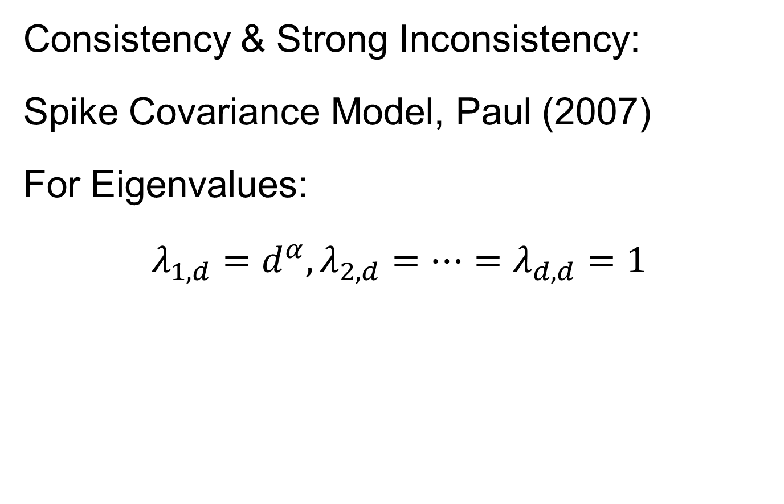
HDLSS Math. Stat. of PCA
Consistency & Strong Inconsistency:
Spike Covariance Model, Paul (2007)
For Eigenvalues:
$λ_{1,d}=d^{α},λ_{2,d}=⋯=λ_{d,d}=1$

Slide 38
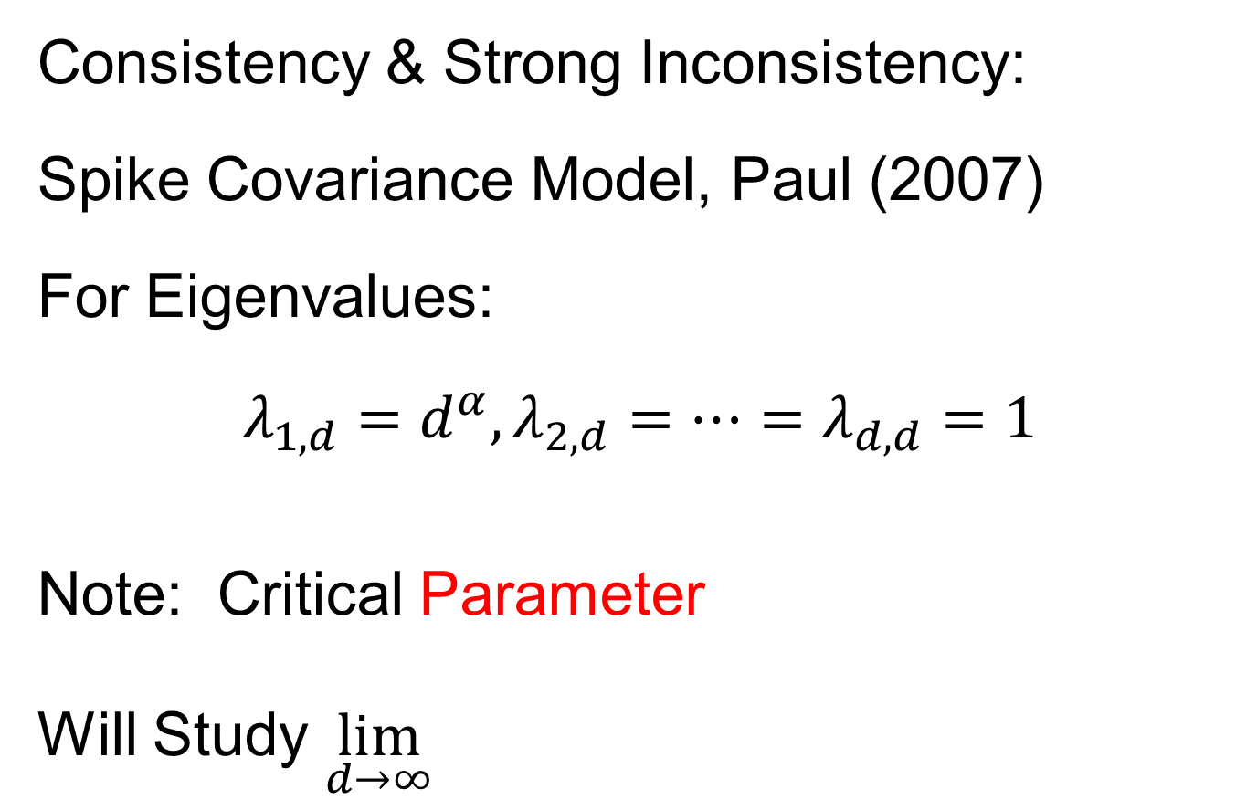
HDLSS Math. Stat. of PCA
Consistency & Strong Inconsistency:
Spike Covariance Model, Paul (2007)
For Eigenvalues:
$λ_{1,d}=d^{α},λ_{2,d}=⋯=λ_{d,d}=1$
Note: Critical Parameter
Will Study $\lim_{d→∞}{}$

Slide 39
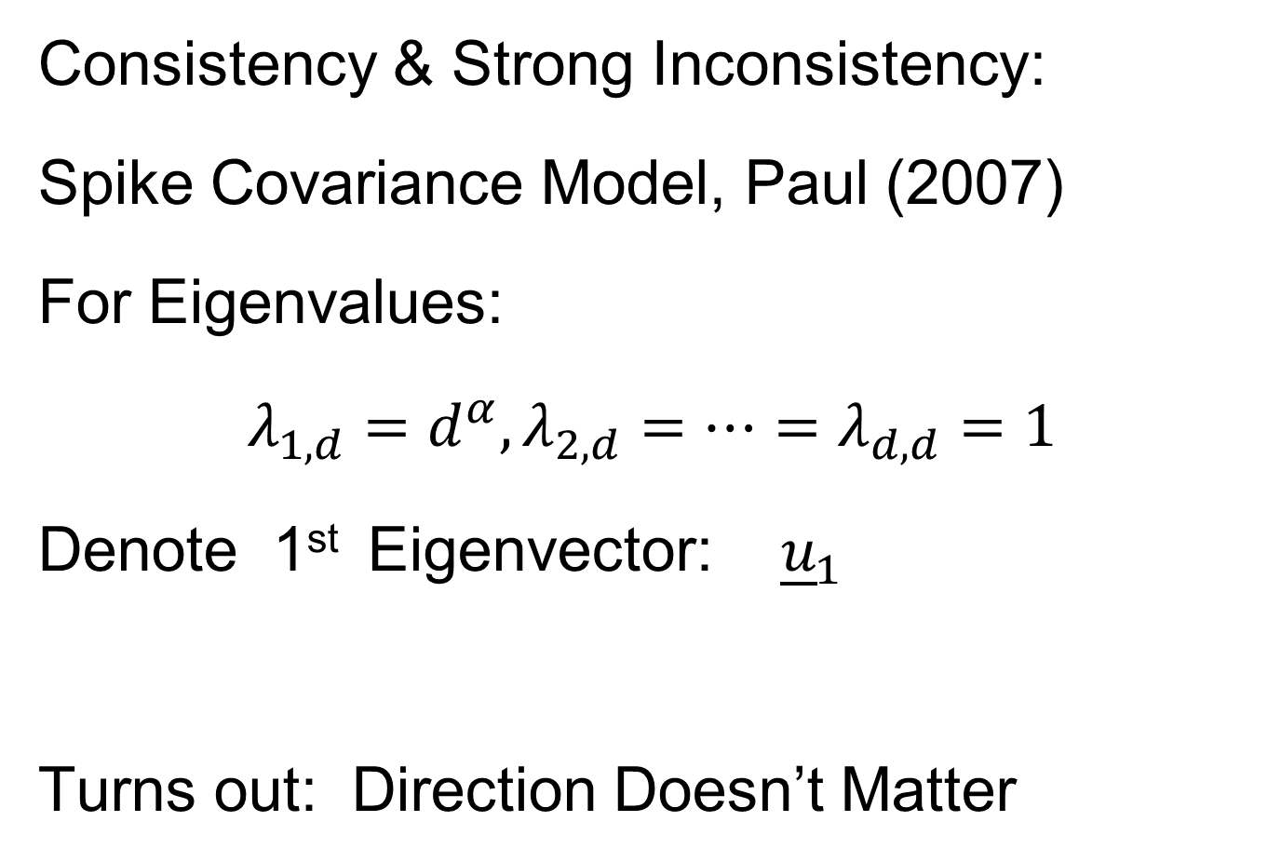
HDLSS Math. Stat. of PCA
Consistency & Strong Inconsistency:
Spike Covariance Model, Paul (2007)
For Eigenvalues:
$λ_{1,d}=d^{α},λ_{2,d}=⋯=λ_{d,d}=1$
Denote 1st Eigenvector: ${\underline{u}}_{1}$
Turns out: Direction Doesn’t Matter

Slide 40
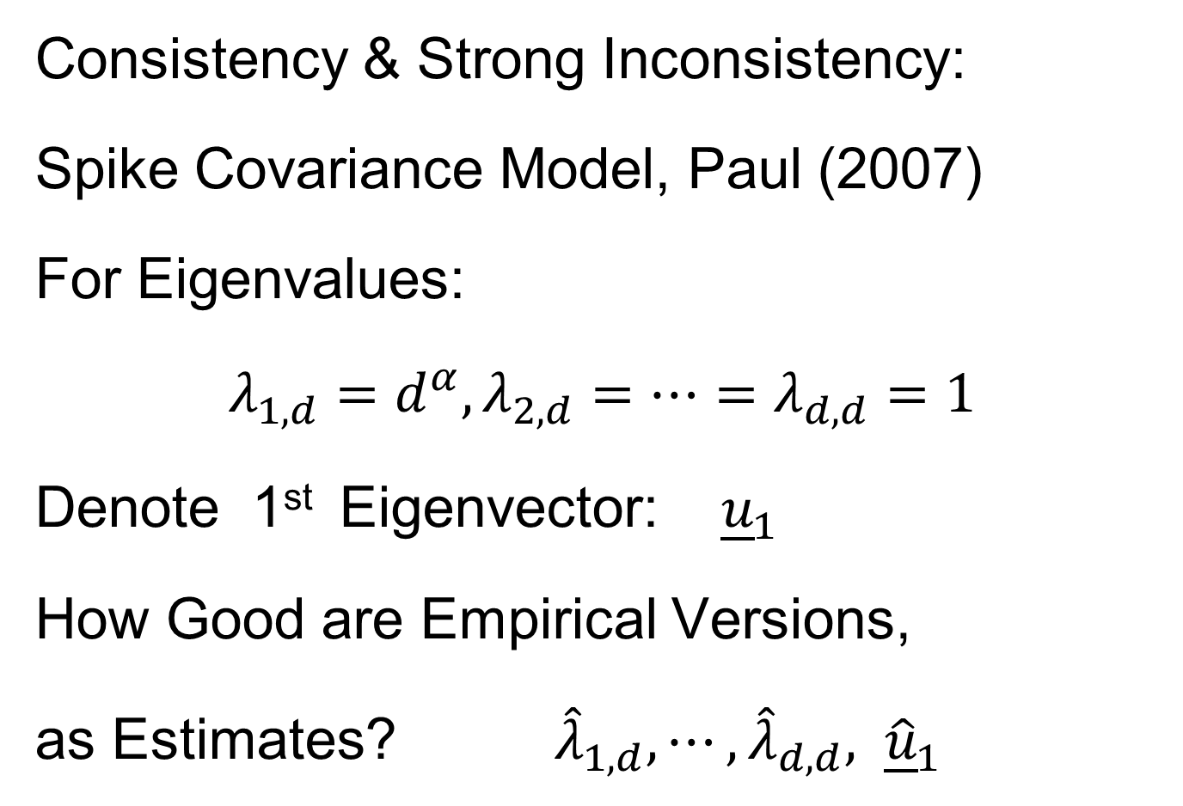
HDLSS Math. Stat. of PCA
Consistency & Strong Inconsistency:
Spike Covariance Model, Paul (2007)
For Eigenvalues:
$λ_{1,d}=d^{α},λ_{2,d}=⋯=λ_{d,d}=1$
Denote 1st Eigenvector: ${\underline{u}}_{1}$
How Good are Empirical Versions,
as Estimates? ${\hat{λ}}_{1,d},⋯,{\hat{λ}}_{d,d}, {\hat{\underline{u}}}_{1}$

Slide 41
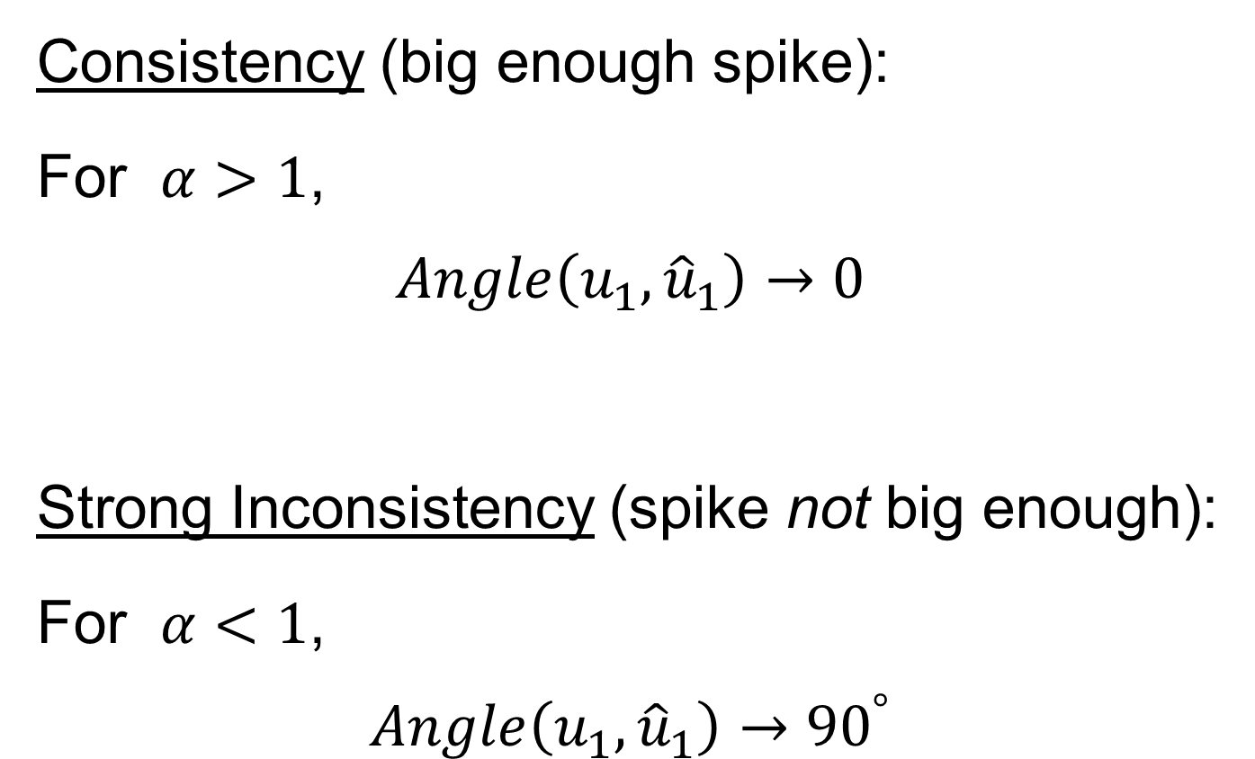
HDLSS Math. Stat. of PCA
Consistency (big enough spike):
For $α>1$,
$$Angle\left(u_{1},{\hat{u}}_{1}\right)→0$$
Strong Inconsistency (spike not big enough):
For $α<1$,
$$Angle\left(u_{1},{\hat{u}}_{1}\right)→{90}^{°}$$

Slide 42
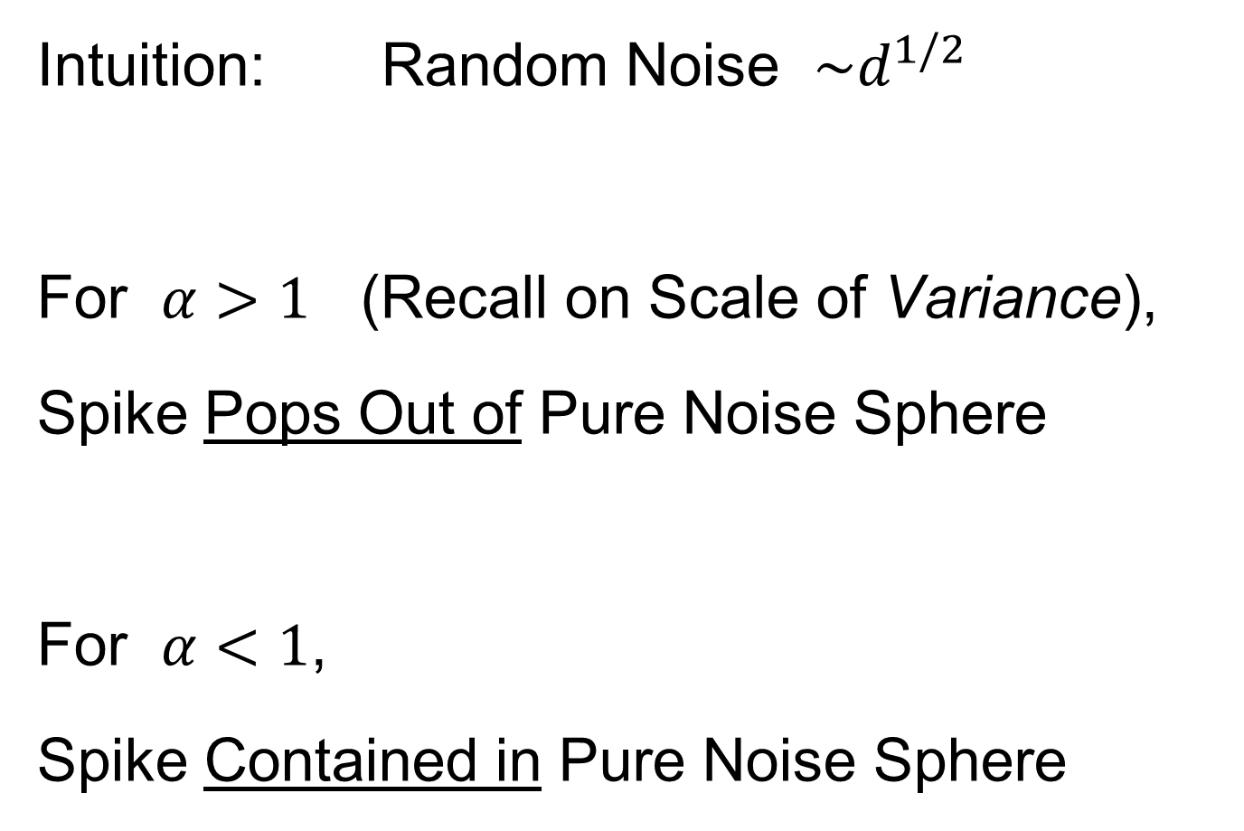
HDLSS Math. Stat. of PCA
Intuition: Random Noise $\sim d^{1/2}$
For $α>1$ (Recall on Scale of Variance),
Spike Pops Out of Pure Noise Sphere
For $α<1$,
Spike Contained in Pure Noise Sphere

Slide 43
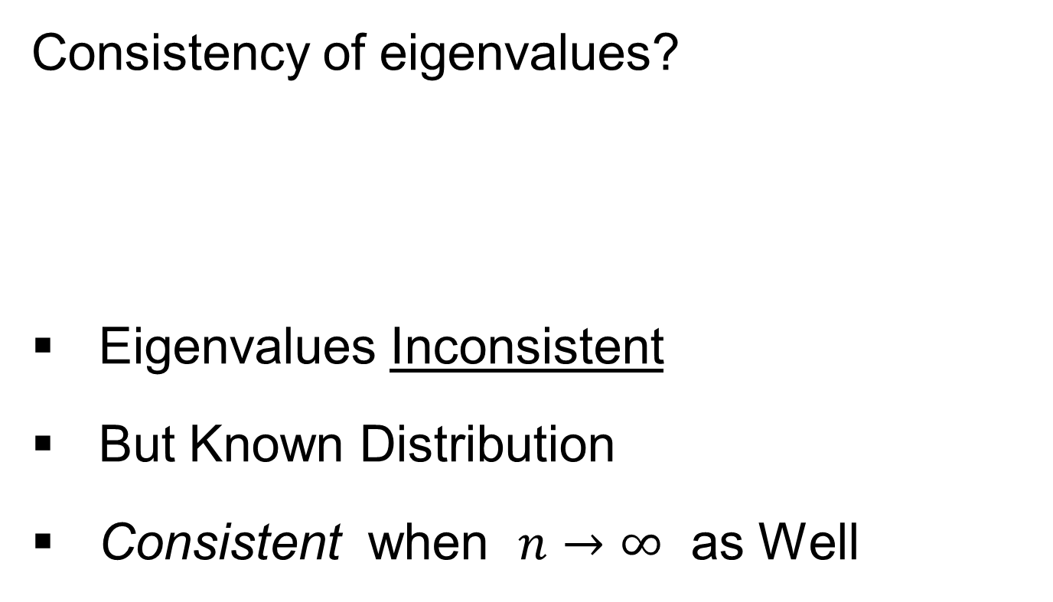
HDLSS Math. Stat. of PCA
Consistency of eigenvalues?
Eigenvalues Inconsistent
But Known Distribution
Consistent when $n→∞$ as Well

Slide 44

HDLSS Math. Stat. of PCA
Careful look at:
PCA Consistency - $α>1$ spike
(Reality Check, Suggested by Reviewer)

Slide 45
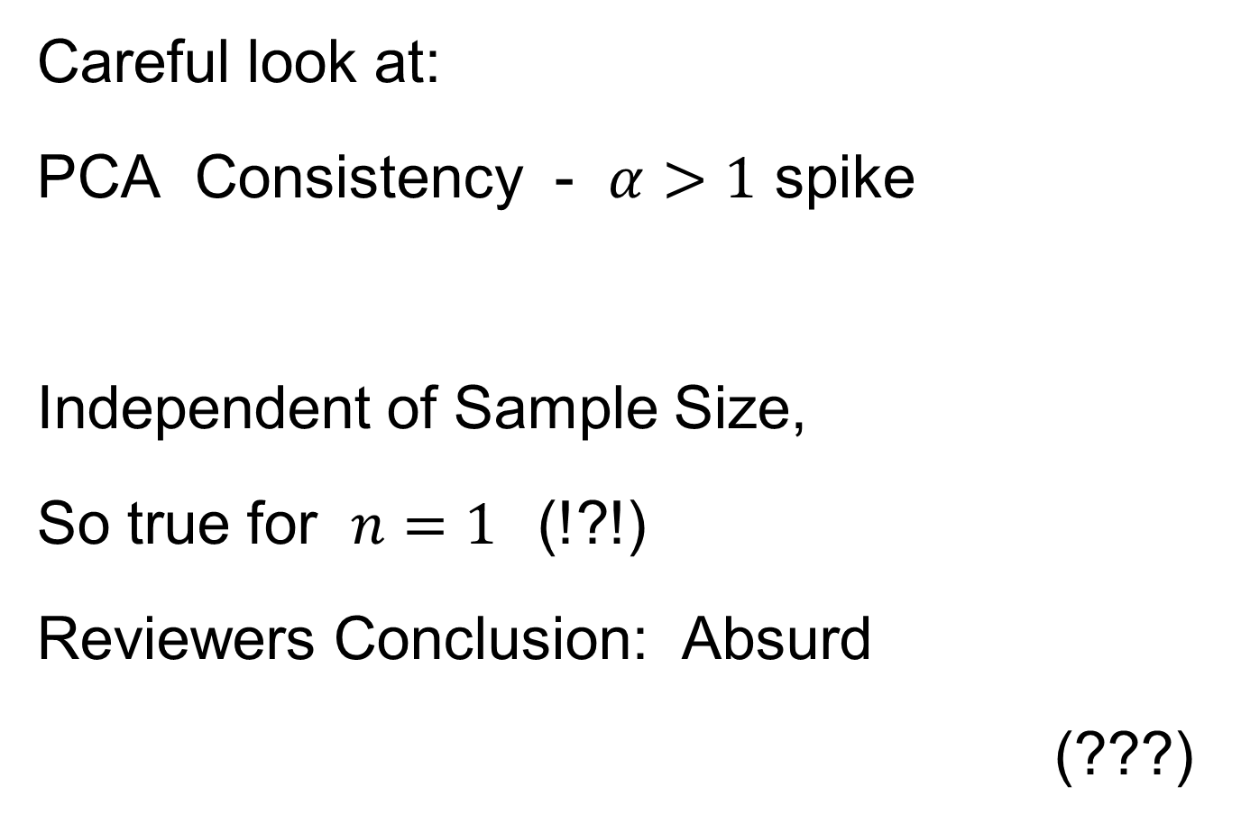
HDLSS Math. Stat. of PCA
Careful look at:
PCA Consistency - $α>1$ spike
Independent of Sample Size,
So true for $n=1$(!?!)
Reviewers Conclusion: Absurd
(???)
Shows assumption too strong for practice

Slide 46
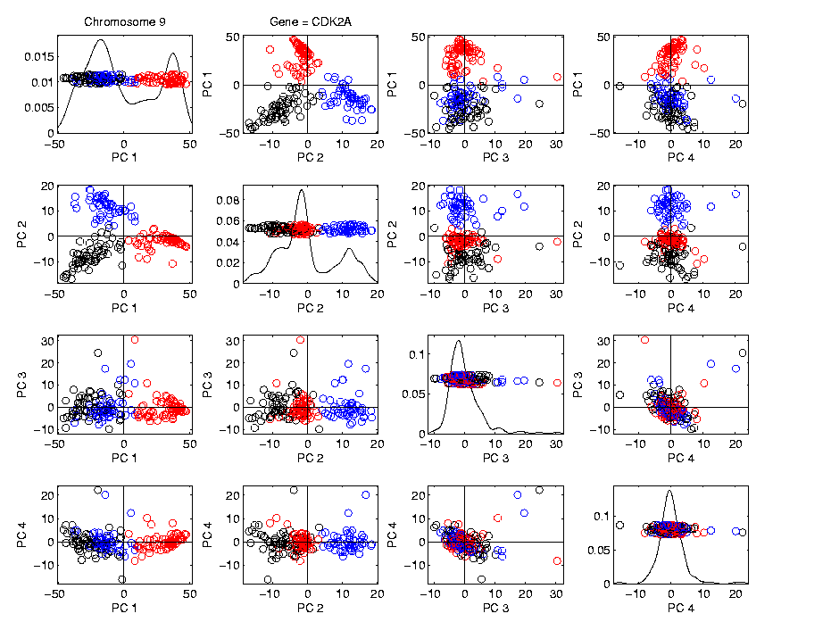
HDLSS Math. Stat. of PCA
HDLSS
PCA
Often
Finds
Signal,
Not Pure
Noise

Slide 47

HDLSS Math. Stat. of PCA
Recall
RNAseq
Example
$d\sim 1700$
$n=180$

Slide 48
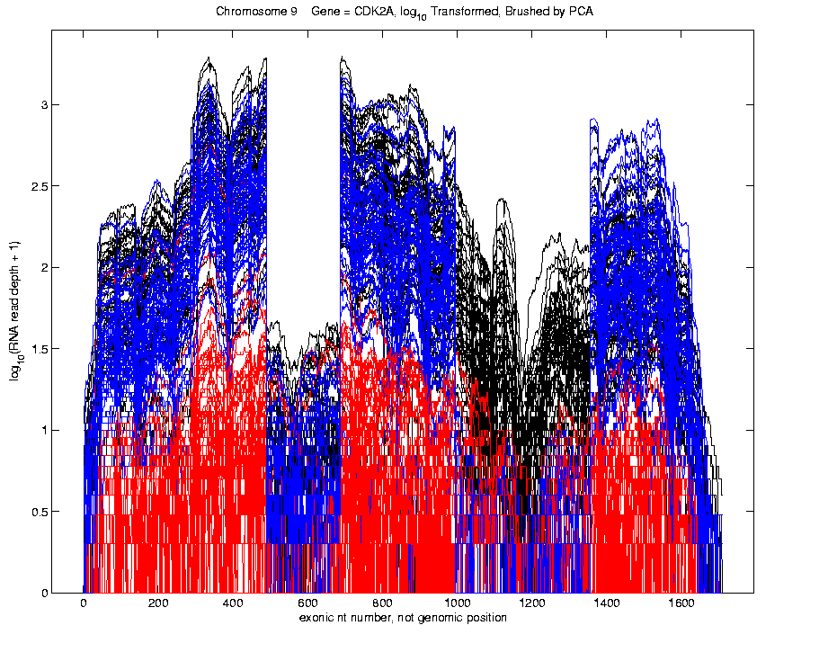
Functional Data Analysis
Manually
Brushed
Clusters
Clear
Alternate
Splicing
Not
Noise!

Slide 49
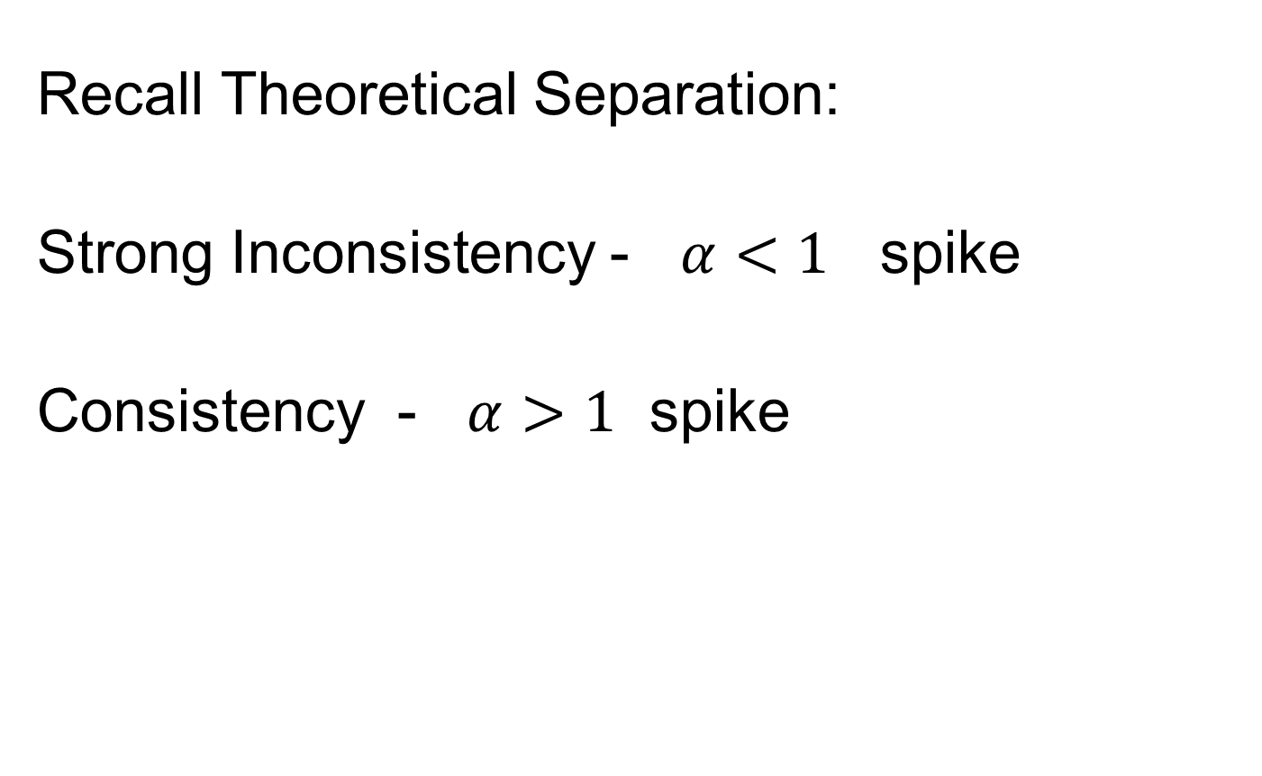
HDLSS Math. Stat. of PCA
Recall Theoretical Separation:
Strong Inconsistency - $α<1$ spike
Consistency - $α>1$ spike

Slide 50
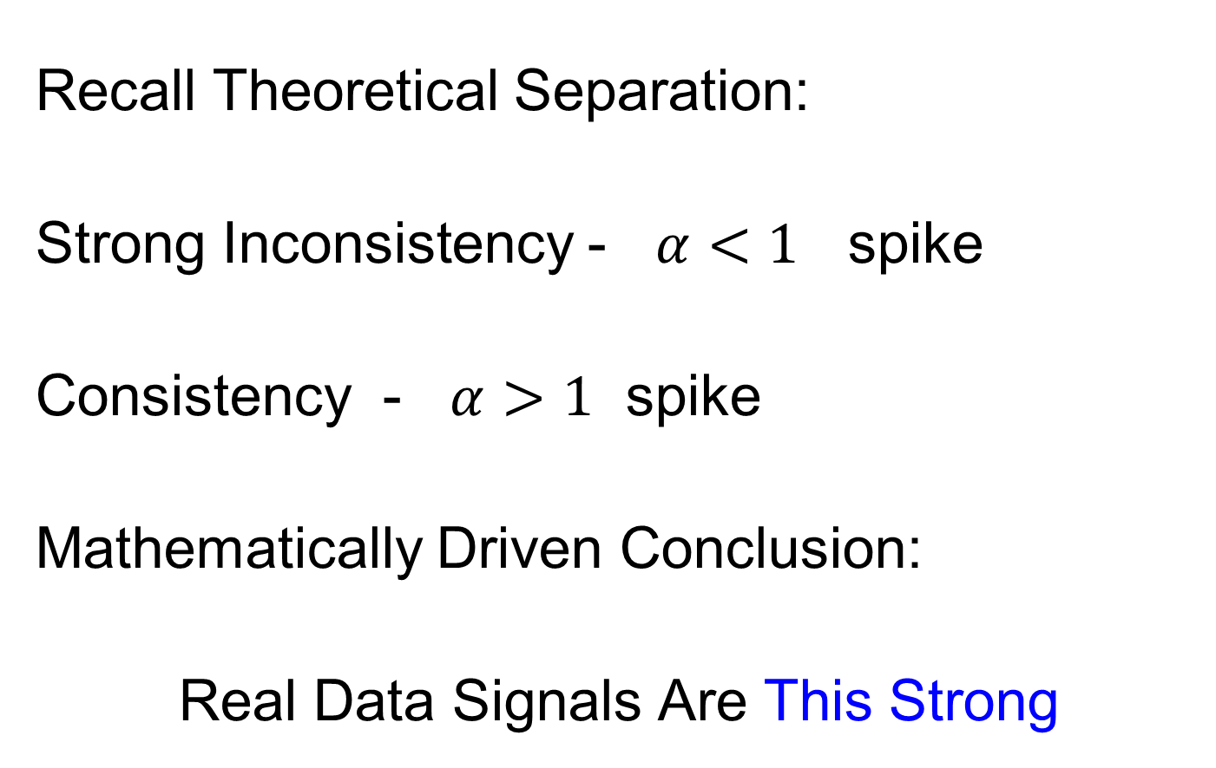
HDLSS Math. Stat. of PCA
Recall Theoretical Separation:
Strong Inconsistency - $α<1$ spike
Consistency - $α>1$ spike
Mathematically Driven Conclusion:
Real Data Signals Are This Strong

Slide 51
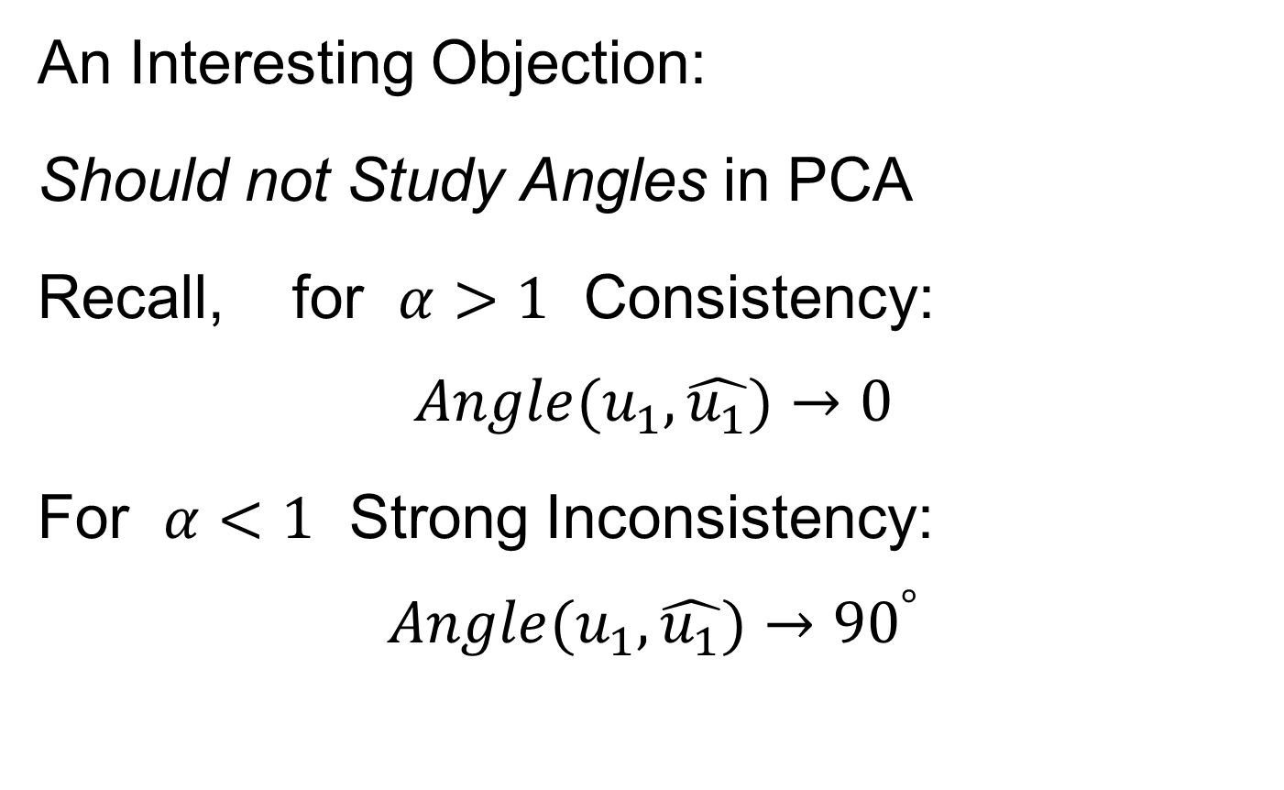
HDLSS Math. Stat. of PCA
An Interesting Objection:
Should not Study Angles in PCA
Recall, for $α>1$ Consistency:
$$Angle(u_{1},\hat{u_{1}})→0$$
For $α<1$ Strong Inconsistency:
$$Angle(u_{1},\hat{u_{1}})→{90}^{°}$$

Slide 52
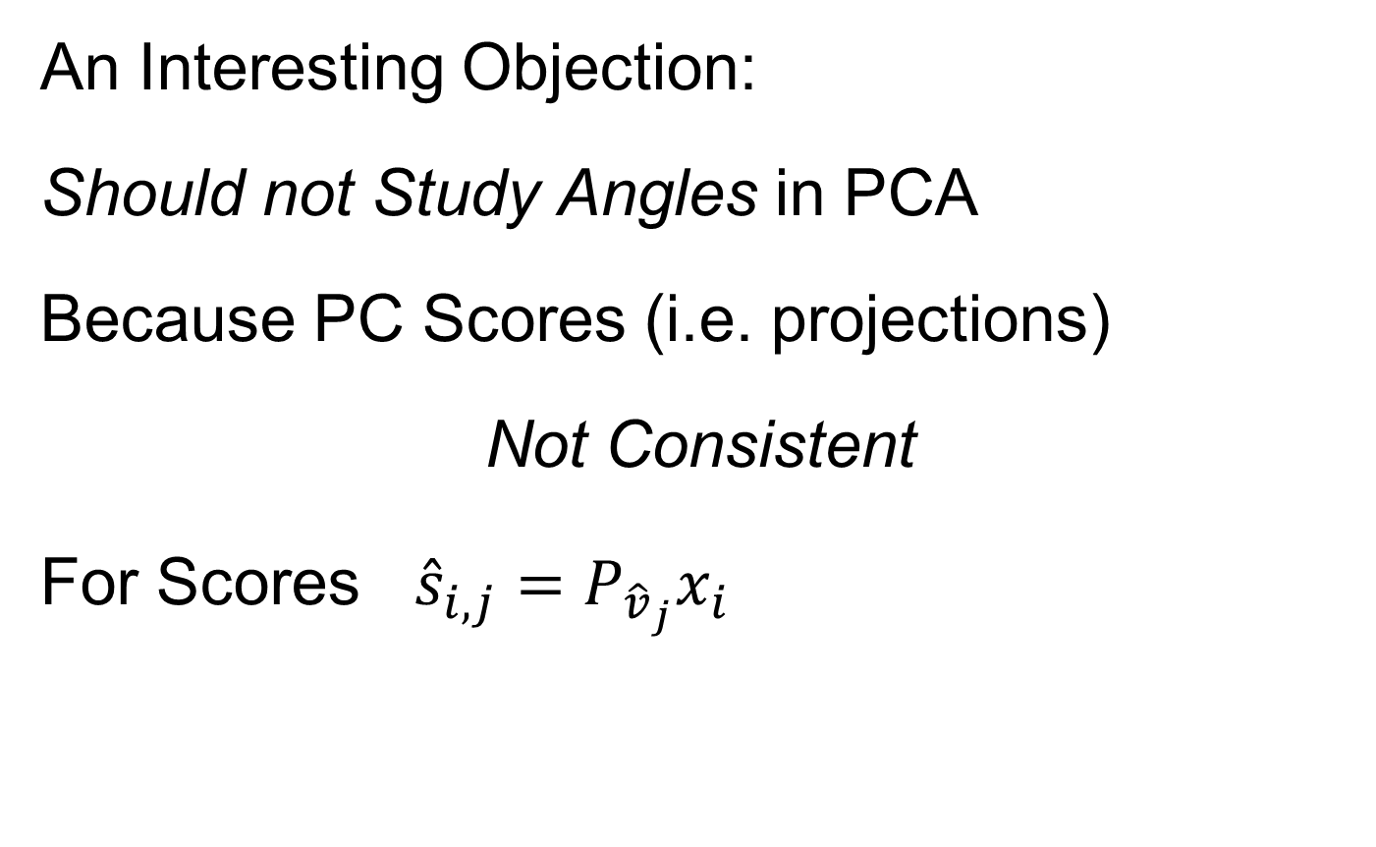
HDLSS Math. Stat. of PCA
An Interesting Objection:
Should not Study Angles in PCA
Because PC Scores (i.e. projections)
Not Consistent
For Scores ${\hat{s}}_{i,j}=P_{{\hat{v}}_{j}}x_{i}$
What we study in PCA scatterplots

Slide 53
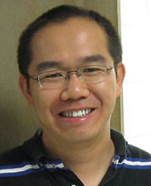
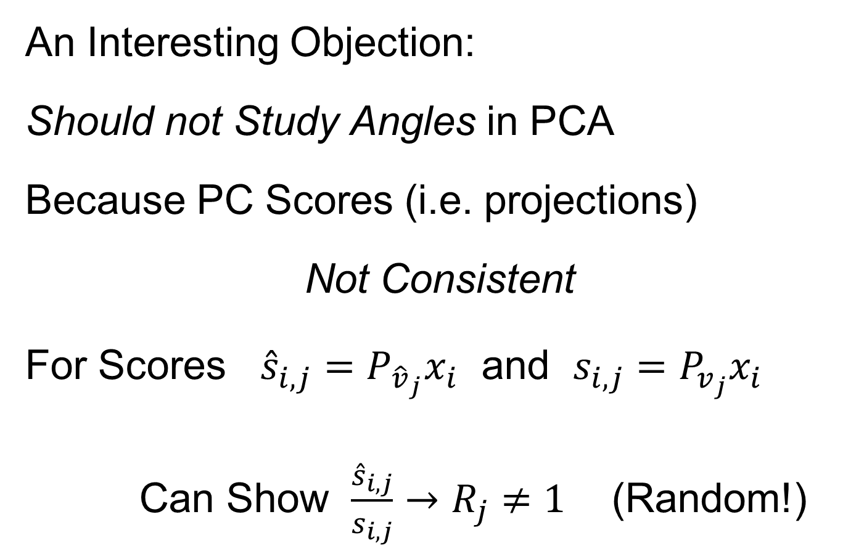
HDLSS Math. Stat. of PCA
An Interesting Objection:
Should not Study Angles in PCA
Because PC Scores (i.e. projections)
Not Consistent
For Scores ${\hat{s}}_{i,j}=P_{{\hat{v}}_{j}}x_{i}$ and $s_{i,j}=P_{v_{j}}x_{i}$
Can Show $\frac{{\hat{s}}_{i,j}}{s_{i,j}}→R_{j}≠1$ (Random!)
Due to Dan Shen

Slide 54
HDLSS Math. Stat. of PCA
PC Scores (i.e. projections)
Not Consistent
So how can PCA find Useful Signals in Data?

Slide 55
HDLSS Math. Stat. of PCA
HDLSS
PCA
Often
Finds
Signal,
Not Pure
Noise

Slide 56
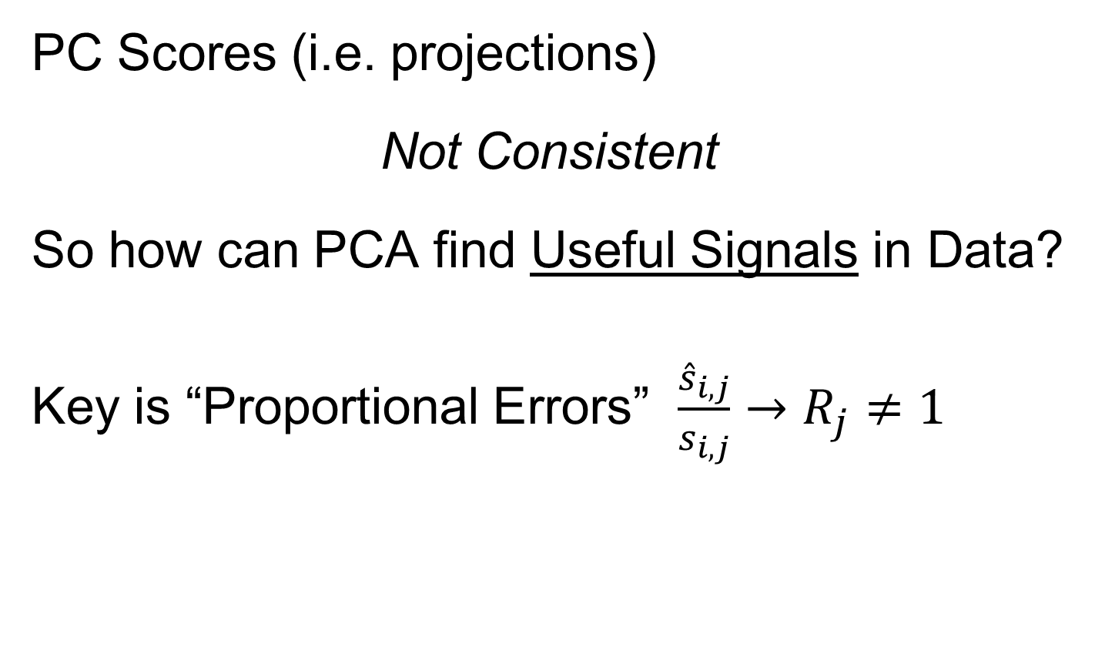
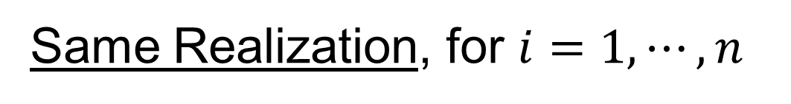
HDLSS Math. Stat. of PCA
PC Scores (i.e. projections)
Not Consistent
So how can PCA find Useful Signals in Data?
Key is “Proportional Errors” $\frac{{\hat{s}}_{i,j}}{s_{i,j}}→R_{j}≠1$
Same Realization, for $i=1,⋯,n$

Slide 57
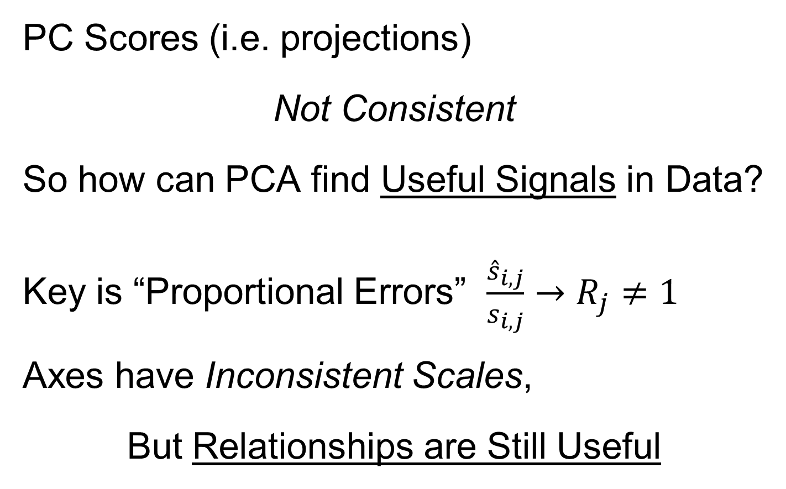
HDLSS Math. Stat. of PCA
PC Scores (i.e. projections)
Not Consistent
So how can PCA find Useful Signals in Data?
Key is “Proportional Errors” $\frac{{\hat{s}}_{i,j}}{s_{i,j}}→R_{j}≠1$
Axes have Inconsistent Scales,
But Relationships are Still Useful

Slide 58
HDLSS Math. Stat. of PCA
Numbers
On Axes
Are Wrong
But
Relationships
Are Right

Slide 59
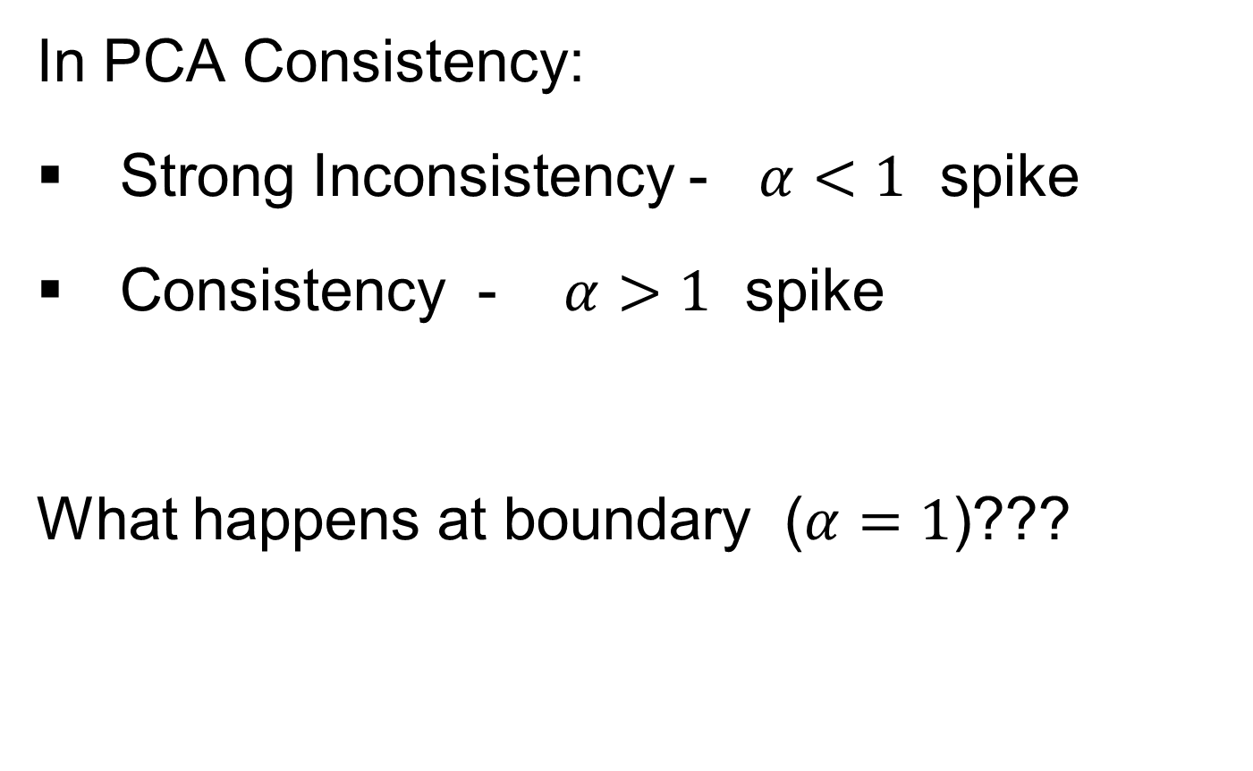
HDLSS Deep Open Problem
In PCA Consistency:
Strong Inconsistency - $α<1$ spike
Consistency - $α>1$ spike
What happens at boundary ($α=1$)???

Slide 60
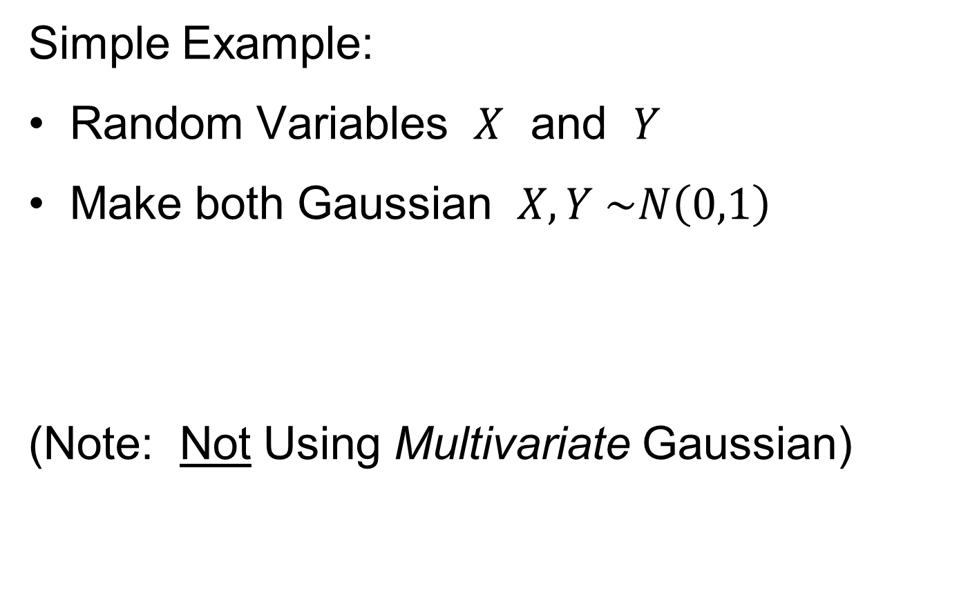
HDLSS Deep Open Problem
Result
In PCA Consistency:
Strong Inconsistency - $α<1$ spike
Consistency - $α>1$ spike
What happens at boundary ($α=1$)???
Ǝ interesting Limit Distn’s
Jung, Sen & Marron (2012)

Slide 61
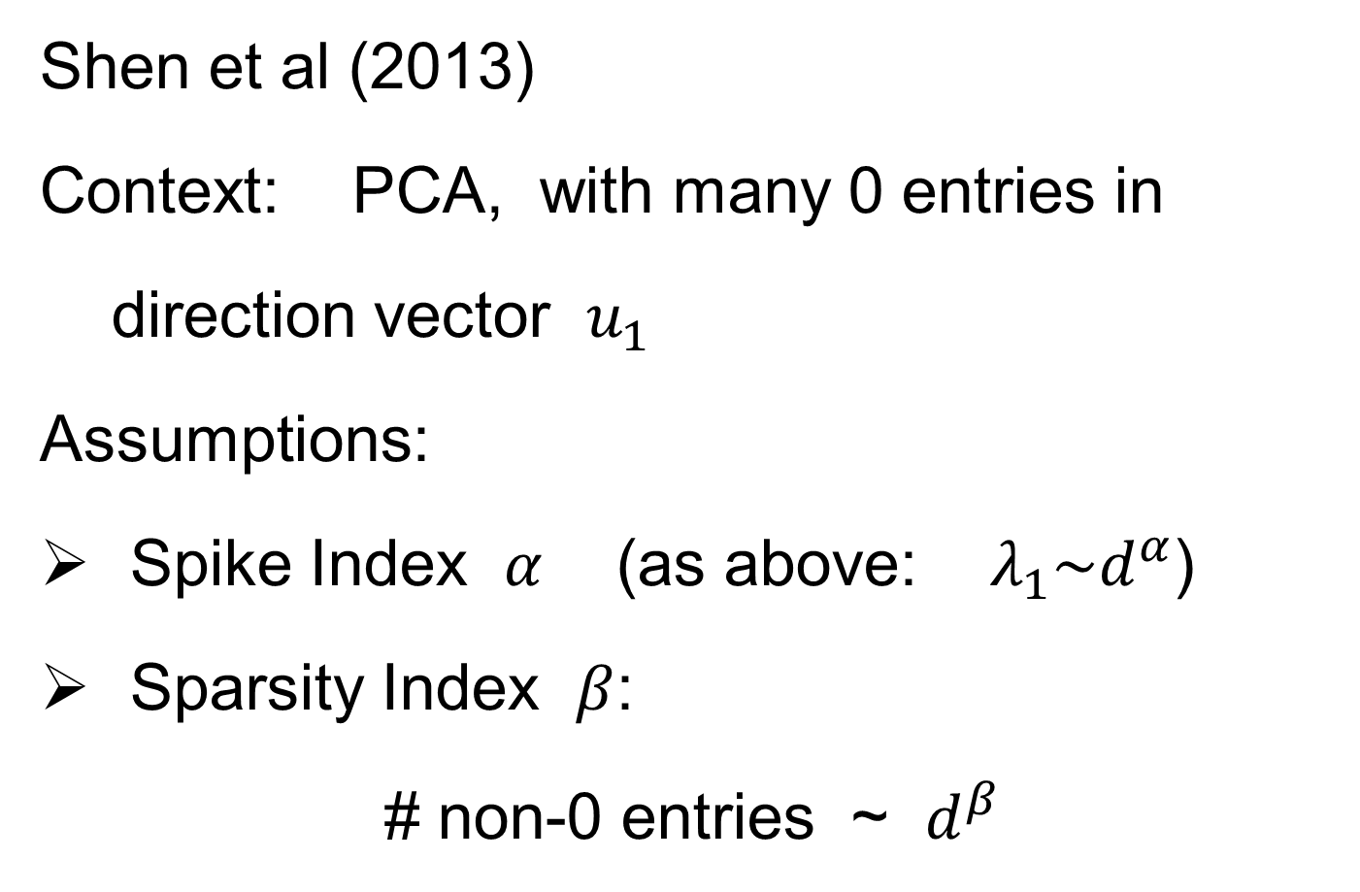
HDLSS & Sparsity
Shen et al (2013)
Context: PCA, with many 0 entries in
direction vector $u_{1}$
Assumptions:
Spike Index $α$ (as above: $λ_{1}\sim d^{α}$)
Sparsity Index $β$:
# non-0 entries ~ $d^{β}$

Slide 62
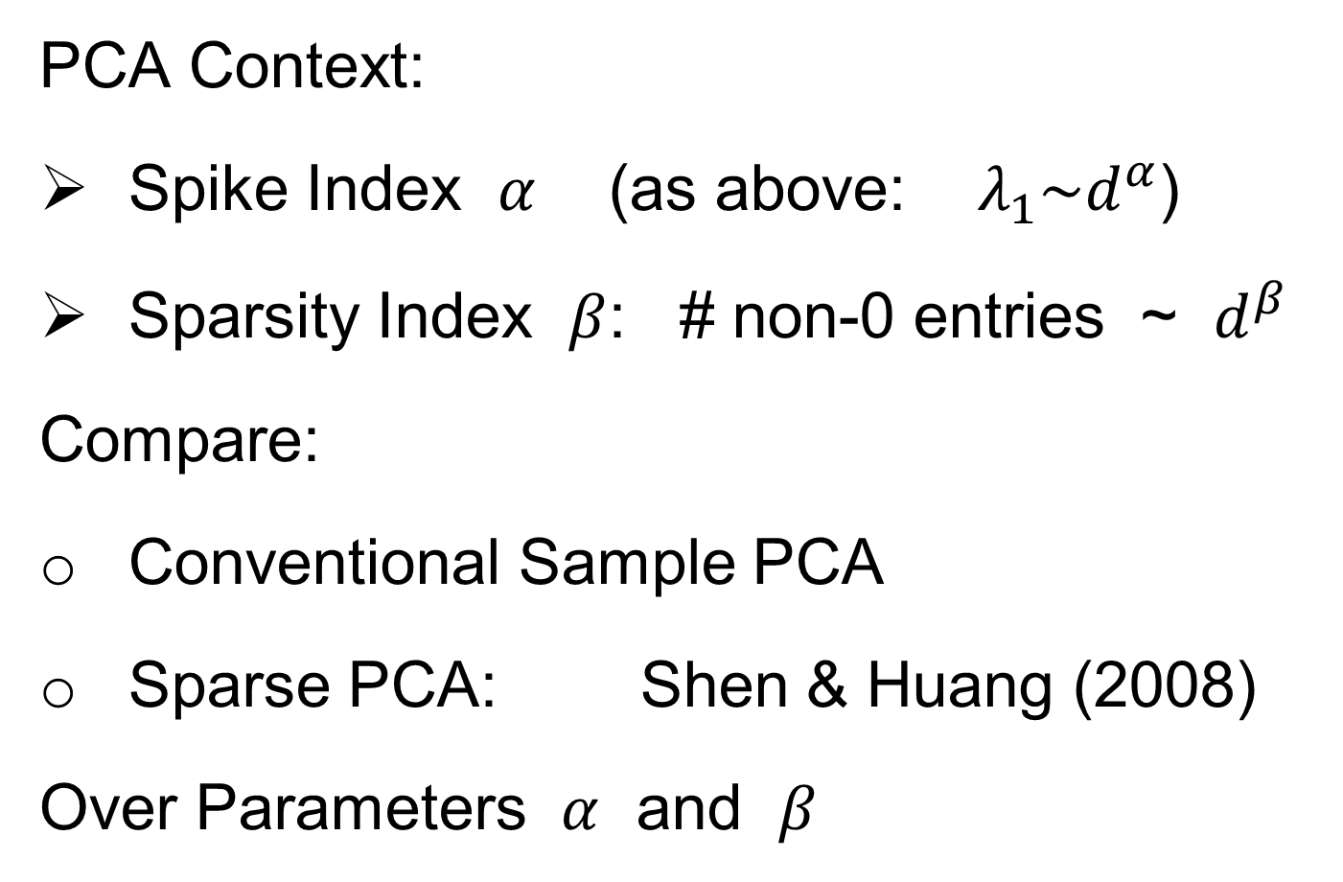
HDLSS & Sparsity
PCA Context:
Spike Index $α$ (as above: $λ_{1}\sim d^{α}$)
Sparsity Index $β$: # non-0 entries ~ $d^{β}$
Compare:
Conventional Sample PCA
Sparse PCA: Shen & Huang (2008)
Over Parameters $α$ and $β$

Slide 63
1
0≤ α < β ≤1
0.7
β
0≤ α = β ≤1
Sparsity Index
α>1
0 ≤ β ≤1
0.5
0.3
0≤β<α≤1
0.1
0
0
0.2
0.4
0.6
0.8
1
Jung and Marron
α
Spike Index
Regular PCA: Inconsistent & Consistent

Slide 64
1
0≤ α < β ≤1
0.7
β
0≤ α = β ≤1
Sparsity Index
α>1
0 ≤ β ≤1
0.5
0.3
0≤β<α≤1
0.1
0
0
0.2
0.4
0.6
0.8
1
Jung and Marron
α
Spike Index
Sparse PCA: Inconsistent & New Consistency Region

Slide 65
HDLSS & Sparsity
Sparse PCA Opens Up Whole New
Region of Consistency

Slide 66
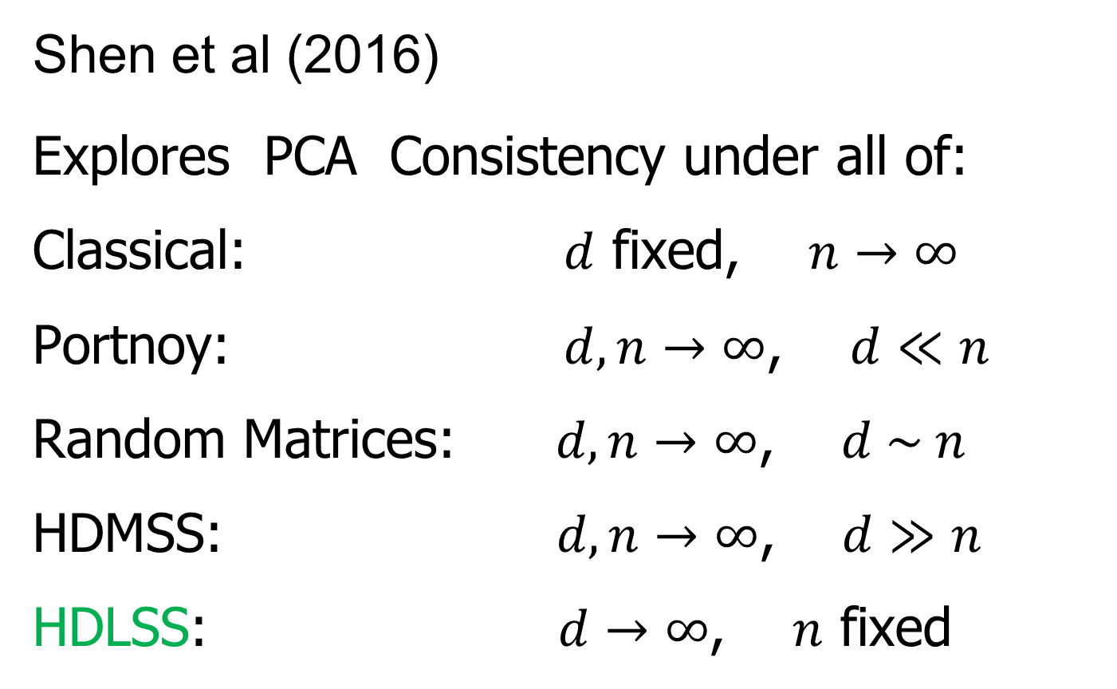
HDLSS & Other Asymptotics
Shen et al (2016)
Explores PCA Consistency under all of:
Classical: $d$ fixed, $n→∞$
Portnoy: $d, n→∞$, $d≪n$
Random Matrices: $d, n→∞$, $d \sim n$
HDMSS: $d, n→∞$, $d≫n$
HDLSS: $d→∞$, $n$ fixed

Slide 67
(A) Single Spike - Example 1.1
(B) Multi Spike - Example 1.2
Consistency
1
1
Sample Index
α + γ >1
γ
α + γ >1, γ >0
Sample Index (Johnstone and Lu (2009))
γ
Strong Inconsistency
0≤ α + γ <1
0≤ α + γ <1
(0,0)
Strong Inconsistency
1
Consistency
(0,0)
Strong Inconsistency
1
α
α
Subspace Consistency
Spike Index (Jung and Marron (2009))
Spike Index (Jung and Marron (2009))

Slide 68
(A) Single Spike - Example 1.1
(B) Multi Spike - Example 1.2
Consistency
1
1
Sample Index
α + γ >1
γ
α + γ >1, γ >0
Sample Index (Johnstone and Lu (2009))
γ
Strong Inconsistency
0≤ α + γ <1
0≤ α + γ <1
(0,0)
Strong Inconsistency
1
Consistency
(0,0)
Strong Inconsistency
1
α
α
Subspace Consistency
Spike Index (Jung and Marron (2009))
Spike Index (Jung and Marron (2009))

Slide 69
More HDLSS Asymptotics
Yata & Aoshima (2009,…,2012)
Natural Covariance Matrix Assumptions
(non-Gaussian)
Improvements on PCA
(Milder Consistency Cond.)
Using Clever Dual Space Calculations

Slide 70


HDLSS Analysis of DiProPerm
Wei et al (2015)
Background: HDLSS Hypothesis Testing
$H_{0}: μ_{1}=μ_{2}$ vs. $H_{0}: μ_{1}≠μ_{2}$
or
$H_{0}: ℒ_{1}=ℒ_{2}$ vs. $H_{0}: ℒ_{1}≠ℒ_{2}$
Recall from 8-29-2019
Most Generally, But Test is Designed
for Maximal Power in Direction of Mean

Slide 71

HDLSS Analysis of DiProPerm
Wei et al (2015)
Choice 1: Direction on which to Project?
Distance Weigthed Discrimination (DWD)
Mean Difference $\frac{{\overline{X}}_{1}−{\overline{X}}_{2}}{\left\|{\overline{X}}_{1}−{\overline{X}}_{2}\right\|}$

Slide 72

HDLSS Analysis of DiProPerm
Wei et al (2015)
Recall: N(0,1) data (both classes)

Slide 73
HDLSS Analysis of DiProPerm
Choice 2:
Which Statistic to Summarize Projections?
2 – Sample t statistic
Mean Difference

Slide 74



HDLSS Analysis of DiProPerm
Jack Prothero Simulations
$g=0$, $g=$1, $g=5$, $g=10$
$$N_{d}\left(\left(\begin{matrix}±g \\ ±g \\ \begin{matrix}0 \\ ⋮ \\ 0\end{matrix}\end{matrix}\right), I_{d}\right)$$
$$d=50$$ | $$d=100$$
$$d=500$$ | $$d=1000$$

Slide 75

HDLSS Analysis of DiProPerm
Jack Prothero Simulations

Slide 76

HDLSS Analysis of DiProPerm
Jack Prothero Simulations

Slide 77

HDLSS Analysis of DiProPerm
Jack Prothero Simulations
For Large $d$ MD-Stat Better than t-Stat
Opposite for Low $d$, MD-Dir’n
DWD-Dir’n & MD-Stat Overall Best
Every Dog Has His Day

Slide 78

HDLSS Robust PCA
Recall Robust PCA via Spherical Projection

Slide 79
HDLSS Robust PCA
Recall Robust PCA via Spherical Projection
Zhou and Marron (2015) showed:
No Outliers: Similar Performance
Outliers: Spherical PCA is Better

Slide 80
HDLSS GWAS Data Analysis
Recall that Robust PCA via Spherical Projection Failed for GWAS Data

Slide 81

GWAS Data Analysis
PCA View
Clear Ethnic
Groups
And Several
Outliers!
Eliminate With
Spherical PCA?

Slide 82

GWAS Data Analysis
Spherical
PCA
Looks Same?!?
What is
going on?
Will Explain
Later

Slide 83

Failure of Sph’l PCA for GWAS Outliers
Explanation:
HDLSS geometric representation
Recall in limit as $d→∞$ with $n$ fixed,
Data lie near surface of $\sqrt{d}$-sphere
Data tend to be ~orthogonal
Family members are half the same
Thus relatively small angle $\left(\sim {60}^{°}\right)$
Enough for families to dominate PCs
Spherical PC doesn’t change anything!

Slide 84


HDLSS Asymptotics in Classification
Recall in Simulations,
Methods Came Together, for High $d$

Slide 85
HDLSS Asymptotics in Classification
Explanation of Observed (Simulation) Behavior:
“everything similar for very high d ”
2 popn’s are 2 simplices (i.e. regular n-hedrons)
All are same distance from the other class
i.e. everything is a support vector
i.e. all sensible directions show “data piling”
so “sensible methods are all nearly the same”

Slide 86
HDLSS Asymptotics in Classification
Further Consequences of Geometric Represen’tion
1. DWD more stable than SVM
(based on deeper limiting distributions)
(reflects intuitive idea feeling sampling variation)
(something like mean vs. median)
Hall, Marron, Neeman (2005)
2. 1-NN rule inefficiency is quantified.
Hall, Marron, Neeman (2005)
3. Inefficiency of DWD for uneven sample size
(motivates weighted version)
Qiao, et al (2010)

Slide 87
Participant Presentation
Yue Pan
Data Visualization for
single cell RNA-seq data,
Andrew Hamilton
Time Series Prediction

