Slide 1
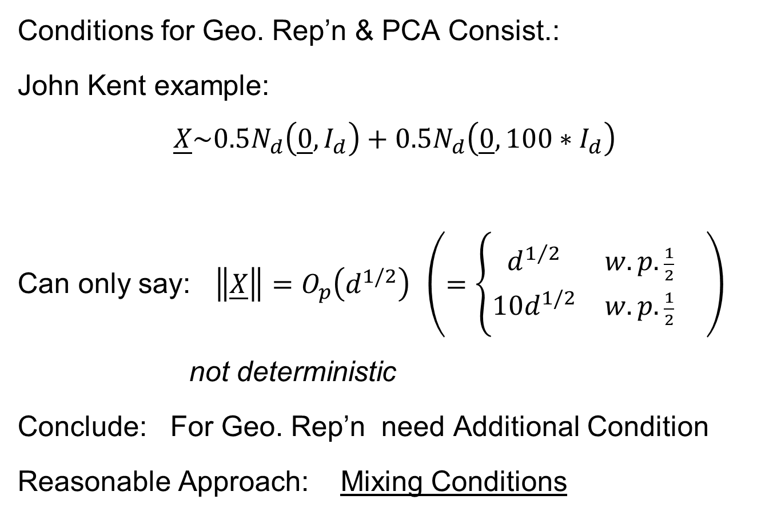
HDLSS Math. Stat. of PCA
Conditions for Geo. Rep’n & PCA Consist.:
John Kent example:
$$\underline{X}\sim 0.5N_{d}\left(\underline{0},I_{d}\right)+0.5N_{d}\left(\underline{0},{100∗I}_{d}\right)$$
Can only say: $\left\|\underline{X}\right\|=O_{p}\left(d^{1/2}\right)$ $\left(=\left\{\begin{matrix}d^{1/2} & w.p.\frac{1}{2} \\ 10d^{1/2} & w.p.\frac{1}{2}\end{matrix}\right. \right)$
not deterministic
Conclude: For Geo. Rep’n need Additional Condition
Reasonable Approach: Mixing Conditions

Slide 2
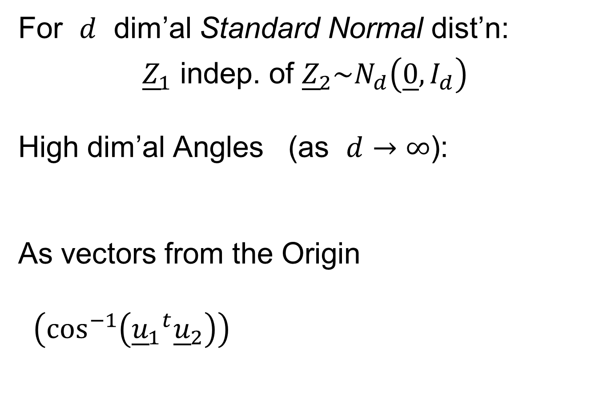
Mixing Conditions
Mixing Condition Used Here:
Rho – Mixing
For Random Variables ${\left\{Z_{j}\right\}}_{−∞}^{+∞}$, Define
$$ρ\left(m\right)=\sup_{j,f,g}\left|corr(f,g)\right|,$$
Where $f∈ℑ_{−∞}^{j}$, $g∈ℑ_{m+j}^{+∞}$
Assume: $\lim_{m→∞}{ρ\left(m\right)=0}$
Idea: Uncorrelated at Far Lags

Slide 3


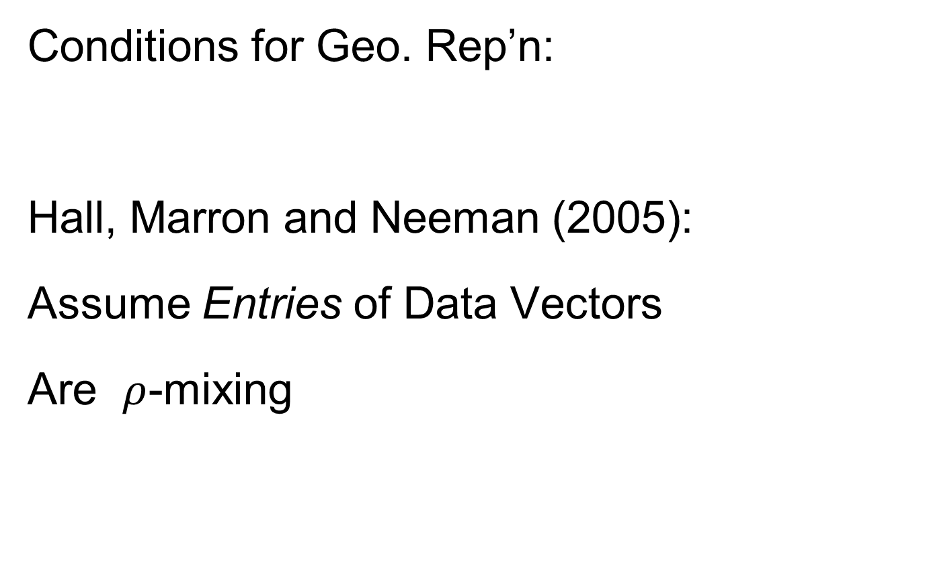
HDLSS Geometric Representation
Conditions for Geo. Rep’n:
Hall, Marron and Neeman (2005):
Assume Entries of Data Vectors
Are $ρ$-mixing

Slide 4
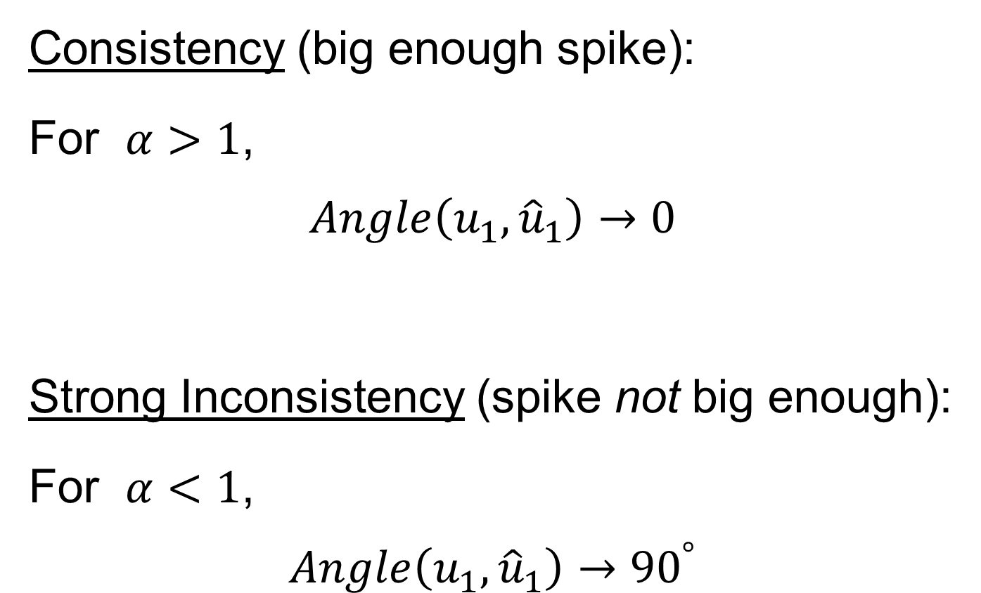
HDLSS Math. Stat. of PCA
Consistency (big enough spike):
For $α>1$,
$$Angle\left(u_{1},{\hat{u}}_{1}\right)→0$$
Strong Inconsistency (spike not big enough):
For $α<1$,
$$Angle\left(u_{1},{\hat{u}}_{1}\right)→{90}^{°}$$

Slide 5

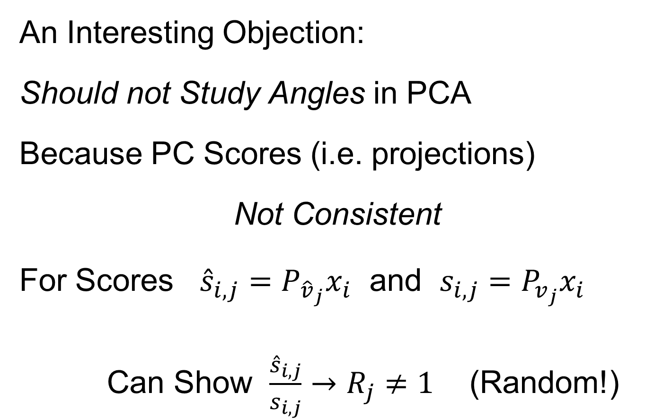
HDLSS Math. Stat. of PCA
An Interesting Objection:
Should not Study Angles in PCA
Because PC Scores (i.e. projections)
Not Consistent
For Scores ${\hat{s}}_{i,j}=P_{{\hat{v}}_{j}}x_{i}$ and $s_{i,j}=P_{v_{j}}x_{i}$
Can Show $\frac{{\hat{s}}_{i,j}}{s_{i,j}}→R_{j}≠1$ (Random!)
Due to Dan Shen

Slide 6
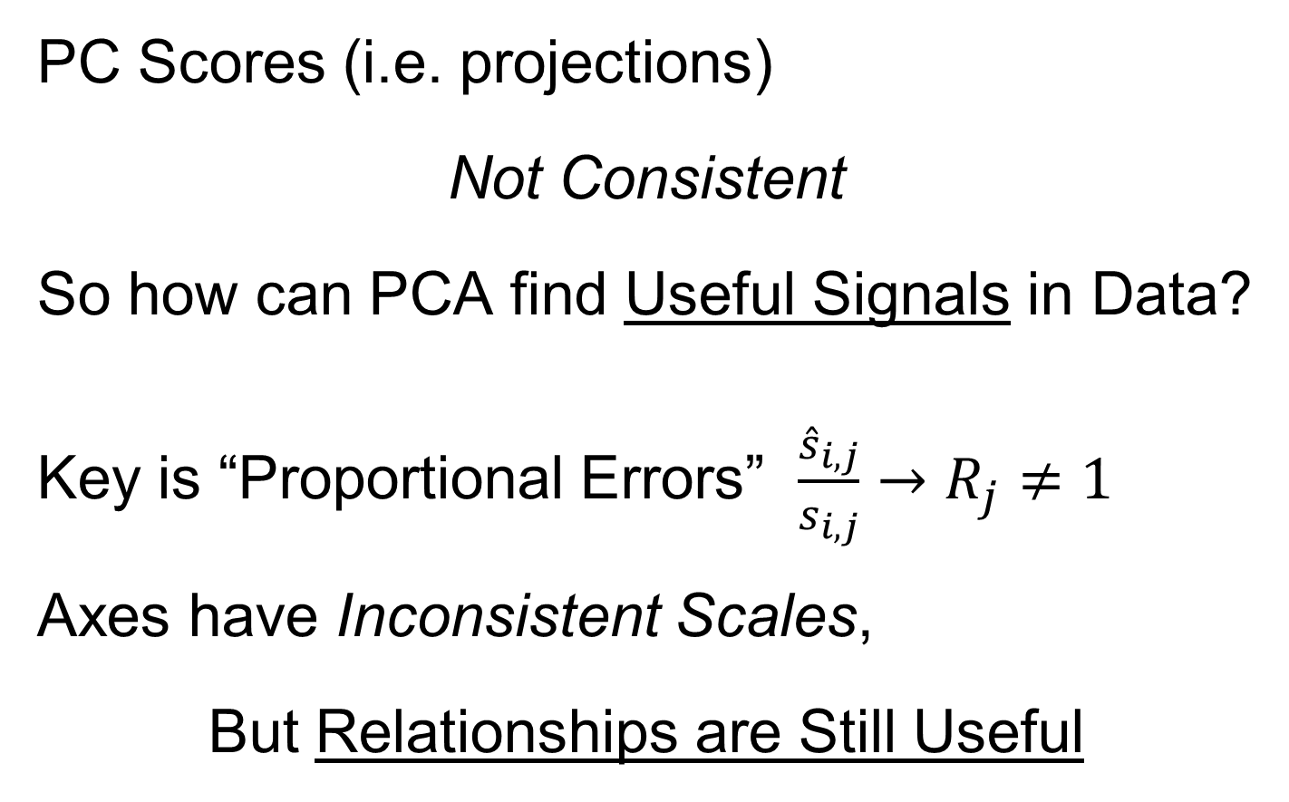
HDLSS Math. Stat. of PCA
PC Scores (i.e. projections)
Not Consistent
So how can PCA find Useful Signals in Data?
Key is “Proportional Errors” $\frac{{\hat{s}}_{i,j}}{s_{i,j}}→R_{j}≠1$
Axes have Inconsistent Scales,
But Relationships are Still Useful

Slide 7
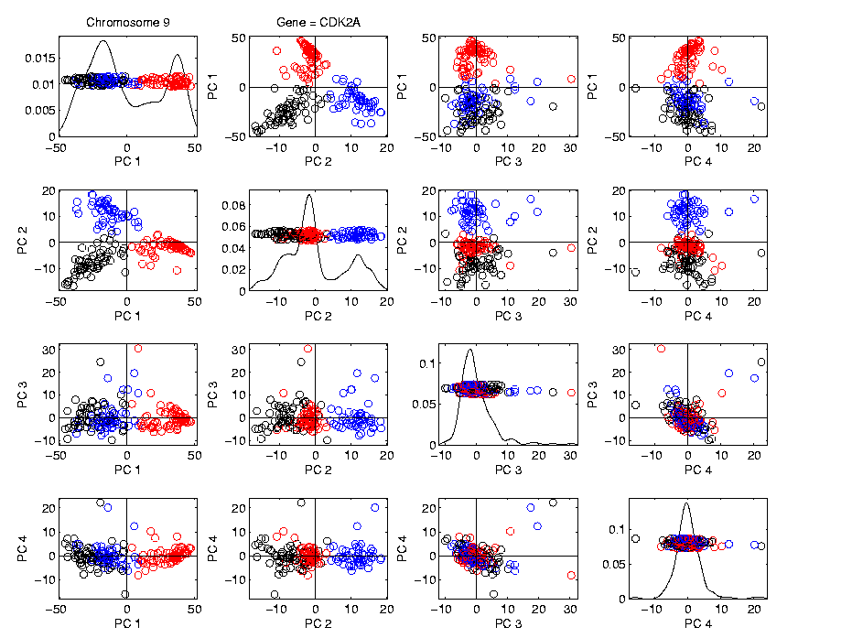
HDLSS Math. Stat. of PCA
Numbers
On Axes
Are Wrong
But
Relationships
Are Right

Slide 8
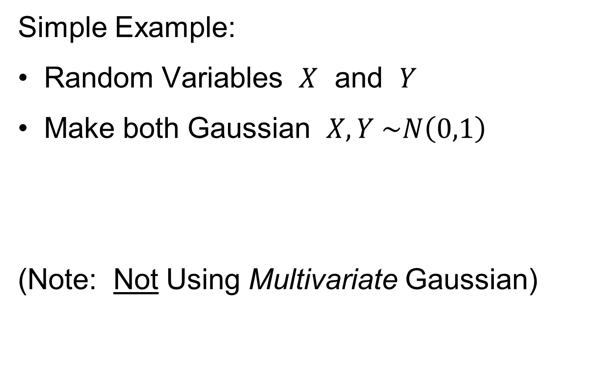
HDLSS Deep Open Problem
Result
In PCA Consistency:
Strong Inconsistency - $α<1$ spike
Consistency - $α>1$ spike
What happens at boundary ($α=1$)???
Ǝ interesting Limit Distn’s
Jung, Sen & Marron (2012)

Slide 9
1
0≤ α < β ≤1
0.7
β
0≤ α = β ≤1
Sparsity Index
α>1
0 ≤ β ≤1
0.5
0.3
0≤β<α≤1
0.1
0
0
0.2
0.4
0.6
0.8
1
Jung and Marron
α
Spike Index
Sparse PCA: Inconsistent & New Consistency Region

Slide 10
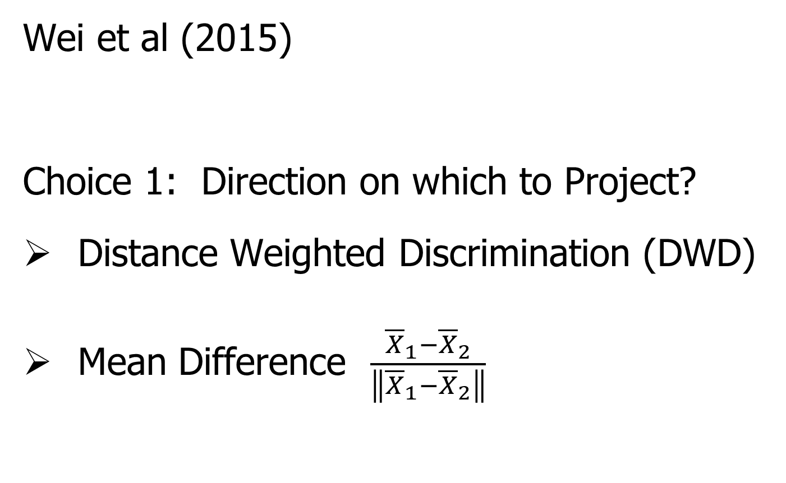
HDLSS Analysis of DiProPerm
Wei et al (2015)
Choice 1: Direction on which to Project?
Distance Weighted Discrimination (DWD)
Mean Difference $\frac{{\overline{X}}_{1}−{\overline{X}}_{2}}{\left\|{\overline{X}}_{1}−{\overline{X}}_{2}\right\|}$

Slide 11
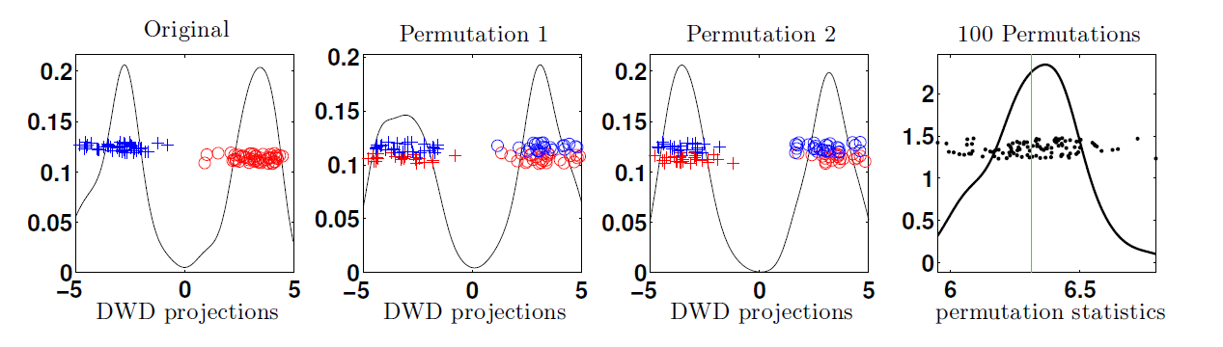
HDLSS Analysis of DiProPerm
Choice 2:
Which Statistic to Summarize Projections?
2 – Sample t statistic
Mean Difference

Slide 12
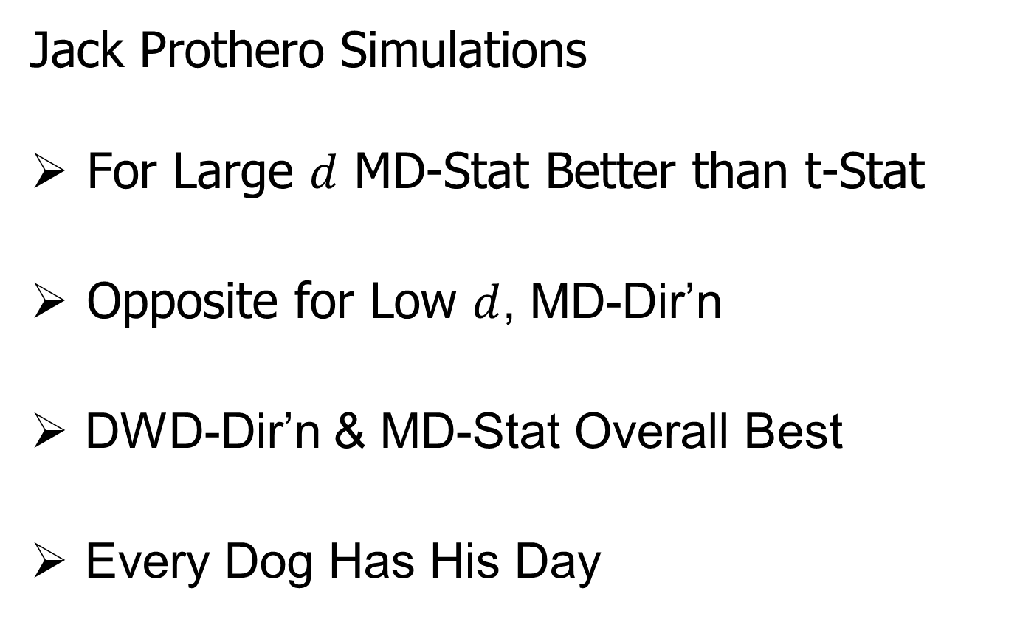
HDLSS Analysis of DiProPerm
Jack Prothero Simulations
For Large $d$ MD-Stat Better than t-Stat
Opposite for Low $d$, MD-Dir’n
DWD-Dir’n & MD-Stat Overall Best
Every Dog Has His Day

Slide 13
HDLSS Robust PCA
Recall Robust PCA via Spherical Projection
Zhou and Marron (2015) showed:
No Outliers: Similar Performance
Outliers: Spherical PCA is Better

Slide 14
HDLSS Asymptotics in Classification
Explanation of Observed (Simulation) Behavior:
“everything similar for very high d ”
2 popn’s are 2 simplices (i.e. regular n-hedrons)
All are same distance from the other class
i.e. everything is a support vector
i.e. all sensible directions show “data piling”
so “sensible methods are all nearly the same”

Slide 15
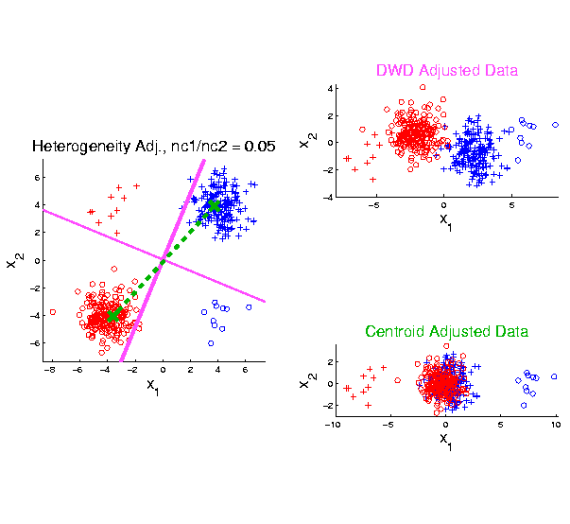
Twiddle ratios of subtypes
2-d Toy
Example
Unbalanced
Mixture

Slide 16
Why not adjust by means?
DWD robust against non-proportional subtypes…
Mathematical Statistical Question:
Are there mathematics behind this?
Notes:
16

Slide 17
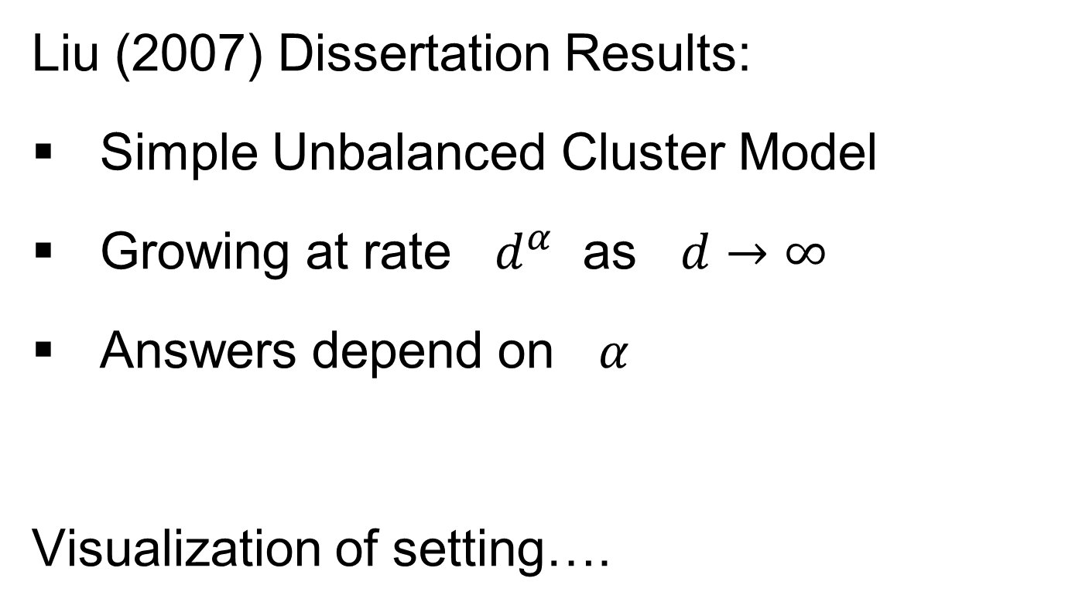
HDLSS Data Combo Mathematics
Liu (2007) Dissertation Results:
Simple Unbalanced Cluster Model
Growing at rate $d^{α}$ as $d→∞$
Answers depend on $α$
Visualization of setting….

Slide 18
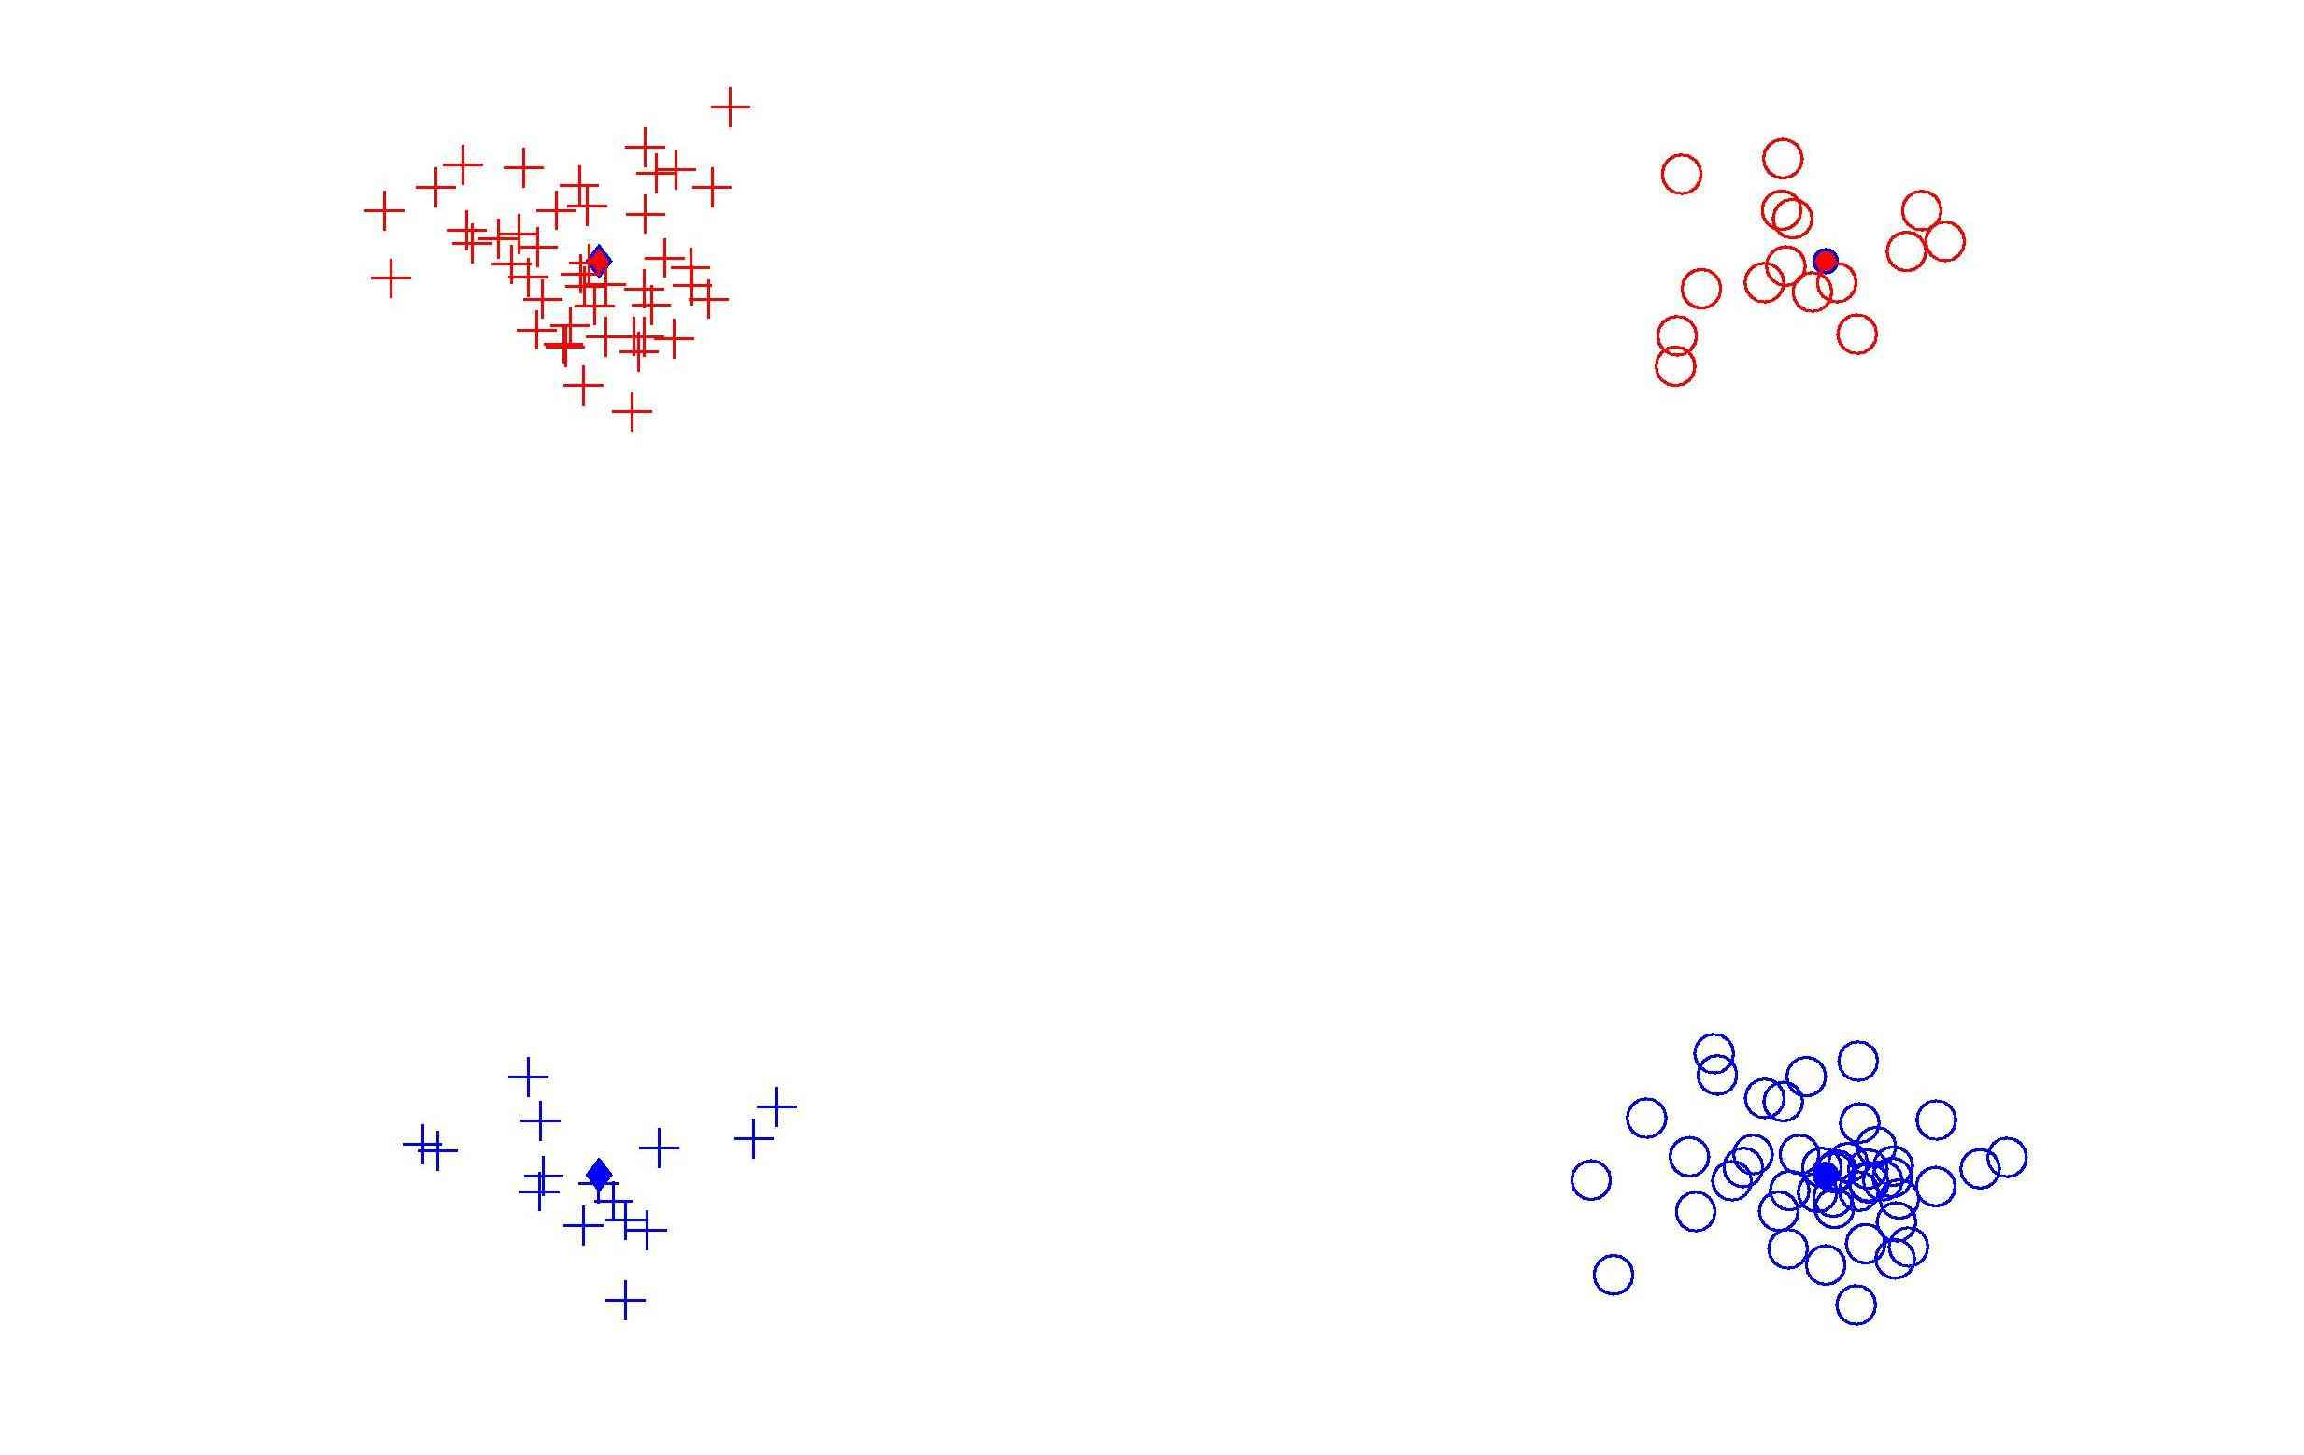
HDLSS Data Combo Mathematics

Slide 19
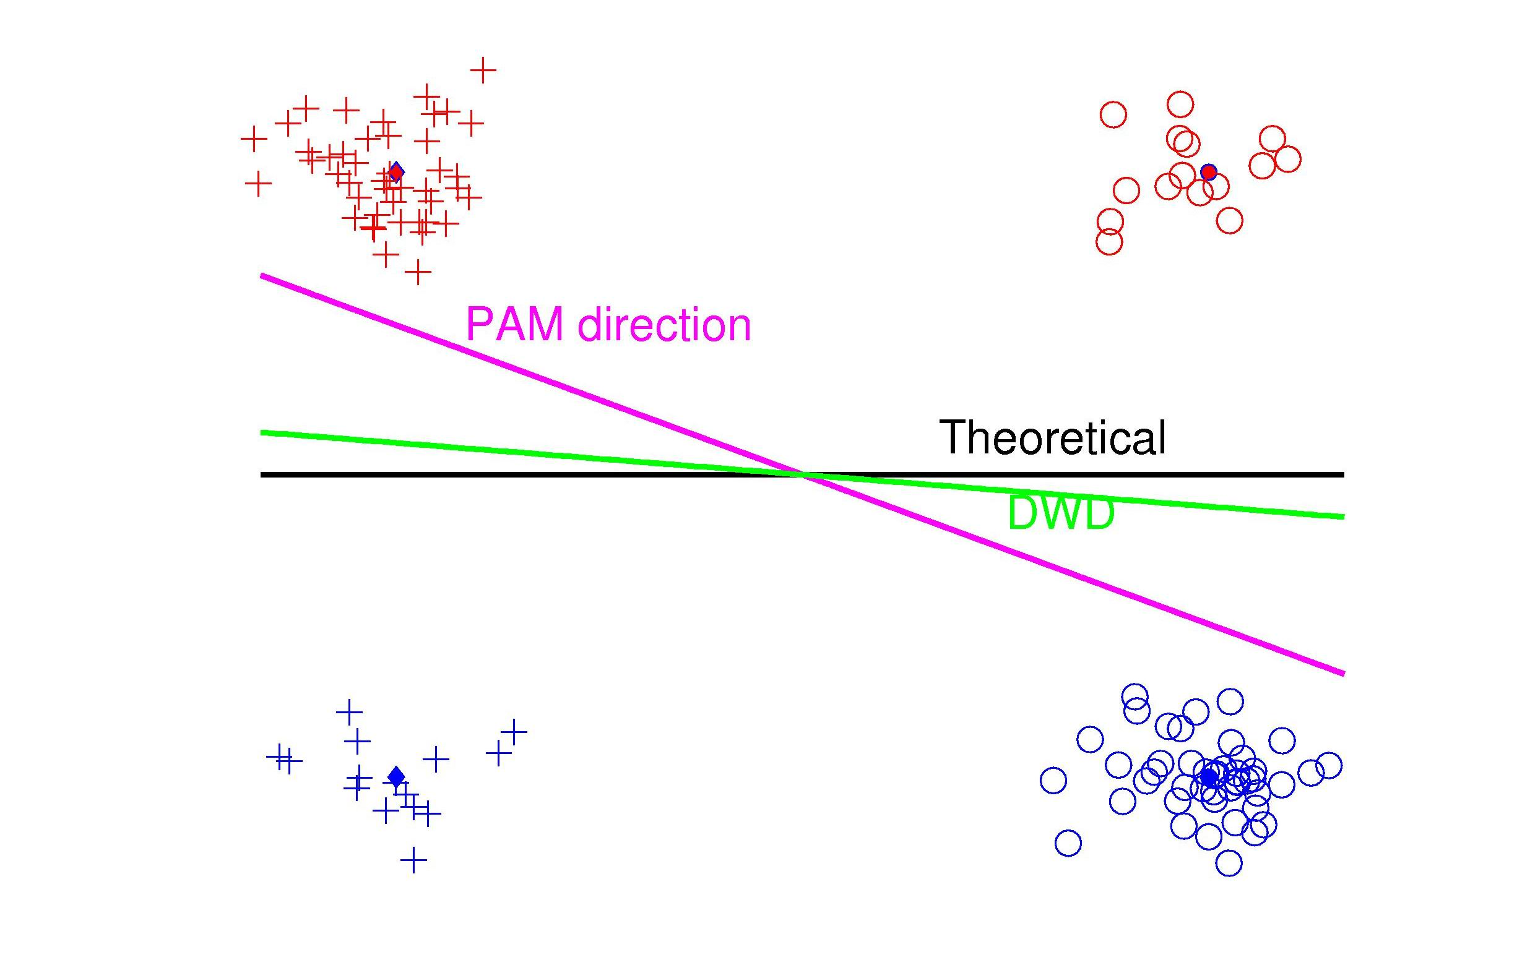
HDLSS Data Combo Mathematics

Slide 20
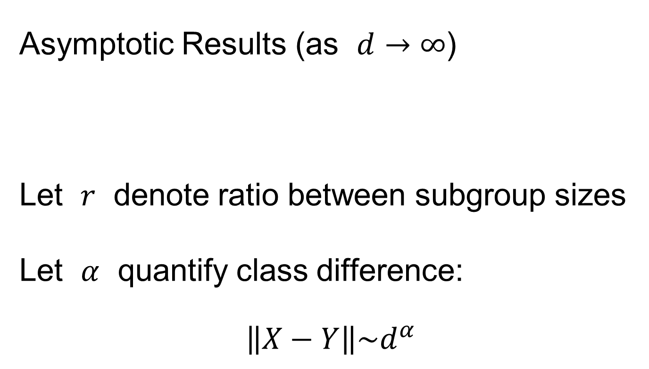
HDLSS Data Combo Mathematics
Asymptotic Results (as $d→∞$)
Let $r$ denote ratio between subgroup sizes
Let $α$ quantify class difference:
$$\left\|X−Y\right\|\sim d^{α}$$

Slide 21
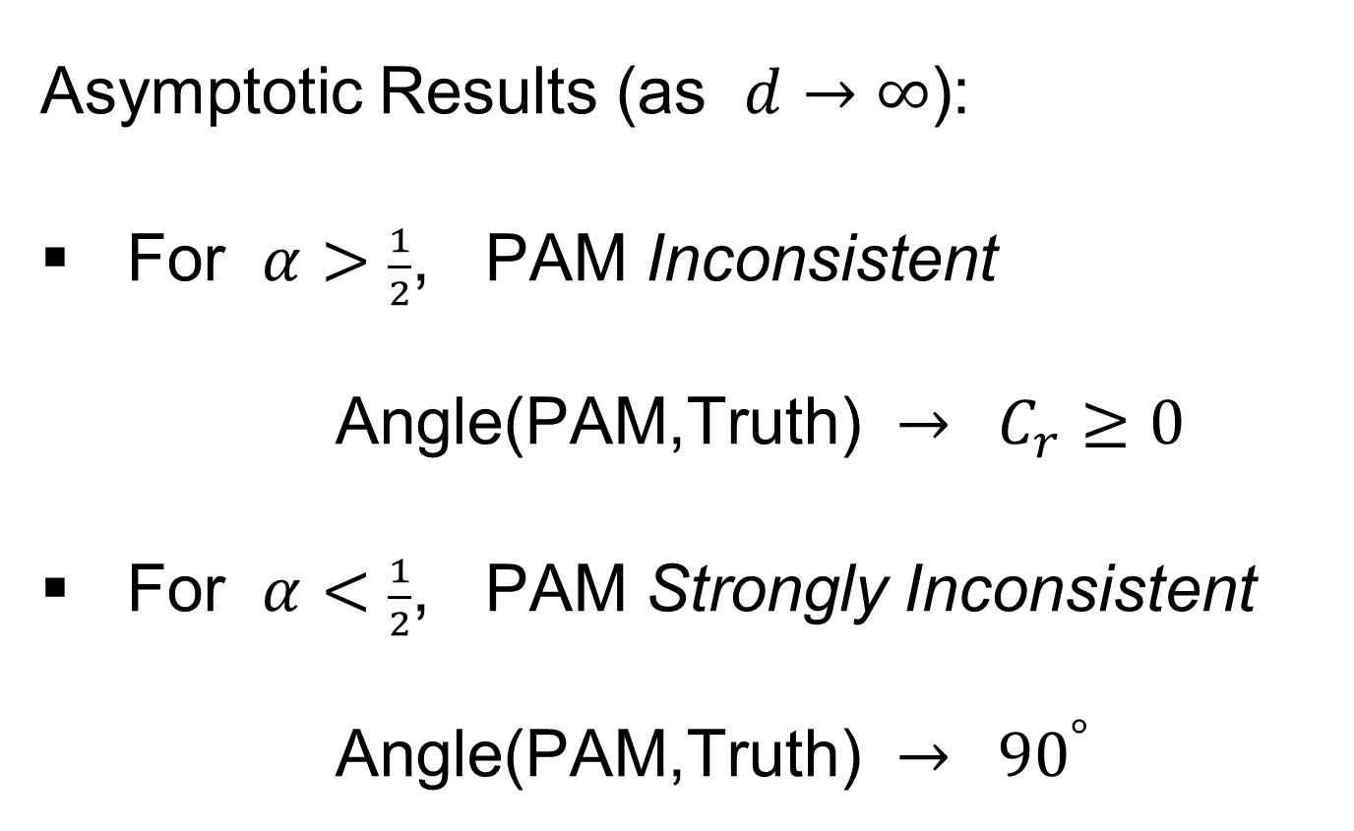
HDLSS Data Combo Mathematics
Asymptotic Results (as $d→∞$):
For $α>\frac{1}{2}$, PAM Inconsistent
Angle(PAM,Truth) $→ C_{r}≥0$
For $α<\frac{1}{2}$, PAM Strongly Inconsistent
Angle(PAM,Truth) $→ {90}^{°}$

Slide 22
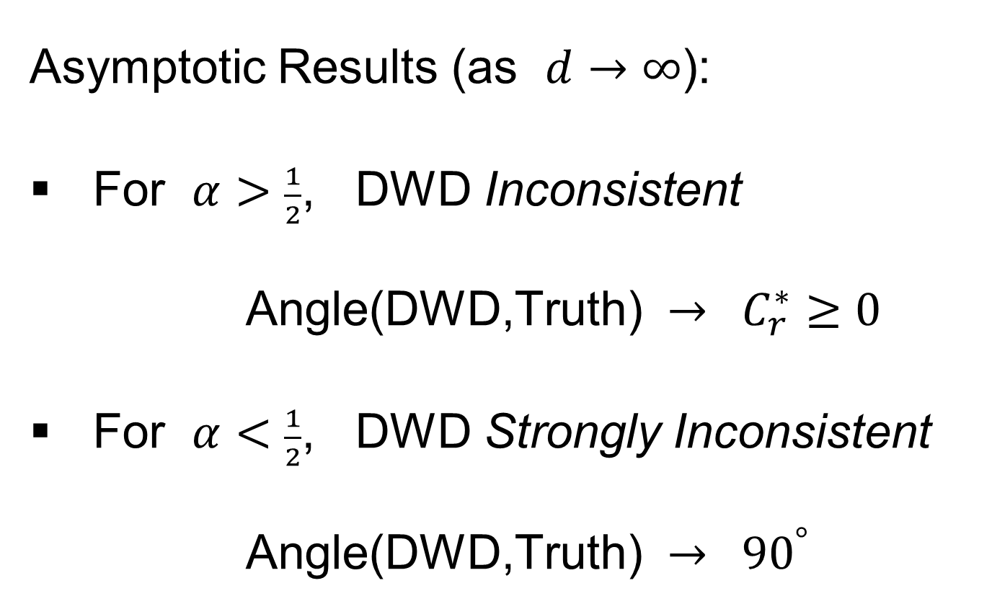
HDLSS Data Combo Mathematics
Asymptotic Results (as $d→∞$):
For $α>\frac{1}{2}$, DWD Inconsistent
Angle(DWD,Truth) $→ C_{r}^{∗}≥0$
For $α<\frac{1}{2}$, DWD Strongly Inconsistent
Angle(DWD,Truth) $→ {90}^{°}$

Slide 23

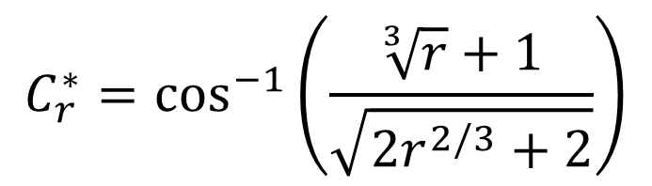
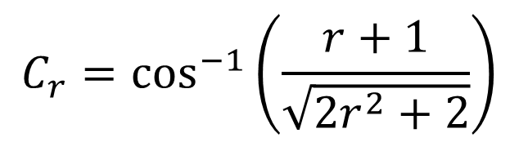
HDLSS Data Combo Mathematics
Value of $C_{r}$ and $C_{r}^{∗}$, for sample size ratio $r$:
$C_{r}^{∗}=C_{r}=0$, only when $r=1$
Otherwise for $r≠1$, both are Inconsistent
$$C_{r}=\cos^{−1}\left(\frac{r+1}{\sqrt{2r^{2}+2}}\right)$$
$$C_{r}^{∗}=\cos^{−1}\left(\frac{\sqrt[3]{r}+1}{\sqrt{2r^{2/3}+2}}\right)$$

Slide 24

HDLSS Data Combo Mathematics
Comparison between PAM and DWD?
I.e. between $C_{r}$ and $C_{r}^{∗}$?

Slide 25
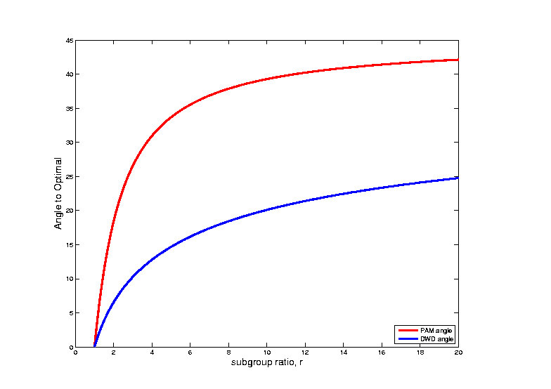
HDLSS Data Combo Mathematics
Comparison between PAM and DWD?

Slide 26
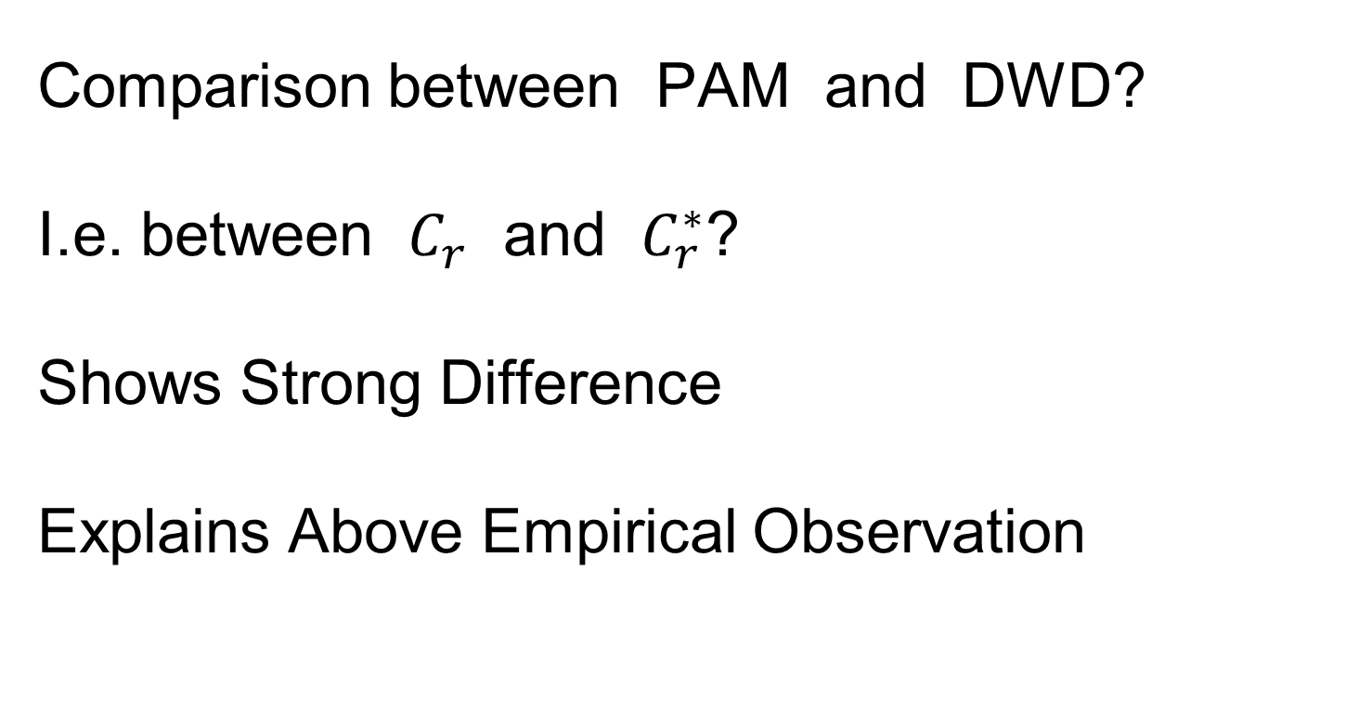
HDLSS Data Combo Mathematics
Comparison between PAM and DWD?
I.e. between $C_{r}$ and $C_{r}^{∗}$?
Shows Strong Difference
Explains Above Empirical Observation

Slide 27
HDLSS Asymptotics
Survey & Introductory Paper:
Aoshima, Shen, Shen, Yata, Zhou & Marron (2018) Australian & New Zealand Journal of Statistics, 60, 4-19.
Memorial to Peter G. Hall

Slide 28
HDLSS Asymptotics
Personal Observations:
HDLSS world is…
Surprising (many times!)
[Think I’ve got it, and then …]
Mathematically Beautiful (?)
Practically Relevant

Slide 29
The Future of HDLSS Asymptotics
“Contiguity” in Hypo Testing?
Rates of Convergence?
Improvements of DWD?
(e.g. other functions of distance than inverse)
Many Others?
It is still early days …

Slide 30
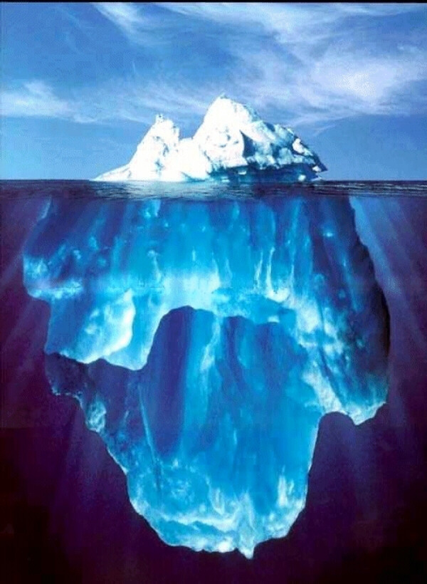
State of HDLSS Research?
Development
Of Methods
Mathematical
Assessment
…
(thanks to:
defiant.corban.edu/gtipton/net-fun/iceberg.html)

Slide 31
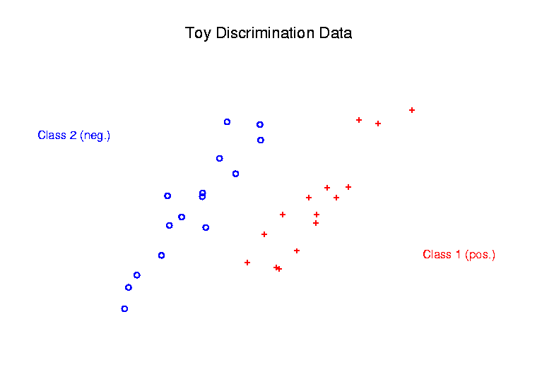
Radial DWD
Main Idea:
Linear Classifiers Good When Each Class Lives in a Distinct Region
Notes:
31

Slide 32
Radial DWD
Main Idea:
Linear Classifiers Good When Each Class Lives in a Distinct Region
Hard When All Members Of One Class Are Outliers in a Random Direction
Notes:
32

Slide 33
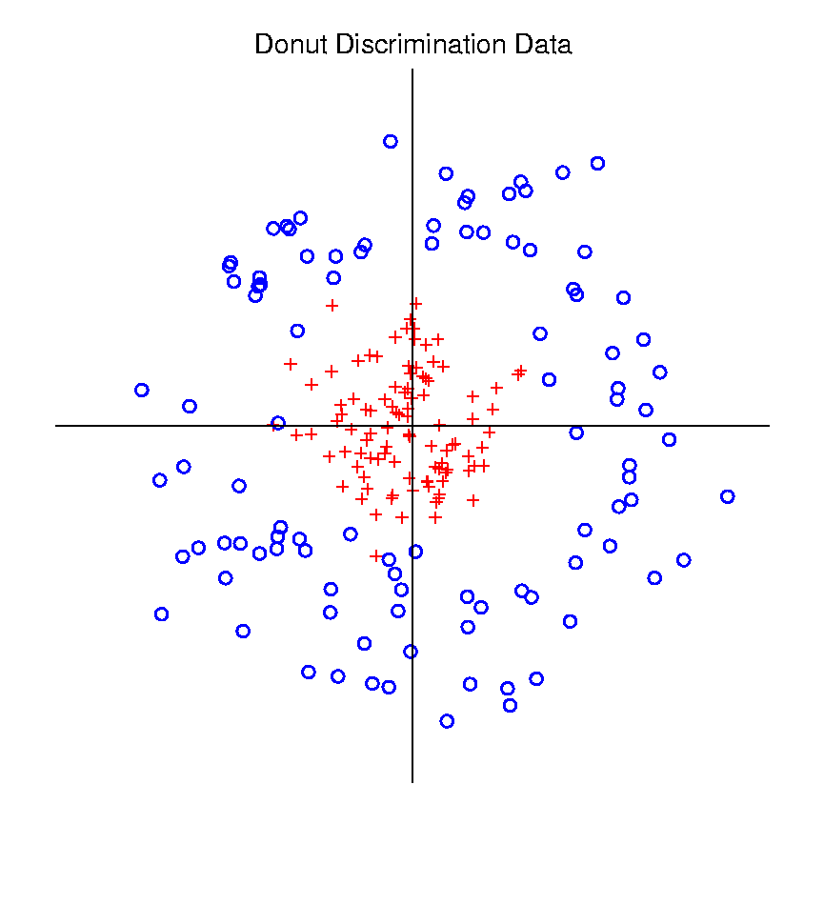
Radial DWD
Hard When All Members Of One Class Are Outliers in a Random Direction
Think HDLSS
Version of
Notes:
33

Slide 34
Radial DWD
Hard When All Members Of One Class Are Outliers in a Random Direction
E.g. Normal Cases
& Randomly Degraded
Notes:
34

Slide 35


Radial DWD
Reference:
Xiong, Dittmer & Marron (2016)
Notes:
35

Slide 36
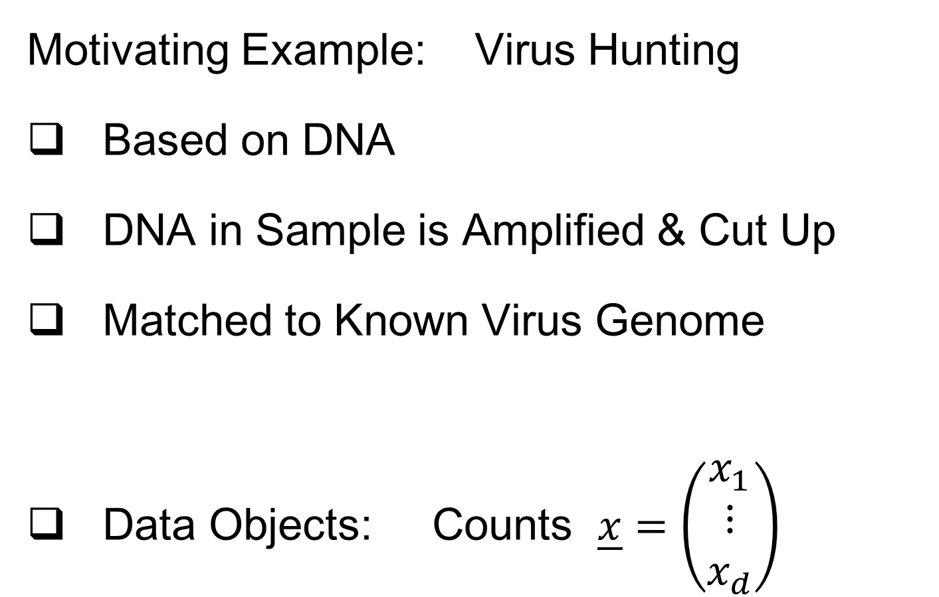
Radial DWD
Motivating Example: Virus Hunting
Based on DNA
DNA in Sample is Amplified & Cut Up
Matched to Known Virus Genome
Data Objects: Counts $\underline{x}=\left(\begin{matrix}x_{1} \\ ⋮ \\ x_{d}\end{matrix}\right)$
Notes:
36

Slide 37
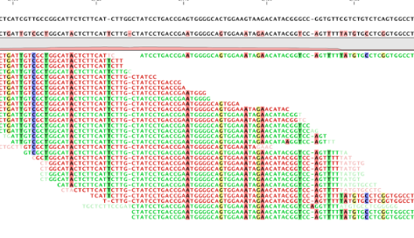

Virus Hunting
“Reads” Matched to Virus Genome & Counted to give $x_{1},⋯,x_{d}$
Notes:
37

Slide 38
Virus Hunting
Challenge 1:
Highly Variable DNA Amplification
Solution:
Standardize by Dividing by Total
Notes:
38

Slide 39
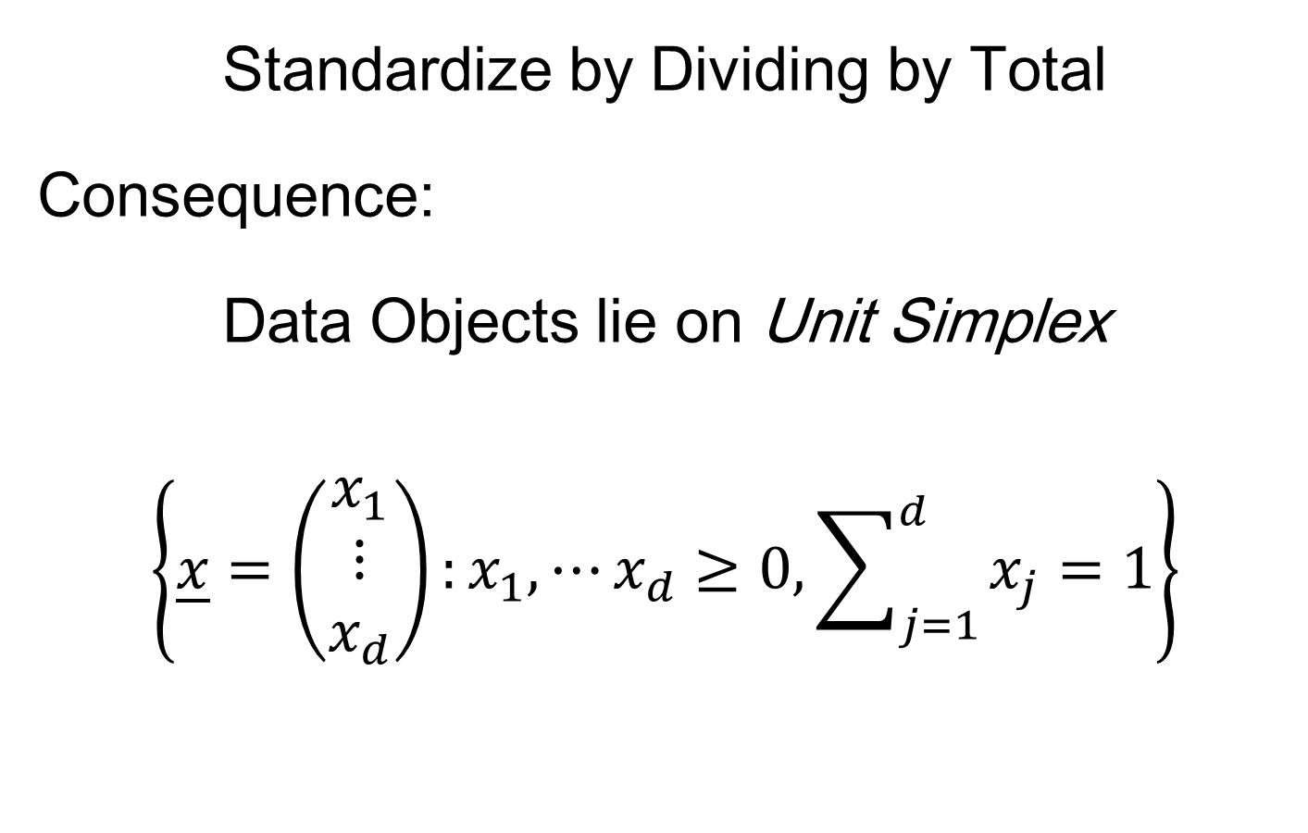
Virus Hunting
Standardize by Dividing by Total
Consequence:
Data Objects lie on Unit Simplex
$$\left\{\underline{x}=\left(\begin{matrix}x_{1} \\ ⋮ \\ x_{d}\end{matrix}\right):x_{1},⋯x_{d}≥0,\sum_{j=1}^{d}{x_{j}}=1\right\}$$
Notes:
39

Slide 40
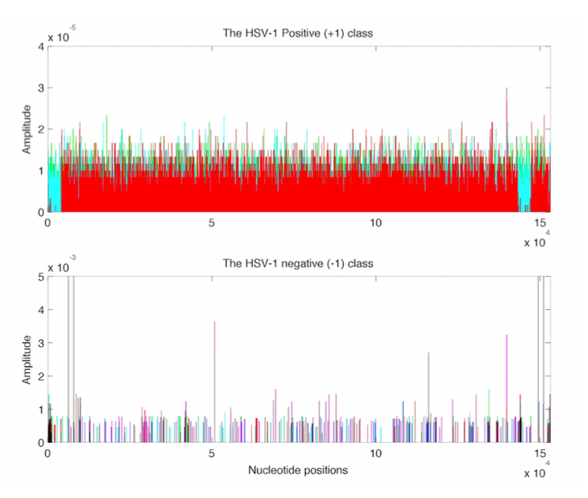
Virus Hunting
Look at
Data:
Mostly
Non-0
Near Simplex Center
Almost
All 0
Near Simplex Corners
Notes:
40

Slide 41
Virus Hunting
Look at
Data:
Note:
Heights
Orders of
Magnitude
-5 << -3
Different
Notes:
41

Slide 42
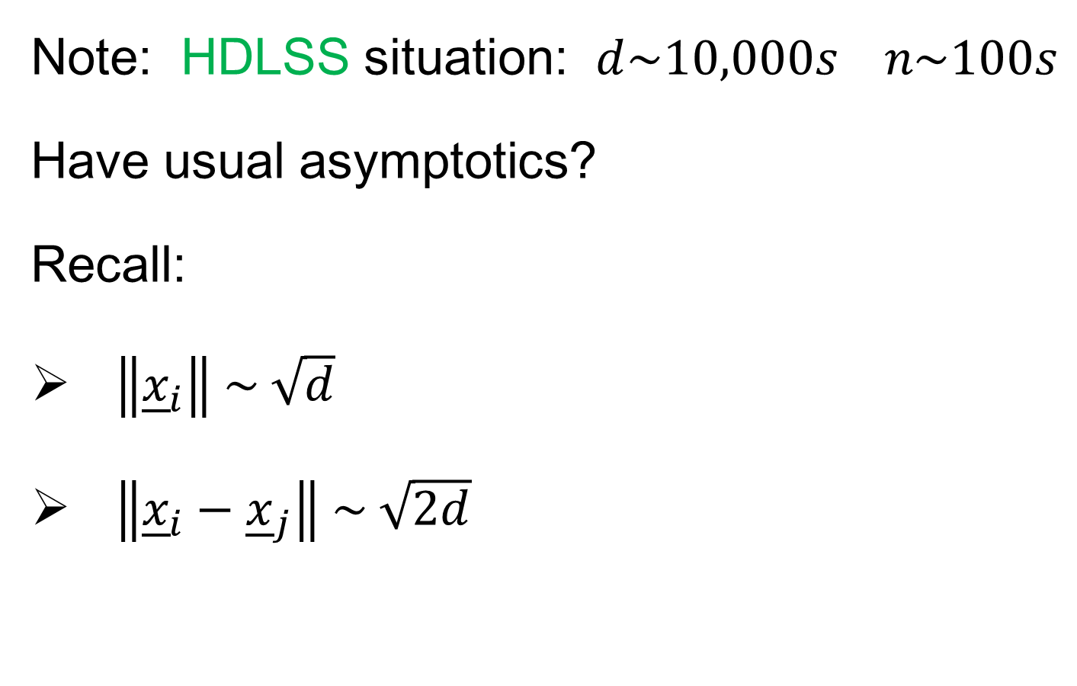
Virus Hunting
Note: HDLSS situation: $d\sim 10,000s n\sim 100s$
Have usual asymptotics?
Recall:
$\left\|{\underline{x}}_{i}\right\| \sim \sqrt{d}$
$\left\|{\underline{x}}_{i}−{\underline{x}}_{j}\right\| \sim \sqrt{2d}$
Notes:
42

Slide 43
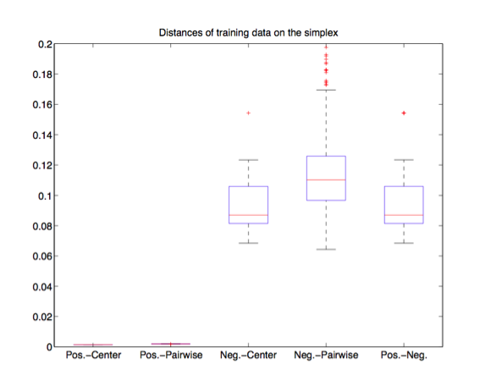
Virus Hunting
Check
HDLSS
Dist’s
Notes:
43

Slide 44
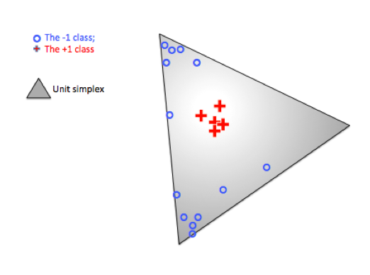
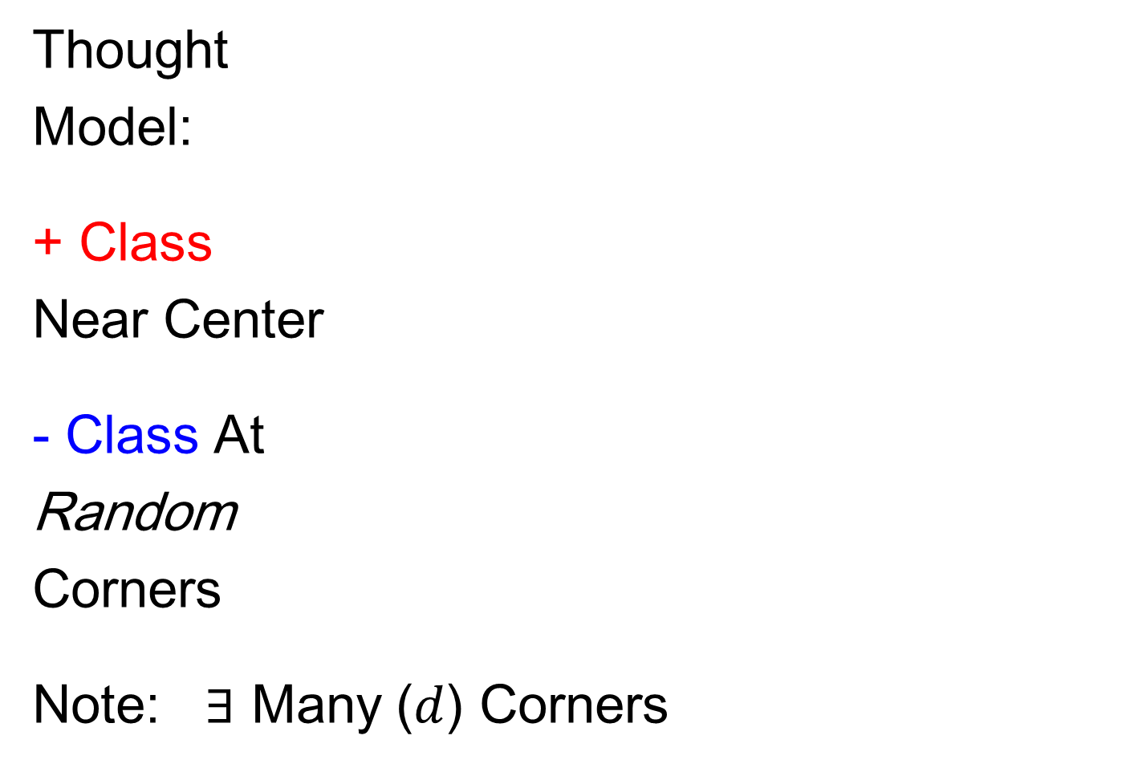
Radial DWD
Thought
Model:
+ Class
Near Center
- Class At
Random
Corners
Note: $∃$ Many ($d$) Corners
Notes:
44

Slide 45
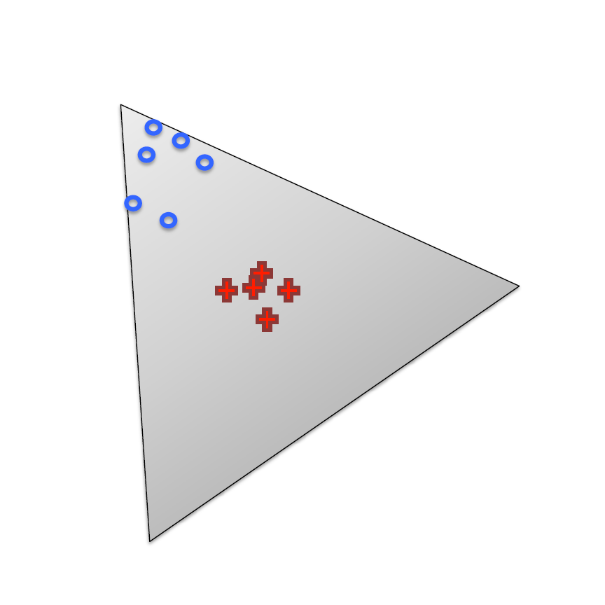
Radial DWD
Consider Training Data
+ Class in Center
- Class Really in
Multiple Corners
Notes:
45

Slide 46
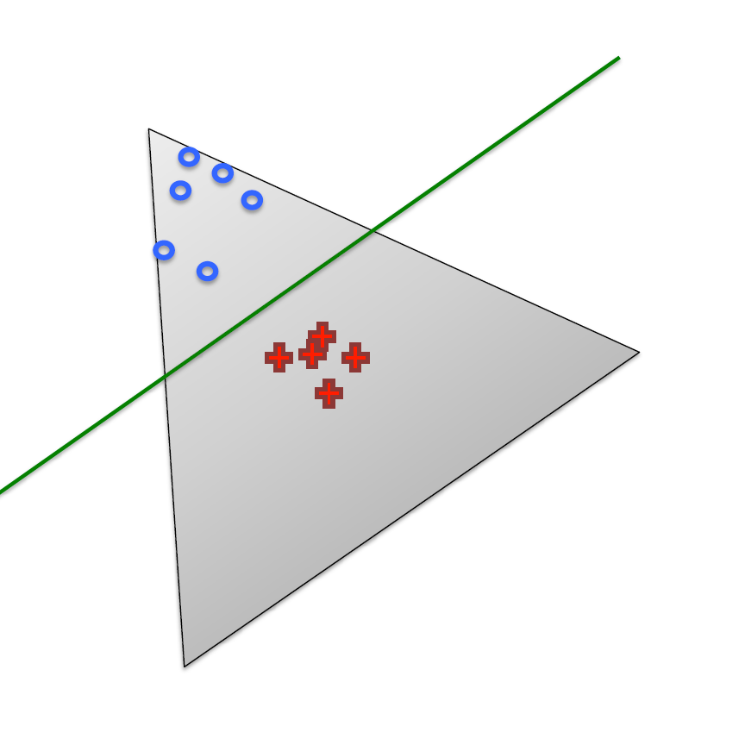
Radial DWD
Consider Training Data
Classify Using
Separating Plane
Notes:
46

Slide 47
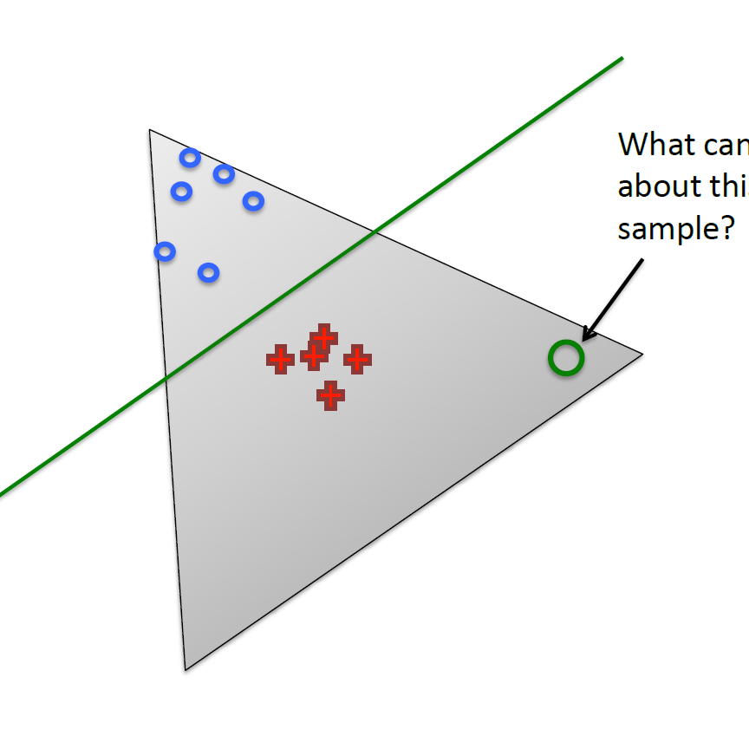
Radial DWD
Consider Training Data
But What About
Test Point In A
Different Corner
???
Notes:
47

Slide 48
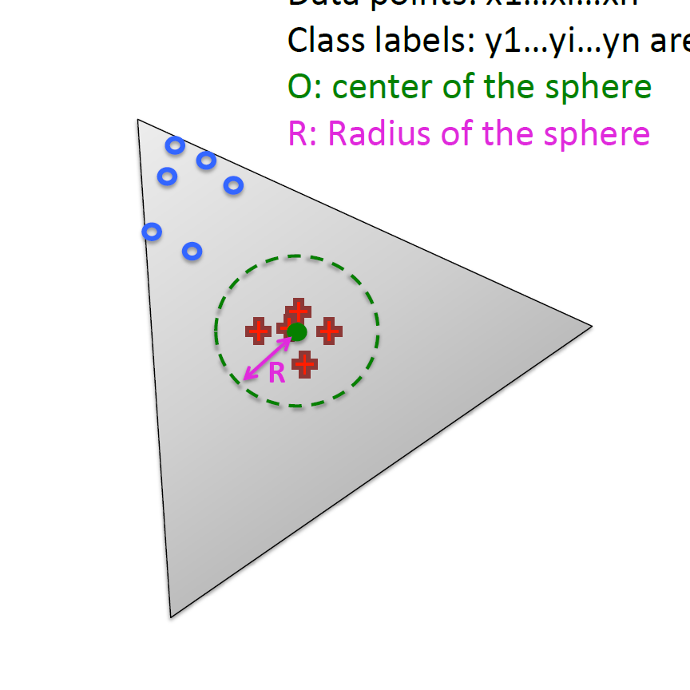
Radial DWD
Approach:
Replace Separating Plane
With Separating Sphere
Find Parameters
Via DWD-like
Optimization
Enables Finding Corners
With No Training Data
Notes:
48

Slide 49
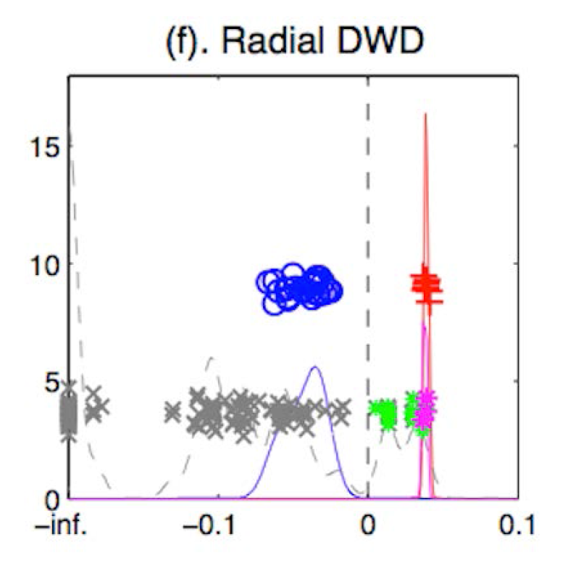
Virus Hunting
Real Data Result:
Train + (+)
Train – (o)
Test + (*)
Related (*)
Test - (x)
Notes:
49

Slide 50
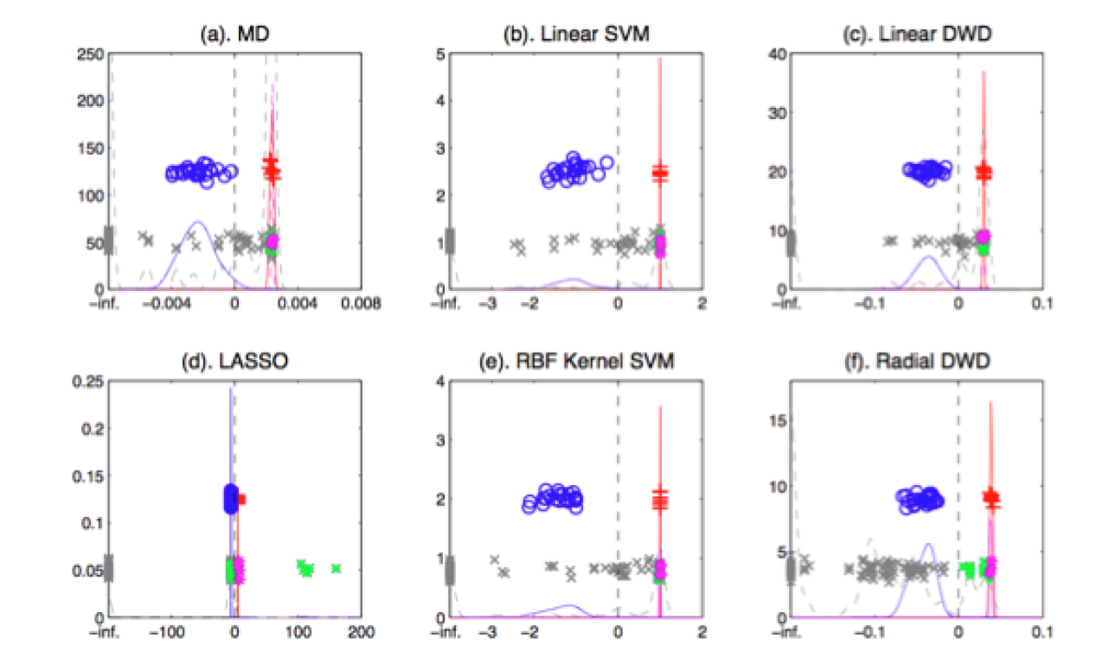
Virus Hunting
Compare With Other Classifiers
Includes Above Radial DWD
Notes:
50

Slide 51
Virus Hunting
Compare With Other Classifiers
Linear Methods All Poor
Notes:
51

Slide 52
Virus Hunting
Compare With Other Classifiers
Even Kernel SVM Fails!!!
Reason:
Test Data
Lies In
Corners
With No
Training
Data
Notes:
52

Slide 53
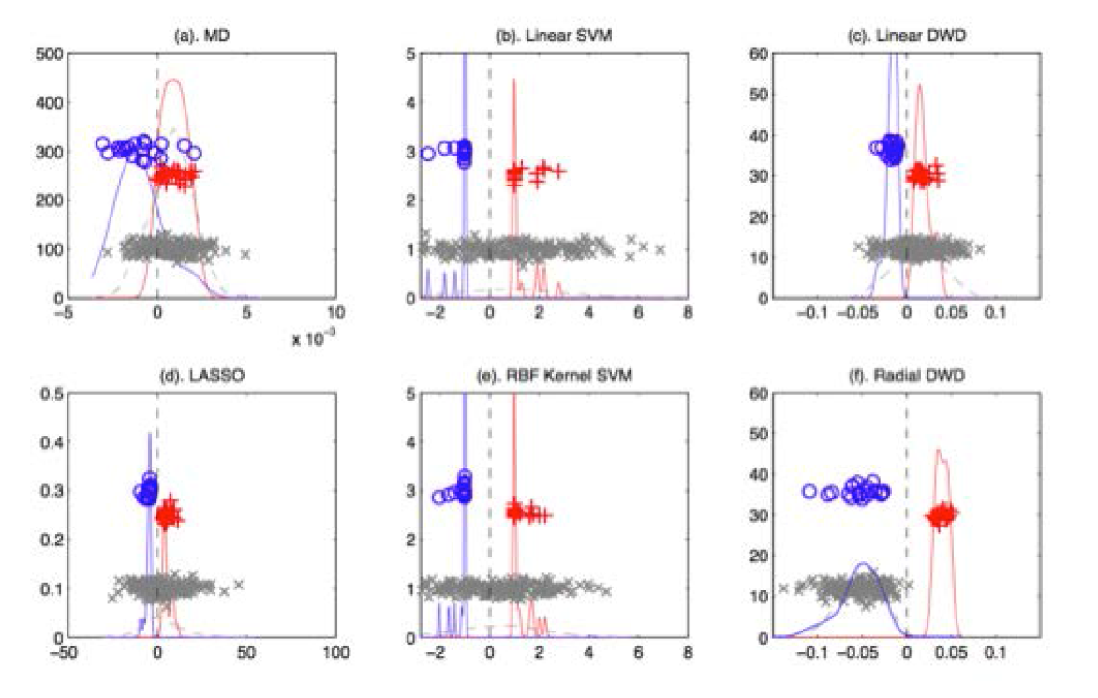
Radial DWD
Verify With Simulation Study
Note: Very Similar Behavior!
Notes:
53

Slide 54
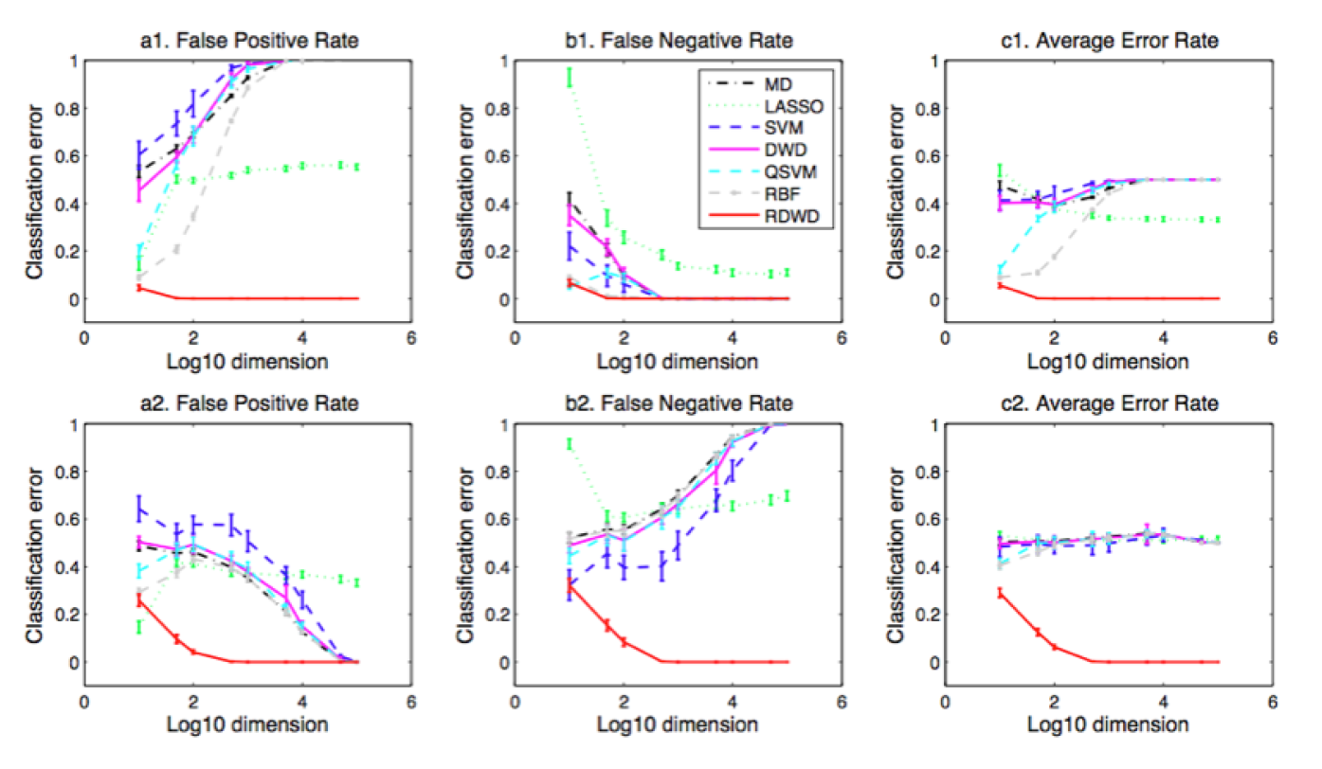

Radial DWD
Verify With Simulation Study
Stunning Test Classificat’n Rates as $d$ grows!
Notes:
54

Slide 55
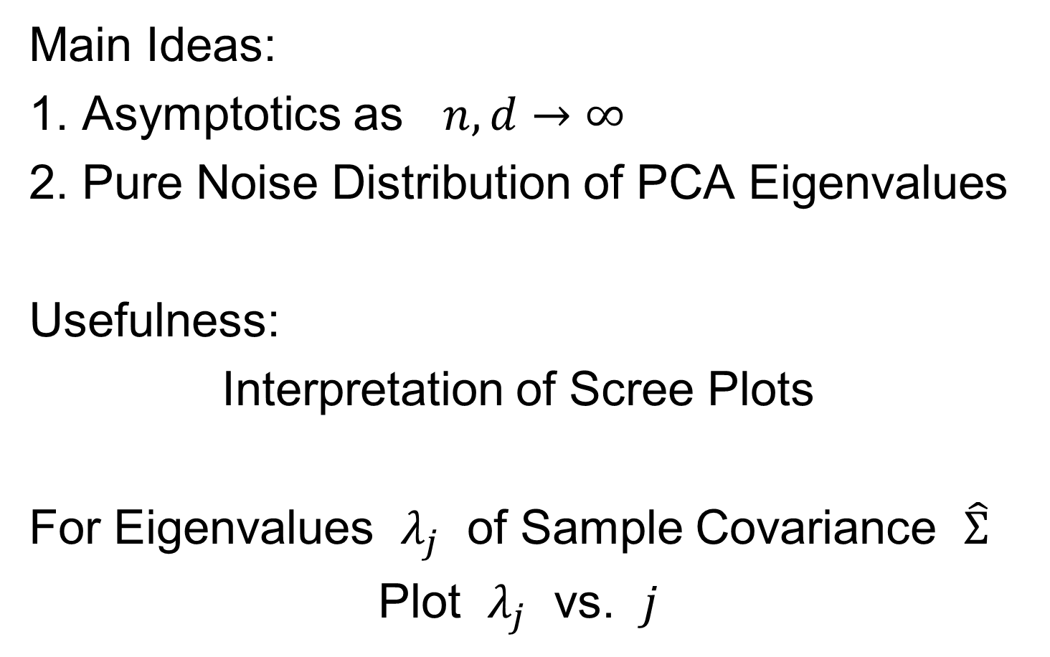
Random Matrix Theory
Main Ideas:
1. Asymptotics as $n,d→∞$
2. Pure Noise Distribution of PCA Eigenvalues
Usefulness:
Interpretation of Scree Plots
For Eigenvalues $λ_{j}$ of Sample Covariance $\hat{Σ}$
Plot $λ_{j}$ vs. $j$

Slide 56
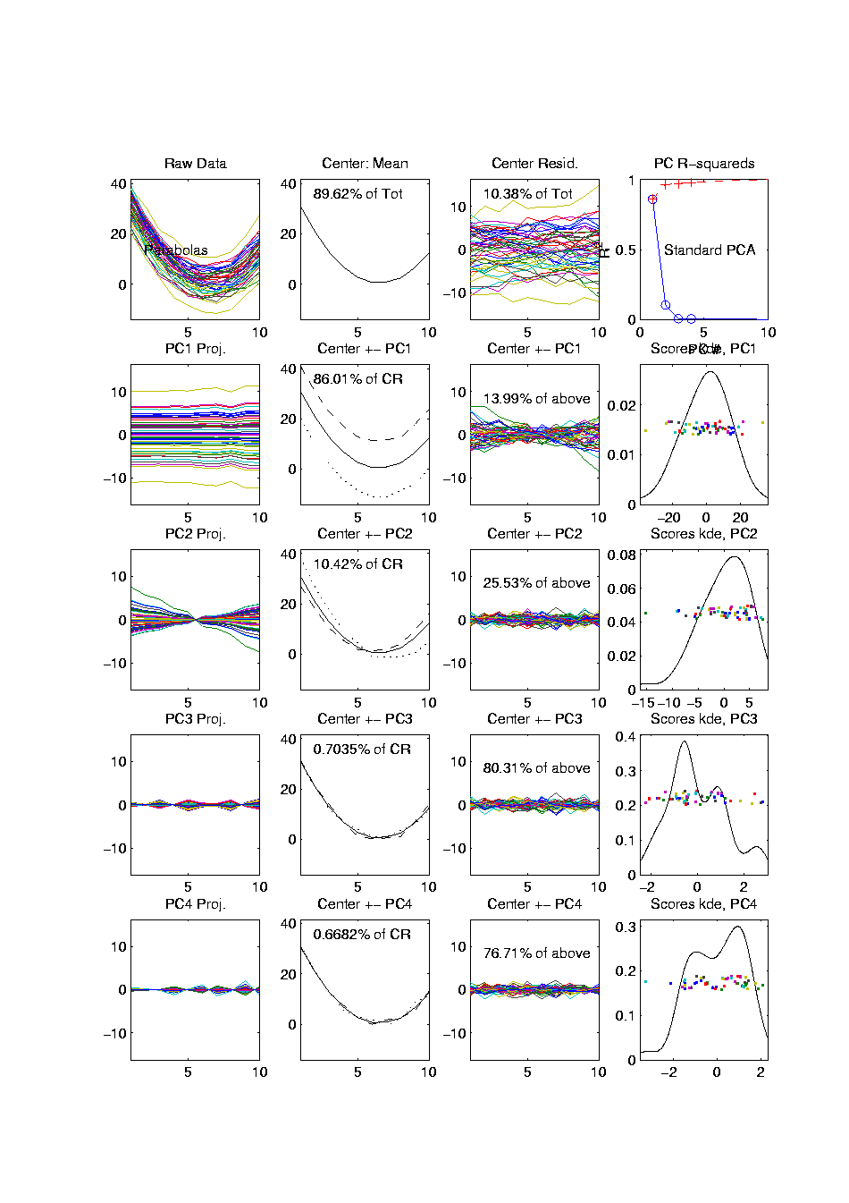
PCA Redist’n of Energy (Cont.)
Note, have already considered some of these Useful Plots:
Power Spectrum (as %s)
Cumulative Power Spectrum (%)
Common Terminology:
Power Spectrum is Called
“Scree Plot”
Kruskal (1964) Cattell (1966)
(all but name “scree”) (1st Appearance of name???)
Notes:
56

Slide 57
PCA Redist’n of Energy (Cont.)
Note, have already considered some of these Useful Plots:
Power Spectrum (as %s)
Cumulative Power Spectrum (%)
Large Values Reflect
Important Structure
Notes:
57

Slide 58
PCA Redist’n of Energy (Cont.)
Note, have already considered some of these Useful Plots:
Power Spectrum (as %s)
Cumulative Power Spectrum (%)
Zoom In & Characterize Noise
Notes:
58

Slide 59



Random Matrix Theory
Pure Noise Data Matrix:
$X=$
Defined as: Entries i.i.d. $N(0,1)$
$$d$$
Thinking of
Columns As
Data Objects
$$n$$

Slide 60
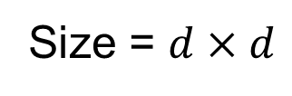
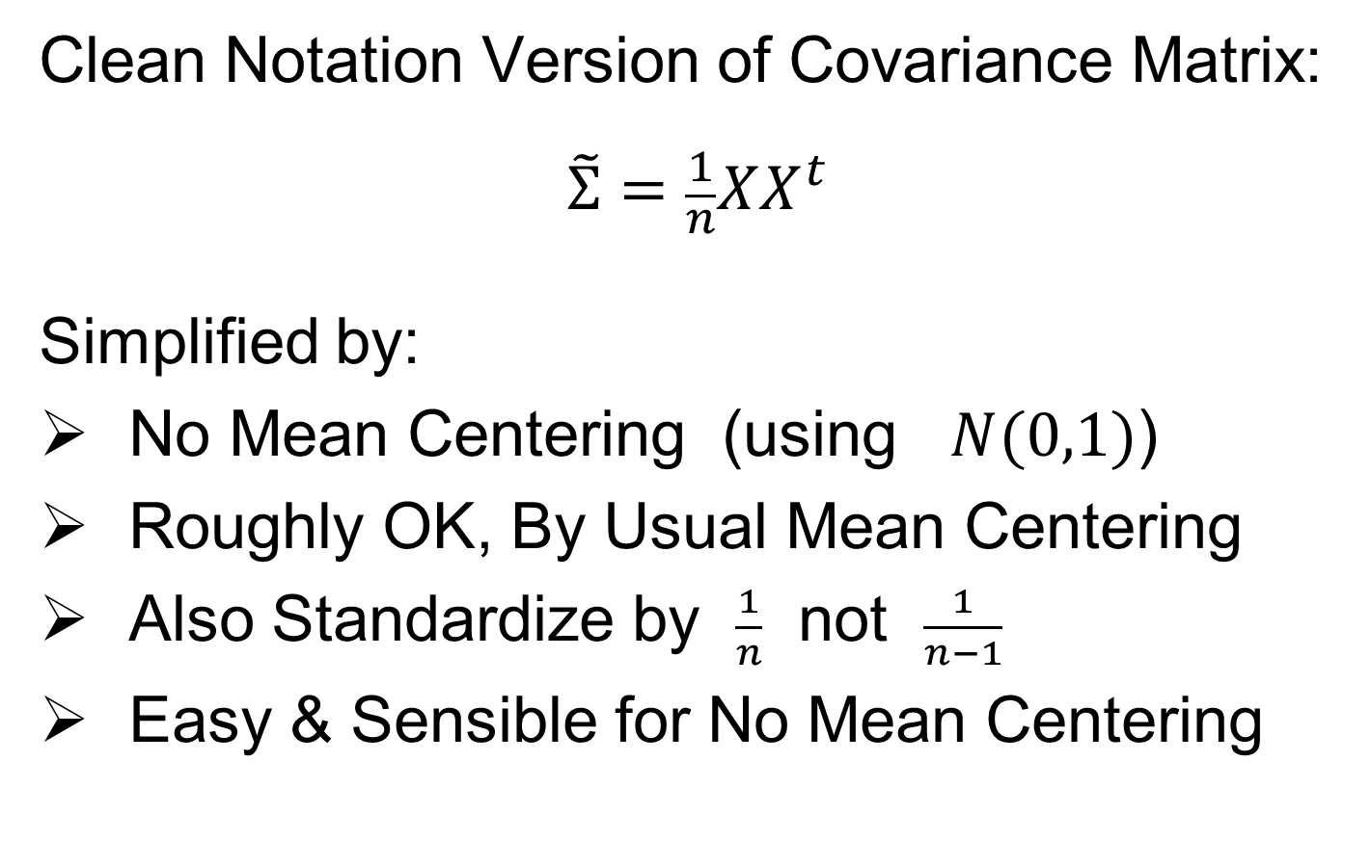
Random Matrix Theory
Clean Notation Version of Covariance Matrix:
$$\tilde{Σ}=\frac{1}{n}XX^{t}$$
Simplified by:
No Mean Centering (using $N(0,1)$)
Roughly OK, By Usual Mean Centering
Also Standardize by $\frac{1}{n}$ not $\frac{1}{n−1}$
Easy & Sensible for No Mean Centering
Size = $d×d$

Slide 61

Random Matrix Theory
Eigenvalues are $\tilde{λ_{j}}$, diagonal entries of $Λ$ in
$$\tilde{Σ}=UΛU^{t}$$
(Eigen-analysis)
Distribution of $\tilde{λ_{j}}$?

Slide 62


Random Matrix Theory
For $d=100$, $n=1000$, Eigenvalues $≈1$
But There Is (Chance) Variation

Slide 63


Random Matrix Theory
Smaller $n=500$ Boosts Variation
(More Uncertainty)

Slide 64


Random Matrix Theory
Smaller $n=200$ Boosts Variation
(More Uncertainty)

Slide 65


Random Matrix Theory
Smaller $n=100$ Boosts Variation
But Can’t Go Negative
Although
Can Get
Large

Slide 66


Random Matrix Theory
Larger $n=10,000$ Reduces Variation

Slide 67


Random Matrix Theory
Larger $n=100,000$ Reduces Variation

Slide 68


Random Matrix Theory
Fix $y=\frac{d}{n}=5$, and let $d$, $n$ grow ($→∞$).
Essentially
Same
Shape

Slide 69

Random Matrix Theory
Fix $y=\frac{d}{n}=5$, and let $d$, $n$ grow ($→∞$).
Essentially
Same
Shape

Slide 70


Random Matrix Theory
Fix $y=\frac{d}{n}=5$, and let $d$, $n$ grow ($→∞$).
But Less
Sampling
Noise

Slide 71

Random Matrix Theory
Fix $y=\frac{d}{n}=5$, and let $d$, $n$ grow ($→∞$).
But Less
Sampling
Noise

Slide 72


Random Matrix Theory
Fix $y=\frac{d}{n}=5$, and let $d$, $n$ grow ($→∞$).
What Is
That Shape?

Slide 73

Random Matrix Theory
Shape is Captured by
Empirical Spectral Density
“Density”
Of These
Eigenvalues

Slide 74

Random Matrix Theory
Limiting Spectral Density
(in limit as $n, d→∞$, with $y=\frac{d}{n}$)
References:
Marčenko Pastur (1967)
Yao et al (2015)
Dobriban (2015)

Slide 75

Random Matrix Theory
Limiting Spectral Density
(in limit as $n, d→∞$, with $y=\frac{d}{n}$)
Limit Exists
No Closed Form
But Can Implicitly Define
(Using Integral Equations)
And Numerically Approximate

Slide 76


Random Matrix Theory
Limiting Spectral Density, for given $y=\frac{d}{n}$
Convenient Visualization Interface
By Hyo Young Choi

Slide 77
Participant Presentation
David Bang:
Catboost: Handling Large Categorical Variables
Carson Mosso:
Manifold Learning
Katelyn Heath:
Using ViSR Ultrasound breast data to diagnose malignancy in patients

