Slide 1
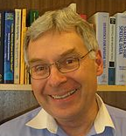
HDLSS Asymptotics
Survey & Introductory Paper:
Aoshima, Shen, Shen, Yata, Zhou & Marron (2018) Australian & New Zealand Journal of Statistics, 60, 4-19.
Memorial to Peter G. Hall

Slide 2
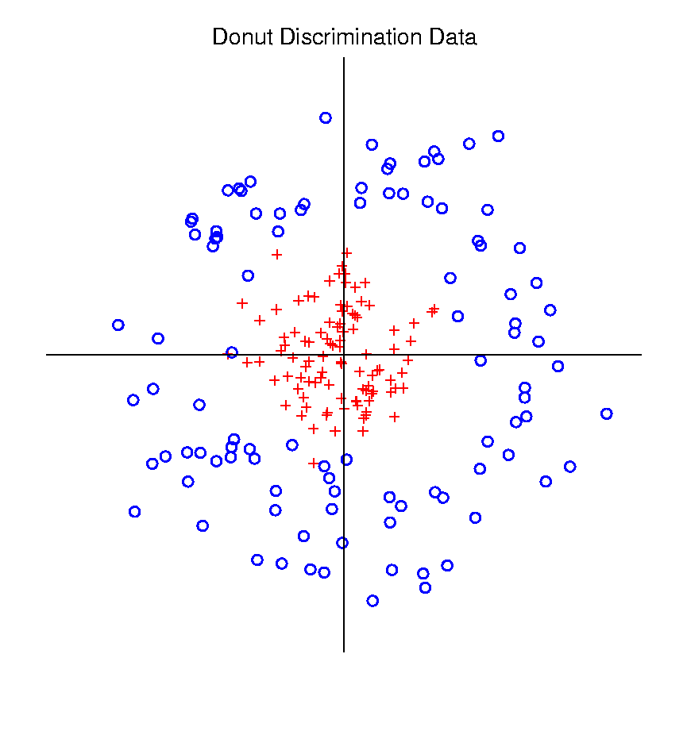
Radial DWD
Hard When All Members Of One Class Are Outliers in a Random Direction
Think HDLSS
Version of
Notes:
2

Slide 3
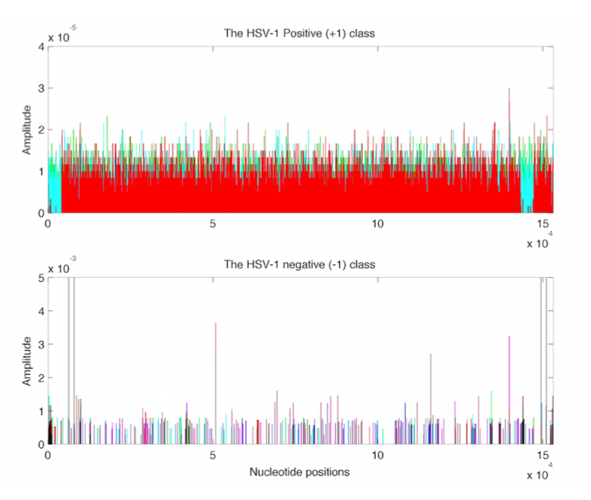
Virus Hunting
Look at
Data:
Mostly
Non-0
Near Simplex Center
Almost
All 0
Near Simplex Corners
Notes:
3

Slide 4
Virus Hunting
Look at
Data:
Note:
Heights
Orders of
Magnitude
-5 << -3
Different
Notes:
4

Slide 5
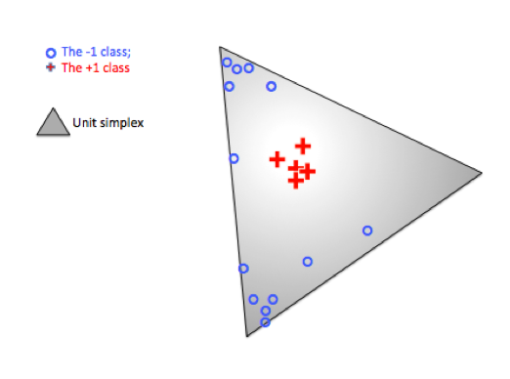
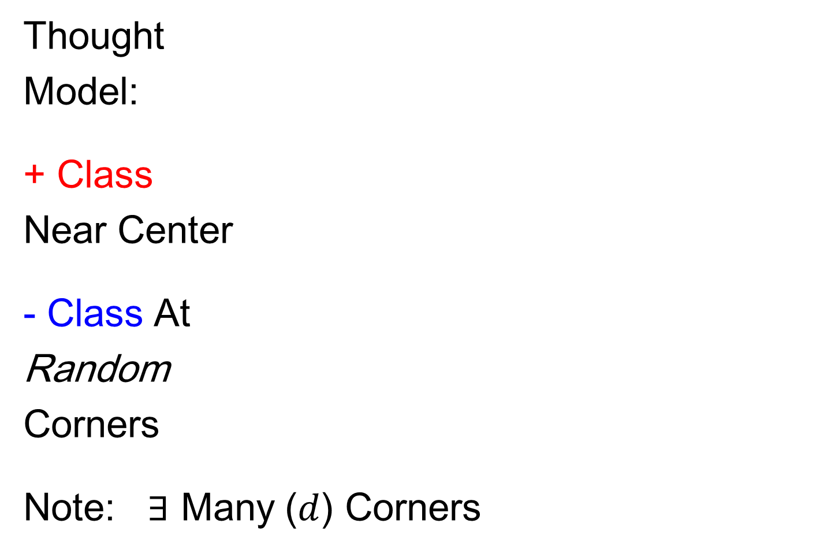
Radial DWD
Thought
Model:
+ Class
Near Center
- Class At
Random
Corners
Note: $∃$ Many ($d$) Corners
Notes:
5

Slide 6
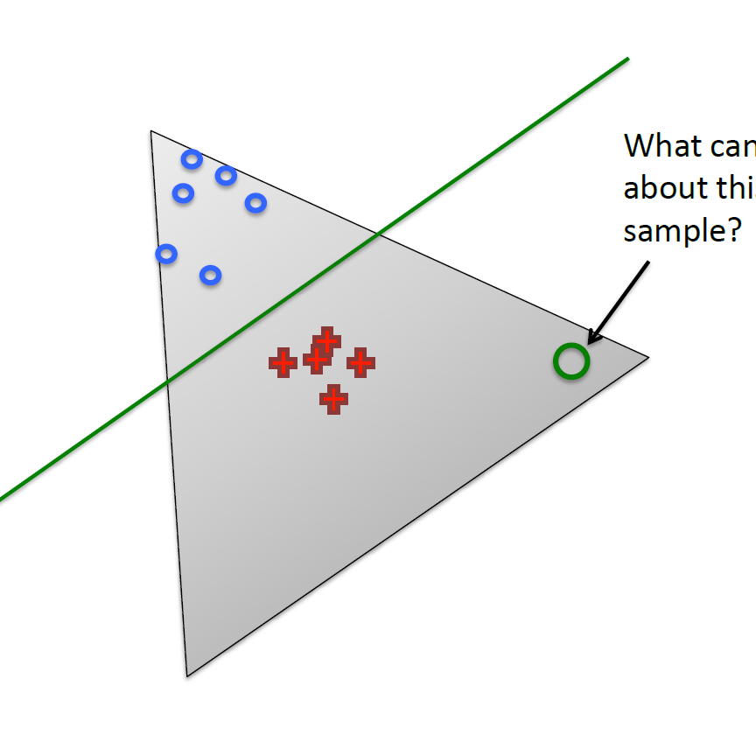
Radial DWD
Consider Training Data
But What About
Test Point In A
Different Corner
???
Notes:
6

Slide 7
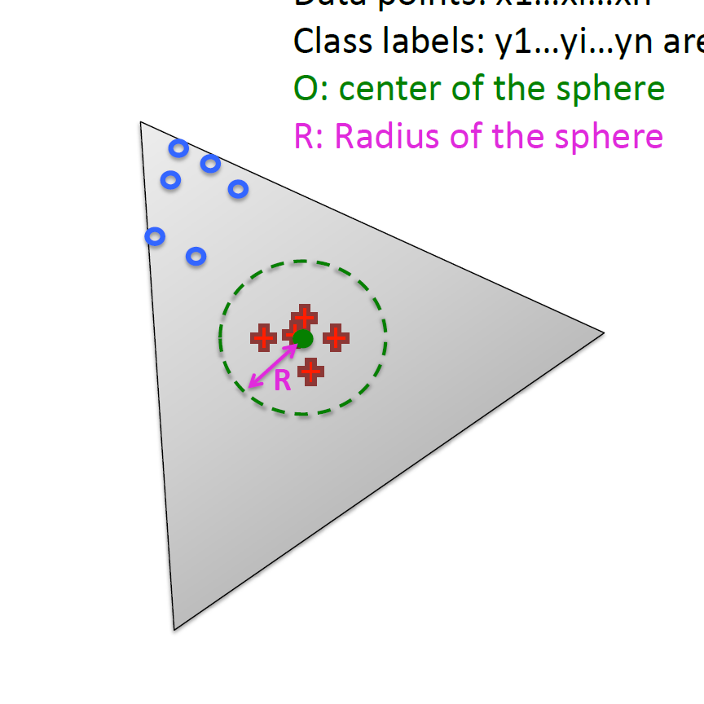
Radial DWD
Approach:
Replace Separating Plane
With Separating Sphere
Find Parameters
Via DWD-like
Optimization
Enables Finding Corners
With No Training Data
Notes:
7

Slide 8
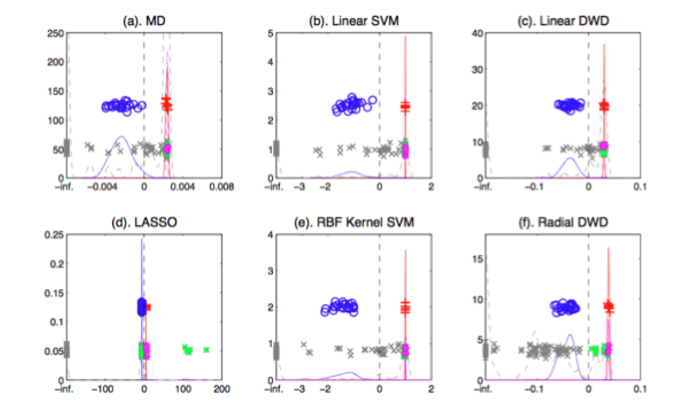
Virus Hunting
Compare With Other Classifiers
Even Kernel SVM Fails!!!
Reason:
Test Data
Lies In
Corners
With No
Training
Data
Notes:
8

Slide 9
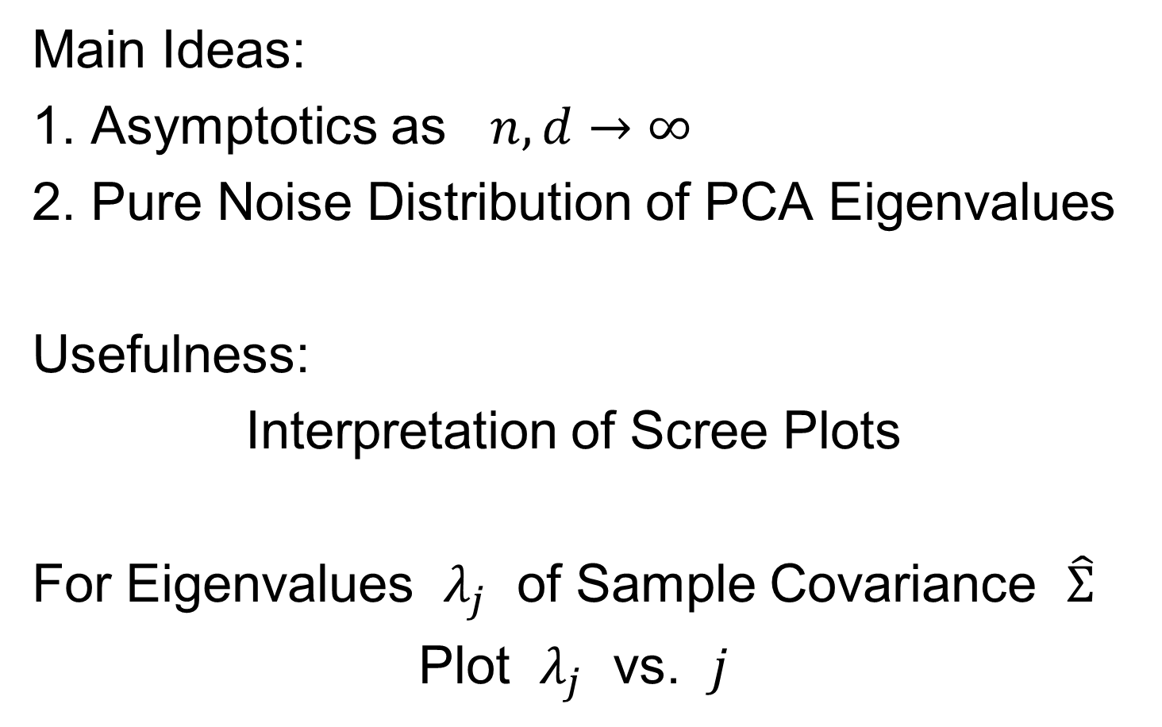
Random Matrix Theory
Main Ideas:
1. Asymptotics as $n,d→∞$
2. Pure Noise Distribution of PCA Eigenvalues
Usefulness:
Interpretation of Scree Plots
For Eigenvalues $λ_{j}$ of Sample Covariance $\hat{Σ}$
Plot $λ_{j}$ vs. $j$

Slide 10
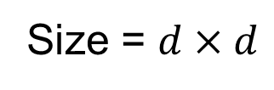
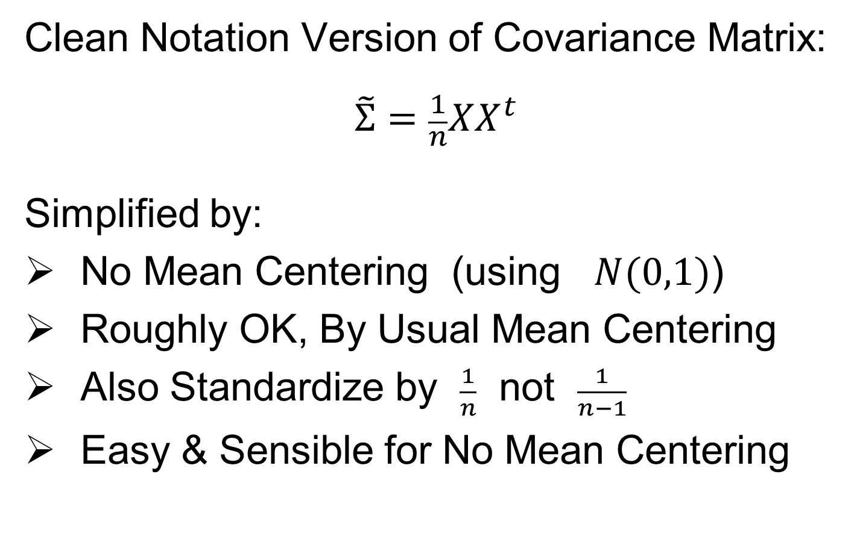
Random Matrix Theory
Clean Notation Version of Covariance Matrix:
$$\tilde{Σ}=\frac{1}{n}XX^{t}$$
Simplified by:
No Mean Centering (using $N(0,1)$)
Roughly OK, By Usual Mean Centering
Also Standardize by $\frac{1}{n}$ not $\frac{1}{n−1}$
Easy & Sensible for No Mean Centering
Size = $d×d$

Slide 11
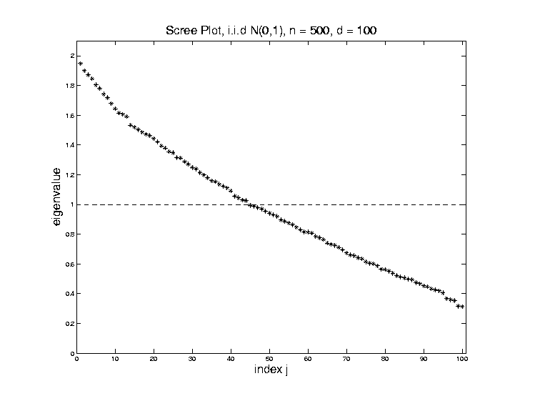

Random Matrix Theory
Fix $y=\frac{d}{n}=\frac{1}{5}$, and let $d$, $n$ grow ($→∞$).
Essentially
Same
Shape

Slide 12
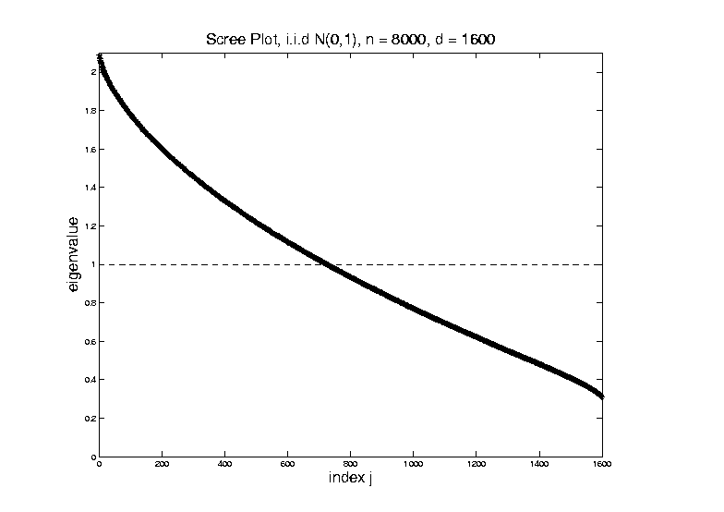

Random Matrix Theory
Fix $y=\frac{d}{n}=\frac{1}{5}$, and let $d$, $n$ grow ($→∞$).
What Is
That Shape?

Slide 13
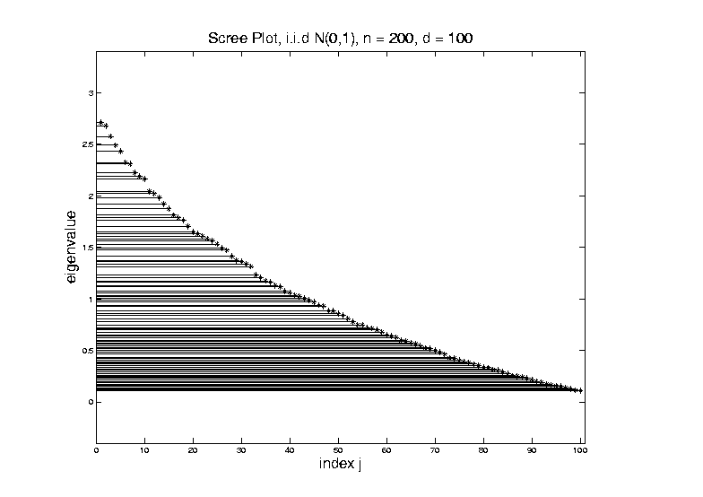
Random Matrix Theory
Shape is Captured by
Empirical Spectral Density
“Density”
Of These
Eigenvalues

Slide 14
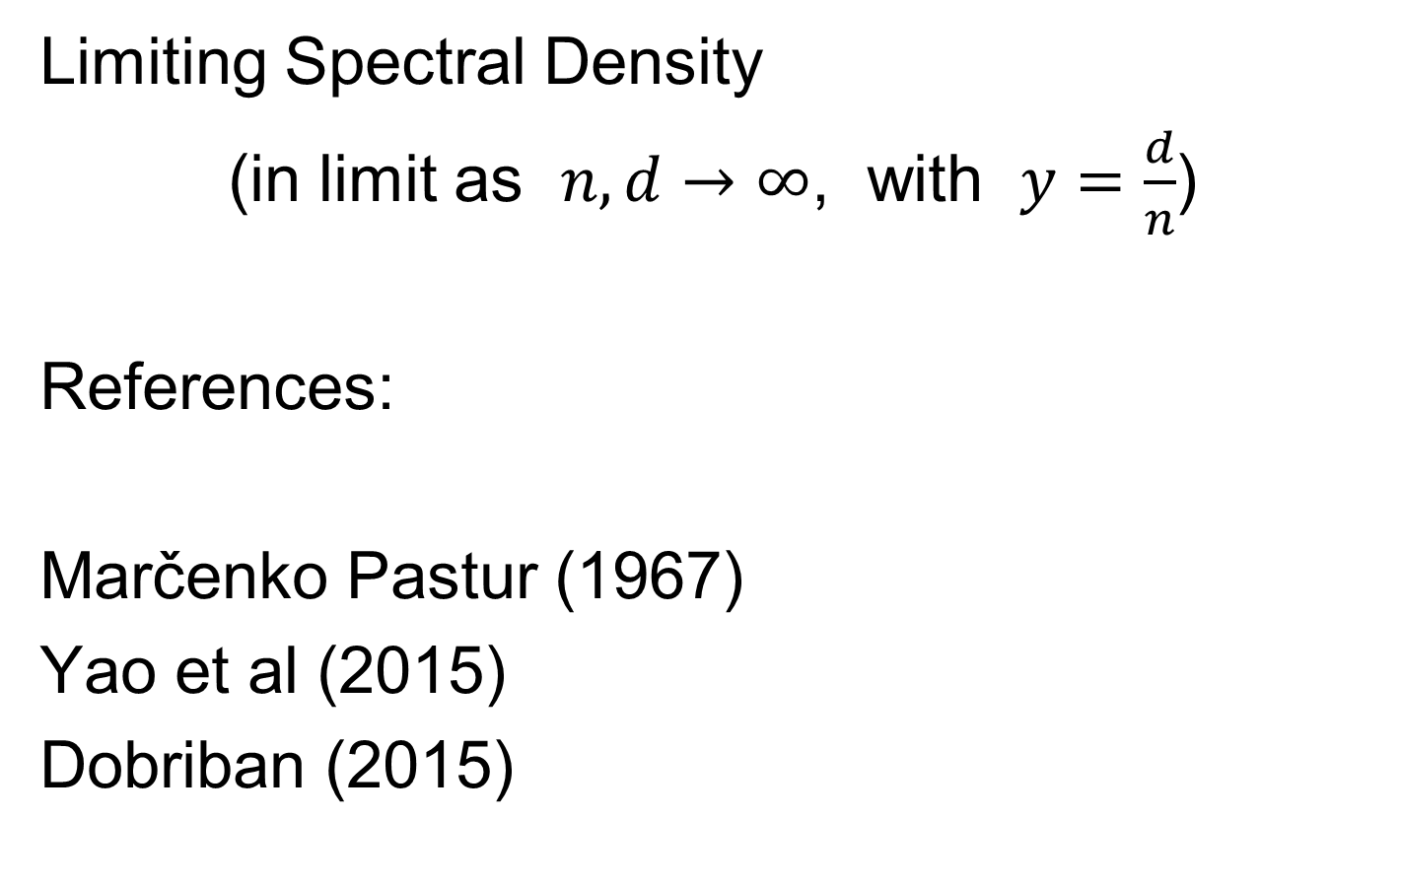
Random Matrix Theory
Limiting Spectral Density
(in limit as $n, d→∞$, with $y=\frac{d}{n}$)
References:
Marčenko Pastur (1967)
Yao et al (2015)
Dobriban (2015)

Slide 15
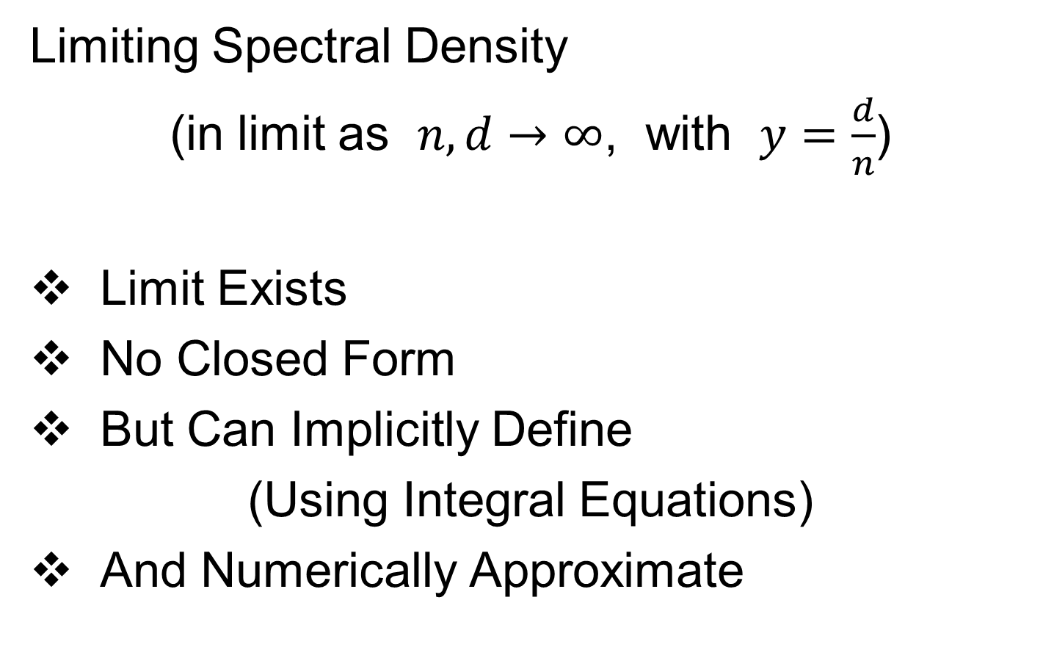
Random Matrix Theory
Limiting Spectral Density
(in limit as $n, d→∞$, with $y=\frac{d}{n}$)
Limit Exists
No Closed Form
But Can Implicitly Define
(Using Integral Equations)
And Numerically Approximate

Slide 16

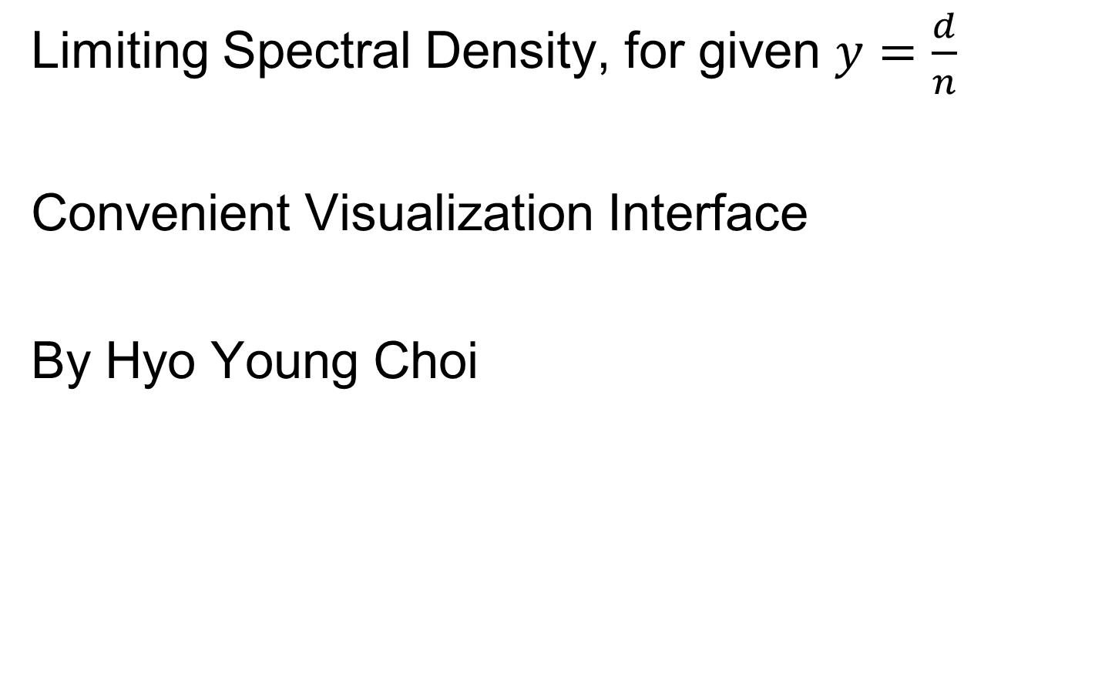
Random Matrix Theory
Limiting Spectral Density, for given $y=\frac{d}{n}$
Convenient Visualization Interface
By Hyo Young Choi

Slide 17

Random Matrix Theory
LSD:
Above
Case
$n=200,$
$d=100$

Slide 18
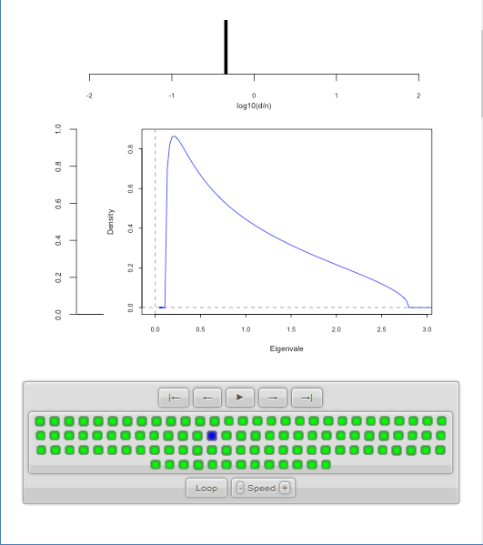

Random Matrix Theory
LSD:
Above
Case
$n=200,$
$d=100,$
$y=0.5$
$\log_{10}{y}=−0.301$

Slide 19

Random Matrix Theory
LSD
Note: These
Have Finite
Support
$⊂(0,∞)$

Slide 20


Random Matrix Theory
LSD
In Particular:
$$σ^{2}{\left(1−\sqrt{y}\right)}^{2}$$
$$σ^{2}{\left(1+\sqrt{y}\right)}^{2}$$

Slide 21
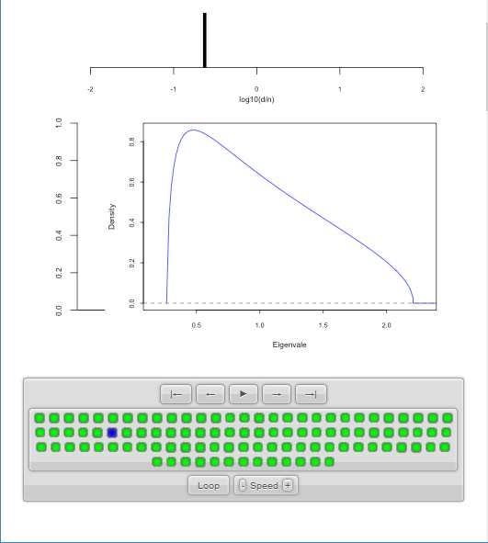

Random Matrix Theory
LSD:
Now Try Smaller
(More Negative)
Values of $y=\frac{d}{n}$

Slide 22

Random Matrix Theory
LSD:
Now Try Smaller
(More Negative)
Values of $y=\frac{d}{n}$

Slide 23
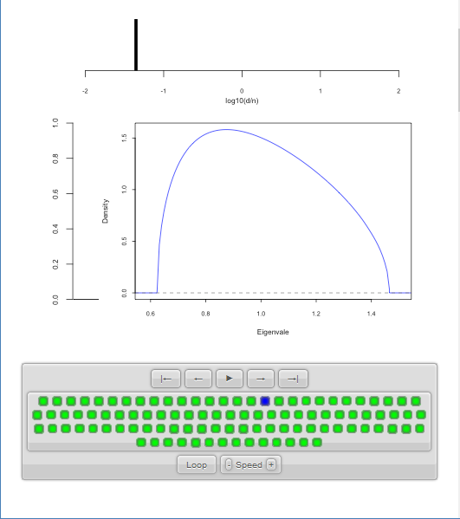

Random Matrix Theory
LSD:
Now Try Smaller
(More Negative)
Values of $y=\frac{d}{n}$
Note: Support
Points $→1$

Slide 24
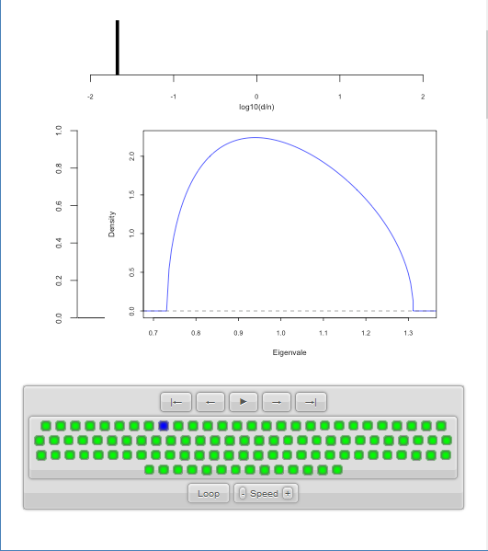
Random Matrix Theory
LSD:
Now Try Smaller
(More Negative)
Values of $y=\frac{d}{n}$

Slide 25

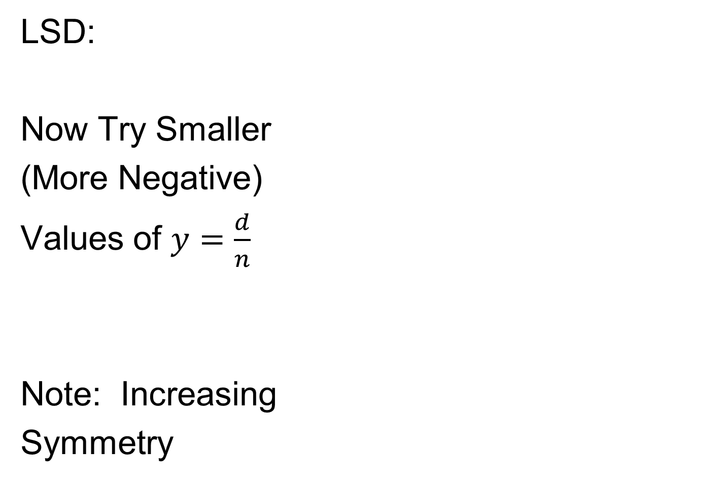
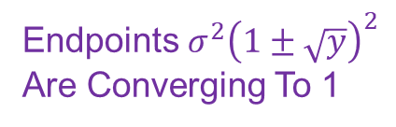
Random Matrix Theory
LSD:
Now Try Smaller
(More Negative)
Values of $y=\frac{d}{n}$
Note: Increasing
Symmetry
Endpoints $σ^{2}{\left(1±\sqrt{y}\right)}^{2}$
Are Converging To 1

Slide 26
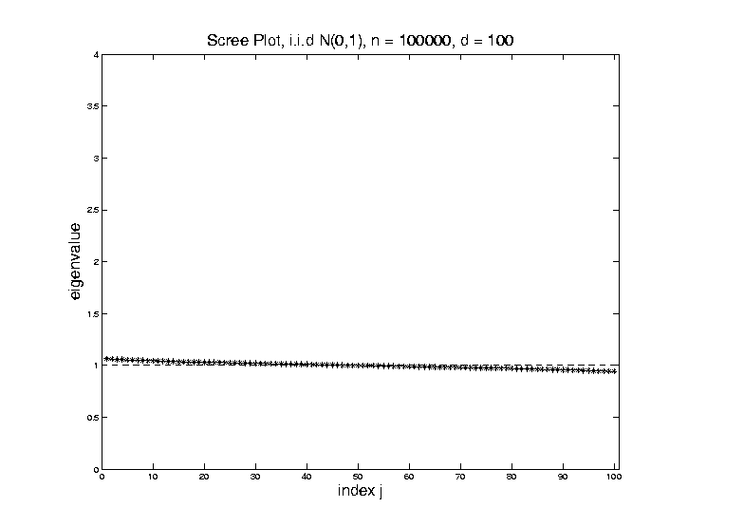

Random Matrix Theory
Larger $n=100,000$ Reduces Variation
Recall
Previous
Large $n$
Case,
LSD is
Zooming
In On This

Slide 27
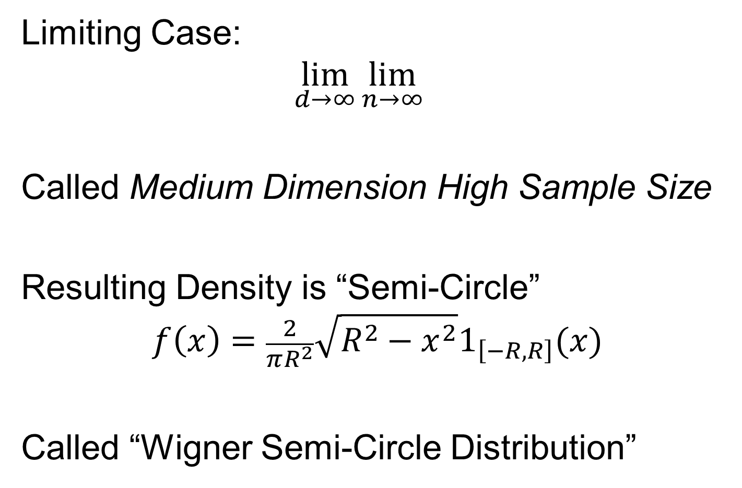
Random Matrix Theory
Limiting Case:
$$\lim_{d→∞}{\lim_{n→∞}{}}$$
Called Medium Dimension High Sample Size
Resulting Density is “Semi-Circle”
$$f\left(x\right)=\frac{2}{πR^{2}}\sqrt{R^{2}−x^{2}}1_{\left[−R,R\right]}(x)$$
Called “Wigner Semi-Circle Distribution”

Slide 28
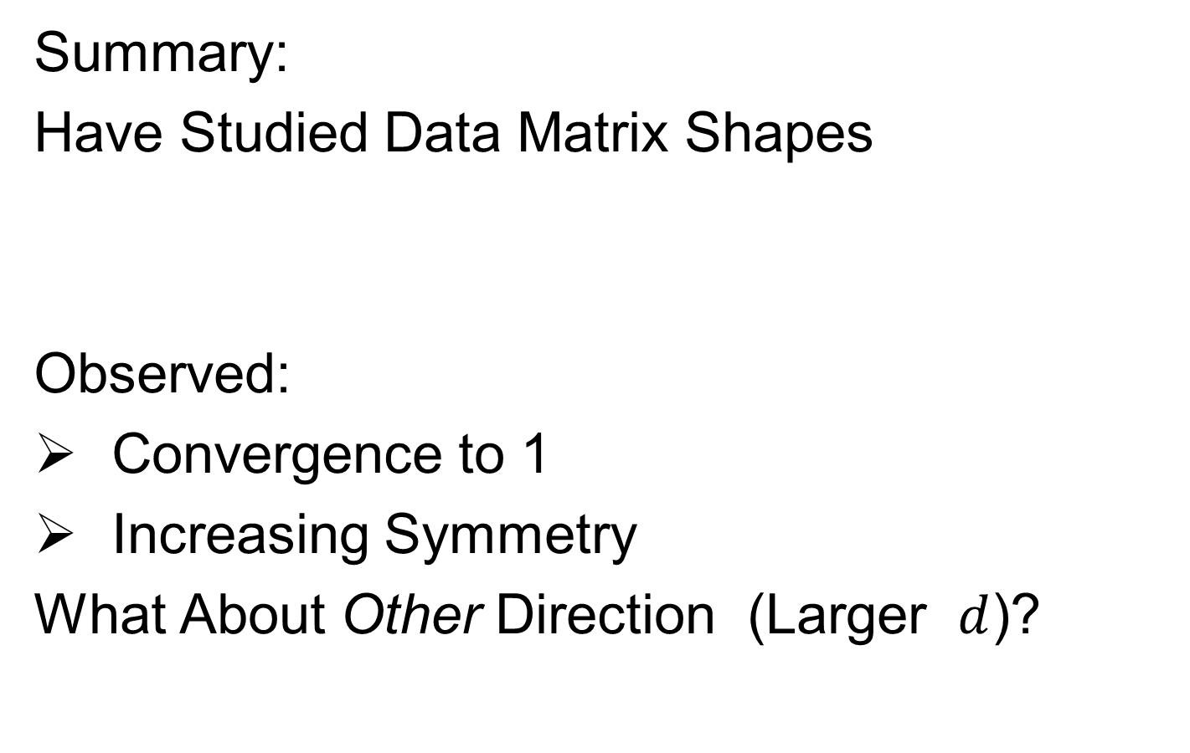
Random Matrix Theory
Summary:
Have Studied Data Matrix Shapes
Observed:
Convergence to 1
Increasing Symmetry
What About Other Direction (Larger $d$)?

Slide 29
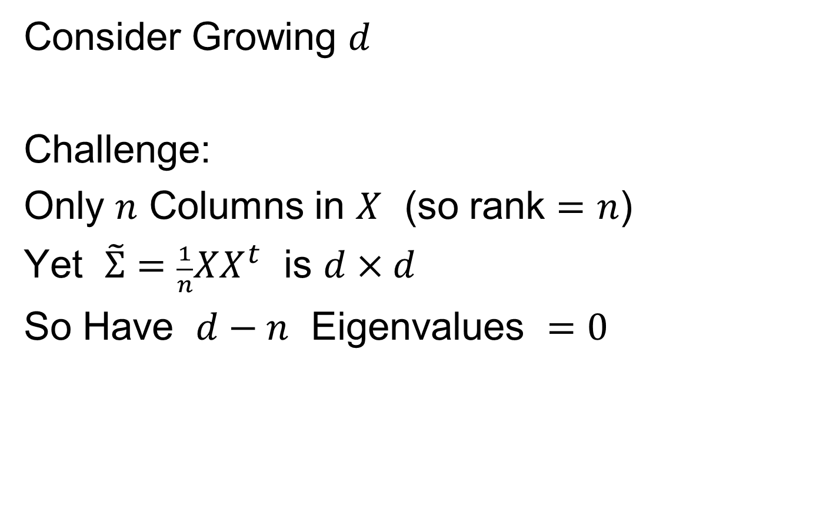
Random Matrix Theory
Consider Growing $d$
Challenge:
Only $n$ Columns in $X$ (so rank $=n$)
Yet $\tilde{Σ}=\frac{1}{n}XX^{t}$ is $d×d$
So Have $d−n$ Eigenvalues $=0$

Slide 30
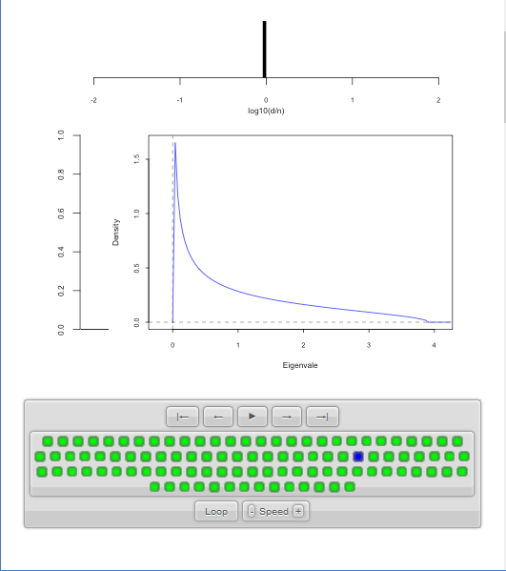

Random Matrix Theory
LSD:
Start With
$y=\frac{d}{n}≈1$
Case

Slide 31
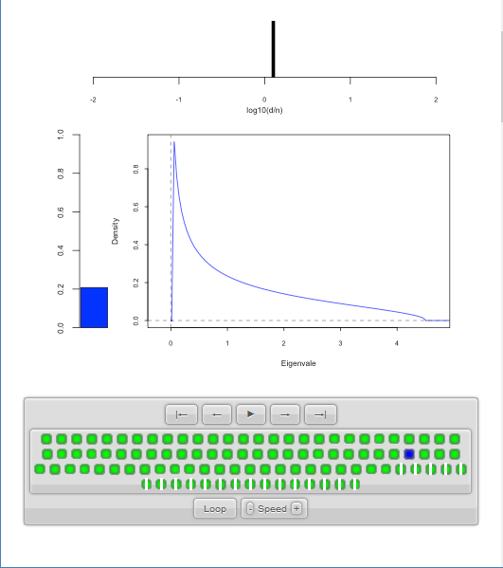

Random Matrix Theory
LSD:
Now Try Larger
Values of $y=\frac{d}{n}$
Proportion of
0 Eigenvalues

Slide 32
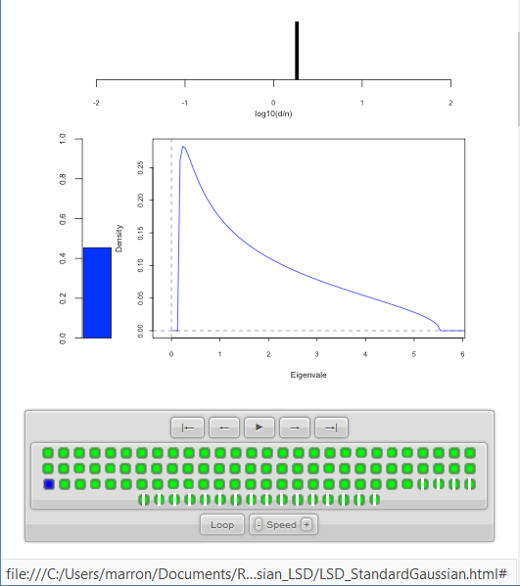
Random Matrix Theory
LSD:
Now Try Larger
Values of $y=\frac{d}{n}$
Spectral Density of
Non-0 Eigenvalues

Slide 33
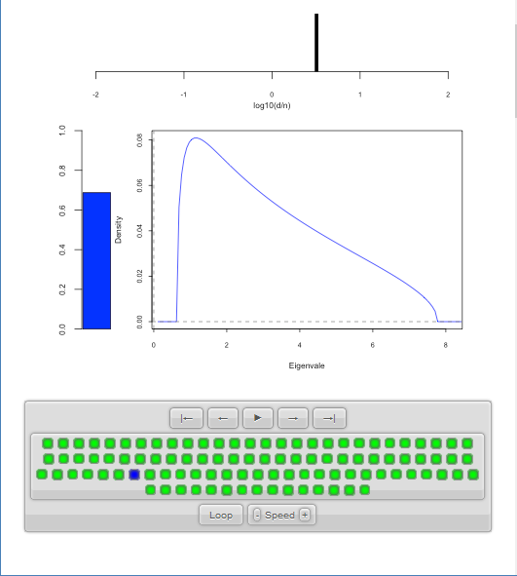
Random Matrix Theory
LSD:
Now Try Larger
Values of $y=\frac{d}{n}$

Slide 34
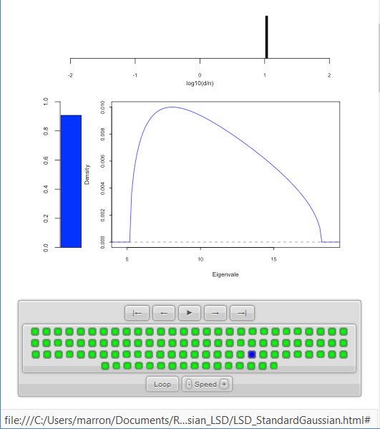
Random Matrix Theory
LSD:
Now Try Larger
Values of $y=\frac{d}{n}$

Slide 35
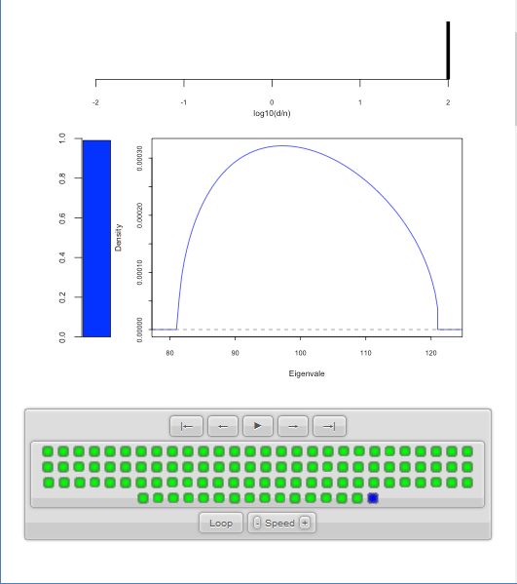
Random Matrix Theory
LSD:
Now Try Larger
Values of $y=\frac{d}{n}$
Again Heads
Towards Semi-Circle
But Small
Proportion

Slide 36

Random Matrix Theory
LSD:
Now Try Larger
Values of $y=\frac{d}{n}$
Note:
Shapes Seem Similar to Above

Slide 37
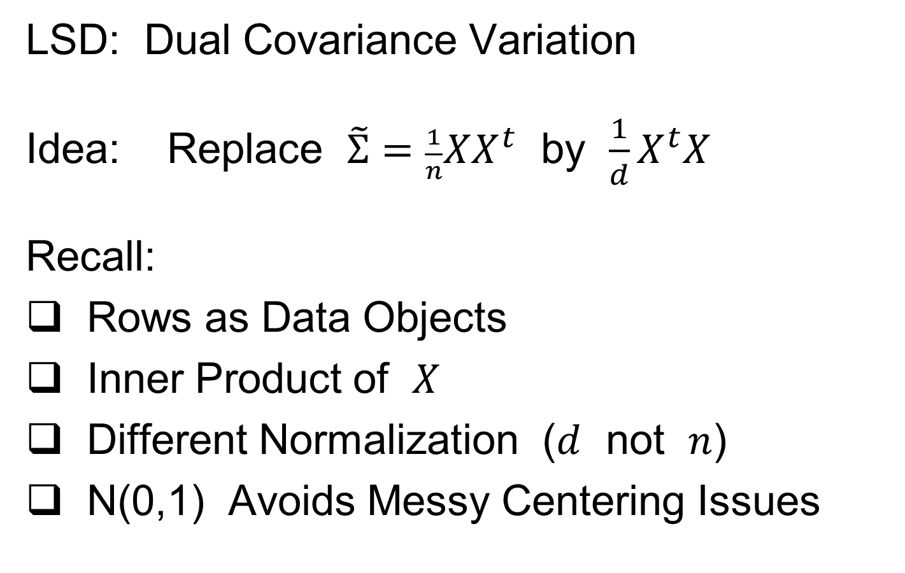
Random Matrix Theory
LSD: Dual Covariance Variation
Idea: Replace $\tilde{Σ}=\frac{1}{n}XX^{t}$ by $\frac{1}{d}X^{t}X$
Recall:
Rows as Data Objects
Inner Product of $X$
Different Normalization ($d$ not $n$)
N(0,1) Avoids Messy Centering Issues

Slide 38
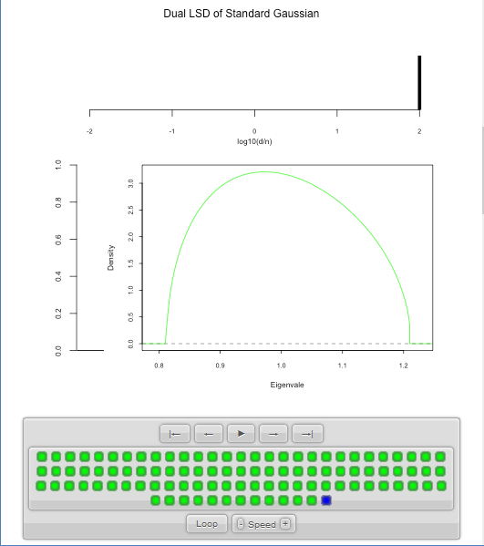

Random Matrix Theory
LSD: Dual Covariance Variation
$y=\frac{d}{n}=100$ Is
Close to Semi-Circle

Slide 39
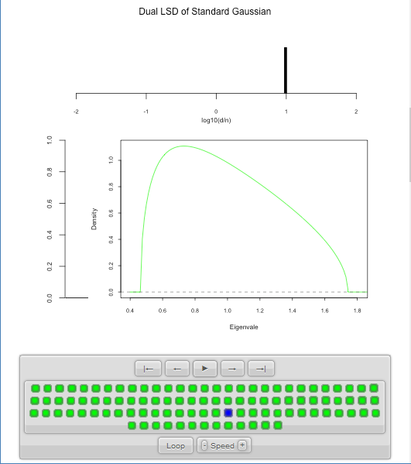
Random Matrix Theory
LSD: Dual Covariance Variation

Slide 40
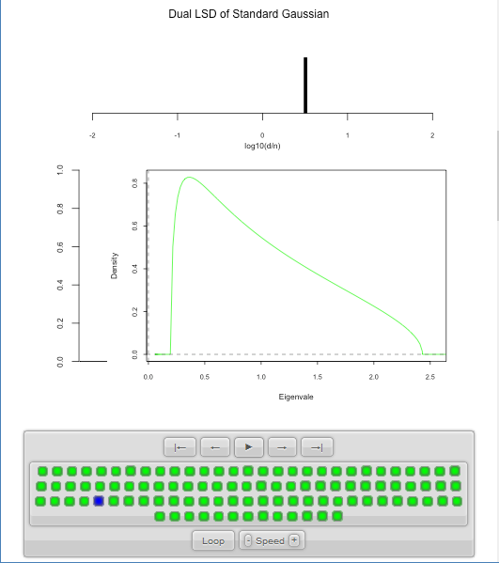
Random Matrix Theory
LSD: Dual Covariance Variation
Seem to Follow
Similar Pattern

Slide 41
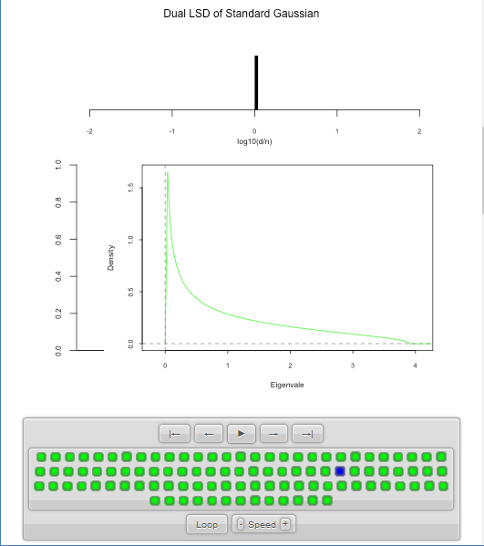
Random Matrix Theory
LSD: Dual Covariance Variation

Slide 42


Random Matrix Theory
LSD: Dual Covariance Variation
For $d<n$ Now
Get 0 Eignevalues

Slide 43

Random Matrix Theory
LSD: Dual Covariance Variation

Slide 44

Random Matrix Theory
LSD: Dual Covariance Variation

Slide 45

Random Matrix Theory
LSD: Dual Covariance Variation
Again Heads To
Semi-Circle

Slide 46

Random Matrix Theory
LSD: Primal & Dual
Overlaid For
Direct
Comparison
Notes:
Area = 1
Area = 1 - Bar

Slide 47

Random Matrix Theory
LSD: Primal & Dual

Slide 48


Random Matrix Theory
LSD: Primal & Dual
Very Close
For $d≈n$

Slide 49

Random Matrix Theory
LSD: Primal & Dual
Very Close
For $d≈n$

Slide 50

Random Matrix Theory
LSD: Primal & Dual

Slide 51

Random Matrix Theory
LSD: Primal & Dual

Slide 52

Random Matrix Theory
LSD: Primal & Dual

Slide 53


Random Matrix Theory
LSD: Rescaled
Primal & Dual
$\sqrt{y}×LSD$
(underneath)
$\frac{1}{\sqrt{y}}×Dual LSD$

Slide 54

Random Matrix Theory
LSD: Rescaled
Primal & Dual

Slide 55

Random Matrix Theory
LSD: Rescaled
Primal & Dual

Slide 56

Random Matrix Theory
LSD: Rescaled
Primal & Dual

Slide 57

Random Matrix Theory
LSD: Rescaled
Primal & Dual

Slide 58

Random Matrix Theory
LSD: Rescaled
Primal & Dual

Slide 59
Random Matrix Theory
Conclusion:
Family of Marcenko – Pastur Distributions
Has Several Interesting Symmetries

Slide 60
Random Matrix Theory
Important Parallel Theory:
Distribution of Largest Eigenvalue
(Assuming Matrix of i.i.d. N(0,1)s)
Tracey & Widom (1994)
Good Discussion of Statistical Implications
Johnstone (2008)

Slide 61


High $d$ Asymptotics & Kernel Methods
Recall
Flexibility
From
Kernel
Embedding
Idea

Slide 62

High $d$ Asymptotics & Kernel Methods
Recall
Flexibility
From
Kernel
Embedding
Idea

Slide 63

High $d$ Asymptotics & Kernel Methods
Recall
Flexibility
From
Kernel
Embedding
Idea

Slide 64



High $d$ Asymptotics & Kernel Methods
Interesting Question:
Behavior in Very High Dimensions?
Answer: El Karoui (2010)
In Random Matrix Limit, $n\sim d→∞$
Kernel Embedded Classifiers ~
~ Linear Classifiers
Discussed on 10/15/19,
But Now Know Limit

Slide 65
High $d$ Asymptotics & Kernel Methods
Interesting Question:
Behavior in Very High Dimensions?
Implications for DWD:
Recall Main Advantage is for High d
So Not Clear Embedding Helps
Thus Not Yet Implemented in DWD

Slide 66
Clusters in data
Common Statistical Task:
Find Clusters in Data
Interesting sub-populations?
Important structure in data?
How to do this?
PCA & visualization is very simple approach
There is a large literature of other methods
(will study more later)

Slide 67

PCA to find clusters
Toy Example (2 clusters) (from 8/22/19)

Slide 68
PCA to find clusters
Toy Example (2 clusters)
Dominant direction finds very distinct clusters
Skewer through meatballs (in point cloud space)
Shows up clearly in scores plot
An important use of scores plot is finding such structure

Slide 69

PCA to find clusters
Recall Toy Example with more clusters:
(From
8/27/19)

Slide 70

PCA to find clusters
Best revealed by 2d scatterplots (4 clusters):

Slide 71

PCA to find clusters
Recall Data Discovery in RNAseq Data (8/27/19)

Slide 72

PCA to find clusters
Recall Data Discovery in RNAseq Data (8/27/19)
Used
Brushing
To Visualize
Clusters

Slide 73
PCA to find clusters
Caution: there are limitations…
Revealed by NCI60 data
Recall Microarray data
With 8 known different cancer types

Slide 74

PCA to find clusters
Specific DWD directions, for NCI60 Data:
Good
Separation
Of Cancer
Types

Slide 75

PCA to find clusters
PCA directions, for NCI60 Data:
PC2:
Melanoma
PC1-3
Leukemia

Slide 76

PCA to find clusters
Off Diagonal PC1-4 & 5-8, NCI60 Data:
PC1 & 5
Renal
Leukemia
(separated)
PC2:
Melanoma

Slide 77
PCA to find clusters
Main Lesson:
PCA is limited at finding clusters
Revealed by NCI60 data
Recall Microarray data
With 8 known different cancer types
PCA does not find all 8 clusters
Recall only finds dirn’s of max variation
Does not use class label information

Slide 78
PCA to find clusters
A deeper example:
Mass Flux Data
Data from Enrica Bellone,
National Center for Atmospheric Research
Mass Flux for quantifying cloud types
How does mass change when moving into a cloud

Slide 79


PCA to find clusters
Mean Captures
Mountain Shape
PCA of Mass Flux Data:
PC1 is
Height
Variation
Impression
Enhanced
By Smooth
Histogram
Are Clusters “Really There”?
Shows Up Well
In Mean $±$ Panel
Discovery?
Noise Artifact?
Scores
Suggest
3 Clusters

Slide 80


PCA to find clusters
PCA of Mass Flux Data:
PC3
Shows
Width
Adjustment
Nonlinear Modes of Variation?
PC2 is
Location
Of Peak
Again
Best In
Mean $±$
Panel
Shows Up Best
In Mean $±$ Panel

Slide 81
PCA to find clusters
Return to Investigation of PC1 Clusters:
Can see 3 bumps in smooth histogram
Main Question:
Important structure
or
sampling variability?
Approach: SiZer
(SIgnificance of ZERo crossings of deriv.)

Slide 82
Statistical Smoothing
In 1 Dimension
(Numbers as Data Objects)

Slide 83
Statistical Smoothing
In 1 Dimension, 2 Major Settings:
Density Estimation
“Histograms”
Nonparametric Regression
“Scatterplot Smoothing”

Slide 84
Density Estimation
E.g. Hidalgo Stamp Data
Thicknesses of Postage Stamps
Produced in Mexico
Over ~ 70 years
During 1800s
Paper produced in several factories?
How many factories? (Records lost)
Brought to statistical literature by:
Izenman and Sommer (1988)

Slide 85
Density Estimation
E.g. Hidalgo Stamp Data
Thicknesses of Postage Stamps
Produced in Mexico
Over ~ 70 years
During 1800s
Paper produced in several factories?
(Thicknesses vary by up to factor of 2)

Slide 86

Density Estimation
E.g. Hidalgo Stamp Data
A histogram
“Oversmoothed”
Bin Width too
large?
Miss important
structure?
Hard to Say Much
About # of Factories

Slide 87

Density Estimation
E.g. Hidalgo Stamp Data
Another histogram
Smaller binwidth
Suggests 2 modes?
2 factories making
the paper?

Slide 88

Density Estimation
E.g. Hidalgo Stamp Data
Another histogram
Smaller binwidth
Suggests 6 modes?
6 factories making
the paper?

Slide 89

Density Estimation
E.g. Hidalgo Stamp Data
Another histogram
Even smaller binwidth
Suggests many modes?
Really believe
modes are “there”?
Or just sampling
variation?

Slide 90

Density Estimation
E.g. Hidalgo Stamp Data
Critical Issue for histograms:
Choice of binwidth (well understood?)

Slide 91

Histograms
Less Well Understood Issue:
Choice of bin location
Major impact on number of modes (2-7)
All for same binwidth

Slide 92

Histograms
Choice of bin location:
What is going on?
Compare with Average Histogram

Slide 93

Density Estimation
Compare shifts with Average Histogram
For 7 mode shift
Peaks line up with bin centers
So shifted histo’s
find peaks

Slide 94

Density Estimation
Compare shifts with Average Histogram
For 2 (3?) mode shift
Peaks split between bins
So shifted histo’s
miss peaks
This Is Why Histograms
Were Not Used in Many
Displays of 1-d Dist’ns,
Earlier in Course

Slide 95
Density Estimation
Histogram Drawbacks:
Need to choose bin width
Need to choose bin location
But Average Histogram reveals structure
So should use that, instead of histo
Name: Kernel Density Estimate

Slide 96
Kernel Density Estimation
Chondrite Data:
Stony (metal) Meteorites (hit the earth)
So have a chunk of rock
Study “% of silica”
From how many sources?
Only 22 rocks…
Histogram hopeless?
Brought to statistical literature by:
Good and Gaskins (1980)

Slide 97

Kernel Density Estimation
Chondrite Data:
Represent points by red bars
Where are data “more dense”?

Slide 98

Kernel Density Estimation
Chondrite Data:
Put probability mass 1/n at each point
Smooth piece of “density”

Slide 99

Kernel Density Estimation
Chondrite Data:
Sum pieces to estimate density
Suggests 3 modes (rock sources)

Slide 100

Kernel Density Estimation
Mathematical Notation:
$${\hat{f}}_{h}\left(x\right)=\frac{1}{n}\sum_{i=1}^{n}{K_{h}\left(x−X_{i}\right)}$$
Where
Window shape given by “kernel”,
$$K_{h}\left(∙\right)=\frac{1}{h}K\left(\frac{∙}{h}\right)$$
Window width given by “bandwidth”, $h$

Slide 101

Kernel Density Estimation
Mathematical Notation:
$${\hat{f}}_{h}\left(x\right)=\frac{1}{n}\sum_{i=1}^{n}{K_{h}\left(x−X_{i}\right)}$$
This
Was
Used
In PCA
Graphics

Slide 102


Kernel Density Estimation
Recall Subdensities For Different Groups
Black Curves
have Area = 1
Colored Curves
have Area = $\frac{n_{k}}{n}$
Use Same Window
Width, So They Sum

Slide 103
Participant Presentation
Dhruv Patel:
Connections between Persistence Homology and Curvature
Hang Su:
Characterization of Collaborative Cross Genomes

