Slide 1
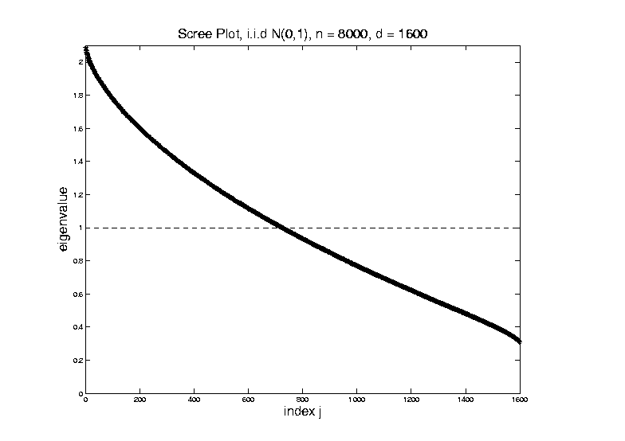

Random Matrix Theory
Fix $y=\frac{d}{n}=\frac{1}{5}$, and let $d$, $n$ grow ($→∞$).
What Is
That Shape?

Slide 2
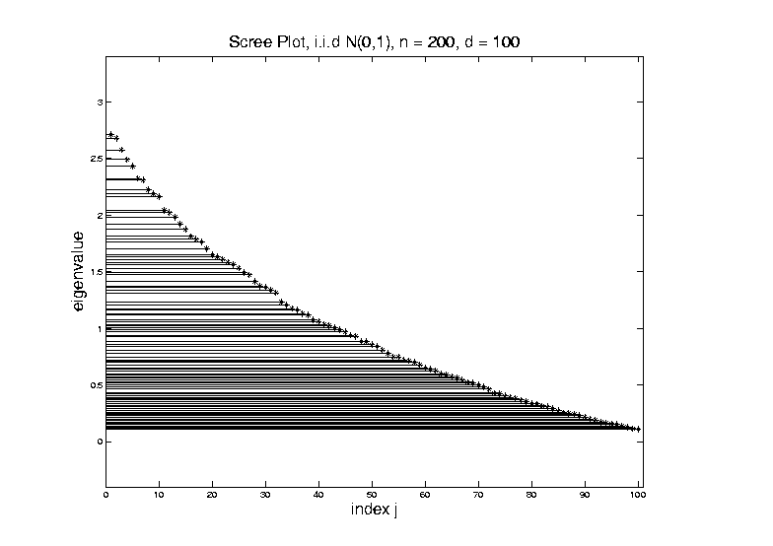
Random Matrix Theory
Shape is Captured by
Empirical Spectral Density
“Density”
Of These
Eigenvalues

Slide 3
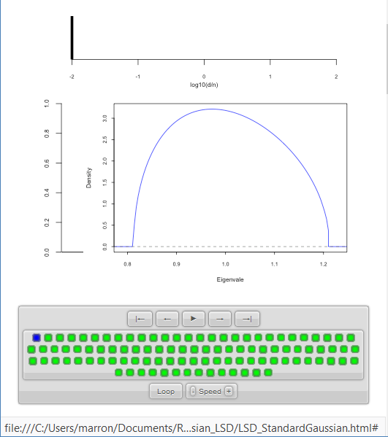
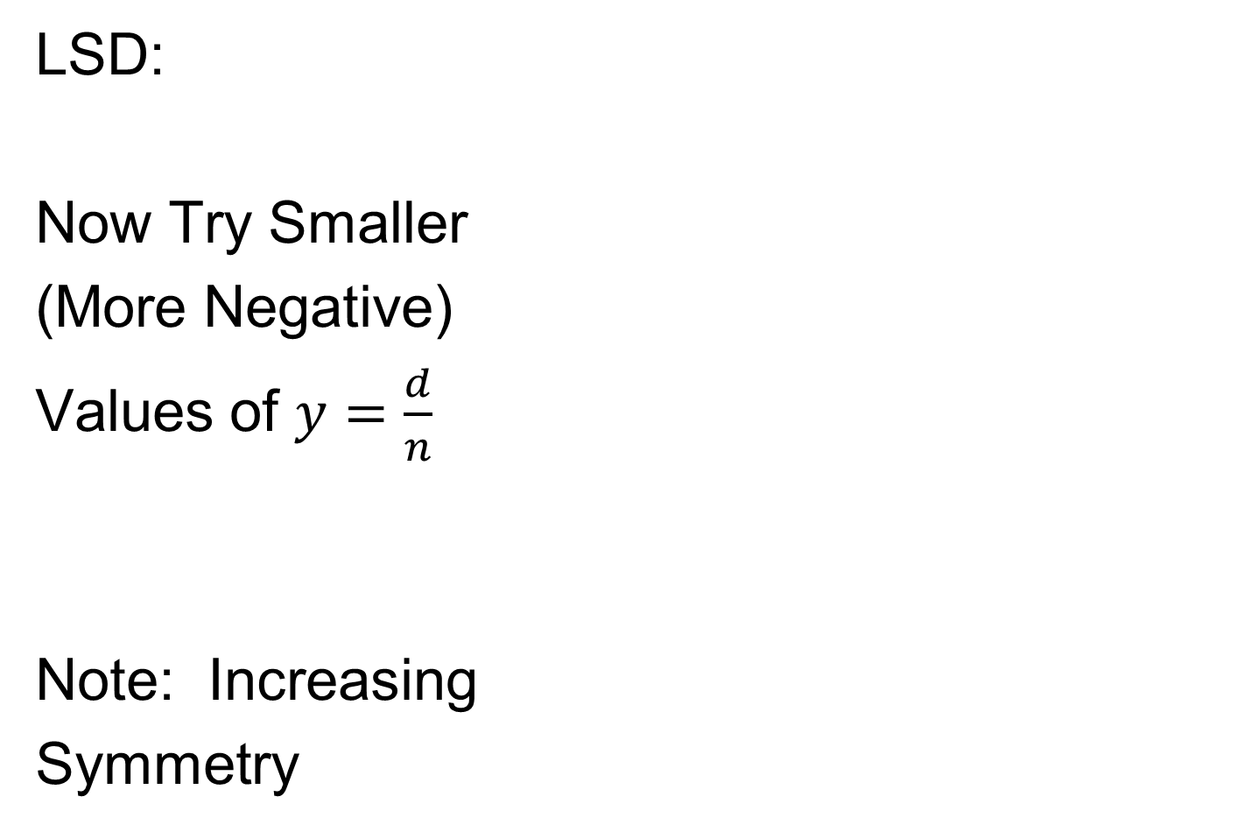
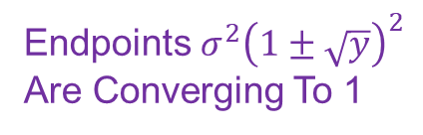
Random Matrix Theory
LSD:
Now Try Smaller
(More Negative)
Values of $y=\frac{d}{n}$
Note: Increasing
Symmetry
Endpoints $σ^{2}{\left(1±\sqrt{y}\right)}^{2}$
Are Converging To 1

Slide 4
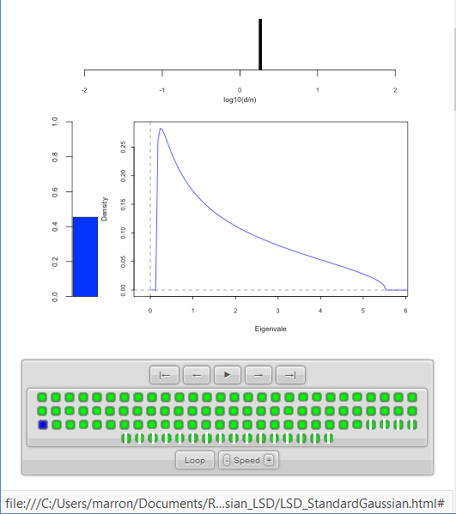

Random Matrix Theory
LSD:
Now Try Larger
Values of $y=\frac{d}{n}$
Spectral Density of
Non-0 Eigenvalues

Slide 5
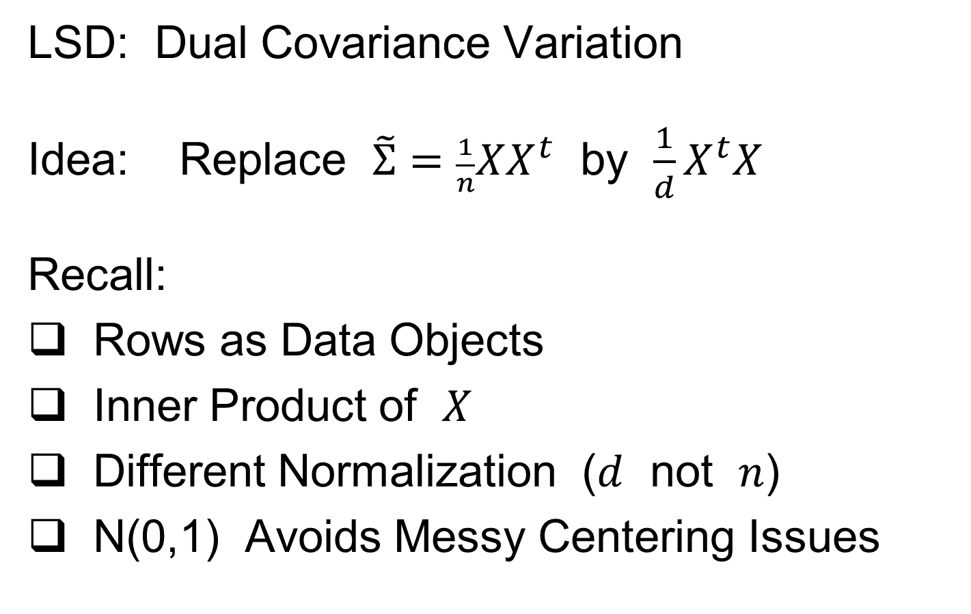
Random Matrix Theory
LSD: Dual Covariance Variation
Idea: Replace $\tilde{Σ}=\frac{1}{n}XX^{t}$ by $\frac{1}{d}X^{t}X$
Recall:
Rows as Data Objects
Inner Product of $X$
Different Normalization ($d$ not $n$)
N(0,1) Avoids Messy Centering Issues

Slide 6
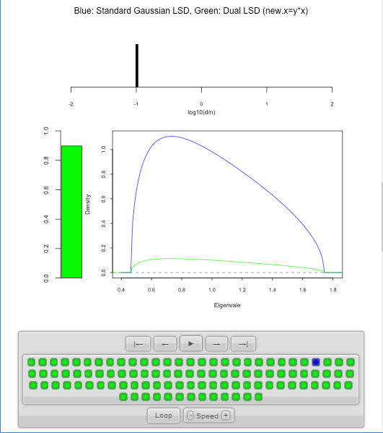
Random Matrix Theory
LSD: Primal & Dual
Overlaid For
Direct
Comparison
Notes:
Area = 1
Area = 1 - Bar

Slide 7

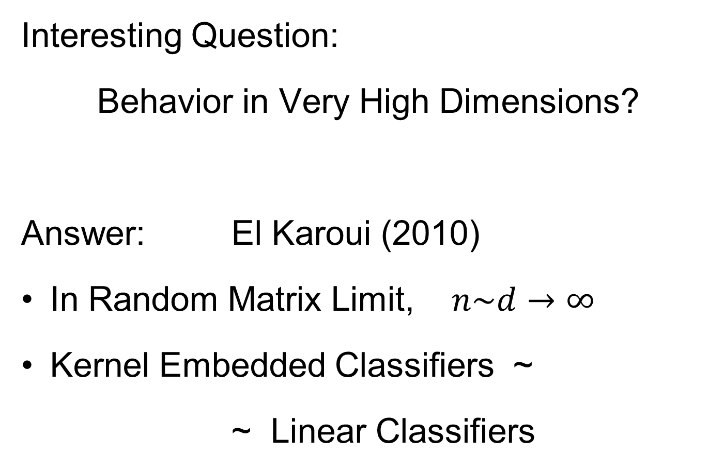


High $d$ Asymptotics & Kernel Methods
Interesting Question:
Behavior in Very High Dimensions?
Answer: El Karoui (2010)
In Random Matrix Limit, $n\sim d→∞$
Kernel Embedded Classifiers ~
~ Linear Classifiers
Discussed on 10/15/19,
But Now Know Limit

Slide 8
Clusters in data
Common Statistical Task:
Find Clusters in Data
Interesting sub-populations?
Important structure in data?
How to do this?
PCA & visualization is very simple approach
There is a large literature of other methods
(will study more later)

Slide 9
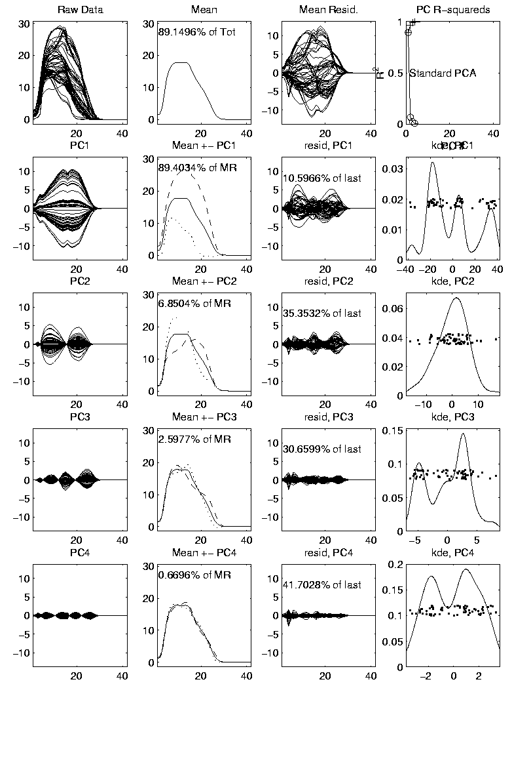

PCA to find clusters
Mean Captures
Mountain Shape
PCA of Mass Flux Data:
PC1 is
Height
Variation
Impression
Enhanced
By Smooth
Histogram
Are Clusters “Really There”?
Shows Up Well
In Mean $±$ Panel
Discovery?
Noise Artifact?
Scores
Suggest
3 Clusters

Slide 10
Statistical Smoothing
In 1 Dimension, 2 Major Settings:
Density Estimation
“Histograms”
Nonparametric Regression
“Scatterplot Smoothing”

Slide 11
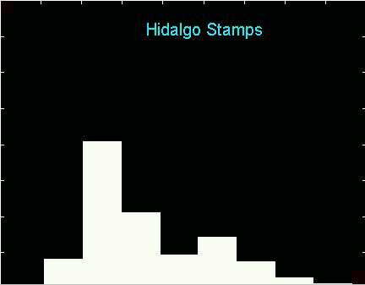
Density Estimation
E.g. Hidalgo Stamp Data
Another histogram
Smaller binwidth
Suggests 2 modes?
2 factories making
the paper?

Slide 12
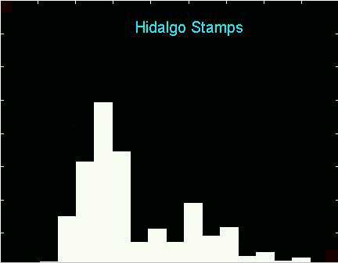
Density Estimation
E.g. Hidalgo Stamp Data
Another histogram
Smaller binwidth
Suggests 6 modes?
6 factories making
the paper?

Slide 13
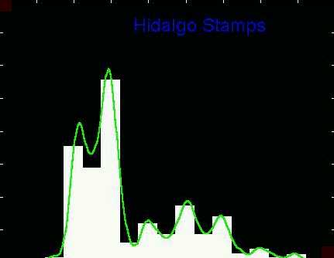
Density Estimation
Compare shifts with Average Histogram
For 7 mode shift
Peaks line up with bin centers
So shifted histo’s
find peaks

Slide 14
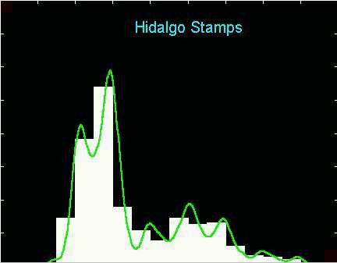
Density Estimation
Compare shifts with Average Histogram
For 2 (3?) mode shift
Peaks split between bins
So shifted histo’s
miss peaks
This Is Why Histograms
Were Not Used in Many
Displays of 1-d Dist’ns,
Earlier in Course

Slide 15
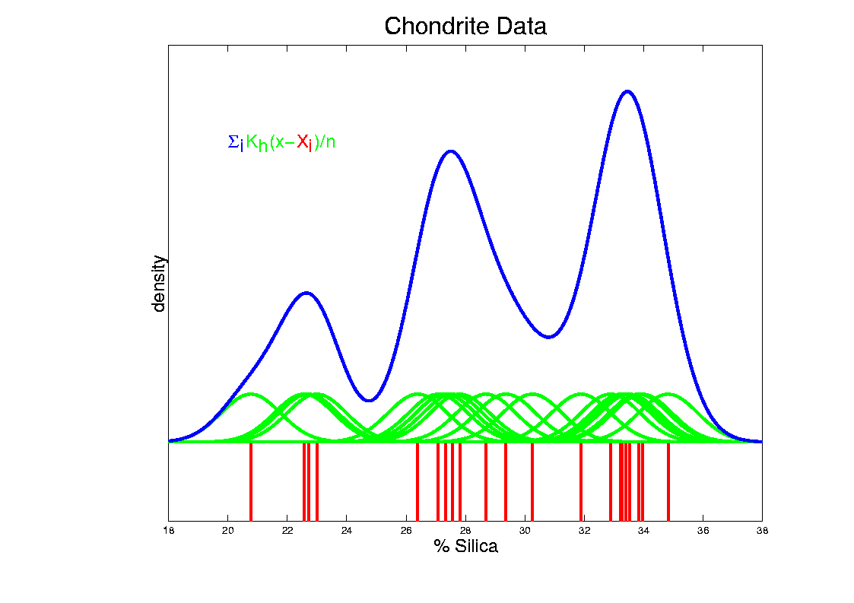
Kernel Density Estimation
Chondrite Data:
Sum pieces to estimate density
Suggests 3 modes (rock sources)

Slide 16
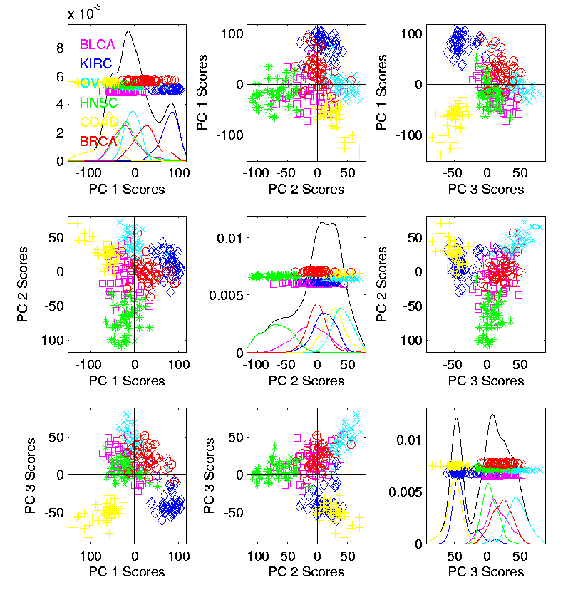

Kernel Density Estimation
Recall Subdensities For Different Groups
Black Curves
have Area = 1
Colored Curves
have Area = $\frac{n_{k}}{n}$
Use Same Window
Width, So They Sum

Slide 17
Kernel Density Estimation
Choice of kernel (window shape)?
Controversial issue
Want Computational Speed?
Want Statistical Efficiency?
Want Smooth Estimates?
There is more, but personal choice:
Gaussian
Good Overall Reference:
Wand and Jones (1994)
Looks the Best,
Minimal Distracting
Small Scale Noise

Slide 18
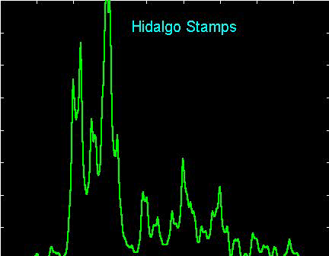
Kernel Density Estimation
Choice of bandwidth (window width)?
Very important to performance
Fundamental Issue:
Which modes are “really there”?

Slide 19
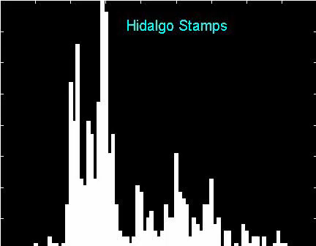
Density Estimation
How to use histograms if you must:
Undersmooth (minimizes bin edge effect)
Human eye is OK at “post-smoothing”

Slide 20
Statistical Smoothing
2 Major Settings:
Density Estimation
“Histograms”
Nonparametric Regression
“Scatterplot Smoothing”

Slide 21

Scatterplot Smoothing
E.g. Bralower Fossil Data
Prof. of Geosciences
Penn. State Univ.

Slide 22
Scatterplot Smoothing
E.g. Bralower Fossil Data
Study Global Climate
Time scale of millions of years
Data points are fossil shells
Dated by surrounding material
Ratio of Isotopes of Strontium
Surrogate for Sea Level (Ice Ages)

Slide 23
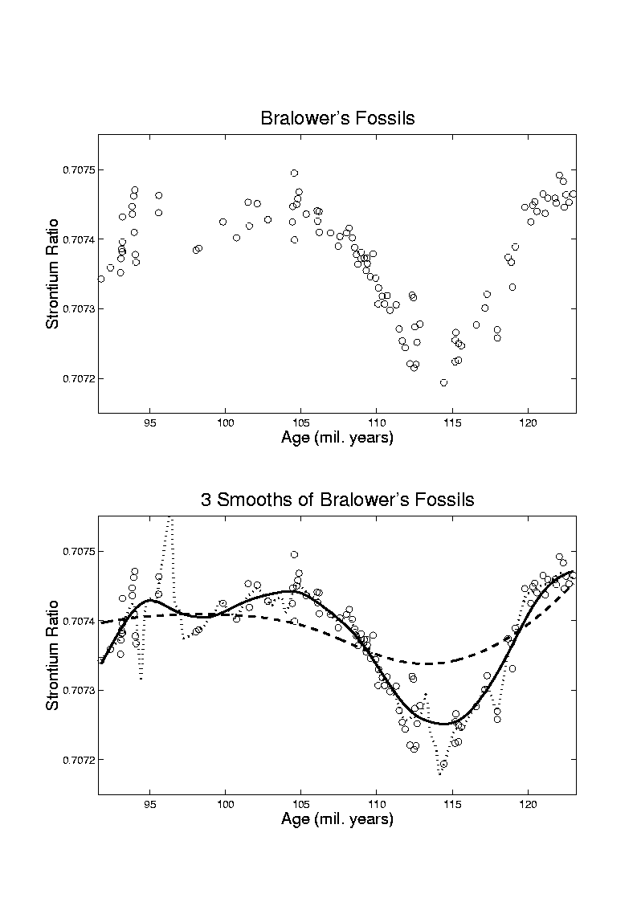
Scatterplot Smoothing
E.g. Bralower Fossil Data
Differences in 4th
Decimal Place!
No Parametric (e.g. Linear) Model
~50 m
Sea
Level
Diff.
Yet Clear
Systematic
Structure
Humans on Earth ~1mil. Years

Slide 24
Scatterplot Smoothing
E.g. Bralower Fossil Data
Way to bring out structure:
Smooth the data
Methods of smoothing?
  Local Averages
  Splines (several types)
  Fourier – trim high frequencies
  Other bases
  …
  Also controversial

Slide 25
Scatterplot Smoothing
E.g. Bralower Fossil Data – some smooths

Slide 26
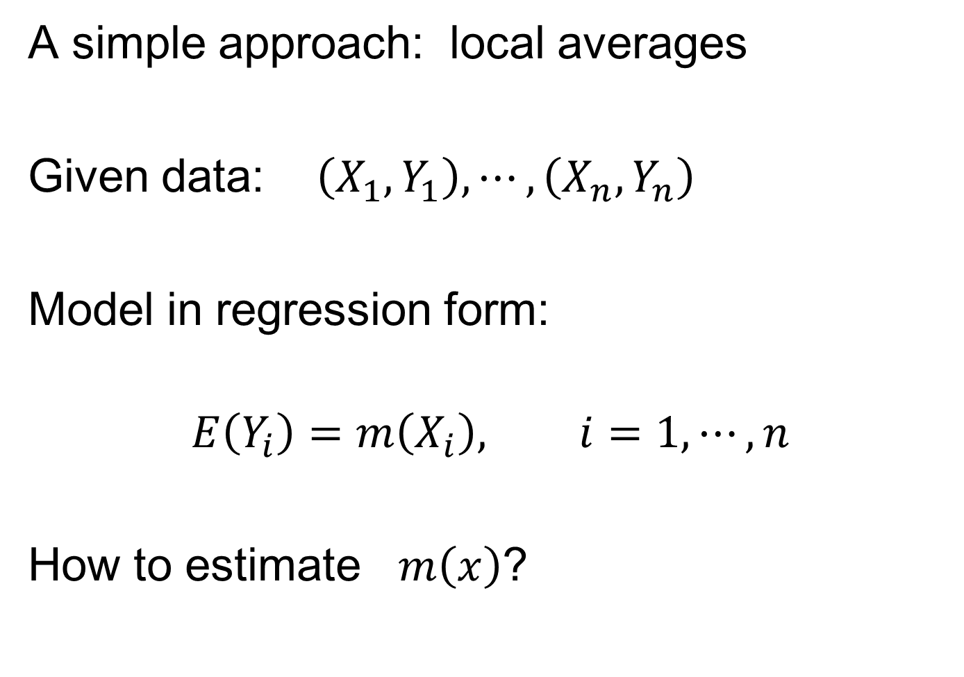
Scatterplot Smoothing
A simple approach: local averages
Given data: $\left(X_{1},Y_{1}\right),⋯,\left(X_{n},Y_{n}\right)$
Model in regression form:
$$E\left(Y_{i}\right)=m\left(X_{i}\right), i=1,⋯,n$$
How to estimate $m\left(x\right)$?

Slide 27
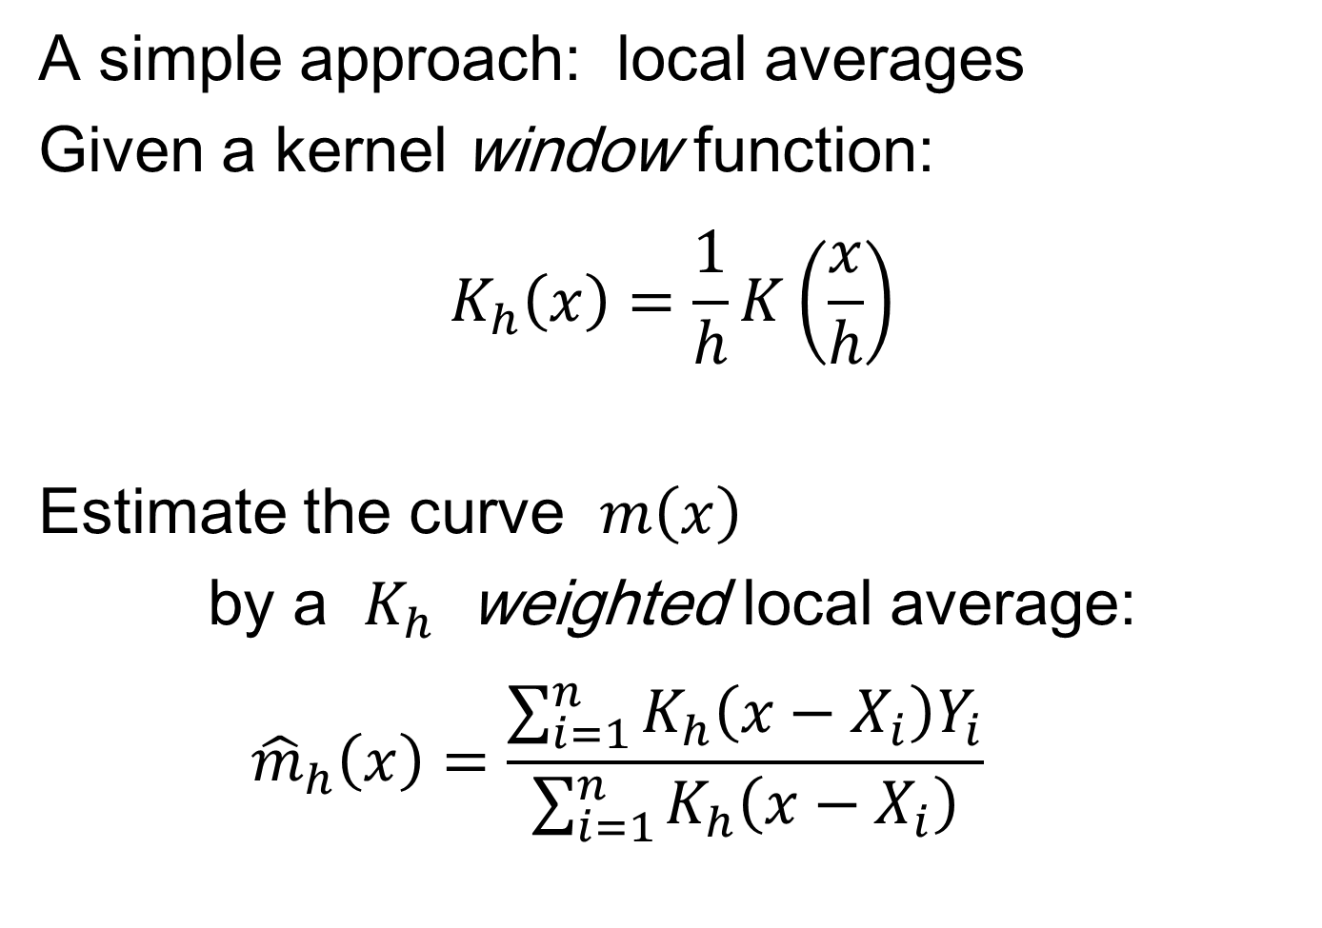
Scatterplot Smoothing
A simple approach: local averages
Given a kernel window function:
$$K_{h}\left(x\right)=\frac{1}{h}K\left(\frac{x}{h}\right)$$
Estimate the curve $m\left(x\right)$
by a $K_{h}$ weighted local average:
$${\hat{m}}_{h}\left(x\right)=\frac{\sum_{i=1}^{n}{K_{h}\left(x−X_{i}\right)Y_{i}}}{\sum_{i=1}^{n}{K_{h}\left(x−X_{i}\right)}}$$

Slide 28
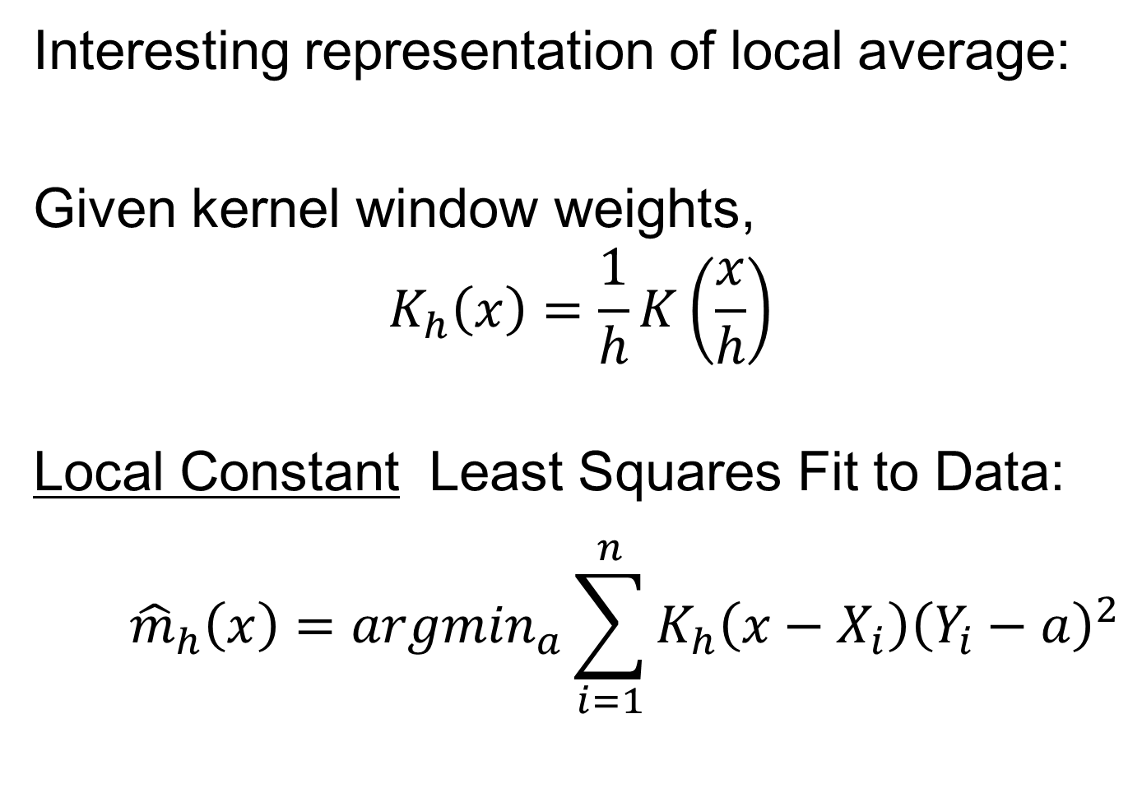
Scatterplot Smoothing
Interesting representation of local average:
Given kernel window weights,
$$K_{h}\left(x\right)=\frac{1}{h}K\left(\frac{x}{h}\right)$$
Local Constant Least Squares Fit to Data:
$${\hat{m}}_{h}\left(x\right)={argmin}_{a}\sum_{i=1}^{n}{K_{h}\left(x−X_{i}\right){\left(Y_{i}−a\right)}^{2}}$$
Kernel Weighted Fréchet Mean

Slide 29
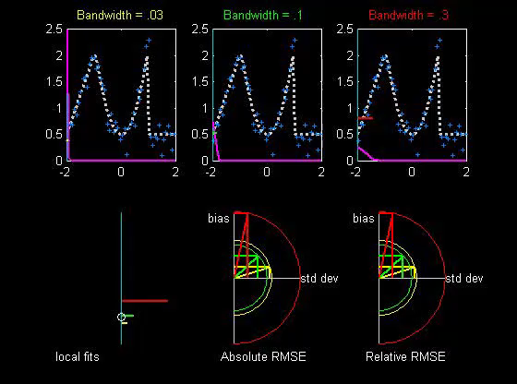

Scatterplot Smoothing
Local Constant Fits (visually):
“Moving Average”
Window width $h$ is critical (~ k.d.e.)
Goldilocks
Smoothing
Levels
Too Small
About Right
Too Big
Recommended
For Manual
Window Choice
Thanks to
Brad Davis

Slide 30
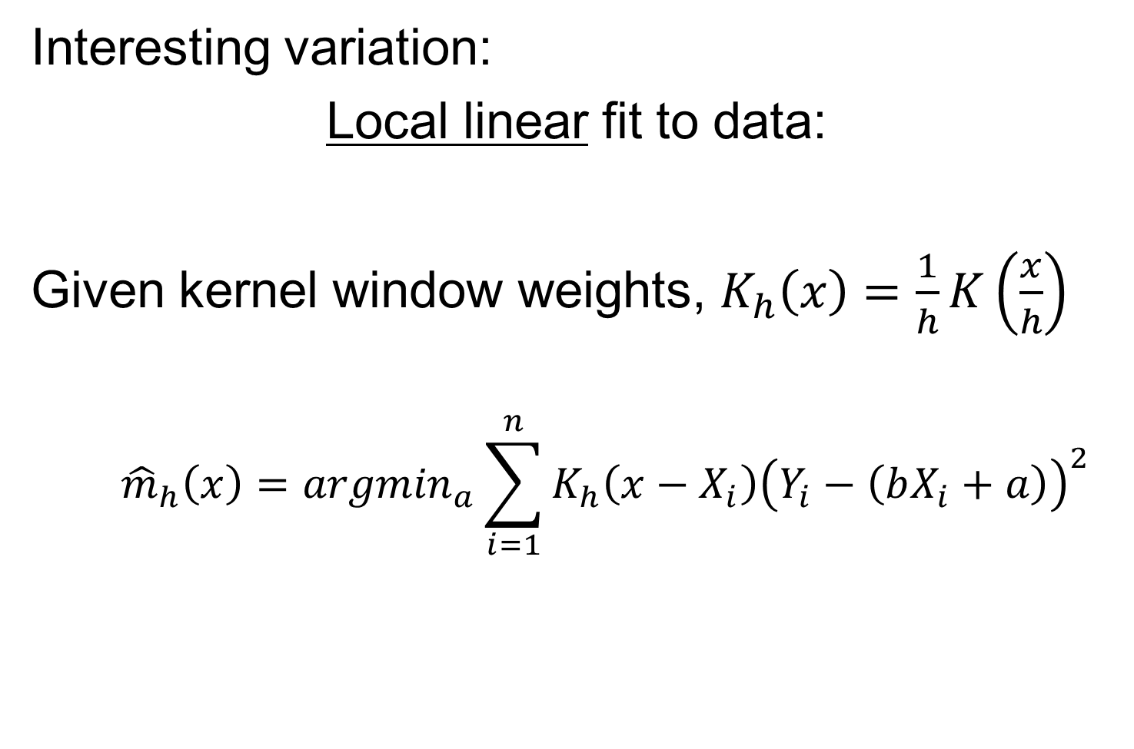
Scatterplot Smoothing
Interesting variation:
Local linear fit to data:
Given kernel window weights, $K_{h}\left(x\right)=\frac{1}{h}K\left(\frac{x}{h}\right)$
$${\hat{m}}_{h}\left(x\right)={argmin}_{a}\sum_{i=1}^{n}{K_{h}\left(x−X_{i}\right){\left(Y_{i}−\left(bX_{i}+a\right)\right)}^{2}}$$

Slide 31
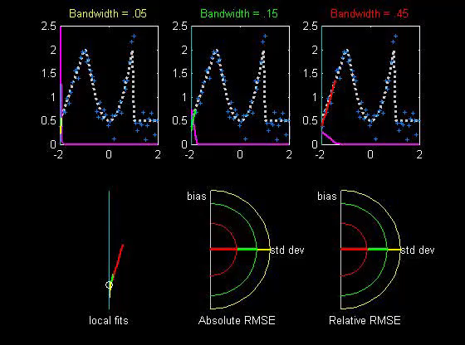

Scatterplot Smoothing
Local Linear Fits (visually):
“Intercept of Moving Fit Line”
Window width $h$ is critical (~ k.d.e.)

Slide 32
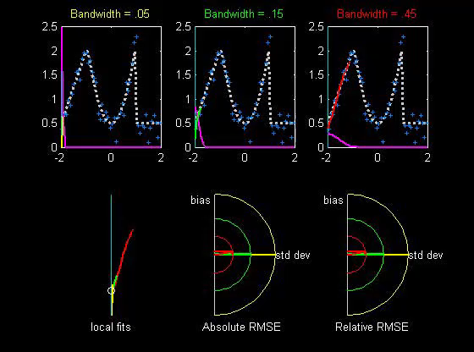

Scatterplot Smoothing
Another variation:
“Intercept of Moving Polynomial Fit”
Window width $h$ is critical (~ k.d.e.)

Slide 33
Scatterplot Smoothing
Local Polynomial Smoothing
What is best polynomial degree?
Once again controversial…
Advocates for all of 0, 1, 2, 3.
Depends on personal weighting of factors involved
Good reference:
  Fan & Gijbels (1995)
Personal choice: degree 1, local linear

Slide 34
Scatterplot Smoothing
E.g. Bralower Fossils – local linear smooths

Slide 35
Scatterplot Smoothing
Smooths of Bralower Fossil Data:
Oversmoothed misses structure
Undersmoothed feels sampling noise?
About right shows 2 valleys:
  One seems clear
  Is other one really there?
  Same question as above…
Needs “Statistical Inference”,
i.e. Confirmatory Analysis

Slide 36
Kernel Density Estimation
Choice of bandwidth (window width)?
Very important to performance
Fundamental Issue:
Which modes are “really there”?

Slide 37
Kernel Density Estimation
Choice of bandwidth (window width)?
Very important to performance
Data Based Choice?
Controversial Issue
Many recommendations
Suggested Reference:
Jones, Marron & Sheather (1996)
Never a consensus…

Slide 38
Kernel Density Estimation
Choice of bandwidth (window width)?
Alternate Choice:
  Consider all of them!
  I.e. look at whole spectrum of smooths
  Can see different structure
  At different smoothing levels
  Connection to Scale Space
E.g. Stamps data
  How many modes?
  All answers are there….

Slide 39
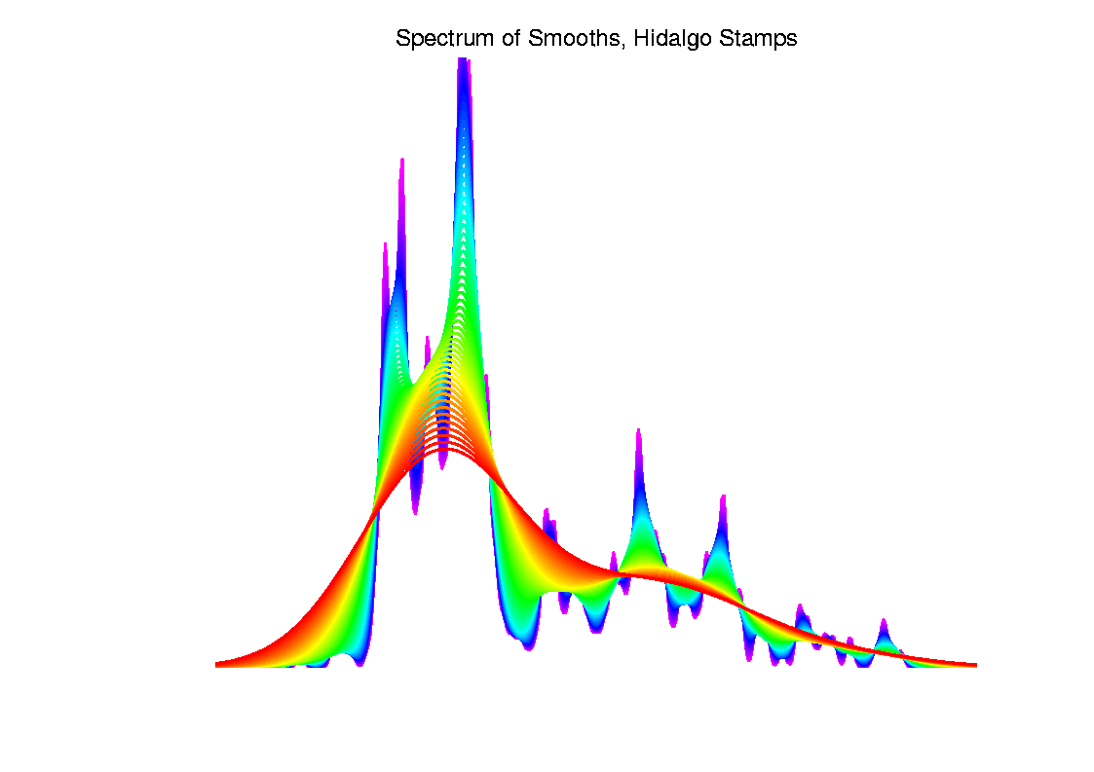
Kernel Density Estimation

Slide 40
Statistical Smoothing
Fundamental Question
For both of
Density Estimation: “Histograms”
Regression: “Scatterplot Smoothing”
Which bumps are “really there”?
vs. “artifacts of sampling noise”?

Slide 41
SiZer Background
Scale Space – Idea from Computer Vision
Goal: Teach Computers to “See”
Modern Research:
Extract “Information” from Images
Early Theoretical work

Slide 42
SiZer Background
Scale Space – Idea from Computer Vision
Conceptual basis:
Oversmoothing = “view from afar”
(macroscopic)
Undersmoothing = “zoomed in view”
(microscopic)
Main idea: all smooths contain useful information, so study “full spectrum”
(i. e. all smoothing levels)
Recommended reference: Lindeberg (1994)

Slide 43
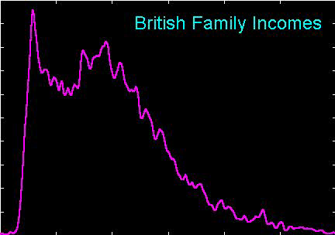
SiZer Background
Fun Scale Space Views
(of Family Incomes Data)

Slide 44
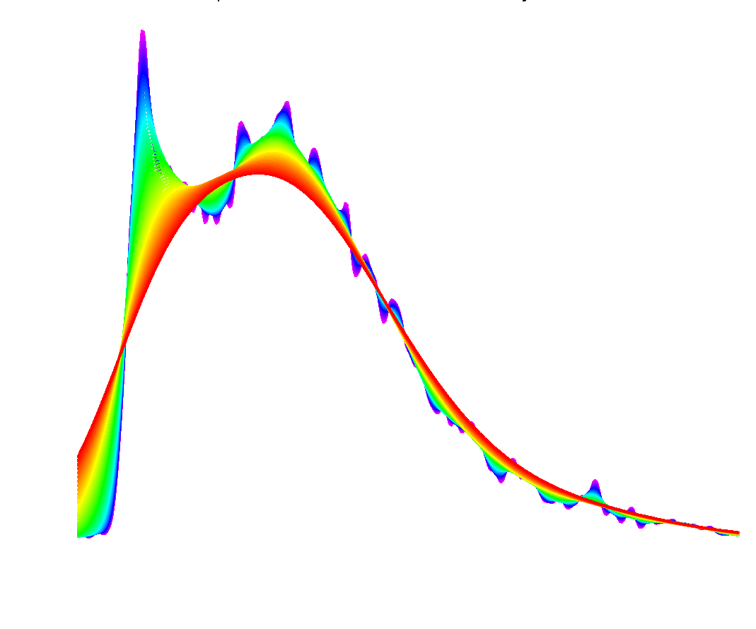
SiZer Background
Fun Scale Space Views (Incomes Data)
Spectrum Overlay

Slide 45
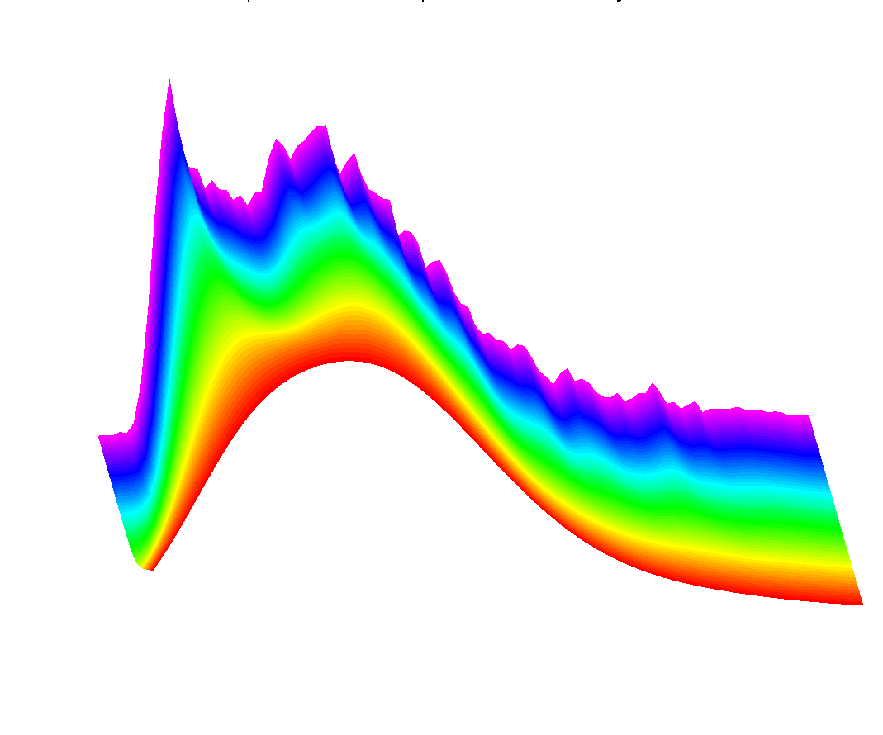
SiZer Background
Fun Scale Space Views (Incomes Data)
Surface View

Slide 46
SiZer Background
Fun Scale Space Views
(of Family Incomes Data)
Note:
The scale space viewpoint makes
Data Dased Bandwidth Selection
Much less important
(than I once thought….)

Slide 47
SiZer Background
SiZer:
Significance of Zero crossings, of the derivative, in scale space
Combines:
  needed statistical inference
  novel visualization
To get: a powerful exploratory + confirmatory data analysis method
Main references:
Chaudhuri & Marron (1999)
Hannig & Marron (2006)

Slide 48
SiZer Background
Basic idea: a bump is characterized by:
an increase
followed by a decrease
Generalization:
Many features of interest captured
by sign of the slope of the smooth
Foundation of SiZer:
Statistical inference on slopes,
over scale space

Slide 49
SiZer Background
SiZer Visual presentation:
Color map over scale space:
Blue: slope significantly upwards
(derivative CI above 0)
Red: slope significantly downwards
(derivative CI below 0)
Purple: slope insignificant
(derivative CI contains 0)

Slide 50
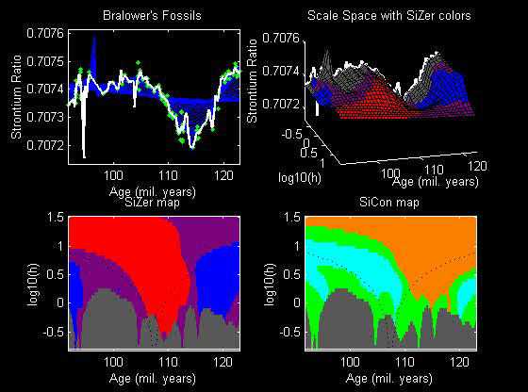
SiZer Background
SiZer analysis of Fossils data:

Slide 51
SiZer Background
SiZer analysis of Fossils data:
Upper Left: Scatterplot, family of smooths, 1 highlighted
Upper Right: Scale space rep’n of family, with SiZer colors
Lower Left: SiZer map, more easy to view
Lower Right: SiCon map – replace slope by curvature
Slider (in movie viewer) highlights different smoothing levels

Slide 52
SiZer Background
SiZer analysis of Fossils data (cont.):
Oversmoothed (top of SiZer map):
Decreases at left, not on right
Medium smoothed (middle of SiZer map):
Main valley significant, and left most increase
Smaller valley not statistically significant
Undersmoothed (bottom of SiZer map):
“noise wiggles” not significant
Additional SiZer color: gray - not enough data for inference

Slide 53
SiZer Background
SiZer analysis of Fossils data (cont.):
Common Question: Which is right?
Decreases on left, then flat
(top of SiZer map)
Up, then down, then up again
(middle of SiZer map)
No significant features
(bottom of SiZer map)
Answer: All are right
Just different scales of view,
i.e. levels of resolution of data

Slide 54
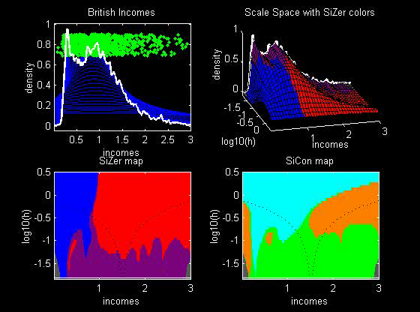
SiZer Background
SiZer analysis of British Incomes data:

Slide 55
SiZer Background
SiZer analysis of British Incomes data:
Oversmoothed: Only one mode
Medium smoothed: Two modes, statistically significant
Confirmed by Schmitz & Marron, (1992)
Undersmoothed: many noise wiggles, not significant
Again: all are correct,
just different scales

Slide 56
Participant Presentation
Wei Gu:
A Heuristic Approach to Portfolio Optimization with Cardinality Constraints
Nicole Kramer:
Calling DNA Loops in Hi-C Data

