Slide 1
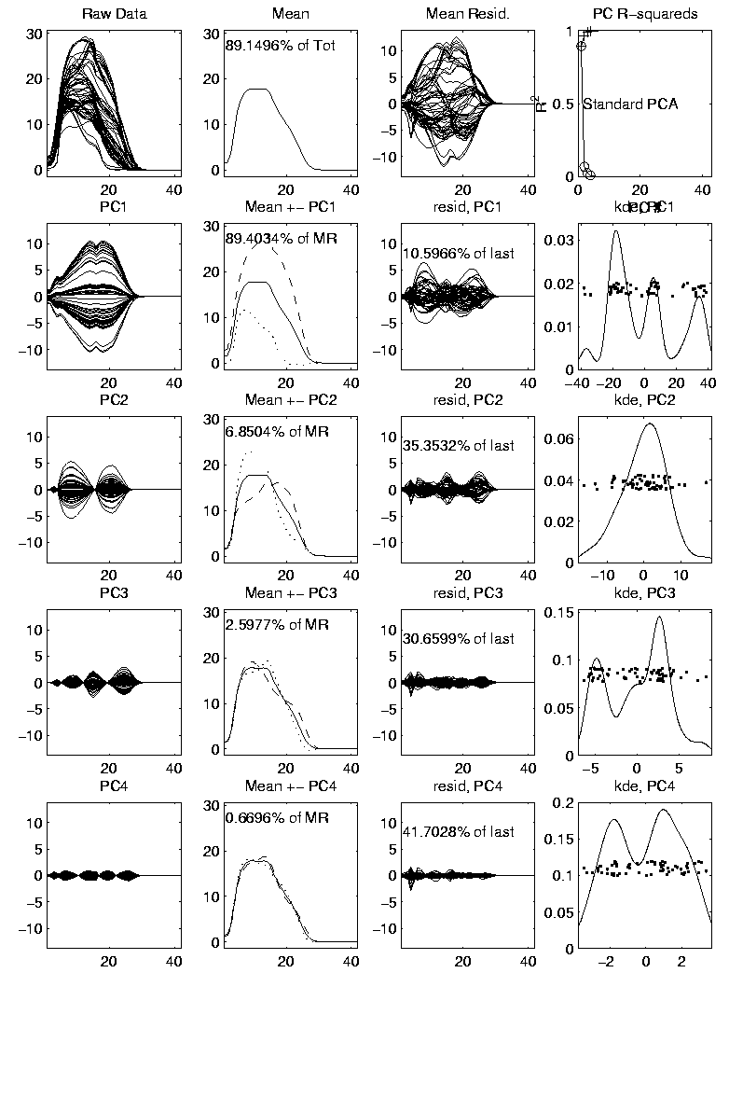
PCA to find clusters
Return to PCA of Mass Flux Data:
Big Question:
Are The
3 Clusters
Really There?
Notes:
MassFlux1d1p1.ps

Slide 2
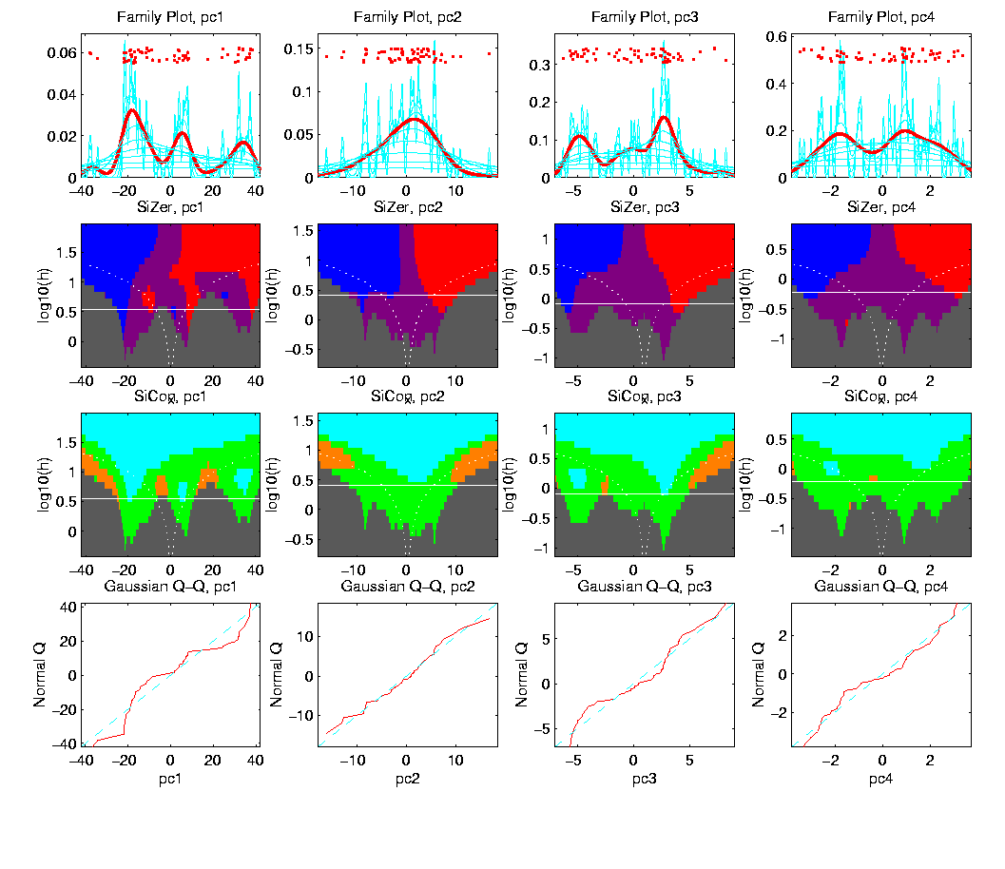
PCA to find clusters
SiZer analysis of Mass Flux, PC1
All 3
Signif’t
Notes:
MassFlux1d1p1s.ps

Slide 3
Statistical Smoothing
Usefulness of SiZer :
Detailed & Insightful Analysis of 1 Dataset
To Analyze Many Data Sets
Need Automatic Choice
Reference:
Jones, et al. (1996)
Also Recall Goldilocks Visual Approach
Too Small, Too Big, Just Right

Slide 4
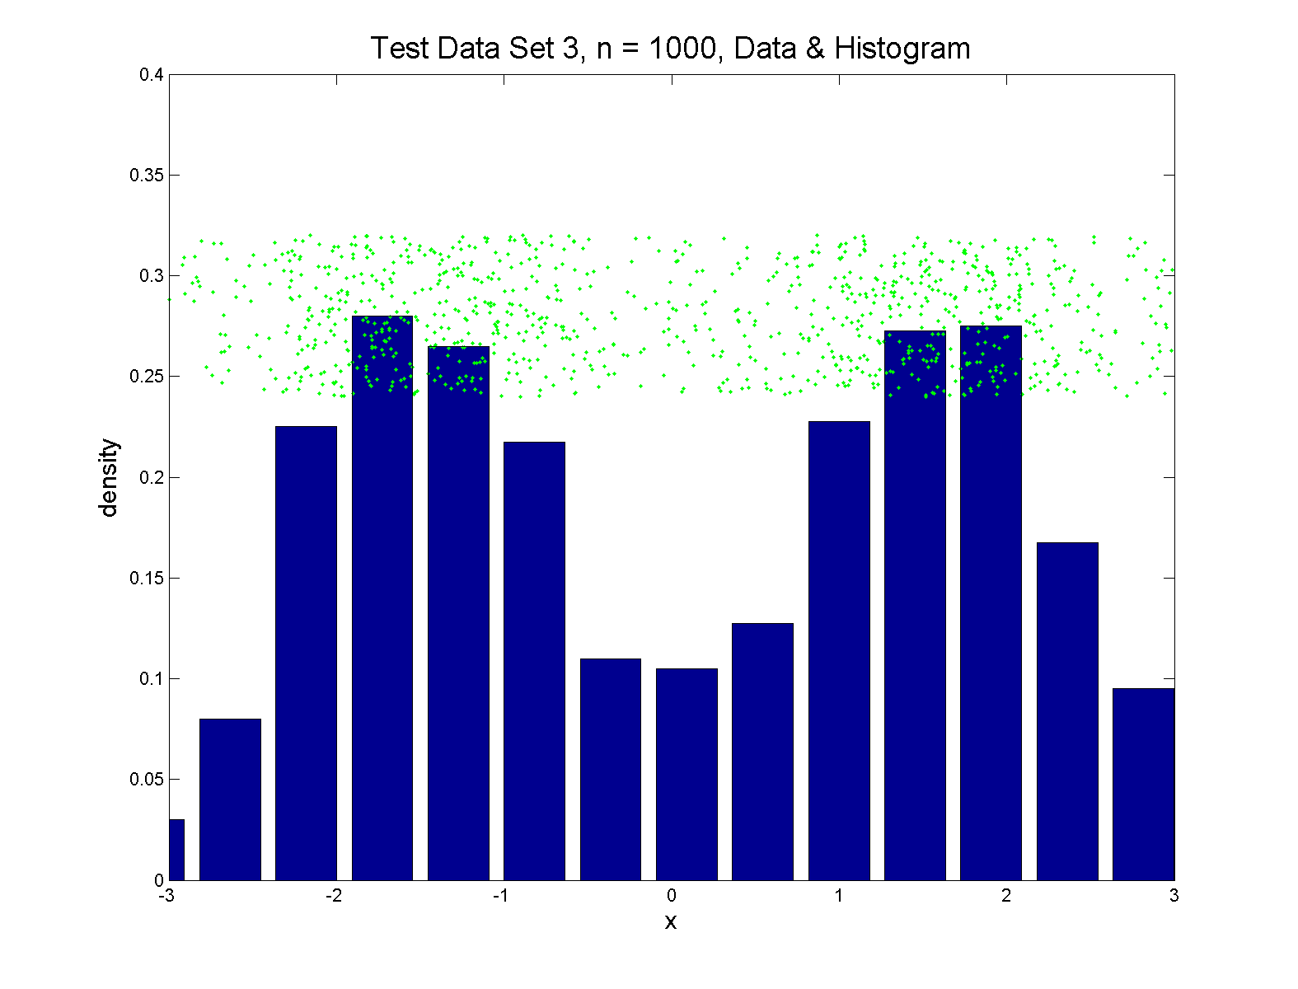
Q-Q plots
Simple Toy Example, non-Gaussian!

Slide 5
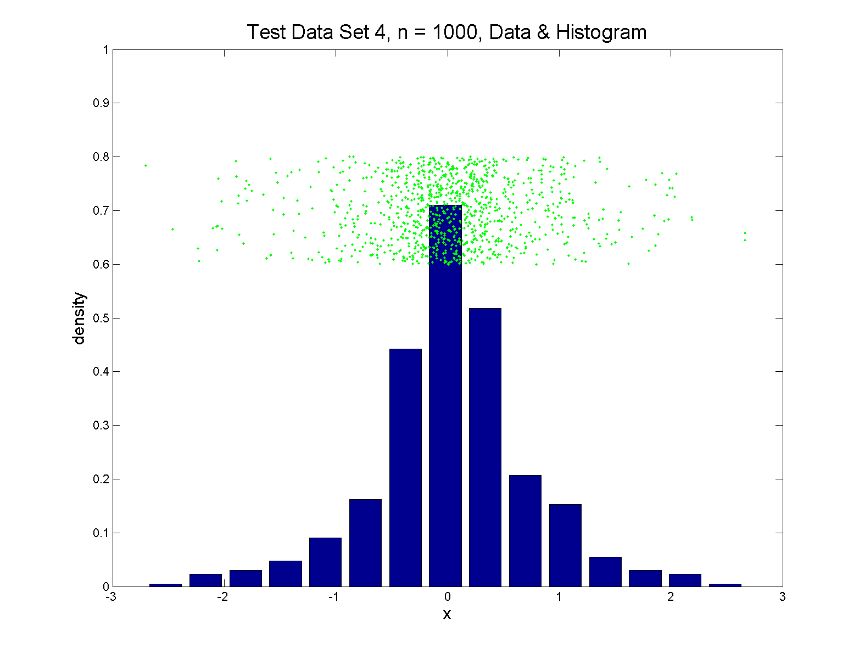
Q-Q plots
Simple Toy Example, non-Gaussian(?)

Slide 6
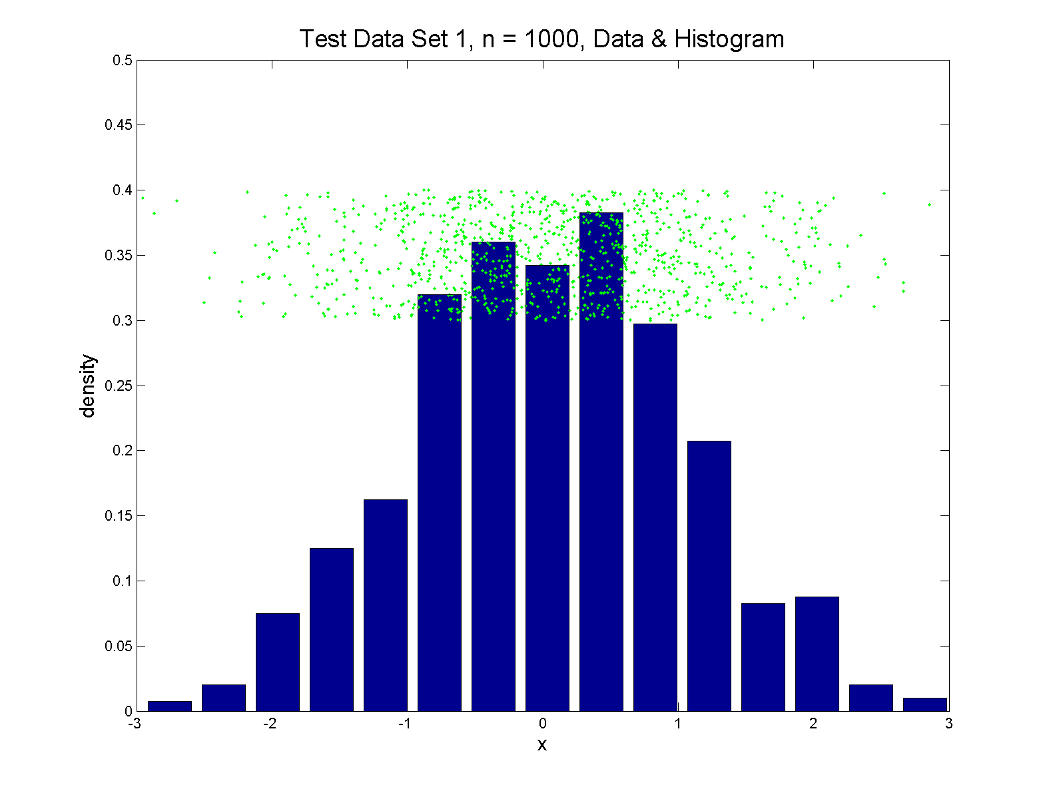
Q-Q plots
Simple Toy Example, Gaussian

Slide 7
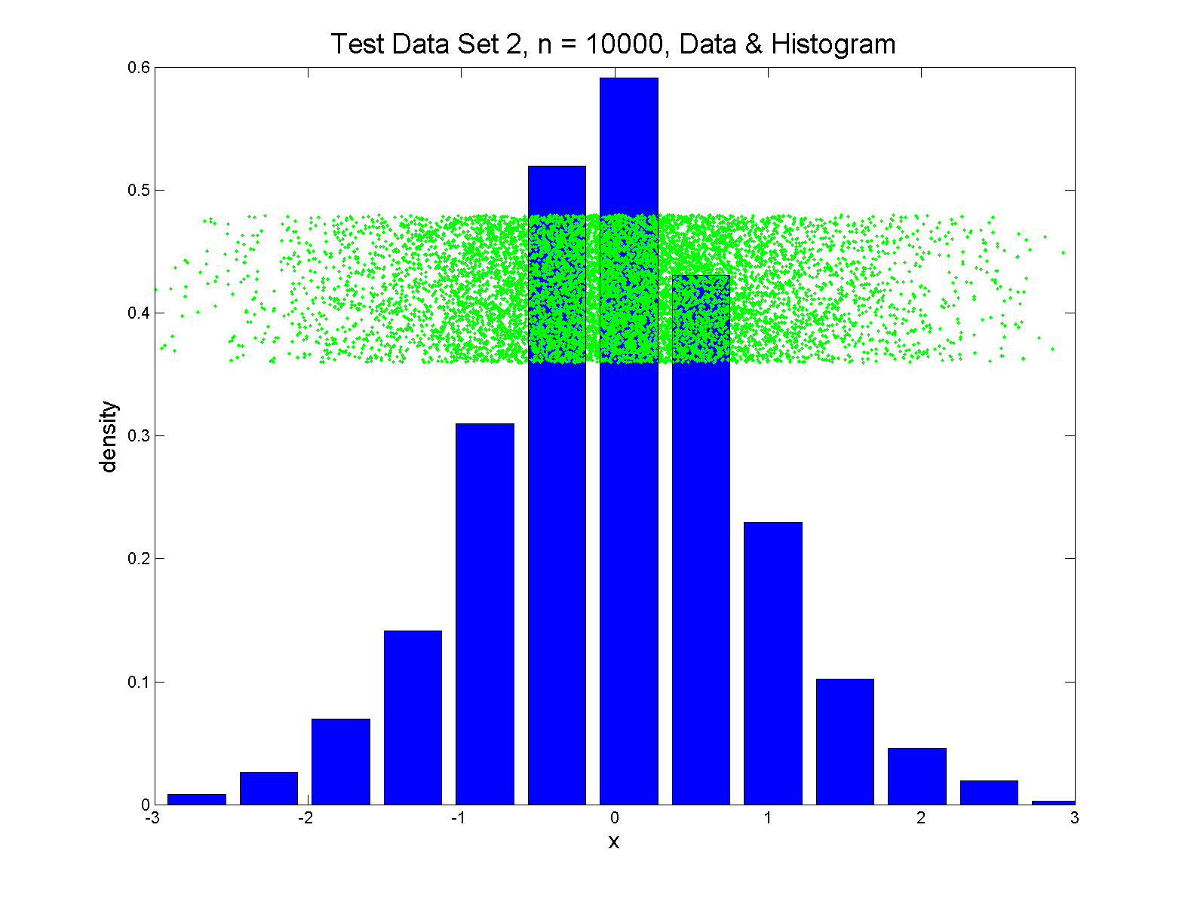
Q-Q plots
Simple Toy Example, Gaussian?

Slide 8
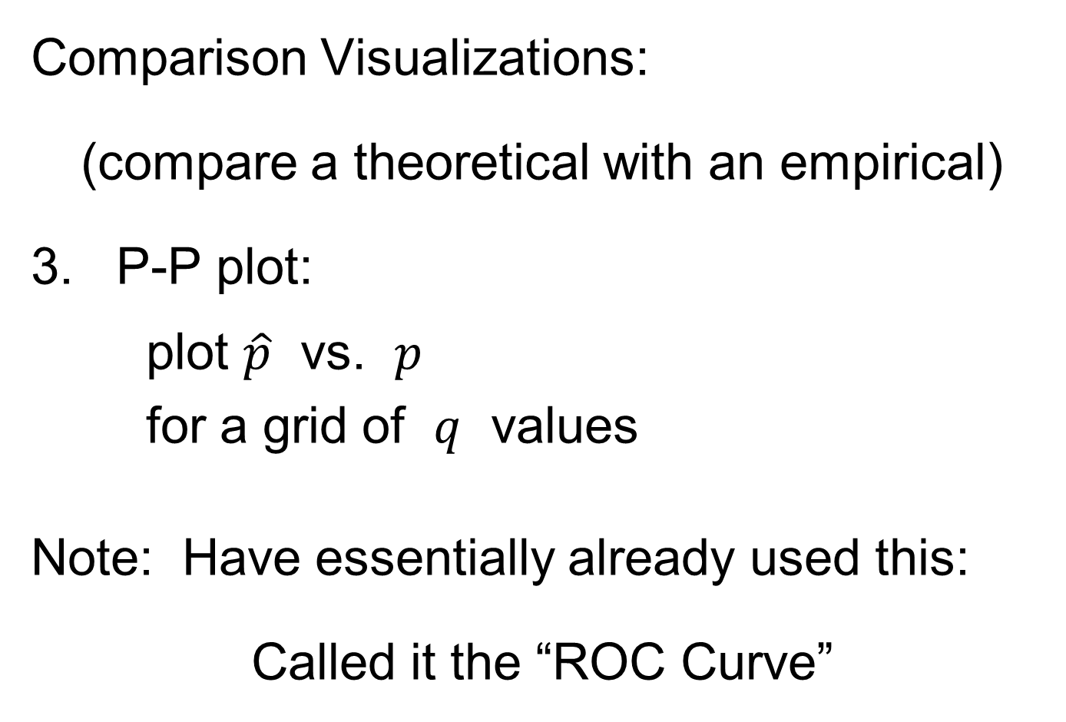
Q-Q plots
Comparison Visualizations:
(compare a theoretical with an empirical)
P-P plot:
plot $\hat{p}$ vs. $p$
for a grid of $q$ values
Note: Have essentially already used this:
Called it the “ROC Curve”

Slide 9
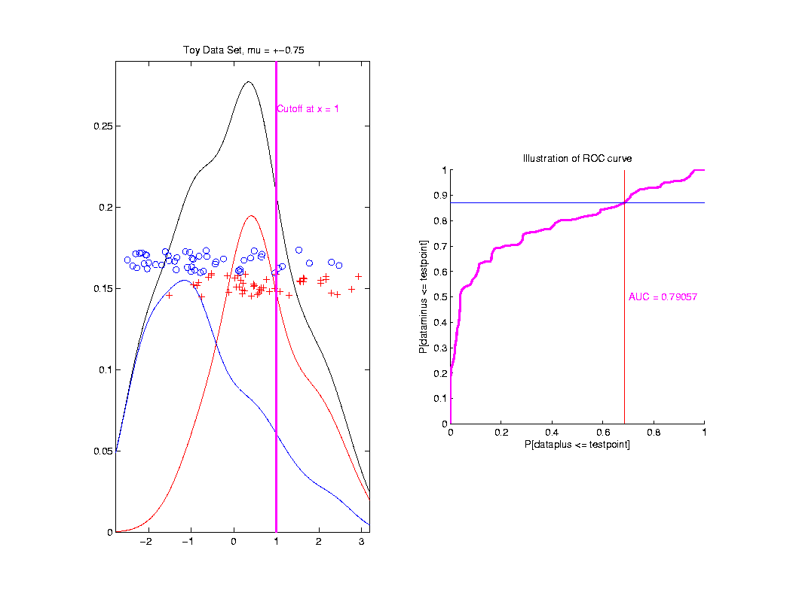
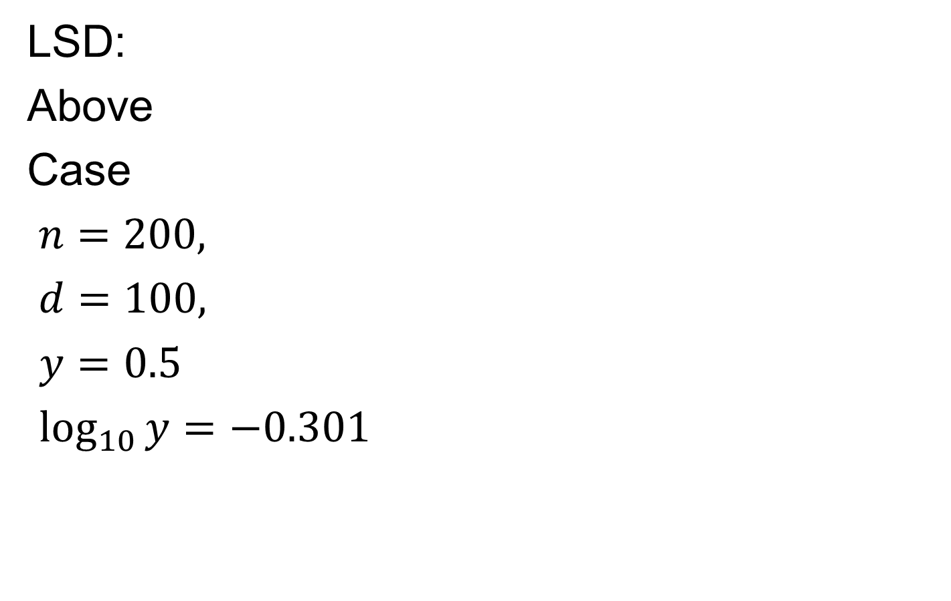

ROC Curve
Slide
Cutoff
To
Trace
Out
Curve
Plot $\hat{p}$ vs. $p$
For Grid of $q$ Values

Slide 10
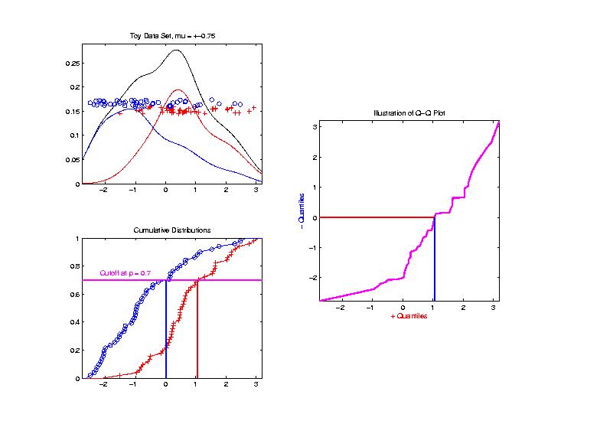
Q-Q plots
Slide
Cutoff
To
Trace
Out
Curve

Slide 11
Q-Q plots
Illustrative graphic (toy data set):
Empirical Qs near Theoretical Qs
when
Q-Q curve is near 45⁰ line
(general use of Q-Q plots)

Slide 12
Alternate Viewpoints
P-P Plot = ROC Curve:
Study Differences Between Data Sets
Focus on Main Body of Distributions
Q-Q Plot: For Checking
Empirical Distribution
vs.
Theoretical Distribution
Focus on Tails

Slide 13
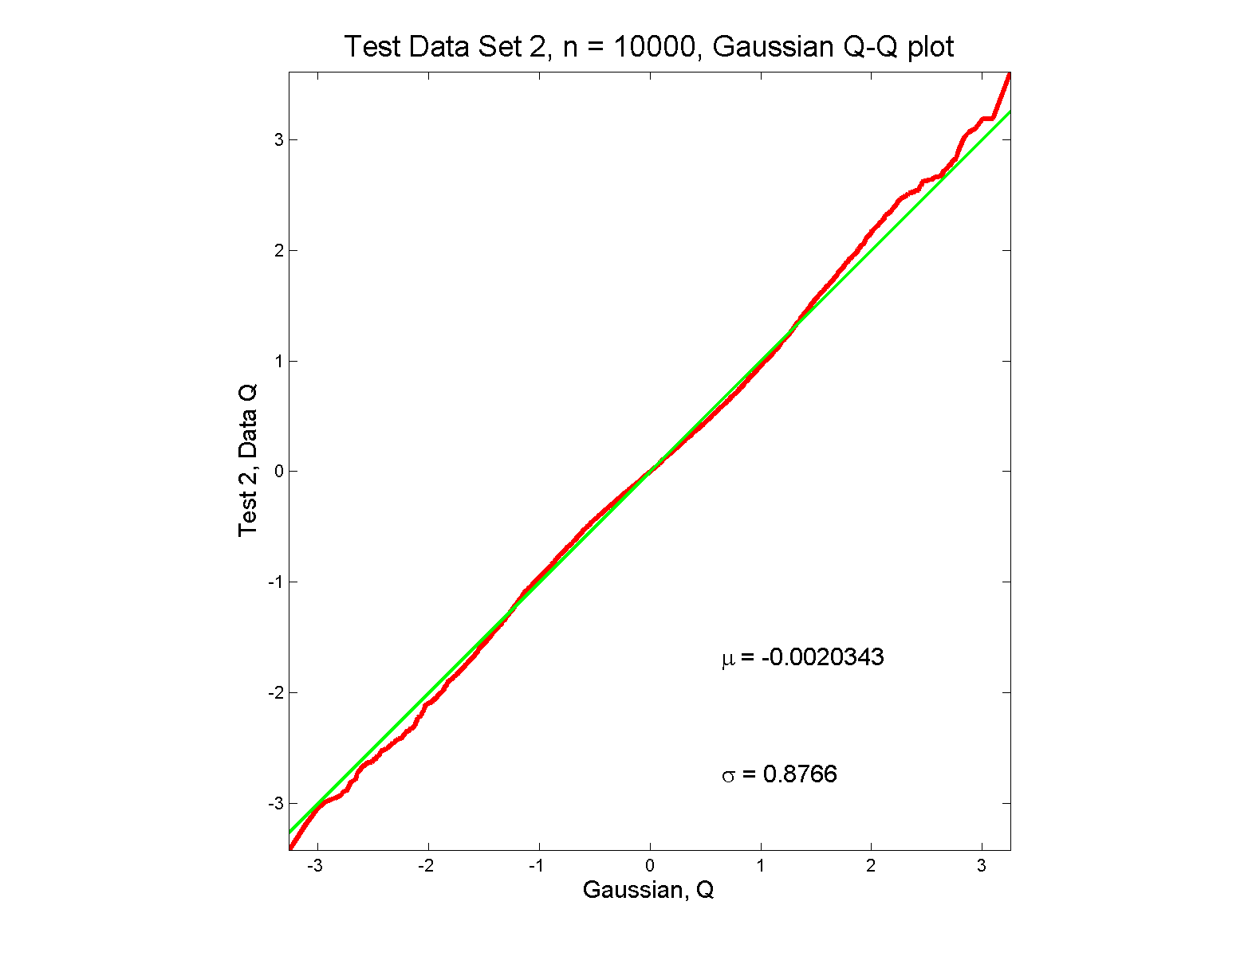
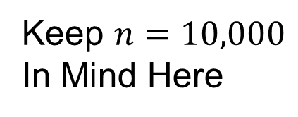
Q-Q plots
Gaussian? Departures from line?
Keep $n=10,000$
In Mind Here

Slide 14
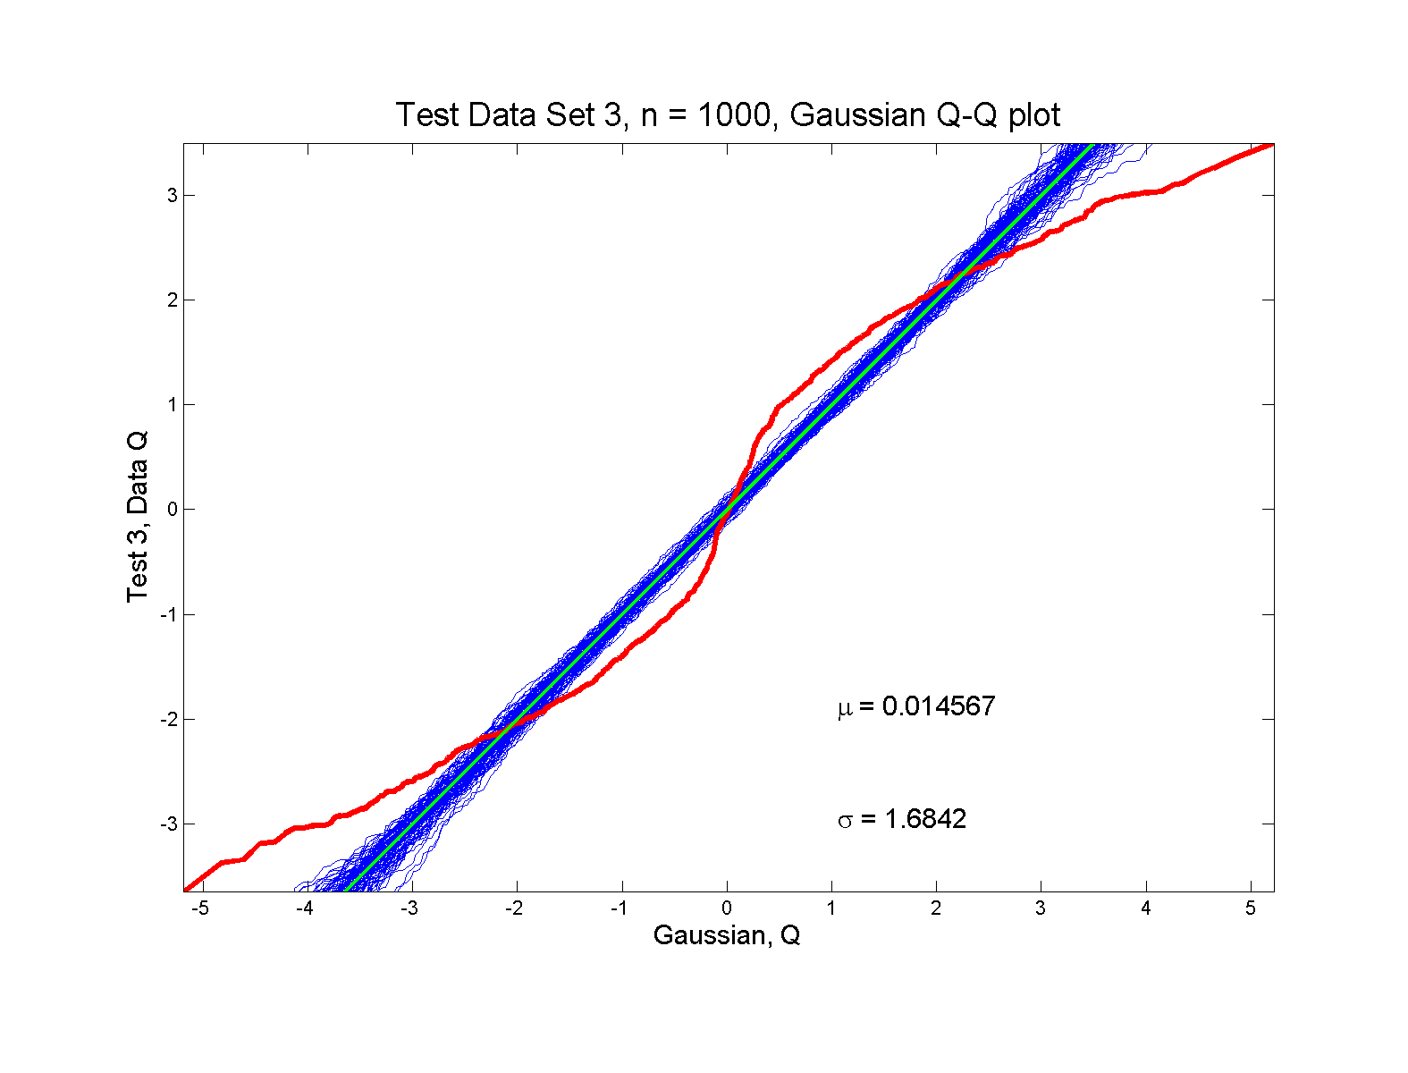
Q-Q plots
non-Gaussian! departures from line?

Slide 15
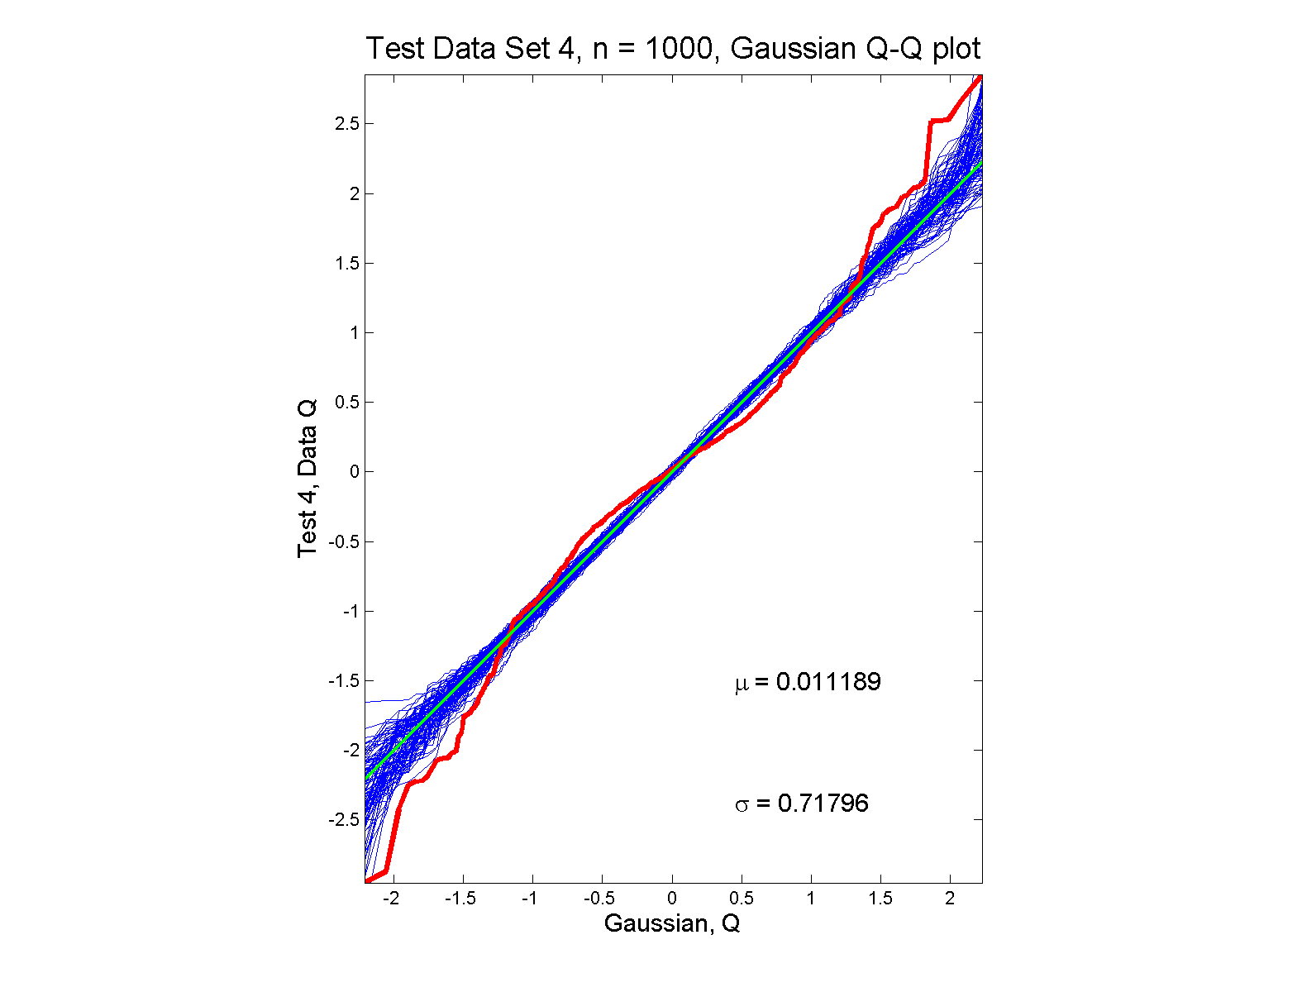
Q-Q plots
non-Gaussian (?) departures from line?

Slide 16
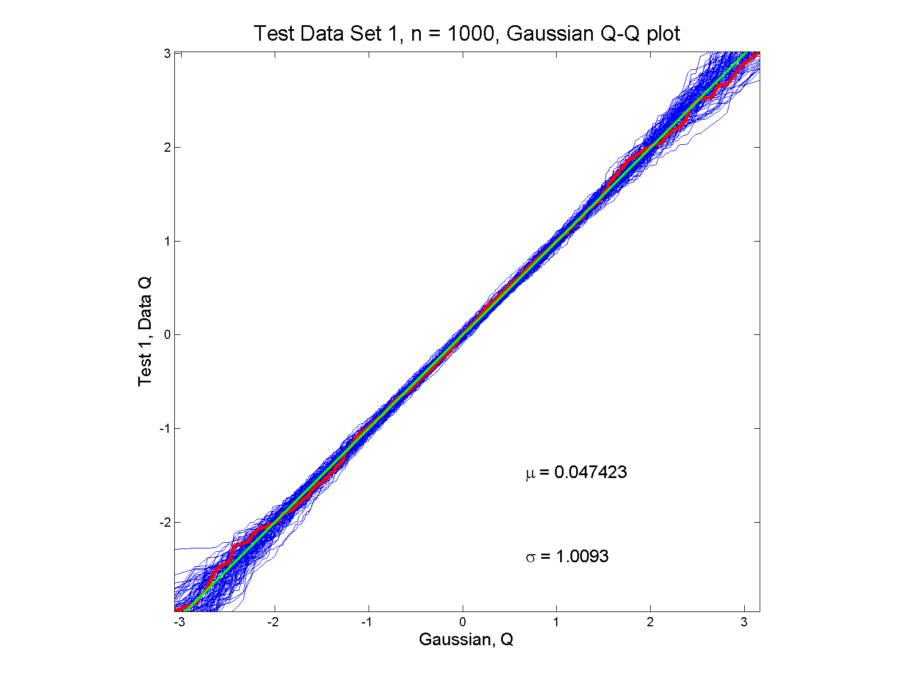
Q-Q plots
Gaussian: Stays Within Envelope
As Expected,
Since This Is
Null Hypothesis

Slide 17
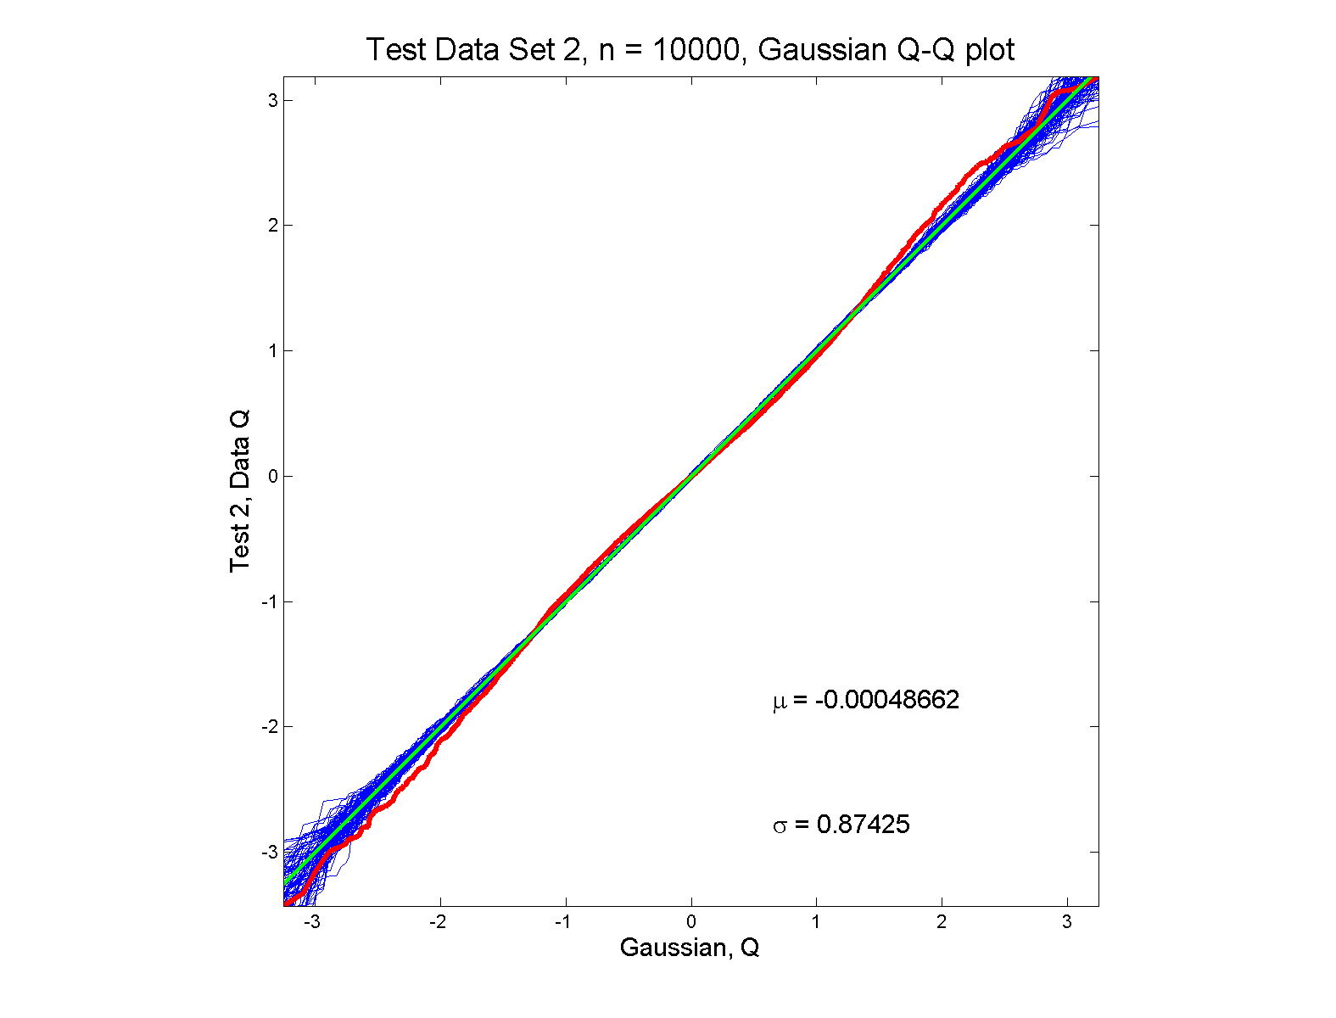
Q-Q plots
Gaussian? departures from line?

Slide 18
Q-Q plots
What were these distributions?
Non-Gaussian!
0.5 N(-1.5,0.75²) + 0.5 N(1.5,0.75²)
Non-Gaussian (?)
0.4 N(0,1) + 0.3 N(0,0.5²) + 0.3 N(0,0.25²)
Gaussian
Gaussian?
0.7 N(0,1) + 0.3 N(0,0.5²)

Slide 19
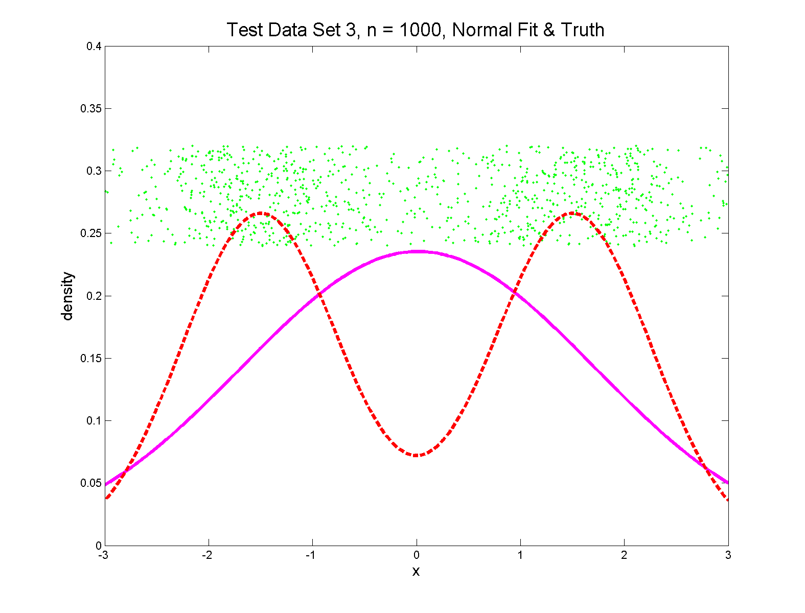
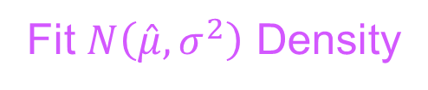
Q-Q plots
Non-Gaussian! .5 N(-1.5,0.75²) + 0.5 N(1.5,0.75²)
True Density
Fit $N\left(\hat{μ},σ^{2}\right)$ Density

Slide 20
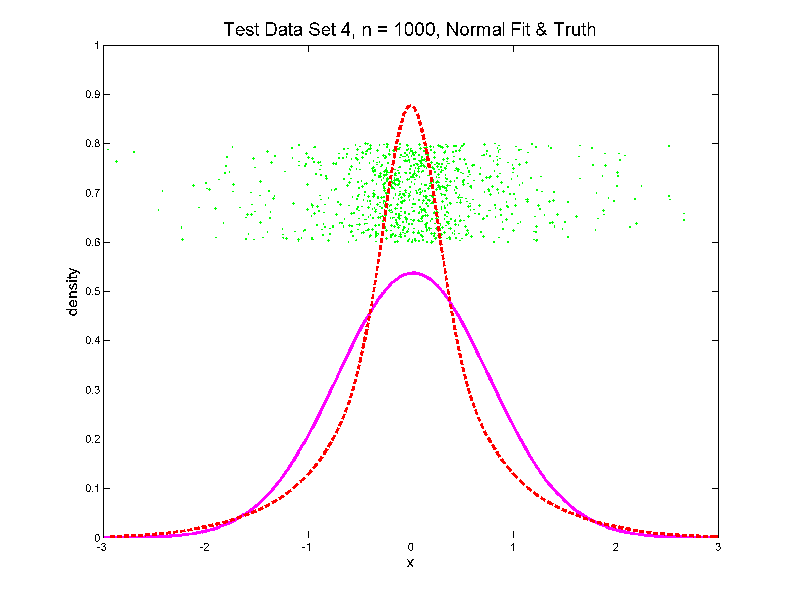
Q-Q plots
Non-Gaussian (?) 0.4 N(0,1) + 0.3 N(0,0.5²) + 0.3 N(0,0.25²)
Strong Kurtosis
Now Visible

Slide 21
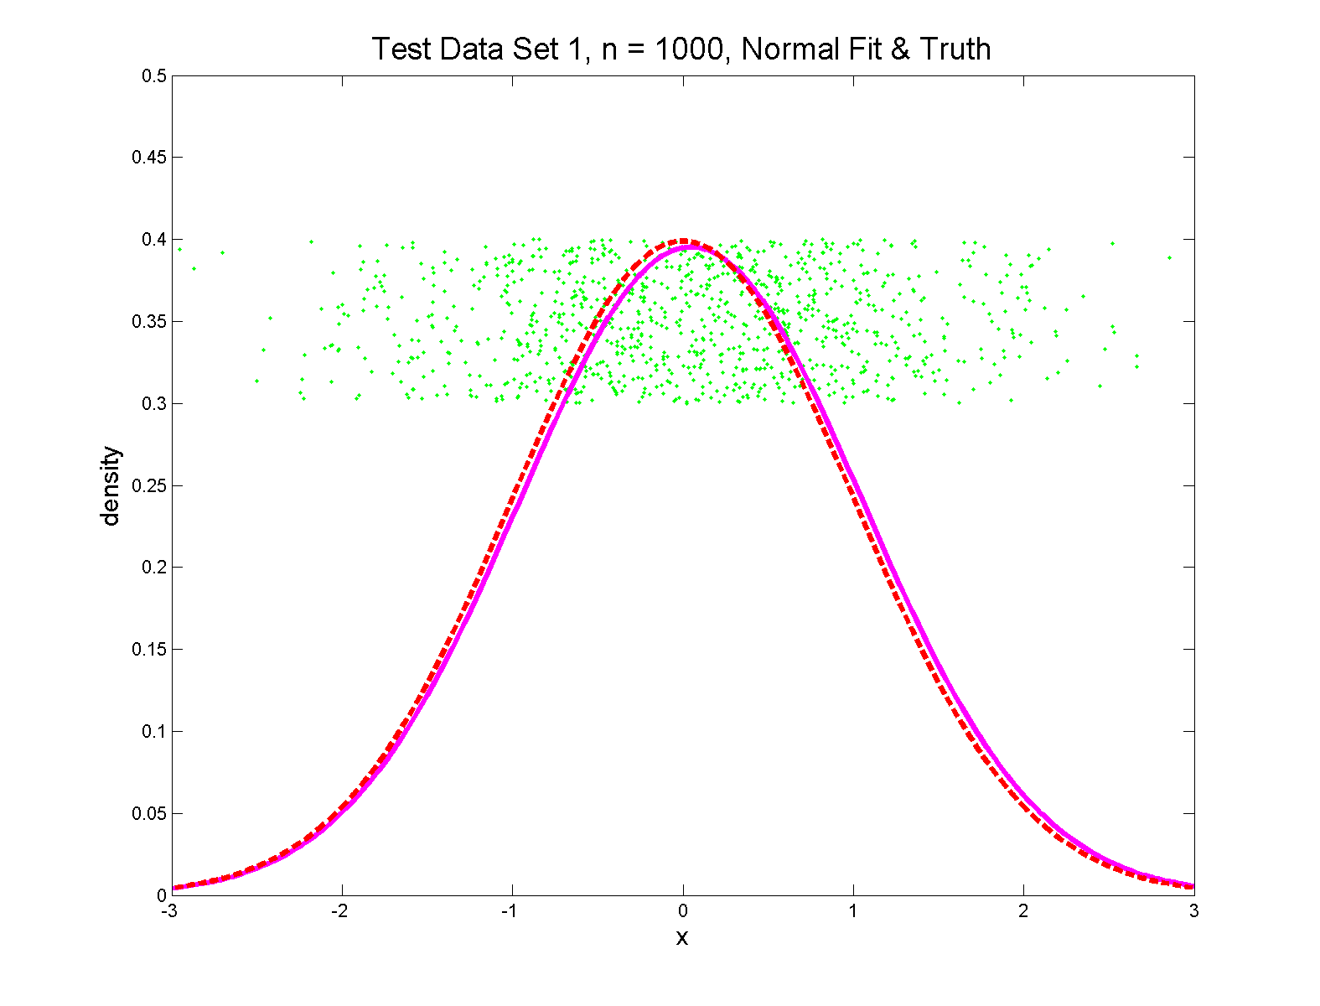
Q-Q plots
Gaussian

Slide 22
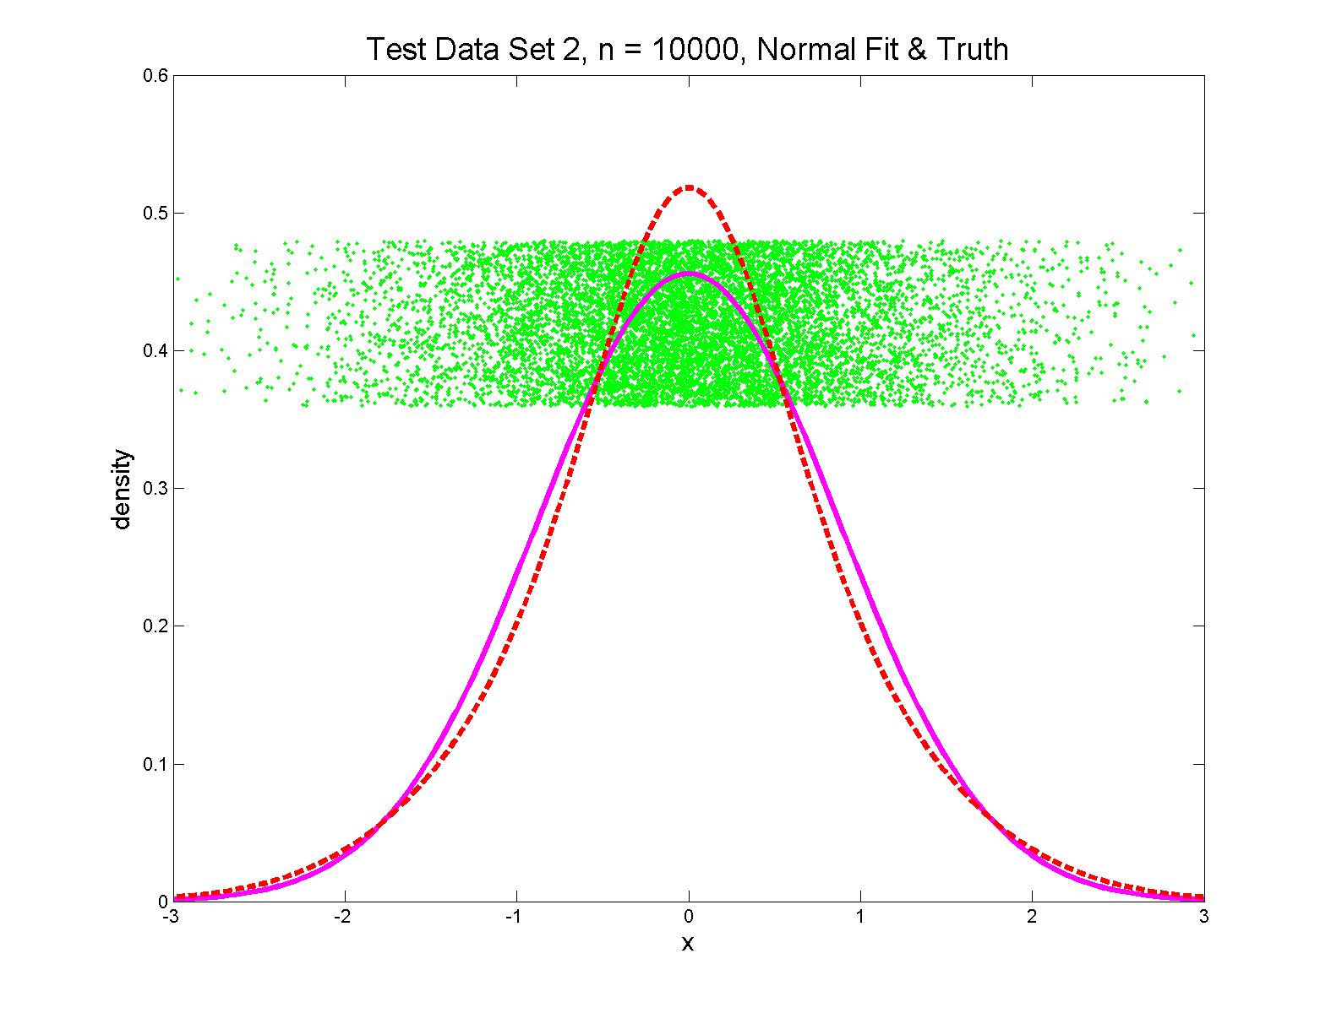
Q-Q plots
Gaussian? 0.7 N(0,1) + 0.3 N(0,0.5²)
Less Kurtosis
But Present

Slide 23
Q-Q Envelope Plots
Marron’s Matlab Software:
qqLM.m
In General Directory

Slide 24
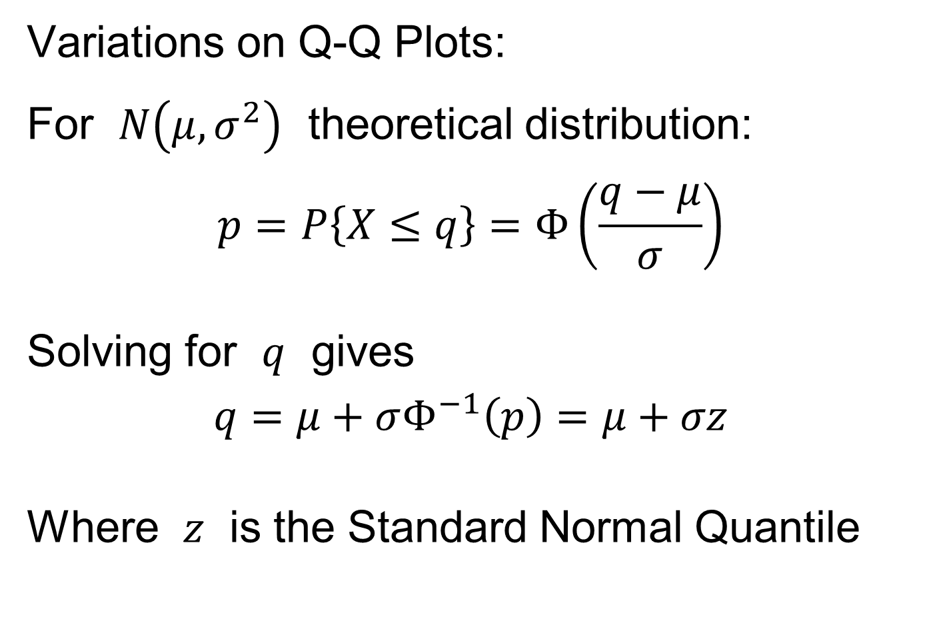
Q-Q plots
Variations on Q-Q Plots:
For $N\left(μ,σ^{2}\right)$ theoretical distribution:
$$p=P\left\{X≤q\right\}=Φ\left(\frac{q−μ}{σ}\right)$$
Solving for $q$ gives
$$q=μ+σΦ^{−1}\left(p\right)=μ+σz$$
Where $z$ is the Standard Normal Quantile

Slide 25
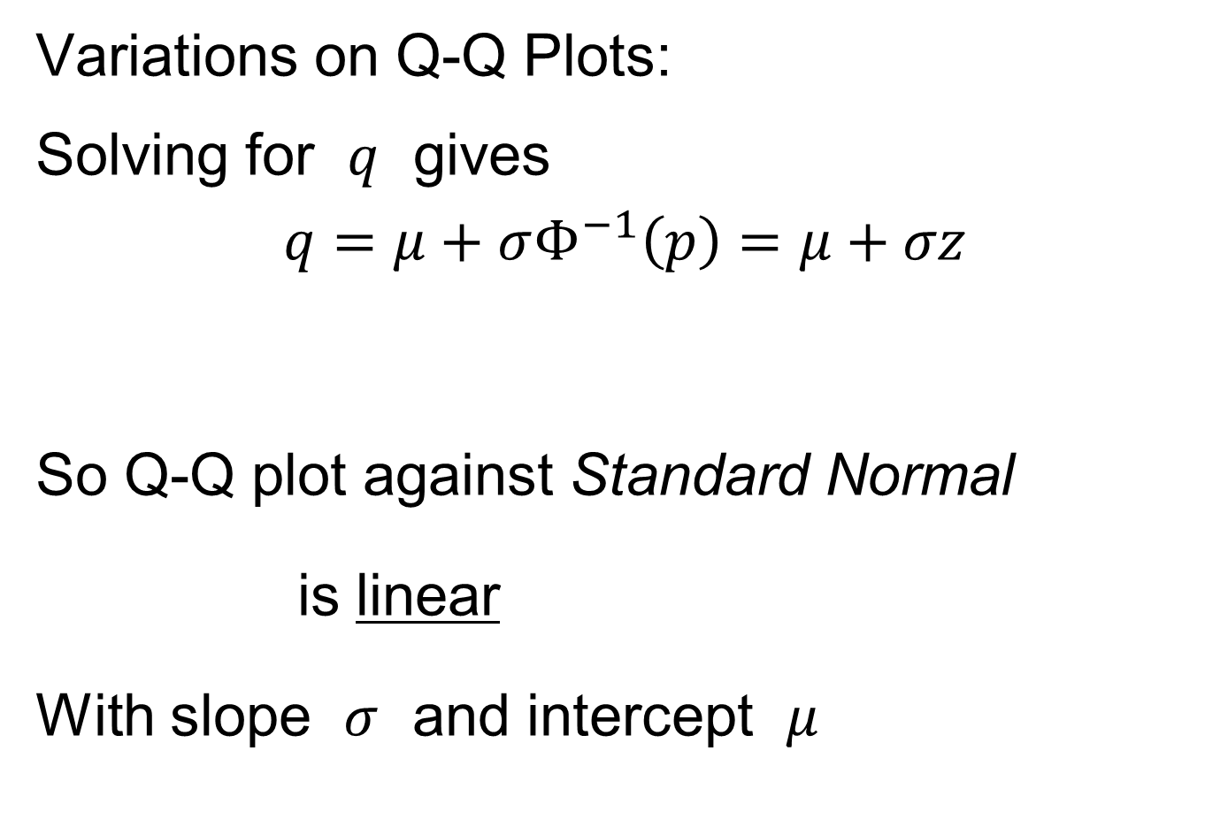
Q-Q plots
Variations on Q-Q Plots:
Solving for $q$ gives
$$q=μ+σΦ^{−1}\left(p\right)=μ+σz$$
So Q-Q plot against Standard Normal
is linear
With slope $σ$ and intercept $μ$

Slide 26
Q-Q plots
Variations on Q-Q Plots:
Can replace Gaussian with other dist’ns
Can compare 2 theoretical distn’s
Can compare 2 empirical distn’s
Could also Vary P-P plots = ROC curves

Slide 27
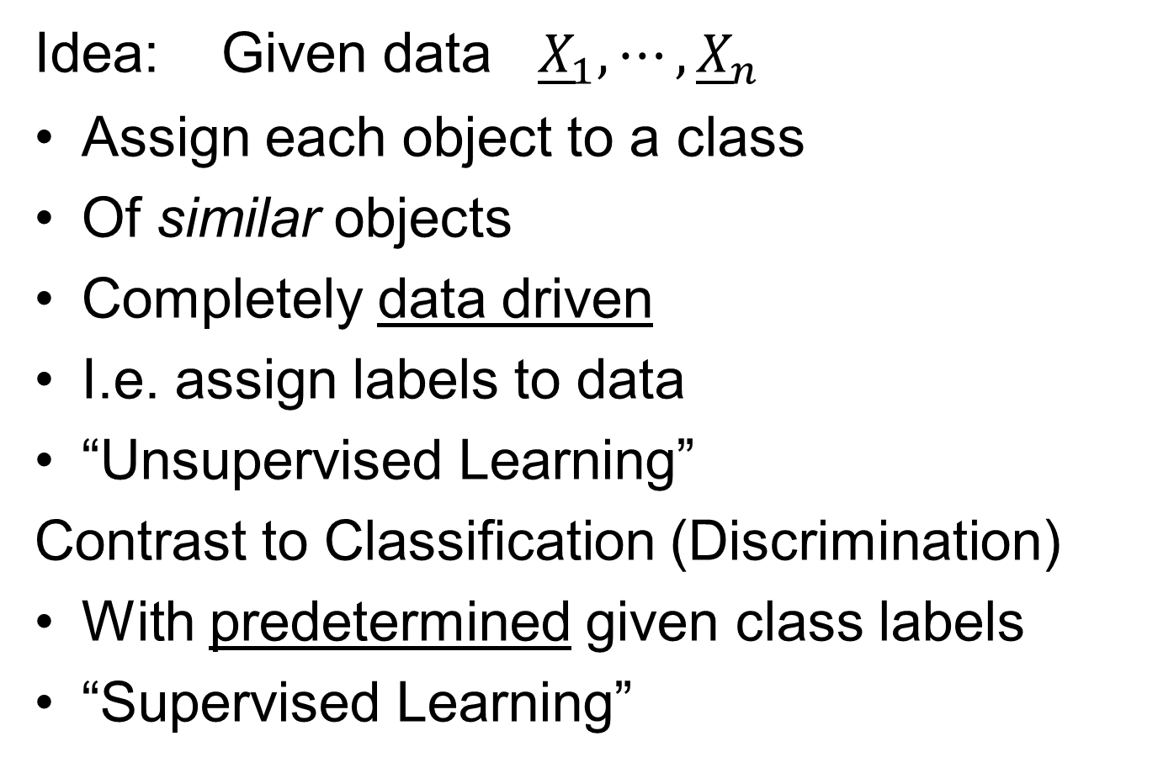
Clustering
Idea: Given data ${\underline{X}}_{1},⋯,{\underline{X}}_{n}$
Assign each object to a class
Of similar objects
Completely data driven
I.e. assign labels to data
“Unsupervised Learning”
Contrast to Classification (Discrimination)
With predetermined given class labels
“Supervised Learning”

Slide 28
Clustering
Important References:
MacQueen (1967)
Hartigan (1975)
Gersho and Gray (1992)
Kaufman and Rousseeuw (2005)
See Also: Wikipedia

Slide 29
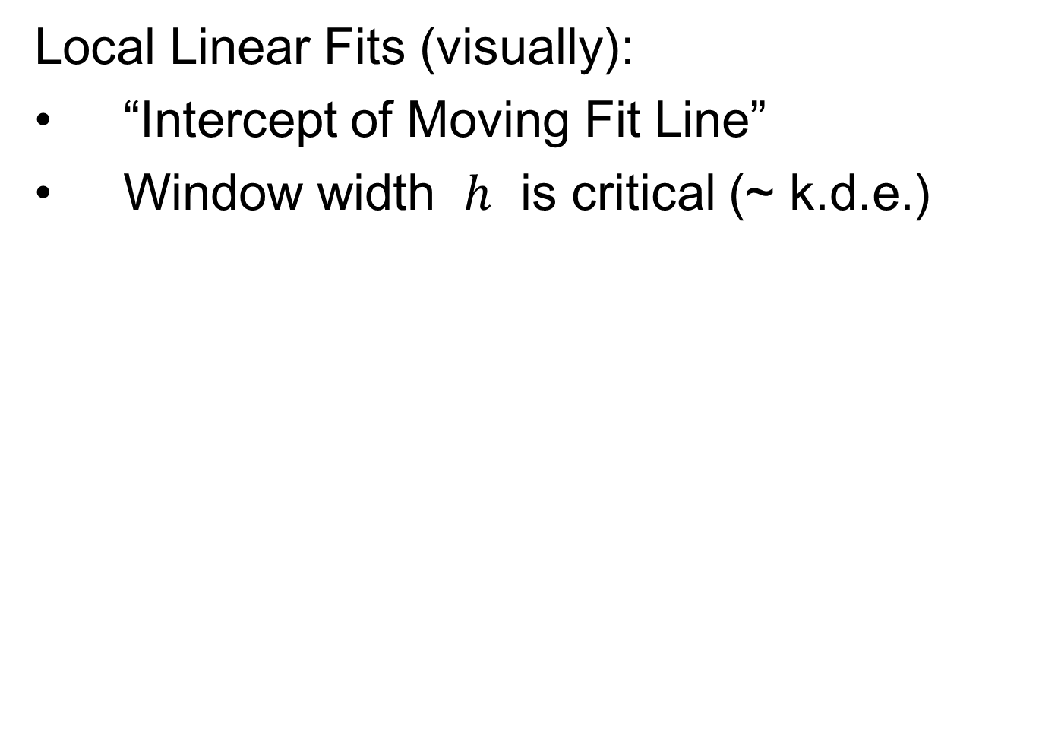
K-means Clustering
Main Idea: for data ${\underline{X}}_{1},⋯,{\underline{X}}_{n}$
Partition indices $i=1,⋯,n$
among classes $C_{1},⋯$, $C_{K}$
Given index sets $C_{1},⋯$, $C_{K}$
that partition $\left\{1,⋯,n\right\}$
represent clusters by “class means”
i.e, ${\overline{\underline{X}}}_{j}=\frac{1}{\#\left(C_{j}\right)}\sum_{i∈C_{j}}{{\underline{X}}_{i}}$ (within class means)
Each goes into
exactly 1 class

Slide 30
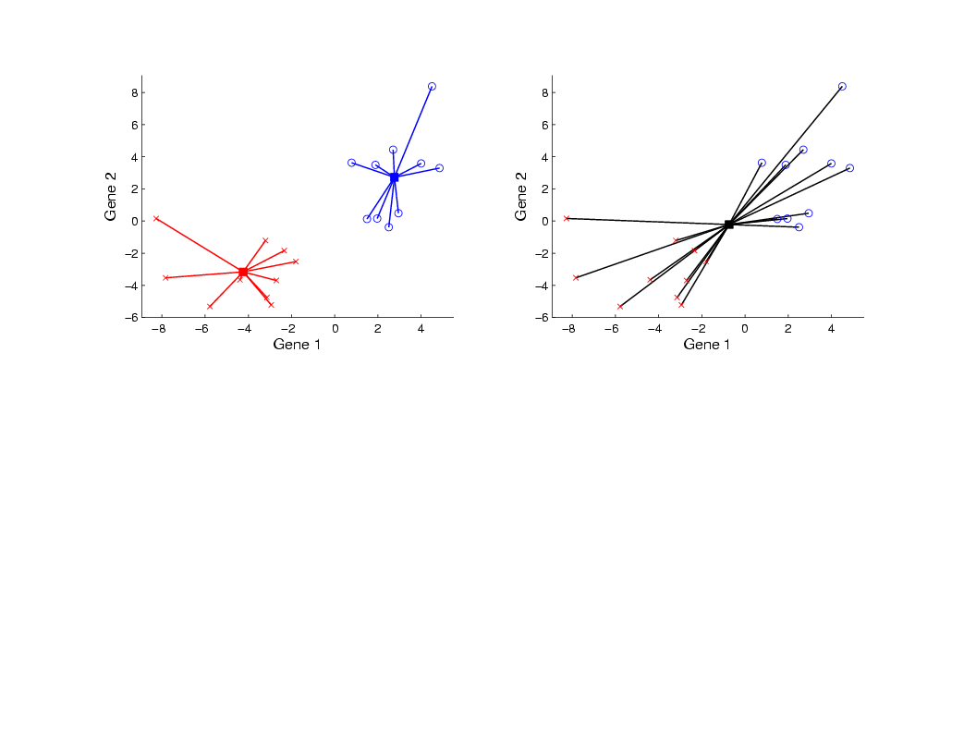
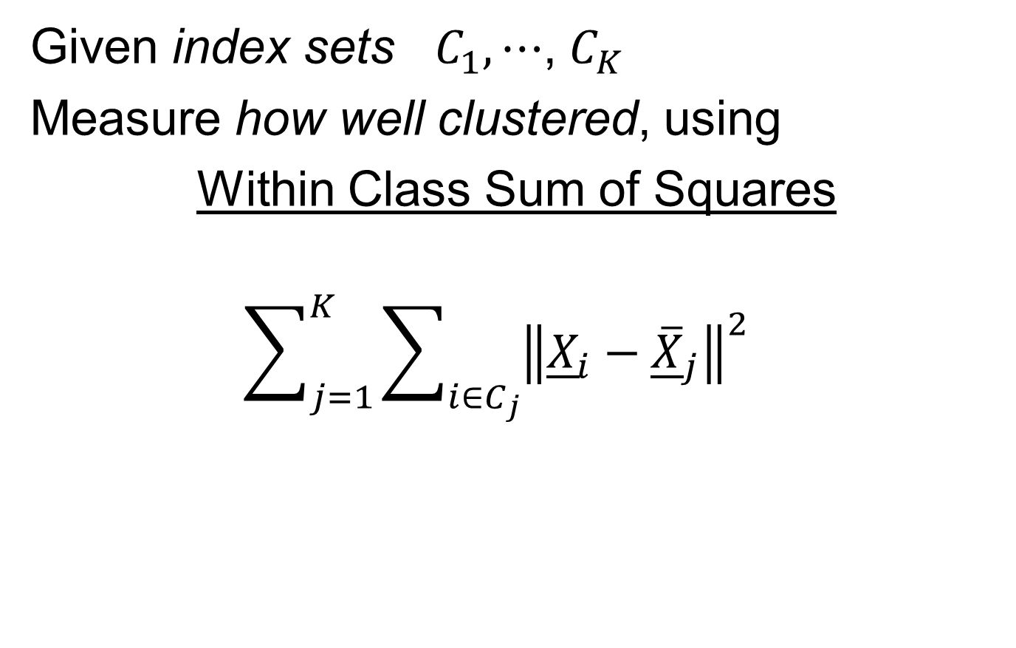
K-means Clustering
Given index sets $C_{1},⋯$, $C_{K}$
Measure how well clustered, using
Within Class Sum of Squares
$$\sum_{j=1}^{K}{\sum_{i∈C_{j}}{{\left\|{\underline{X}}_{i}−{\overline{\underline{X}}}_{j}\right\|}^{2}}}$$

Slide 31

K-means Clustering
Common Variation:
Put on scale of proportions (i.e. in [0,1])
By dividing “within class SS”
by “overall SS”
Gives Cluster Index:
$$CI\left(C_{1},⋯,C_{K}\right)=\frac{\sum_{j=1}^{K}{\sum_{i∈C_{j}}{{\left\|{\underline{X}}_{i}−{\overline{\underline{X}}}_{j}\right\|}^{2}}}}{\sum_{i=1}^{n}{{\left\|{\underline{X}}_{i}−\overline{\underline{X}}\right\|}^{2}}}$$

Slide 32
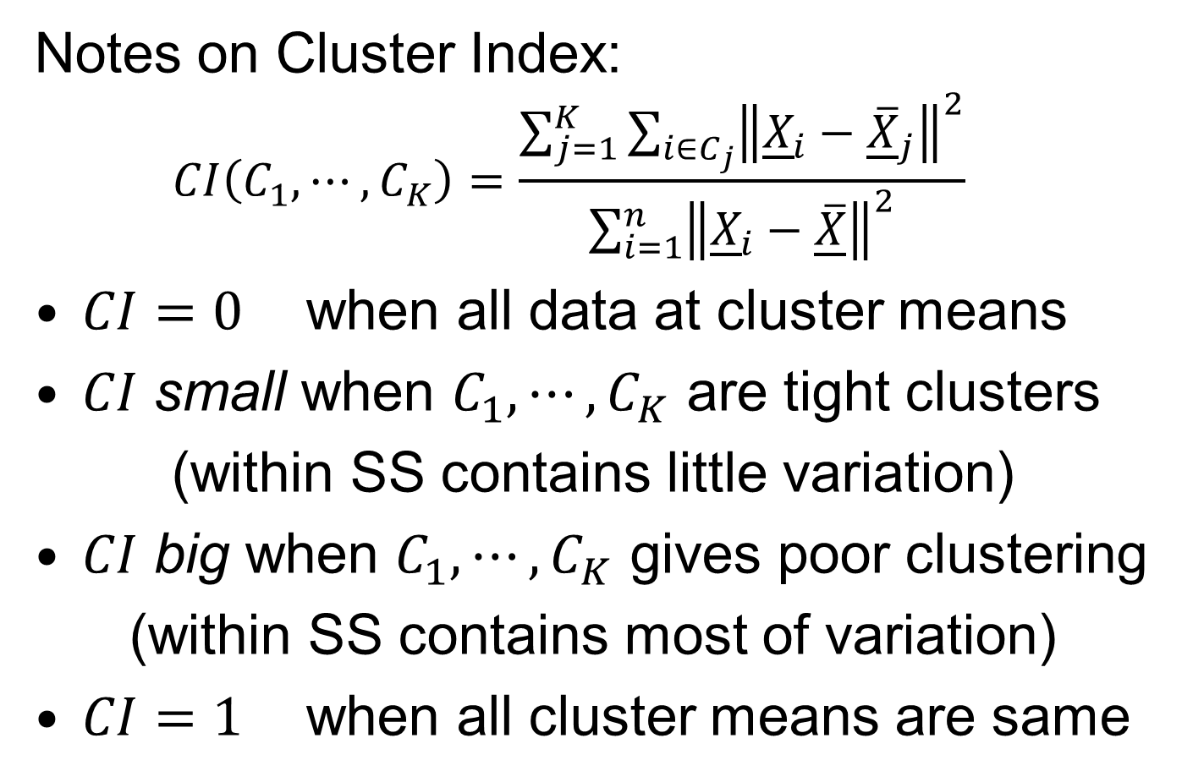
K-means Clustering
Notes on Cluster Index:
$$CI\left(C_{1},⋯,C_{K}\right)=\frac{\sum_{j=1}^{K}{\sum_{i∈C_{j}}{{\left\|{\underline{X}}_{i}−{\overline{\underline{X}}}_{j}\right\|}^{2}}}}{\sum_{i=1}^{n}{{\left\|{\underline{X}}_{i}−\overline{\underline{X}}\right\|}^{2}}}$$
$CI=0$ when all data at cluster means
$CI$ small when $C_{1},⋯,C_{K}$ are tight clusters
(within SS contains little variation)
$CI$ big when $C_{1},⋯,C_{K}$ gives poor clustering
(within SS contains most of variation)
$CI=1$ when all cluster means are same

Slide 33
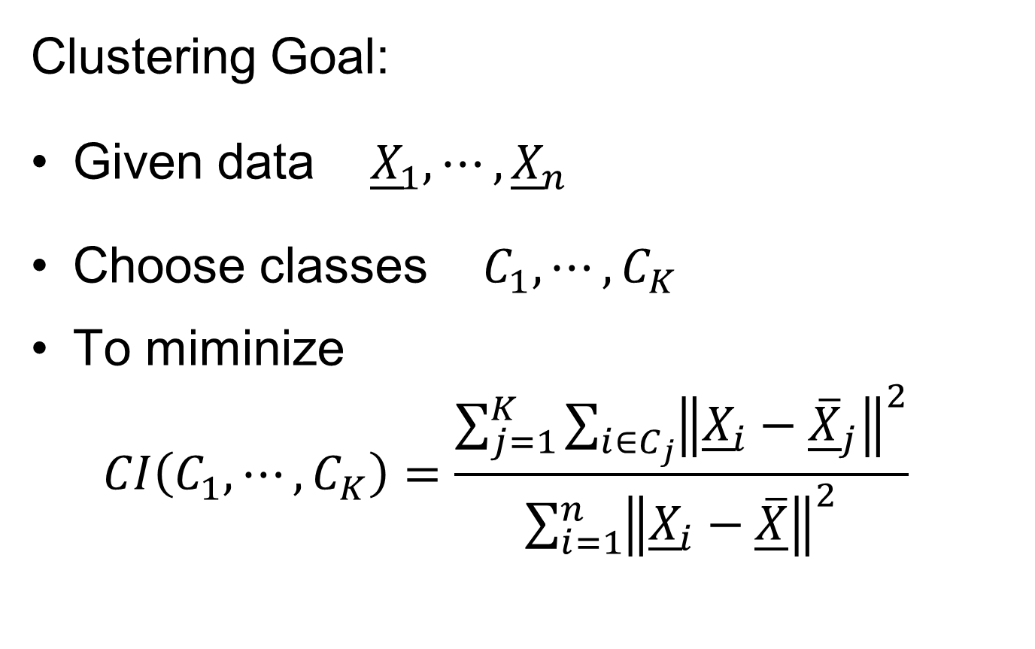
K-means Clustering
Clustering Goal:
Given data ${\underline{X}}_{1},⋯,{\underline{X}}_{n}$
Choose classes $C_{1},⋯,C_{K}$
To miminize
$$CI\left(C_{1},⋯,C_{K}\right)=\frac{\sum_{j=1}^{K}{\sum_{i∈C_{j}}{{\left\|{\underline{X}}_{i}−{\overline{\underline{X}}}_{j}\right\|}^{2}}}}{\sum_{i=1}^{n}{{\left\|{\underline{X}}_{i}−\overline{\underline{X}}\right\|}^{2}}}$$

Slide 34
2-means Clustering
Study CI, using simple 1-d examples
Varying Standard Deviation

Slide 35
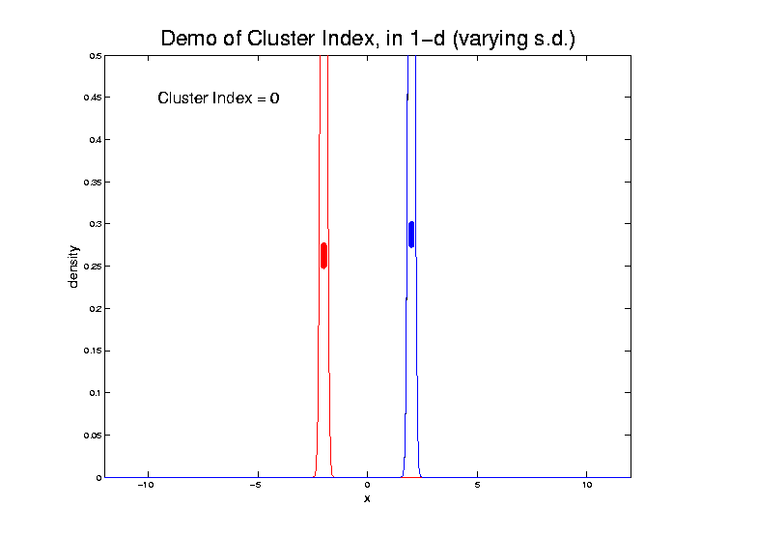
2-means Clustering

Slide 36
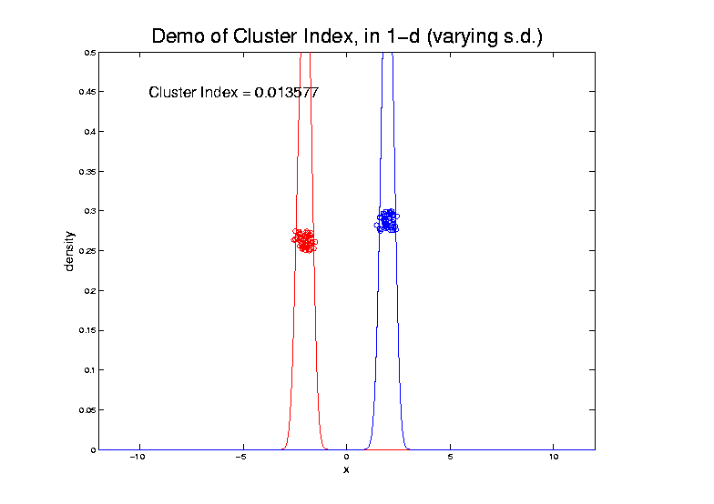
2-means Clustering

Slide 37
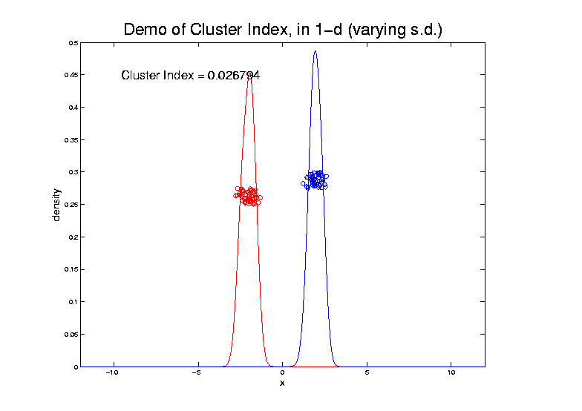
2-means Clustering

Slide 38
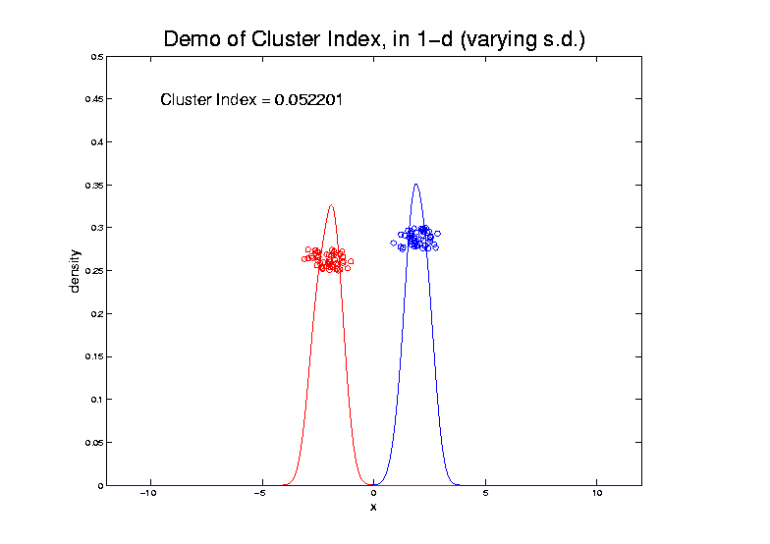
2-means Clustering

Slide 39
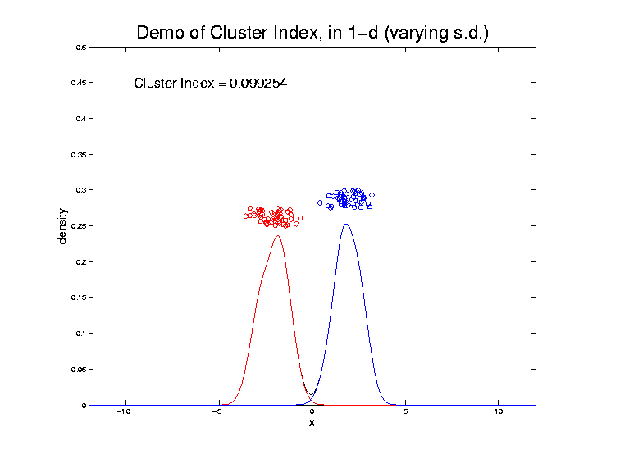
2-means Clustering

Slide 40
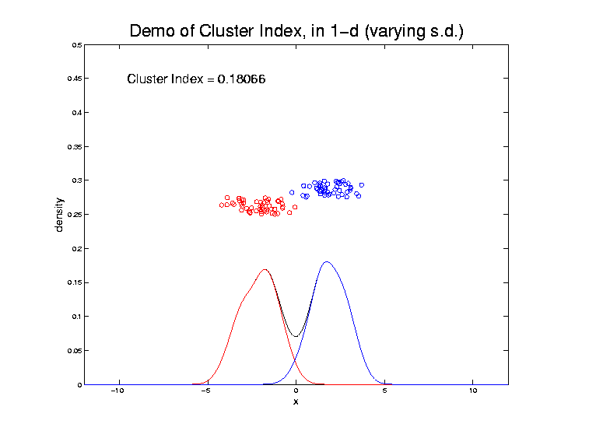
2-means Clustering

Slide 41
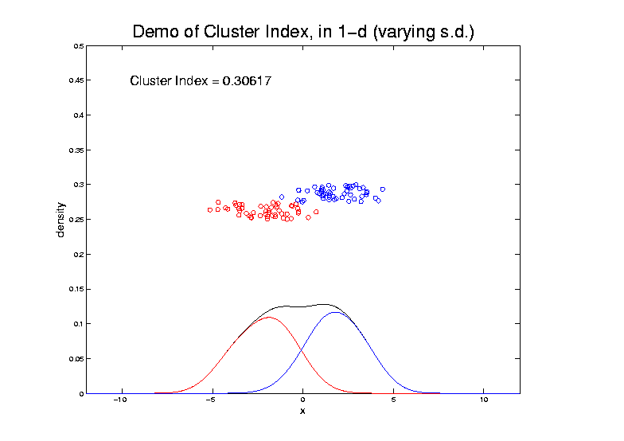
2-means Clustering

Slide 42
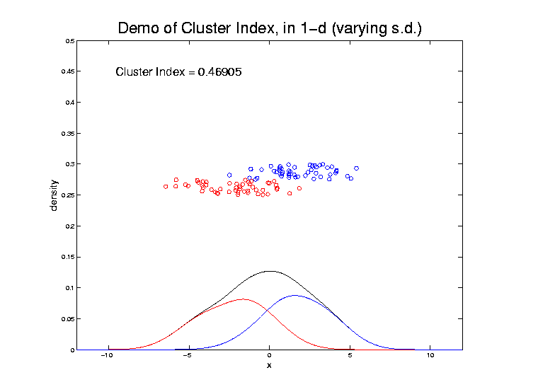
2-means Clustering

Slide 43
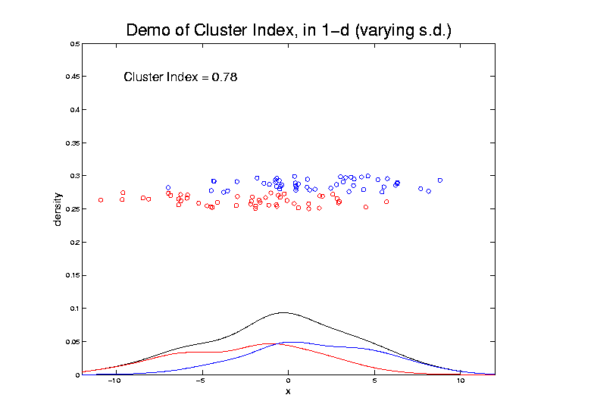
2-means Clustering

Slide 44
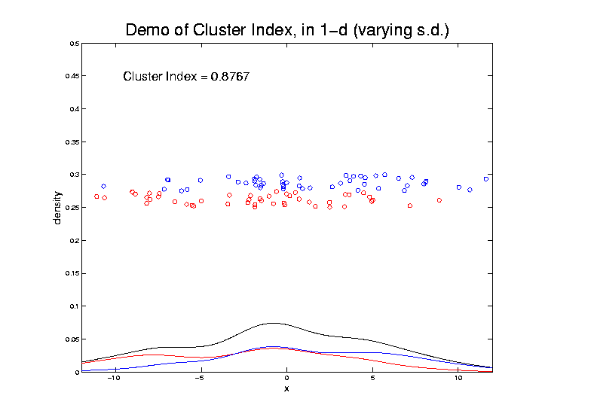
2-means Clustering

Slide 45
2-means Clustering
Study CI, using simple 1-d examples
Varying Standard Deviation
Varying Mean

Slide 46
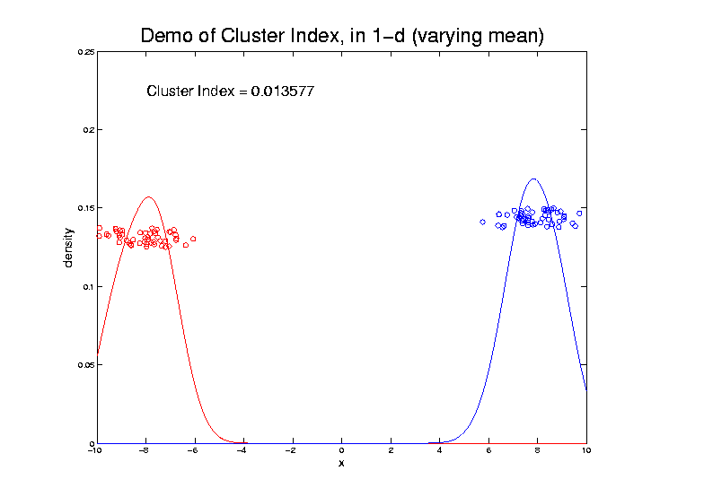
2-means Clustering

Slide 47
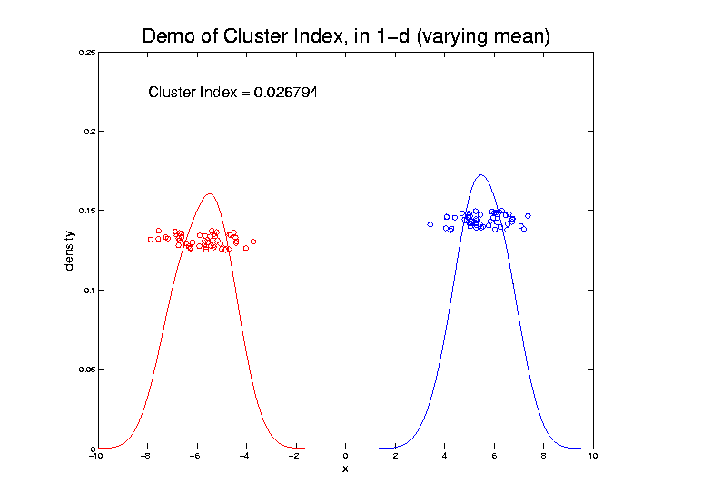
2-means Clustering

Slide 48
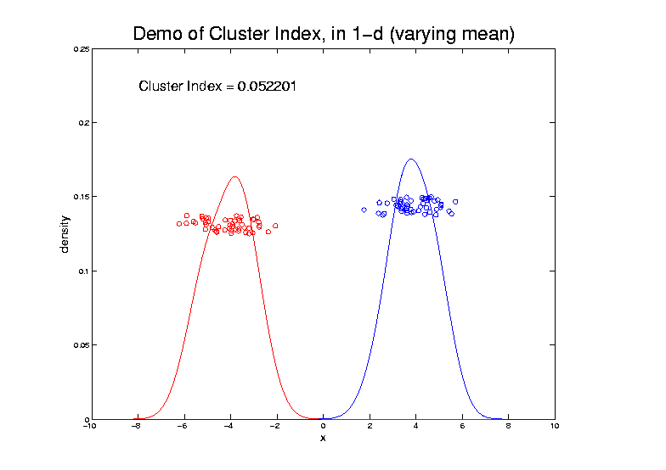
2-means Clustering

Slide 49
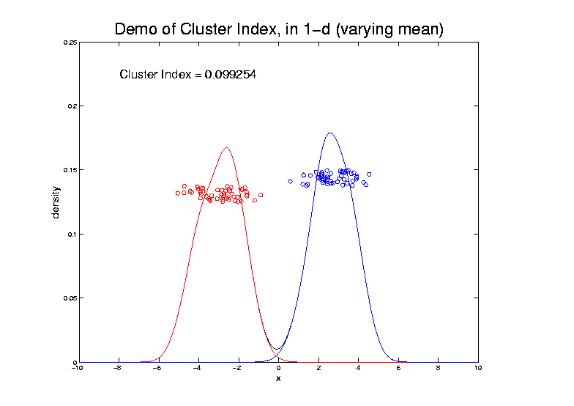
2-means Clustering

Slide 50
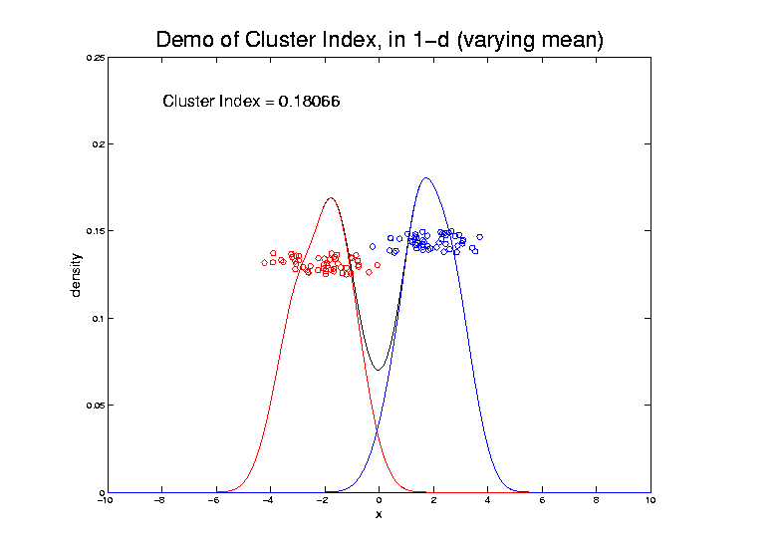
2-means Clustering

Slide 51
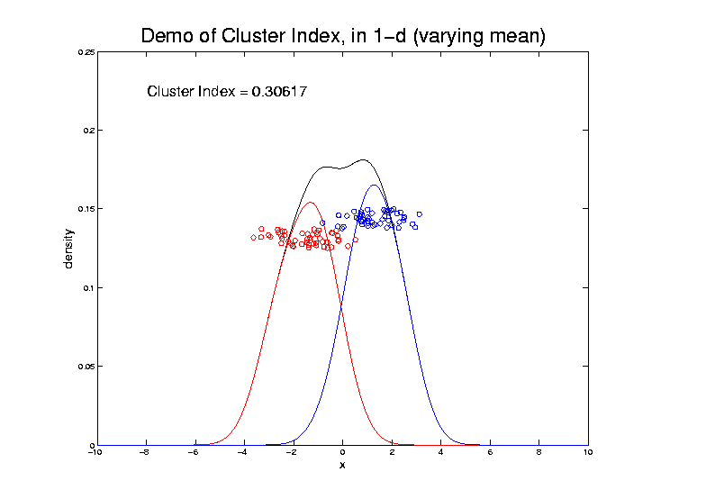
2-means Clustering

Slide 52
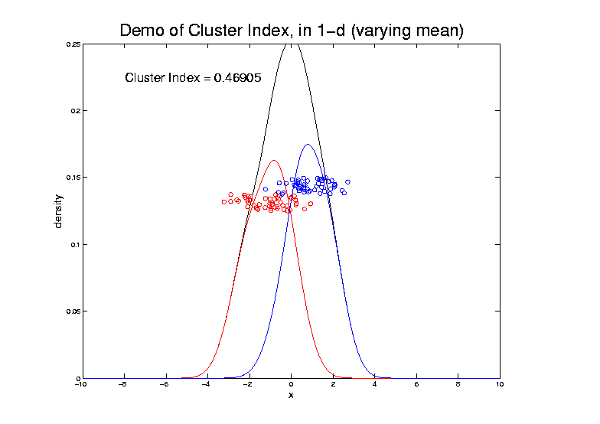
2-means Clustering

Slide 53
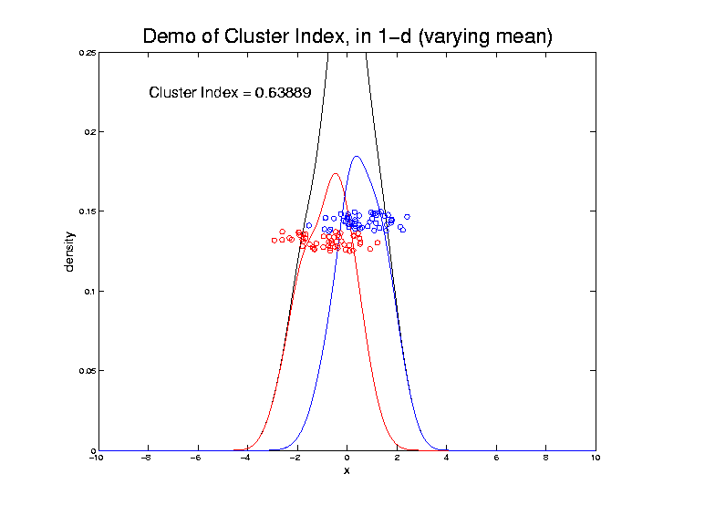
2-means Clustering

Slide 54
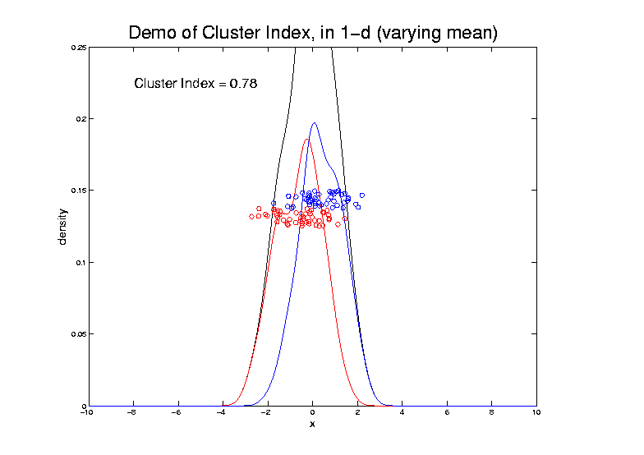
2-means Clustering

Slide 55
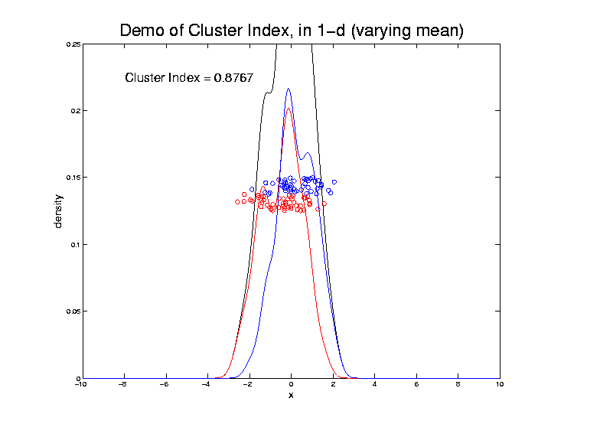
2-means Clustering

Slide 56

2-means Clustering

Slide 57

2-means Clustering

Slide 58
2-means Clustering
Study CI, using simple 1-d examples
Varying Standard Deviation
Varying Mean
Varying Proportion

Slide 59

2-means Clustering

Slide 60

2-means Clustering

Slide 61

2-means Clustering

Slide 62

2-means Clustering

Slide 63

2-means Clustering

Slide 64

2-means Clustering

Slide 65

2-means Clustering

Slide 66

2-means Clustering

Slide 67

2-means Clustering

Slide 68

2-means Clustering

Slide 69

2-means Clustering

Slide 70

2-means Clustering

Slide 71

2-means Clustering

Slide 72

2-means Clustering

Slide 73
2-means Clustering
Study CI, using simple 1-d examples
Over changing Classes (moving b’dry)

Slide 74

2-means Clustering

Slide 75

2-means Clustering

Slide 76

2-means Clustering

Slide 77

2-means Clustering
C. Index for
Clustering
Greens
& Blues

Slide 78

2-means Clustering

Slide 79

2-means Clustering

Slide 80

2-means Clustering

Slide 81

2-means Clustering

Slide 82

2-means Clustering

Slide 83

2-means Clustering
Curve Shows CI for Many
Reasonable Clusterings

Slide 84

2-means Clustering
Study CI, using simple 1-d examples
Over changing Classes (moving b’dry)
Multi-modal data → interesting effects
Multiple local minima (large number)
Maybe disconnected
Optimization (over $C_{1},⋯$, $C_{K}$) can be tricky…
(even in 1 dimension, with $K=2$)

Slide 85

2-means Clustering

Slide 86
2-means Clustering
Study CI, using simple 1-d examples
Over changing Classes (moving b’dry)
Multi-modal data → interesting effects
Can have 4 (or more) local mins
(even in 1 dimension, with K = 2)

Slide 87

2-means Clustering

Slide 88
2-means Clustering
Study CI, using simple 1-d examples
Over changing Classes (moving b’dry)
Multi-modal data → interesting effects
Local mins can be hard to find
i.e. iterative procedures can “get stuck”
(even in 1 dimension, with K = 2)
Common, But Slippery,
Approach: Many
Random Restarts

Slide 89
2-means Clustering
Study CI, using simple 1-d examples
Effect of a single outlier?

Slide 90

2-means Clustering
Minimum CI
Splits in Half

Slide 91

2-means Clustering
Already Have
Local Minima

Slide 92

2-means Clustering

Slide 93

2-means Clustering
Global CI
Minimum
Now Here

Slide 94

2-means Clustering

Slide 95

2-means Clustering

Slide 96

2-means Clustering

Slide 97

2-means Clustering

Slide 98

2-means Clustering

Slide 99

2-means Clustering

Slide 100

2-means Clustering
Single Outlier Can Make CI Arbitrarily Small

Slide 101
2-means Clustering
Study CI, using simple 1-d examples
Effect of a single outlier?
Can create local minimum
Can also yield a global minimum
This gives a one point class
Can make CI arbitrarily small
(really a “good clustering”???)

Slide 102

K-Means Clustering
2-d Toy Example
Recall From Before
(When Studying
Kernel PCA)
Long Thin Cluster
Close Round Clusters
Outliers or Clusters???

Slide 103





K-Means Clustering
2-d Toy Example
$k=2$, Groups
All Small Ones
$k=3$, Splits
Round Ones
K-Means Can Be Slippery
$k=4$, Splits
Long Cluster
Local Minimum?
$k=5$, Splits
Outliers, Not
Round Ones?

Slide 104



K-Means Clustering
2-d Toy Example, No Outliers
$k=2$, Groups
All Small Ones
$k=3$, Splits
Round Ones
K-Means Can Be Slippery,
Careful About Local Minima
$k=$4, Splits
Long Cluster
$k=5$, Not
Round Ones?

Slide 105
SWISS Score
Another Application of CI (Cluster Index)
Cabanski et al (2010)
Idea: Use CI in bioinformatics to
“measure quality of data preprocessing”
Philosophy: Clusters Are Scientific Goal
So Want to Accentuate Them

Slide 106


SWISS Score
Toy Examples (2-d):
Which are “More Clustered?”

Slide 107

SWISS Score
Toy Examples (2-d):
Which are “More Clustered?”

Slide 108

SWISS Score
SWISS =
Standardized Within class Sum of Squares
$$SWISS=CI\left(C_{1},⋯,C_{K}\right)=\frac{\sum_{j=1}^{K}{\sum_{i∈C_{j}}{{\left\|{\underline{X}}_{i}−{\overline{\underline{X}}}_{j}\right\|}^{2}}}}{\sum_{i=1}^{n}{{\left\|{\underline{X}}_{i}−\overline{\underline{X}}\right\|}^{2}}}$$

Slide 109
SWISS Score
SWISS =
Standardized Within class Sum of Squares
$$SWISS=CI\left(C_{1},⋯,C_{K}\right)=\frac{\sum_{j=1}^{K}{\sum_{i∈C_{j}}{{\left\|{\underline{X}}_{i}−{\overline{\underline{X}}}_{j}\right\|}^{2}}}}{\sum_{i=1}^{n}{{\left\|{\underline{X}}_{i}−\overline{\underline{X}}\right\|}^{2}}}$$

Slide 110
SWISS Score
SWISS =
Standardized Within class Sum of Squares
$$SWISS=CI\left(C_{1},⋯,C_{K}\right)=\frac{\sum_{j=1}^{K}{\sum_{i∈C_{j}}{{\left\|{\underline{X}}_{i}−{\overline{\underline{X}}}_{j}\right\|}^{2}}}}{\sum_{i=1}^{n}{{\left\|{\underline{X}}_{i}−\overline{\underline{X}}\right\|}^{2}}}$$

Slide 111

SWISS Score
Recall Graphical Introduction:
$$SWISS=CI\left(C_{1},⋯,C_{K}\right)=\frac{\sum_{j=1}^{K}{\sum_{i∈C_{j}}{{\left\|{\underline{X}}_{i}−{\overline{\underline{X}}}_{j}\right\|}^{2}}}}{\sum_{i=1}^{n}{{\left\|{\underline{X}}_{i}−\overline{\underline{X}}\right\|}^{2}}}$$

Slide 112
SWISS Score
Recall Graphical Introduction:
$$SWISS=CI\left(C_{1},⋯,C_{K}\right)=\frac{\sum_{j=1}^{K}{\sum_{i∈C_{j}}{{\left\|{\underline{X}}_{i}−{\overline{\underline{X}}}_{j}\right\|}^{2}}}}{\sum_{i=1}^{n}{{\left\|{\underline{X}}_{i}−\overline{\underline{X}}\right\|}^{2}}}$$

Slide 113
SWISS Score
Revisit Toy Examples (2-d):
Which are “More Clustered?”

Slide 114
SWISS Score
Toy Examples (2-d):
Which are “More Clustered?”

Slide 115

SWISS Score
Toy Examples (2-d):
Which are “More Clustered?”

Slide 116

SWISS Score
Now Consider $K>2$:
$$SWISS=CI\left(C_{1},⋯,C_{K}\right)=\frac{\sum_{j=1}^{K}{\sum_{i∈C_{j}}{{\left\|{\underline{X}}_{i}−{\overline{\underline{X}}}_{j}\right\|}^{2}}}}{\sum_{i=1}^{n}{{\left\|{\underline{X}}_{i}−\overline{\underline{X}}\right\|}^{2}}}$$
How well does it work?

Slide 117

SWISS Score
$K=3$, Toy Example:

Slide 118
SWISS Score
$K=3$, Toy Example:

Slide 119
SWISS Score
$K=3$, Toy Example:

Slide 120

SWISS Score
$K=3$, Toy Example:
But C
Seems
“Better
Clustered”

Slide 121
SWISS Score
K-Class SWISS:
Instead of using K-Class CI
Use Average of Pairwise SWISS Scores

Slide 122
SWISS Score
K-Class SWISS:
Instead of using K-Class CI
Use Average of Pairwise SWISS Scores
(Preserves [0,1] Range)

Slide 123
SWISS Score
Avg. Pairwise SWISS – Toy Examples

Slide 124
SWISS Score
Additional Feature:
Ǝ Hypothesis Tests:
H₁: SWISS₁ < 1
H₁: SWISS₁ < SWISS₂
Permutation Based
See Cabanski et al (2010)

Slide 125
Clustering
A Very Large Area
K-Means is Only One Approach
Has its Drawbacks
(Many Toy Examples of This)
Ǝ Many Other Approaches
Important (And Broad) Class
Hierarchical Clustering

Slide 126
Hierarchical Clustering
Idea: Consider Either:
Bottom Up Aggregation:
One by One Combine Data
Top Down Splitting:
All Data in One Cluster & Split
Through Entire Data Set, to get Dendogram

Slide 127

Hierarchical Clustering
Aggregate or Split, to get Dendogram
Thanks to US EPA: water.epa.gov

Slide 128
Hierarchical Clustering
Aggregate or Split, to get Dendogram
Aggregate:
Start With
Individuals

Slide 129
Hierarchical Clustering
Aggregate or Split, to get Dendogram
Aggregate:
Start With
Individuals,
Move Up

Slide 130
Hierarchical Clustering
Aggregate or Split, to get Dendogram
Aggregate:
Start With
Individuals,
Move Up

Slide 131
Hierarchical Clustering
Aggregate or Split, to get Dendogram
Aggregate:
Start With
Individuals,
Move Up

Slide 132
Hierarchical Clustering
Aggregate or Split, to get Dendogram
Aggregate:
Start With
Individuals,
Move Up

Slide 133
Hierarchical Clustering
Aggregate or Split, to get Dendogram
Aggregate:
Start With
Individuals,
Move Up,
End Up With
All in 1 Cluster

Slide 134
Hierarchical Clustering
Aggregate or Split, to get Dendogram
Split:
Start With
All in 1 Cluster

Slide 135
Hierarchical Clustering
Aggregate or Split, to get Dendogram
Split:
Start With
All in 1 Cluster,
Move Down

Slide 136
Hierarchical Clustering
Aggregate or Split, to get Dendogram
Split:
Start With
All in 1 Cluster,
Move Down,
End With
Individuals

Slide 137
Hierarchical Clustering
Aggregate or Split, to get Dendogram
While Result
Is Same,
There Are
Computational
Considerations

Slide 138

Hierarchical Clustering
Vertical Axis in Dendogram:
Based on:
Distance Metric
(Ǝ many, e.g. $L^{2}$, $L^{1}$, $L^{∞}$, …)
Linkage Function
(Reflects Clustering Type)
A Lot of “Art” Involved

Slide 139
Hierarchical Clustering
Dendogram Interpretation
Branch
Length
Reflects
Cluster
Strength

Slide 140
Hierarchical Clustering
2-d Toy Example
Recall From Before
(When Studying
Kernel PCA)
Long Thin Cluster
Close Round Clusters
Outliers or Clusters???

Slide 141
Participant Presentation
Ram Basak:
FDA on Health Outcomes
Siqi Xiang:
Analysis of Knee Osteoarthritis Data: Auto transformation and BET
Nicolas Wolczynski:
Urban Sound Classification
Mingyi Wang:
Symbolic Data principal component analysis

